Slide 1
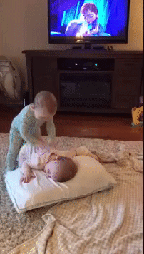
Behavioral Cloning from Observation
Faraz Torabi¹, Garrett Warnell², and Peter Stone¹
¹The University of Texas at Austin
²U.S. Army Research Laboratory

Slide 2
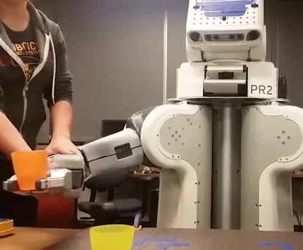
Imitation Learning
goal: learn how to make decisions by trying to imitate another agent
conventionally: observations of other agent (demonstrations) consist of state-action pairs
problem: large amounts of demonstration data do not come with actions (e.g., YouTube videos)
Figure: Finn, Chelsea, Sergey Levine, and Pieter Abbeel. "Guided cost learning: Deep inverse optimal control via policy optimization.“
International Conference on Machine Learning. 2016

Slide 3
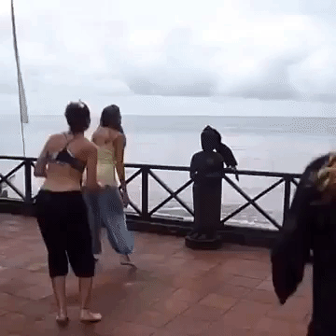
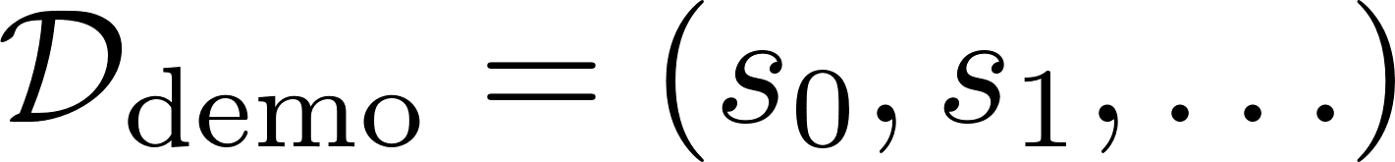
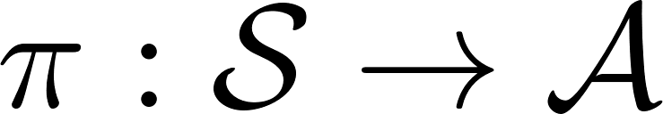
Imitation from Observation
learn how to perform a task given state-only demonstrations
formulation
given
learn

Slide 4
Handling Missing Actions
imitation learning
imitation from observation
our solution:
(1) estimate actions using a learned inverse dynamics model
(2) perform behavioral cloning

Slide 5

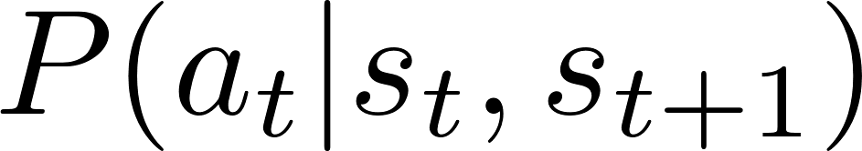
Behavioral Cloning from Observation (BCO)
policy initialization: initialize randomly
data collection: use to gather experience
model learning: learn inverse dynamics model
action estimation: infer demonstrator actions using model
policy learning: update using behavioral cloning over state-(action estimate) pairs

Slide 6
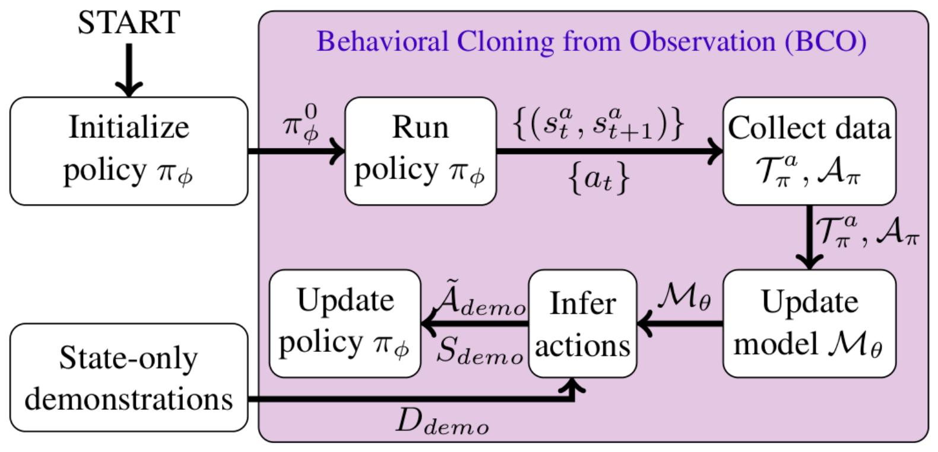
Behavioral Cloning from Observation (BCO)

Slide 7
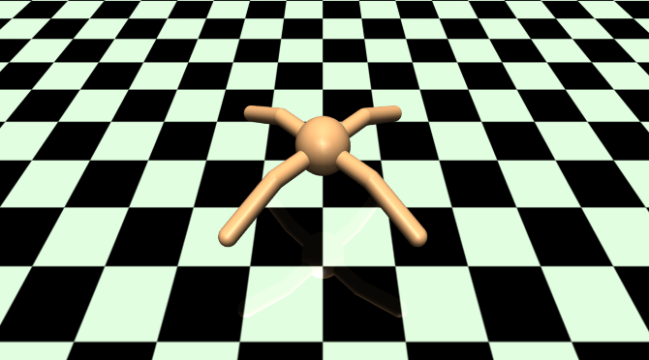
Results
domain: “ant” (others in paper)

Slide 8
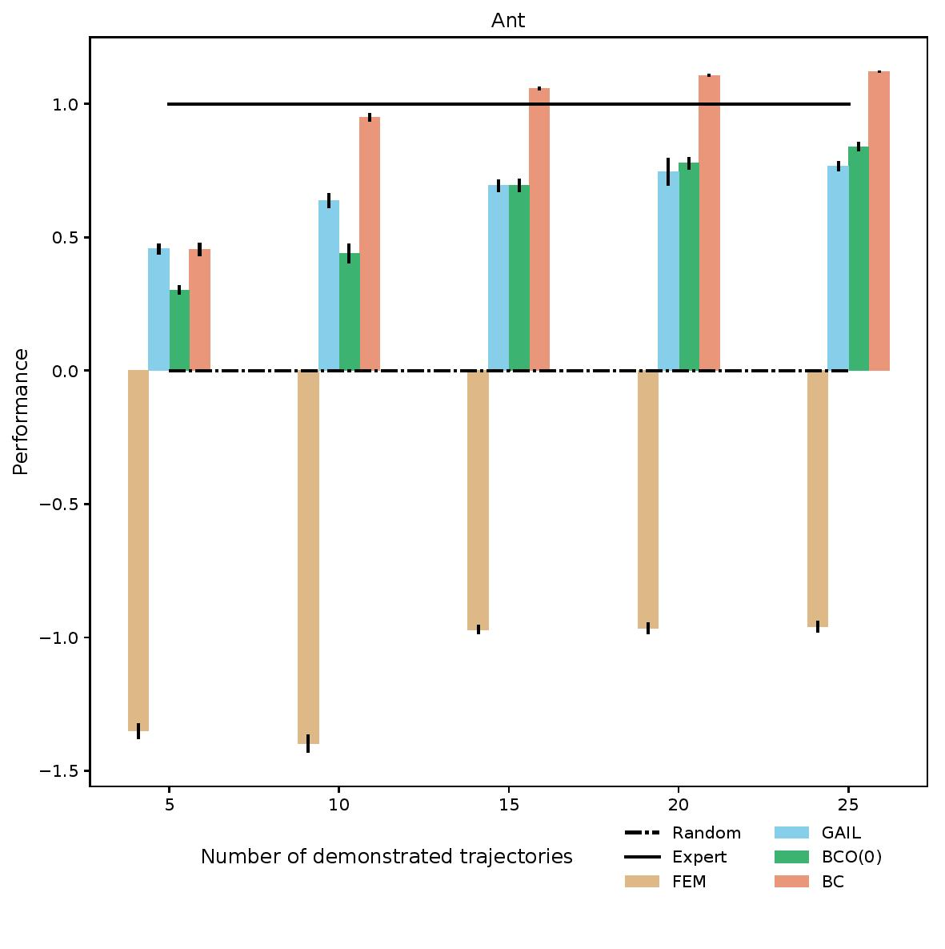
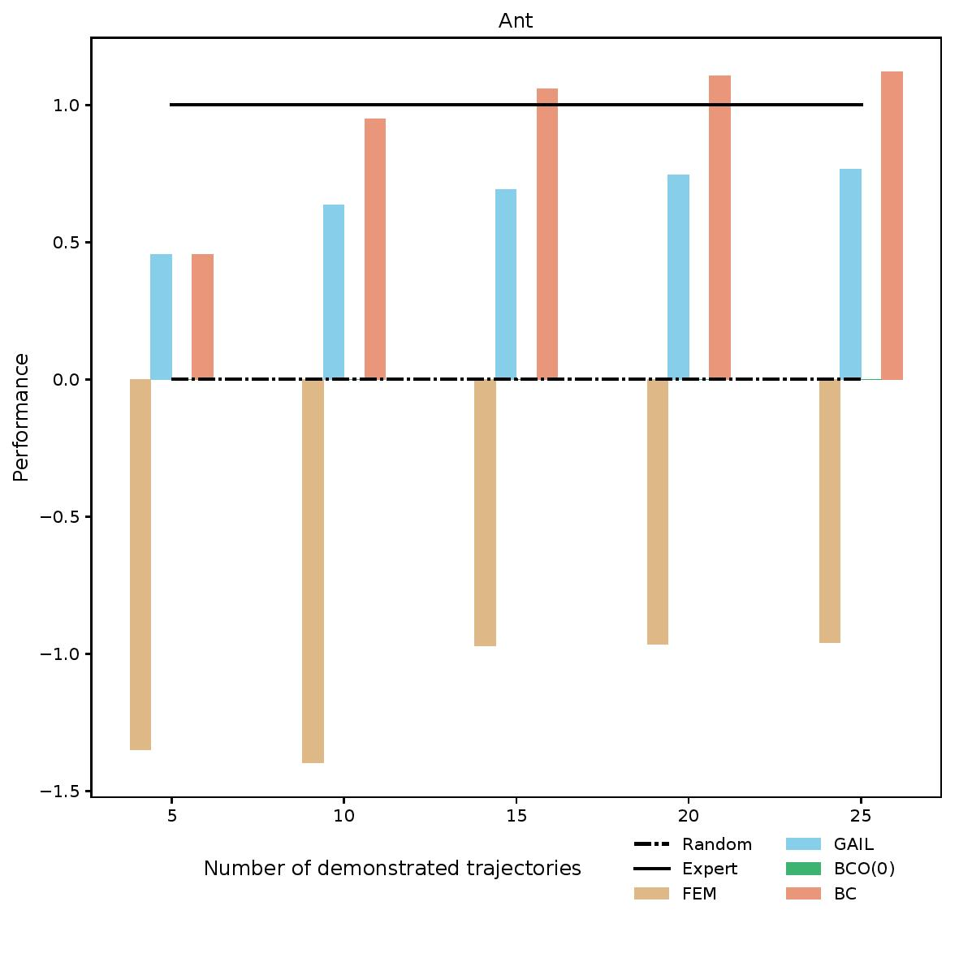
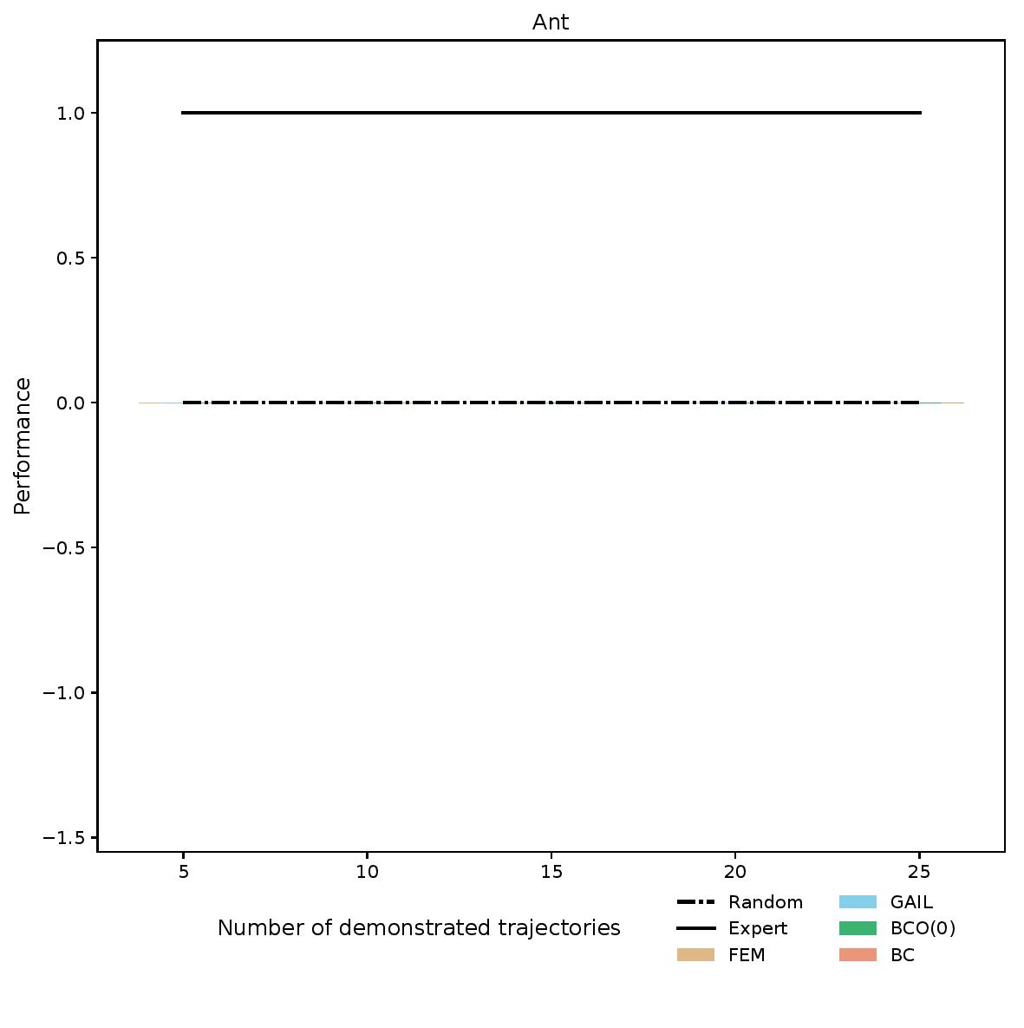
Results
BCO v. imitation learning (has actions)

Slide 9
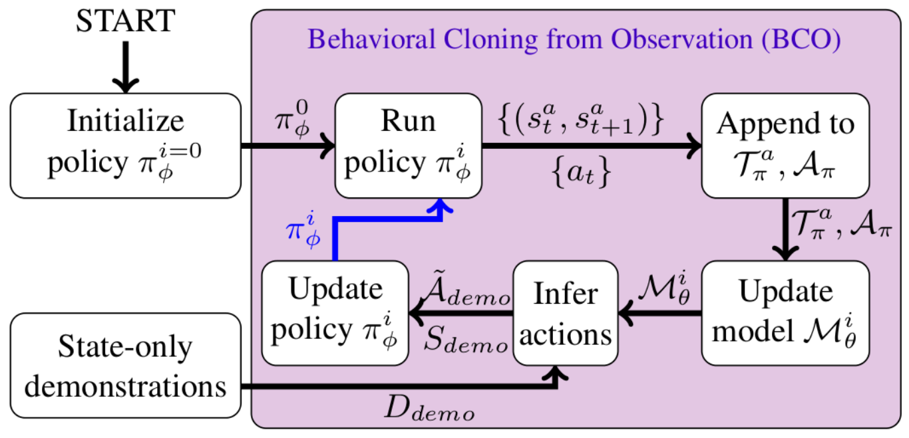
BCO(α)
idea: learn a better model by gathering more experience
generate more experience using latest policy
α controls amount of extra experience gathered

Slide 10
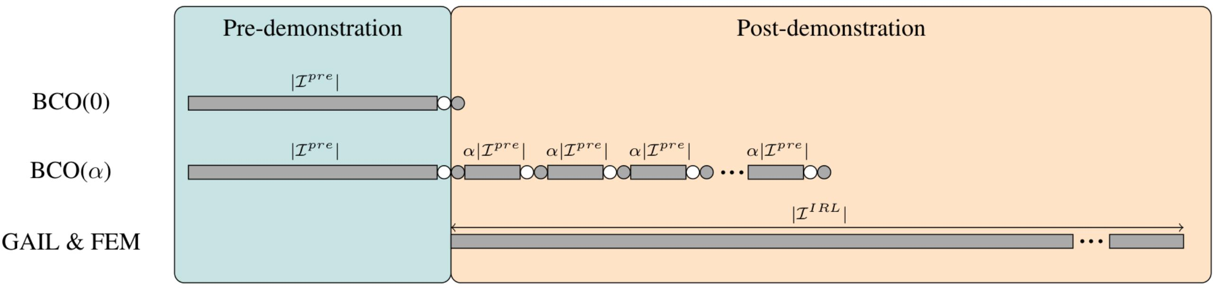
Time to Imitation
time, interactions, cost, …

Slide 11
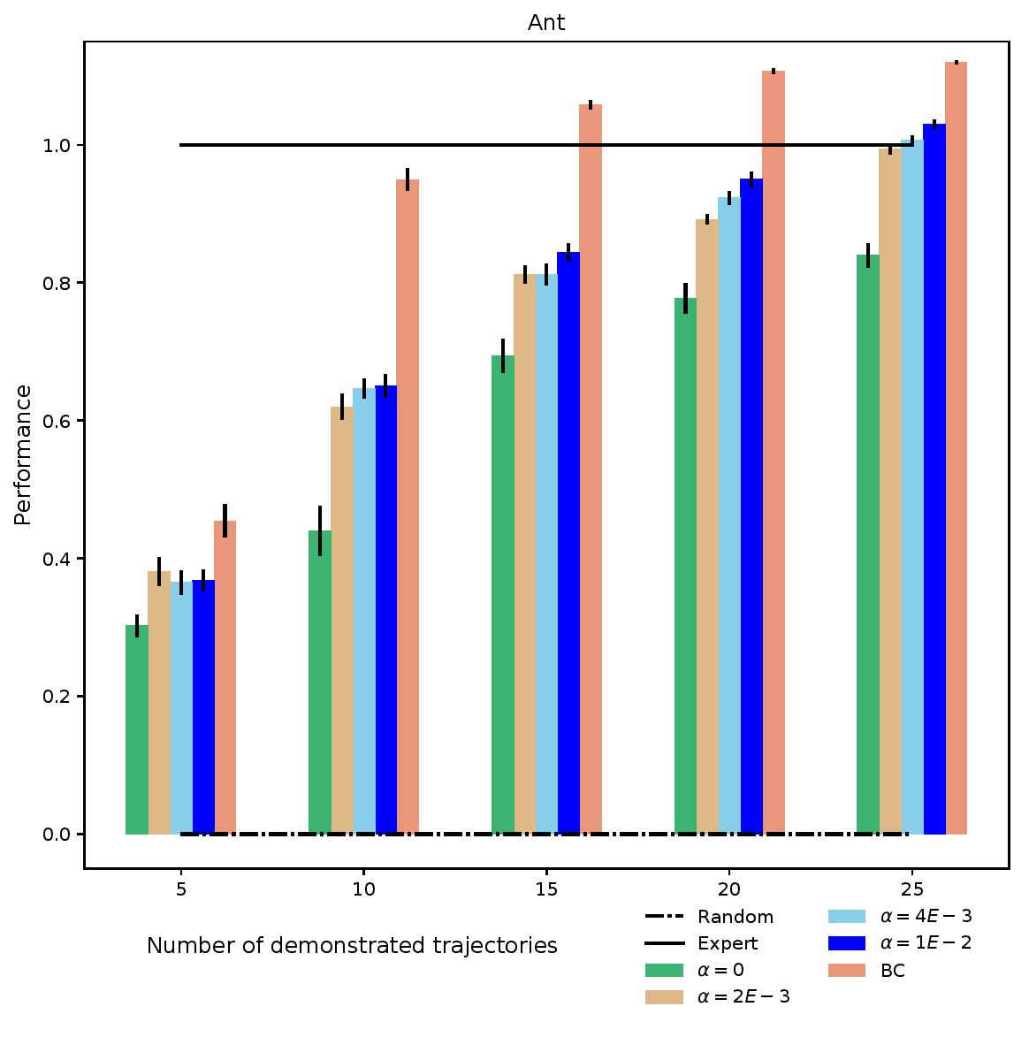
Results
varying α

Slide 12
Related Work
Sermanet et al. "Time-contrastive networks: Self-supervised learning from multi-view observation." CVPR 2017.
Liu et al. "Imitation from observation: Learning to imitate behaviors from raw video via context translation." ICRA 2018.
Gupta et al. “Learning invariant feature spaces to transfer skills with reinforcement learning.” ICLR 2017.

Slide 13
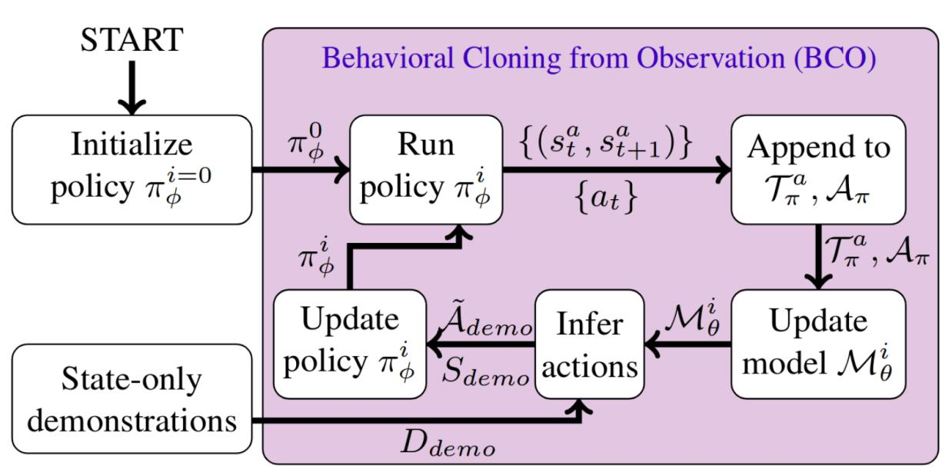

Summary
can we bring the benefits of behavioral cloning to imitation from observation?
Faraz Torabi
faraztrb@cs.utexas.edu

