Slide 1
August 2018
A Study of Human-robot Copilot Systems for En-route Destination Changing
The 27th IEEE International Symposium on Robot and Human Interactive Communication (RO-MAN)
Yu-Sian Jiang (Sharon)^{1,} Garrett Warnell², Eduardo Munera³, and Peter Stone¹
1: The Learning Agents Research Group (LARG) at The University of Texas at Austin
2: US Army Research Laboratory (ARL)
3: Mindtronic AI

Slide 2
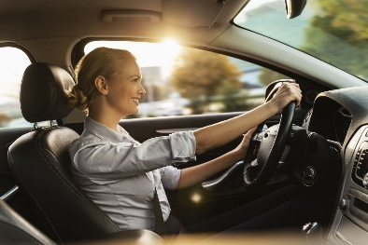
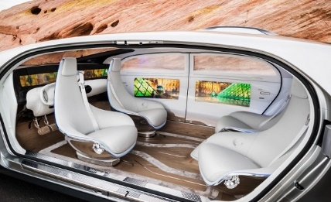
Self Driving is Cool, but What If…
Yu-Sian Jiang (Sharon), Garrett Warnell, Eduardo Munera, and Peter Stone
Learning Agent Research Group (LARG) at UT Austin, ARL, MAI
What’s Missing is…
Reactivity: an autonomous car is not able to serve driver’s need for en-route destination change.
Manual Driving
Fully Autonomous
Human-Robot Copilot System
Notes:
A popular vision for self-driving cars is that of a passenger pre-specifying a destination and the car autonomously maneuvering to that destination.
however, if the passenger wishes to modify the destination during their trip, the passenger would need to either respecify the destination, or disengage the autonomous driving agent to take over steering and manually drive there.
(e.g., deciding to stop for lunch when the passenger happens to notice a restaurant through the vehicle’s window).
In this paper, we explicitly consider the above problem, i.e., en-route destination changing.
Challenge: Real-time intent recognition

Slide 3
Research Question to Study:
Yu-Sian Jiang (Sharon), Garrett Warnell, Eduardo Munera, and Peter Stone
Learning Agent Research Group (LARG) at UT Austin, ARL, MAI
Is there benefit in using a copilot system over manual driving?
For a copilot system, is there any benefit in using gaze tracking to detect a destination change versus a system that instead uses a more traditional, keyboard-based method of input?
Notes:
the experiments only get at one aspect of driving (parking) - not all of driving

Slide 4
Related Work
Yu-Sian Jiang (Sharon), Garrett Warnell, Eduardo Munera, and Peter Stone
Learning Agent Research Group (LARG) at UT Austin, ARL, MAI
Shared Autonomy
Predict-then-blend (Dragan & Srinivasa 2013)
Partially observable Markov decision process (POMDP) (Macindoe & Kaelbling 2012)
Intention Inference
Observing state and/or action of the human to reason about the human’s plans and goals (Hiatt, Harrison & Trafton 2011)
Notes:
Our work is one of the first that considers these problems in the context of autonomous vehicles; we are aware of only one other work which proposes the idea of using an autonomous co-driver with a behavioral architecture that enables co-driving

Slide 5
Copilot System Study on a Vehicle Parking Task
Yu-Sian Jiang (Sharon), Garrett Warnell, Eduardo Munera, and Peter Stone
Learning Agent Research Group (LARG) at UT Austin, ARL, MAI
Notes:
Top-down illustration of autonomous parking task
Proposed a human-robot copilot system that responds to the user’s intent to drive to and park next to a particular billboard.
Successful intent recognition is required before the vehicle reaches the safe parking margin.
Studied manual driving vs. text-based Copilot system (CopilotKey) vs. gaze-based Copilot system (CopilotGaze)
Please read our paper for detailed algorithms

Slide 6
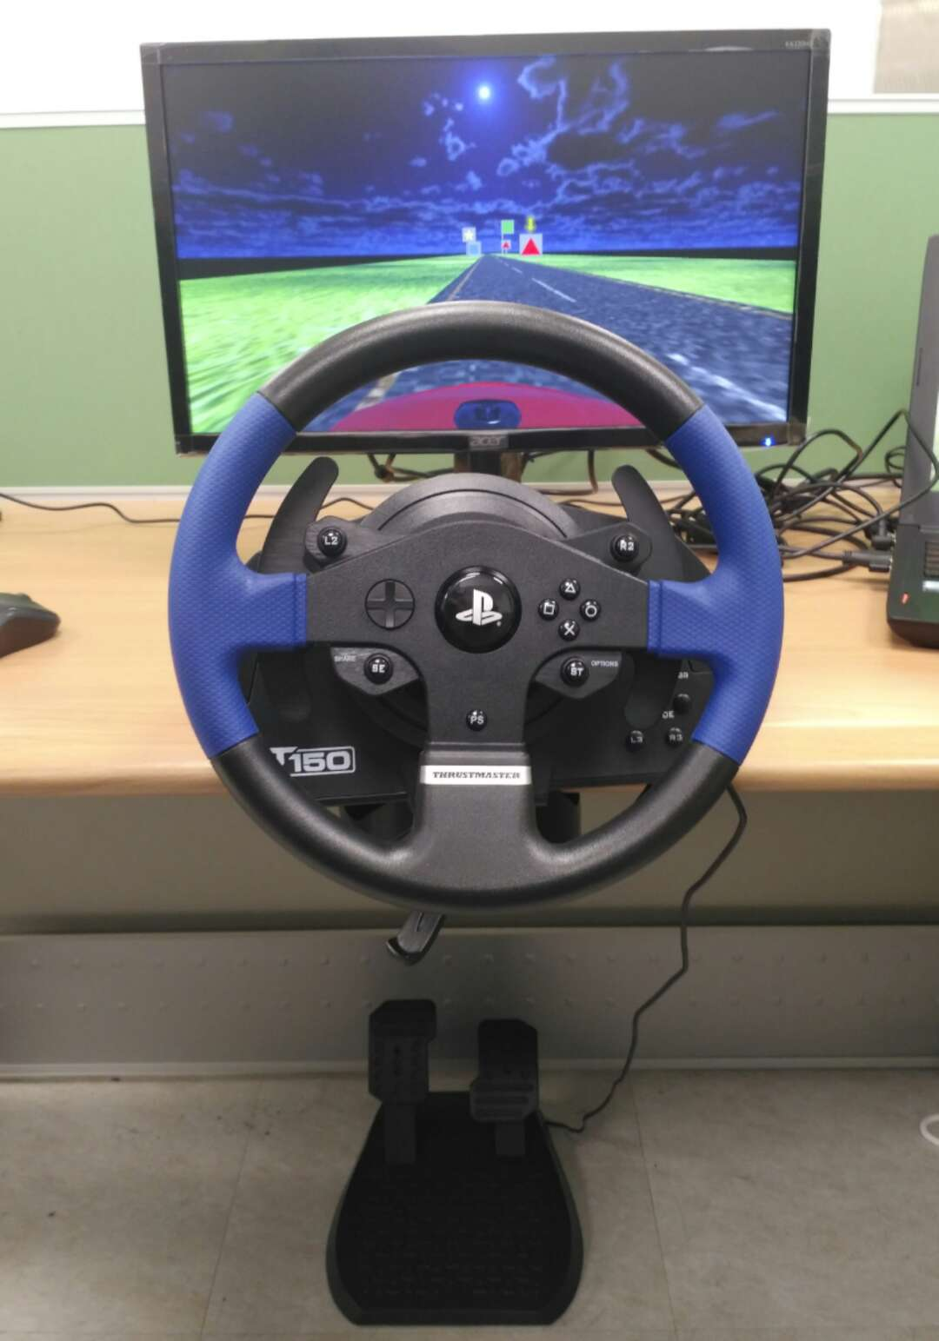
Experimental Setup : Manual Driving
Yu-Sian Jiang (Sharon), Garrett Warnell, Eduardo Munera, and Peter Stone
Learning Agent Research Group (LARG) at UT Austin, ARL, MAI
Objective 1: to answer experimentally whether there is benefit to the proposed copilot system versus manual driving.
The manual driving system includes a steering wheel, pedals, and a desktop screen to display a driving scene.

Slide 7
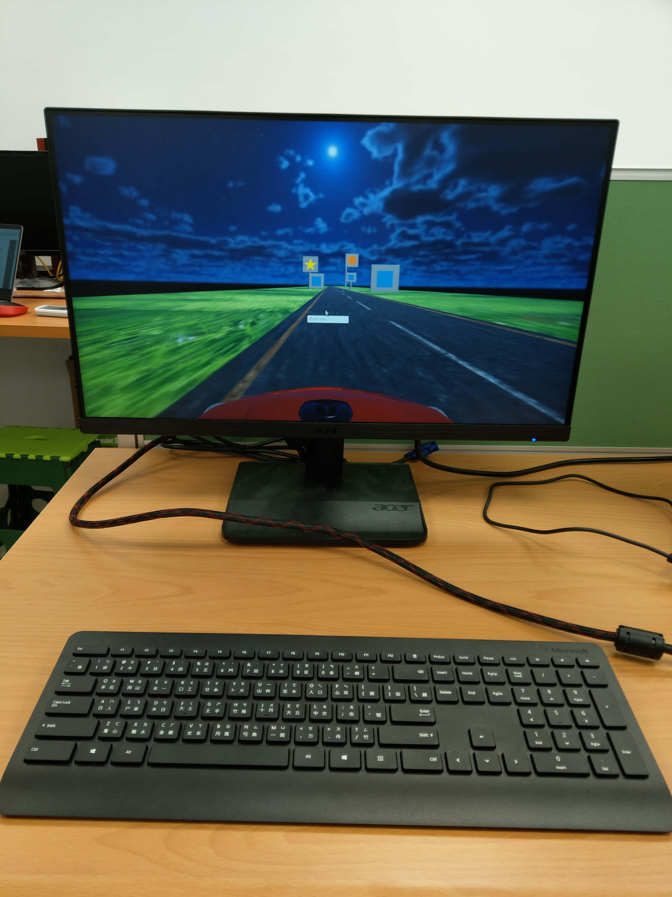
Experimental Setup: CopilotKey
Yu-Sian Jiang (Sharon), Garrett Warnell, Eduardo Munera, and Peter Stone
Learning Agent Research Group (LARG) at UT Austin, ARL, MAI
A keyboard for desktop computer is used to represent the keypad in a real vehicle.
A key-in entry is shown on the screen.
The intention inference engine matches the color and shape of the nearest interest point with the user’s text input.
Key-in entry
Keyboard

Slide 8
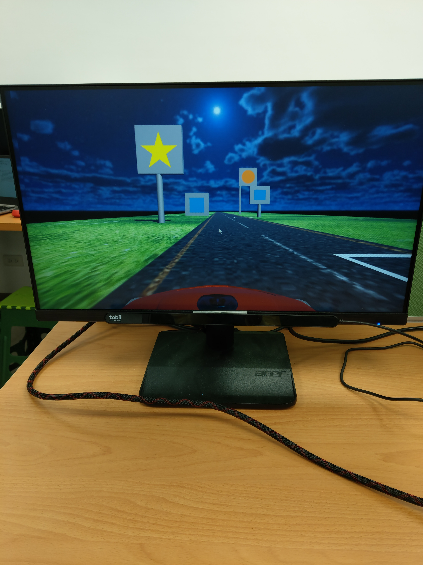
Experimental Setup: CopilotGaze
Yu-Sian Jiang (Sharon), Garrett Warnell, Eduardo Munera, and Peter Stone
Learning Agent Research Group (LARG) at UT Austin, ARL, MAI
Objective 2: to answer experimentally whether inference from gaze helps our copilot system.
The intention inference engine utilizes the Dynamic Interest Point Detection (DIPD) algorithm^{[1][2]} to infer the user's intended destination using gaze tracking data and a dynamic Markov Random Field (MRF) model.
[1] Y.-S. Jiang, G. Warnell, and P. Stone, “DIPD: Gaze-based intention inference in dynamic environments,” the AAAI Workshop on Plan, Activity, and Intent Recognition (PAIR) (2018).
[2] Y.-S. Jiang, G. Warnell, and P. Stone, “Inferring User Intention using Gaze in Vehicles,” The 20th ACM International Conference on Multimodal Interaction (ICMI) (2018).
Eye-tracker

Slide 9
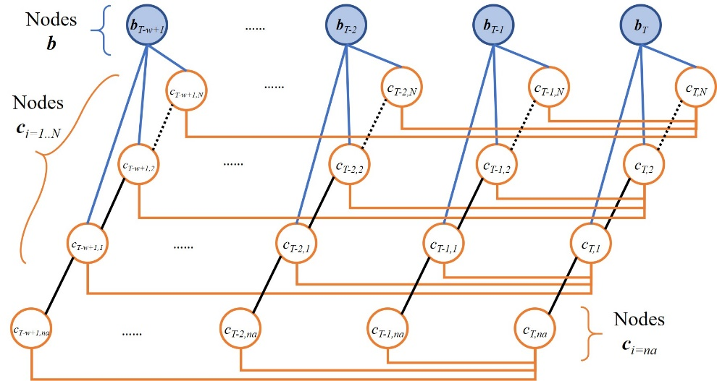
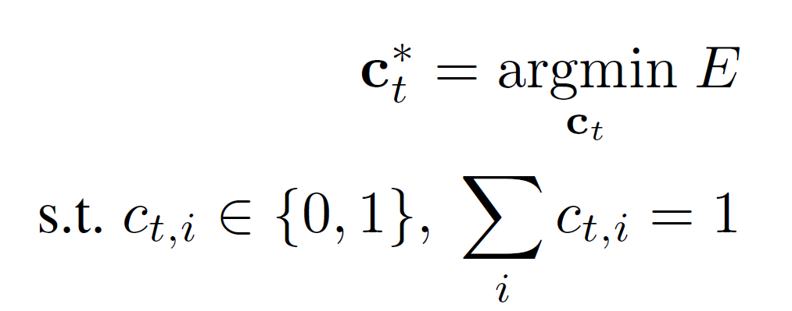
DIPD (Dynamic Interest Point Detection)
Challenges
Yu-Sian Jiang (Sharon), Garrett Warnell, Eduardo Munera, and Peter Stone
Learning Agent Research Group (LARG) at UT Austin, ARL, MAI
Challenges of gaze-based intention inference in a car includes clustered interest points, non-linear motion relative to the human within the vehicle, varying size, and multiple sources of noise: vehicle shaking, occlusion, eye blinks, …
DIPD includes a dynamic MRF model with an energy function designed to be robust to noise.
Nodes b: gaze points
Nodes c_{i=1...N}: all points of interest
Nodes c_{i=na}: User is not attending any of interest points
P(b|c_{i}): Gaussian distribution centered at each interest point
Energy E: tracking + time-consistency

Slide 10
Demographic Information
Yu-Sian Jiang (Sharon), Garrett Warnell, Eduardo Munera, and Peter Stone
Learning Agent Research Group (LARG) at UT Austin, ARL, MAI
15 human participants
Age: 23 - 46
Gender: 6 females and 9 males.
Each participant had a driver’s license
Five of them had no or very little scientific background.

Slide 11
Yu-Sian Jiang (Sharon), Garrett Warnell, Eduardo Munera, and Peter Stone
Learning Agent Research Group (LARG) at UT Austin, ARL, MAI
Notes:
we tell the person where to try to get the car to park, and then evaluate how successful it is.

Slide 12
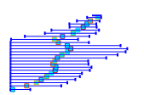
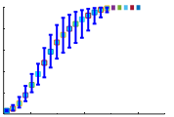
Results
Yu-Sian Jiang (Sharon), Garrett Warnell, Eduardo Munera, and Peter Stone
Learning Agent Research Group (LARG) at UT Austin, ARL, MAI
Is there benefit in using a copilot system over manual driving?
Manual Driving vs. Copilot
Vehicle trajectories generated by the copilot system are smoother and lower-variance.
The copilot system allowed the users to reach their intended goal more quickly.
Manual driving
(mean)
Manual driving
(std. dev.)
Copilot system
(15 km/h)
Copilot system
(30 km/h)
Copilot system
(45 km/h)
Notes:
Long distance goal

Slide 13
Results
Yu-Sian Jiang (Sharon), Garrett Warnell, Eduardo Munera, and Peter Stone
Learning Agent Research Group (LARG) at UT Austin, ARL, MAI
Is there benefit in using a copilot system over manual driving?
Manual Driving vs. Copilot
Manual driving requires more user activity
There is no number reported for the CopilotGaze system since the users control the system using only their eye gaze.
 | Manual driving | CopilotKey | CopilotGaze
Short Distance Goal | 41.93 (2.41) | 12.87 (1.60) | 0
Middle Distance Goal | 44.80 (4.21) | 13.20 (3.24) | 0
Long Distance Goal | 44.60 (4.13) | 13.18 (1.55) | 0
The number of user actions required for reaching an intended goal (mean & std. err.)

Slide 14
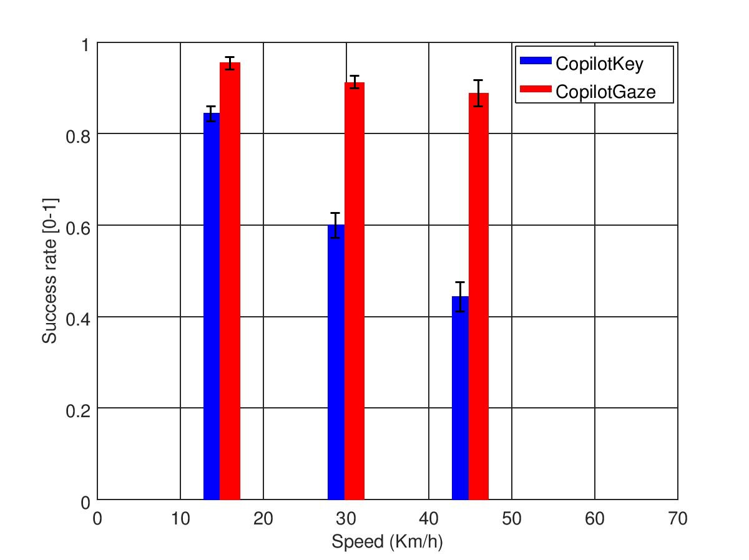
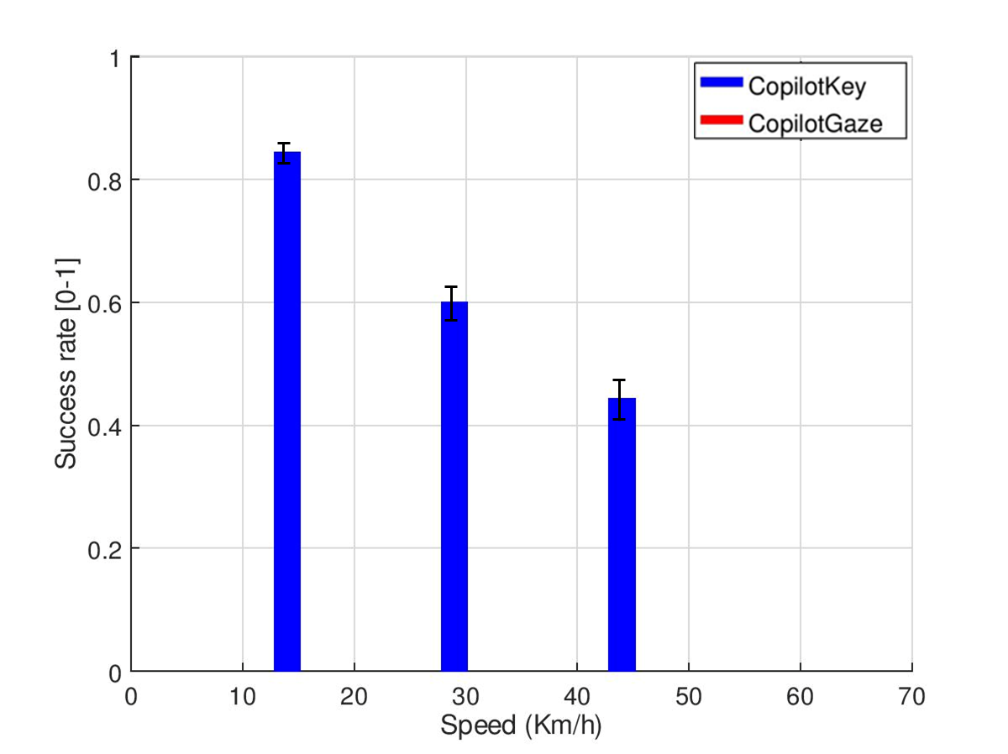
Results
Yu-Sian Jiang (Sharon), Garrett Warnell, Eduardo Munera, and Peter Stone
Learning Agent Research Group (LARG) at UT Austin, ARL, MAI
For a copilot system, is there any benefit in using gaze tracking to detect a destination change versus a system that instead uses a more traditional, keyboard-based method of input?
CopilotKey vs. CopilotGaze
As the speed is increased, the success rate of CopilotGaze is significantly higher than that of CopilotKey.
CopilotGaze enables fast communication between human passenger and robot vehicle.
CopilotGaze resolves ambiguity.

Slide 15
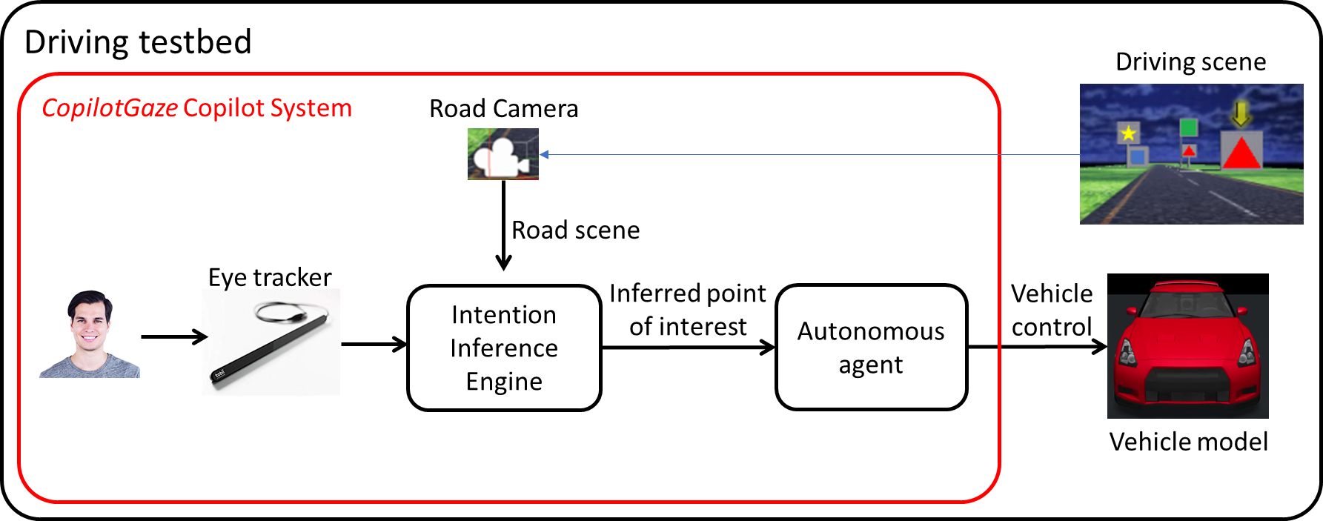
Conclusion
Yu-Sian Jiang (Sharon), Garrett Warnell, Eduardo Munera, and Peter Stone
Learning Agent Research Group (LARG) at UT Austin, ARL, MAI
YES
Is there benefit in using a copilot system over manual driving?
For a copilot system, is there any benefit in using gaze tracking to detect a destination change versus a system that instead uses a more traditional, keyboard-based method of input?
YES
Notes:
We proposed using human intent recognition to influence the behavior of the autonomous agent.

Slide 16
Backup
Yu-Sian Jiang (Sharon), Garrett Warnell, Eduardo Munera, and Peter Stone
Learning Agent Research Group (LARG) at UT Austin, ARL, MAI

Slide 17
FAQ
Yu-Sian Jiang (Sharon), Garrett Warnell, Eduardo Munera, and Peter Stone
Learning Agent Research Group (LARG) at UT Austin, ARL, MAI
How do you separate looking for the purpose of parking vs. looking for some other purpose?
In practice, a button or a voice input can be used to indicate the car to enter the parking mode.

Slide 18
FAQ
Yu-Sian Jiang (Sharon), Garrett Warnell, Eduardo Munera, and Peter Stone
Learning Agent Research Group (LARG) at UT Austin, ARL, MAI
How much practice did the human drivers have before parking? The video didn't look like the person was very practiced.
- maybe in the video say that this was a particularly bad one - that
most people are better
- say that they got to practice first
In a car racing game, the car is typically sensitive to the change of the steering wheel angle. Though in a real car, the car trajectory is not so sensitive to the steering wheel angle, the fact that manual driving has higher variance than copilot still holds.

Slide 19
FAQ
Yu-Sian Jiang (Sharon), Garrett Warnell, Eduardo Munera, and Peter Stone
Learning Agent Research Group (LARG) at UT Austin, ARL, MAI
Is it fair to compare a fast input (gaze) vs. slow input (typing) interface? Could you use voice instead?
Voice input is challenging for noise immunity, it also needs a preamble such as “OK Google” to start the service. Obviously, this will make voice input slower than gaze. Moreover, saying a location of a parking space is much harder than just look at it.

Slide 20
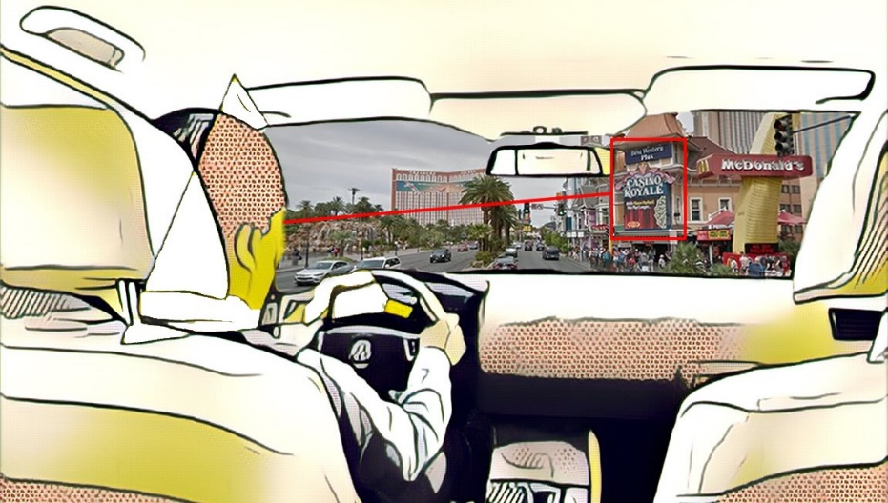
DIPD (Dynamic Interest Point Detection)
Yu-Sian Jiang (Sharon), Garrett Warnell, Eduardo Munera, and Peter Stone
Learning Agent Research Group (LARG) at UT Austin, ARL, MAI
DIPD utilizes a dynamic MRF model with an energy function designed to be robust to noise.
DIPD outperforms Nearest Neighbor based approach.
Improvement is especially significant for small, challenging objects in congested scenarios.

Slide 21
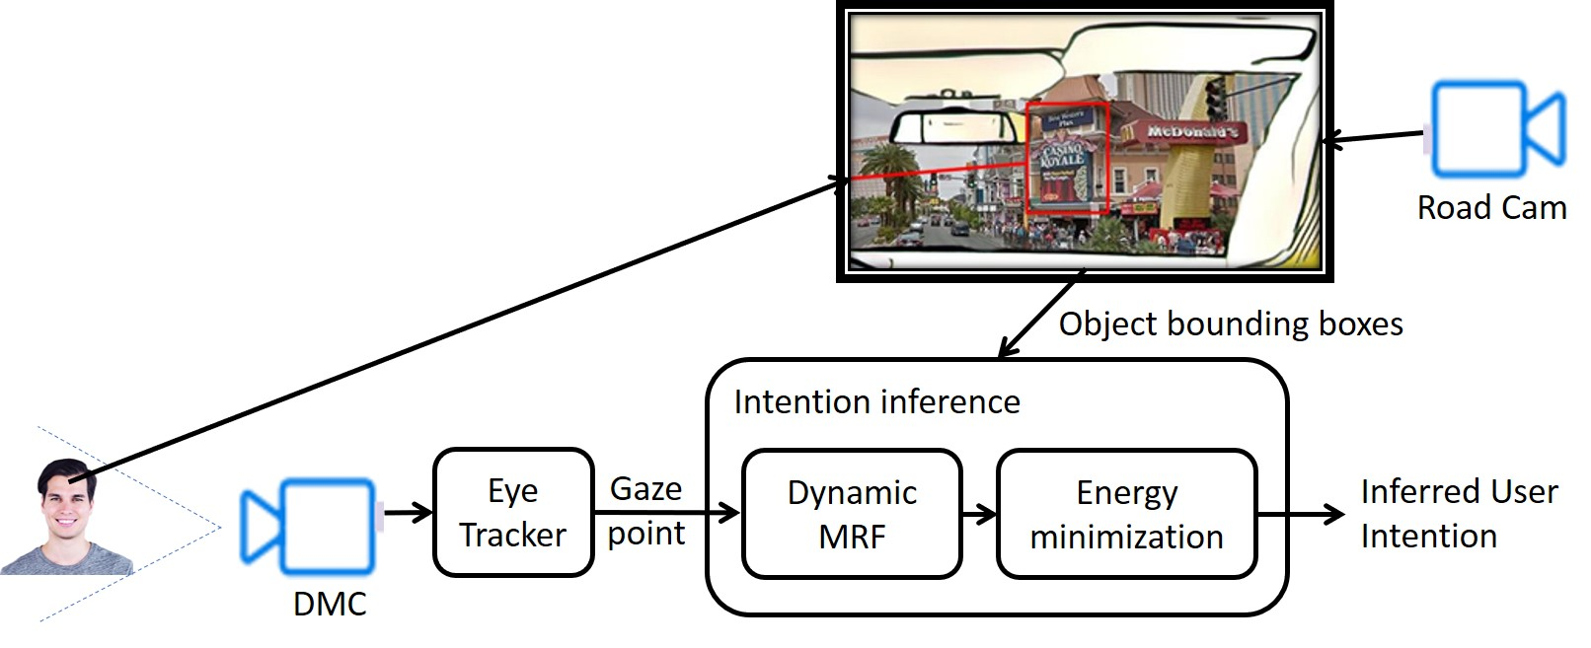
DIPD (Dynamic Interest Point Detection) System Overview
Yu-Sian Jiang (Sharon), Garrett Warnell, Eduardo Munera, and Peter Stone
Learning Agent Research Group (LARG) at UT Austin, ARL, MAI
One camera facing inward for user face
Another camera facing outward for road scene
(bounding box of user’s point of interest)
DMC: Driver monitor Camera
MRF: Markov Random Field
Notes:
To infer the driver’s intention, we propose to setup …

Slide 22
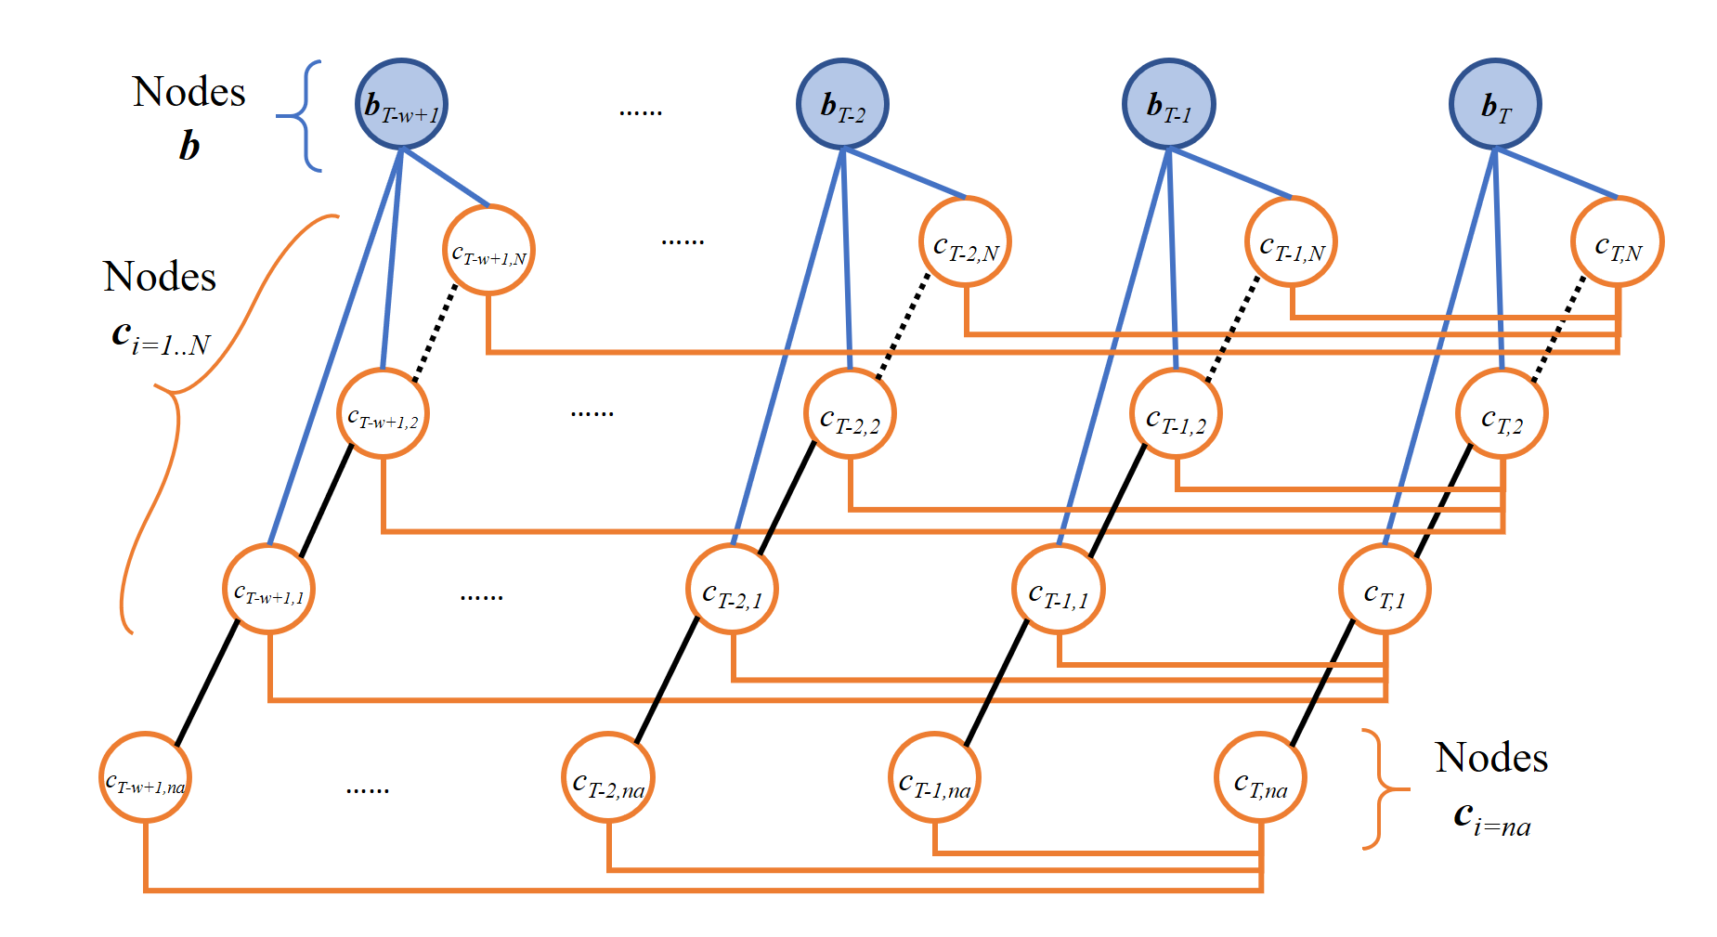
DIPD: Dynamic MRF + Energy Min
Yu-Sian Jiang (Sharon), Garrett Warnell, Eduardo Munera, and Peter Stone
Learning Agent Research Group (LARG) at UT Austin, ARL, MAI
Tracking
Nodes b: gaze points
Nodes c_{i=1...N}: all points of interest
Nodes c_{i=na}: User is not attending any of interest points
P(b|c_{i}): Gaussian distribution centered at each interest point
Energy E: tracking + time-consistency
Time-consistency

Slide 23
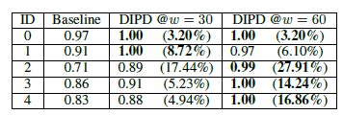
Experimental Results: Success rate
Yu-Sian Jiang (Sharon), Garrett Warnell, Eduardo Munera, and Peter Stone
Learning Agent Research Group (LARG) at UT Austin, ARL, MAI
Baseline: Nearest Neighbor approach
DIPD: our dynamic interest point detection method
DIPD performs better for inferring user intent among finer-grain objects in a dynamic environment
Improvement is especially significant for small, challenging objects in congested scenarios.
(Challenging object: Mean = 16.45; S.D. = 8.45, Others: Mean = 7.11, S.D.= 7:46; z = 4.85, p < 0.00001).

Slide 24
Experimental Setup
Manual Driving
CopilotKey
CopilotGaze
Key-in entry
Keyboard
Eye-tracker
Notes:
Objective 1: to answer experimentally whether there is benefit to the proposed copilot system versus manual driving.
The manual driving system includes a steering wheel, pedals, and a desktop screen to display a driving scene.
A keyboard for desktop computer is used to represent the keypad in a real vehicle.
A key-in entry is shown on the screen.
The intention inference engine matches the color and shape of the nearest interest point with the user’s text input.

