Slide 1


APPLR: Adaptive Planner Parameter Learning from Reinforcement
Zifan Xu¹, Gauraang Dhamankar¹, Anirudh Nair¹, Xuesu Xiao¹, Garrett Warnell², Bo Liu¹, Zizhao Wang¹, Peter Stone^{1, 3}
¹The University of Texas at Austin
²Army Research Laboratory
³Sony AI

Slide 2
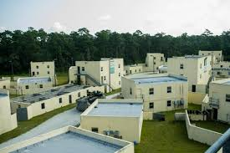

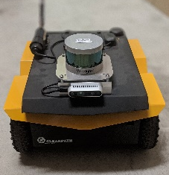
Classical navigation system
A fixed set of parameters does not work for all the environments
Re-tuning the parameters requires expert knowledges

Slide 3
Adaptive planner parameter learning from demonstration
Learn a library of parameters for different navigation scenarios from human demonstration
  (Xiao et al. 2020)

Slide 4
Adaptive planner parameter learning from reinforcement
Proposal: learn a parameter policy that adaptively tune the parameters of the classical navigation system
Directly improve upon the classical navigation system, while preserve the benefits (e.g. safety assurance)
Sample-efficient by reducing the costly random exploration
Possibility to generalize to all kinds of environments

Slide 5
Related work
Parameter tuning
  Automatic parameter tuning specific one fixed navigation scenario (e.g. [Bhardwaj et al. 2019])
  Learn parameters libraries for limited set of navigation scenarios from demonstration [Xiao et al. 2020]
End-to-end learning-base navigation
  Require large mount of training data
  Sim-to-real gap leads to catastrophic failures (e.g. [Pfeiffer el al. 2017])

Slide 6
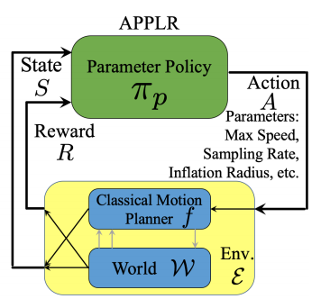
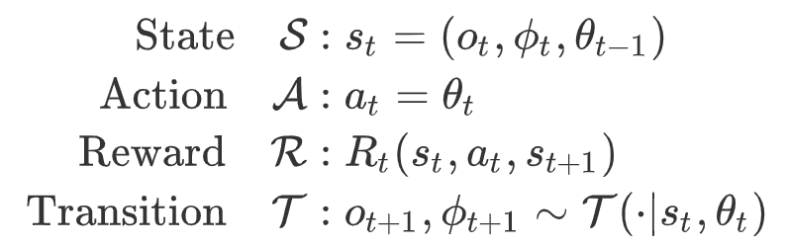
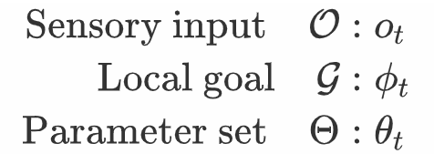
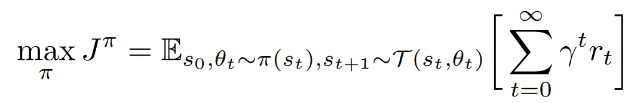
Markov decision process (MDP) and parameter policy
Optimization objective:

Slide 7
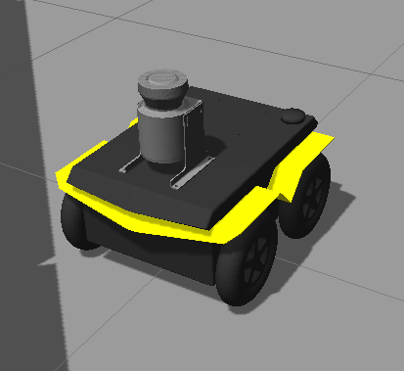
Experiment
Jackal mobile robot in Gazebo simulation
Sensory input: 720-dimensional planar laser scan
Classical navigation system: DWA
Tune 7 hyper-parameters of DWA
Time step: 2s

Slide 8
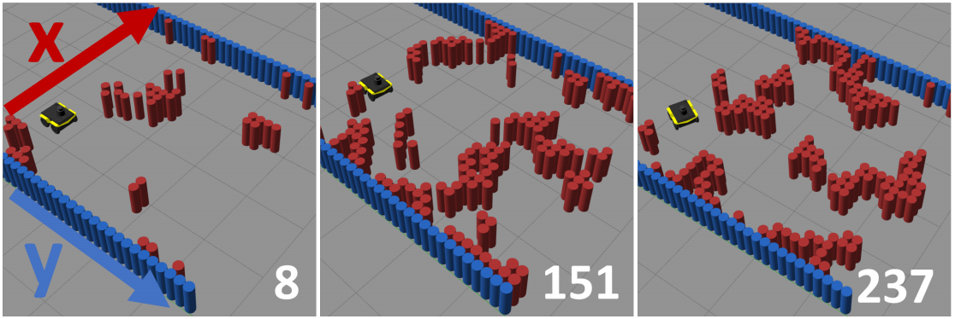
BARN dataset
To learn a generalized policy, we train the model on 250 different environments, and test the model on another 50 environments
(Perille et al. 2020)

Slide 9
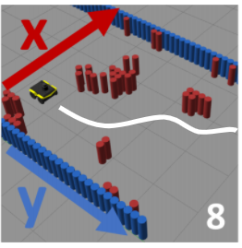
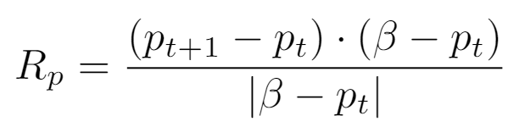

Reward design
d(o_{t+1})
Encourage to Reduce the total time cost
Encourage the local progress in the direction from
starting to the goal
Discourage the collision
p_{t}
p_{t+1}
β

Slide 10
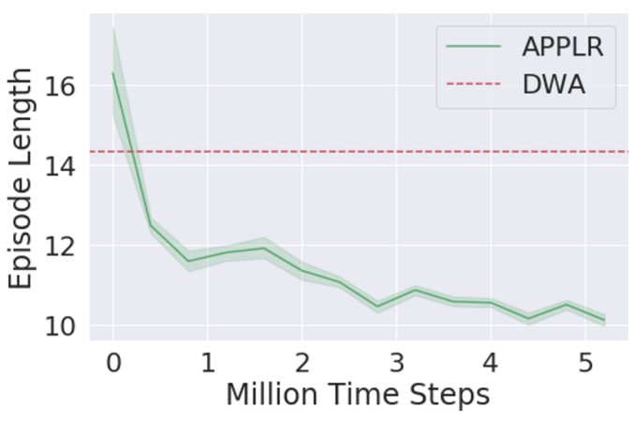
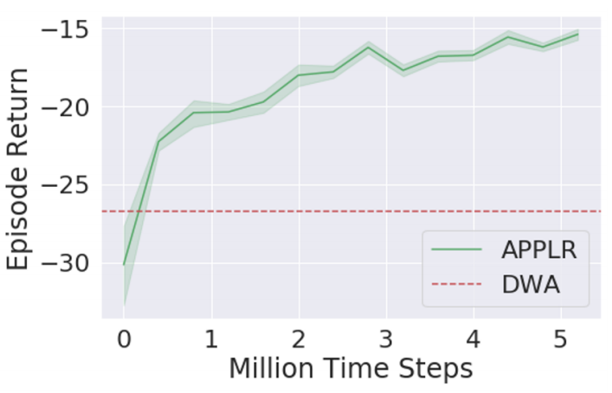
Training
RL algorithm: Twin Delayed Deep Deterministic policy gradient (TD3)
Neural network: three 512-unit layers of MLP
Distributed actor-critic training:
  500 actors running 250 environments in BARN dataset
  One central learner
  Train 5 million steps in about 6h

Slide 11
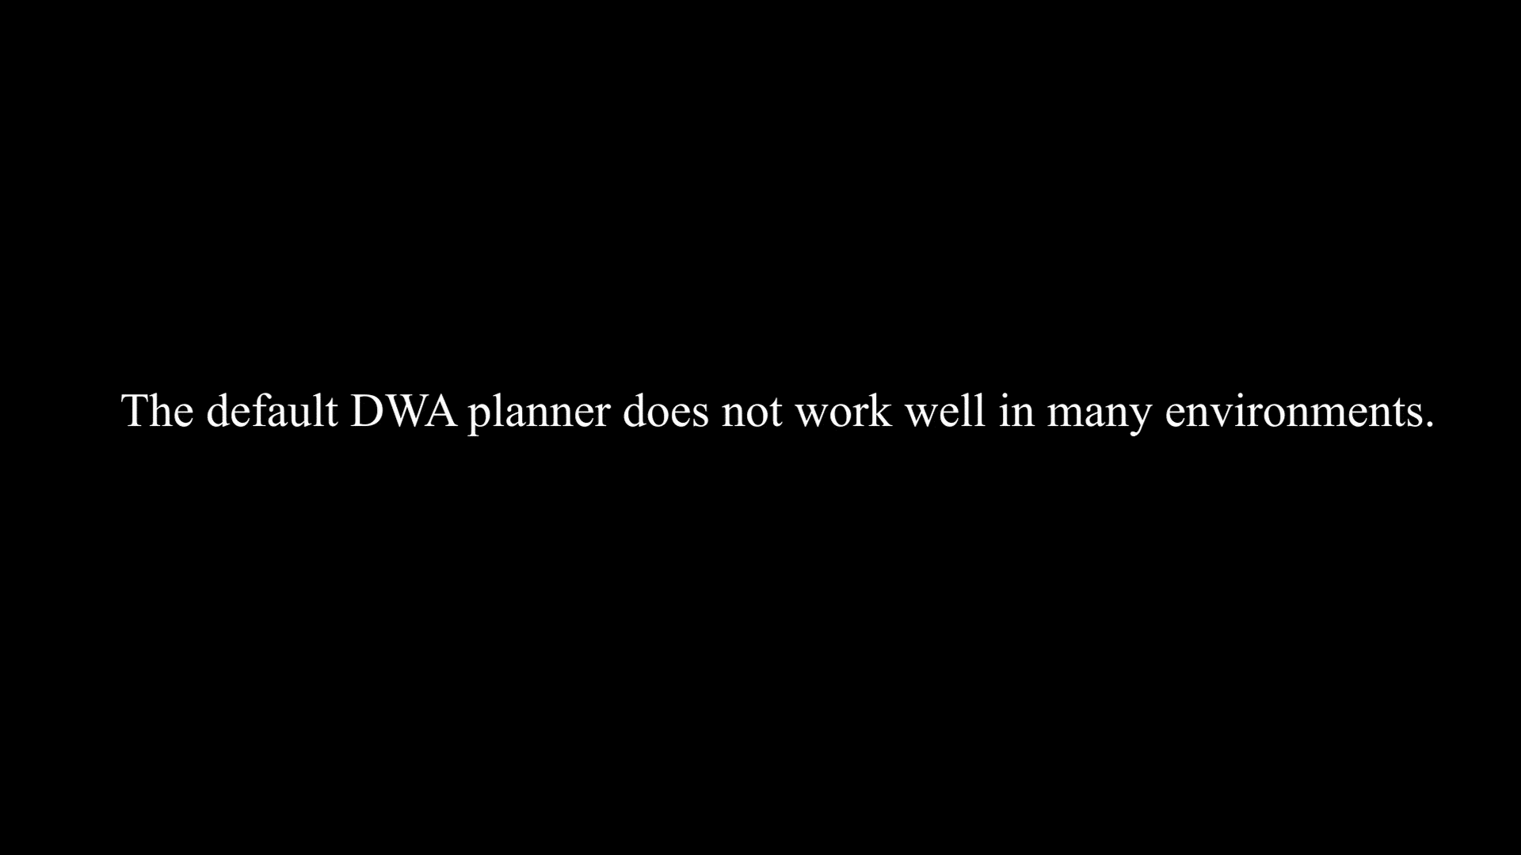
Training
Improvement of the policy at different training steps

Slide 12
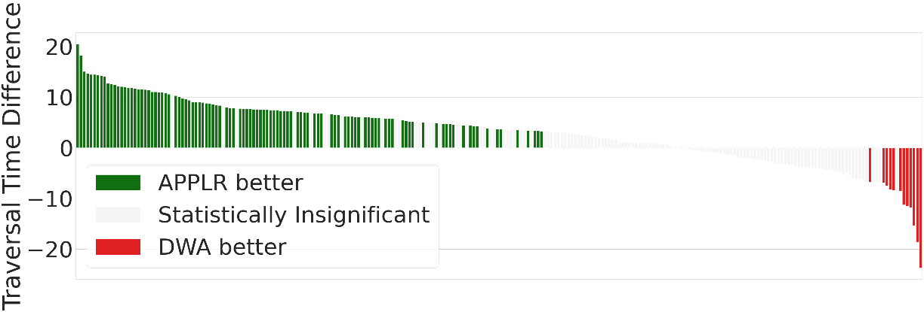
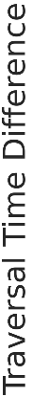
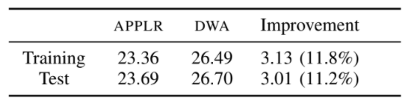
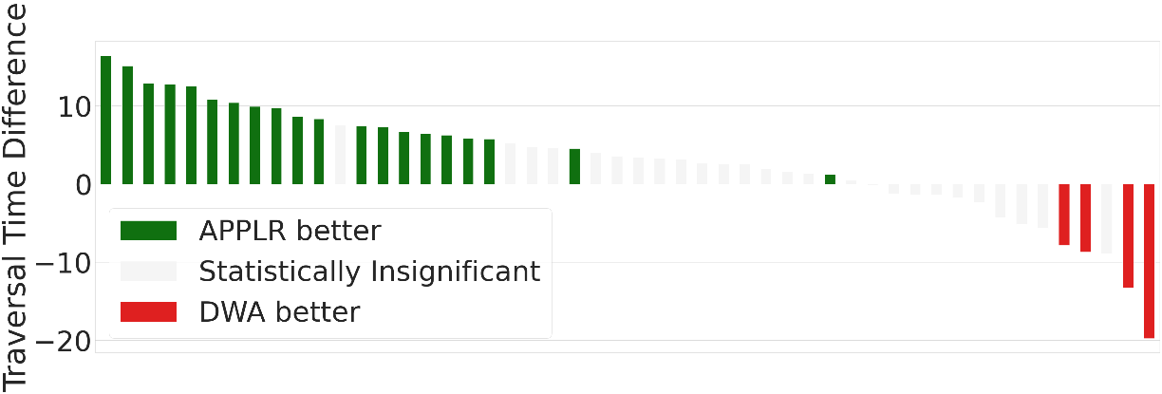
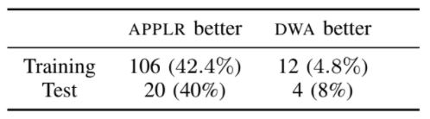
Evaluation
Evaluate on both training and test set
40 trials for each environment
T-test between APPLR and DWA
Out of distribution due to partially observability

Slide 13
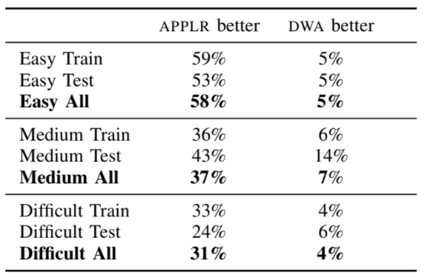
Sensitivity to the environment difficulties
Measure the difficulty by the traversal time of DWA
Less improvements are shown in the difficult environments
The performance is limited by the underlying navigation stack

Slide 14
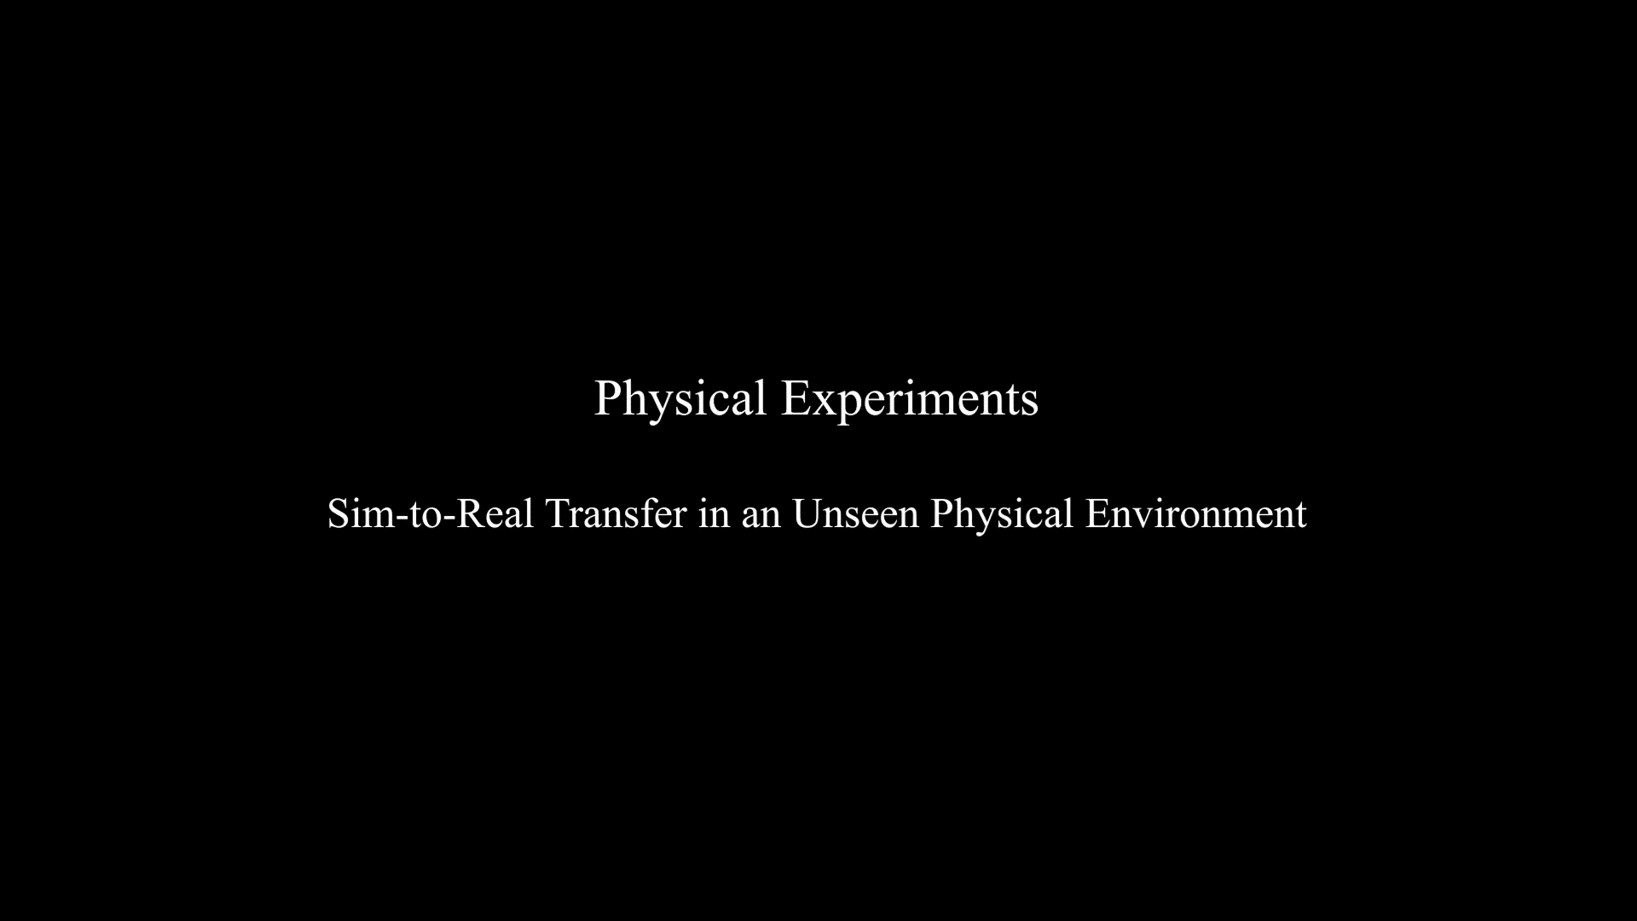
Physical experiment
Compares DWA, APPLD and APPLR in unseen physical environment

Slide 15
Summary
A direct improvement upon existing navigation system, while preserving the safety assurance
A generalized policy over variety of environments
Good sim-to-real transfer

Slide 16









Thanks for Listening!
APPLR: Adaptive Planner Parameter Learning from Reinforcement
Zifan Xu¹, Gauraang Dhamankar¹, Anirudh Nair¹, Xuesu Xiao¹, Garrett Warnell², Bo Liu¹, Zizhao Wang¹, Peter Stone^{1, 3}

