Slide 1
Maximum Benefit from a Minimal HTM
Owen Hofmann, Chris Rossbach, and Emmett Witchel
The University of Texas at Austin
Notes:
HTM

Slide 2
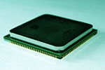
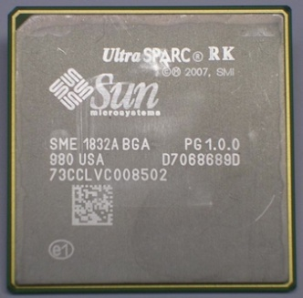
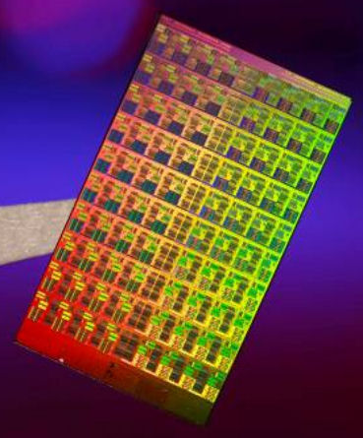
Concurrency is here
Core count ever increasing
Parallel programming is difficult
Synchronization perilous
Performance/complexity
Many ideas for simpler parallelism
TM, Galois, MapReduce
2 core
16 core
80 core

Slide 3
Transactional memory
Better performance from simple code
Change performance/complexity tradeoff
Replace locking with memory transactions
Optimistically execute in parallel
Track read/write sets, roll back on conflict
W_{A}∩(R_{B}∪W_{B}) != ∅
Commit successful changes
Notes:
Parallelism offered by versioning and conflict detection

Slide 4
TM ain't easy
TM must be fast
Lose benefits of concurrency
TM must be unbounded
Keeping within size not easy programming model
TM must be realizable
Implementing TM an important first step

Slide 5
TM ain't easy
 | Fast | Realizable | Unbounded
Best-effort HTM | ✔
Version and detect conflicts with existing structures
Cache coherence, store buffer

Slide 6
TM ain't easy
 | Fast | Realizable | Unbounded
Best-effort HTM | ✔ | ✔
Version and detect conflicts with existing structures
Cache coherence, store buffer
Simple modifications to processor
Very realizable (stay tuned for Sun Rock)

Slide 7
TM ain't easy
 | Fast | Realizable | Unbounded
Best-effort HTM | ✔ | ✔ | ✖
Version and detect conflicts with existing structures
Cache coherence, store buffer
Simple modifications to processor
Very realizable (stay tuned for Sun Rock)
Resource-limited
Cache size/associativity, store buffer size

Slide 8
TM ain't easy
 | Fast | Realizable | Unbounded
Best-effort HTM | ✔ | ✔ | ✖
STM | ✖ | ✔ | ✔
Software endlessly flexible
Transaction size limited only by virtual memory
Slow
Instrument most memory references

Slide 9
TM ain't easy
 | Fast | Realizable | Unbounded
Best-effort HTM | ✔ | ✔ | ✖
STM | ✖ | ✔ | ✔
Unbounded HTM | ✔ | ✖ | ✔
Versioning unbounded data in hardware is difficult
Unlikely to be implemented

Slide 10
TM ain't easy
 | Fast | Realizable | Unbounded
Best-effort HTM | ✔ | ✔ | ✖
STM | ✖ | ✔ | ✔
Unbounded HTM | ✔ | ✖ | ✔
Hybrid TM | ~ | ~ | ✔
Tight marriage of hardware and software
Disadvantages of both?
Notes:
Hybrid share data between software and hardware

Slide 11
Back to basics
 | Fast | Realizable | Unbounded
Best-effort HTM | ✔ | ✔ | ✖
Cache-based HTM
Speculative updates in L1
Augment cache line with transactional state
Detect conflicts via cache coherence
Operations outside transactions can conflict
Asymmetric conflict
Detected and handled in strong isolation

Slide 12
Back to basics
 | Fast | Realizable | Unbounded
Best-effort HTM | ✔ | ✔ | ✖
Transactions bounded by cache
Overflow because of size or associativity
Restart, return reason
Not all operations supported
Transactions cannot perform I/O
Notes:
In both these cases,(click) it is necessary for software to work around the limitations of the HTM

Slide 13
Back to basics
 | Fast | Realizable | Unbounded
Best-effort HTM | ✔ | ✔ | ✖
Transactions bounded by cache
Software finds another way
Not all operations supported
Software finds another way

Slide 14
Maximum benefit
 | Fast | Realizable | Unbounded
Best-effort HTM | ✔ | ✔ | ✔
Creative software and ISA makes best-effort unbounded
TxLinux
Better performance from simpler synchronization
Transaction ordering
Make best-effort unbounded
Notes:
No shift

Slide 15
Linux: HTM proving ground
Large, complex application(s)
With different synchronization
Jan. 2001: Linux 2.4
5 types of synchronization
~8,000 dynamic spinlocks
Heavy use of Big Kernel Lock
Dec. 2003: Linux 2.6
8 types of synchronization
~640,000 dynamic spinlocks
Restricted Big Kernel Lock use

Slide 16
Linux: HTM proving ground
Large, complex application
With evolutionary snapshots
Linux 2.4
Simple, coarse synchronization
Linux 2.6
Complex, fine-grained synchronization

Slide 17
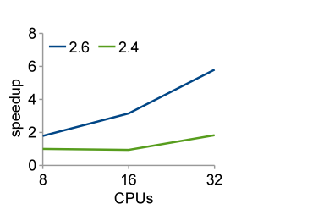
Linux: HTM proving ground
Modified Andrew Benchmark

Slide 18
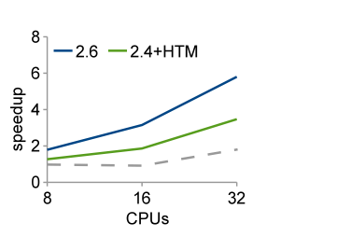
Linux: HTM proving ground
Modified Andrew Benchmark

Slide 19
HTM can help 2.4
Software must back up hardware
Use locks
Cooperative transactional primitives
Replace locking function
Execute speculatively, concurrently in HTM
Tolerate overflow, I/O
Restart, (fairly) use locking if necessary
acquire_lock(lock)
release_lock(lock)
Notes:
Next on “replace locking function”

Slide 20
HTM can help 2.4
Software must back up hardware
Use locks
Cooperative transactional primitives
Replace locking function
Execute speculatively, concurrently in HTM
Tolerate overflow, I/O
Restart, (fairly) use locking if necessary
cx_begin(lock)
cx_end(lock)
Notes:
No include/linux
Visual representation of cooperative transactional

Slide 21
HTM can help 2.4
Software must back up hardware
Use locks
Cooperative transactional primitives
Replace locking function
Execute speculatively, concurrently in HTM
Tolerate overflow, I/O
Restart, (fairly) use locking if necessary
cx_begin(lock)
cx_end(lock)
TX A
TX B
Notes:
No include/linux
Visual representation of cooperative transactional

Slide 22
HTM can help 2.4
Software must back up hardware
Use locks
Cooperative transactional primitives
Replace locking function
Execute speculatively, concurrently in HTM
Tolerate overflow, I/O
Restart, (fairly) use locking if necessary
cx_begin(lock)
cx_end(lock)
TX A
do_IO() TX B
Notes:
No include/linux
Visual representation of cooperative transactional

Slide 23
HTM can help 2.4
Locking B
Software must back up hardware
Use locks
Cooperative transactional primitives
Replace locking function
Execute speculatively, concurrently in HTM
Tolerate overflow, I/O
Restart, (fairly) use locking if necessary
cx_begin(lock)
cx_end(lock)
TX A
Notes:
Acquires the lock using special instruction, such that any transactions are allowed to commit first

Slide 24
HTM can help 2.4
Locking B
Software must back up hardware
Use locks
Cooperative transactional primitives
Replace locking function
Execute speculatively, concurrently in HTM
Tolerate overflow, I/O
Restart, (fairly) use locking if necessary
cx_begin(lock)
cx_end(lock)
TX A
Notes:
Better cooperative talking

Slide 25
Adding HTM
Spinlocks: good fit for best-effort transactions
Short, performance-critical synchronization
cxspinlocks (SOSP '07)
2.4 needs cooperative transactional mutexes
Must support blocking
Complicated interactions with BKL
cxmutex
Must modify wakeup behavior
Notes:
“cooperative transactional”

Slide 26
Adding HTM, cont.
Reorganize data structures
Linked lists
Shared counters
~120 lines of code
Atomic lock acquire
Record locks
Acquire in transaction
Commit changes
Linux 2.4 ➔ TxLinux 2.4
Change synchronization, not use
cx_begin(lock)
cx_end(lock)
stat++ TX B
Notes:
Statistics counter changes to per-cpu counter

Slide 27
Adding HTM, cont.
Reorganize data structures
Linked lists
Shared counters
~120 lines of code
Atomic lock acquire
Record locks
Acquire in transaction
Commit changes
Linux 2.4 ➔ TxLinux 2.4
Change synchronization, not use
cx_begin(lock)
cx_end(lock)
stat[CPU]++ TX B
Notes:
Relate to coarse-grained (only need 4!)
Less cryptic (visual)
Changed synchronization, not its use

Slide 28
Adding HTM, cont.
Reorganize data structures
Linked lists
Shared counters
~120 lines of code
Atomic lock acquire
Record locks
Acquire in transaction
Commit changes
Linux 2.4 ➔ TxLinux 2.4
Change synchronization, not use
cx_begin(lock)
do_IO()
cx_end(lock)
TX B
Notes:
Relate to coarse-grained (only need 4!)
Less cryptic (visual)
Changed synchronization, not its use

Slide 29
Adding HTM, cont.
Reorganize data structures
Linked lists
Shared counters
~120 lines of code
Atomic lock acquire
Record locks
Acquire in transaction
Commit changes
Linux 2.4 ➔ TxLinux 2.4
Change synchronization, not use
cx_begin(lock)
do_IO()
cx_end(lock)
acquire_locks() TX B
Notes:
Relate to coarse-grained (only need 4!)
Less cryptic (visual)
Changed synchronization, not its use

Slide 30
Adding HTM, cont.
Reorganize data structures
Linked lists
Shared counters
~120 lines of code
Atomic lock acquire
Record locks
Acquire in transaction
Commit changes
Linux 2.4 ➔ TxLinux 2.4
Change synchronization, not use
cx_begin(lock)
do_IO()
cx_end(lock)
do_IO() Locking B
Notes:
Changed synchronization, not its use

Slide 31
Evaluating TxLinux
MAB
Modified Andrew Benchmark
dpunish
Stress dcache synchronization
find
Parallel find + grep
config
Parallel software package configure
pmake
Parallel make
Notes:
Kernel is the benchmark

Slide 32
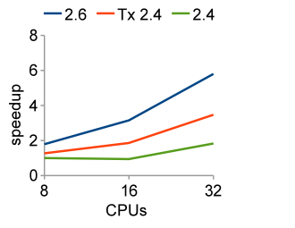
Evaluation: MAB
2.4 wastes 63% kernel time synchronizing
Notes:
With 32 processors executing this benchmark, unmodified Linux 2.4 wastes
This is a graph of speedup over unmodified Linux 2.4 on 8 processors

Slide 33
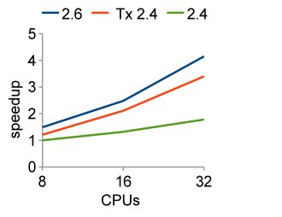
Evaluation: dpunish
2.4 wastes 57% kernel time synchronizing
Notes:
Not 16/32
De-color coordinate

Slide 34
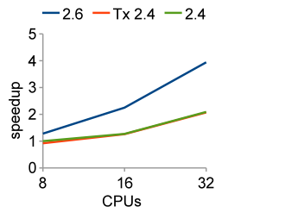
Evaluation: config
2.4 wastes 30% kernel time synchronizing
Notes:
Not 16/32
De-color coordinate

Slide 35
From kernel to user
Best-effort HTM means simpler locking code
Good programming model for kernel
Fall back on locking when necessary
Still permits concurrency
HTM promises transactions
Good model for user
Need software synchronization fallback
Don’t want to expose to user
Want concurrency
Notes:
Mention hybrid designs

Slide 36
Software, save me!
HTM falls back on software transactions
Global lock
STM
Concurrency
Conflict detection
HTM workset in cache
STM workset in memory
Global lock – no workset
Communicate between disjoint SW and HW
No shared data structures
Notes:
No shared data structures

Slide 37
Hardware, save me!
HTM has strong isolation
Detect conflicts with software
Restart hardware transaction
Only if hardware already has value in read/write set
Transaction ordering
Commit protocol for hardware
Wait for concurrent software TX
Resolve inconsistencies
Hardware/OS contains bad side effects
Notes:
Hardware/OS contains

Slide 38
Transaction ordering
char* r
int idx
Notes:
“bad”

Slide 39
Transaction ordering
char* r
int idx
Transaction A
begin_transaction()
r[idx] = 0xFF
end_transaction()
Transaction B
begin_transaction()
r = new_array
idx = new_idx
end_transaction()
Invariant: idx is valid for r
Notes:
“bad”

Slide 40
Transaction ordering
char* r
int idx
Transaction A
begin_transaction()
r[idx] = 0xFF
end_transaction()
Transaction B
begin_transaction()
r = new_array
idx = new_idx
end_transaction()
Invariant: idx is valid for r
Inconsistent read causes bad data write
Notes:
“bad”

Slide 41
Transaction ordering
A(HW)
r=new_array idx=new_idx
read:
write:
r = old_array
time
idx = old_idx
B(HW)
r[idx] = 0xFF
read:
write:
Notes:
Time arrow
Put code in

Slide 42
Transaction ordering
A(HW)
r=new_array idx=new_idx
read:
write: r
r = new_array
time
idx = old_idx
B(HW)
r[idx] = 0xFF
read:
write:

Slide 43
Transaction ordering
A(HW)
r=new_array idx=new_idx
Conflict!
read:
write: r
r = new_array
time
idx = old_idx
B(HW)
r[idx] = 0xFF
read: r
write:

Slide 44
Transaction ordering
A(HW)
r=new_array idx=new_idx
read:
write: r
r = new_array
time
idx = old_idx
B(HW)
r[idx] = 0xFF
Restart
read:
write:

Slide 45
Transaction ordering
A(HW)
r=new_array idx=new_idx
read:
write:
r = old_array
time
idx = old_idx
B(HW)
r[idx] = 0xFF
read:
write:
Notes:
Time arrow
Put code in

Slide 46
Transaction ordering
A(SW)
r=new_array idx=new_idx
r = old_array
time
idx = old_idx
B(HW)
r[idx] = 0xFF
read:
write:

Slide 47
Transaction ordering
A(SW)
r=new_array idx=new_idx
r = new_array
time
idx = old_idx
B(HW)
r[idx] = 0xFF
read:
write:
Notes:
Because A is software, no hardware visible write-set to add to

Slide 48
Transaction ordering
A(SW)
r=new_array idx=new_idx
Conflict not detected
r = new_array
time
idx = old_idx
B(HW)
r[idx] = 0xFF
read: r
write:

Slide 49
Transaction ordering
A(SW)
r=new_array idx=new_idx
r = new_array
time
idx = old_idx
B(HW)
r[idx] = 0xFF
read: r, idx
write: r[idx]
new_array[old_idx] = 0xFF

Slide 50
Transaction ordering
A(SW)
r=new_array idx=new_idx
r = new_array
time
idx = old_idx
Oh, no!
B(HW)
r[idx] = 0xFF
read: r, idx
write: r[idx]
new_array[old_idx] = 0xFF

Slide 51
Transaction ordering
A(SW)
r=new_array idx=new_idx
r = new_array
time
idx = old_idx
B(HW)
r[idx] = 0xFF
read: r, idx
write: r[idx]
Hardware contains effects of B
Unless B commits

Slide 52
Transaction ordering
A(SW)
r=new_array idx=new_idx
r = new_array
time
idx = old_idx
B(HW)
r[idx] = 0xFF
read: r, idx
write: r[idx]
Hardware contains effects of B
Unless B commits

Slide 53
Transaction ordering
A(SW)
r=new_array idx=new_idx
r = new_array
time
idx = new_idx
B(HW)
r[idx] = 0xFF
read: r, idx
write: r[idx]
Hardware contains effects of B
Unless B commits

Slide 54
Transaction ordering
A(SW)
r=new_array idx=new_idx
Asymmetric
conflict!
r = new_array
time
idx = new_idx
B(HW)
r[idx] = 0xFF
read: r, idx
write: r[idx]
Hardware contains effects of B
Unless B commits

Slide 55
Transaction ordering
A(SW)
r=new_array idx=new_idx
r = new_array
time
idx = new_idx
B(HW)
r[idx] = 0xFF
Restart
read: a, idx
write: a[idx]
Hardware contains effects of B
Unless B commits

Slide 56
Software + hardware mechanisms
Commit protocol
Hardware commit waits for any current software TX
Implemented as sequence lock
Operating system
Inconsistent data can cause spurious fault
Resolve faults by TX restart
Hardware
Even inconsistent TX must commit correctly
Pass commit protocol address to transaction_begin()

Slide 57
Transaction ordering
Safe, concurrent hardware and software
Evaluated on STAMP benchmarks
ssca2 – graph kernels
vacation – reservation system
High-contention
Low-contention
yada – Delauney mesh refinement
Best-effort + Single Global Lock STM (ordered)
Idealized HTM (free)
Notes:
From unrelated systems

Slide 58
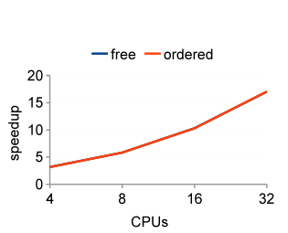
Evaluation: ssca2
No overflow – performance == ideal
Notes:
There are two lines here, one on top

Slide 59
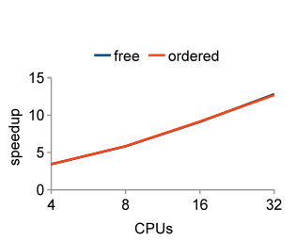
Evaluation: vacation-low
<1% overflow – performance == ideal

Slide 60
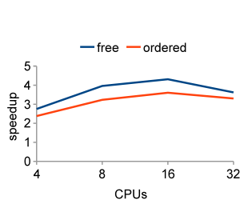
Evaluation: vacation-high
~3% overflow – performance near ideal

Slide 61
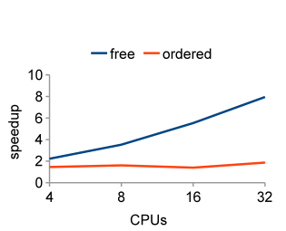
Evaluation: yada
~11% overflow – software bottleneck
85% execution spent in software

Slide 62
Evaluation
Small overflow rates, performance near ideal
Typical overflow unknown
TxLinux 2.4: <1%
Can be limited by software synchronization
Global lock: yada has long critical path
STM can help
Notes:
Remember atomic quake
Txlinux 2.4

Slide 63
Related work
Best-effort HTM
Herlihy & Moss ISCA '93
Sun Rock (Dice et al. ASPLOS '09)
Speculative Lock Elision
Rajwar & Goodman MICRO '01, ASPLOS '02
Hybrid TM
Damron et al. ASPLOS '06
Saha et al. MICRO '06
Shriraman et al. TRANSACT '06
Notes:
Less talky

Slide 64
We have the technology
TxLinux 2.4
Add concurrency to simpler locking
Transaction ordering
Best-effort becomes unbounded
Creative software + simple ISA additions

