Slide 1
Operating Systems must support GPU abstractions
Chris Rossbach, Microsoft Research
Jon Currey, Microsoft Research
Emmett Witchel, University of Texas at Austin
HotOS 2011

Slide 2
GPU Haiku (apropos 10 min talks)
Lots of GPUs
Must they be so hard to use?
We need dataflow…

Slide 3
GPU Haiku (apropos 10 min talks)
Lots of GPUs
Must they be so hard to use?
We need dataflow…
…support in the OS

Slide 4
Motivation and Agenda
There are lots of GPUs!
~ more powerful than CPUs
Great for Halo <X> and HPC, but little else
Underutilized
GPUs are difficult to program
SIMD execution model
Cannot access main memory
Treated as I/O device by OS

Slide 5
Motivation and Agenda
There are lots of GPUs!
~ more powerful than CPUs
Great for Halo <X> and HPC, but little else
Underutilized
GPUs are difficult to program
SIMD execution model
Cannot access main memory
Treated as I/O device by OS
These two things are related
We need OS abstractions
(dataflow)

Slide 6
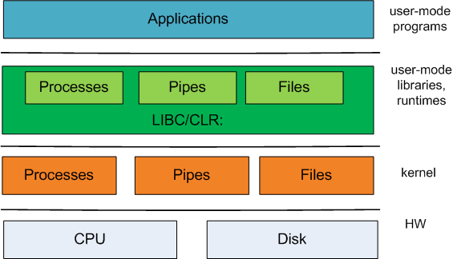
Traditional OS-Level abstractions
programmer-
visible interface
OS-level
abstractions
Hardware
interface

Slide 7
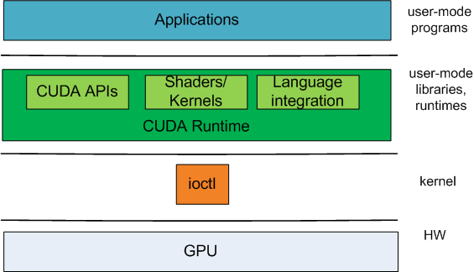
GPU Abstractions
programmer-
visible interface
1 OS-level
abstraction!
The programmer gets to work with great abstractions…
Why is this a problem?

Slide 8
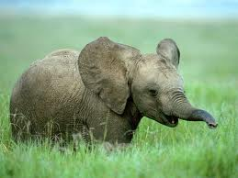
Why isn’t ioctl() enough?
We expect traditional OS guarantees:
Fairness
Isolation
No user-space runtime can provide these!
No kernel-facing interface
The OS cannot use the GPU
OS cannot manage the GPU
Lost optimization opportunities
Suboptimal data movement
Poor composability

Slide 9
CPU-bound processes hurt GPUs
invocations per second
Higher is
better
CPU scheduler and GPU scheduler not integrated!
Windows 7 x64 8GB RAM
Intel Core 2 Quad 2.66GHz
nVidia GeForce GT230

Slide 10
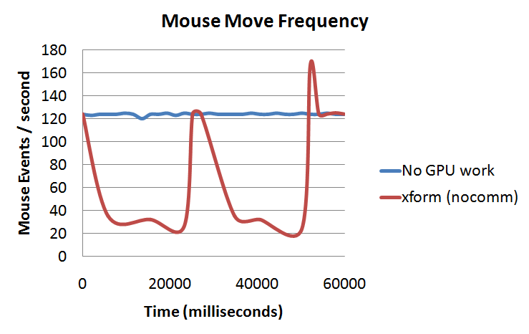
GPU-bound processes hurt CPUs
Flatter lines
Are better
Windows 7 x64 8GB RAM
Intel Core 2 Quad 2.66GHz
nVidia GeForce GT230

Slide 11
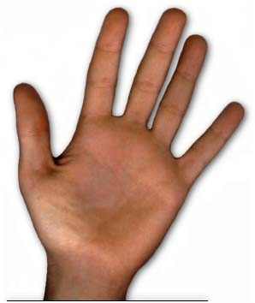
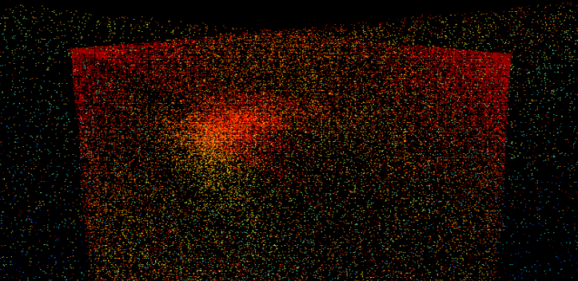
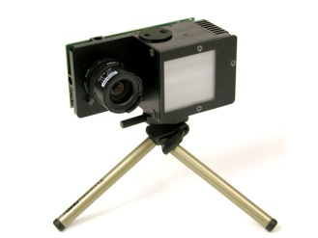
Composability: Gestural Interface
Raw images
“Hand”
events
Point cloud
HID
Input→OS
capture
filter
detect
#> capture | filter | detect | hidinput &
Data crossing u/k boundary
Double-buffering between camera drivers and GPU drivers
Pipes between filter and detect
move data to and from GPU even
when it’s already there

Slide 12
Meaningful GPGPU implies GPUs should be managed like CPUs
Process API analogues
IPC API analogues
Scheduler hint analogues
Abstractions that enable:
Composition
Data movement optimization
Easier programming

Slide 13
OS abstractions: dataflow!
ptask (parallel task)
Have priority for fairness
Analogous to a process for GPU execution
List of input/output resources (e.g. stdin, stdout…)
ports
Can be mapped to ptask input/outputs
A data source or sink (e.g. buffer in GPU memory)
channels
Similar to pipes
Connect arbitrary ports
Specialize to eliminate double-buffering

Slide 14
Gestural interface revisited
process:
capture
det_inp
ptask:
detect
usbsrc
rawimg
ptask:
filter
hands
hid_in
process:
hidinput
= process
cloud
= ptask
= port
Computation expressed as a graph
Synthesis [Masselin 89] (streams, pumps)
Dryad [Isard 07]
SteamIt [Thies 02]
Offcodes [Weinsberg 08]
others…
= channel

Slide 15
Gestural interface revisited
process:
capture
det_inp
USB→GPU mem
ptask:
detect
usbsrc
rawimg
ptask:
filter
hands
hid_in
process:
hidinput
= process
cloud
= ptask
= port
GPU mem →GPU mem
= channel
Eliminate unnecessary communication…

Slide 16
Gestural interface revisited
process:
capture
New data triggers new computation
det_inp
ptask:
detect
usbsrc
rawimg
ptask:
filter
hands
hid_in
process:
hidinput
= process
cloud
= ptask
= port
= channel
Eliminates unnecessary communication
Eliminates u/k crossings, computation

Slide 17
Conclusions
OS must get involved in GPU support
Current approaches:
Require wasteful data movement
Inhibit modularity/reuse
Cannot guarantee fairness, isolation
OS-level abstractions are required
Questions?

