Slide 1
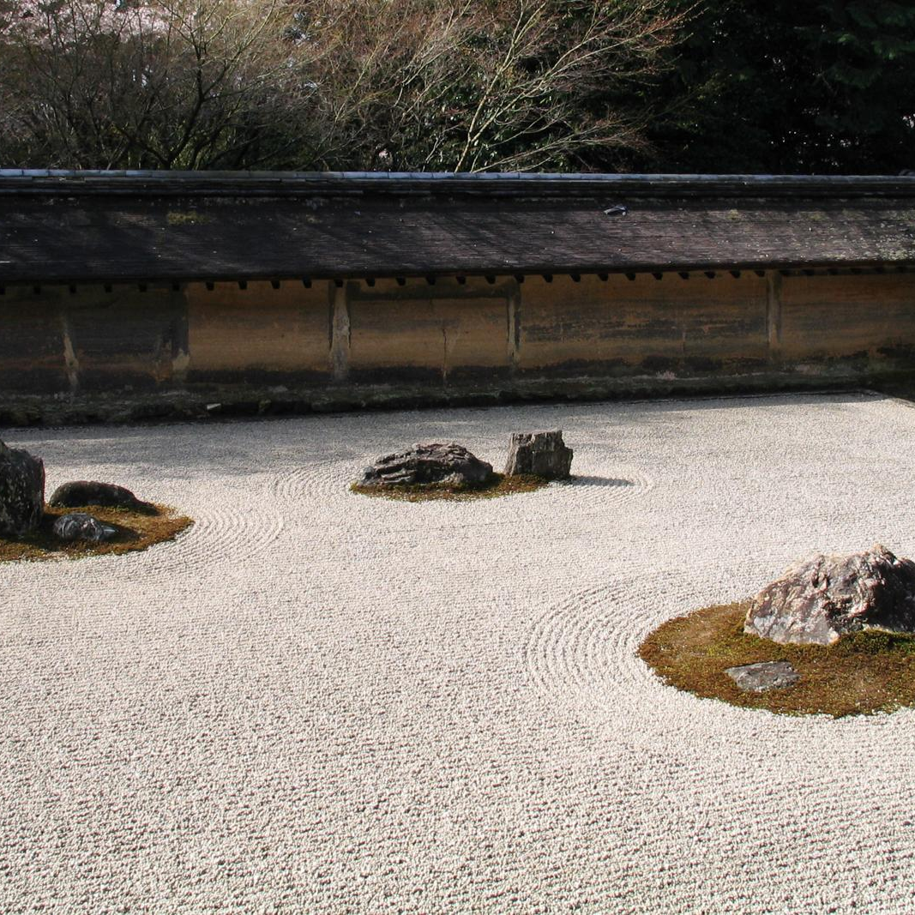
Ryoan: A Distributed Sandbox for Untrusted Computation on Secret Data
Tyler Hunt, Zhiting Zhu, Yuanzhong Xu, Simon Peter, Emmett Witchel

Slide 2
Disease risk assessment: Trust issues
Disease Risk
Notes:
Emph user data,
Ryoan’s story starts with these remote services.
In the service shown, users upload their genome and some information about their health to 23andMe, and receive a figure denoting how at risk they are for a paticular disease.

Slide 3
Disease risk assessment: Trust issues
Classification Result
Disease Risk
Notes:
Work more platforms in.
More about why 23andMe might be untrusted, dropped down, owned by russia, etc

Slide 4
Disease risk assessment: Trust issues
Classification Result
Disease Risk
Notes:
Other parties, perhaps parties that are only interested in gathering information and not providing a service.

Slide 5
Disease risk assessment: Trust issues
Classification Result
Disease Risk
Notes:
Other parties, perhaps parties that are only interested in gathering information and not providing a service.

Slide 6
Disease risk assessment: Trust issues
Classification Result
Disease Risk
Notes:
Other parties, perhaps parties that are only interested in gathering information and not providing a service.

Slide 7
Disease risk assessment: Trust issues
Classification Result
Disease Risk

Slide 8
Talk outline
Introduction
Controlling untrusted modules
Covert and side channels
Evaluation

Slide 9
Ryoan’s goals
Provide user data secrecy
Without trusting the application
Without trusting the platform (OS, Hypervisor)
Support cooperation between service providers
Userspace
Platform ( )
Notes:
user/kernel line

Slide 10
Ryoan’s goals
Provide user data secrecy
Without trusting the application
Without trusting the platform (OS, Hypervisor)
Support cooperation between service providers
Ryoan Sandbox
Userspace
Platform ( )

Slide 11
Ryōan-ji
Notes:
Ryoan-ji don’t chat too long on this
awesome sandbox implies awesome sandbox

Slide 12
Threat model
Users
Don’t trust service providers for secrecy
Don’t trust platforms for secrecy
Service Providers
Control platforms
Don’t trust other service provides for secrecy
Everyone
Trusts Ryoan
Trusts Intel SGX
Untrusted Code
Ryoan
User
User Data
Untrusted Platform
SGX
Notes:
more red boxes, walk though slide

Slide 13
Threat model
Users
Don’t trust service providers for secrecy
Don’t trust platforms for secrecy
Service Providers
Control platforms
Don’t trust other service provides for secrecy
Everyone
Trusts Ryoan
Trusts Intel SGX
Untrusted Code
Ryoan
User
User Data
Untrusted Platform
SGX
Notes:
more red boxes, walk though slide

Slide 14
Threat model
Users
Don’t trust service providers for secrecy
Don’t trust platforms for secrecy
Service Providers
Control platforms
Don’t trust other service provides for secrecy
Everyone
Trusts Ryoan
Trusts Intel SGX
Untrusted Code
Ryoan
User
User Data
Untrusted Platform
SGX
Notes:
more red boxes, walk though slide

Slide 15
Threat model
Users
Don’t trust service providers for secrecy
Don’t trust platforms for secrecy
Service Providers
Control platforms
Don’t trust other service provides for secrecy
Everyone
Trusts Ryoan
Trusts Intel SGX
Untrusted Code
Ryoan
User
User Data
Untrusted Platform
SGX
Notes:
more red boxes, walk though slide

Slide 16
Ryoan’s world
Modules
NaCl x86 binaries from service providers
Application logic
Platforms
More service providers’ code
Host computation
Sandboxes
Trusted code
Confine modules
Based on Google’s Native Client (NaCl)
Module
Notes:
Reorder sandboxes and platform

Slide 17
Ryoan’s world
Modules
NaCl x86 binaries from service providers
Application logic
Platforms
More service providers’ code
Host computation
Sandboxes
Trusted code
Confine modules
Based on Google’s Native Client (NaCl)
Module
Notes:
Reorder sandboxes and platform

Slide 18
Ryoan’s world
Modules
NaCl x86 binaries from service providers
Application logic
Platforms
More service providers’ code
Host computation
Sandboxes
Trusted code
Confine modules
Based on Google’s Native Client (NaCl)
Module
Notes:
Reorder sandboxes and platform

Slide 19
Ryoan’s world
Modules
NaCl x86 binaries from service providers
Application logic
Platforms
More service providers’ code
Host computation
Sandboxes
Trusted code
Confine modules
Based on Google’s Native Client (NaCl)
Module
Notes:
Reorder sandboxes and platform

Slide 20
Ryoan applications
Modules
Request oriented
Well defined unit of work
One request→one result
e.g, 1 email, 1 photo
Composable
Modules can be connected to build services
Module
Notes:
Ditch users put pipeline on the slide

Slide 21
Talk outline
Introduction
Controlling untrusted modules
Covert and side channels
Evaluation

Slide 22
Intel SGX in 2 minutes (or less)
Provides Enclaves
Regions of a process's virtual address space
Enclaves
Can only be accessed by enclave code
Still have access to the rest of memory
Attestations
Hardware signed hashes of initial code and data
Enclave Code’s View
Ryoan Instance
Module
Other Code’s View
Enclave (Inaccessible)
Notes:
Make sure to talk about attestations before next,
say crypto?

Slide 23
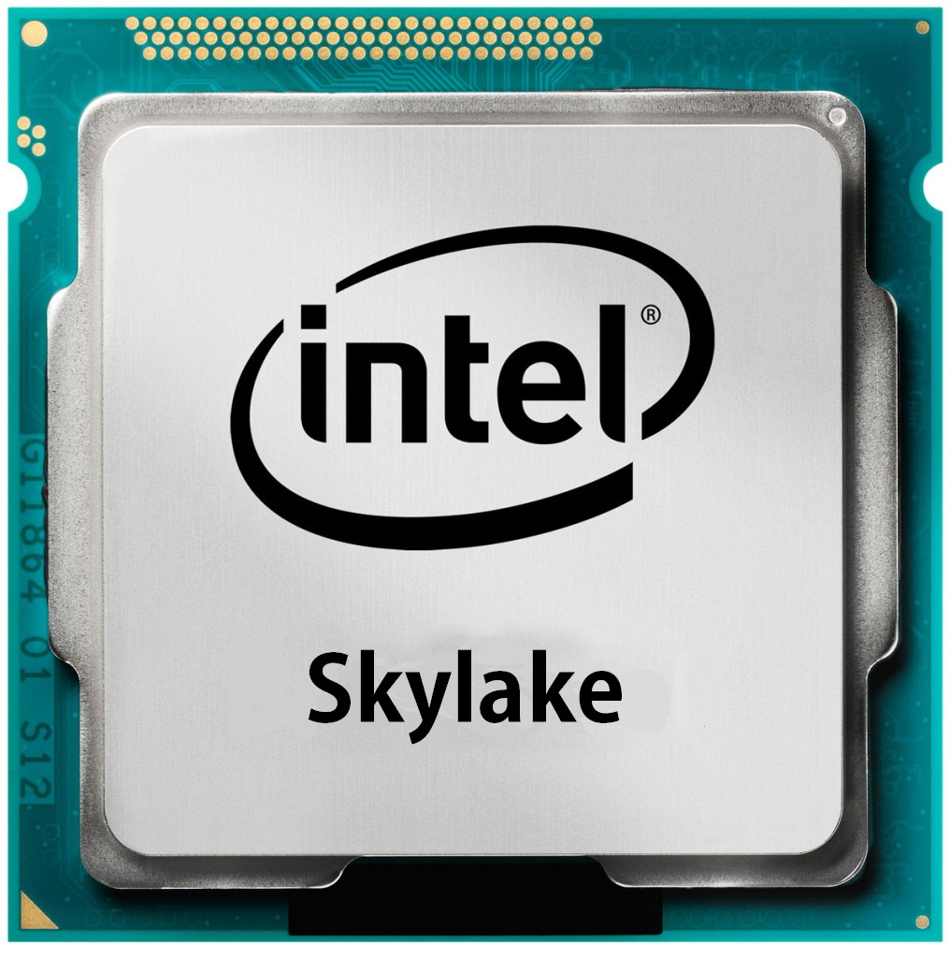
Chain of trust
SGX provides unforgeable attestation of the sandbox
Statements Ryoan makes about the module can now be trusted
Attests
Ryoan
Ryoan
Attests
Module
Notes:
Add definition of attestation?

Slide 24
Ryoan’s view of SGX
SGX gives you:
Trusted computation on secret data
Ryoan uses SGX to give you:
Guarantees on Untrusted computation

Slide 25
Confining untrusted code
Problem:
Platform can read secrets out of memory
Solution:
Execute module inside of an enclave
Module

Slide 26
Confining untrusted code
Problem:
Platform can read secrets out of memory
Solution:
Execute module inside of an enclave
Enclave
Module

Slide 27
Confining untrusted code
Problem:
Module can copy secrets to non-enclave memory
Solution:
Restrict accessible memory with a sandbox
Property of NaCl
Enclave
Module

Slide 28
Confining untrusted code
Problem:
Module can copy secrets to non-enclave memory
Solution:
Restrict accessible memory with a sandbox
Property of NaCl
Sandbox
Module
Notes:
nacl, compiler

Slide 29
Confining untrusted code
Problem:
Modules can use system calls to write out user data
Solution:
NaCl modules call sandbox to access system calls
Enforce encryption
Sandbox
Module
write( );
Notes:
add text about nacl restriction

Slide 30
Confining untrusted code
Problem:
Modules can use system calls to write out user data
Solution:
NaCl modules call sandbox to access system calls
Enforce encryption
Sandbox
Module
write([CIPHERTEXT]);

Slide 31
Confining untrusted code
Module
Module
Problem:
Modules can collude with users to steal data
Solution:
Don’t let modules keep state between requests
It’s ME!
Disease Risk
Later

Slide 32
Confining untrusted code
Module
Module
Problem:
Modules can collude with users to steal data
Solution:
Don’t let modules keep state between requests
It’s ME!
Disease Risk
Later

Slide 33
Modules cannot keep state
Module life cycle imposed by Ryoan
Read, process, write, destroy
Sandbox enforces one request per module execution
Represent a complete unit of work
Only contain content from one user
Initialize
Read Input
Process
Write
Output
Destroy
Notes:
Ryoan applies this restriction by using its control over system calls to enforce this life cycle on modules. Modules can read, process, and write data just like before, except now the module is destroyed when it is done, and must be reinitialized before it can process another request. By allowing a module to process only one users request we remove it’s ability to save state and forward requests between users.

Slide 34
Talk outline
Introduction
Controlling untrusted modules
Covert and side channels
Evaluation

Slide 35
Covert and side channels
Output, via some externally visible property of execution
Ryoan: Software covert channels
System calls
Execution time
Hardware covert channels:
Hardware vendor’s responsibility
Module
Notes:
don’t say intel

Slide 36
System call covert channel
0101110
Module
write(8bytes); write(16bytes); write(8bytes); write(16bytes); write(16bytes); write(16bytes); write(8bytes);
0101110
8bytes | 0
16bytes | 1
Notes:
say, data is encrypted

Slide 37
Eliminating system call channel
Remove modules ability to make system calls
Ryoan performs all data input and output independent of the content
Confined; Module cannot make system calls.
Initialize
Read Input
Process
Done
Ryoan
makes input available
Ryoan flushes all output
Destroy
Notes:
box
Bring back compatibility api slide

Slide 38
Initialization is expensive
ClamAV (virus scanner):
25.0 seconds to initialize
0.1 seconds to process a request
Checkpoint
Confined; Module cannot make system calls.
Initialize
Read Input
Process
Done
Restore Checkpoint
Notes:
kind of like copy on write details in the paper

Slide 39
Confined compatibility API
Dynamic Memory
Modules can call mmap for “new” memory
Return memory from a pre-allocated pool.
In-memory file API
File system operations in memory
Examples:
Temp files
Preexisting files
Replaced system calls:
mmap
Replaced system calls:
open, close, read, write, stat, lseek, unlink, mkdir, rmdir, getdents
Notes:
Shouldn't backward compatibility be on this slide somewhere?

Slide 40
Confined compatibility API
Dynamic Memory
Modules can call mmap for “new” memory
Return memory from a pre-allocated pool.
In-memory file API
File system operations in memory
Examples:
Temp files
Preexisting files
Replaced system calls:
mmap
Replaced system calls:
open, close, read, write, stat, lseek, unlink, mkdir, rmdir, getdents
Notes:
Shouldn't backward compatibility be on this slide somewhere?

Slide 41
Confined compatibility API
Dynamic Memory
Modules can call mmap for “new” memory
Return memory from a pre-allocated pool.
In-memory file API
File system operations in memory
Examples:
Temp files
Preexisting files
Replaced system calls:
mmap
Replaced system calls:
open, close, read, write, stat, lseek, unlink, mkdir, rmdir, getdents
Notes:
Shouldn't backward compatibility be on this slide somewhere?

Slide 42
Talk outline
Introduction
Controlling untrusted modules
Covert channels
Evaluation

Slide 43
Health
Parse
Input
Classifier
Return
Results
Translation
Moses
In: French text
Out: English text
In: Genome/health data
Out: Disease risk
Images
Email
Recognize
Face
Distribute
Distribute
Combine
Recognize
Horse
Combine
Recognize
NSFW
In: Pictures
Out: Array of objects
In: Emails
Out: Spam & virus status
Notes:
Say Application, don’t say example

Slide 44
Health
Parse
Input
Classifier
Return
Results
Translation
Moses
In: French text
Out: English text
In: Genome/health data
Out: Disease risk
Images
Email
Recognize
Face
Distribute
Distribute
Combine
Recognize
Horse
Combine
Recognize
NSFW
In: Pictures
Out: Array of objects
In: Emails
Out: Spam & virus status
Notes:
Say Application, don’t say example

Slide 45
Health
Parse
Input
Classifier
Return
Results
Translation
Moses
In: French text
Out: English text
In: Genome/health data
Out: Disease risk
Images
Email
Recognize
Face
Distribute
Distribute
Combine
Recognize
Horse
Combine
Recognize
NSFW
In: Pictures
Out: Array of objects
In: Emails
Out: Spam & virus status
Notes:
Say Application, don’t say example

Slide 46
Health
Parse
Input
Classifier
Return
Results
Translation
Moses
In: French text
Out: English text
In: Genome/health data
Out: Disease risk
Images
Email
Recognize
Face
Distribute
Distribute
Combine
Recognize
Horse
Combine
Recognize
NSFW
In: Pictures
Out: Array of objects
In: Emails
Out: Spam & virus status
Notes:
Say Application, don’t say example

Slide 47
Health
Parse
Input
Classifier
Return
Results
Translation
Moses
In: French text
Out: English text
In: Genome/health data
Out: Disease risk
Images
Email
Recognize
Face
Distribute
Distribute
Combine
Recognize
Horse
Combine
Recognize
NSFW
In: Pictures
Out: Array of objects
In: Emails
Out: Spam & virus status
Notes:
Say Application, don’t say example

Slide 48
Evaluation
Implementation requires SGX v2 instructions (spec: Fall 2014, coming soon)
Dynamic memory allocation/protection
SGX performance model
Measured SGX v1 latencies on our hardware
Estimated SGX v2 latencies (sensitivity study in paper)
Flush TLB on all system calls, page faults, and interrupts
Notes:
Public spec, date of spec

Slide 49
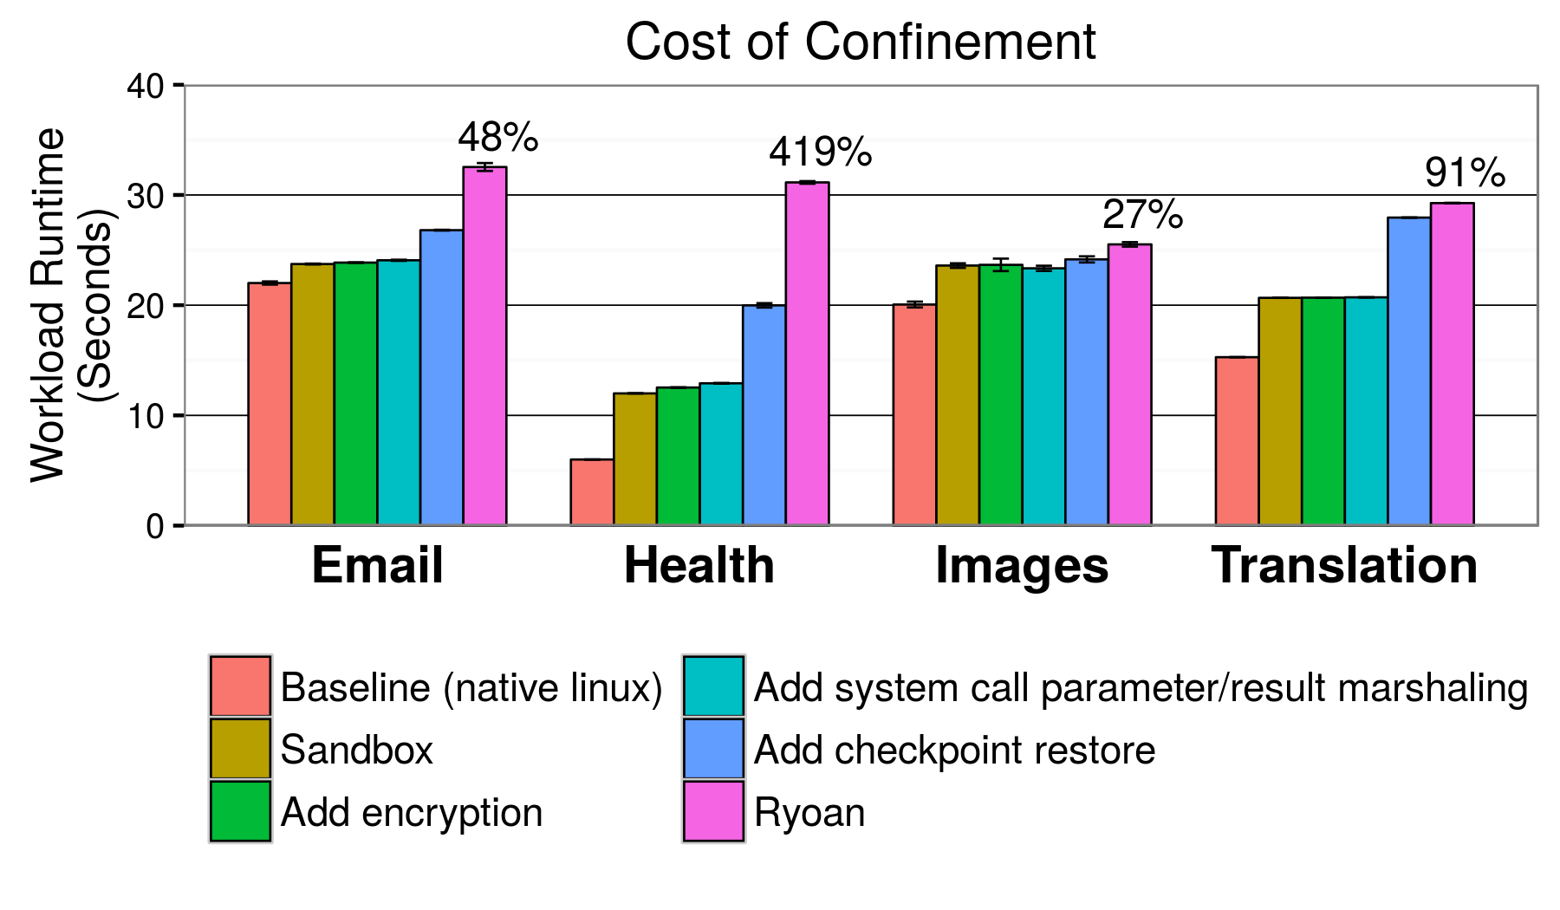
Health | 20,000 1.4KB Boolean vectors from different users
Translation | 30 short paragraphs, sizes 25-300B, 4.1KB total
Images | 12 images, sizes 17KB-613KB
Email | 250 emails, 30% with 103KB-12MB attachment
Notes:
say hardware overheads

Slide 50
Health | 20,000 1.4KB Boolean vectors from different users
Translation | 30 short paragraphs, sizes 25-300B, 4.1KB total
Images | 12 images, sizes 17KB-613KB
Email | 250 emails, 30% with 103KB-12MB attachment
Notes:
Red box, step through where overheads come from

Slide 51
Health | 20,000 1.4KB Boolean vectors from different users
Translation | 30 short paragraphs, sizes 25-300B, 4.1KB total
Images | 12 images, sizes 17KB-613KB
Email | 250 emails, 30% with 103KB-12MB attachment
Notes:
Red box, step through where overheads come from

Slide 52
Health | 20,000 1.4KB Boolean vectors from different users
Translation | 30 short paragraphs, sizes 25-300B, 4.1KB total
Images | 12 images, sizes 17KB-613KB
Email | 250 emails, 30% with 103KB-12MB attachment
Notes:
Red box, step through where overheads come from

Slide 53
Health | 20,000 1.4KB Boolean vectors from different users
Translation | 30 short paragraphs, sizes 25-300B, 4.1KB total
Images | 12 images, sizes 17KB-613KB
Email | 250 emails, 30% with 103KB-12MB attachment
Notes:
Red box, step through where overheads come from

Slide 54
Ryoan summary
Allows untrusted code to operate on secret data on untrusted platforms
Sandbox with SGX
Eliminates explicit channels
Module can’t call platform
Eliminates covert channels
Mostly backwards compatible
Sandbox code implements system calls

Slide 56
(Backup Slides Follow)

Slide 57
Output Size
Output Size is a (configurable) fixed function of input size.
Output is padded or truncated by Ryoan
Always predefined in the specification
Examples (n bytes of input)
Virus Scanner output: n bytes + 1 bit
Machine Translation output: 2n bytes
Module
n bytes
n bytes
n bytes
n/2 bytes

