Slide 1


Telekine: Secure Computing with Cloud GPUs
NSDI 2020
Tyler Hunt, Zhipeng Jia, Vance Miller, Ariel Szekely, Yige Hu, Christopher J. Rossbach, Emmett Witchel

Slide 2


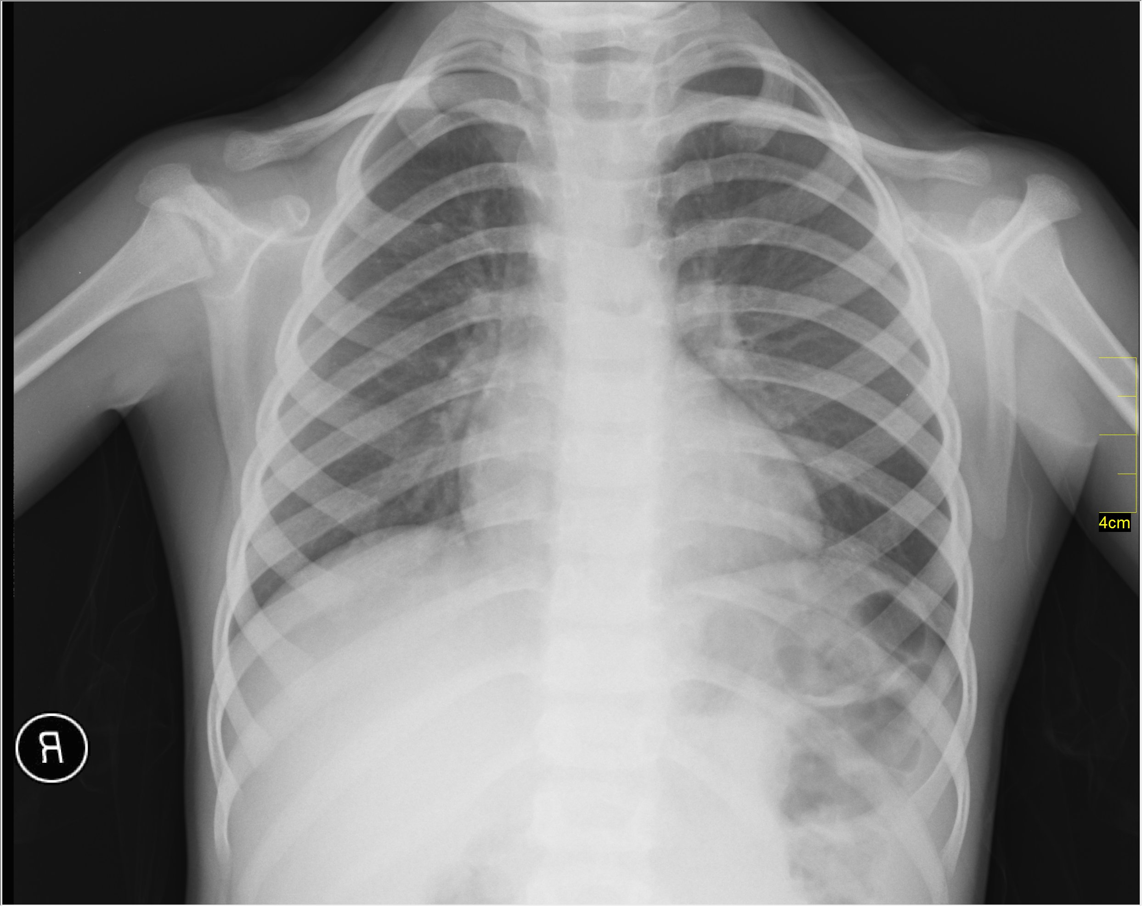


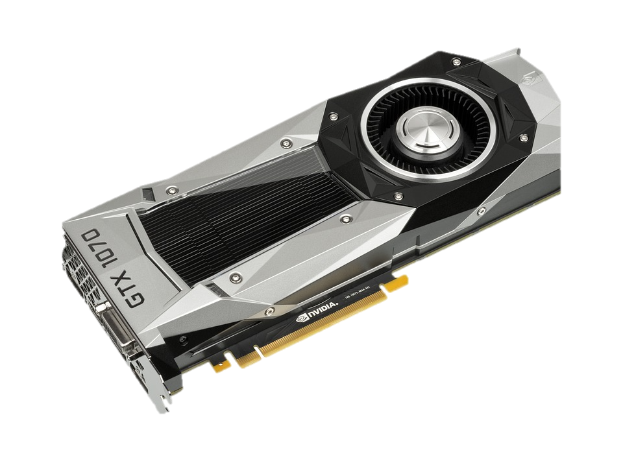

Trusting the cloud provider is difficult
Recognition
Results
Attackers can exploit system bugs to steal data
The cloud provider has their own interests (e.g., monetizing user data)
Many administrators; some may be malicious
Notes:
There have been documented cases of administrators abusing their permissions
<<<transition>> It should be clear that

Slide 3

Avoiding trust in the cloud provider is difficult
Trusted
Untrusted
Data
Legend:
Trusted
Tensorflow/MXNet
Recognition
Results
Neural Net
Computation
OS/Hypervisor allows provider to see user’s secret data
Notes:
Introduce legend

Slide 4
Introduce TEEs to isolate computation
Trusted
Untrusted
Data
Legend:
Trusted
(TEE is Trusted Execution Environment)
TEEs cannot be bypassed by software
  Hardware root of trust (e.g., SGX on Intel, TrustZone on ARM)
Protect communication from the provider with cryptography
Research proposals exist for GPU TEEs
  Graviton [OSDI`18], HIX [ASPLOS`19]
  Performance critical hardware unchanged
Tensorflow/MXNet
TEE
Recognition
Results
Neural Net
Computation
TEE
Notes:
Be more specific about Graviton and HIx

Slide 5
TEEs have limitations
Trusted
Untrusted
Data
Legend:
Trusted
CPU TEES:
Cache Side Channels, Spectre attacks
Tensorflow/MXNet
TEE
Recognition
Results
Neural Net
Computation
TEE
Mitigations require heroic effort, especially for complex software
Notes:
Say “speculative execution”

Slide 6
Telekine addresses TEE limitations
Trusted
Untrusted
Data
Legend:
Trusted
GPU
API
Proxy
Tensorflow/MXNet
Neural Net
Computation
TEE
Recognition
Results
Notes:
Also say that this is a challenge that Telekine must solve

Slide 7
Telekine uses API-remoting instead of CPU TEEs
Trusted
Untrusted
Data
Legend:
Trusted
Interpose on GPU API calls
Application does not have to be modified, user does not need GPU
Turn every API call into an RPC, executed by the remote machine
Traffic is encrypted/authenticated; the proxy does not need protection
GPU
API
Proxy
Tensorflow/MXNet
Neural Net
Computation
TEE
Recognition
Results
Notes:
Say something about API Proxy
<<make the fact that it runs on the cpu explicit>>

Slide 8

TEEs still have limitations
Trusted
Untrusted
Data
Legend:
Trusted
GPU
API
Proxy
Tensorflow/MXNet
Neural Net
Computation
TEE
Recognition
Results
All TEES:
Communication timing attacks
Notes:
Careful about the ”All TEEs” don’t reveal it until you’re ready to talk about it

Slide 9
Telekine addresses communication timing channels
TEEs do not consider communication side channels
  Securing the processor (CPU/GPU) does not secure communication
GPU programing paradigm features frequent communication
  CPU-to-CPU communication is also vulnerable
Communication patterns tend to leak timing information
  E.g., GPU kernel execution time
TEE
TEE
TEE
TEE
TEE
TEE
TEE
Notes:
communication is not in the TEE security model full stop.
<<Make explicit that processor is generic>>

Slide 10
In the rest of the talk we will answer:
Can information be extracted from GPU communication patterns?
How does Telekine remove that information?
What are Telekine’s overheads?
Yes, we demonstrate a communication timing attack
Replace GPU streams with new data-oblivious streams
Overheads are reasonable: ~20% for neural network training

Slide 11
Expanded image recognition
Trusted
Untrusted
Data
Legend:
Trusted
GPU
API
Proxy
Tensorflow/MXNet
Neural Net
Computation
GPU TEE
Recognition
Results

Slide 12

Expanded image recognition
Trusted
Untrusted
Data
Legend:
Trusted
Kernel execution times!
Tensorflow/MXNet
GPU TEE
memcpy()
GPU
API
Proxy
launchKernel(1)
.
.
launchKernel(n)
Start
Neural Net
State/Code
Done
Start
Done
Recognition
Results
memcpy()
GPU raises interrupt on kernel completion
Recognition
Results
[Encrypted Result]
GPU
Stream

Slide 13
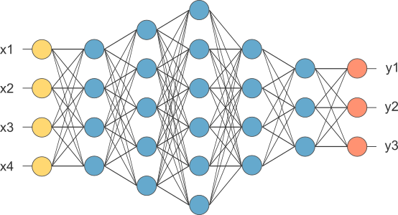
Information gained from kernel execution time
Application
1.6X
Image class
Attack
Start
Kernel timing classifier
1.6X
Done

Slide 14
In the rest of the talk we will answer:
Can information be extracted from GPU communication patterns?
How does Telekine remove that information?
What are Telekine’s overheads?
Yes, we demonstrate a communication timing attack
Replace GPU streams with new data-oblivious streams
Overheads are reasonable: ~20% for neural network training

Slide 15
Timing information is abundant
Trusted
Untrusted
Data
Legend:
Trusted
Tensorflow/MXNet
GPU TEE
memcpy()
GPU
API
Proxy
launchKernel(1)
.
.
launchKernel(n)
Start
Neural Net
State/Code
Done
Start
Done
Recognition
Results
memcpy()
Recognition
Results
GPU
Stream

Slide 16
Timing information is abundant
Trusted
Untrusted
Data
Legend:
Trusted
Application
GPU TEE
GPU API Proxy
memcpy()
DMA
Other potential timing channel sources:
Commands may be different sizes
Application’s API use pattern may depend on secret data
Start
MMIO
launchKernel()
Done
DMA
memcpy()
GPU
Stream
Operations are distinguishable because of the hardware they use
GPU raises interrupt on kernel completion

Slide 17
Data-oblivious streams
Trusted
Untrusted
Data
Legend:
Trusted
Application
LibTelekine
GPU TEE
GPU API Proxy
memcpy queue
memcpy()
GPU stream
DMA
launchKernel()
memcpy()
launchKernel queue
GPU stream
MMIO
Data-oblivious
Stream
GPU
Stream

Slide 18
Data-oblivious streams
Trusted
Untrusted
Data
Legend:
Trusted
Divide commands by type so they can be scheduled independently
  Adversary sees two independent streams of operations
  Telekine manages data dependencies between types
Split and pad commands as necessary; enforce a uniform size
Queue commands and send them (or no-ops) out deterministically
  E.g., launch 32 kernels every 15ms, memcpy 1MB both directions every 30ms
Application
LibTelekine
GPU TEE
GPU API Proxy
memcpy queue
memcpy()
GPU stream
DMA
launchKernel()
memcpy()
launchKernel queue
Data-oblivious
Stream
GPU stream
MMIO

Slide 19
Data-oblivious streams
Trusted
Untrusted
Data
Legend:
Trusted
Divide commands by type so they can be scheduled independently
  Adversary sees two independent streams of operations
  Telekine manages data dependencies between types
Split and pad commands as necessary; enforce a uniform size
Queue commands and send them (or no-ops) out deterministically
  E.g., launch 32 kernels every 15ms, memcpy 1MB both directions every 30ms
Application
LibTelekine
GPU TEE
GPU API Proxy
memcpy queue
memcpy()
GPU stream
DMA
launchKernel()
memcpy()
launchKernel queue
Data-oblivious
Stream
GPU stream
MMIO

Slide 20
In the rest of the talk we will answer:
Can information be extracted from GPU communication patterns?
How does Telekine remove that information?
What are Telekine’s overheads?
Yes, we demonstrate a communication timing attack
Replace GPU streams with new data-oblivious streams
Overheads are reasonable: ~20% for neural network training

Slide 21


Testbeds
(RTT is “Roundtrip Time”)
The cloud machine (Austin, Texas):
Intel i9-9900K, 8 cores @3.60GHz
32GB of RAM
Radeon RX VEGA 64 GPU with 8GB of RAM
Real WAN testbed
Simulated WAN testbed
877Mbps, 12ms RTT
1Gbps, various RTTs
Geo-distributed client (Dallas, Texas):
Vultr cloud VM, 8 vCPUS
32GB of RAM
Client (Austin, Texas):
Intel Xeon E3-1270 v6, 4 cores @3.8GHz
32GB of RAM

Slide 22
We compare Telekine to an insecure baseline: running on the GPU server without protections
Workloads:
Data movement vs. GPU work microbenchmark
Neural net inference on MXNet:
  ResNet50[He et. al 2016], InceptionV3[Szegedy et. al 2016], DenseNet [Huang et. al 2017]
Neural net training on MXNet:
  (Same networks as above)
Graph analytics on Galois:
  BFS, PageRank, SSSP (across 1 and 2 GPUs)
Notes:
Remember neural network inference is an important workload
<<Talk about the different networks>>

Slide 23
MXNet neural net inference (Real WAN)
Trusted
Untrusted
Data
Legend:
Trusted
User sends a batch of images to be classified
Baseline: user sends batch to remote MXNet
Telekine: user sends batch to local MXNet
  Telekine remotes computation to the GPU
MXNet
MXNet
GPU TEE
ResNet50 | InceptionV3 | DenseNet
10.0X | 6.6X | 7.7X
3.4X | 2.2X | 2.5X
Batch Size | ResNet50 | InceptionV3 | DenseNet
1
8
64
ResNet50 | InceptionV3 | DenseNet
10.0X | 6.6X | 7.7X
1.0X | 1.1X | 1.0X

Slide 24
MXNet neural net training
(Real WAN)
Large dataset of images, processed in batches of size 64
Baseline: data set is on the cloud machine, passed to MXNet
Telekine: data set is on a client, passed to MXNet instance
  Telekine connects that instance to the remote GPU
  As a result Telekine uses a consistent 533 Mb/s network bandwidth
MXNet
Overheads are low because GPUs overlap the extra work with computation
E.g., CUs can keep processing while the DMA engine performs transfers
MXNet
GPU TEE
ResNet50 | InceptionV3 | DenseNet
1.23X | 1.08X | 1.22X
ResNet50 | InceptionV3 | DenseNet

Slide 25
MXNet neural net training breakdown (Simulated WAN)
10ms RTT
(Real WAN)
ResNet50 | InceptionV3 | DenseNet
1.23X | 1.08X | 1.22X

Slide 26
Telekine: Secure Computing with Cloud GPUs
Eliminates communication timing channels with data-oblivious streams
Transparent to applications because it maintains GPU API semantics
Has modest performance overheads for level of security provided
Thanks!

Slide 27
Backup slides follow

Slide 28
MXNet training RTT sensitivity (Simulated WAN)
RTT to cloud provider can vary
The effect in performance depends on the workload
RTT | ResNet50 | InceptionV3 | Densenet
10ms | 1.19X | 1.10X | 1.22X
20ms | 1.29X | 1.13X | 1.37X
30ms | 1.44X | 1.16X | 1.49X
40ms | 1.53X | 1.18X | 1.66X
50ms | 1.62X | 1.30X | 2.09X

Slide 29
Attack accuracy for batched inference
GPU kernels operate on an entire batch
  Cannot measure kernel execution time for individual images
Task: correctly identify the class with the most images
  Accuracy varies with how many more images there are (purity)
  Batches of 32, four classes
  Images selected from target class up to “Purity”
  Batch filled out with images from other three classes
Batch size | Purity | Accuracy
1 | 100% | 42%
32 | 25% | 29%
32 | 80% | 50%
32 | 100% | 65%

Slide 30
Communication vs GPU work (Simulated WAN)
10ms RTT
Copy16MB to the GPU
Compute for x-axis seconds
Copy16MB from the GPU

