Slide 1
Is Transactional Programming Actually Easier?
Christopher J. Rossbach,
Owen S. Hofmann,
Emmett Witchel
University of Texas at Austin, USA

Slide 2
Transactional Memory: Motivation Mantra
We need better parallel programming tools
(Concurrent programming == programming w/locks)
Locks are difficult
CMP ubiquity → urgency
Transactional memory is “promising”:
No deadlock, livelock, etc.
Optimistic → likely more scalable
Conclusion:
Transactional Memory is easier than locks
Corollary: All TM papers should be published
Notes:
Average programmer

Slide 3
Is TM really easier than locks?
Programmers still must write critical sections
Realizable TM will have new issues
HTM overflow
STM performance
Trading one set of difficult issues for another?
Ease-of-use is a critical motivator for TM research
It’s important to know the answer to this question

Slide 4
How can we answer this question?
Step 1: Get some programmers
(preferrably inexperienced)
This talk:
TM vs. locks user study
UT Austin OS undergrads
same program using
locks (fine/coarse)
monitors
transactional memory
Step 2: have them write the same program with TM and locks
Step 3: Ask them how it went
Step 4: Evaluate their code

Slide 5
Outline
Motivation
Programming Problem
User Study Methodology
Results
Conclusion

Slide 6
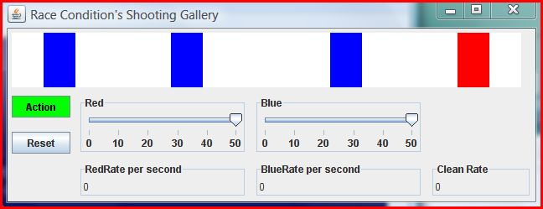
The programming problem
sync-gallery: a rogue’s gallery of synchronization
Metaphor → shooting gallery (welcome to Texas)
Rogues → shoot paint-balls in lanes (1 red, 1 blue)
Cleaners → change targets back to white
Shot by red
rogue
Unshot lane
Shot by blue rogue

Slide 7
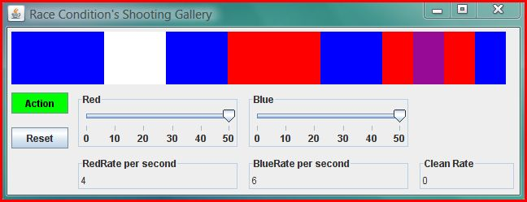
Sync-gallery invariants
Only one shooter per lane (Uh, hello, dangerous?!)
Don’t shoot colored lanes (no fun)
Clean only when all lanes shot (be lazy)
Only one cleaner at a time
Shot by both rogues

Slide 8
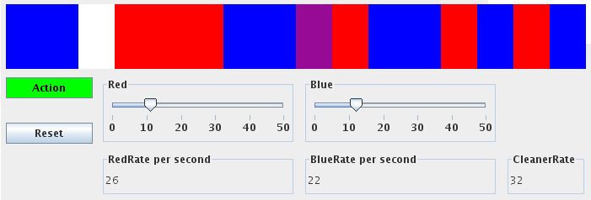
Sync-gallery Implementations
Program specification variations
Single-lane
Two-lane
Cleaner (condition vars + additional thread)
Synchronization primitive variations
Coarse: single global lock
Fine: per lane locks
Transactional Memory

Slide 9
Variation 1: “single-lane rogue”
Rogue() {
while(true) {
Lane lane = randomLane();
if(lane.getColor() == WHITE)
lane.shoot();
if(allLanesShot())
clean();
}
}
beginTransaction()
globalLock.lock()
lane.lock()
lane.unlock()
lockAllLanes() ???
endTransaction()
globalLock.unlock()
Invariants:
One shooter per lane
Don’t shoot colored lanes
One cleaner thread
Clean only when all lanes shot
Fine-grain locking
Coarse-grain locking
Transactions

Slide 10
Variation 2: “two-lane rogue”
globalLock.lock()
Rogue() {
while(true) {
Lane a = randomLane();
Lane b = randomLane();
if(a.getColor() == WHITE &&
b.getColor() == WHITE) {
a.shoot();
b.shoot();
}
if(allLanesShot())
clean();
}}
a.lock();
b.lock();
Requires lock-ordering!
lockAllLanes() ???
globalLock.unlock()
Invariants:
One shooter per lane
Don’t shoot colored lanes
One cleaner thread
Clean only when all lanes shot
Fine-grain locking
Coarse-grain locking
Notes:
Don’t say miraculous

Slide 11
Variation 3: “cleaner rogues”
Rogue() {
while(true)
Lane lane = randomLane();
if(lane.getColor() == WHITE)
lane.shoot();
} }
Cleaner() {
while(true) {
if(allLanesShot())
clean();
} }
if(allLanesShot())
lanesFull.signal();
while(!allLanesShot()
lanesFull.await()
Invariants:
One shooter per lane
Don’t shoot colored lanes
One cleaner thread
Clean only when all lanes shot
(still need other locks!)

Slide 12
Synchronization Cross-product
 | Coarse | Fine | TM
Single-lane | Coarse | Fine | TM
Two-lane | Coarse2 | Fine2 | TM2
Cleaner | CoarseCleaner | FineCleaner | TMCleaner
9 different Rogue implementations
Notes:
Find a way to emphasize what is interesting…
CIRCLE THE ITEMS I’m talking about

Slide 13
Outline
Motivation
Programming Problem
User Study Methodology
TM Support
Survey details
Results
Conclusion

Slide 14
TM Support
Year 1: DSTM2 [Herlihy 06]
Year 2+3: JDASTM [Ramadan 09]
Library, not language support
No atomic blocks
Read/write barriers encapsulated in lib calls
Different concrete syntax matters

Slide 15
DSTM2 concrete syntax
Callable c = new Callable<Void> {
public Void call() {
GalleryLane l = randomLane();
if(l.color() == WHITE))
l.shoot(myColor);
return null;
}
}
Thread.doIt(c); // ← transaction here

Slide 16
JDASTM concrete syntax
Transaction tx = new Transaction(id);
boolean done = false;
while(!done) {
try {
tx.BeginTransaction();
GalleryLane l = randomLane();
if(l.TM_color() == WHITE))
l.TM_shoot(myColor);
done = tx.CommitTransaction();
} catch(AbortException e) {
tx.AbortTransaction();
done = false;
}}

Slide 17
Undergrads: the ideal TM user-base
TM added to undergrad OS curriculum
Survey accompanies sync-gallery project
Analyze programming mistakes
TM’s benchmark for success
Easier to use than fine grain locks or conditions
Notes:
REWORK

Slide 18
Survey
Measure previous exposure
Used locks/TM before, etc
Track design/code/debug time
Rank primitives according along several axes:
Ease of reasoning about
Ease of coding/debugging
Ease of understanding others’ code
http://www.cs.utexas.edu/~witchel/tx/sync-gallery-survey.html

Slide 19
Data collection
Surveyed 5 sections of OS students
2 sections x 2 semesters + 1 section x 1 semester
237 students
1323 rogue implementations
Defect Analysis
Automated testing using condor
Examined all implementations

Slide 20
Outline
Motivation
Programming Problem
User Study Methodology
Results
Conclusion

Slide 21
Development Effort: year 2
hours
Notes:
CIRCLE the data points

Slide 22
Development Effort: year 2
Implementation order:
Coarse
hours
rand&2?
Fine
TM
Notes:
CIRCLE the data points

Slide 23
Development Effort: year 2
hours
Notes:
CIRCLE the data points

Slide 24
Development Effort: year 2
hours
Notes:
CIRCLE the data points

Slide 25
Qualitative preferences: year 2
Best Syntax
Ranking | 1 | 2 | 3 | 4
Coarse | 62% | 30% | 1% | 4%
Fine | 6% | 21% | 45% | 40%
TM | 26% | 32% | 19% | 21%
Conditions | 6% | 21% | 29% | 40%
Easiest to Think about
Ranking | 1 | 2 | 3 | 4
Coarse | 81% | 14% | 1% | 3%
Fine | 1% | 38% | 30% | 29%
TM | 16% | 32% | 30% | 21%
Conditions | 4% | 14% | 40% | 40%
(Year 2)

Slide 26
Qualitative preferences: year 2
Easiest to Think about
Best Syntax
Ranking | 1 | 2 | 3 | 4
Coarse | 62% | 30% | 1% | 4%
Fine | 6% | 21% | 45% | 40%
TM | 26% | 32% | 19% | 21%
Conditions | 6% | 21% | 29% | 40%
Easier
Coarse
Fine
TM
Harder
Easiest to Think about
Ranking | 1 | 2 | 3 | 4
Coarse | 81% | 14% | 1% | 3%
Fine | 1% | 38% | 30% | 29%
TM | 16% | 32% | 30% | 21%
Conditions | 4% | 14% | 40% | 40%
Conditions
(Year 2)

Slide 27
Qualitative preferences: year 2
Best Syntax
Best Syntax
Ranking | 1 | 2 | 3 | 4
Coarse | 62% | 30% | 1% | 4%
Fine | 6% | 21% | 45% | 40%
TM | 26% | 32% | 19% | 21%
Conditions | 6% | 21% | 29% | 40%
Easier
Coarse
TM
Harder
Easiest to Think about
Fine
Conditions
Ranking | 1 | 2 | 3 | 4
Coarse | 81% | 14% | 1% | 3%
Fine | 1% | 38% | 30% | 29%
TM | 16% | 32% | 30% | 21%
Conditions | 4% | 14% | 40% | 40%
(Year 2)
Notes:
Talk through this

Slide 28
Analyzing Programming Errors
Error taxonomy: 10 classes
Lock-ord: lock ordering
Lock-cond: checking condition outside critsec
Lock-forgot: forgotten Synchronization
Lock-exotic: inscrutable lock usage
Cv-exotic: exotic condition variable usage
Cv-use: condition variable errors
TM-exotic: TM primitive misuse
TM-forgot: Forgotten TM synchronization
TM-cond: Checking conditions outside critsec
TM-order: Ordering in TM

Slide 29
Error Rates by Defect Type
cv-use: 63%
TM: 0-27%
Notes:
Note that it’s mostly 0 for TM.
Different years are color-coded

Slide 30
Overall Error Rates
Locks: 58-75%
TM: 8-20%
Proportion of errors
Geometric Mean:
Coarse Locks: 27%
Fine Locks: 62%
TM: 10%

Slide 31
Outline
Motivation
Programming Problem
User Study Methodology
Results
Conclusion

Slide 32
Conclusion
General qualitative ranking:
Coarse-grain locks (easiest)
TM
Fine-grain locks/conditions (hardest)
Error rates overwhelmingly in favor of TM
TM may actually be easier

Slide 33
Overall Error Rates: Year 2
Proportion of errors

