Slide 1
Is Transactional Programming Actually Easier?
Christopher J. Rossbach,
Owen S. Hofmann,
Emmett Witchel
UT Austin

Slide 2
TM Research Mantra
We need better parallel programming tools
CMP ubiquity
(Concurrent programming == programming w/locks)
Locks are difficult
Transactional memory is “promising”:
No deadlock, livelock, etc.
Optimistic → likely more scalable
Therefore:
Transactional Memory is easier than locks
All TM papers should be published

Slide 3
Is TM really easier than locks?
Programmers still must write critical sections
Realizable TM will have new issues
HTM overflow
STM performance
Trading one set of difficult issues for another?
Ease-of-use is a critical motivator for TM research
It’s important to know the answer to this question

Slide 4
How can we answer this question?
Step 1: Get some programmers
(preferrably inexperienced)
This talk:
TM vs. locks user study
UT Austin OS undergrads
same program using
locks (fine/coarse)
monitors
transactional memory
Step 2: have them write the same program with TM and locks
Step 3: Ask them how it went
Step 4: Evaluate their code

Slide 5
Outline
Motivation
Programming Problem
User Study Methodology
Results
Conclusion

Slide 6
The programming problem
sync-gallery: a rogue’s gallery of synchronization
Metaphor → shooting gallery (welcome to UT)
Rogues → shoot paint-balls in lanes
Each rogue has a unique color
Shooting → target takes rogue’s color
Cleaners → change targets back to white
Rogues/cleaners must synchronize
maintain 4 invariants

Slide 7
Sync-gallery invariants
Only one shooter per lane (Uh, hello, dangerous?!)
Don’t shoot colored lanes (no fun)
Clean only when all lanes shot (be lazy)
Only one cleaner thread

Slide 8
Task: “single-lane rogue”
Rogue() {
while(true) {
Lane lane = randomLane();
if(lane.getColor() == WHITE)
lane.shoot();
if(allLanesShot())
clean();
}
}
beginTransaction()
globalLock.lock()
lane.lock()
lane.unlock()
lockAllLanes() ???
endTransaction()
globalLock.unlock()
Invariants:
One shooter per lane
Don’t shoot colored lanes
One cleaner thread
Clean only when all lanes shot
Fine-grain locking
Coarse-grain locking
Transactions

Slide 9
Variation: “two-lane rogue”
globalLock.lock()
Rogue() {
while(true) {
Lane a = randomLane();
Lane b = randomLane();
if(a.getColor() == WHITE &&
b.getColor() == WHITE) {
a.shoot();
b.shoot();
}
if(allLanesShot())
clean();
}}
a.lock();
b.lock();
Requires lock-ordering!
lockAllLanes() ???
globalLock.unlock()
Invariants:
One shooter per lane
Don’t shoot colored lanes
One cleaner thread
Clean only when all lanes shot
Fine-grain locking
Coarse-grain locking

Slide 10
Variation 2: “cleaner rogues”
Rogue() {
while(true)
Lane lane = randomLane();
if(lane.getColor() == WHITE)
lane.shoot();
} }
Cleaner() {
while(true) {
if(allLanesShot())
clean();
} }
if(allLanesShot())
lanesFull.signal();
while(!allLanesShot()
lanesFull.await()
Invariants:
One shooter per lane
Don’t shoot colored lanes
One cleaner thread
Clean only when all lanes shot
(still need other locks!)

Slide 11
Sync-gallery in action

Slide 12
Synchronization Cross-product
 | Coarse | Fine | TM
Single-lane | Coarse | Fine | TM
Two-lane | Coarse2 | Fine2 | TM2
Cleaner | CoarseCleaner | FineCleaner | TMCleaner
9 different Rogue implementations
Notes:
Find a way to emphasize what is interesting…
CIRCLE THE ITEMS I’m talking about

Slide 13
Outline
Motivation
Programming Problem
User Study Methodology
TM Support
Survey details
Results
Conclusion

Slide 14
TM Support
Year 1: DSTM2 [Herlihy 06]
Year 2: JDASTM [Ramadan 09]
Library, not language support
No atomic blocks
Different concrete syntax
Read/write barriers

Slide 15
DSTM2 concrete syntax
Callable c = new Callable<Void> {
public Void call() {
GalleryLane l = randomLane();
if(l.color() == WHITE))
l.shoot(myColor);
return null;
}
}
Thread.doIt(c);

Slide 16
JDASTM concrete syntax
Transaction tx = new Transaction(id);
boolean done = false;
while(!done) {
try {
tx.BeginTransaction();
GalleryLane l = randomLane();
if(l.color() == WHITE))
l.TM_shoot(myColor);
done = tx.CommitTransaction();
} catch(AbortException e) {
tx.AbortTransaction();
done = false;
}}

Slide 17
Undergrads: the ideal TM user-base
TM added to undergrad OS curriculum
Survey students
Analyze programming mistakes
TM’s benchmark for success
Easier to use than fine grain locks or conditions
Notes:
REWORK

Slide 18
Survey
Measure previous exposure
Used locks/TM before, etc
Track design/code/debug time
Rank primitives according along several axes:
Ease of reasoning about
Ease of coding/debugging
Ease of understanding others’ code
http://www.cs.utexas.edu/~witchel/tx/sync-gallery-survey.html

Slide 19
Data collection
Surveyed 4 sections of OS students
2 sections x 2 semesters
147 students
1323 rogue implementations
Defect Analysis
Examined year 2 (604 implementations)
Automated testing using condor

Slide 20
Outline
Motivation
Programming Problem
User Study Methodology
Results
Conclusion

Slide 21
Development Effort
hours
Notes:
CIRCLE the data points

Slide 22
Development Effort
Implementation order:
Coarse
hours
rand&2?
Fine
TM
Notes:
CIRCLE the data points

Slide 23
Development Effort
hours
Notes:
CIRCLE the data points

Slide 24
Development Effort
hours
Notes:
CIRCLE the data points

Slide 25
Qualitative preferences
Best Syntax
Ranking | 1 | 2 | 3 | 4
Coarse | 62% | 30% | 1% | 4%
Fine | 6% | 21% | 45% | 40%
TM | 26% | 32% | 19% | 21%
Conditions | 6% | 21% | 29% | 40%
Easiest to Think about
Ranking | 1 | 2 | 3 | 4
Coarse | 81% | 14% | 1% | 3%
Fine | 1% | 38% | 30% | 29%
TM | 16% | 32% | 30% | 21%
Conditions | 4% | 14% | 40% | 40%
(Year 2)

Slide 26
Qualitative preferences
Best Syntax
Best Syntax
Ranking | 1 | 2 | 3 | 4
Coarse | 62% | 30% | 1% | 4%
Fine | 6% | 21% | 45% | 40%
TM | 26% | 32% | 19% | 21%
Conditions | 6% | 21% | 29% | 40%
Coarse > (TM|Coarse) >
Fine > (Fine|Conditions)
Easiest to Think about
Easiest to Think about
Ranking | 1 | 2 | 3 | 4
Coarse | 81% | 14% | 1% | 3%
Fine | 1% | 38% | 30% | 29%
TM | 16% | 32% | 30% | 21%
Conditions | 4% | 14% | 40% | 40%
Coarse > (Fine|TM) > Conditions
(Year 2)

Slide 27
Analyzing Programming Errors
Error taxonomy: 8 classes
Lock-ord: lock ordering
Lock-cond: checking condition outside critsec
Lock-forgot: forgotten Synchronization
Cv-exotic: exotic condition variable usage
Cv-use: condition variable errors
TM-exotic: TM primitive misuse
TM-forgot: Forgotten TM synchronization
TM-order: Ordering in TM

Slide 28
Error Rates by Defect Type

Slide 29
Overall Error Rates
Proportion of errors

Slide 30
Outline
Motivation
Programming Problem
User Study Methodology
Results
Conclusion

Slide 31
Conclusion
General qualitative ranking:
Coarse-grain locks (easiest)
TM
Fine-grain locks/conditions (hardest)
Error rates overwhelmingly in favor of TM
TM may actually be easier…

Slide 32
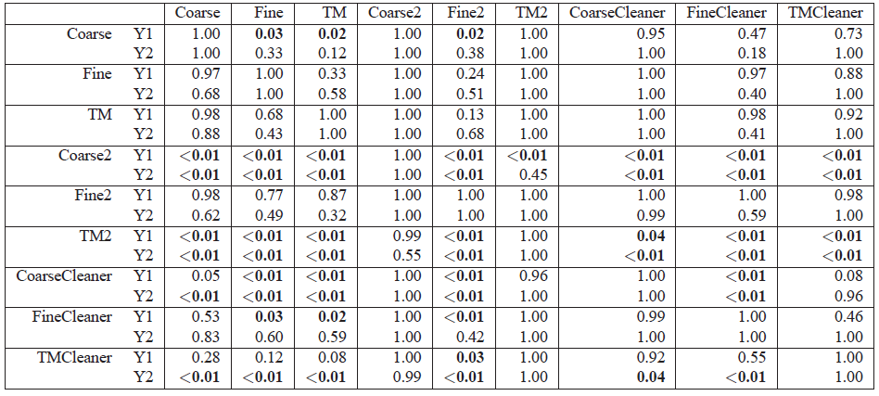
P-values

Slide 33
Development Effort
hours

Slide 34
Synchronization Potpourri
Rogue | Synchronization | R/C Threads | Additional Requirements
Coarse | Global lock | not distinct
Coarse2 | Global lock | not distinct | Shoot at 2 lanes
CoarseCleaner | Global lock, conditions | Distinct | wait/notify
Fine | Per-lane locks | not distinct
Fine2 | Per-lane locks | not distinct | Shoot at 2 lanes
FineCleaner | Per-lane locks, conditions | Distinct | wait/notify
TM | TM | not distinct
TM2 | TM | not distinct | Shoot at 2 lanes
TMCleaner | TM | distinct
Notes:
Find a way to emphasize what is interesting…
CIRCLE THE ITEMS I’m talking about

