Slide 1
ACID: The Wrong Way To Think About Concurrency
Emmett Witchel
The University of Texas At Austin

Slide 2
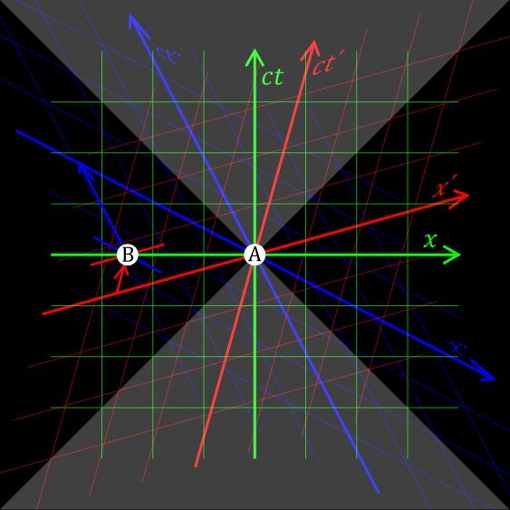
Q: When is everything happening?
A: Now
A: Concurrently

Slide 3
Concurrency is central to CS
CS is at forefront of understanding concurrency
  We operate near light speed
Concurrent computer systems ubiquitous
  Multiprocessors
  Distributed systems
  Data centers
Great recent progress, but more to go

Slide 4

What is a concurrent program?
A concurrent program is different computations occurring simultaneously that share resources
What is a parallel program?
  A single computation
  Controlled decomposition
  Orderly coordination
  E.g., bulk-synchronous computation
Concurrent systems more difficult to coordinate

Slide 5
Concurrent counter increment
load c to reg
increment reg
store reg to c
load c to reg
increment reg
store reg to c
load c to reg
increment reg
store reg to c
Green and blue thread increment counter
  Each thread on different processor
  Threads share memory
So c_{final} == c_{init}+ 2

Slide 6
Some interleavings are bad
load c to reg
increment reg
store reg to x
Global order
load c to reg
load c to reg
increment reg
increment reg
store reg to c
store reg to c
load c to reg
increment reg
store reg to c
Some parallel executions are wrong
  A bad interleaving causes c_{final} == c_{init}+1
Critical region needs special handling

Slide 7
Critical region
Critical region – a code region requiring special properties to protect it from concurrent execution of other code
begin critical region
load c to reg
increment reg
store reg to x
end critical region

Slide 8
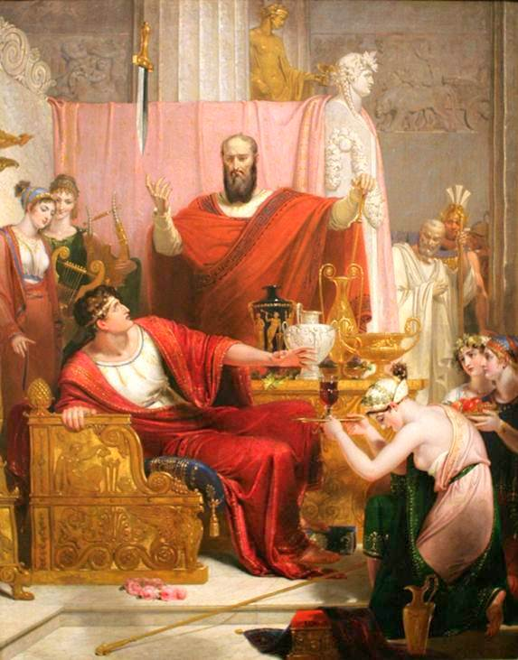
Basis for critical regions
Computer system
  State machine + Communication (I/O)
Communication can happen at any time
  Direct (messages)
  Indirect (memory)
But some states should remain private
Concurrency a sword of Damocles

Slide 9
My agenda
Problem: concurrency, critical regions
Solution
  Transactions
  Transaction processing system (TPS)
Define the ACID properties
  ACID != transactions
  ACID is a single point, let’s see the space
Scheduling concurrency
  Understand concurrency by eliminating it

Slide 10
What are transactions?
A transaction defines a critical region
  Begin transaction
  End transaction
A transaction processing system (TPS) specifies proper concurrent execution
Transactions and TPS as generic concurrency control
  Possibly the “simplest” idea to specify concurrency

Slide 11
Transactions aren’t a thing
Less specific than an algorithm
Less specific than a data structure
Less specific than a design pattern

Slide 12
Database example
Transaction procedures
  txbegin
  txend
  txabort
Transactions read and write rows and tables
BEGIN TRAN T1;
UPDATE table1 ...;
SELECT * from table1;
COMMIT TRAN T1;

Slide 13
Transactional memory example
Transaction instructions
  txbegin
  txend
Transactions read and write cache lines
  Increment a counter
lea c, %rax
retry:
SPECULATE
jnz retry
lock mov (%rax), %rbx
incr %rbx
lock mov %rbx, (%rax)
COMMIT

Slide 14
The story so far
Some code is vulnerable to other concurrently executing code
Delimit critical region as a transaction
Execute transaction in TPS
WIN!
…but what is the transaction processing system (TPS) supposed to do?
  Traditional response: provide ACID properties
  My response: schedule transactions

Slide 15
ACID Properties
Consistency is
Data structure invariants hold
Atomicity: The transaction executes completely or not at all
Consistency: The transaction preserves the internal consistency of the database
Isolation: The transaction executes as if it were running alone, with no other transactions
Durability: The transaction’s results will not be lost in a failure [B&N 2009]

Slide 16
Database invariants
Some can be maintained by system
  E.g., referential integrity, roughly no dangling pointers
  E.g., primary key values are unique
Some externally enforced
  E.g., Salary cannot decrease unless demotion
  E.g., Number of widgets in DB equals physical widgets in warehouse

Slide 17
Memory invariants
Processor (ISA) invariants
  E.g., 64-bit writes are indivisible
Most externally enforced
  E.g., List pointers correct
    node->next->prev == node
  E.g., Total items on list kept up to date with list membership

Slide 18
Consistency not part of TPS
A transaction system can’t guarantee consistency!
  A transaction can violate a data structure invariant
…the transaction processing system does its part for the C in ACID only by guaranteeing AID. [B&N 2009]
It’s the application programmer’s responsibility to ensure the transaction program preserves consistency. [B&N 2009]

Slide 19
Isolation (from wikipedia)
  Isolation refers to the requirement that no transaction should be able to interfere with another transaction. One way of achieving this is to ensure that no transactions that affect the same rows can run concurrently, since their sequence, and hence the outcome, might be unpredictable. This property of ACID is often partly relaxed due to the huge speed decrease this type of concurrency management entails.[citation needed]

Slide 20
Schedule [H&S ’08]
r.write(7)
r.write(-3)
r.read(-3)
1
2
3
time
A schedule consists of method invocations and responses (also called a history)
A scheduler generates legal global orders
  E.g., Methods should appear to happen in a one-at-a-time, sequential order

Slide 21
Scheduling concurrency
-3
r.write(7)
r.read(7)
A
1
2
3
r.write(-3)
B
1
2
Many schedules are legal
  r.read(-3) would also be “correct”
  But reads return latest writes
Scheduler defines safety and liveness
  E.g., sequential consistency, serializability
  E.g., r.read(-7) too weak for most TPSs

Slide 22
Atomicity or Isolation?
Two threads conflict…
  Restart for atomicity - it must appear that either all of A's operations happened, or none.
  Restart for isolation - not seeing partial results is an isolation property
Transaction
restart
txbegin(t1)
r.write(8)
txbegin(t1)
A
txbegin(t2)
r.write(2)
B

Slide 23
Atomicity or Isolation?
A thread gets exclusive access and dies
  For atomicity, abort and roll back transaction
  For isolation, B cannot block indefinitely because of A, so transaction must abort
txbegin(t1)
r.write(8)
die
A
txbegin(t2)
r.write(2)
B

Slide 24
Durability or Isolation?
txbegin(t1)
r.write(7)
txend(t1)
r.read(7)
A
1
txbegin(t2)
r.write(-3)
txend(t2)
B
2
Last read should be -3
  Might be a durability failure
  Might be a isolation failure
Resultant history looks bad
  Not sequentially consistent

Slide 25
Let’s retire ACID
Transactions have AID, not ACID
Atomicity, isolation, and durability are poorly differentiated
  Real situations are a superposition
  Distinction makes you see things that aren’t there
  Subsumed by schedules

Slide 26
Where do we go from here?
Concurrent operations need to be scheduled – TPS
  Traditional scheduling via locking
  Performance issues
Generalize the notion of transaction and transaction processing system.
  TPS: seq. consistency, linearizability, dependent transactions
  Read-copy update: Radical future

Slide 27
Designing a TPS
TPS schedules operations
Operations have defined semantics
  E.g., read returns last written value
  Constrains correct executions
Figuring out new scheduling models and/or new operations ongoing work
  E.g., read_best_effort()
Notes:
Failures always a possible operation
Program, OS, machine, network, data center

Slide 28
Basic algorithm for serializability
  Before reading data, acquire its read lock
  Before writing data, acquire its write lock
  Before searching (updating) a predicate, acquire a read (write) lock on the predicate (DB only)
    Protects both real and (infinite) phantom items
  If locks from two transactions conflict, abort one
    Locks conflict if at least one is a write lock
  Hold all locks until transaction commit
    2 phase locking (acquire and release phases)

Slide 29
Concurrency and performance
More legal schedules = More performance
  More concurrency
  More scalability
  Two phase locking often lacks performance
Weak semantics = More schedules
  E.g., item appears to be on list twice
  Weak semantics = programming difficulty
    Try eventual consistency for distributed systems

Slide 30
Sequential consistency
r.write(7)
r.write(-3)
r.read(7)
1
2
3
Sequential consistency used in multiprocessors
  Methods appear one-at-a-time, sequentially
  Methods must appear in program order
read(7) is not sequentially consistent
  Though legal for weaker models

Slide 31
Linearizability
q.enq(x)
q.deq(y)
A
2
3
B
q.enq(y)
1
FIFO queue
History is serializable, but does not respect real time order
Sequentially consistent, not linearizable

Slide 32
Classic isolation failure
r=0
txbegin(t1)
r.write(7)
txabort(t1)
A
1
3
txbegin(t2)
r.read(7)
txend(t2)
B
2
4
Data written by t1 read by t2 (dirty read)
t2 commits!
Where did read data come from?

Slide 33
Dependent transactions
r=0
txbegin(t1)
r.write(7)
txend(t1)
A
1
3
txbegin(t2)
r.read(7)
txend(t2)
B
2
4
Data written by t1 forwarded to t2
  t1 must commit before t2
  If t1 aborts, t2 must abort (no dirty read)
TPS accepts more schedules
  Cascading aborts? Only problem for DB systems

Slide 34
Read-copy update (RCU)
Defines readers and writers
  Begin read-only transaction
  More like reader-writer lock than transaction
Reduce read synchronization to nothing
  Avoids expensive atomic instructions & fences
Make writers careful
  Readers always see a consistent view
Specialized to lists (but that is changing)

Slide 35
Example: Linked lists
This implementation needs synchronization
A
C
D
B
B’s next pointer is uninitialized; Reader gets a page fault
Reader goes to B

Slide 36
Example: Linked lists
A
C
D
B
Garbage collect C after all readers finished
Reader goes to C or B---either is ok

Slide 37
Basic RCU lists [McKenney]
Create node B, with all outgoing pointers
Then overwrite the pointer from A
  Either traversal is safe
  No atomic instruction needed
  Need compiler memory barrier
    HW memory barrier only on DEC Alpha
List always readable
  Writers must take care
  Writers might wait for all current readers (quiesce)

Slide 38
Scheduling RCU
rcu_r()
rcu_r()
rcu_r()
A
rcu_r()
rcu_r()
B
C
remove()
reclaim()
quiesce
Remove item: pointer write
Reclaim: memory free
TPS lengthens quiescence period as needed

Slide 39
Feel the power
Exercise: Describe RCU with ACID
  Heck, describe RCU
Generalizing transactions and TPS
  Databases
  Transactional memory
  Distributed systems

Slide 40

Searching for meaning in concurrency

Slide 41
My group’s work
TxLinux & MetaTM [ISCA, SOSP ’07, CACM ‘08]
  Transactions if possible, locks when necessary (I/O)
Dependent transactions [MICRO ’08, PPoPP ‘09]
  Committing conflicting transactions
Synchronization in Linux [HotOS ’07, ISPASS ‘10]
  Will optimistic primitives scale? Data independence
HW, SW coordinated transactions [ASPLOS ’09]
OS transactions [SOSP ’09, Eurosys ‘12]
Thanks to: Hany E. Ramadan, Christopher J. Rossbach, Indrajit Roy, Donald E. Porter, Owen S. Hofmann, Sangman Kim, Alan M. Dunn, Michael Z. Lee, Mark Silberstein, Yuanzhong Xu

Slide 42
Reading list
The Transaction Concept: Virtues and Limitations [Jim Gray 1981 IEEE]
Principles of Transaction-Oriented Database Recovery [Haerder & Reuter 1983 ACM]
Linearizability: a correctness condition for concurrent objects [Wing & Herlihy 1990 TOPLAS]
Implementing Fault-Tolerant Services Using the State Machine Approach: A Tutorial [Fred Schneider 1990 ACM]
Transaction Processing [Gray and Reuter 93 MK]
*A Critique of ANSI SQL Isolation Levels [Berenson, Bernstein, Gray, Melton, O’Neil, O’Neil 1995 MSR-TR]
*The Art of Multiprocessor Programming [Herlihy & Shavit 2008]
Principles of Transaction Processing [Bernstein & Newcomer 2009 MK]

Slide 43
Insight
Notes:
Riding the bus. My ah-hah moment.
As a professor, many approaches worked (and failed)
Getting into problems
that guy is in the wrong hash bucket
you spend a long time understanding your own theorems

Slide 44
Conclusions
Concurrency management is fun
  Great need for progress
  Ample opportunities for progress
Don’t use ACID as a crutch
Schedule concurrency
  Search for meaning

