Slide 1


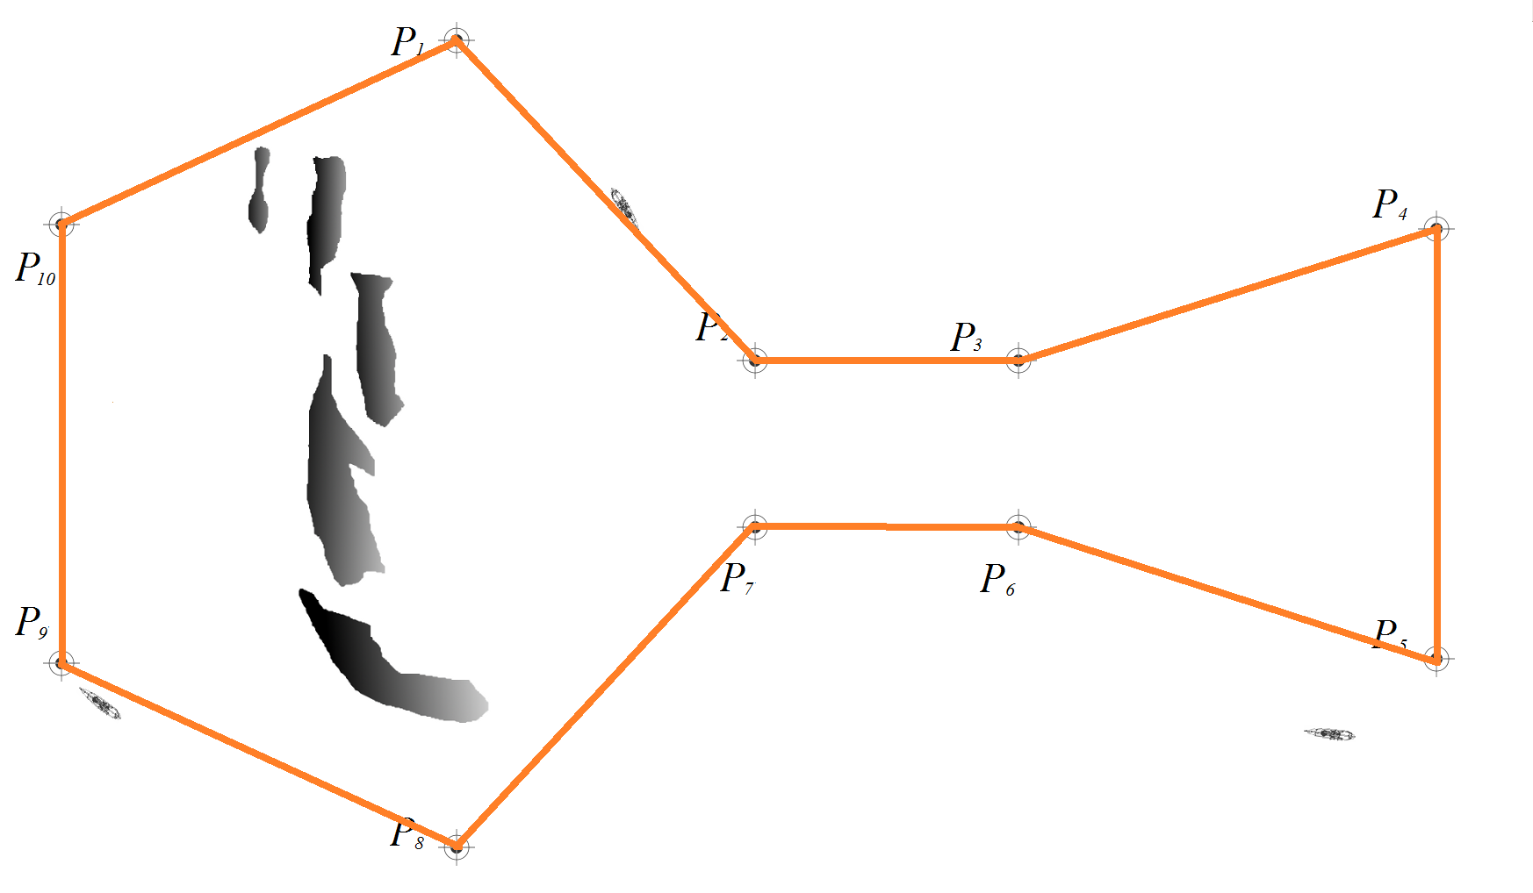
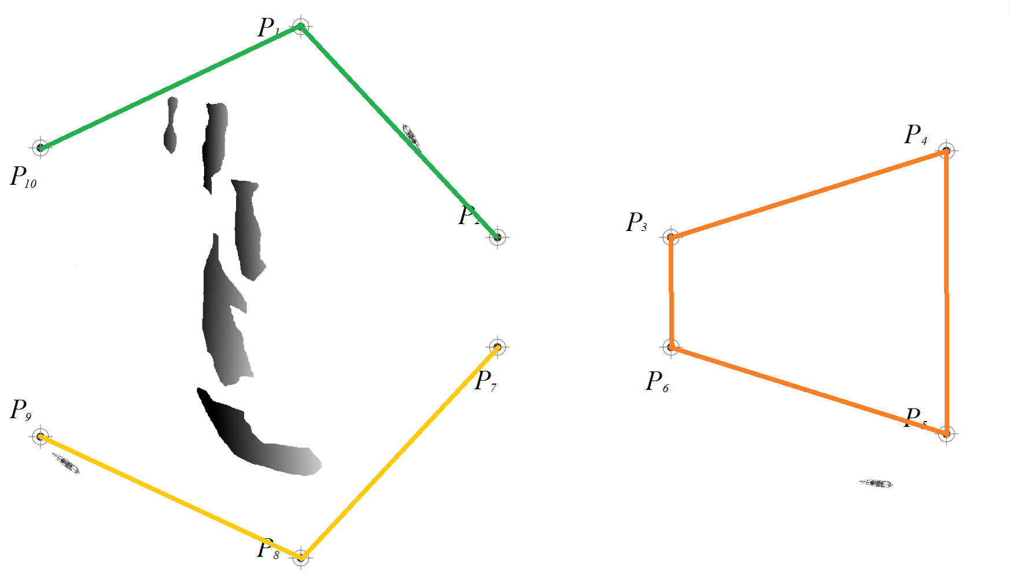
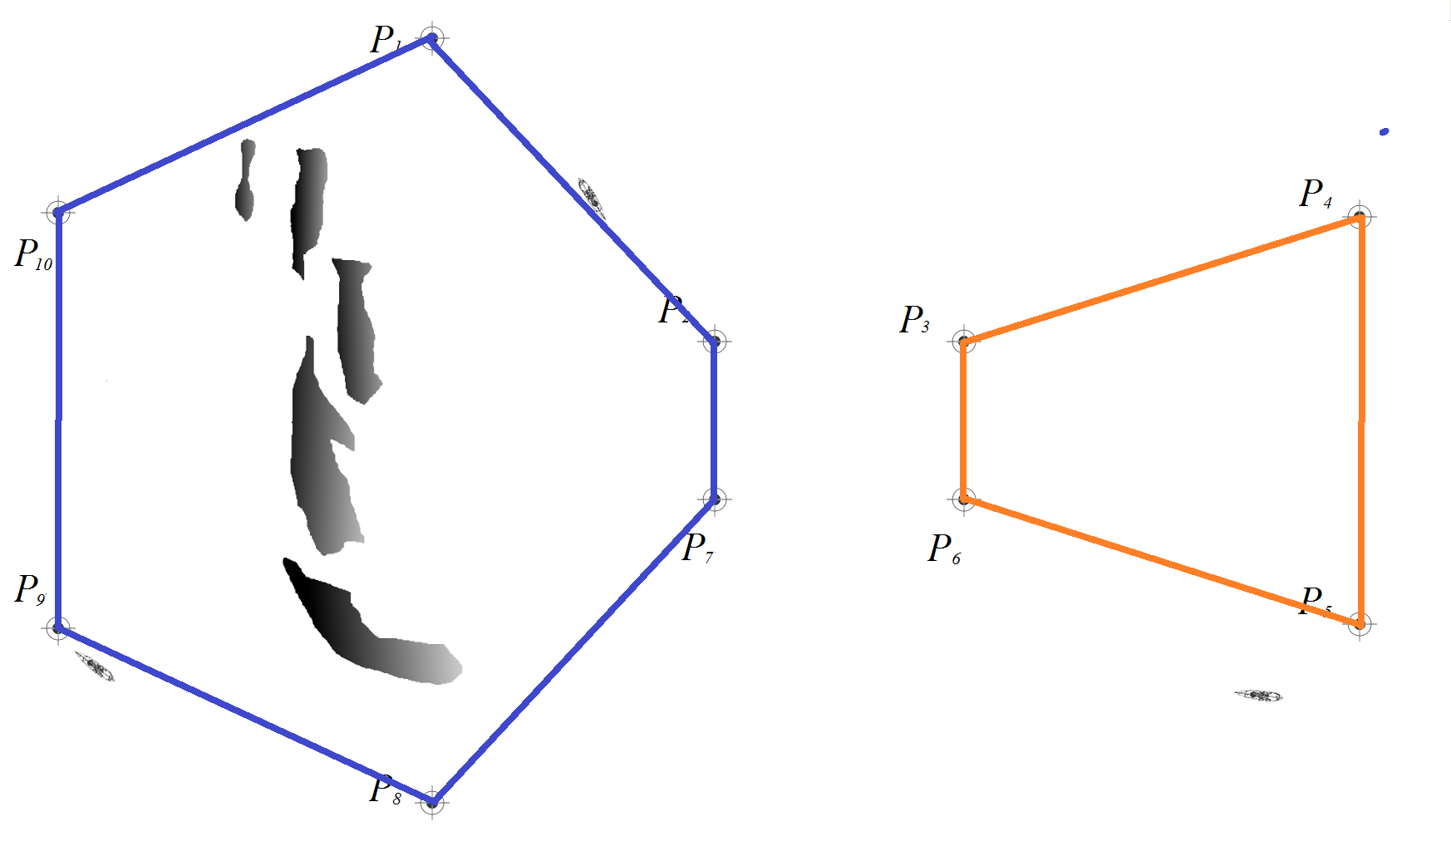
Ship Patrol:
Multiagent Patrol under Complex Environmental Conditions
Noa Agmon, Daniel Urieli and Peter Stone
Department of Computer Science
The University of Texas at Austin
{agmon, urieli, pstone}@cs.utexas.edu
Full paper to appear in AAAI’11
Multiagent Frequency-Based Graph Patrol Problem:
Team of k agents should repeatedly visit nodes of graph G=(V,E) while minimizing idleness at each node
Current Strategies
SingleCycle
All agents travel in coordination along one cycle
UniPartition
V(G) divided into k subgraphs, each agents patrols inside its subgraph
Optimal strategy: Intractable
Optimal strategy: Intractable
Complex Environments
New, General Strategy
Example: Marine Environments
Time of travel does not correspond to physical distance
Influenced by water currents, winds, waves
No triangle inequality → Cannot use common approximation algorithms
MultiPartition
V(G) divided into m≤k subgraphs, with possibly more than one agent patrolling in each subgraph
Current strategies are not necessarily suitable
Biconnected Outerplanar Graphs
A cycle with non intersecting shortcuts
MultiPartition Optimal Strategy Intractable
Finding an optimal MultiPartition strategy that minimizes worst idleness in G is NP-Hard.
Solving the problem in biconnected outerplanar graphs is also intractable Use heuristic algorithm
UTSeaSim
Algorithm HeuristicDivide
Custom-designed naval surface navigation simulator
Realistic 2D physical models of marine environment and sea vessel
Contains three modules:
Sea Environment wind, currents, obstacles
Ship physical properties, sensing and actuators
Decision Making autonomous agent controlling the ship
Examine all divisions of the given cycle into two or three cycles
Choose division that improves and minimizes idleness
Continue recursively with each cycle in the division
Implemented in UTSeaSim
Significantly improves idleness compared to:
SingleCycle
Trivial adjustments
(SinglePatrition cannot be computed)
Medium level of winds and currents

