Slide 1
Welcome!

Slide 2
Announcements
Sit by section?????

Slide 3


Day 1 Course Intro
Professor Ramsey
ramsey@cs.utexas.edu

Slide 4
GETTING TO KNOW US

Slide 5
Ice Breaker
By Section, then Alpha by name
Notes:
sit by alpha, condenses

Slide 6



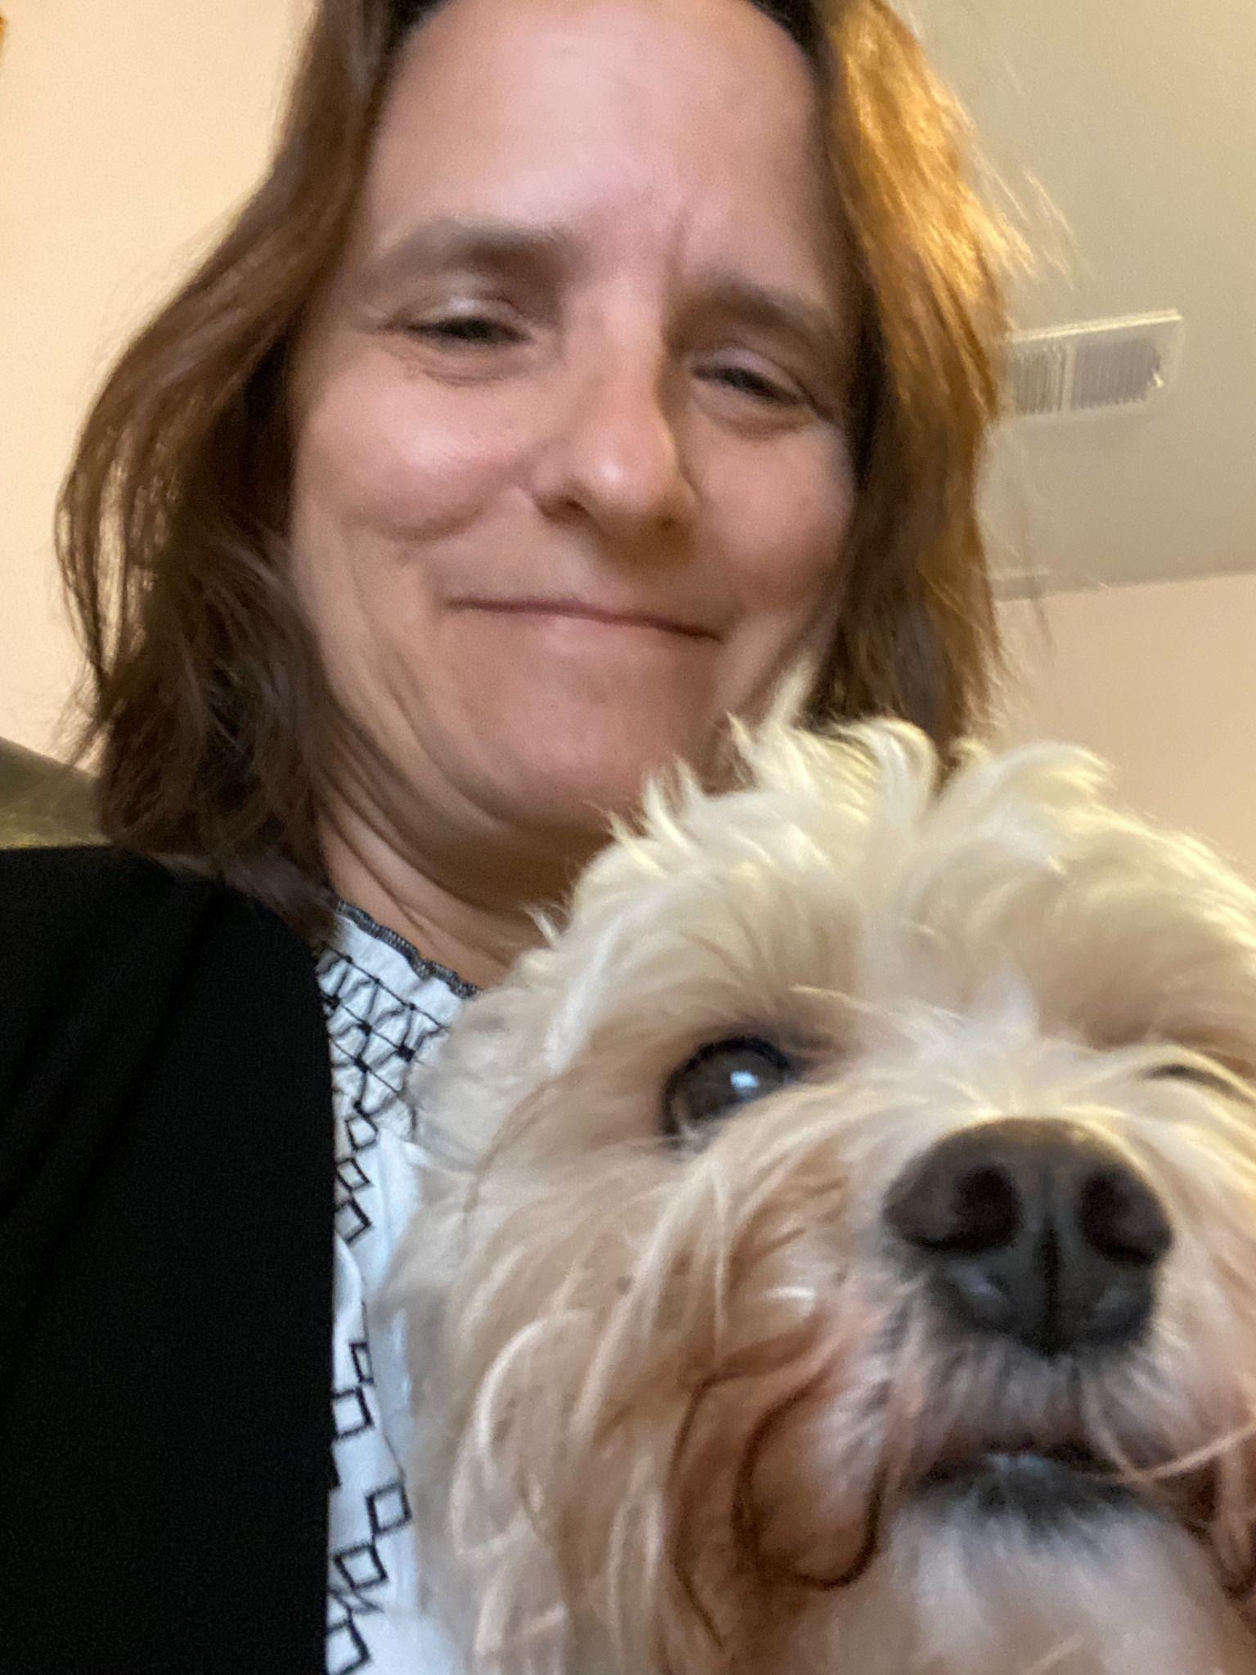








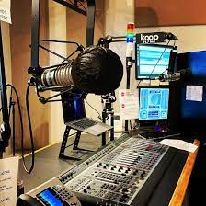
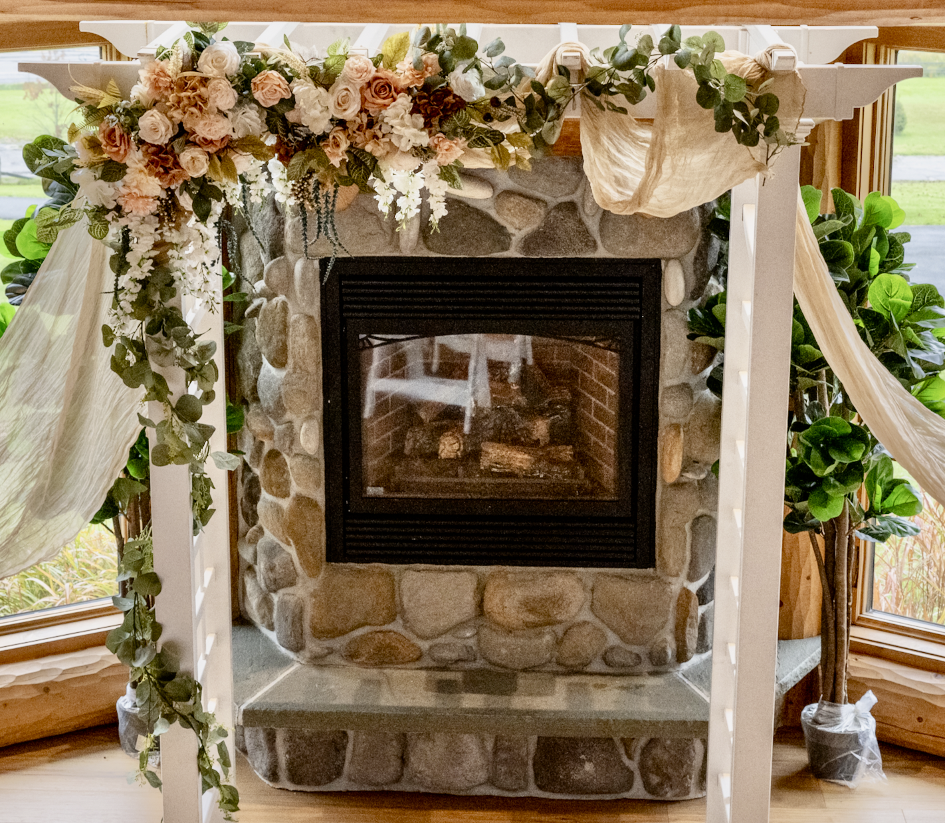
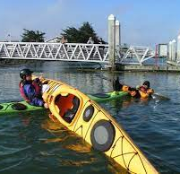

Who Am I?
Computer Science | Computer Science Education
Other
Professor Ramsey

Slide 7
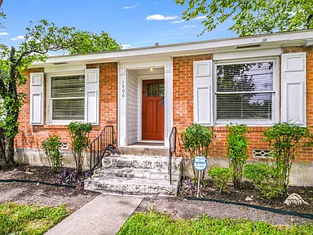
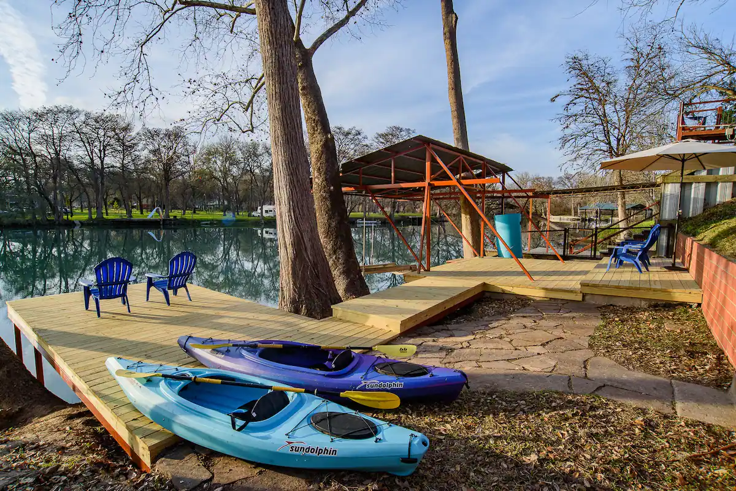

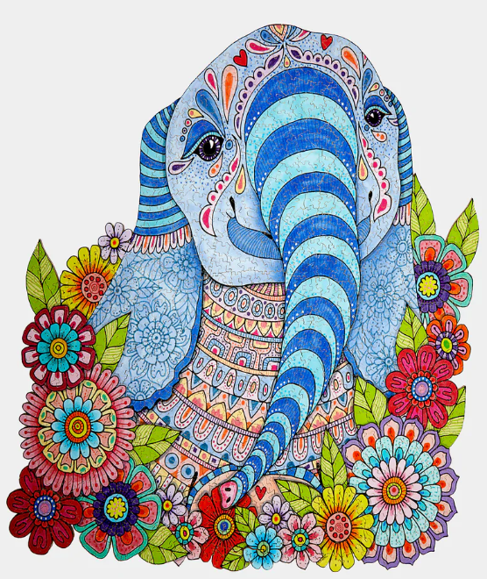
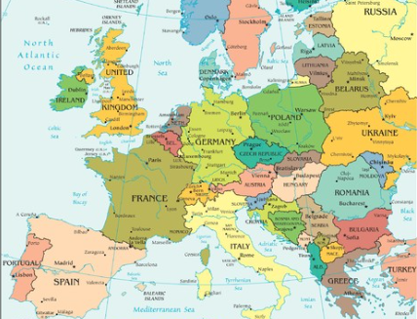

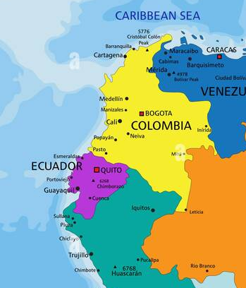
Why CS?

Slide 8
Why are you learning CS?

Slide 9
ABOUT THE COURSE
Notes:
What was it?

Slide 10

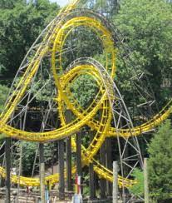

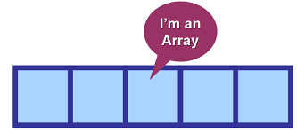


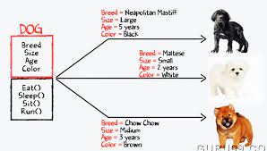
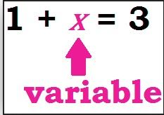
The Content

Slide 11
My Approach
The course assumes no programming experience.
The course requires TIME and practice, practice, practice.
If you got here, you can do this.

Slide 12
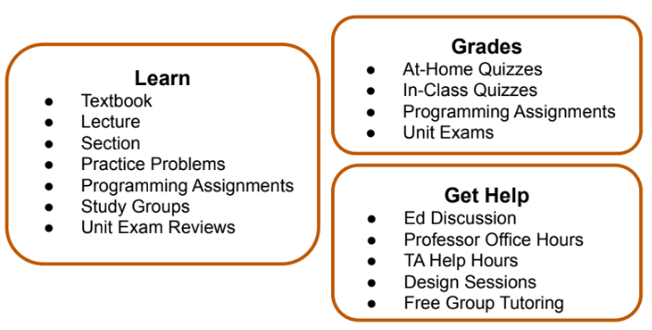
Course Overview
Ed Discussion Help starts today!
Design Sessions start Friday.
Other help starts next week.

Slide 13
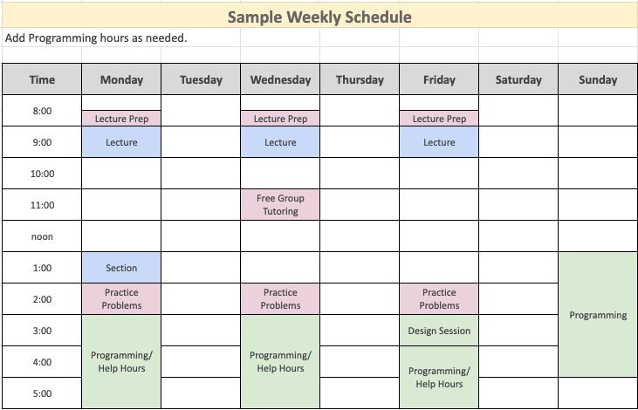

Slide 14
It’s Not All Graded
Work you need to do
Work that is graded directly

Slide 15
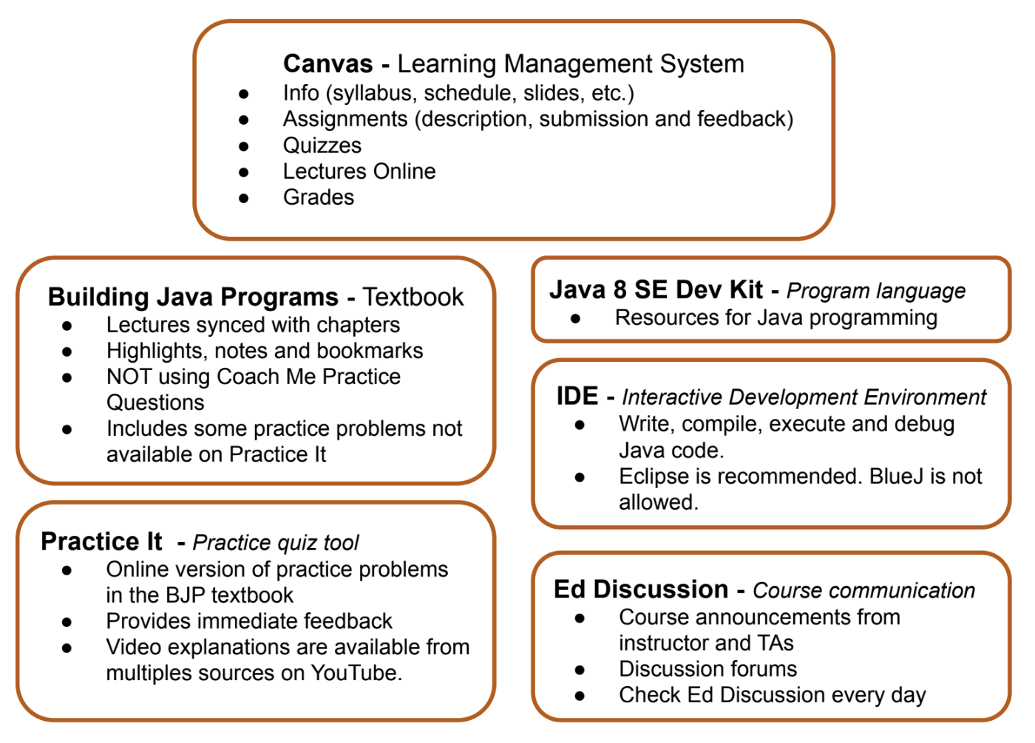
Tools Tour

Slide 16
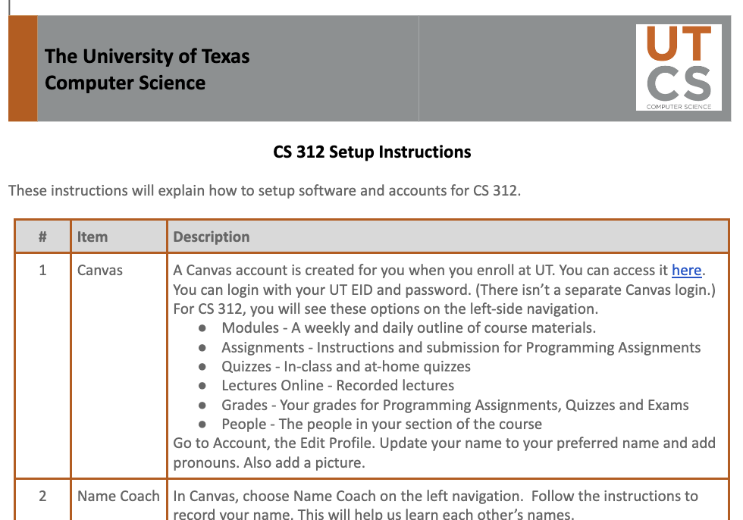
Setup Instructions - Start Today!
Sometimes, setting up Eclipse gets wonky. If you have trouble, go to Design Sessions on Friday afternoon, 2-5 on 3rd floor bridge.

Slide 17
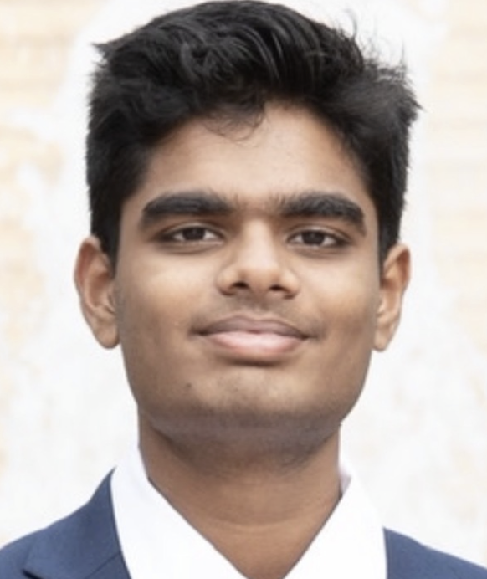
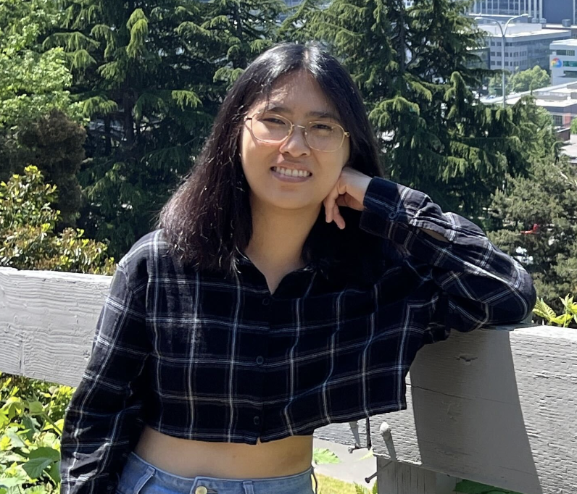
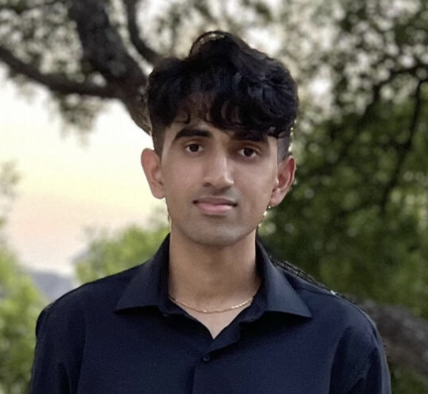
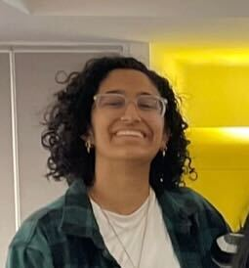
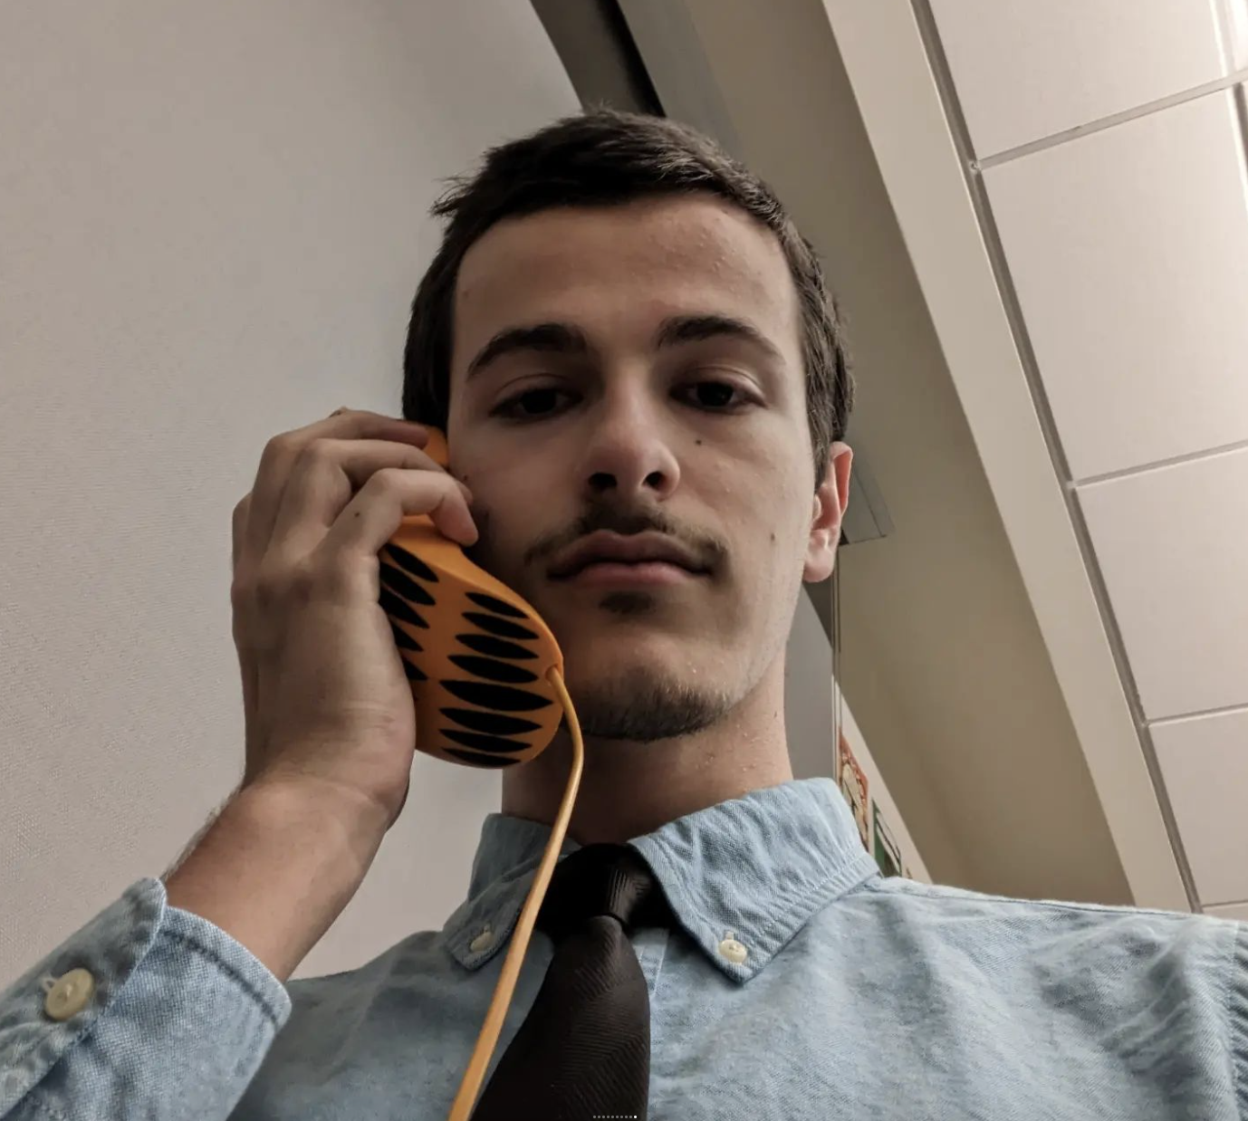
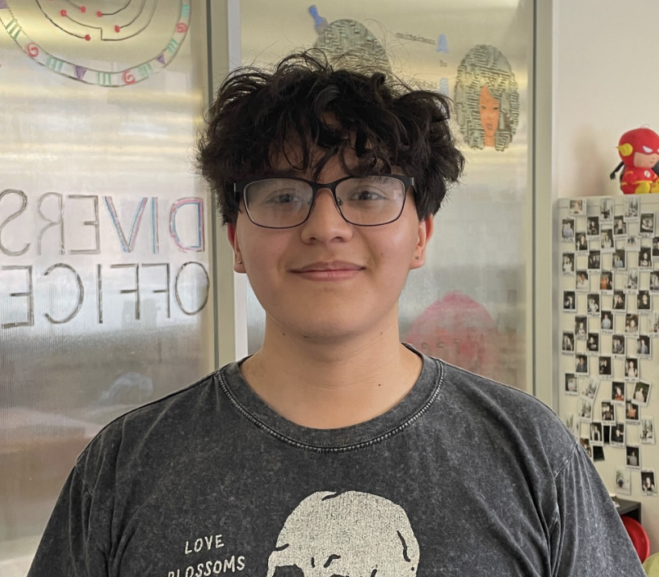
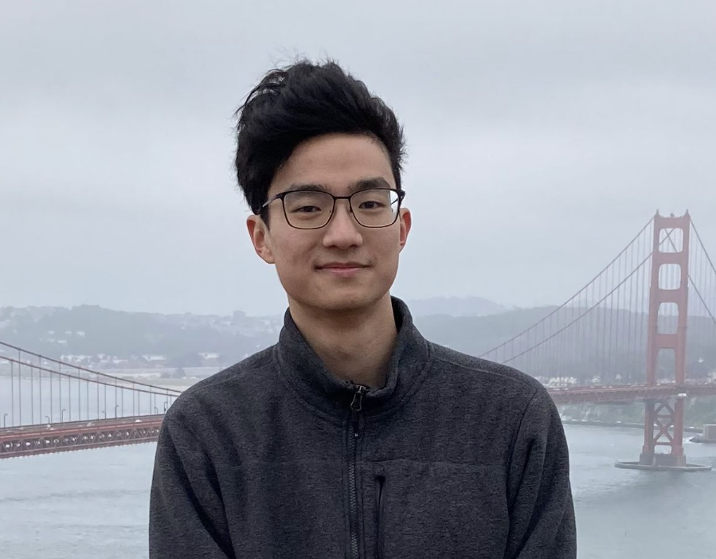
Syllabus - One Day at a Time - Your TAs
Dia and Caleb

Slide 18
Remember
You Belong Here
Setup Instructions due in two days, Friday, January 18.
First Programming Assignment due Thursday, January 25.
Will have a recorded lecture to cover sections you need for the assignment.
Design Sessions start this Friday, January 18, on GDC 3rd floor bridge, to help with both.

Slide 19

In UT News
You Belong Here
Last month, UT volleyball won its second National Championship in a row.

