Slide 1
Welcome!
‹#›
Notes:
Updates - add quick example of raising your own exception (maybe add that section back into the book), also, can you raise a general exception like in Java?

Slide 2


Day 2 Hello World!
PROFESSOR RAMSEY
ramsey@cs.utexas.edu

Slide 3
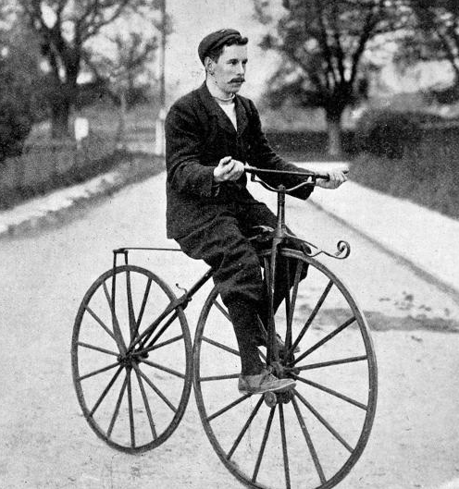
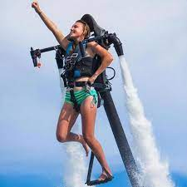
Sections Start MONDAY
Before Section
After Section
Join 20 of your closest friends and a smart and awesome TA for 1 hour each Monday.
TA goal - they want you to do AWESOME in his course.
Lecture provides the basics. Section finishes the job with same difficulty as Programming Assignments and Exams.
Section is required. Attendance is taken.
Quiz Grades may reflect section attendance.

Slide 4
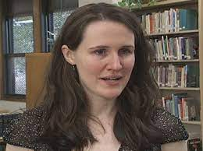
Newbies
From Homeless to Harvard, the Liz Murray Story
It’s hard to learn many new things at the same time. So, for 4 weeks, we have Newbies on Fridays at 1:00 in GDC 2.410.

Slide 5
Announcements
Starts today:
Design Sessions (assignment and setup)
Starts Monday:
Help Hours, Office Hours, Group Tutoring
Lecture Prep
Scavenger Hunt group Quiz
HelloWorld video on Ed Discussion
Before asking or answering, say your name.
On Monday, sit with Section folks or study group folks. We’ll stay put for Unit 1.

Slide 6
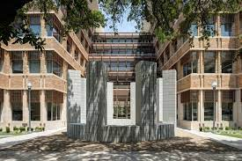
Getting to Know GDC
North tower rooms: *.1,*.2, *.3, *.4, *.5
South tower rooms: *.6, *.7, and *.8
Bridge/atriums are in-between the towers on floors 1-6 (not 7).
Most undergraduate spaces are in the North tower.

Slide 7
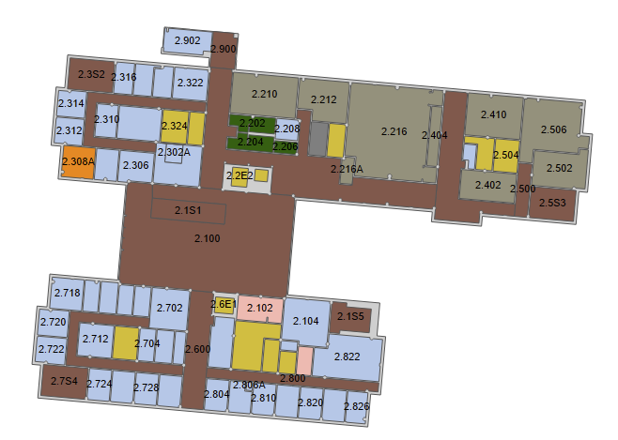


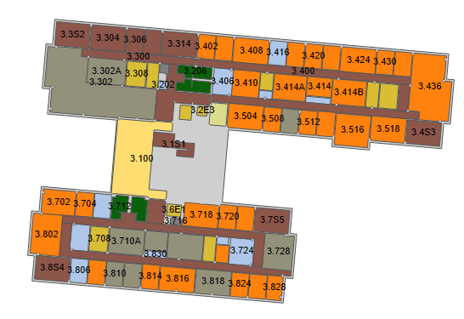
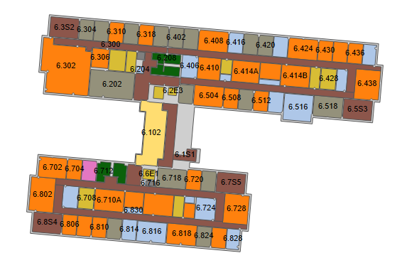
Our Spaces
GDC 2nd Floor
Lecture
Main Doors
GDC 3rd Floor
Coffee
Help Hours Lab
GDC 6th Floor
My Office
Design Sessions

Slide 8
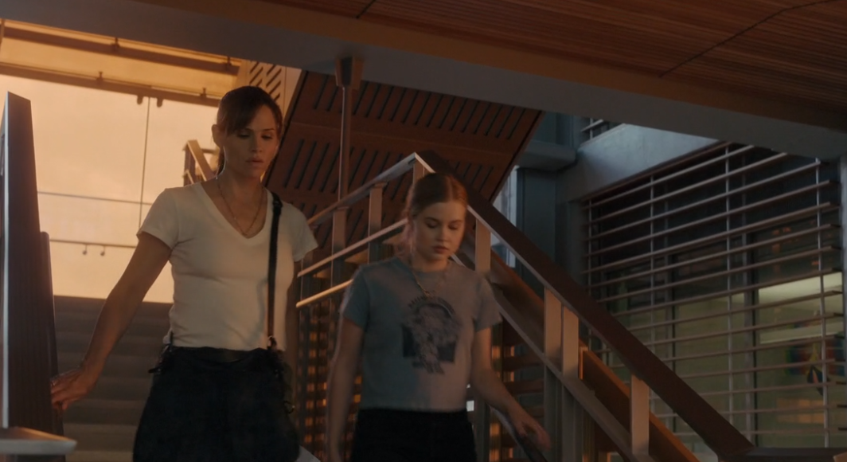
The Stairs
It is OK to use the beautiful stairs. Even Jennifer Gardner uses them.
The Last Thing He Told Me, Apple TV, Episode 4, 17:52, streaming now on Apple TV. UT and Austin featured in episodes 3-5.

Slide 9
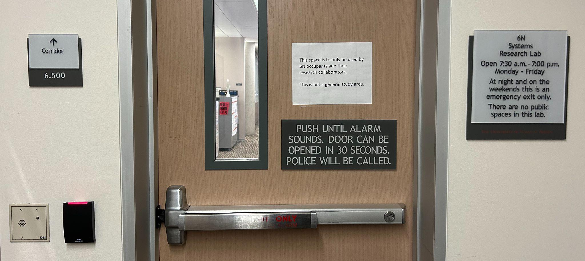
How Not to Get Arrested

Slide 10
Getting to Know Us, continued

Slide 11
Ice Breaker
Would You Rather
If you could have anyone attend a party at your house, who would it be?
King Charles III
Beyonce
Elon Musk
Taylor Swift
Notes:
Best Party: King Charles III…Beyonce…Elon Musk… Elvis
Best Job: CEO of Google….Olympic athlete….Texas Governor…Surf instructor in Hawaii
Best Trip: the world for a year…your own private island…the moon… guest at the Oscars
sit by last category, no gaps

Slide 12
Ice Breaker
Would You Rather
If you could have one of these jobs, which would you choose?
CEO of Google
Olympic athlete
Texas Governor
Surf instructor in Hawaii
Notes:
Best Party: King Charles III…Beyonce…Elon Musk… Elvis
Best Job: CEO of Google….Olympic athlete….Texas Governor…Surf instructor in Hawaii
Best Trip: the world for a year…your own private island…the moon… guest at the Oscars
sit by last category, no gaps

Slide 13
Ice Breaker
Would You Rather
If you could go on one of these trips, which would you choose?
Travel the world for a year
Relax on your own private island
Go to the moon
Be a guest at the Oscars
Notes:
Best Party: King Charles III…Beyonce…Elon Musk… Elvis
Best Job: CEO of Google….Olympic athlete….Texas Governor…Surf instructor in Hawaii
Best Trip: the world for a year…your own private island…the moon… guest at the Oscars
sit by last category, no gaps

Slide 14
Syllabus One Day at a Time - Grading
Type | Extension | Make-up | Drops
At-Home Quizzes | 2 days, no slip days needed | None | 5 quizzes combined
In-Class Quizzes | None, must be taken in class on given day. | None
Programming Assignments | 2 days, slip days charged, 8 max | None | 1 programming assignment
Unit Tests | None | Only for conflicting UT Exam, with pre-approval | None

Slide 15
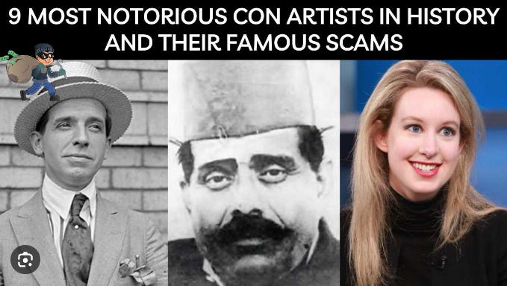
Academic Integrity
You are too young to start your life of crime.
Don’t end up in a documentary like Charles Ponzi, Natwarlal or Elizabeth Holmes.

Slide 16
Short Version
Don’t submit code that didn’t come from your own brain and typing fingers and don’t help anyone else to do the same.

Slide 17
Long Version
See Syllabus. Know the syllabus.

Slide 18
Three More Quizzes Due Thursday
Beginning of Course Survey
Syllabus
Academic Integrity

Slide 19
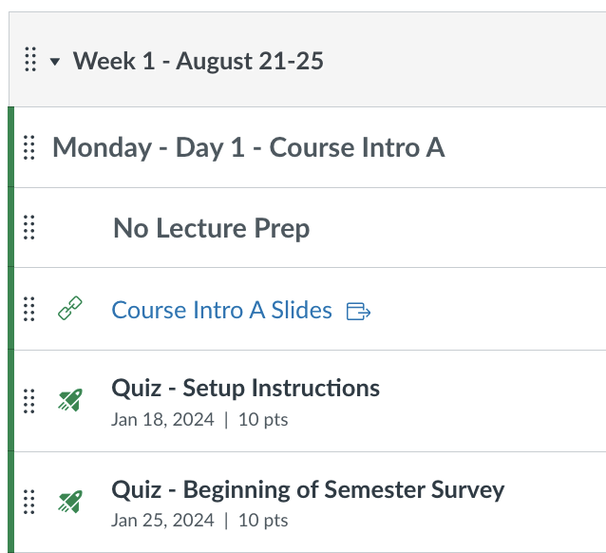
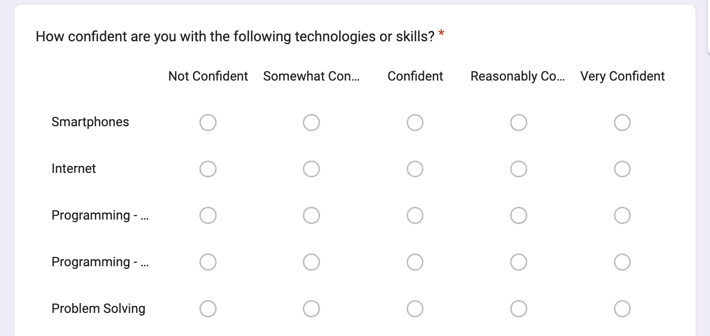
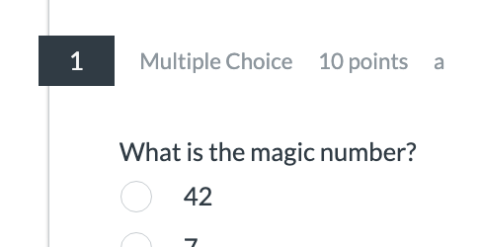

Beginning of Semester Survey and Quiz
#1 #2 #3
Start Quiz in Canvas. Follow link to take survey. Return to Canvas, enter
Find magic number at end. magic number to
get credit.
…

Slide 20
Our First Program
Where to start and end.
What steps to to execute.
How to compile and run.
How to debug.

Slide 21
Demo
HelloWorld.java
Hello.java (with errors)

Slide 22
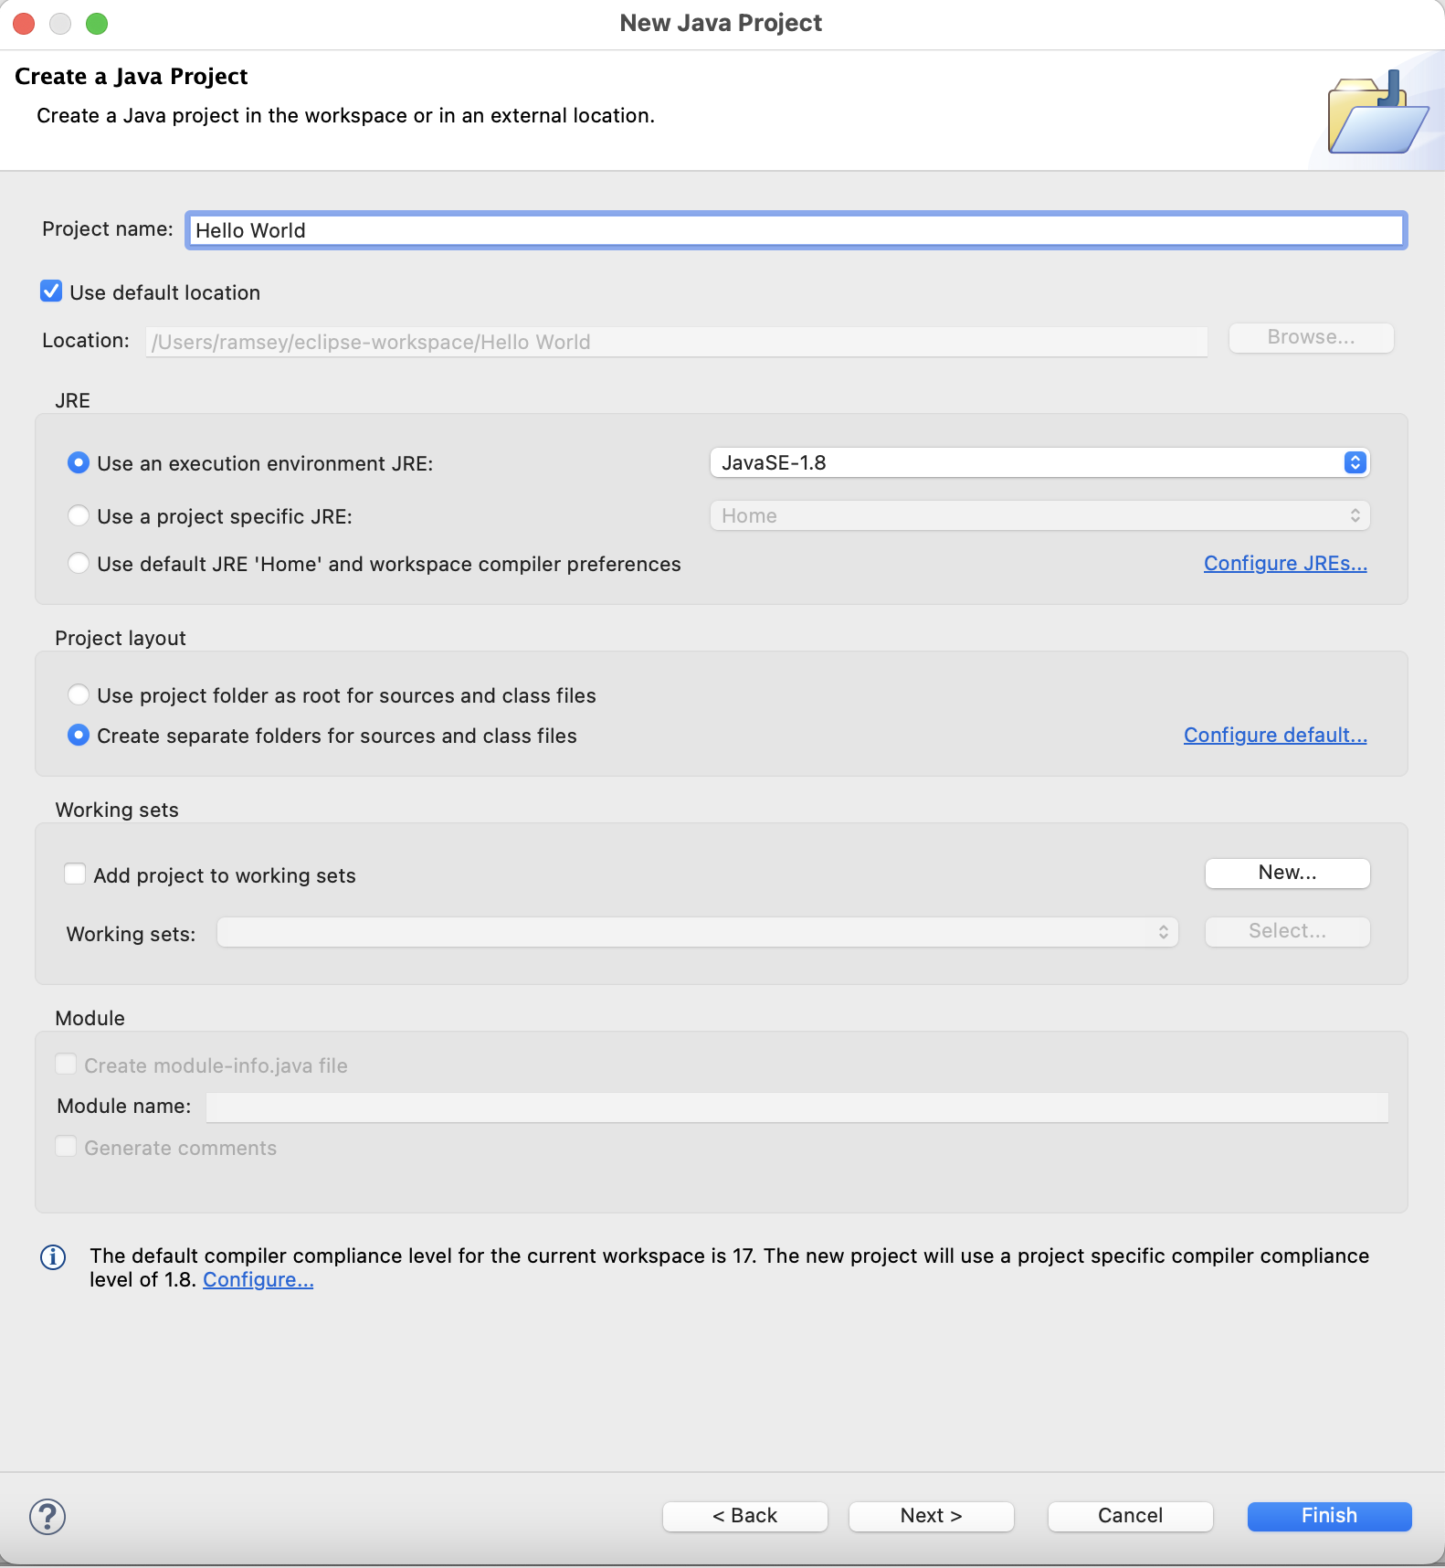
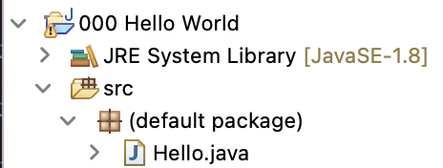
Creating a Project and Java Class

Slide 23
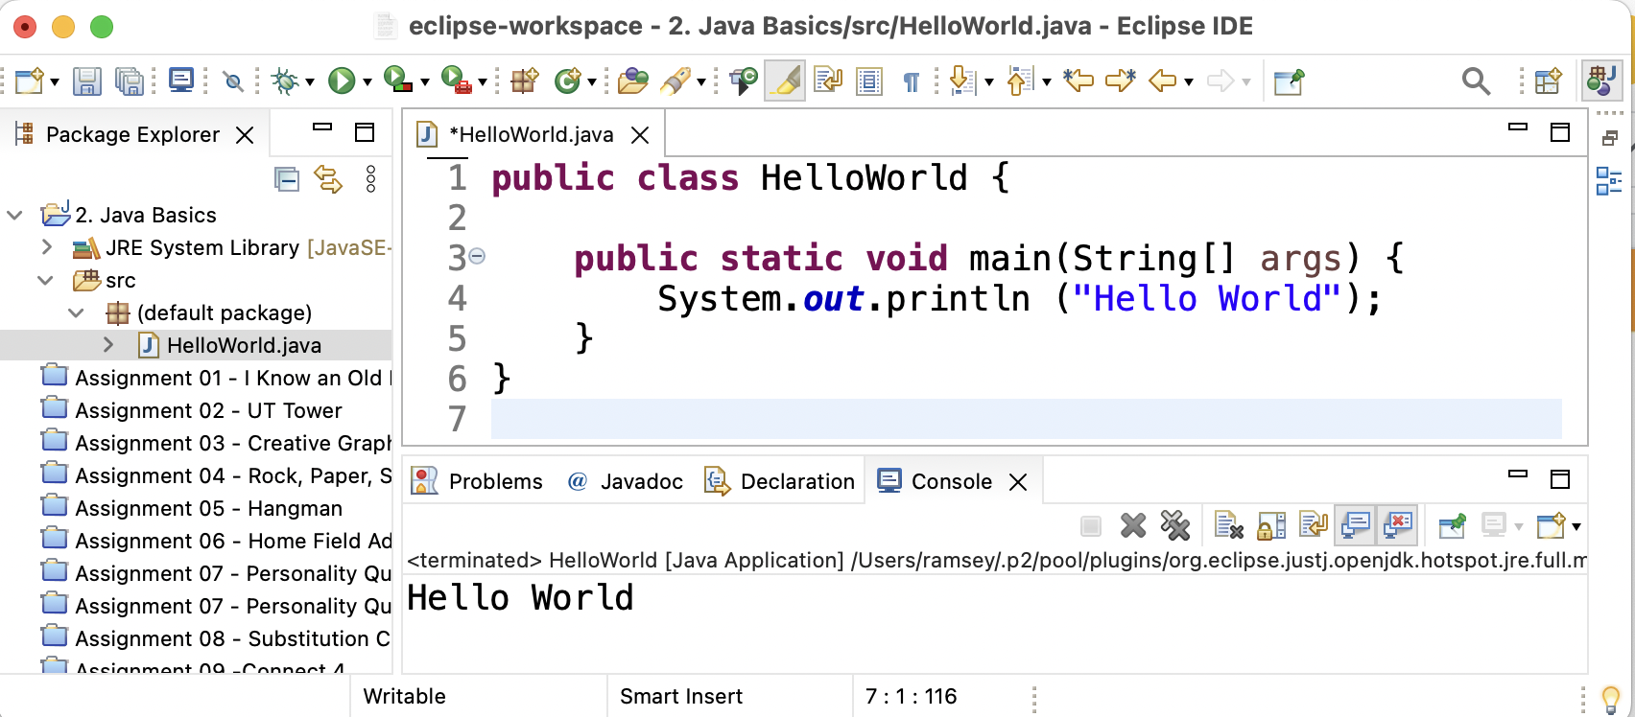
The IDE
save and
compile run tab for each open file
project
Java files
output

Slide 24
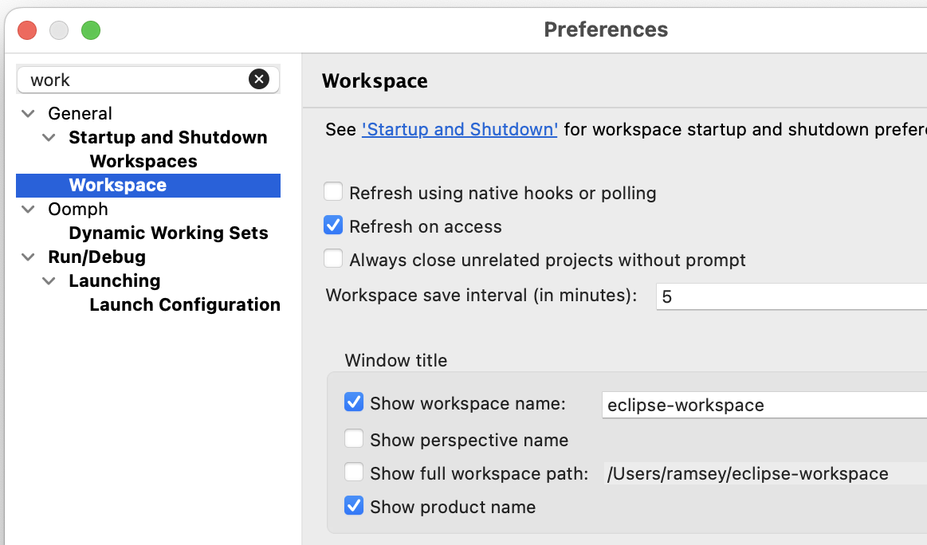
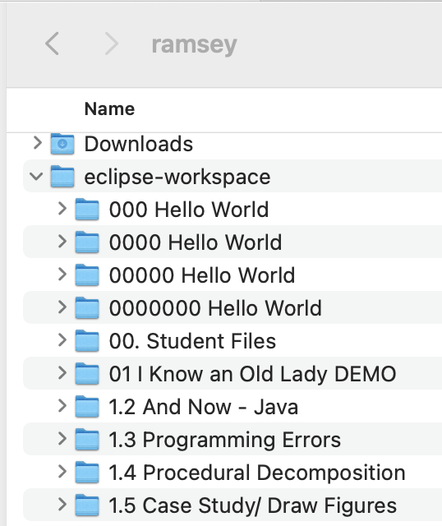
Know Your Workspace

Slide 25
Run Test Cases in GradeScope

Slide 26
Naming Things
Item | Must Do | By Convention | Examples
program | Each program has one class with a main() method. The name of the class matches the filename (<name>.java) exactly. | capitalize each word | SubstitutionCipherDecoder
identifier | Something you name such as a variable or method. | must start with a letter, underscore, or $, subsequent characters can be any of those or 0-9 | Valid: _myName, TheCure, ANSWER_IS_42, $bling$ Invalid: me+u , 49ers , side-swipe, Ph.D's

Slide 27
Literals
Item | Examples
Integer | 12, -345, 0
Decimal | 0.0, 1.271, -4.87111
Character | ‘a’, ‘Z’, ‘)’, ‘|’, ‘8’
String | Valid: “Hello World!” “This is a sentence. It is very long.” “Stella Rose is 4 years old.” Invalid: “This is two lines long.” // can’t span multiple lines “My name is “Mary” and I like kittens.” // can’t include a double quote.

Slide 28
Escape Sequences
A special sequence of characters used to represent certain special characters in a string.
Sequence | Meaning | Example
\t | tab | Code: System.out.println("\\hello\nhow\tare\"you\"?\\\\"); Output: \hello how are "you"?\\
\n | newline
\” | quotation mark
\\ | backslash

Slide 29
Assignment 01 Intro
I Know an Old Lady
Notes:
Session Title: Project Based Learning (PBL) for Equity in CS classes
Session Description: If you are teaching a survey course like Computer Science Principles, or a code intensive course like AP CS A, PBL can serve as a powerful tool to increase student interest and engagement. Learn about research that connects PBL to improved student outcomes, especially for girls and underrepresented minorities. Discover available PBL resources and understand PBL lesson components, so you can build your own.

Slide 30

A Home Design Quiz
One Design quiz per week.
Open on Friday, due on Sunday at 11pm.
Always the same question: Upload your design for the current programming assignment.

Slide 31
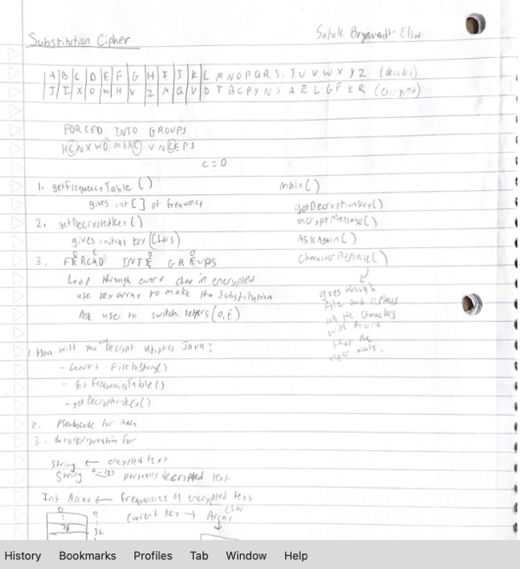
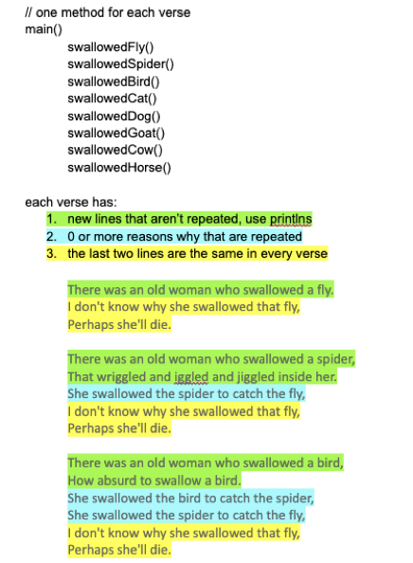
Design Examples

Slide 32
Remember
You Belong Here
Setup Instructions due today. Any troubles, attend Design Sessions today.
First Program Assignment starts today! Another good reason to attend Design Sessions.
Three quizzes next week
Beginning of Year Survey
Syllabus
Academic Integrity
Scavenger Hunt

Slide 33
Friday Austin Fun
You Belong Here
TBD

Slide 34
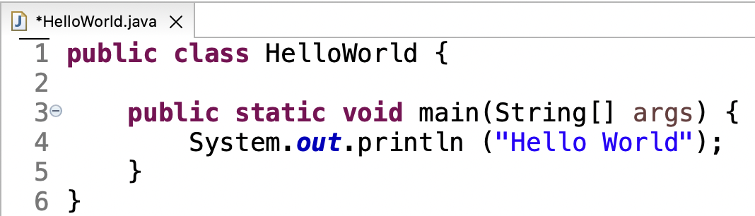
Blueprint - Java Program
Each public class is in a separate file with same name.
Java programs consist of classes.
Each class has a name.
Open and close braces enclose a body of code that is executed as a unit.
Open and close braces enclose a body of code that is executed as a unit.
Each Java program needs one main method inside one of the classes, where execution begins.
Program statements

Slide 35
Blueprint - Println
Pronounced print-lin
Method name
The text that should be printed.
All methods include parenthesis that may or may not include more information.
All methods include parenthesis that may or may not include more information.
Eclipse shortcut - type sysout, then Ctrl+space
Java statements end with a semicolon.
If there is nothing inside the parenthesis, a blank line is printed.
Java statements end with a semicolon.

Slide 36
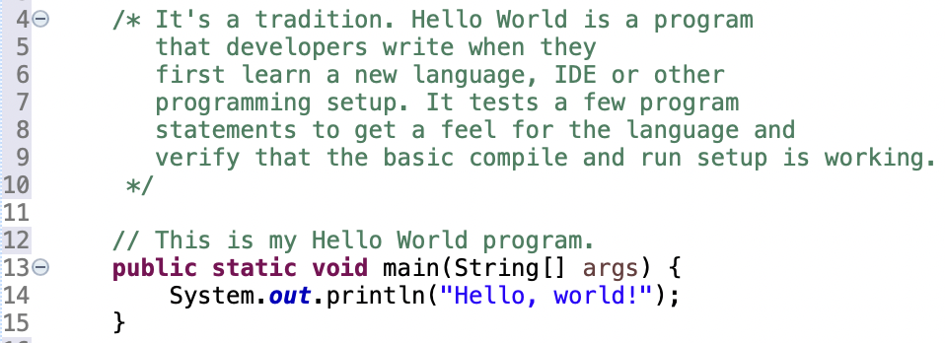
Blueprint - Comments
A multi-line comment begins with /* and ends with */.
A multi-line comment begins with /* and ends with */.
A single-line comment begins with //.

Slide 37
Blueprint - Comments
A multi-line comment begins with /* and ends with */.
A multi-line comment begins with /* and ends with */.
A single-line comment begins with //.

