Slide 1
Welcome!
‹#›

Slide 2


1.4 Procedural Decomposition
PROFESSOR RAMSEY
ramsey@cs.utexas.edu

Slide 3
1.4
Procedural
Decomposition

Slide 4
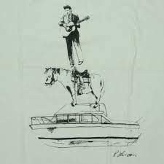
Demo
If I Had a Pony
Demo

Slide 5
Why Decomposition?
To reduce redundancy.
Every line of code has a cost in writing, testing, debugging, maintenance, refactoring, etc.
To organize code so it is easier to read and maintain.
Code is written once, but it is read, updated and maintained for years by many people.
‹#›

Slide 6
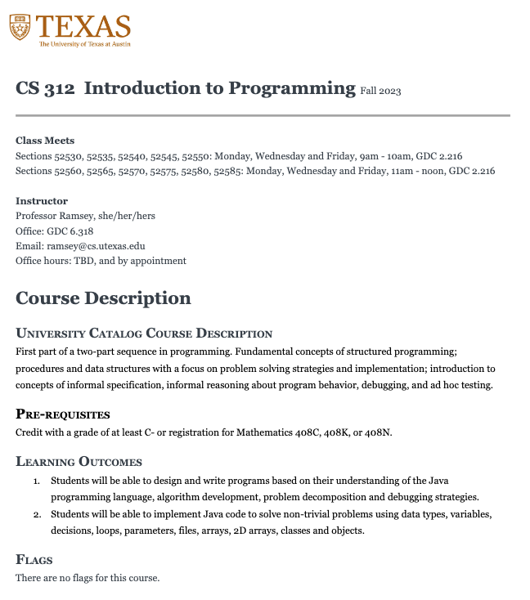
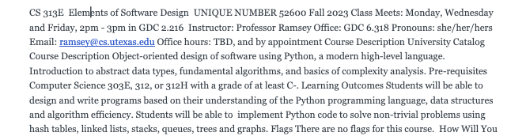
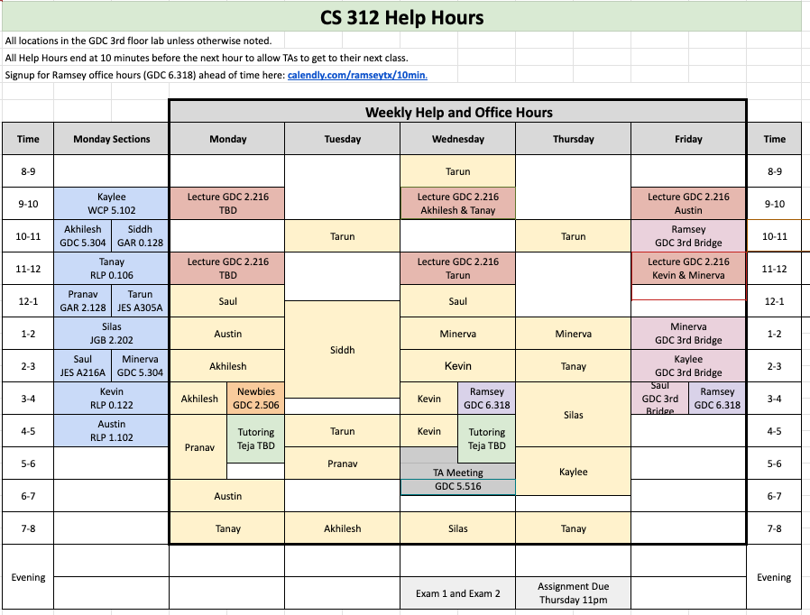
You Do This Already
First page of syllabus, as a blob.
Syllabus divided into paragraphs, with specific capitalization and spacing
Help Hours Schedule in one place, pointed to by Syllabus, Canvas, etc.

Slide 7
Static methods
class
main() method
static method: A named group of statements.
  denotes the structure of a program
  eliminates redundancy by code reuse
procedural decomposition:
dividing a problem into methods
procedural abstraction:
hiding hiding detail to manage complexity
  both ways to manage complexity
Writing a static method is like adding a new command to Java.
method A
  statement
  statement
  statement
method B
  statement
  statement
method C
  statement
  statement
  statement
‹#›

Slide 8
Using static methods
1. Design the algorithm.
  Look at the structure, and which commands are repeated.
  Decide what are the important overall tasks.
  Good programmers do this BEFORE writing any code
2. Write method calls in main().
  Write logical method calls. You can comment them out, then uncomment as you define each one.
3. Define methods, one at a time.
  Code-Test, Code-test in small increments.
‹#›

Slide 9
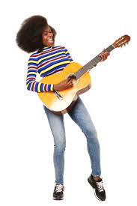


The Taylor Swift Performance Challenge
The musician starts playing one Taylor Swift song.
Someone hands her the music sheet for a new song.
Music for the current song goes on a stack.
The musician sings the new song.
The musician picks up the most previous song and plays it from where she left off.
Each song can get interrupted by 0, one or more than one song.
The stack can hold many songs.
The performance is over when the stack is empty and the first song is finished.

Slide 10
Control Flow
Closure
~~~~~
Midnights
~~~~~~~
~~~~~~~
~~~~~
Midnights
~~~~~
~~~~~~~
~~~~~~~
Karma
~~~~~
Karma
~~~~~
~~~~~~~
My Tears Ricochet
~~~~~~~
~~~~~
My Tears Ricochet
~~~~~
~~~~~~~
~~~~~~~
~~~~~
Start
Stop
Right Where You Left Me
~~~~~
~~~~~~~
Closure
~~~~~~~
‘Tis the Season
~~~~~
All To Well
~~~~~~
‘Tis the Season
~~~~~
~~~~~~~
~~~~~~~
~~~~~
Betty
~~~~~
~~~~~~~
~~~~~~~
~~~~~
All to Well
~~~~~
Betty
~~~~~~~
~~~~~~~
Illicit Affairs
~~~~~
Illicit Affairs
~~~~~
~~~~~~~
~~~~~~~
~~~~~

Slide 11
TwoRockets.java
/\ /\
/ \ / \
/ \ / \
+------+ +------+
| | | |
| | | |
+------+ +------+
|United| |United|
|States| |States|
+------+ +------+
| | | |
| | | |
+------+ +------+
/\ /\
/ \ / \
/ \ / \
What are the methods?
What does main() look like?
In-Class Practice

Slide 12
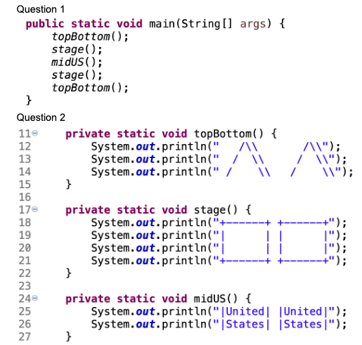
In-Class Practice Answers

Slide 13
Demo
TwoRocketsChained.java
Demo

Slide 14
No Chain Smoking! I Mean Chain Methods!
main should be a concise summary of your program. It is generally poor style if each method calls the next without ever returning (chaining):
A better structure has main make most of the calls. Methods must return values to main to be passed on later.
main
methodA
methodB
methodC
methodD
main
methodA
methodB
methodC
methodD
‹#›

Slide 15
Remember
You Belong Here
Complete Canvas Quizzes.
Start Programming Assignment 1 - I Know an Old Lady.
First Section on Monday!

Slide 16
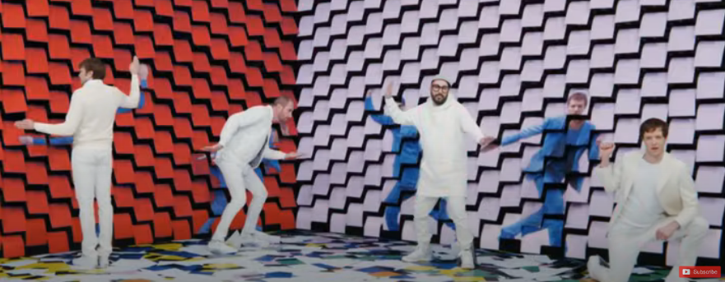
Video Moment of Zen
No Moment of Zen for Video Lecture: https://www.youtube.com/watch?v=LgmxMuW6Fsc

Slide 17
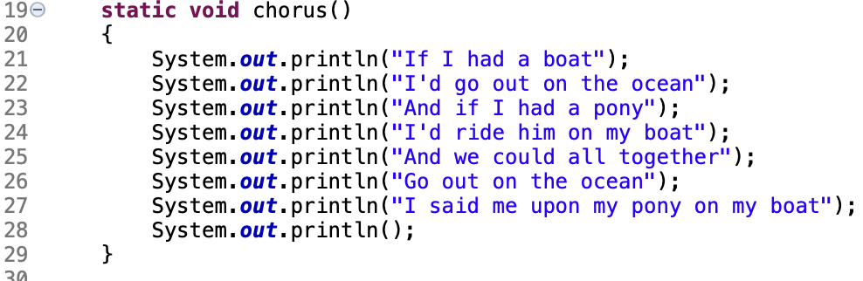
Blueprint - Static Method Definition
void means no value will be returned
method name followed by parenthesis
Body of the method, enclosed in curly braces.

Slide 18

Blueprint - Static Method Call
Name of the method
Parenthesis

