Slide 1
Welcome!
‹#›
Notes:
Updates - add quick example of raising your own exception (maybe add that section back into the book), also, can you raise a general exception like in Java?

Slide 2


2.3 The For Loop
PROFESSOR RAMSEY
GDC 6.318
ramsey@cs.utexas.edu

Slide 3
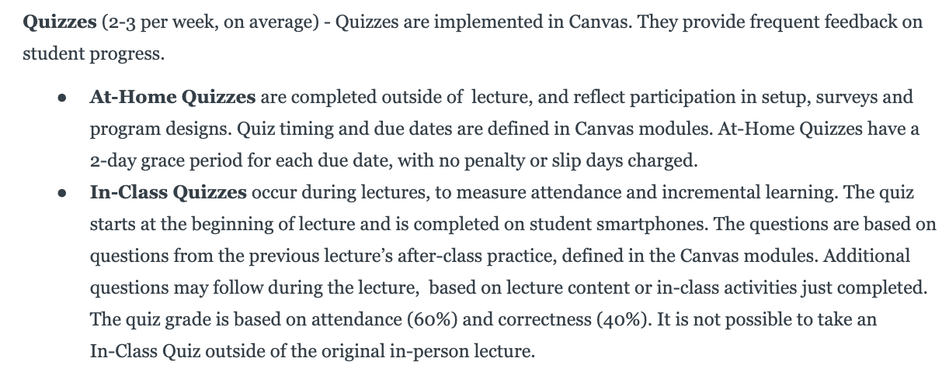
Syllabus One Day at a Time

Slide 4
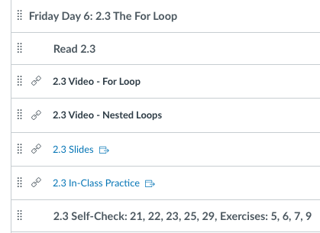
Announcements
TODAY!
Newbies 1pm in GDC 2.410
Design Sessions 2 - 5pm in 3rd floor bridge
In-Class quizzes start on Monday.
Happen first, be on time!
Always a version of previous lecture’s after-class practice.

Slide 5
2.3
The for Loop
Notes:
Session Title: Project Based Learning (PBL) for Equity in CS classes
Session Description: If you are teaching a survey course like Computer Science Principles, or a code intensive course like AP CS A, PBL can serve as a powerful tool to increase student interest and engagement. Learn about research that connects PBL to improved student outcomes, especially for girls and underrepresented minorities. Discover available PBL resources and understand PBL lesson components, so you can build your own.

Slide 6
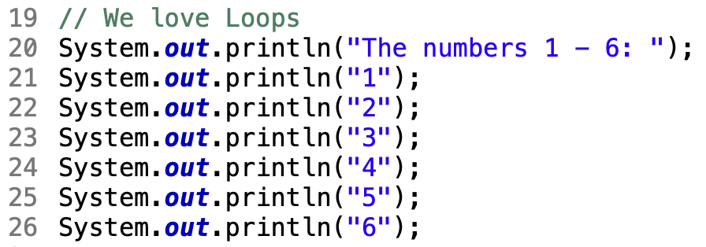
Loops are AWESOME!
This is reasonable:
But, what if we needed to print thousands of numbers?
What would we need to know?
‹#›

Slide 7
Demo
ForLoopExamples.java
demo1()

Slide 8
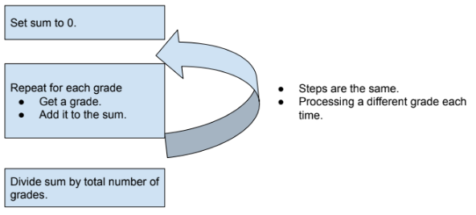
For Loop Concept

Slide 9
Control Structures
The Loop is our first Control Structure. Control Structures alter the default top-to-bottom execution of program statements.
Control Structures:
Loops
Branching (decisions)
continue and break (not used in this course)

Slide 10
Demo
ForLoopExamples.java
demo2()

Slide 11
In-Class Practice
2.3 In-Class Practice
Problems 1 and 2

Slide 12
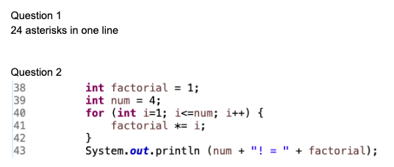
In-Class Practice Answers

Slide 13
Nested For Loops

Slide 14
What About Rows and Columns?
What if I want to print this?
1 2 3 4 5 6 7 8 9 10
11 12 13 14 15 16 17 18 19 20
21 22 23 24 25 26 27 28 29 30
31 32 33 34 35 36 37 38 39 40
41 42 43 44 45 46 47 48 49 50
51 52 53 54 55 56 57 58 59 60
61 62 63 64 65 66 67 68 69 70
71 72 73 74 75 76 77 78 79 80
81 82 83 84 85 86 87 88 89 90
91 92 93 94 95 96 97 98 99 100
A for loop could print the first line. Would I need 10 for loops?

Slide 15
Demo
ForLoopExamples.java
demo3()

Slide 16
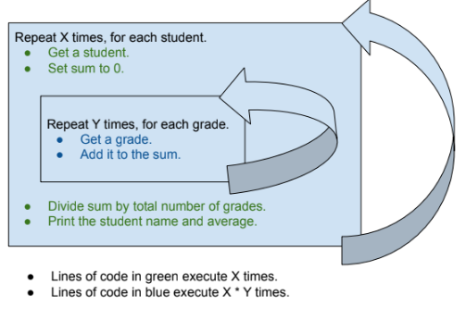
Nested For Loop Concept

Slide 17
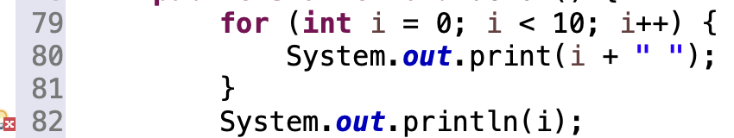
Variable Scope and the for() loop
scope: The part of a program where a variable exists. A variable exists from its declaration to the end of the {} in which it was declared.
‹#›

Slide 18
Demo
ForLoopExamples.java
demo4()

Slide 19
In-Class Practice
2.3 In-Class Practice
Problem 3

Slide 20
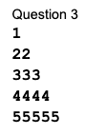
In-Class Practice Answers

Slide 21
Assignment 02 Intro
UT Tower
Notes:
Session Title: Project Based Learning (PBL) for Equity in CS classes
Session Description: If you are teaching a survey course like Computer Science Principles, or a code intensive course like AP CS A, PBL can serve as a powerful tool to increase student interest and engagement. Learn about research that connects PBL to improved student outcomes, especially for girls and underrepresented minorities. Discover available PBL resources and understand PBL lesson components, so you can build your own.

Slide 22
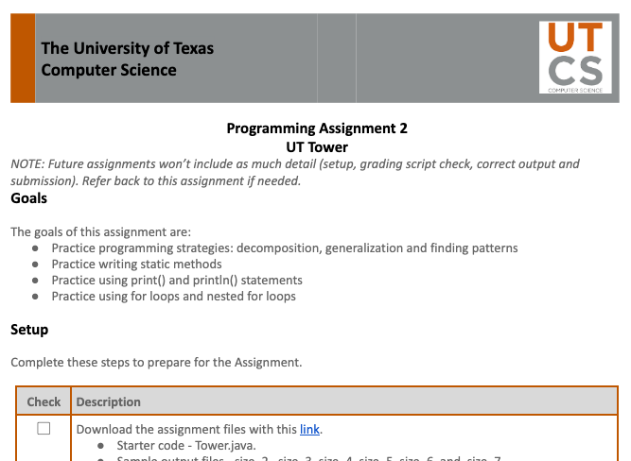
Assignment Instructions

Slide 23
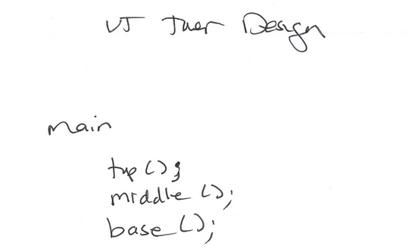
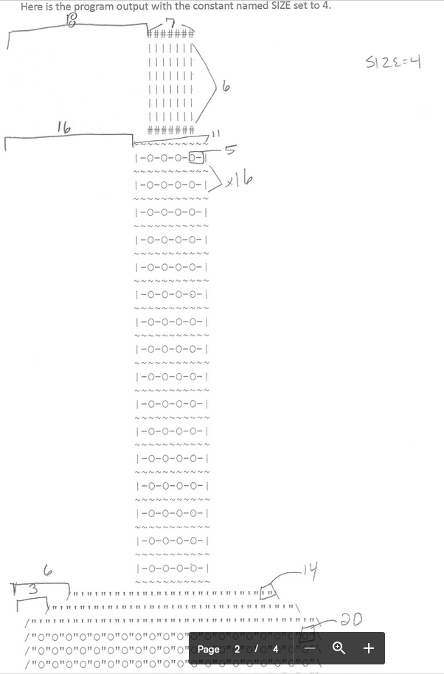
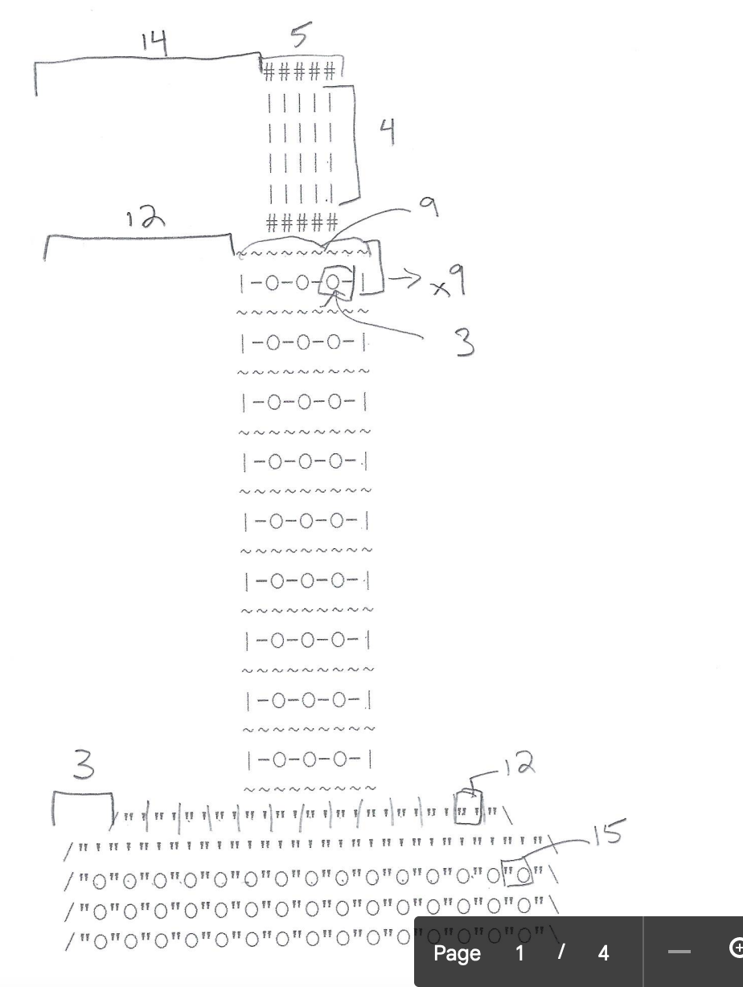
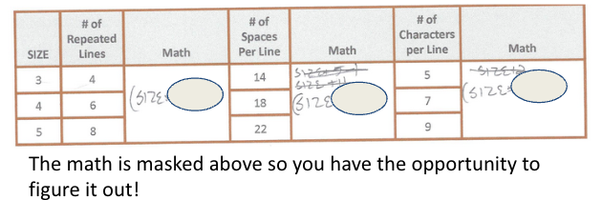
Design Quiz Examples

Slide 24
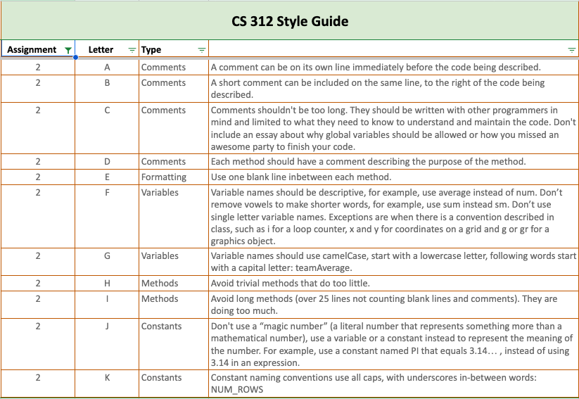
Style Guide - Assignment 02

Slide 25
Remember
In-Class Quizzes start on Monday!
Make a friend in CS (or two).

Slide 26
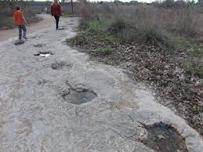
Friday Austin Fun
Olivia Chan
Cypress, Texas
There are dinosaur footprints in Leander that you can just walk right up to. Super cool little day trip to do with friends. Google “dinosaur tracks leander”.

Slide 27
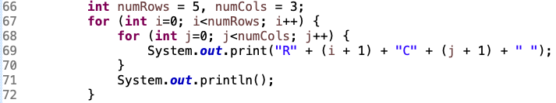
Blueprint - Nested For Loops
Loop | i | j
1 | 0 | 0
2 | 0 | 1
3 | 0 | 2
4 | 1 | 0
5 | 1 | 1
6 | 1 | 2
7 | 2 | 0
8 | 2 | 1
9 | 2 | 2
10 | 3 | 0
11 | 3 | 1
12 | 3 | 2
… | … | …
Two different counters, typically named i, j, k…
Two different counters, typically named i, j, k…, write down what each one means.
Typically, both counters used within the loop.
Typically, both counters used within the loop.
Output
R1C1 R1C2 R1C3 R2C1 R2C2 R2C3 R3C1 R3C2 R3C3 R4C1 R4C2 R4C3 R5C1 R5C2 R5C3

Slide 28

Blueprint - For Loop
1. Initialize: declare and initialize counter variable, traditionally named i, happens one time
2.Test: a true/false expression, loop stops when false, happened at the top of each loop
3. Increment: change the counter value, happens at end of each loop
Output
Loop # = 1, i = 0 Loop # = 2, i = 1 Loop # = 3, i = 2 Loop # = 4, i = 3 Loop # = 5, i = 4 Loop # = 6, i = 5 Loop # = 7, i = 6 Loop # = 8, i = 7 Loop # = 9, i = 8 Loop # = 10, i = 9
Humans count starting at 1.
Computers count starting at 0.
Statements in body of loop enclosed by curly braces.

Slide 29

Blueprint - Counting Loop
1. counter starts at 0.
2. last loop when i = 3.
3. Add one to counter.
You will use this loop a zillion times, only changing the number of times you want the loop to execute.

