Slide 1
Welcome!
‹#›
Notes:
Updates - add quick example of raising your own exception (maybe add that section back into the book), also, can you raise a general exception like in Java?

Slide 2


3.1 Parameters
PROFESSOR RAMSEY
ramsey@cs.utexas.edu
Notes:
maybe add slide 37 back.

Slide 3
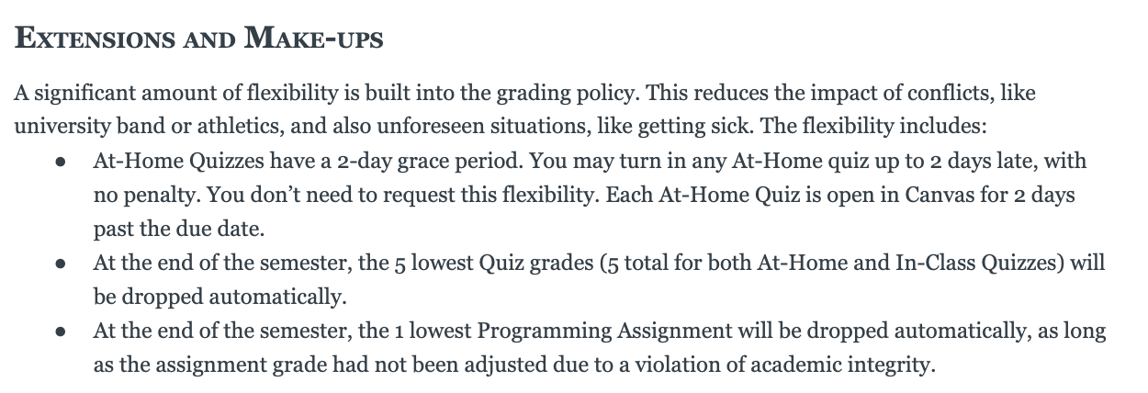
Syllabus One Day at a Time - A

Slide 4
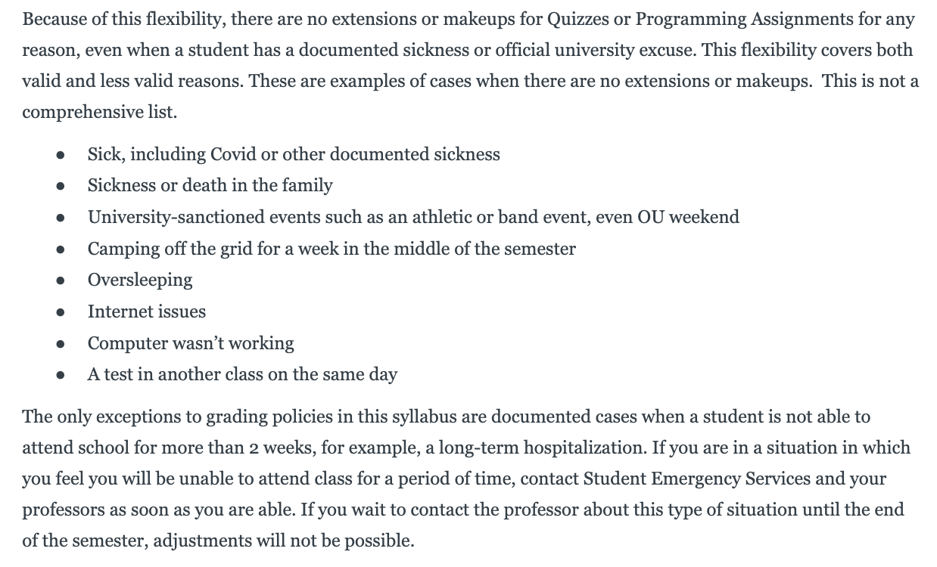
Syllabus One Day at a Time - B

Slide 5
Unit 1 Exam Info
Friday | Weekend | Monday | Tuesday | Wednesday
Design Sessions Fall 2019 Exam Q&A | Meet with Study Group to take Practice Tests | Test Review in Section Practice Test Live! Spring 2023 Exam 7-8:30pm WEL 2.246 | Test Review Fall 2018 Exam 7-8pm WEL 2.246 | Test Review in Lecture TEST* 6:30-8:30pm TBD
* There is an extra time test and a make-up test for students who have been approved ahead of time. There is also an alternate test time for students with a UT testing conflict and who have been approved ahead of time. The day, time and location of these tests will be emailed to the approved students.
‹#›

Slide 6

Quiz

Slide 7
3.1
Parameters
Notes:
Session Title: Project Based Learning (PBL) for Equity in CS classes
Session Description: If you are teaching a survey course like Computer Science Principles, or a code intensive course like AP CS A, PBL can serve as a powerful tool to increase student interest and engagement. Learn about research that connects PBL to improved student outcomes, especially for girls and underrepresented minorities. Discover available PBL resources and understand PBL lesson components, so you can build your own.

Slide 8
ParametersExamples.java
demo1()
What looks off?
Demo

Slide 9
ParametersExamples.java
demo2()
Make it better.
Demo

Slide 10
Using Parameters
parameter: A value passed to a method by its caller.
Using parameters makes a method more re-usable.
With a parameter, the line() method can make a line of any size.
7
main
line
*******
13
line
*************
‹#›

Slide 11
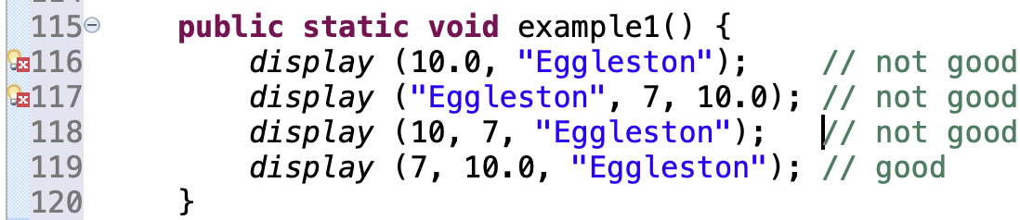
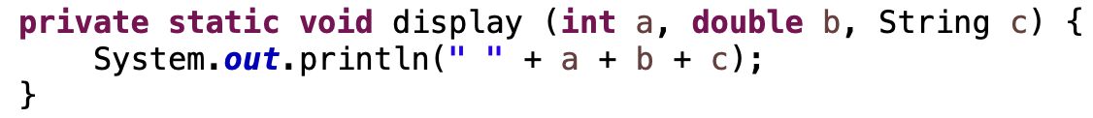

Method Declaration and Call Must Match
Must match in:
number
order
data type
meaning
‹#›

Slide 12
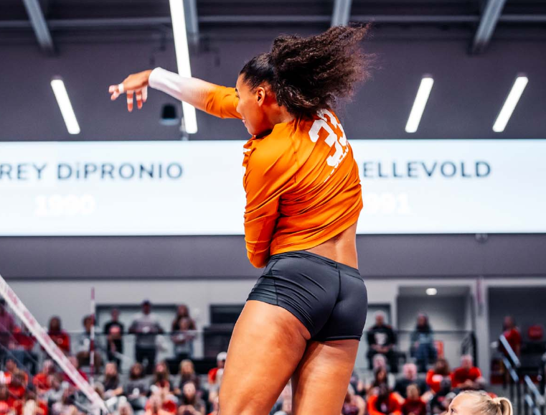
Logan Eggleston

Slide 13
ParametersExamples.java
demo3()
More detail.
Experiment with scope.
Demo

Slide 14
Two Different Memory Stacks
demo3() Memory Stack
player | “Eggleston”
aces | 182
kills | 1921
killsPerSet | 4.29
display() Memory Stack
player | “Eggleston”
careerAces | 182
careerKills | 1921
careerKillsPerSet | 4.29
So far, there isn’t a way to get data back from a method.
‹#›

Slide 15
ArtRocketStart.java
What code is repeated?
What method would reduce repetition?
(don’t write code here)
Demo

Slide 16
In-Class Practice
3.1 In-Class Practice

Slide 17
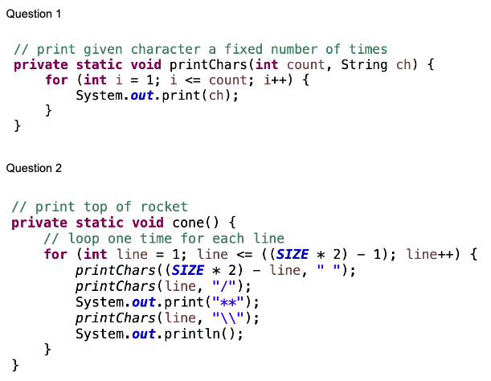
In-Class Practice Answers

Slide 18
Remember
You Belong Here
No

Slide 19
Wednesday UT News
TBD

Slide 20
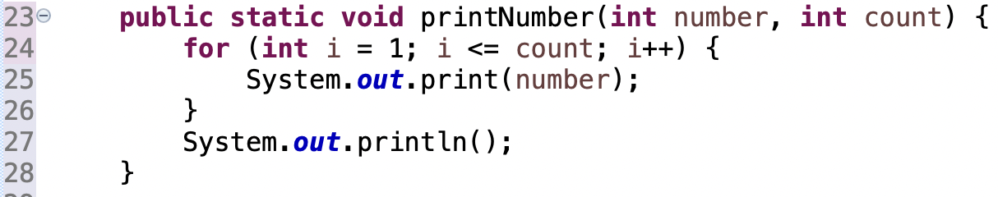
Blueprint - Parameters - Method Declaration
Parameters separated by commas. Data type and order matter.
Parameter names can be the same or different than calling method.
Need data types in method declaration (not method call) because new variables are created here.
A copy of each value is made. Changes made within the method are not reflected in the calling method.
Use each parameter within the method.
Use each parameter within the method.

Slide 21
Blueprint - Parameters - Method Call
List literals or variables to be sent to the method inside the parenthesis, separated by commas.
Don’t include the data type, since the variables are already declared within this scope.

