Slide 1
Welcome!
‹#›
Notes:
Notes: order isn’t good. add more visual examples for Math and String methods.

Slide 2


3.2 Methods that Return Values
3.3 Using Objects
PROFESSOR RAMSEY
GDC 6.318
ramsey@cs.utexas.edu
Notes:
This takes too long

Slide 3
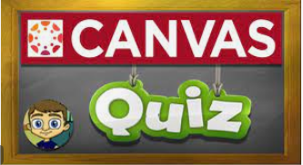
Quiz

Slide 4
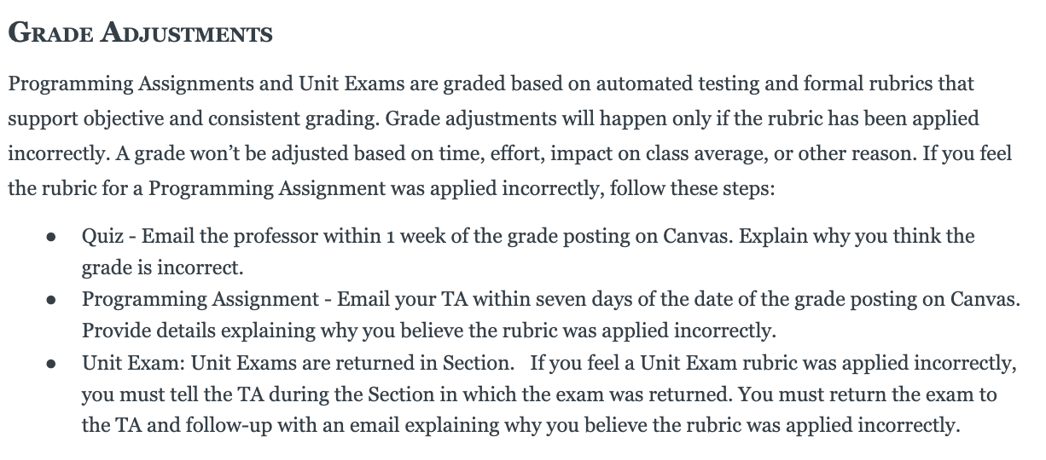
Syllabus One Day at a Time

Slide 5
Announcements
What is your TA’s Name?
TBD

Slide 6
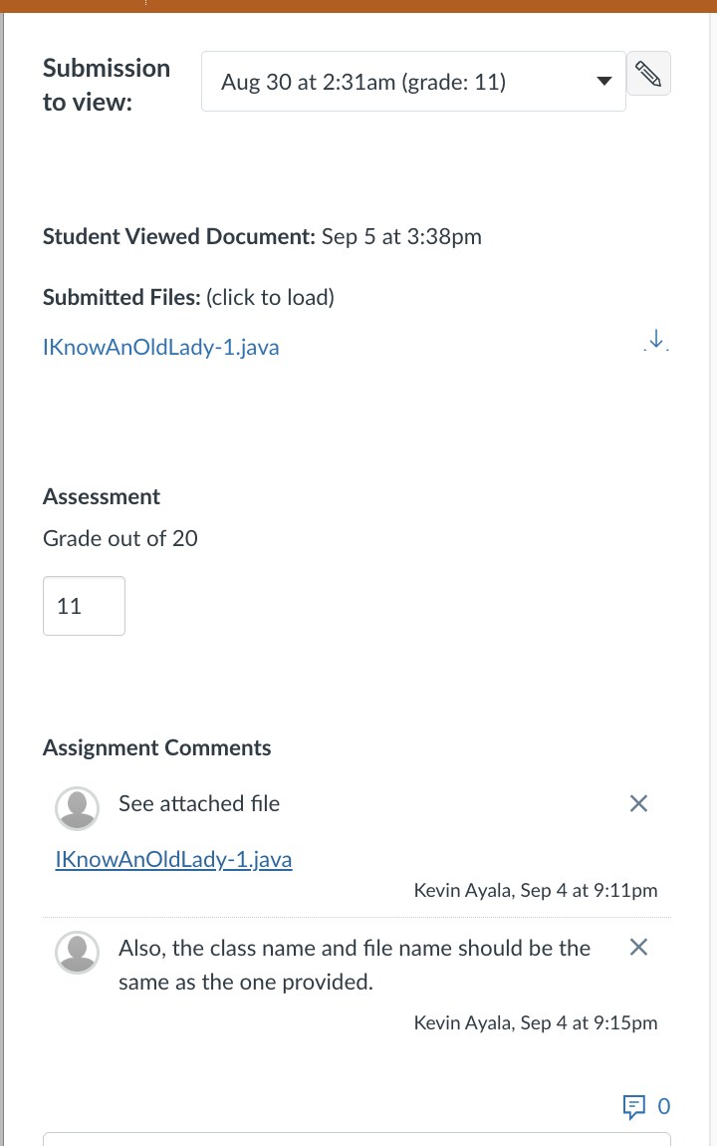
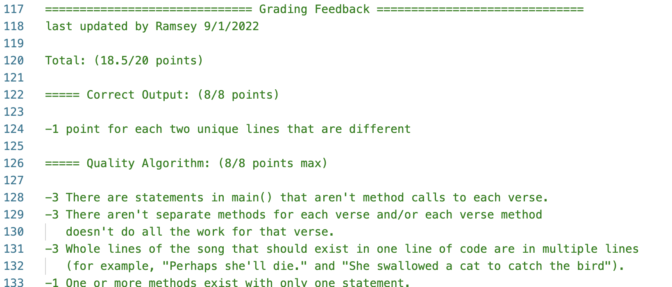
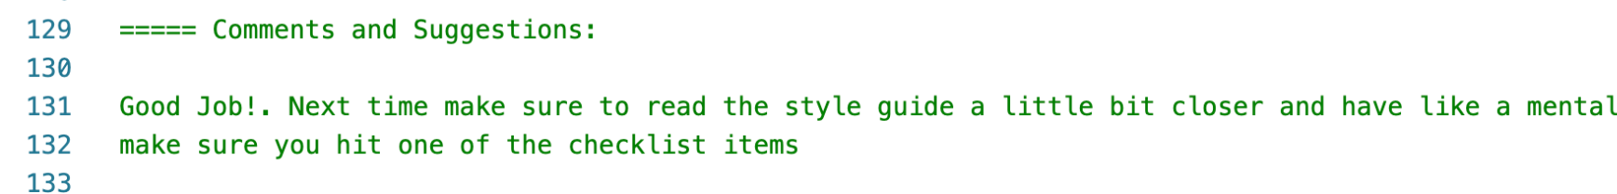
Check for Feedback!

Slide 7
Unit 1 Exam Info
Test covers Chapters 1-3.4. Topics on previous Unit 1 tests not on our test: Graphics, If statement, Scanner, printf and while loop.
Friday | Weekend | Monday | Tuesday | Wednesday
Design Sessions Fall 2019 Exam Q&A | Meet with Study Group to take Practice Tests | Test Review in Section Practice Test Live! Spring 2023 Exam 7-8:30pm WEL 2.246 | Test Review Fall 2018 Exam 7-8pm WEL 2.246 | Test Review in Lecture TEST* 6:30-8:30pm UTC 2.112A
* There is an extra time test and a make-up test for students who have been approved ahead of time. There is also an alternate test time for students with a UT testing conflict and who have been approved ahead of time. The day, time and location of these tests will be emailed to the approved students.
‹#›

Slide 8
3.2
Methods that
Return Values
Notes:
Session Title: Project Based Learning (PBL) for Equity in CS classes
Session Description: If you are teaching a survey course like Computer Science Principles, or a code intensive course like AP CS A, PBL can serve as a powerful tool to increase student interest and engagement. Learn about research that connects PBL to improved student outcomes, especially for girls and underrepresented minorities. Discover available PBL resources and understand PBL lesson components, so you can build your own.

Slide 9
Data and Methods in Java
Type | Examples
Primitive Types | byte, short, int, long, float, double, char, boolean
Java Standard Library | System, String, Graphics, Color, Math, etc.
Objects you create | Can be anything! See Unit 3.
‹#›

Slide 10
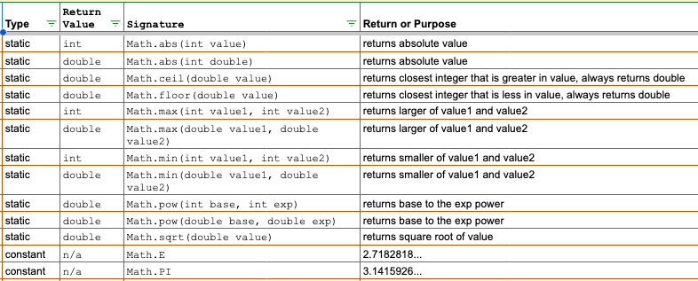
Java Class Reference - Math

Slide 11
Demo
demo1()

Slide 12
The Return
return: To send back a value as the result of a method.
The opposite of a parameter:
    Parameters send information to a method.
    Return values send information back from a method.
-42
Math.abs(-42)
42
main
2.71
3
Math.round(2.71)
‹#›

Slide 13
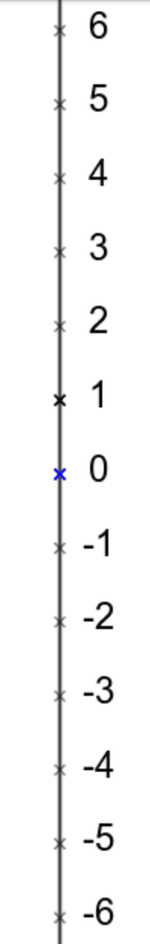

Math.ceil() and Math.floor()
Math.ceil(5.1)
Math.floor(5.7)
Math.ceil(-3.6)
Math.floor(-3.1)
Imagine a room
  ceiling
  floor
For a double number
  ceiling is the closest integer greater in value
  floor is the closest integer less in value
Watch out for negative values

Slide 14
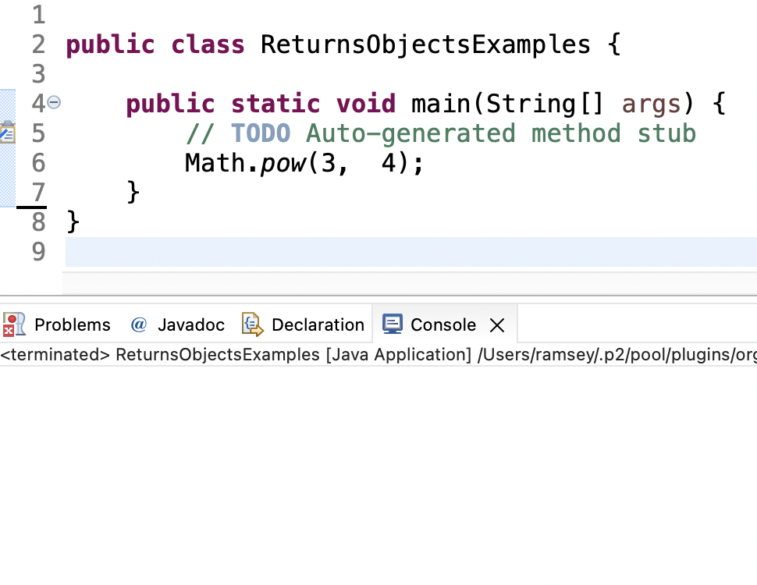
Nothing Happens
The number 81 is lost in space.
81
‹#›

Slide 15
Demo
demo2()
// handle the return
// common errors

Slide 16
Execution and Return Value
32.0
Evaluate right side of equals first.
Calls Math.pow() method with parameters.
At end of Math.pow(), code “returns” 32 and method call is “replaced” with 32.
The return value needs to be assigned or used right away.

Slide 17
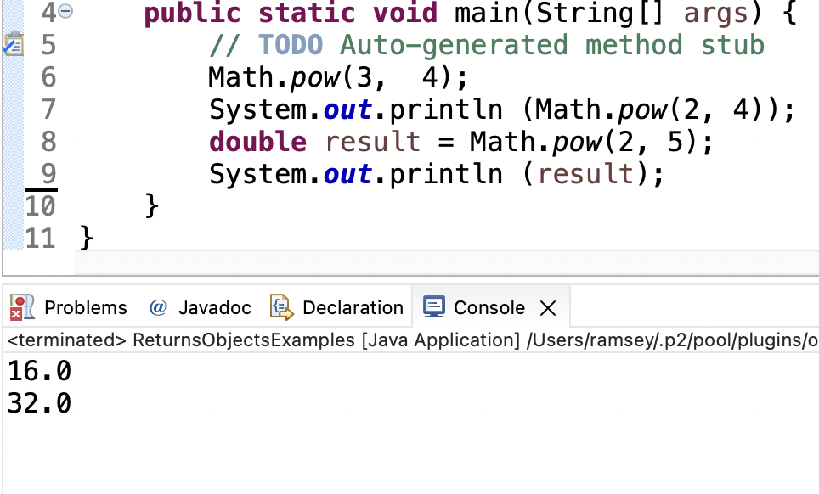
Math Methods use Return Values (EX1)
Need to use or assign the value right away.
‹#›

Slide 18
Demo
demo3()
// fix errors

Slide 19
In-Class Practice
3.2 In-Class Practice
Questions 1 and 2

Slide 20
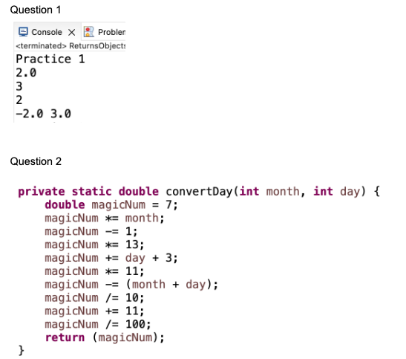
In-Class Practice Answers

Slide 21
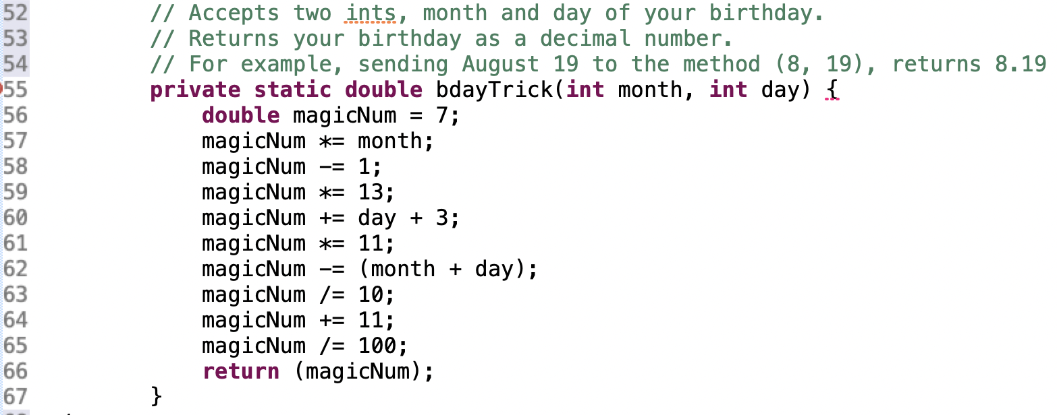
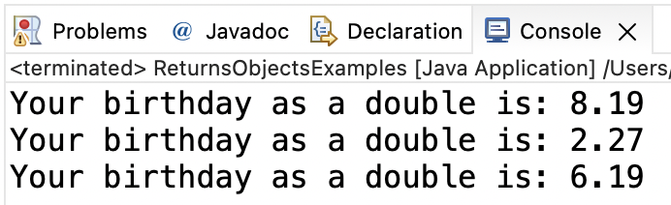
Answer
Write a print statement that calls this method and prints the results.
‹#›

Slide 22
Demo
Write a print statement that calls this method and prints the results.
Problem courtesy of Dr. Mike’s math games for kids: https://www.dr-mikes-math-games-for-kids.com/magical-calculator-birthday-math-trick.html
‹#›

Slide 23
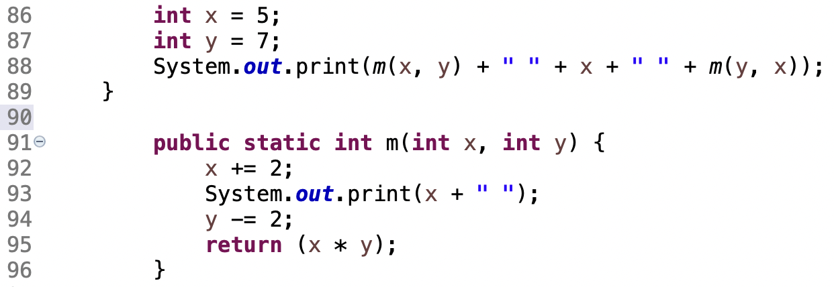
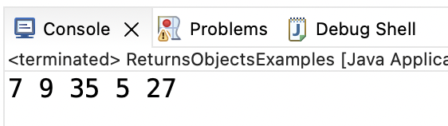
Tricky Methods
What is the output?
‹#›

Slide 24
3.3
Using Objects
Notes:
Session Title: Project Based Learning (PBL) for Equity in CS classes
Session Description: If you are teaching a survey course like Computer Science Principles, or a code intensive course like AP CS A, PBL can serve as a powerful tool to increase student interest and engagement. Learn about research that connects PBL to improved student outcomes, especially for girls and underrepresented minorities. Discover available PBL resources and understand PBL lesson components, so you can build your own.

Slide 25
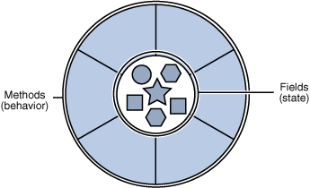
Review - Objects
object: An entity that contains data and behavior.
data - variables inside the object
behavior - methods called on object
You interact with the methods.
The data is hidden in the object.
A class is a data type. You make your own!
‹#›
Notes:
‹#›

Slide 26
Graphics, Math and String Classes
Graphics
Data | object to draw on current color current font object shapes
Behavior | drawRect() fillRect() setColor() getColor() drawImage()
Math
Data | none, a static class
Behavior | abs() pow() sqrt() round()
String
Data | characters
Behavior | charAt() indexOf() length() substring() toUpperCase() toLowerCase()
Must create an object Do not create an object Must create an object
gr.drawRect() result = Math.abs(-7) str.charAt(12)

Slide 27
String Objects
Characters of a string are numbered with 0-based indexes:
String name = "P. Diddy";
– name at index 0 isn ‘P’, name at index 7 == ‘y’
– First character's index : 0
–Last character's index : 1 less than the string's length
–The individual characters are values of type char (seen later)
index | 0 | 1 | 2 | 3 | 4 | 5 | 6 | 7
character | P | . |  | D | i | d | d | y
‹#›
Notes:
‹#›

Slide 28
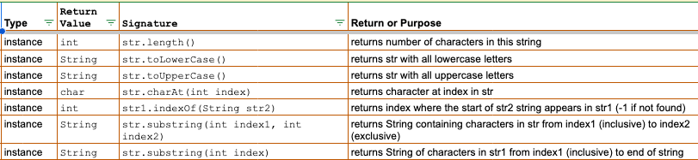
Java Class Reference - String

Slide 29
demo1()
Demo

Slide 30
Instance Methods vs. Static Methods
static - no variable exists to change, a value is returned
instance - a variable exists that is changed by the method. A value might also be returned.

Slide 31
In-Class Practice
3.2 In-Class Practice
Question 3

Slide 32
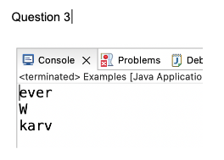
In-Class Practice Answers

Slide 33
System Object
interactive program: Reads input from the console.
truth: Users are nothing but trouble. Commercial software cleans every user input to reject: honest mistakes, goofy behavior and hacking attempts.
Scanner: An object that can read input from many sources (keyboard, files, databases, etc.).
‹#›

Slide 34

Java Class Reference - Scanner

Slide 35
Input tokens
input token: A unit of user input, as read by the Scanner.
Tokens are separated by whitespace (spaces, tabs, new lines).
How many tokens appear on the following line of input?
  23 John Smith 42.0 "Hello world" $2.50
‹#›

Slide 36
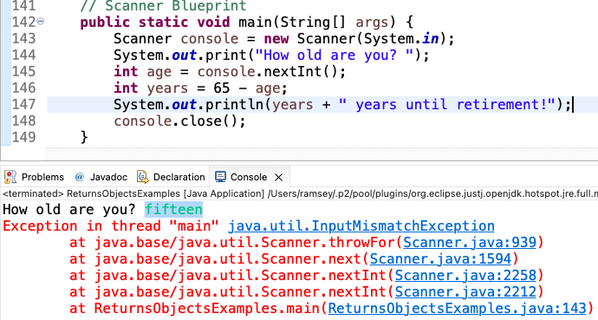
Beware of the User
‹#›

Slide 37
Remember
You Belong Here
Practice is your friend.

Slide 38
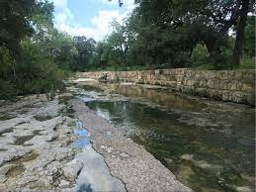
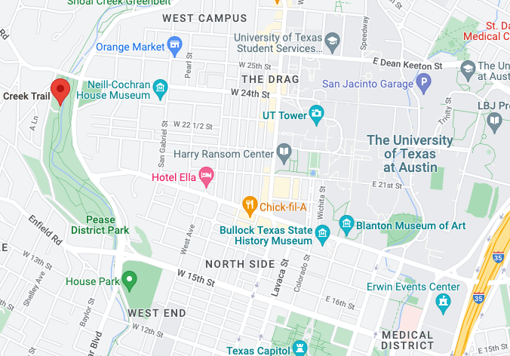
Friday Fun in Austin
Shoal Creek
Head west from campus on 24th street. Cross light at Lamar. Look for walking trail.

Slide 39
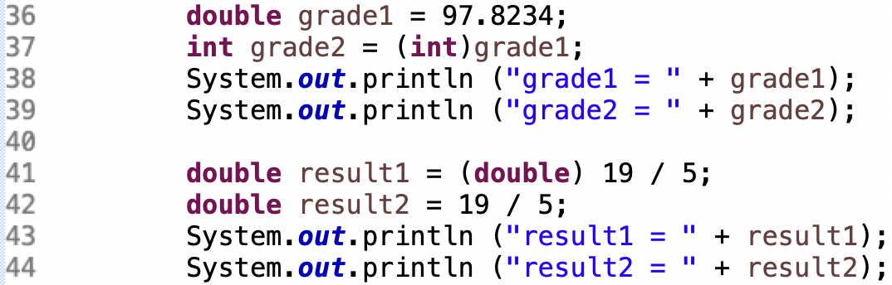
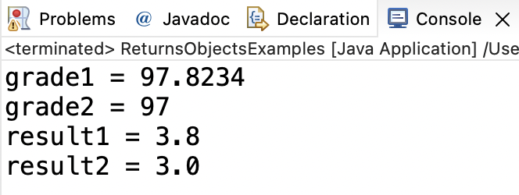
Blueprint - Type Casting
The type to be cast to, inside parenthesis and in front of the number or variable.
The type to be cast to, inside parenthesis and in front of the number or variable.
Casting a double to an int truncates the decimal portion of the number.
Casting only impacts the literal or variable number immediately next to it.

Slide 40
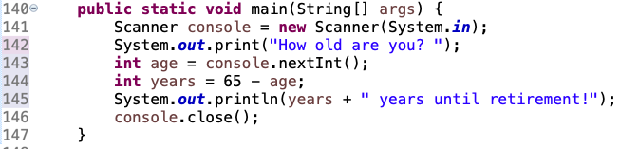

Blueprint - Scanner
Import the Scanner class.
Create a new Scanner.
Accept input from the user.
Close the Scanner.

Slide 41
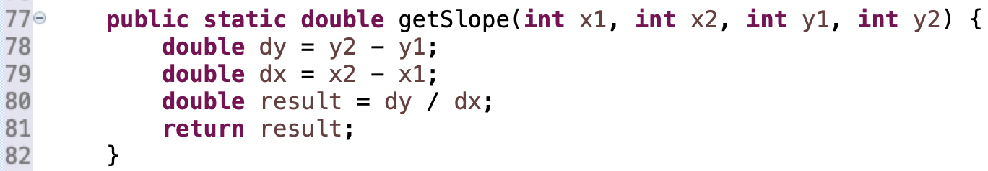
Blueprint - Method Declaration and Call
Memorandum of Understanding (MOU)
Method Call Method Declaration
Same method name, followed by parenthesis.
Same method name, followed by parenthesis
Same number, type, order and meaning of parameters
Same number, type, order and meaning of parameters
Either no return, or a return of the same type.
Either no return, or a return of the same type.

