Slide 1
Welcome!
‹#›
Notes:
Updates - add quick example of raising your own exception (maybe add that section back into the book), also, can you raise a general exception like in Java?

Slide 2


1.1 Basic Computing Concepts
1.2 And Now - Java
1.3 Program Errors
PROFESSOR RAMSEY
ramsey@cs.utexas.edu

Slide 3



Slide 4
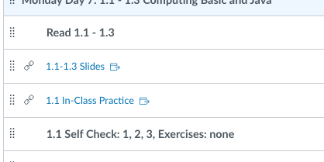
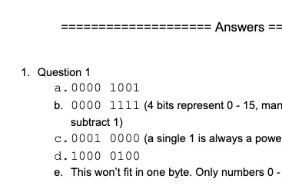
In-Class Practice, After Class
Solutions included

Slide 5

Quiz

Slide 6
1.1
Basic Computing
Concepts

Slide 7
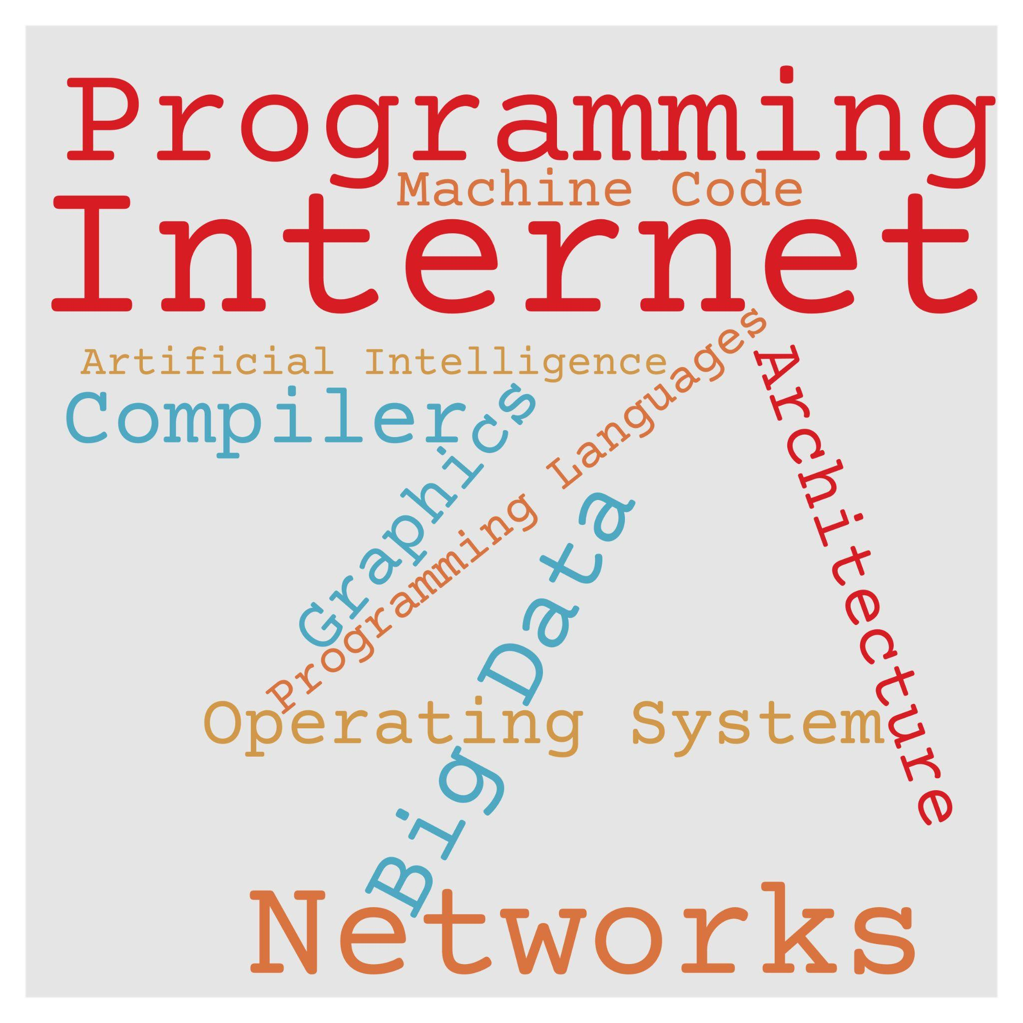
Computer Science
We learn programming first, because it’s the tool that lets us do the rest.

Slide 8
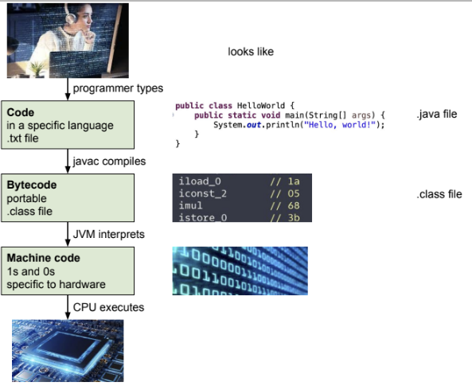
Programming Languages

Slide 9
All About Binary

Slide 10
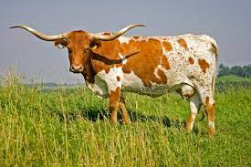
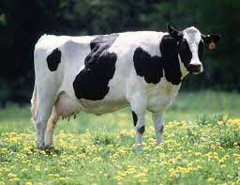
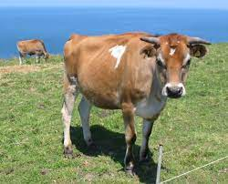
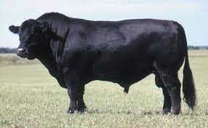
Wait a second! Why binary?
Longhorn
Jersey
Holstein
Angus

Slide 11
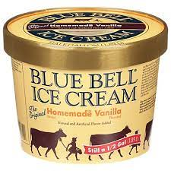
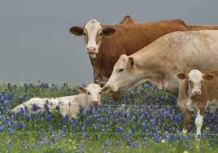
Happiest Cows

Slide 12
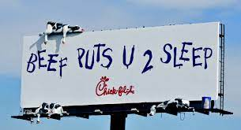
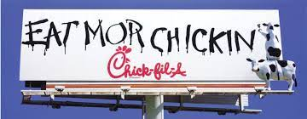
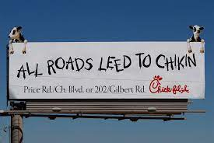
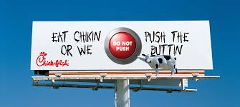
Cow Activists

Slide 13
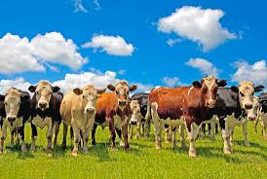
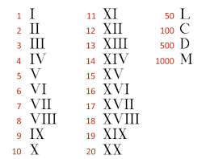
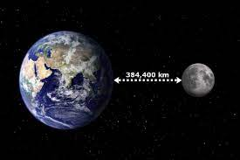
The Trouble With Roman Numerals
Works=>
Doesn’t work=>

Slide 14
The Wild Claim…
My number system has a finite number of digits, but can represent any number, no matter how large, even to the moon and back a million times.

Slide 15
The Secret
If you have 10 digits, count in groups of 1, 10, 100, 1000, etc.
Given 634 cows:
How many groups of 100 cows? 6
How many groups of 10 cows? 3
How many single cows? 4
Base 10
_______ ___6___ ___3___ ___4___
10³ 10² 10¹ 10⁰
1000 100 10 1

Slide 16
Place Value Number Systems
Base 10
_______ _______ _______ _______
10³ 10² 10¹ 10⁰
1000 100 10 1
Base 2
_____ _____ _____ _____ _____ _____ _____ _____
2⁷ 2⁶ 2⁵ 2⁴ 2³ 2² 2¹ 2⁰
128 64 32 16 8 4 2 1

Slide 17
Do You Believe It?
2
16
By adding these
numbers,
I can get these numbers:
7
99
247
32
128
64
1
8
4

Slide 18
Do You Believe It?
2
16
By adding these numbers, I can get these numbers:
7
99
247
32
128
64
1
8
4

Slide 19
Do You Believe It?
2
16
By adding these numbers, I can get these numbers:
7
99
247
32
128
64
1
8
4

Slide 20
Do You Believe It?
2
16
By adding these numbers, I can get these numbers:
7
99
247
I can get any number between 0 and 255.
32
128
64
1
8
4

Slide 21
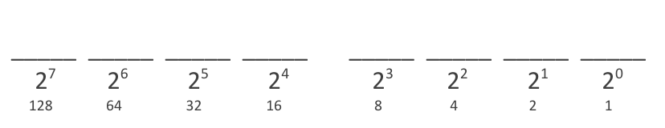
Convert decimal to binary Demo
Self-Check 1.2
6
44
72
131
Answers
0000 0110
0010 1100
0100 1000
1000 0011

Slide 22
Convert binary to decimal Demo
Self-Check 1.3
0000 0100
0000 1011
0010 1010
0100 1110
Answers
4
11
42
78
Notes:
4
11
42
78

Slide 23
In-Class Practice
Day 8 1.1 In-Class Practice

Slide 24
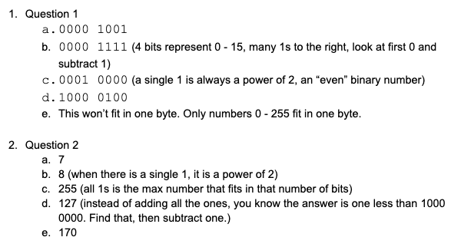
In-Class Practice Answers

Slide 25
Remember - It’s All 1s and 0s
Inside, it’s all 1s and 0s
h 01101000
"hi" 0110100001101001
104 01101000
How can the computer tell the difference between an h and 104?
In general, the earlier bits specify how to interpret the following bits.
In Java, we define a type for each data item: integer, decimal, String, character, etc.
‹#›

Slide 26
Remember - Primitive Types
Type | Description | Examples | Memory | Min and Max
int | positive and negative integers up to 2³¹ - 1 | 42, -3, 0, 387733 | 4 bytes | min: -2,147,483,648 max: 2,147,483,647 (but 32 1s equals 4,294,967,295)
double | positive and negative decimal numbers up to 10³⁰⁸ | 3.0, -0.0004, 14.81e3 | 8 bytes | min: 1.79769313486231570e+308 max: 2.2250738585072014e-308
char | single character | ‘a’, ‘X’, ‘?’ | 2 bytes | all characters in ASCII table
boolean | true or false | true, false | 1 byte (padded) | true or false
‹#›
Notes:
‹#›
We're basically going to manipulate letters and numbers.
We make the integer / real number distinction in English as well. We don't ask, "How many do you weigh?" or, "How much sisters do you have?"
Part of the int/double split is related to how a computer processor crunches numbers. A CPU does integer computations and a Floating Point Unit (FPU) does real number computations.
Why does Java separate int and double? Why not use one combined type called number?

Slide 27
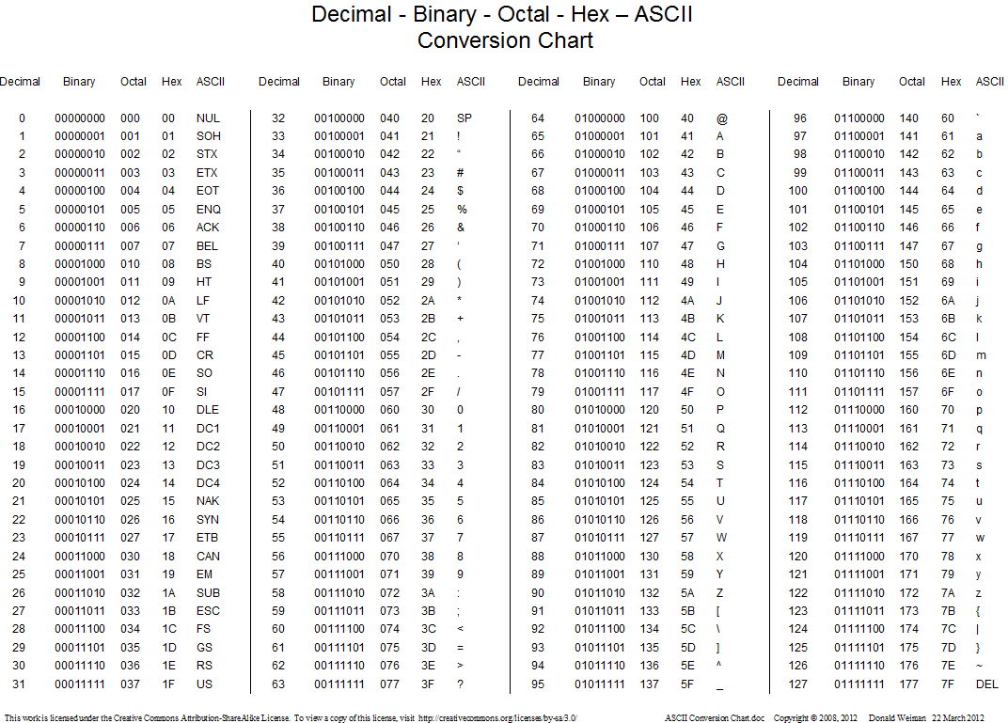
ASCII Table

Slide 28
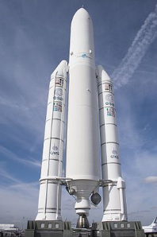
Why Does It Matter?
We don’t code in 1s and 0s.
But, sometimes 1s and 0s make an appearance.
How integers and decimal numbers are represented.
Overflow and round-off errors.
The burnt orange color on this slide header is represented by #BF5700, or
1011 1111 0101 0111 0000 0000
One of Google’s IPV4 addresses is 173.194.255.255, which is also
10101101.11000010.11111111.11111111
Voting machine off by 1,024 votes, exactly one bit. What does that mean? Bit Flip - Radio Lab
The Ariane 5 rocket was lost to a software overflow error. More info here.

Slide 29
Types of Errors
int - If a number assigned to an int is too large or too small to fit, it cause overflow error.
double - If a number has to many significant digits in base or exponent, it will cause an overflow error.
double - If a fractional number is repeating in binary, it’s representation will be slightly off.

Slide 30
But, Why Binary?

Slide 31
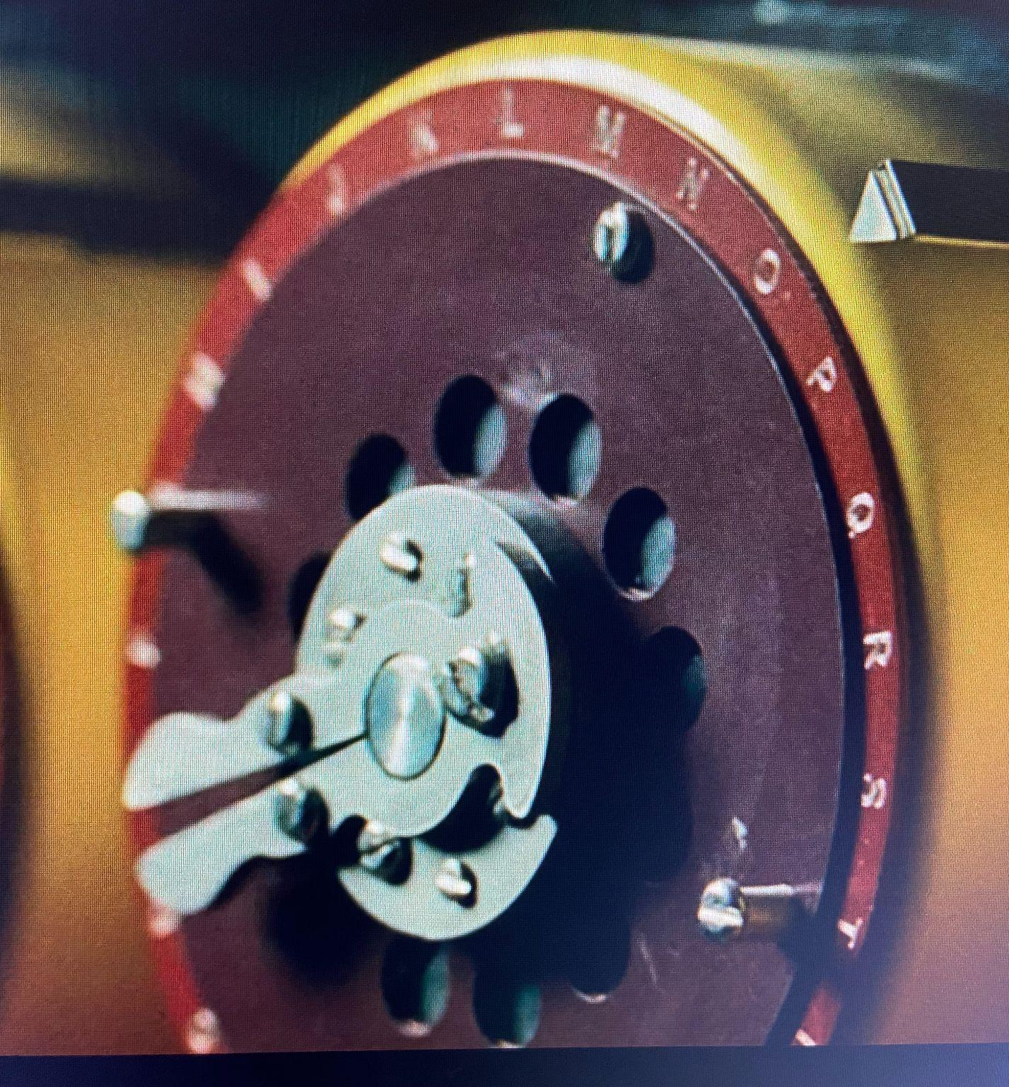
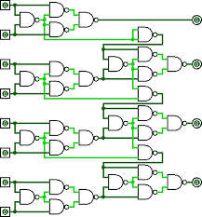
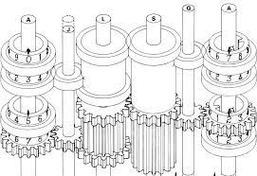
Old way: Mechanical gears with each notch representing a number or letter, this machine can solve one problem.
New way: Electricity on or off in patterns represents anything and can solve any problem (well, mostly).
A gear with notches representing numbers, from Babbage’s design for the Analytical Engine.
A gear with notches representing letters, from the British Bomb, a machine designed by Alan Turning to decrypt German Enigma messages during WWII.
An adding machine using electricity flowing through logic gates

Slide 32
1.3
Program Errors
Notes:
Session Title: Project Based Learning (PBL) for Equity in CS classes
Session Description: If you are teaching a survey course like Computer Science Principles, or a code intensive course like AP CS A, PBL can serve as a powerful tool to increase student interest and engagement. Learn about research that connects PBL to improved student outcomes, especially for girls and underrepresented minorities. Discover available PBL resources and understand PBL lesson components, so you can build your own.

Slide 33
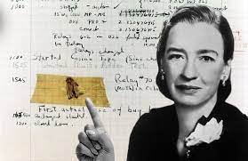
Everyone Has Bugs

Slide 34
Syntax Error
syntax: The set of legal structures and commands
that can be used in a particular language. (Similar to spelling and grammar in a natural language.)
syntax error: A problem in the structure of a program that causes the compiler to fail.
– Missing semicolon
– Too many or too few { } braces, braces not matching
– Class and file names do not match

Slide 35
Runtime Errors
runtime error: A programming error that does not violate rules of the language, but causes undesired behavior while running. Examples:
Program crashes (divide by 0)
Incorrect output is given (a sum is printed when the user expects an average)

Slide 36
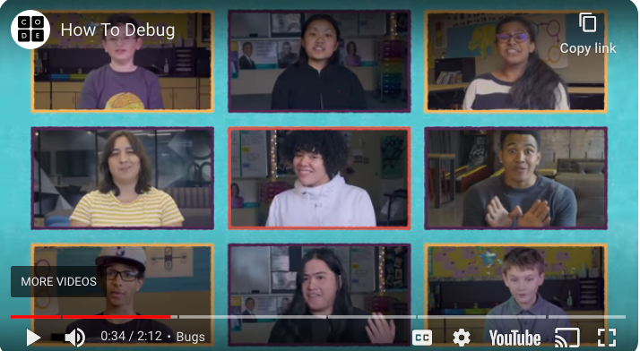
Everyone Gets Bugs

Slide 37
Coding Timeline - Not Good
Glance at the instructions.
Write 50 lines of code at one time.
Submit!

Slide 38

Coding Timeline - Good
Design
Understand the instructions
Solve the problem on paper
Decide what main() does
Outline the method breakdown
Code-Test-Fix one method at a time
Test with different inputs
Run test cases

Slide 39

Coding Timeline - Even Better

Slide 40
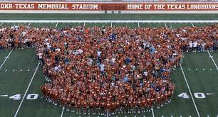
Class Photo

Slide 41
Remember
You Belong Here

Slide 42
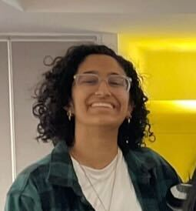
Monday CS Tip
Rumor: TAs are scary and everyone else knows everything.
NOT TRUE!!!
Minerva Sharma

