Slide 1
Harvesting Verifiable Challenges from Oblivious Online Sources
J. Alex Halderman Brent Waters
Princeton University SRI International

Slide 2
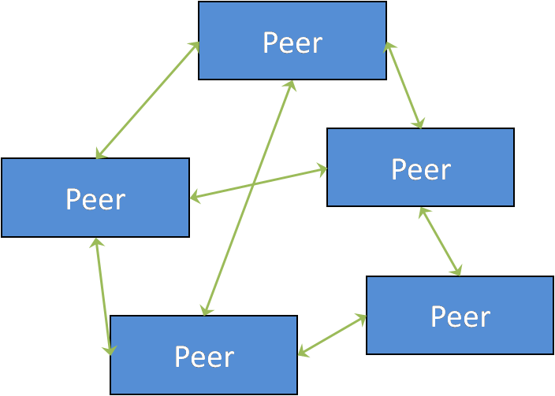

Complete audit expensive → seek probabilistic guarantee
Who chooses what to audit?
Notes:
In systems, frequently want to verify some property of a system.
Distributed storage system – nodes actually storing data
Election system – machine counting accurately
Peer-to-peer network – peers have distinct identities
Often expensive to conduct a complete audit, so choose a subset to check and seek a probabilistic guarantee
Question is: Who chooses the what to audit? Require a trustworthy source of randomness, so adversary can’t cheat
Let’s look deeper into one example: Using client puzzles to protect against P2P Sybil attacks

Slide 3
Motivating Example
Peer
Peer
Peer
Peer
Peer
Peer
Peer
Peer
Peer
Peer

Slide 4
Sybil Attack
Peer
Peer
Peer
Peer
Peer
Peer
Peer
Peer
Peer
Peer
Defense: Require each peer to expend resources (CPU time).
Verify probabilistically?
One machine,
multiple identities

Slide 5

Proof of Work: Client Puzzles
Challenge
Solver
Challenger
Solution
Verify
Puzzle Server
Verifier 1
Challenge,
Certificate
Verify
Sol., Chal., Cert.
Solver
Verifier 2
Sol., Chal., Cert.
Verify

Slide 6
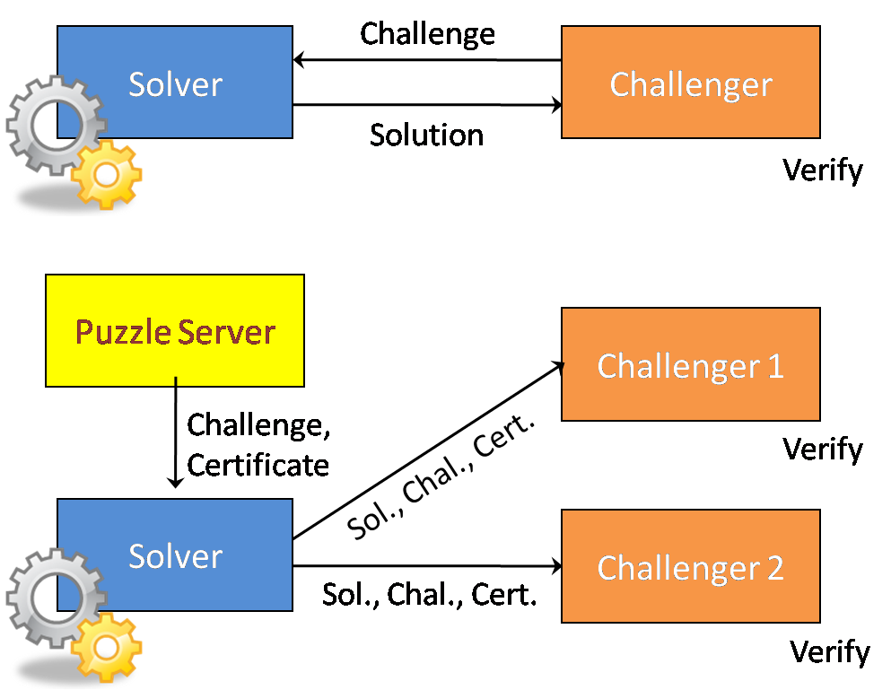
P2P Client Puzzles?
Solve puzzle once for many (unknown) challengers
Decentralized: no puzzle server

Slide 7
Our Approach: Harvested Challenges
Unified tool and framework for producing random challenges from oblivious sources
  Decentralized
  Noninteractive
  Reusable
Useful for many verification applications

Slide 8

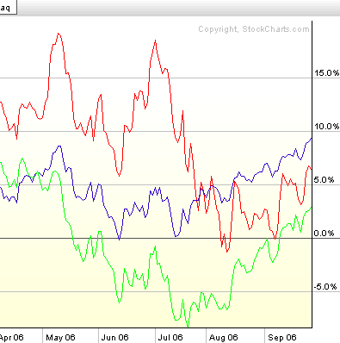
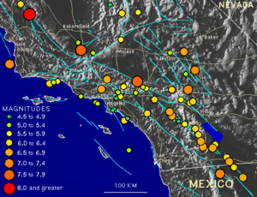
Oblivious Online Sources
RSS Feeds
(news stories,
blogs posts, …)
Financial Data
(market prices,
volumes, …)
Physical Observations
(weather, earthquakes,
sunspots, …)
Abstraction: Logs of discrete items, appended over time
Difficult to control or predict before published
*Past items stable, accessible for some period
Notes:
Widely published
* As you’ll see, we’re able to tolerate an amount of instability and unreliability

Slide 9
Harvesting Challenges
Slashdot
Puzzle Server
NYTimes
Stock Quotes
Challenge,
Certificate
Solver
Verifier
Derivation,
Solution
Sol., Chal., Cert.
Verify
Puzzle server replaced by oblivious Internet sources
Solver derives challenges from sources’ fresh content
Verifiers check source content to confirm derivation
Notes:
I’ll introduce the technique by illustrating how it can be used in a client puzzle application
Data sources that are widely published, regularly updated, and mostly beyond adversarial prediction or control

Slide 10
Using Source Data
4:00 Item 1
4:15 Item 2
4:30 Item 3
4:45 Item 4
5:00 Item 5
5:15 Item 6
5:30 Item 7
5:45 Item 8
6:00 Item 9
5:00 Item 5
5:15 Item 6
5:30 Item 7
5:45 Item 8 Revised Item 8
6:00 Item 9
6:15 Item 10
6:30 Item 11
6:45 Item 12
7:00 Item 13
Mismatch:
Take Deriver’s word?
6 P.M. − Deriver harvests challenge
7 P.M. − Verifier verifies challenge
Challenge := H( )
Derivation :=
Challenge := H( )
Robustness vs. Security: Adversary controls some inputs
Notes:
Robustness – need to use real data, real data is going to change
Security – adversary gains control of some inputs to our hash function

Slide 11

OS X Leopard Firewall Flawed
Ubuntu Killing Your Hard Drive
Claim of a Blu-ray BD+ Crack
a936b29d497
Random Oracle
Notes:
Model hash function as a random oracle, so a different value comes out each time the adversary throws stuff in

Slide 12
OS X Leopard Firewall Flawed
000000000000000000000000
Claim of a Blu-ray BD+ Crack
18e039ca12b
a936b29d497
Random Oracle
Notes:
Gets to pick some data from a subset of the actual content, and he gets to throw in some other stuff that he chooses

Slide 13
OS X Leopard Firewall Flawed
000000000000000000000001
Claim of a Blu-ray BD+ Crack
6400dd3fc1a
Adversary gets
to pick from
bounded set
18e039ca12b
a936b29d497
Random Oracle
Notes:
Limited by number of calls he gets to make – starts when freshest unpredictable data is published, ends at verification
Applications need to tolerate this – ability to choose among q random strings not a big deal, as long as strings are not known in advance

Slide 14

1% sample from set with 10% fraud
Notes:
As beads become finer, adversary has an exponentially small probability of success, so finding a challenge that will allow fraud becomes intractable

Slide 15
Application Policies
Derivers and verifiers share a common policy
Sources: where content will be harvested
Conditions: what source content will be acceptable for application purposes
  Quantity
  Freshness
Policies: acceptable combinations of content from different sources
Notes:
Different applications will have different security requirements, select different robustness vs. security tradeoffs
We’ve created a policy specification language

Slide 16
Source: RSS Feed
source NYTimes (
type = RSSFeed
url = “http://nytimes.com/stories.xml”
min_entries = 5
max_entries = 20
max_age = 86400
)

Slide 17
Source: Stock Quotes
source TechStocks(
type = DailyQuotes
symbols = “GOOG,YHOO,MSFT,INTC,IBM”
min_entries = 4
)

Slide 18
Policies
policy PickOne { NYTimes, CNN, Slashdot }
policy PickTwo { NYTimes, CNN, Slashdot }[2,2]

Slide 19
Complex Policy
policy Nested {
{ NYTimes, CNN, Slashdot }[2,2],
Recent
}
policy Recent {
NYTimes(min_entries=1, max_age=3600)
CNN(min_entries=1, max_age=3600)
}[2,2]

Slide 20
Our Implementation: “Combine”
Python API and command line utility
Open source
Supports RSS feeds, stock prices,
dedicated beacons
Extensible

Slide 21
Combine Usage
$combine –policyfile example.pol –derivation alice.d –derive
derived: Example, a936b29d497…, 1169960994
$combine –policyfile example.pol –derivation alice.d –verify
verified: Example, a936b29d497…, 1169960994
(or failure)

Slide 22
Experimental Evaluation
RSS feeds suitability?
  Availability?
  Rate of new posts?
  Time before posts age out?
  Frequency old posts are changed?
Monitored 275 “popular” and “longtail” feeds
Simulated satisfaction of policies

Slide 23
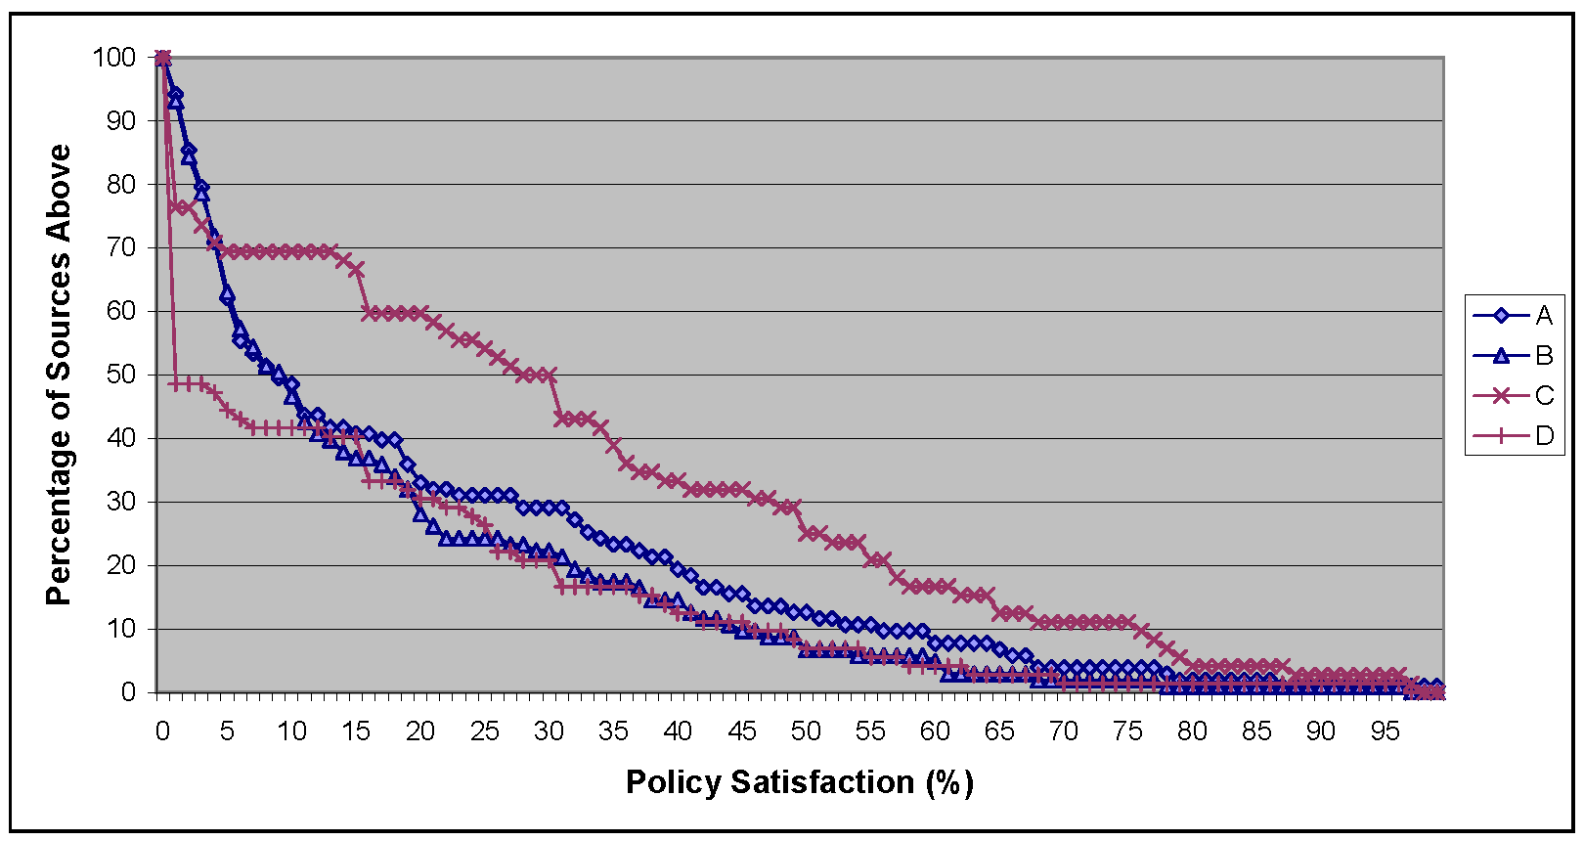
Results: RSS Feed Suitability
Fresh within one hour, verifiable 6 hours later
Fresh within one hour, verifiable 12 hours later
Fresh within one day, verifiable 7 days later
Fresh within one day, verifiable 14 days later
Notes:
Depending on the policy, between 7 and 25% of feeds satisfied the policy at least 50% of the time

Slide 24
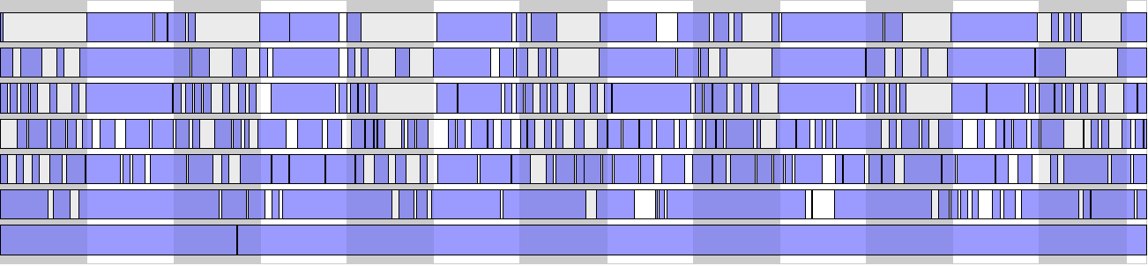

Satisfaction periods for policy “Short”
7 RSS Sources
Satisfaction periods for policy “Long”
7 RSS Sources
7 Days
Notes:
Combining 7 sources gives 100% satisfaction over a 7 day period.
Low quality sources like RSS feeds can be combined redundantly to provide high satisfaction.

Slide 25
Conclusion
Harvested challenges: a general tool to aid in randomly auditing systems
  Create and verify challenges noninteractively using data from oblivious sources
“Combine” library and policy language, available for use
Future: building applications

Slide 26
Harvesting Verifiable Challenges from Oblivious Online Sources
J. Alex Halderman Brent Waters
www.cs.princeton.edu/~jhalderm/projects/combine/

Slide 27


Harvesting Challenges
Item 1
Source 1
Item 3
Source 2
Source 2
Source 1
Derivation
✓
Item 1
Item 1: Source 1, Hash, Time
✓
Item 2: Source 1, Hash, Time
Deriver
✗
Verifier
Item 3: Source 1, Hash, Time
≠
✓
=
Item 4: Source 2, Hash, Time
✓
Item 1
Item 5: Source 2, Hash, Time
…
Item 3
Policy:
Policy:
Freshness?
Matches derivation?
Uses challenge
Freshness?
Max quantity?
Challenge := H(Derivation)
Satisfied?
Uses challenge

