Slide 1
Math 340L - CS
What’s this all about?

Slide 2
What Shall We Do Today?

Slide 3
What Shall We Do Today?
Option 1:
Get an Introduction to the course.

Slide 4
What Shall We Do Today?
Option 2:
Sing some of your favorite campfire songs.

Slide 5
Important Stuff
Course: Math 340LMatrices and Matrix Calculations
Time: T-TH 9:30-11:00 in WAG 201
Instructor: A. K. Cline
Office: GDH 5.808
Office Hours: Tu 11-12, W 11-12, F 1-2, and by appointment
Web Site: http://www.cs.utexas.edu/users/cline/M340L/
Email: cline@cs.utexas.edu
Assistant: Jillian Fisher
Office: TBD
Office Hours: TBD
Email: fisherjillian@ymail.com

Slide 6
Text and Video Lectures
Text: Linear Algebra and its Applications, 4th or 5th ed., by David C. Lay.
Gilbert Strang’s lectures based upon his book may be found at http://ocw.mit.edu/courses/mathematics/18-06-linear-algebra-spring-2010/

Slide 7
Comments
1. Good homework cannot make up for poor exams nor good exams for poor homework. To do well in the course grade, students must have good homework and exams.
2. There will be approximately one set of homework problems assigned each week. These will be submitted electronically due at 9:30, the beginning of the following class. Solutions for each problem set will be distributed.
3. An excellent summary of expectations is found at http://www.cs.utexas.edu/users/ear/CodeOfConduct.html

Slide 8
Homework Specifications
1. Your solutions must be legible. If your writing is not legible, use a word processor.
2. Every sentence - even those using mathematical notation - must be readable. There must be clear subjects and verbs - not just random phrases.
3. Criticize your own solutions. You should be learning not only how to create solutions but how to recognize correct ones. If you wonder about having too much or too little detail, err always on the side of too much detail.
4. If you realize that your solution has gaps or errors, admit that. Put comments about such omissions or possible errors in boxes.
5. Test your computations whenever possible.

Slide 9
Tutoring Sessions
Every Monday evening from 6 to 8 PM, there will be a session in GDC 2.502 to answer questions. The questions may arise from homework assignments or otherwise. Please realize this will not be a repeat of lectures. The TA and a tutor will be present to respond to questions.
More fundamental assistance should be obtained from the TA or me.

Slide 10
Grading
Exam 1: 20%
Exam 2: 20%
Final Exam: 45%
Homework: 15%

Slide 11
New Stuff for You
No dedicated TA – we share

Slide 12
New Stuff for You
No dedicated TA – we share
Undergraduate grader

Slide 13
New Stuff for You
No dedicated TA – we share
Undergraduate grader
Electronic submission of homework

Slide 14
New Stuff for You
No dedicated TA – we share
Undergraduate grader
Electronic submission of homework
Tutoring sessions

Slide 15
Topics:
1. Introduction to Vectors
1.1. Vectors and Linear Combinations
1.2. Lengths and Dot Products
1.3. Matrices
2. Solving Linear Equations
2.1. Vectors and Linear Equations
2.2. The Idea of Elimination
2.3. Elimination Using Matrices
2.4. Rules for Matrix Operations
2.5. Inverse Matrices
2.6. Elimination = Factorization: A = LU
2.7. Transposes and Permutations
3. Vector Spaces and Subspaces
3.1. Spaces of Vectors
3.2. The Nullspace of A: Solving Ax = 0
3.3. The Rank and the Row Reduced Form
3.4. The Complete Solution to Ax = b
3.5. Independence, Basis and Dimension
4. Orthogonality
4.1. Orthogonality of the Four Subspaces
4.2. Projections
4.3. Least Squares Approximations
4.4. Orthogonal Bases and Gram-Schmidt
5. Determinants
5.1. The Area Property
6. Eigenvalues and Eigenvectors
6.1. Introduction to Eigenvalues
6.2. Diagonalizing a Matrix
6.3. Similar Matrices
6.4. Applications
7. Linear Transformations
7.1. The Idea of a Linear Transformation
7.2. The Matrix of a Linear Transformation
7.3. Examples on R^{n} :rotations, projections, shears,
and reflections

Slide 16
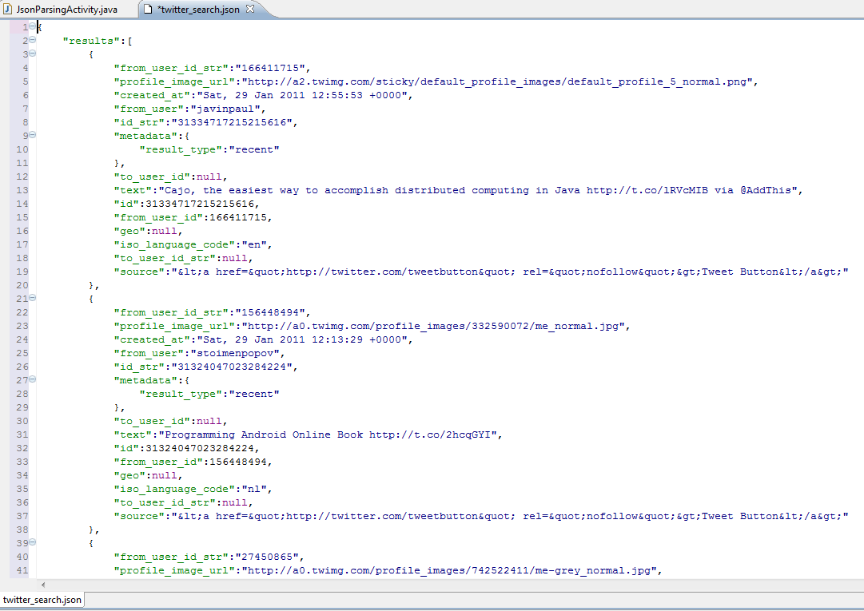
How long does it take for this code to run?

Slide 17
After examining the code you believe that the running time depends entirely upon some input parameter n and …

Slide 18
After examining the code you believe that the running time depends entirely upon some input parameter n and …
a good model for the running time is
Time(n) = a + b·log₂(n) + c·n + d·n·log₂(n)
where a, b, c, and d are constants
but currently unknown.

Slide 19
So you time the code for 4 values of n, namely n = 10, 100, 500, and 1000 and you get the times
Time(10) = 0.685 ms.
Time(100) = 7.247ms.
Time(500) = 38.511ms.
Time(1000) = 79.134 ms.

Slide 20
So you time the code for 4 values of n, namely n = 10, 100, 500, and 1000 and you get the times
Time(10) = 0.685 ms.
Time(100) = 7.247ms.
Time(500) = 38.511ms.
Time(1000) = 79.134 ms.
According to the model you then have
4 equations in the 4 unknowns a, b, c, and d:
a + b·log₂(10) + c·10 + d·10·log₂(10) = 0.685
a + b·log₂(100) + c·100 + d·100·log₂(100) = 7.247
a + b·log₂(500) + c·5000 + d·500·log₂(500) = 38.511
a + b·log₂(1000) + c·1000+ d·1000·log₂(1000) = 79.134

Slide 21
These equations are linear in the unknowns a, b, c, and d.
a + b·log₂(10) + c·10 + d·10·log₂(10) = 0.685
a + b·log₂(100) + c·100 + d·100·log₂(100) = 7.247
a + b·log₂(500) + c·5000 + d·500·log₂(500) = 38.511
a + b·log₂(1000) + c·1000+ d·1000·log₂(1000) = 79.134

Slide 22
These equations are linear in the unknowns a, b, c, and d.
a + b·log₂(10) + c·10 + d·10·log₂(10) = 0.685
a + b·log₂(100) + c·100 + d·100·log₂(100) = 7.247
a + b·log₂(500) + c·5000 + d·500·log₂(500) = 38.511
a + b·log₂(1000) + c·1000+ d·1000·log₂(1000) = 79.134
We solve them and obtain:
a = 6.5
b = 10.3
c = 57.1
d = 2.2
So the final model for the running time is
Time(n) = 6.5 + 10.3·log₂(n) + 57.1·n + 2.2·n·log₂(n)

Slide 23
These equations are linear in the unknowns a, b, c, and d.
a + b·log₂(10) + c·10 + d·10·log₂(10) = 0.685
a + b·log₂(100) + c·100 + d·100·log₂(100) = 7.247
a + b·log₂(500) + c·5000 + d·500·log₂(500) = 38.511
a + b·log₂(1000) + c·1000+ d·1000·log₂(1000) = 79.134
We solve them and obtain:
a = 6.5
b = 10.3
c = 57.1
d = 2.2
So the final model for the running time is
Time(n) = 6.5 + 10.3·log₂(n) + 57.1·n + 2.2·n·log₂(n)

Slide 24
and now we may apply the model
Time(n) = 6.5 + 10.3·log₂(n) + 57.1·n + 2.2·n·log₂(n)
for a particular value of n (for example, n = 10,000)
to estimate a running time of
Time(10,000) = 6.5 + 10.3·log₂(10,000) +
57.1· 10,000 + 2.2· 10,000 ·log₂(10,000)
= 863.47 ms.

Slide 25
What’s a “good” solution when we don’t have the exact solution?

Slide 26
What’s a “good” solution when we don’t have the exact solution?
“Hey. That’s not a question that was
discussed in other math classes.”

Slide 27

What’s a “good” solution when we don’t have the exact solution?
Consider the two equations:
$$\begin{matrix}.780 x+ .563 y= .217 \\ .913 x+ .659 y=.254\end{matrix}$$

Slide 28


Consider two approximate solution pairs:
$$\begin{matrix}x_{1} \\ y_{1} \end{matrix}\begin{matrix}= \\ =\end{matrix}\begin{matrix} .999 \\ −1.001\end{matrix}$$
$$\begin{matrix}x_{2} \\ y_{2} \end{matrix}\begin{matrix}= \\ =\end{matrix}\begin{matrix} .341 \\ −0.087\end{matrix}$$
and these two equations:
$$\begin{matrix}.780 x+ .563 y= .217 \\ .913 x+ .659 y=.254\end{matrix}$$

Slide 29
Consider two approximate solution pairs:
$$\begin{matrix}x_{1} \\ y_{1} \end{matrix}\begin{matrix}= \\ =\end{matrix}\begin{matrix} .999 \\ −1.001\end{matrix}$$
$$\begin{matrix}x_{2} \\ y_{2} \end{matrix}\begin{matrix}= \\ =\end{matrix}\begin{matrix} .341 \\ −0.087\end{matrix}$$
and these two equations:
$$\begin{matrix}.780 x+ .563 y= .217 \\ .913 x+ .659 y=.254\end{matrix}$$
Which pair of these two is better?

Slide 30

Important fact to consider:
$$\begin{matrix}x_{1} \\ y_{1} \end{matrix}\begin{matrix}= \\ =\end{matrix}\begin{matrix} .999 \\ −1.001\end{matrix}$$
$$\begin{matrix}x_{2} \\ y_{2} \end{matrix}\begin{matrix}= \\ =\end{matrix}\begin{matrix} .341 \\ −0.087\end{matrix}$$
The exact solution is:
$$\begin{matrix}x=1 \\ y=−1\end{matrix}$$
Which pair of these two is better?

Slide 31
Consider two approximate solution pairs:
$$\begin{matrix}x_{1} \\ y_{1} \end{matrix}\begin{matrix}= \\ =\end{matrix}\begin{matrix} .999 \\ −1.001\end{matrix}$$
$$\begin{matrix}x_{2} \\ y_{2} \end{matrix}\begin{matrix}= \\ =\end{matrix}\begin{matrix} .341 \\ −0.087\end{matrix}$$
and these two equations:
$$\begin{matrix}.780 x+ .563 y= .217 \\ .913 x+ .659 y=.254\end{matrix}$$
Which pair of these two is better?

Slide 32
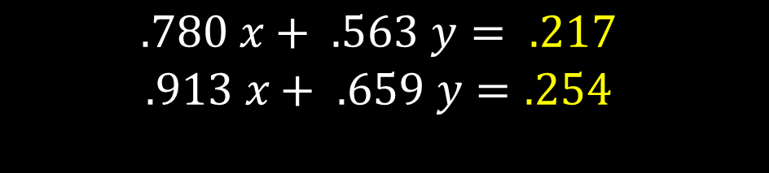
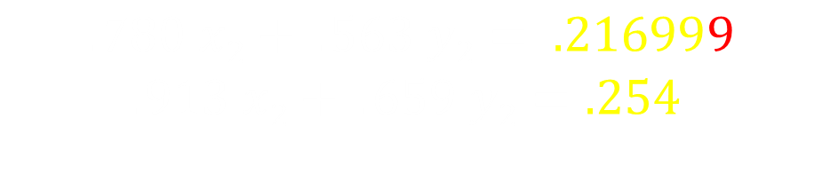
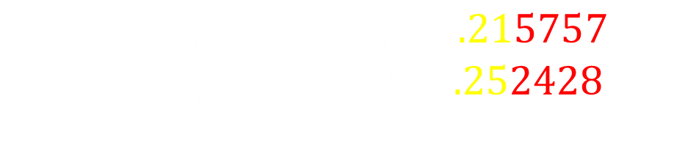
Important fact to consider:
$$\begin{matrix}x_{1} \\ y_{1} \end{matrix}\begin{matrix}= \\ =\end{matrix}\begin{matrix} .999 \\ −1.001\end{matrix}$$
$$\begin{matrix}x_{2} \\ y_{2} \end{matrix}\begin{matrix}= \\ =\end{matrix}\begin{matrix} .341 \\ −0.087\end{matrix}$$
Recall we are trying to solve:
$$\begin{matrix}.780 x+ .563 y= .217 \\ .913 x+ .659 y=.254\end{matrix}$$
For the first pair, we have:
$$\begin{matrix}.780 x1+ .563 y1= .215757 \\ .913 x1+ .659 y1=.252428\end{matrix}$$
For the second pair, we have:
$$\begin{matrix}.780 x2+ .563 y2= .216999 \\ .913 x2+ .659 y2=.254 \end{matrix}$$
Which pair of these two is better?

Slide 33
Important fact to consider:
$$\begin{matrix}x_{1} \\ y_{1} \end{matrix}\begin{matrix}= \\ =\end{matrix}\begin{matrix} .999 \\ −1.001\end{matrix}$$
$$\begin{matrix}x_{2} \\ y_{2} \end{matrix}\begin{matrix}= \\ =\end{matrix}\begin{matrix} .341 \\ −0.087\end{matrix}$$
Which pair of these two is better?

Slide 34

Student: “Is there something funny about that problem?”

Slide 35

Student: “Is there something funny about that problem?”
Professor: “You bet your life. It looks innocent but it is very strange. The problem is knowing when you have a strange case on your hands.”
CLINE

Slide 36
Professor: “Geometrically, solving equations is like finding the intersections of lines.”
CLINE

Slide 37
When lines have no thickness …
here’s the intersection?

Slide 38
… but when lines have thickness …
where’s the intersection?

Slide 39

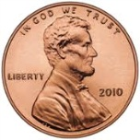
Galveston Island
25.96 miles

Slide 40
Galveston Island
25.96 miles
Where’s the intersection?

Slide 41
London Olympics Swimming
http://www.youtube.com/watch?v=fFiV4ymEDfY&feature=related
1:19

Slide 42
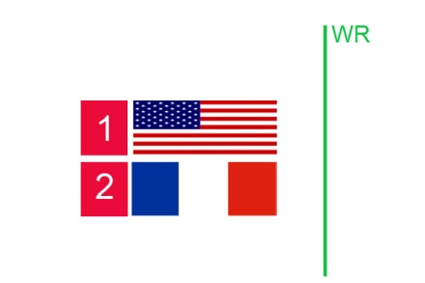
How do you transform this image …

Slide 43
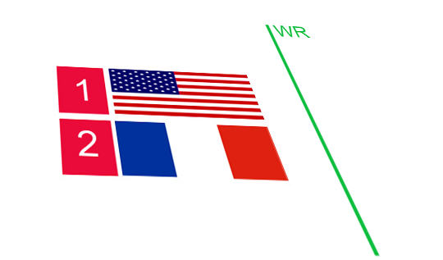
How do you transform this image …
into the coordinate system of another image?

Slide 44


and in greater generality, transform
3-dimensional objects

Slide 45
The $25 Billion Eigenvector
How does Google do Pagerank?

Slide 46
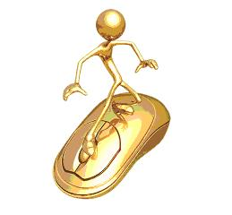
The Imaginary Web Surfer:
Starts at any page,
Randomly goes to a page linked from the current page,
Randomly goes to any web page from a dangling page,
… except sometimes (e.g. 15% of the time) go to a purely random page.

Slide 47
[U,G] = surfer (‘http://www/utexas.edu, 500)

Slide 48
[U,G] = surfer (‘http://www/utexas.edu, 100)

Slide 49
pagerank (U, G)

Slide 50
x = pagerank (U, G)
[Y,I] = sort (x, 1, ‘descend’)
U(I)
'http://www.utexas.edu'
'http://www.utexas.edu/emergency'
'http://www.utexas.edu/maps'
'http://www.lib.utexas.edu'
'http://m.utexas.edu'
'http://healthyhorns.utexas.edu'
'http://www.utexas.edu/parking/transportation/shuttle'
'http://www.utexas.edu/know/feed'
'http://www.utexas.edu/know'
'http://www.texasexes.org/uthistory'
'http://www.utexas.edu/news'
'http://www.lib.utexas.edu/maps'
'http://youtu.be/itO9IXiH4Nk'
'http://www.engr.utexas.edu'

Slide 51
How much storage to hold this array?
Notes:
http://www.smartplanet.com/blog/thinking-tech/what-is-the-worlds-data-storage-capacity/6256

Slide 52
How much storage to hold this array?
Current estimate of indexed WWW:
      4.7 · 10¹⁰ web pages
Notes:
http://www.smartplanet.com/blog/thinking-tech/what-is-the-worlds-data-storage-capacity/6256

Slide 53
How much storage to hold this array?
Current estimate of indexed WWW:
      4.7 · 10¹⁰ web pages
If placed into an array this would have
      2.21 · 10²¹ elements
Notes:
http://www.smartplanet.com/blog/thinking-tech/what-is-the-worlds-data-storage-capacity/6256

Slide 54
How much storage to hold this array?
Current estimate of indexed WWW:
      4.7 · 10¹⁰ web pages
If placed into an array this would have
      2.21 · 10²¹ elements
If each element is stored in 4 bytes, this would be
    8.8 · 10²² bytes
Notes:
http://www.smartplanet.com/blog/thinking-tech/what-is-the-worlds-data-storage-capacity/6256

Slide 55
How much storage to hold this array?
Current estimate of indexed WWW:
      4.7 · 10¹⁰ web pages
If placed into an array this would have
      2.21 · 10²¹ elements
If each element is stored in 4 bytes, this would be
    8.8 · 10²² bytes
Feb. 2011 estimate of world’s data storage capacity is 3.0 · 10²⁰ bytes (.3% of necessary space)
http://www.smartplanet.com/blog/thinking-tech/what-is-the-worlds-data-storage-capacity/6256
Notes:
http://www.smartplanet.com/blog/thinking-tech/what-is-the-worlds-data-storage-capacity/6256

