Slide 1
Two Least Squares Applications
Noise Suppression
Data Fitting

Slide 2
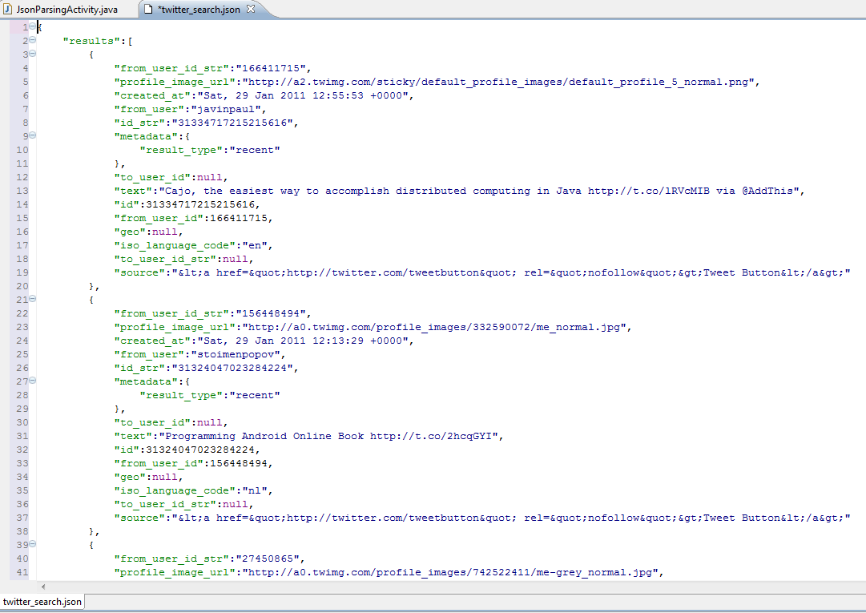
How long does it take for this code to run?

Slide 3
After examining the code you believe that the running time depends entirely upon some input parameter n and …

Slide 4
After examining the code you believe that the running time depends entirely upon some input parameter n and …
a good model for the running time is
Time(n) = a + b·log₂(n) + c·n + d·n·log₂(n) + e·n²
where a, b, c, d, and e are constants
but currently unknown.

Slide 5
So you time the code for 30 values of n, and you get these times {(n_{i},t_{i})}

Slide 6
If the model was perfect
and there were no errors in the timings
then for some values a, b, c, d, and e:
a + b·log₂(n_{i}) + c·n_{i} + d·n_{i}·log₂(n_{i}) +e·n_{i}² = t_{i}
for i =1,…,30

Slide 7
But the model was not perfect
and there were error in the timings
So we do not expect to get any values a, b, c, d, and e so that:
a + b·log₂(n_{i}) + c·n_{i} + d·n_{i}·log₂(n_{i}) +e·n_{i}² = t_{i}
for i =1,…,30
We will settle for values a, b, c, d, and e so that:
a + b·log₂(n_{i}) + c·n_{i} + d·n_{i}·log₂(n_{i}) +e·n_{i}² ≈ t_{i}
for i =1,…,30

Slide 8
Our sense of
a + b·log₂(n_{i}) + c·n_{i} + d·n_{i}·log₂(n_{i}) +e·n_{i}² ≈ t_{i}
for i =1,…,30
Will be to get a, b, c, d, and e so that sum of squares of all of the differences
∑ (a + b·log₂(n_{i}) + c·n_{i} + d·n_{i}·log₂(n_{i}) +e·n_{i}² - t_{i})²
is minimized over all possible choices of a, b, c, d, and e

Slide 9
We form a 30 by 5 matrix whose rows are
1 log₂(n_{i}) n_{i} n_{i}·log₂(n_{i}) n_{i}² for i =1,…,30 and a column of length 30 with the timings t_{i} for i =1,…,30

Slide 10
After solving the least squares system to get the best values of a, b, c, d, and e, we plot a + b·log₂(n) + c·n + d·n·log₂(n) + e·n²

Slide 11
An application for noise suppression
The intent is to recover a sound wave that
has been covered with noise

Slide 12
The matrix is 32,768 by 13
The columns are discrete - not continuous (although the plots make them appear continuous because there are so many elements.)
Each column is 1/2 second worth of sound samples.
The sound is sampled at 65,536 samples per second.
32,768
13

Slide 13

A section of the columns of the matrix

Slide 14
Waveform of an A Major chord

Slide 15
Waveform of a noisy A Major chord
This is the right hand side

Slide 16
Waveform of the recovered A Major chord
original in blue – recovered in green

Slide 17
3. Waveform of the recovered A Major chord
1. Waveform of an A Major chord
2. Waveform of a noisy A Major chord

Slide 18
Pushing the limits
We will make the noise 32 times larger than the chord and see if the chord can still be reconstructed

Slide 19
3. Waveform of the recovered A Major chord
1. Waveform of an A Major chord
2. Waveform of a very noisy A Major chord

