Slide 1
Milestones of The Dean’s Scholars

Slide 2
Memory
For the first time, DS will be doing X.time

Slide 3
(which means …)
For the first time in perhaps three years, DS will be doing X.time

Slide 4
Memory
As always, DS will be doing X.time

Slide 5
(which means …)
As for at least the last three years, DS will be doing X.time

Slide 6
Memory
X happened.

Slide 7
(which means)
Maybe X happened, but I’m not sure what I had for breakfast.

Slide 8
The Beginning 1983-84

Slide 9
The Beginning 1983-84
Program intended to admit about 25 per year – achieve a steady state of 100.

Slide 10
The Beginning 1983-84
Program intended to admit about 25 per year – achieve a steady state of 100.
Jim Vick was Director.

Slide 11
The Beginning 1983-84
Program intended to admit about 25 per year – achieve a steady state of 100.
Jim Vick was Director.
Mike Starbird taught the freshman seminar.

Slide 12
The Beginning 1983-84
Program intended to admit about 25 per year – achieve a steady state of 100.
Jim Vick was Director.
Mike Starbird taught the freshman seminar.
January trip to Port Aransas

Slide 13
The Beginning 1983-84
Program intended to admit about 25 per year – achieve a steady state of 100.
Jim Vick was Director.
Mike Starbird taught the freshman seminar.
January trip to Port Aransas

Slide 14
The Beginning 1983-84
Program intended to admit about 25 per year – achieve a steady state of 100.
Jim Vick was Director.
Mike Starbird taught the freshman seminar.
January trip to Port Aransas

Slide 15
1985-86
Starbird goes on leave.

Slide 16
1985-86
Starbird goes on leave.
Cline replaces him in the freshman seminar.

Slide 17
1986-87
Freshmen DS includes only 5 women.

Slide 18
1986-87
Freshmen DS includes only 5 women.
First DS Musicale.
Sandman Song

Slide 19
1986-87
Freshmen DS includes only 5 women.
First DS Musicale.
Sandman Song
First end of year dinner.
Snicker’s Cake

Slide 20
1987- 88
Student group (Rozendaal, Slagle, Wobus, Otillar, Fleckenstein) propose a more serious program.

Slide 21
1987- 88
Student group (Rozendaal, Slagle, Wobus, Otillar, Fleckenstein) propose a more serious program.
Fall Picnic

Slide 22
1988-89
Vick becomes Student Affairs VP.

Slide 23
1988-89
Vick becomes Student Affairs VP.
Starbird becomes Associate Dean and DS Director.

Slide 24
1989-90:
Second student group recommends changes.

Slide 25
1989-90:
Second student group recommends changes.
Starbird says all DSers should complete departmental honors degrees.

Slide 26
1990-91:
Cline out of program.

Slide 27
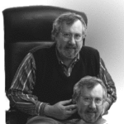
1991-92
Cline becomes DS Director

Slide 28
1991-92
Cline becomes DS Director
Tiny freshman class. (2 women).

Slide 29
1991-92
Cline becomes DS Director
Tiny freshman class. (2 women).
Monthly activities started
Beitzel, Ramser, Murthy, Herrod, Huckaby

Slide 30
1991-92
Cline becomes DS Director
Tiny freshman class. (2 women).
Monthly activities started
Beitzel, Ramser, Murthy, Herrod, Huckaby
1994 – Computer Accounts for DS

Slide 31
1991-92
Cline becomes DS Director
Tiny freshman class. (2 women).
Monthly activities started
Beitzel, Ramser, Murthy, Herrod, Huckaby
1994 – Computer Accounts for DS
Middle School Enrichment Program initiated (Murthy, Feldmeyer)

Slide 32
1991-92
Cline becomes DS Director
Tiny freshman class. (2 women).
Monthly activities started
Beitzel, Ramser, Murthy, Herrod, Huckaby
1994 – Computer Accounts for DS
Middle School Enrichment Program initiated (Murthy, Feldmeyer)

Slide 33
Picnics
(a little side presentation)

Slide 34
Picnic 1994

Slide 35
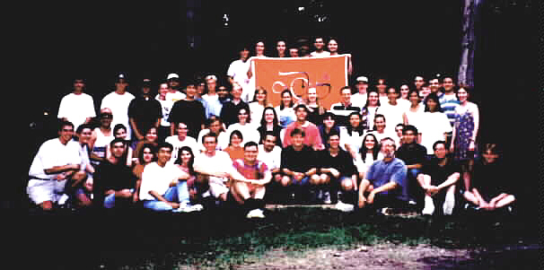
Picnic 1995

Slide 36
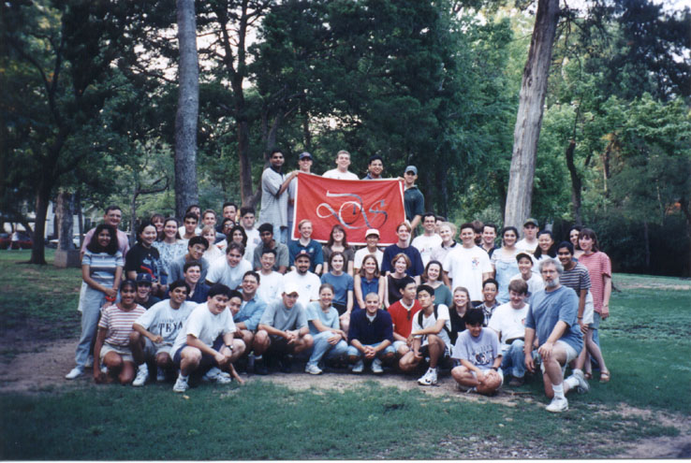
Picnic 1996

Slide 37
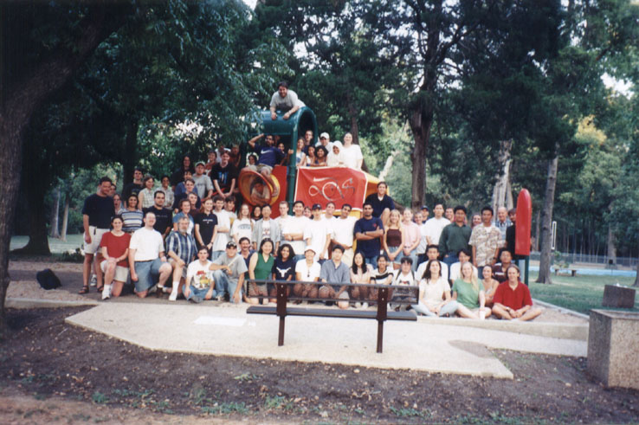
Picnic 1997

Slide 38
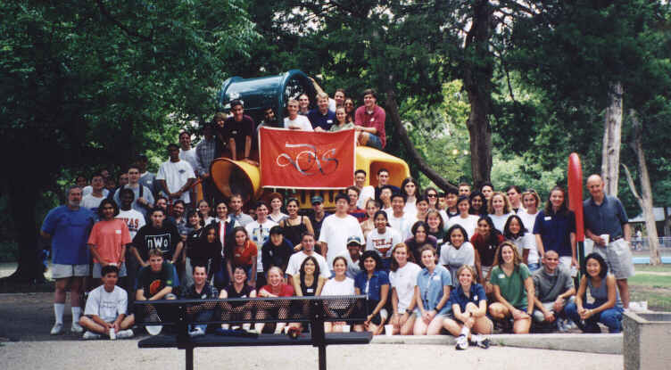
Picnic 1998

Slide 39
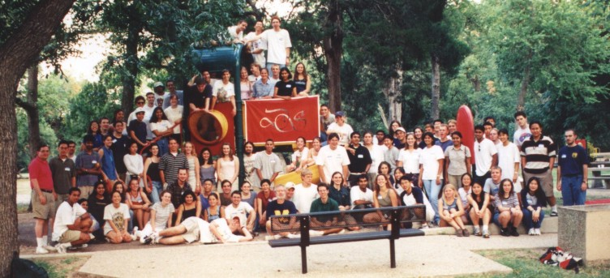
Picnic 1999

Slide 40
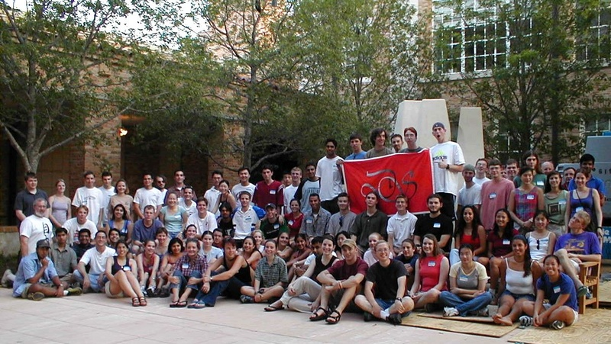
Picnic 2000

Slide 41
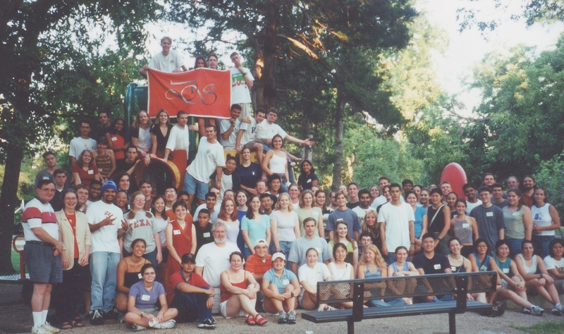
Picnic 2001

Slide 42
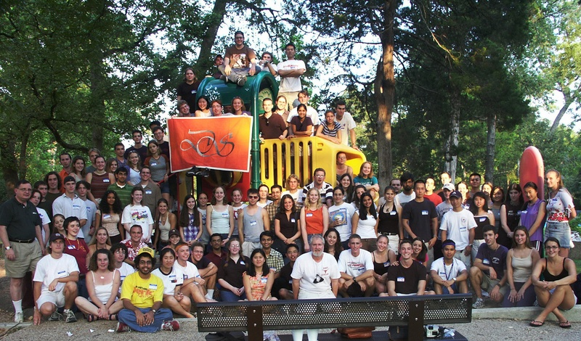
Picnic 2002

Slide 43
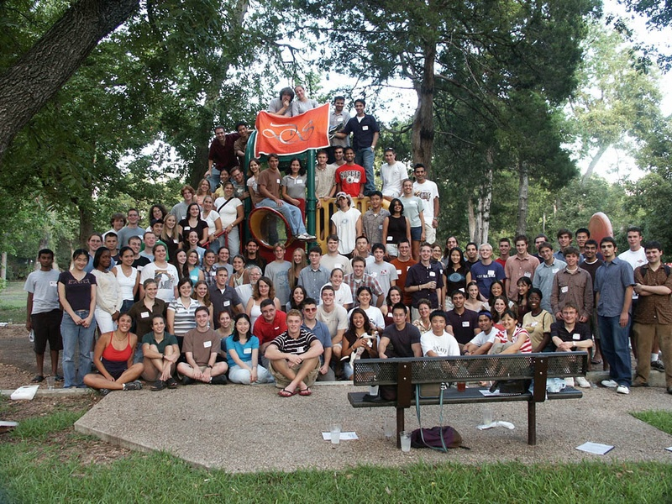
Picnic 2003

Slide 44
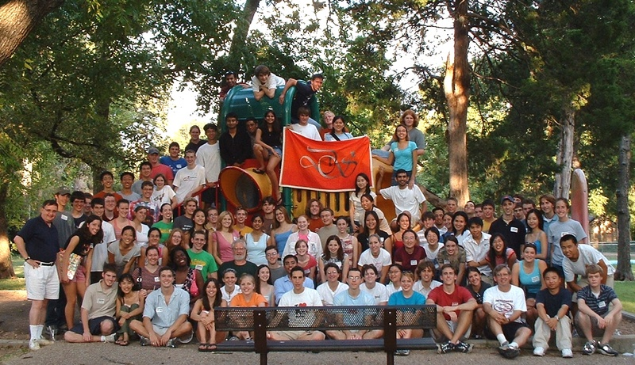
Picnic 2004

Slide 45
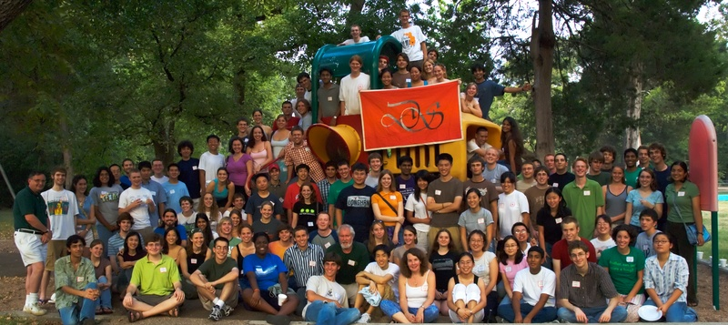
Picnic 2005

Slide 46
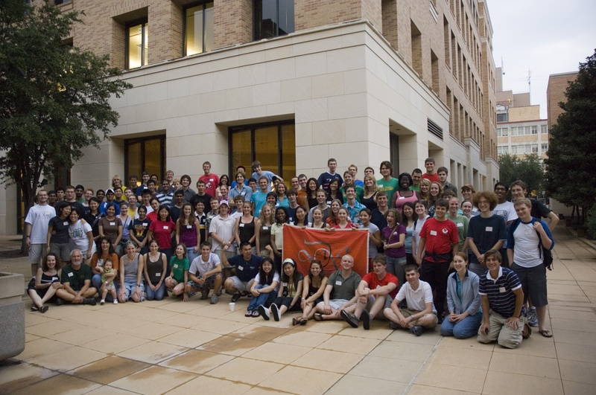
Picnic 2006

Slide 47
Picnic 2007
Where are you?

Slide 48
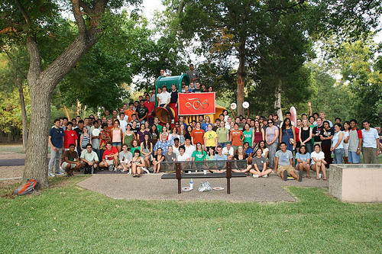
Picnic 2008

Slide 49
Picnics 2008 and beyond

Slide 50
Picnics 2008 and beyond
Enough already

Slide 51
… and then
1994 - Present Berdahl speaks at lunch

Slide 52
… and then
1994 - Present Berdahl speaks at lunch
1994 – Priority Registration for DS

Slide 53
… and then
1994 - Present Berdahl speaks at lunch
1994 – Priority Registration for DS
1995 - MSEP brings students to UT (Bhogte)

Slide 54
The Charge
1996 – Program approaching 100 Dean’s Scholars

Slide 55
The Charge
1996 – Program approaching 100 Dean’s Scholars
Dean Rankin asks for the program to be doubled

Slide 56
The DS Student Association

Slide 57
The DS Student Association
DS Student Association born in 1997
suggested by Brehm
First council chaired by Lily Liao

Slide 58
The DS Student Association
DS Student Association born in 1997
suggested by Brehm
First council chaired by Lily Liao
Third Student Committee
Second year’s speaking seminars

Slide 59
The DS Student Association
1997 – 1998 Lillian Liao
1998 – 1999 Jennifer Posey
1999 – 2000 Arundathi Shenoy
2000 – 2001 Kyle Wedin / Pooja Paranjpe
2001 – 2002 Brandon Zinn
2002 – 2003 Clare Rivello
2003 – 2004 Bess Frost
2004 – 2005 Chad Vicenik
2005 – 2006 Sanjita Ravishankar
2006 – 2007 Robert Seilheimer
2007 – 2008 Sarah Miller
2008 – 2009 Richa Gupta
2009 – 2010 Patrick Lawlor
2010 – 2011 Zesong Liu
2011 – 2012 Matthew Tien
2012 – 2013 Rathi Kannan
2013 – 2014 Nalin Ratnayeke
2014 – 2015 Patrick Haley
2015 – 2016 Patrick Haley
2016 – 2017 Ellen Zippi
2017 – 2018 Griffin Glenn
2018 – 2019 Maike Morrison
2019 – 2020 Meghan Mallya

Slide 60
…and more activities
1998 – Upper Division DS Speaker Series
2000 – Oliver Sacks, Jared Diamond, …

Slide 61
…and more activities
1998 – Upper Division DS Speaker Series
2000 – Oliver Sacks, Jared Diamond, …
1998 – December dinner

Slide 62
…and more activities
1998 – Upper Division DS Speaker Series
2000 – Oliver Sacks, Jared Diamond, …
1998 – December dinner
1998 - DS given office space in ESB
“The Dungeon”

Slide 63
…and more activities
1998 – Upper Division DS Speaker Series
2000 – Oliver Sacks, Jared Diamond, …
1998 – December dinner
1998 - DS given office space in ESB
“The Dungeon”
2000 - Organ Donor Drive (DeZern)

Slide 64
Where did we stand? March, 2001
160 Dean’s Scholars
8-10 seminars
30 admitted from HS – 20 from current students
about half pre-med (several MD/PhD per year)

Slide 65
Looking Back from 2001
400 Alumni
Many scientists and physicians
4 UT Outstanding Students
3 Marshall Scholars plus many NSF and other leading fellowships
Three DS marriages

Slide 66
Where do we stand? March, 2011
Currently 160 Dean’s Scholars
8-10 seminars
30 admitted from HS – 20 from current students
about half pre-med (several MD/PhD per year)
215
11
35
15
40%

Slide 67
And 2011
1000
400 Alumni
Many scientists and physicians
4 UT Outstanding Students
3 Marshall Scholars plus many NSF and other leading fellowships
Three DS marriages
6
many

Slide 68
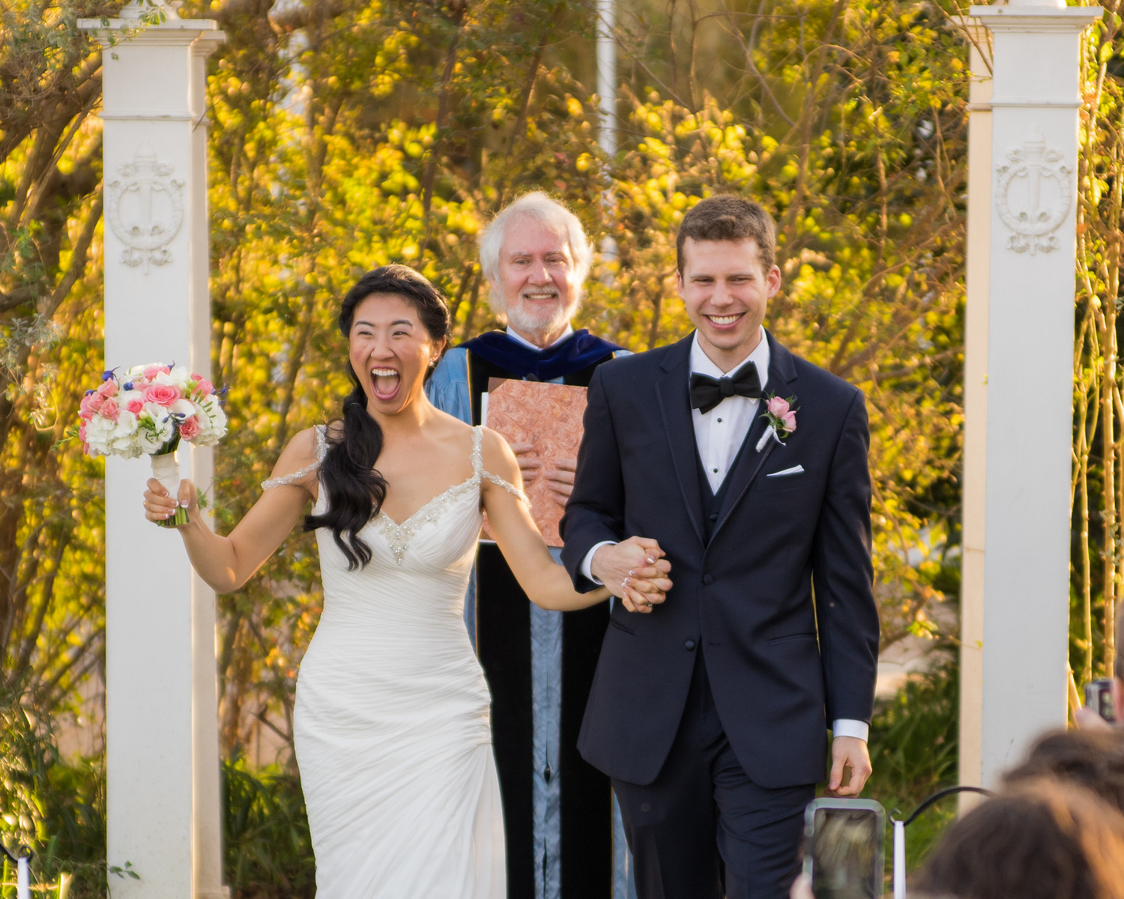
February 23, 2016

Slide 69
And 2011
1000
400 Alumni
Many scientists and physicians
4 UT Outstanding Students
3 Marshall Scholars plus many NSF and other leading fellowships
Three DS marriages plus divorces
6
many

Slide 70
And 2011
1000
400 Alumni
Many scientists and physicians
4 UT Outstanding Students
3 Marshall Scholars plus many NSF and other leading fellowships
Three DS marriages
One Gates Scholar
One Rhodes Scholar
6
many

Slide 71
New Activities
2003 Picasso at the Lapin Agile

Slide 72
New Activities
2003 Picasso at the Lapin Agile
2003 Arsenic and Old Lace … and more

Slide 73
New Activities
2003 Picasso at the Lapin Agile
2003 Arsenic and Old Lace … and more
Three Time Intramural Women’s Track Champions

Slide 74
New Activities
2003 Picasso at the Lapin Agile
2003 Arsenic and Old Lace … and more
Three Time Intramural Women’s Track Champions
One Time (B League) Coed Soccer Champions (James Scott in goal)

Slide 75
New Activities
2003 Picasso at the Lapin Agile
2003 Arsenic and Old Lace … and more
Three Time Intramural Women’s Track Champions
One Time (B League) Coed Soccer Champions
Tutoring

Slide 76
New Activities
2003 Picasso at the Lapin Agile
2003 Arsenic and Old Lace … and more
Three Time Intramural Women’s Track Champions
One Time (B League) Coed Soccer Champions
Tutoring
Lunch (yes, but not like before)

Slide 77
New Activities
2003 Picasso at the Lapin Agile
2003 Arsenic and Old Lace … and more
Three Time Intramural Women’s Track Champions
One Time (B League) Coed Soccer Champions
Tutoring
Lunch (yes, but not like before)
DS Dance (on, off, on)

Slide 78
Administrative Assistance
1983-1992 – Dean’s Office

Slide 79
Administrative Assistance
1983-1992 – Dean’s Office
1992-2001 – Students (lots)

Slide 80
Administrative Assistance
1983-1992 – Dean’s Office
1992-2001 – Students (lots)
2001-2005 – Brett Westbrook-Program Coordinator

Slide 81
Administrative Assistance
1983-1992 – Dean’s Office
1992-2001 – Students (lots)
2001-2005 – Brett Westbrook-Program Coordinator
2005-2006 - Dean’s Office (again)

Slide 82
Administrative Assistance
1983-1992 – Dean’s Office
1992-2001 – Students (lots)
2001-2005 – Brett Westbrook-Program Coordinator
2005-2006 - Dean’s Office (again)
2006-2010 – Allisa Carter – Program Coordinator + academic advisors

Slide 83
Administrative Assistance
1983-1992 – Dean’s Office
1992-2001 – Students (lots)
2001-2005 – Brett Westbrook-Program Coordinator
2005-2006 - Dean’s Office (again)
2006-2010 – Allisa Carter – Program Coordinator + academic advisors
2010-present - Office for Honors, Research and International Study / Honors Center

Slide 84
The Faculty Review as of 2001
An expanded program ?
More students ?
Special Classes ?

Slide 85
Recommendations - 2002
Dean’s Scholars Honors Degrees to be administered by the college
Honors Courses – Biology, Mathematics, Computer Sciences, Physics, Chemistry

Slide 86
Approved - 2003
Dean’s Scholars Honors Degrees to be administered by the departments
Honors Courses – Biology, Mathematics, Computer Sciences, Physics, Chemistry

Slide 87
The Dean’s Scholars Degrees

Slide 88
The Dean’s Scholars Degrees
30 hours in major

Slide 89
The Dean’s Scholars Degrees
30 hours in major
30 hours DS requirements
Honors courses in 4 or 5 areas
Rhetoric
Research and Honors Thesis

Slide 90
The Dean’s Scholars Degrees
30 hours in major
30 hours DS requirements
Honors courses in 4 or 5 areas
Rhetoric
Research and Honors Thesis
30 hours UT requirements
History, Government, Humanities, Fine Arts

Slide 91
The Dean’s Scholars Degrees
30 hours in major
30 hours DS requirements
Honors courses in 4 or 5 areas
Rhetoric
Research and Honors Thesis
30 hours UT requirements
History, Government, Humanities, Fine Arts
30 Hours Electives

Slide 92
The Dean’s Scholars Degrees
First Three Graduates 2006
First Four Year Graduates 2007

Slide 93
The Dean’s Scholars Degrees
First Three Graduates 2006
First Four Year Graduates 2007
Applications – 600 (2007)

Slide 94
The Dean’s Scholars Degrees
First Three Graduates 2006
First Four Year Graduates 2007
Applications – 600 (2007) …
and past 1000 still more (2008)

Slide 95
The Dean’s Scholars Degrees
First Three Graduates 2006
First Four Year Graduates 2007
Applications – 600 (2007) …
and past 1000 still more (2008)
Quality of applications – hard to believe

Slide 96
The Dean’s Scholars Degrees
First Three Graduates 2006
First Four Year Graduates 2007
Applications – 600 (2007) …
and past 1000 still more (2008)
Quality of applications – hard to believe
Quality of Graduates – even harder to believe

Slide 97
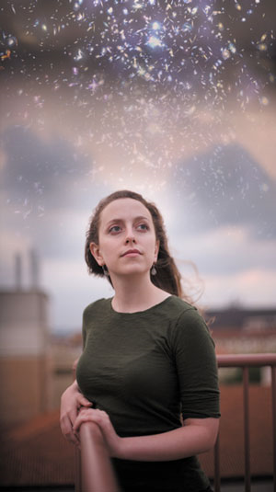
2008
First Rhodes Scholar:
Sarah Miller

Slide 98
2008
Why have I never seen
all these stars over RLM
before?
First Rhodes Scholar:
Sarah Miller

Slide 99
Award 2009
Dean’s Scholars Student Association wins
Swing Out Award as “Best New Organization”

Slide 100
Applications 2009-10
67

Slide 101
Applications 2009-10
67
For the 2010 class, there were 67 high school valedictorians who applied for the program … .

Slide 102
Applications 2009-10
67
For the 2010 class, there were 67 high school valedictorians who applied for the program and were rejected.

Slide 103
2010 New Program
Health Science Honors Program

Slide 104
2010 DS in Space

Slide 105
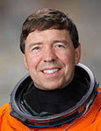
2010 DS in Space
Dean’s Scholar Joseph Barratt’s father Dr. Michael Barratt offers to carry memento of program aboard the final flight of space shuttle Discovery

Slide 107
2010 DS in Space
Launched Thursday, February 24, 2011

Slide 108
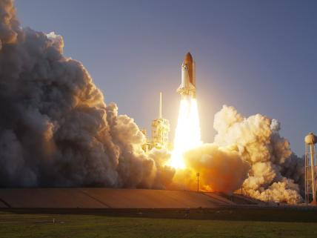

Slide 109
2010 Some Setbacks

Slide 110
2010 Some Setbacks
Lost our coordinator

Slide 111
2010 Some Setbacks
Lost our coordinator
Lost most scholarships

Slide 112
2011
Third DS Alumni Reunion

Slide 113
2011
Third DS Alumni Reunion
Cline steps down as director

Slide 114
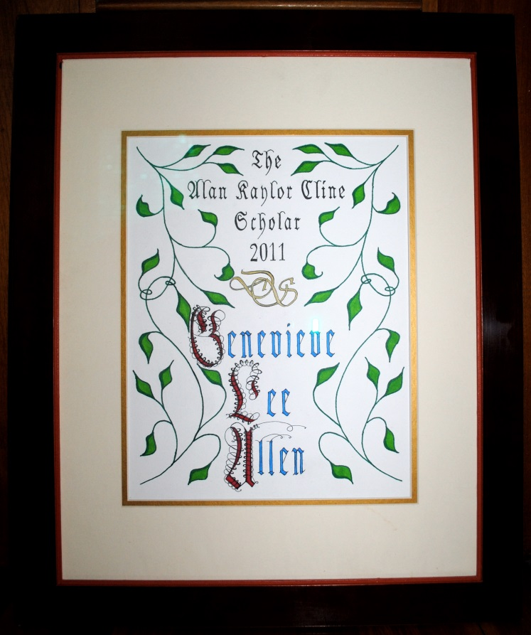
Dean’s Scholars Endowment Fund 2011

Slide 115
AKC Scholarship – 2011
Griffin Dale Glenn Ted Shi (that’s his full name) Rachel Maria Rapagnani
Griffin Dale Glenn Ted Shi (that’s his full name) Rachel Maria Rapagnani
2011: Genevieve Allen
2012: Guadalupe Jasso
2013: Patrick Hunt
2014: Nalin Ratnayeke
2015: Nakita Klimovich
2016: Michael Miyagi
2017: Hannah Hasson
2018: Griffin Glenn, Ted Shi, Rachel Rapagnani
2019: Maike Morrison, Emrys Peets

Slide 116
AKC Scholarship – 2011
Griffin Dale Glenn Ted Shi (that’s his full name) Rachel Maria Rapagnani
Griffin Dale Glenn Ted Shi (that’s his full name) Rachel Maria Rapagnani
2011: Genevieve Allen
2012: Guadalupe Jasso
2013: Patrick Hunt
2014: Nalin Ratnayeke
2015: Nakita Klimovich
2016: Michael Miyagi
2017: Hannah Hasson
2018: Griffin Glenn, Ted Shi, Rachel Rapagnani
2019: Maike Morrison, Emrys Peets
2020: YOU???

Slide 117
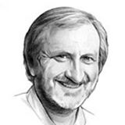
2011
David Hillis is fourth DS Director

Slide 118
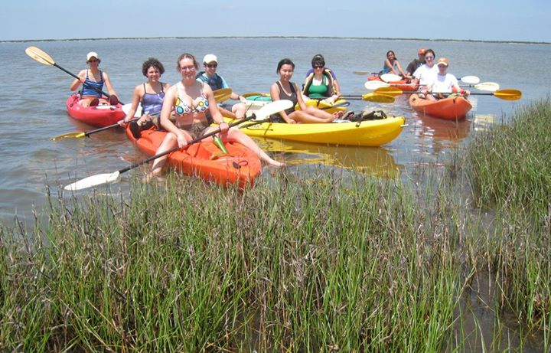
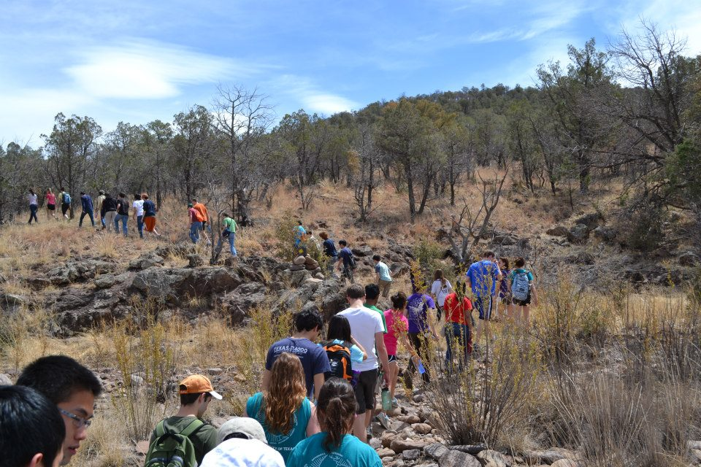

Slide 119
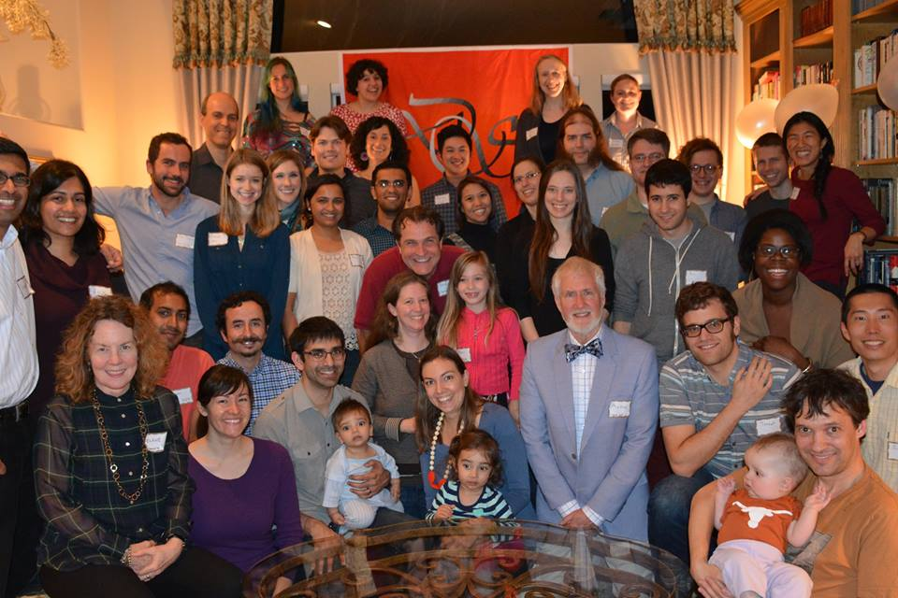
2015
DS Alumni Dinners – CA and TX

Slide 120
2019
40 for 40 Campaign for the DS Endowment
$13,248

Slide 121
The Deans Scholars Scrapbook
Dinner menus, recipes,
and zillions of photos:
https://deansscholars.github.io/DS-Scrapbook/

Slide 122
What is DS?

Slide 123
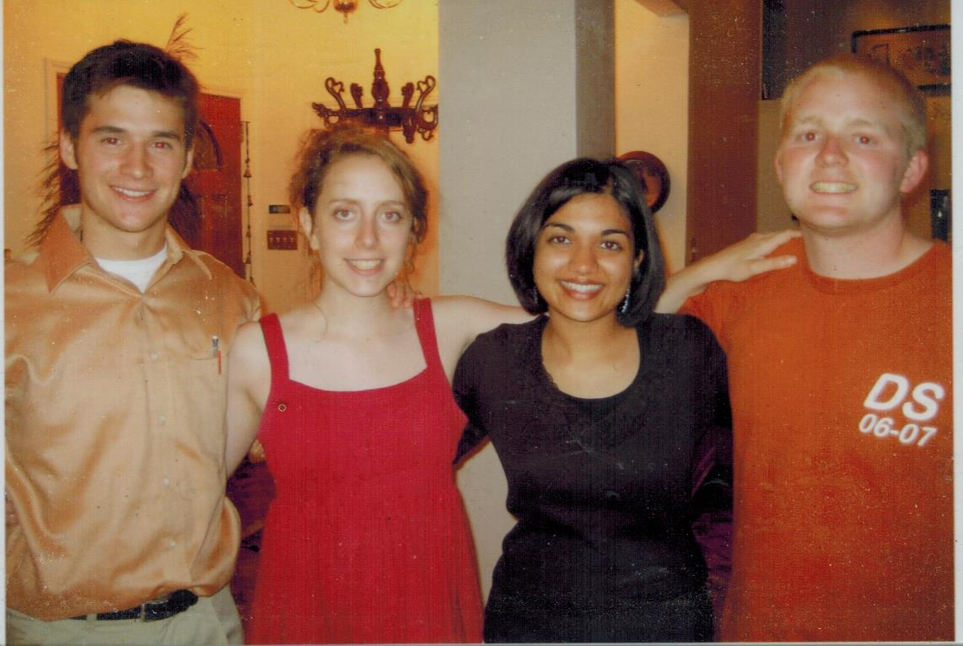
What is DS?

Slide 124
What is DS?
Pat Lawlor, in MD/PhD program at Northwestern

Slide 125
What is DS?
Pat Lawlor, in MD/PhD program at Northwestern
Rob Seilheimer, in MD/PhD program at Baylor College of Medicine

Slide 126
What is DS?
Pat Lawlor, in MD/PhD program at Northwestern
Rob Seilheimer, in MD/PhD program at Baylor College of Medicine
Richa Gupta, MD/Masters of Public Health program at Johns Hopkins

Slide 127
What is DS?
Pat Lawlor, in MD/PhD program at Northwestern
Rob Seilheimer, in MD/PhD program at Baylor College of Medicine
Richa Gupta, MD/Masters of Public Health program at Johns Hopkins
Sarah Miller, Rhodes Scholar, PhD Oxford

Slide 128
What is DS?
Pat Lawlor, in MD/PhD program at Northwestern
Rob Seilheimer, in MD/PhD program at Baylor College of Medicine
YOU
You, wonderful stuff
Richa Gupta, in MD/Masters of Public Health program at Johns Hopkins
Sarah Miller, Rhodes Scholar, PhD Oxford

