Slide 1

Milestones of The
Dean’s Scholars

Slide 2
The Beginning 1983-84

Slide 3
The Beginning 1983-84
Program intended to admit about 25 per year – achieve a steady state of 100.

Slide 4
The Beginning 1983-84
Program intended to admit about 25 per year – achieve a steady state of 100.
Jim Vick was Director.

Slide 5
The Beginning 1983-84
Program intended to admit about 25 per year – achieve a steady state of 100.
Jim Vick was Director.
Mike Starbird taught the freshman seminar.

Slide 6
The Beginning 1983-84
Program intended to admit about 25 per year – achieve a steady state of 100.
Jim Vick was Director.
Mike Starbird taught the freshman seminar.
January trip to Port Aransas

Slide 7
The Beginning 1983-84
Program intended to admit about 25 per year – achieve a steady state of 100.
Jim Vick was Director.
Mike Starbird taught the freshman seminar.
January trip to Port Aransas

Slide 8
The Beginning 1983-84
Program intended to admit about 25 per year – achieve a steady state of 100.
Jim Vick was Director.
Mike Starbird taught the freshman seminar.
January trip to Port Aransas

Slide 9
1985-86
Starbird goes on leave.

Slide 10
1985-86
Starbird goes on leave.
Cline replaces him in the freshman seminar.

Slide 11
1986-87
Freshmen DS includes only 5 women.

Slide 12
1986-87
Freshmen DS includes only 5 women.
First DS Musicale.
Sandman Song

Slide 13
1986-87
Freshmen DS includes only 5 women.
First DS Musicale.
Sandman Song
First end of year dinner.
Snicker’s Cake

Slide 14
1987- 88
Student group (Rozendaal, Slagle, Wobus, Otillar, Fleckenstein) propose a more serious program.

Slide 15
1987- 88
Student group (Rozendaal, Slagle, Wobus, Otillar, Fleckenstein) propose a more serious program.
Fall Picnic

Slide 16
1988-89
Vick becomes Student Affairs VP.

Slide 17
1988-89
Vick becomes Student Affairs VP.
Starbird becomes Associate Dean and DS Director.

Slide 18
1989-90:
Second student group recommends changes.

Slide 19
1989-90:
Second student group recommends changes.
Starbird says all DSers should complete departmental honors degrees.

Slide 20
1990-91:
Cline out of program.

Slide 21
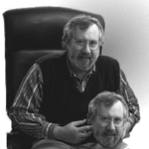
1991-92
Cline becomes DS Director

Slide 22
1991-92
Cline becomes DS Director
Tiny freshman class. (2 women).

Slide 23
1991-92
Cline becomes DS Director
Tiny freshman class. (2 women).
Monthly activities started
Beitzel, Ramser, Murthy, Herrod, Huckaby

Slide 24
1991-92
Cline becomes DS Director
Tiny freshman class. (2 women).
Monthly activities started
Beitzel, Ramser, Murthy, Herrod, Huckaby
1994 – Computer Accounts for DS

Slide 25
1991-92
Cline becomes DS Director
Tiny freshman class. (2 women).
Monthly activities started
Beitzel, Ramser, Murthy, Herrod, Huckaby
1994 – Computer Accounts for DS
Twenty Minute Meetings

Slide 26
1991-92
Cline becomes DS Director
Tiny freshman class. (2 women).
Monthly activities started
Beitzel, Ramser, Murthy, Herrod, Huckaby
1994 – Computer Accounts for DS
Twenty Minute Meetings
Middle School Enrichment Program initiated (Murthy, Feldmeyer)

Slide 27
Picnics
(a little side presentation)

Slide 28
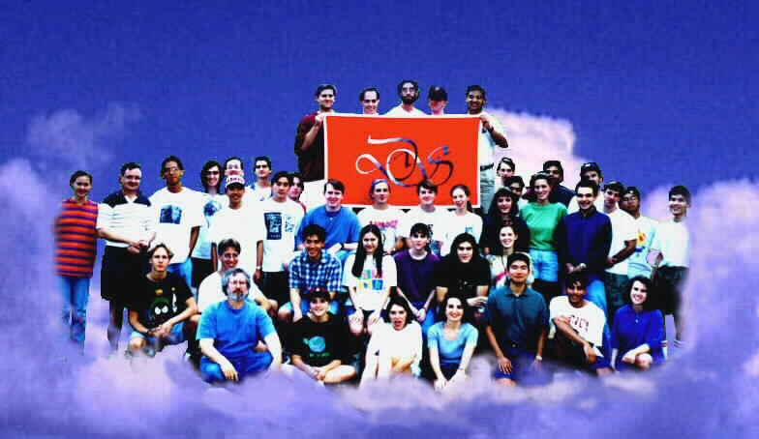
Picnic 1994

Slide 29
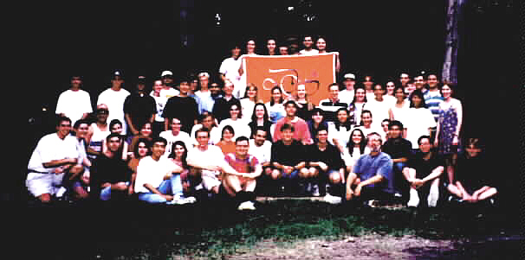
Picnic 1995

Slide 30
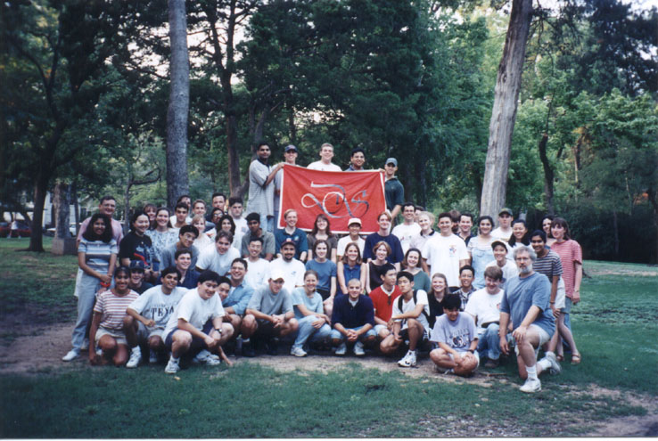
Picnic 1996

Slide 31
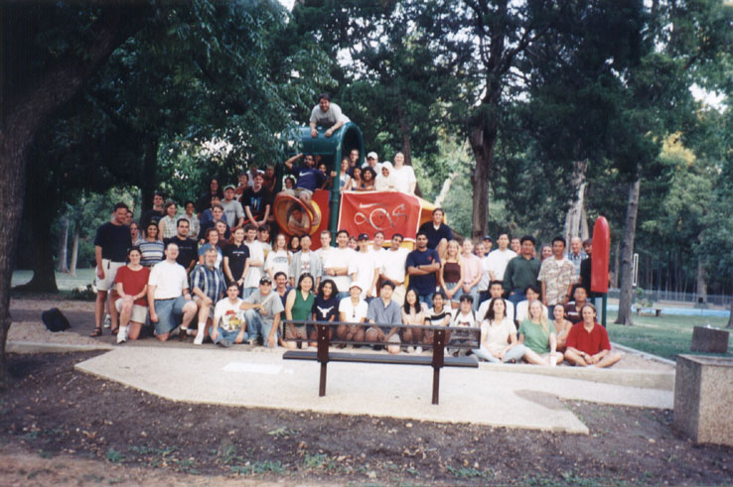
Picnic 1997

Slide 32
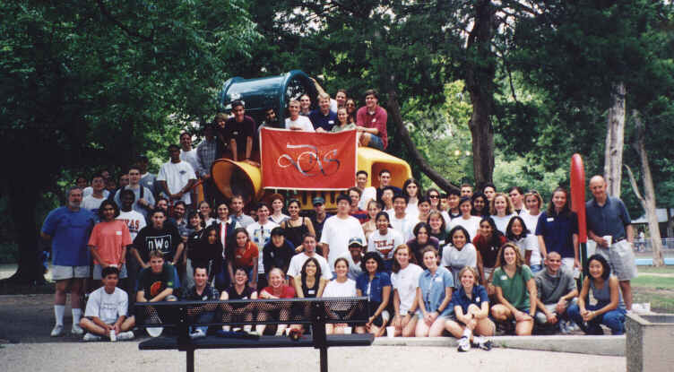
Picnic 1998

Slide 33
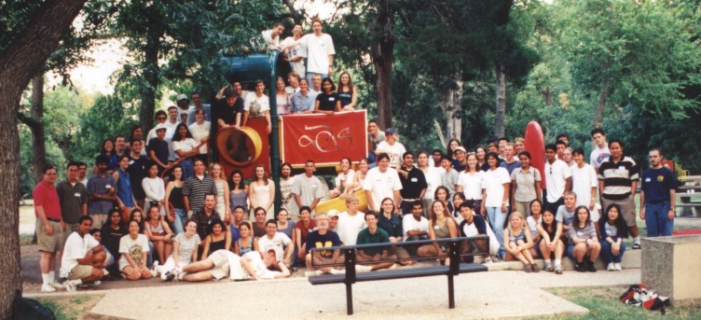
Picnic 1999

Slide 34
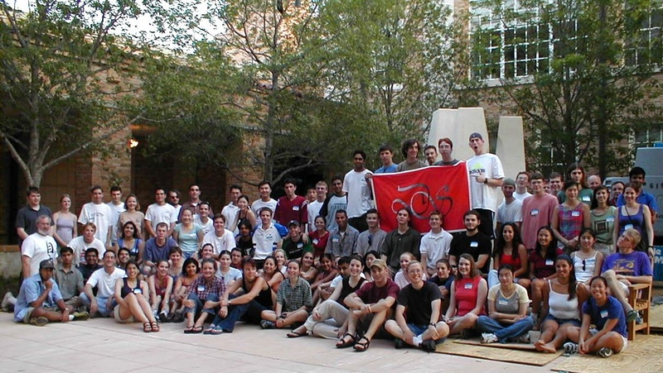
Picnic 2000

Slide 35
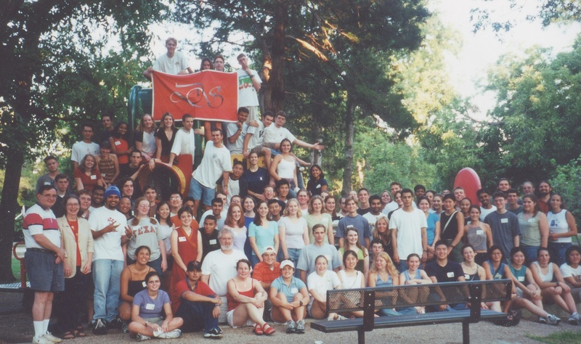
Picnic 2001

Slide 36
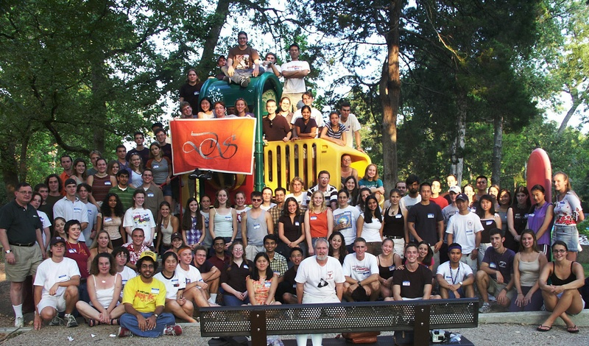
Picnic 2002

Slide 37
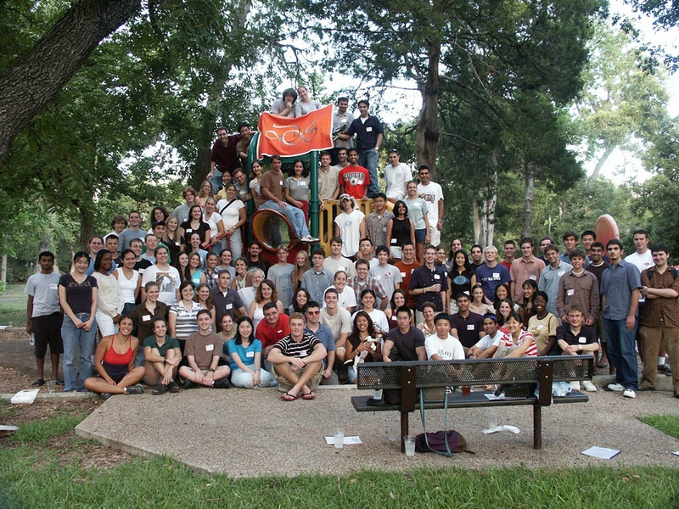
Picnic 2003

Slide 38
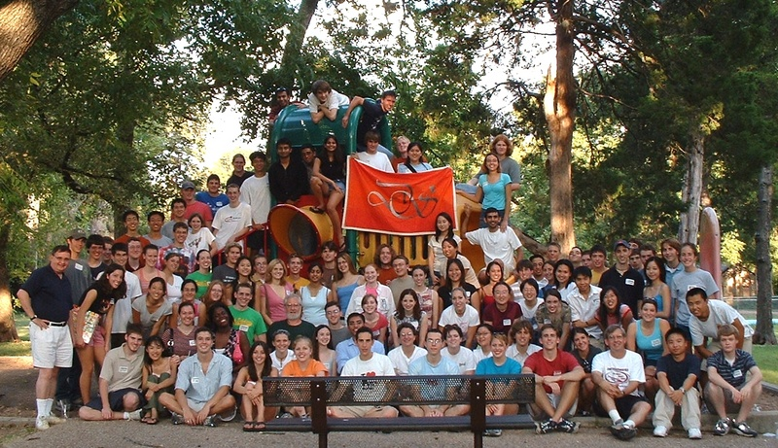
Picnic 2004

Slide 39
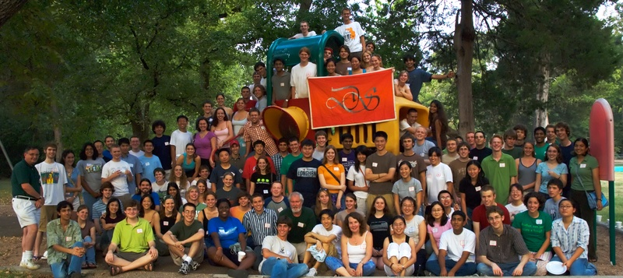
Picnic 2005

Slide 40
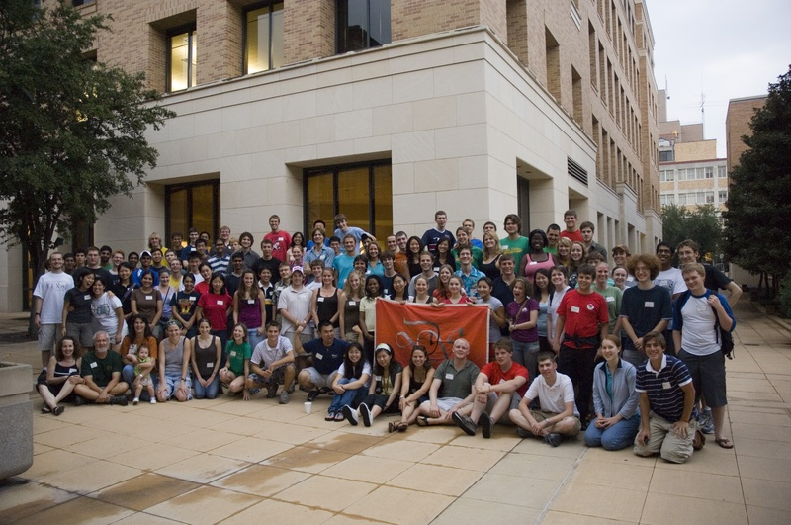
Picnic 2006

Slide 41
Picnic 2007
Where are you?

Slide 42
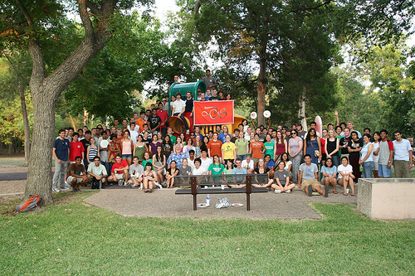
Picnic 2008

Slide 43
Picnics 2008 and beyond

Slide 44
Picnics 2008 and beyond
Enough already

Slide 45
… and then
1994 - Present Berdahl speaks at lunch

Slide 46
… and then
1994 - Present Berdahl speaks at lunch
1994 – Priority Registration for DS

Slide 47
… and then
1994 - Present Berdahl speaks at lunch
1994 – Priority Registration for DS
1995 - MSEP brings students to UT (Bhogte)

Slide 48
The Charge
1996 – Program approaching 100 Dean’s Scholars

Slide 49
The Charge
1996 – Program approaching 100 Dean’s Scholars
Dean Rankin asks for the program to be doubled

Slide 50
The DS Student Association

Slide 51
The DS Student Association
Third Student Committee
Second year’s speaking seminars

Slide 52
The DS Student Association
Third Student Committee
Second year’s speaking seminars
DS Student Association born in 1997
suggested by Brehm
First council chaired by Lily Liao

Slide 53
The DS Student Association
1997 – 1998 Lillian Liao
1998 – 1999 Jennifer Posey
1999 – 2000 Arundathi Shenoy
2000 – 2001 Kyle Wedin / Pooja Paranjpe
2001 – 2002 Brandon Zinn
2002 – 2003 Clare Rivello
2003 – 2004 Bess Frost
2004 – 2005 Chad Vicenik
2005 – 2006 Sanjita Ravishankar
2006 – 2007 Robert Seilheimer
2007 – 2008 Sarah Miller
2008 – 2009 Richa Gupta
2009 – 2010 Patrick Lawlor
2009 – 2010 Patrick Lawlor
2010 – 2011 Zesong Liu
2011 – 2012 Matthew Tien
2012 – 2013 Rathi Kannan
2013 – 2014 Nalin Ratnayeke
2014 – 2015 Patrick Haley
2015 – 2016 Patrick Haley
2016 – 2017 Ellen Zippi
2017 – 2018 Griffin Glenn
2018 – 2019 Maike Morrison
2019 – 2020 Meghan Mallya
2020 – 2021 Tanvi Ingle

Slide 54
…and more activities
1998 – Upper Division DS Speaker Series
2000 – Oliver Sacks, Jared Diamond, …

Slide 55
…and more activities
1998 – Upper Division DS Speaker Series
2000 – Oliver Sacks, Jared Diamond, …
1998 – December dinner

Slide 56
…and more activities
1998 – Upper Division DS Speaker Series
2000 – Oliver Sacks, Jared Diamond, …
1998 – December dinner
1998 - DS given office space in ESB
“The Dungeon”

Slide 57
…and more activities
1998 – Upper Division DS Speaker Series
2000 – Oliver Sacks, Jared Diamond, …
1998 – December dinner
1998 - DS given office space in ESB
“The Dungeon”
2000 - Organ Donor Drive (DeZern)

Slide 58
Where did we stand?
March, 2001
160 Dean’s Scholars
8-10 seminars
30 admitted from HS – 20 from current students
about half pre-med (several MD/PhD per year)

Slide 59
Looking Back from 2001
400 Alumni
Many scientists and physicians
4 UT Outstanding Students
3 Marshall Scholars plus many NSF and other leading fellowships
Three DS marriages

Slide 60
Where do we stand?
March, 2011
Currently 160 Dean’s Scholars
8-10 seminars
30 admitted from HS – 20 from current students
about half pre-med (several MD/PhD per year)
215
11
35
15
40%

Slide 61
And 2011
1000
400 Alumni
Many scientists and physicians
4 UT Outstanding Students
3 Marshall Scholars plus many NSF and other leading fellowships
Three DS marriages
6
many

Slide 62
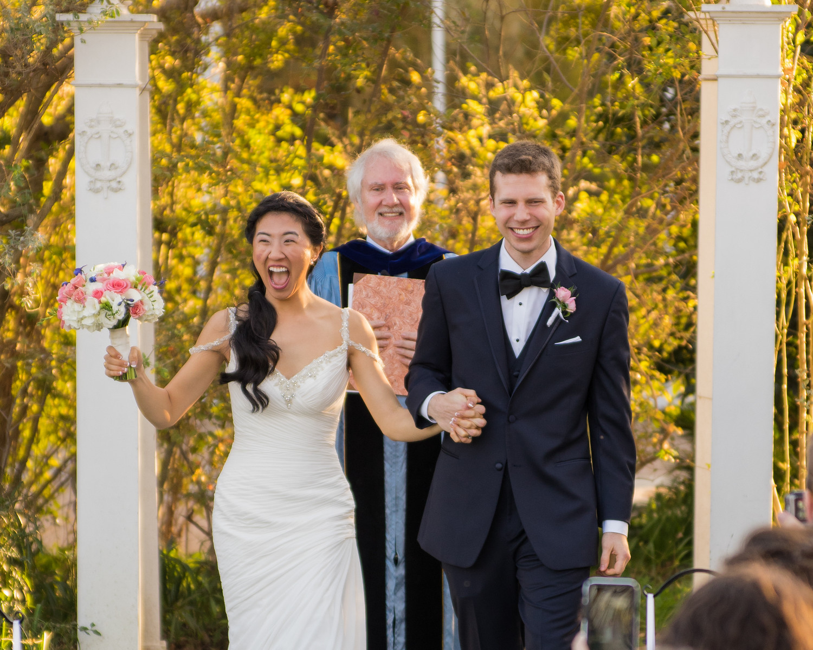
February 23, 2016

Slide 63
And 2011
1000
400 Alumni
Many scientists and physicians
4 UT Outstanding Students
3 Marshall Scholars plus many NSF and other leading fellowships
Three DS marriages plus divorces
6
many

Slide 64
And 2011
1000
400 Alumni
Many scientists and physicians
4 UT Outstanding Students
3 Marshall Scholars plus many NSF and other leading fellowships
Three DS marriages
One Gates Scholar
One Rhodes Scholar
6
many

Slide 65
New Activities
2003 Picasso at the Lapin Agile

Slide 66
New Activities
2003 Picasso at the Lapin Agile
2003 Arsenic and Old Lace … and more

Slide 67
New Activities
2003 Picasso at the Lapin Agile
2003 Arsenic and Old Lace … and more
Three Time Intramural Women’s Track Champions

Slide 68
New Activities
2003 Picasso at the Lapin Agile
2003 Arsenic and Old Lace … and more
Three Time Intramural Women’s Track Champions
One Time (B League) Coed Soccer Champions (James Scott in goal)

Slide 69
New Activities
2003 Picasso at the Lapin Agile
2003 Arsenic and Old Lace … and more
Three Time Intramural Women’s Track Champions
One Time (B League) Coed Soccer Champions
Tutoring

Slide 70
New Activities
2003 Picasso at the Lapin Agile
2003 Arsenic and Old Lace … and more
Three Time Intramural Women’s Track Champions
One Time (B League) Coed Soccer Champions
Tutoring
Lunch (yes, but not like before)

Slide 71
New Activities
2003 Picasso at the Lapin Agile
2003 Arsenic and Old Lace … and more
Three Time Intramural Women’s Track Champions
One Time (B League) Coed Soccer Champions
Tutoring
Lunch (yes, but not like before)
DS Dance (on, off, on)

Slide 72
The Faculty Review as of 2001
An expanded program ?
More students ?
Special Classes ?

Slide 73
Recommendations - 2002
Dean’s Scholars Honors Degrees to be administered by the college
Honors Courses – Biology, Mathematics, Computer Sciences, Physics, Chemistry

Slide 74
Approved - 2003
Dean’s Scholars Honors Degrees to be administered by the departments
Honors Courses – Biology, Mathematics, Computer Sciences, Physics, Chemistry

Slide 75
The Dean’s Scholars Degrees

Slide 76
The Dean’s Scholars Degrees
30 hours in major

Slide 77
The Dean’s Scholars Degrees
30 hours in major
30 hours DS requirements
  Honors courses in 4 or 5 areas
  Rhetoric
  Research and Honors Thesis

Slide 78
The Dean’s Scholars Degrees
30 hours in major
30 hours DS requirements
  Honors courses in 4 or 5 areas
  Rhetoric
  Research and Honors Thesis
30 hours UT requirements
  History, Government, Humanities, Fine Arts

Slide 79
The Dean’s Scholars Degrees
30 hours in major
30 hours DS requirements
  Honors courses in 4 or 5 areas
  Rhetoric
  Research and Honors Thesis
30 hours UT requirements
  History, Government, Humanities, Fine Arts
30 Hours Electives

Slide 80
The Dean’s Scholars Degrees
First Three Graduates 2006
First Four Year Graduates 2007

Slide 81
The Dean’s Scholars Degrees
First Three Graduates 2006
First Four Year Graduates 2007
Applications – 600 (2007)

Slide 82
The Dean’s Scholars Degrees
First Three Graduates 2006
First Four Year Graduates 2007
Applications – 600 (2007) …
and past 1000 still more (2008)

Slide 83
The Dean’s Scholars Degrees
First Three Graduates 2006
First Four Year Graduates 2007
Applications – 600 (2007) …
and past 1000 still more (2008)
Quality of applications – hard to believe

Slide 84
The Dean’s Scholars Degrees
First Three Graduates 2006
First Four Year Graduates 2007
Applications – 600 (2007) …
and past 1000 still more (2008)
Quality of applications – hard to believe
Quality of Graduates – even harder to believe

Slide 85
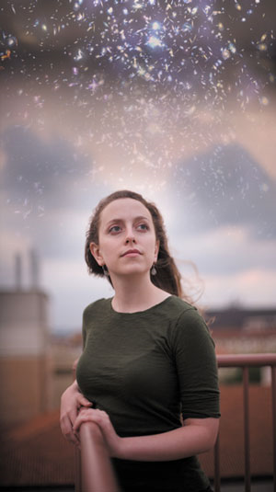
2008
First Rhodes Scholar:
Sarah Miller

Slide 86
2008
Why have I never seen
all these stars over RLM
before?
First Rhodes Scholar:
Sarah Miller

Slide 87
Award 2009
Dean’s Scholars Student Association wins
Swing Out Award as “Best New Organization”

Slide 88
Applications 2009-10
67

Slide 89
Applications 2009-10
67
For the 2010 class, there were 67 high school valedictorians who applied for the program … .

Slide 90
Applications 2009-10
67
For the 2010 class, there were 67 high school valedictorians who applied for the program and were rejected.

Slide 91
2010
New Program
Health Science Honors Program

Slide 92
2010
DS in Space

Slide 93
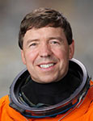
2010
DS in Space
Dean’s Scholar Joseph Barratt’s father Dr. Michael Barratt offers to carry memento of program aboard the final flight of space shuttle Discovery

Slide 94


Slide 95
2010
DS in Space
Launched Thursday, February 24, 2011

Slide 96
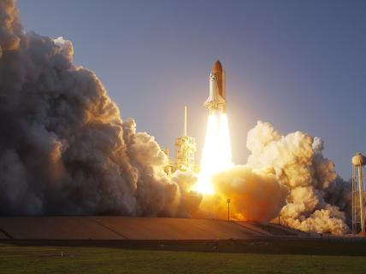

Slide 97
2011
Third DS Alumni Reunion

Slide 98
2011
Third DS Alumni Reunion
Cline steps down as director

Slide 99
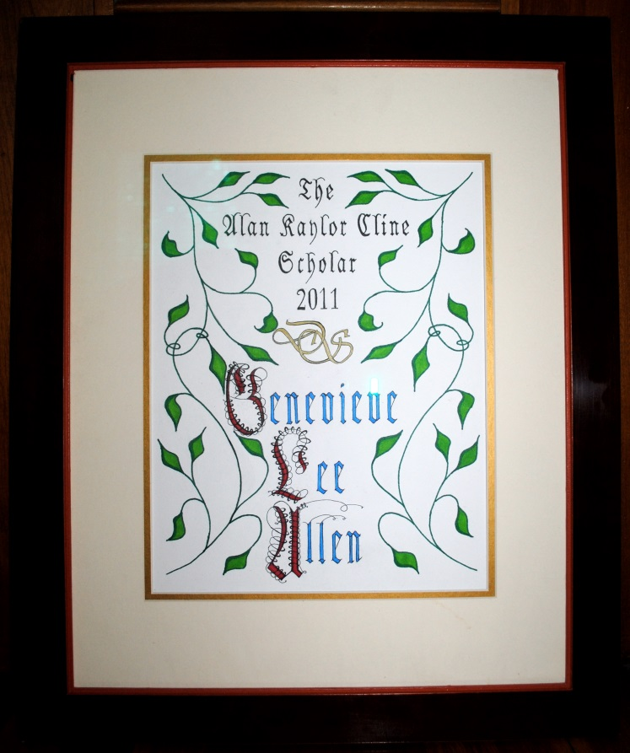
Dean’s Scholars Endowment Fund
2011

Slide 100
AKC Scholarship – 2011
2011: Genevieve Allen
2012: Guadalupe Jasso
2013: Patrick Hunt
2014: Nalin Ratnayeke
2015: Nakita Klimovich
2016: Michael Miyagi
2017: Hannah Hasson
2018: Griffin Glenn, Ted Shi, Rachel Rapagnani
2019: Maike Morrison, Emrys Peets
2020: Meghan Mallya

Slide 101
AKC Scholarship – 2011
2011: Genevieve Allen
2012: Guadalupe Jasso
2013: Patrick Hunt
2014: Nalin Ratnayeke
2015: Nakita Klimovich
2016: Michael Miyagi
2017: Hannah Hasson
2018: Griffin Glenn, Ted Shi, Rachel Rapagnani
2019: Maike Morrison, Emrys Peets
2020: Meghan Mallya
2021: YOU????

Slide 102
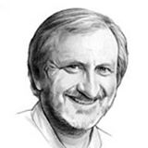
2011
David Hillis is fourth DS Director

Slide 103
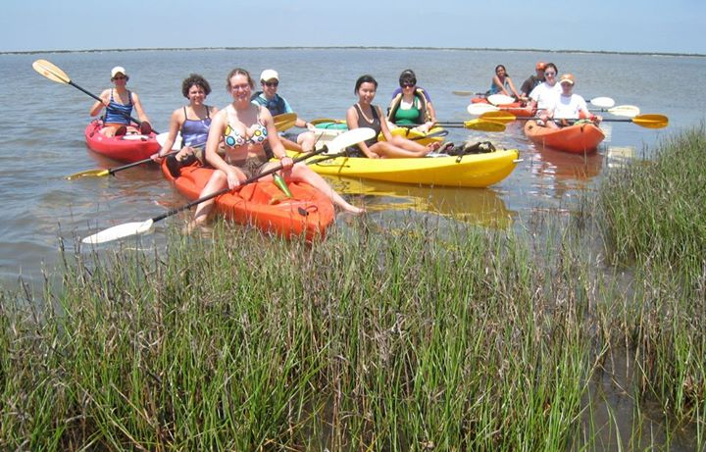
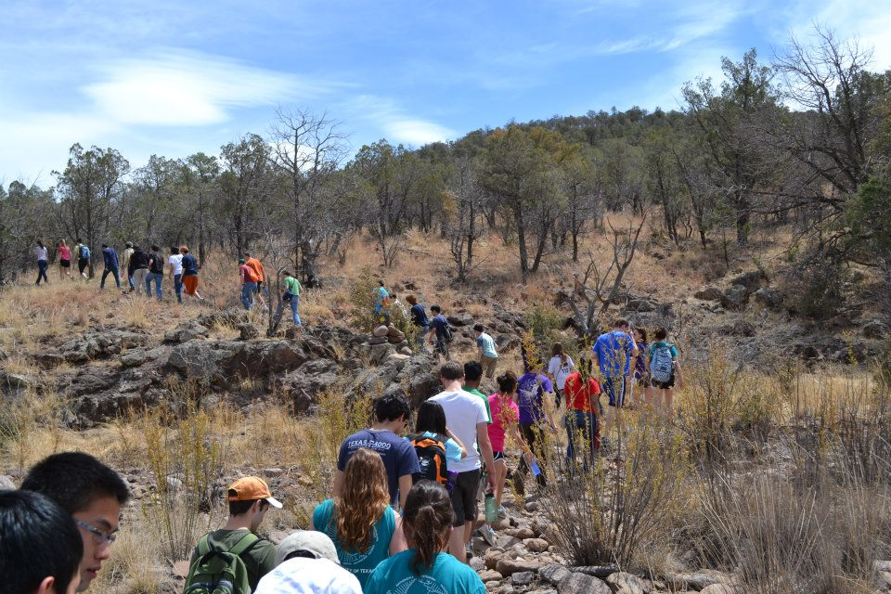
Post-2011

Slide 104
Post-2011
Increasing emphasis on research
including presentation of research -
ResULTS (Research and
Undergraduate Learning Talk Series)

Slide 105
Post-2011
Increasing emphasis on research
including presentation of research -
ResULTS (Research and
Undergraduate Learning Talk Series)
Holiday Dinner moved up to
late November – trivia competition,
dance

Slide 106
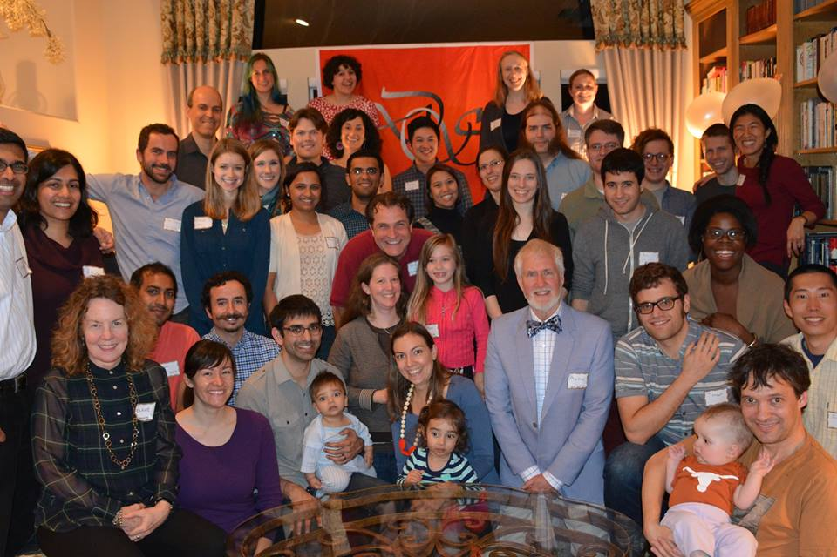
2015
DS Alumni Dinners – CA and TX

Slide 107
2019
40 for 40 Campaign for the DS Endowment
$13,248

Slide 108
2021
40 for 40 Campaign for the DS Endowment
$30,814

Slide 109
The Deans Scholars Scrapbook
Dinner menus, recipes,
and zillions of photos:
https://deansscholars.github.io/DS-Scrapbook/

Slide 110
What is DS?

Slide 111
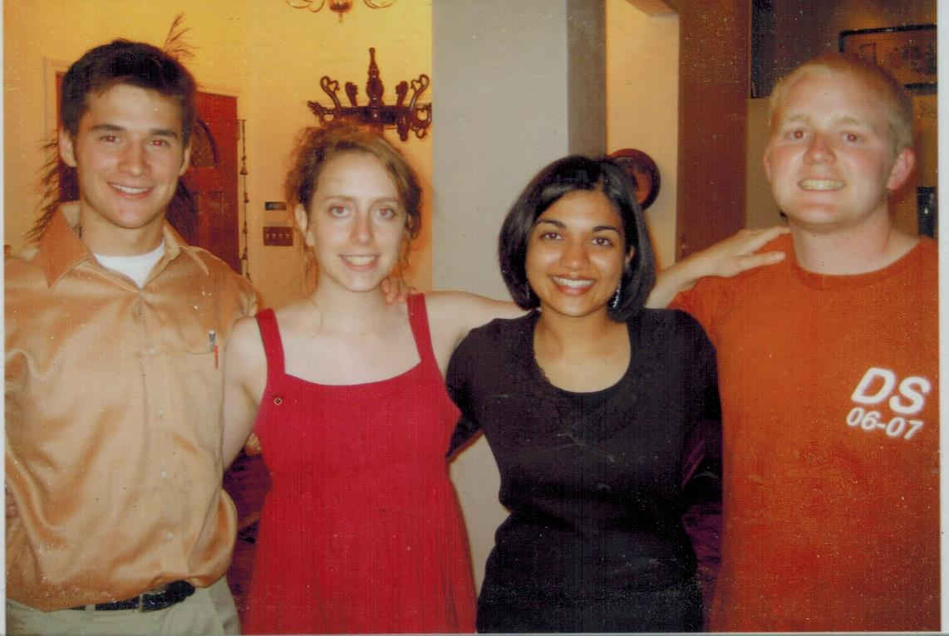
What is DS?

Slide 112
What is DS?
Pat Lawlor, in MD/PhD program at Northwestern

Slide 113
What is DS?
Pat Lawlor, in MD/PhD program at Northwestern
Rob Seilheimer, in MD/PhD program at Baylor College of Medicine

Slide 114
What is DS?
Pat Lawlor, in MD/PhD program at Northwestern
Rob Seilheimer, in MD/PhD program at Baylor College of Medicine
Richa Gupta, MD/Masters of Public Health program at Johns Hopkins

Slide 115
What is DS?
Pat Lawlor, in MD/PhD program at Northwestern
Rob Seilheimer, in MD/PhD program at Baylor College of Medicine
Richa Gupta, MD/Masters of Public Health program at Johns Hopkins
Sarah Miller, Rhodes Scholar, PhD Oxford

Slide 116
What is DS?
Pat Lawlor, in MD/PhD program at Northwestern
Rob Seilheimer, in MD/PhD program at Baylor College of Medicine
YOU
You, wonderful stuff
Richa Gupta, in MD/Masters of Public Health program at Johns Hopkins
Sarah Miller, Rhodes Scholar, PhD Oxford

Slide 117
2021
Tenth Anniversary of David Hillis
as DS Director

