Slide 1
Linear Algebra in a
Computational Setting
Alan Kaylor Cline
Dean’s Scholars Seminar
January 22, 2014

Slide 2
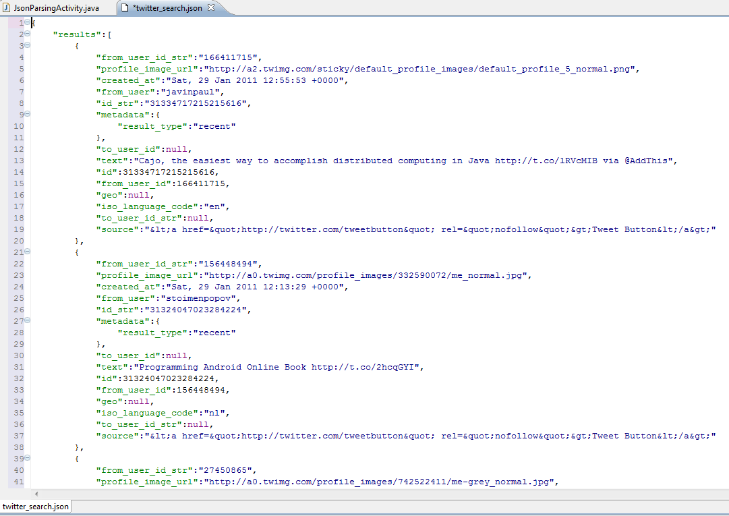
How long does it take for this code to run?

Slide 3
After examining the code you believe that the running time depends entirely upon some input parameter n and …
a good model for the running time is
Time(n) = a + b·log₂(n) + c·n + d·n·log₂(n)
where a, b, c, and d are constants
but currently unknown.

Slide 4
So you time the code for 4 values of n, namely n = 10, 100, 500, and 1000 and you get the times
Time(10) = 0.685 ms.
Time(100) = 7.247ms.
Time(500) = 38.511ms.
Time(1000) = 79.134 ms.
According to the model you then have
4 equations in the 4 unknowns a, b, c, and d:
a + b·log₂(10) + c·10 + d·10·log₂(10) = 0.685
a + b·log₂(100) + c·100 + d·100·log₂(100) = 7.247
a + b·log₂(500) + c·5000 + d·500·log₂(500) = 38.511
a + b·log₂(1000) + c·1000+ d·1000·log₂(1000) = 79.134

Slide 5
These equations are linear in the unknowns a, b, c, and d.
a + b·log₂(10) + c·10 + d·10·log₂(10) = 0.685
a + b·log₂(100) + c·100 + d·100·log₂(100) = 7.247
a + b·log₂(500) + c·5000 + d·500·log₂(500) = 38.511
a + b·log₂(1000) + c·1000+ d·1000·log₂(1000) = 79.134
We solve them and obtain:
a = 6.5
b = 10.3
c = 57.1
d = 2.2
So the final model for the running time is
Time(n) = 6.5 + 10.3·log₂(n) + 57.1·n + 2.2·n·log₂(n)

Slide 6
and now we may apply the model
Time(n) = 6.5 + 10.3·log₂(n) + 57.1·n + 2.2·n·log₂(n)
for a particular value of n (for example, n = 10,000)
to estimate a running time of
Time(10,000) = 6.5 + 10.3·log₂(10,000) +
57.1· 10,000 + 2.2· 10,000 ·log₂(10,000)
= 863.47 ms.

Slide 7
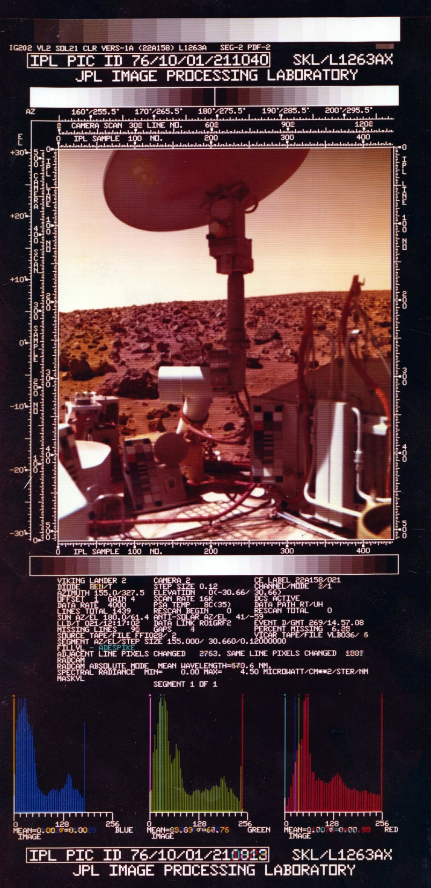
Picture from Mars
Oct. 1, 1976
One approach to the coloring of the images was to adjust manually the colors in the various patches.

Slide 8
Picture from Mars
Oct. 1, 1976
One approach to the coloring of the images was to adjust manually the colors in the various patches.

Slide 9
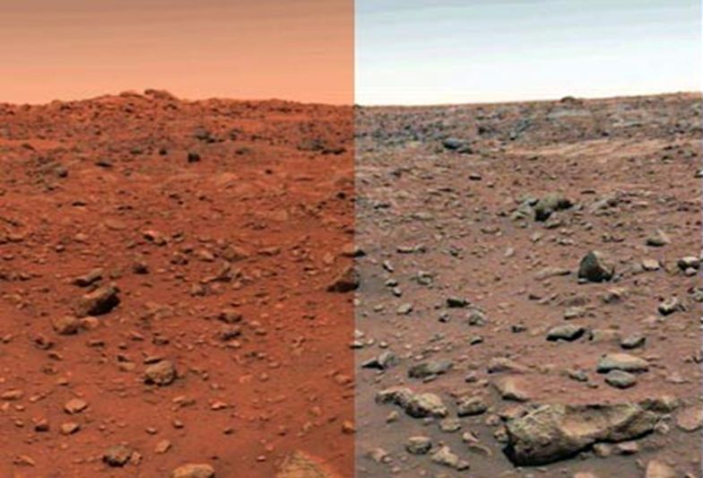
Picture from Mars
Oct. 1, 1976
One approach to the coloring of the images was to adjust manually the colors in the various patches.
This is what resulted:

Slide 10
Picture from Mars
Oct. 1, 1976
The other approach was to solve 6 x 6 linear systems for each pixel. The systems were based on the filters being used.

Slide 11
Picture from Mars
Oct. 1, 1976
The other approach was to solve 6 x 6 linear systems for each pixel. The systems were based on the filters being used.
This is what resulted:

Slide 12
Picture from Mars
Oct. 1, 1976
Compare the two:

Slide 13
But have we ignored something?

Slide 14
So you time the code for 30 values of n, and you get these times {(n_{i},t_{i})}

Slide 15
If the model was perfect
and there were no errors in the timings
then for some values a, b, c, d, and e:
a + b·log₂(n_{i}) + c·n_{i} + d·n_{i}·log₂(n_{i}) +e·n_{i}² = t_{i}
for i =1,…,30

Slide 16
But the model was not perfect
and there were error in the timings
So we do not expect to get any values a, b, c, d, and e so that:
a + b·log₂(n_{i}) + c·n_{i} + d·n_{i}·log₂(n_{i}) +e·n_{i}² = t_{i}
for i =1,…,30
We will settle for values a, b, c, d, and e so that:
a + b·log₂(n_{i}) + c·n_{i} + d·n_{i}·log₂(n_{i}) +e·n_{i}² ≈ t_{i}
for i =1,…,30

Slide 17
Our sense of
a + b·log₂(n_{i}) + c·n_{i} + d·n_{i}·log₂(n_{i}) +e·n_{i}² ≈ t_{i}
for i =1,…,30
Will be to get a, b, c, d, and e so that sum of squares of all of the differences
∑ (a + b·log₂(n_{i}) + c·n_{i} + d·n_{i}·log₂(n_{i}) +e·n_{i}² - t_{i})²
is minimized over all possible choices of a, b, c, d, and e

Slide 18
After solving the least squares system to get the best values of a, b, c, d, and e, we plot a + b·log₂(n) + c·n + d·n·log₂(n) + e·n²

Slide 19
What’s a “good” solution when we don’t have the exact solution?

Slide 20
What’s a “good” solution when we don’t have the exact solution?
“Hey. That’s not a question that was
discussed in other math classes.”

Slide 21

What’s a “good” solution when we don’t have the exact solution?
Consider the two equations:
$$\begin{matrix}.780 x+ .563 y= .217 \\ .913 x+ .659 y=.254\end{matrix}$$

Slide 22


Consider two approximate solution pairs:
$$\begin{matrix}x_{1} \\ y_{1} \end{matrix}\begin{matrix}= \\ =\end{matrix}\begin{matrix} .999 \\ −1.001\end{matrix}$$
$$\begin{matrix}x_{2} \\ y_{2} \end{matrix}\begin{matrix}= \\ =\end{matrix}\begin{matrix} .341 \\ −0.087\end{matrix}$$
and these two equations:
$$\begin{matrix}.780 x+ .563 y= .217 \\ .913 x+ .659 y=.254\end{matrix}$$

Slide 23
Consider two approximate solution pairs:
$$\begin{matrix}x_{1} \\ y_{1} \end{matrix}\begin{matrix}= \\ =\end{matrix}\begin{matrix} .999 \\ −1.001\end{matrix}$$
$$\begin{matrix}x_{2} \\ y_{2} \end{matrix}\begin{matrix}= \\ =\end{matrix}\begin{matrix} .341 \\ −0.087\end{matrix}$$
and these two equations:
$$\begin{matrix}.780 x+ .563 y= .217 \\ .913 x+ .659 y=.254\end{matrix}$$
Which pair of these two is better?

Slide 24

Important fact to consider:
$$\begin{matrix}x_{1} \\ y_{1} \end{matrix}\begin{matrix}= \\ =\end{matrix}\begin{matrix} .999 \\ −1.001\end{matrix}$$
$$\begin{matrix}x_{2} \\ y_{2} \end{matrix}\begin{matrix}= \\ =\end{matrix}\begin{matrix} .341 \\ −0.087\end{matrix}$$
The exact solution is:
$$\begin{matrix}x=1 \\ y=−1\end{matrix}$$
Which pair of these two is better?

Slide 25
Consider two approximate solution pairs:
$$\begin{matrix}x_{1} \\ y_{1} \end{matrix}\begin{matrix}= \\ =\end{matrix}\begin{matrix} .999 \\ −1.001\end{matrix}$$
$$\begin{matrix}x_{2} \\ y_{2} \end{matrix}\begin{matrix}= \\ =\end{matrix}\begin{matrix} .341 \\ −0.087\end{matrix}$$
and these two equations:
$$\begin{matrix}.780 x+ .563 y= .217 \\ .913 x+ .659 y=.254\end{matrix}$$
Which pair of these two is better?

Slide 26
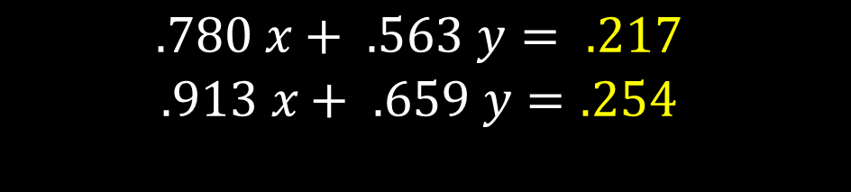
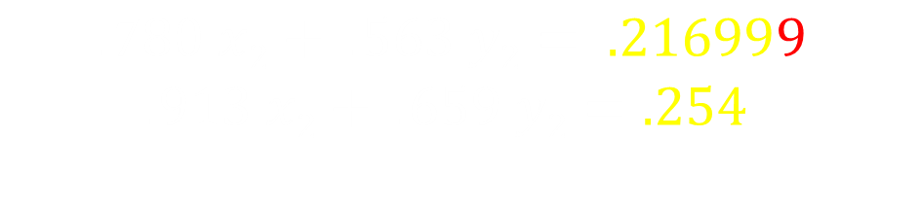
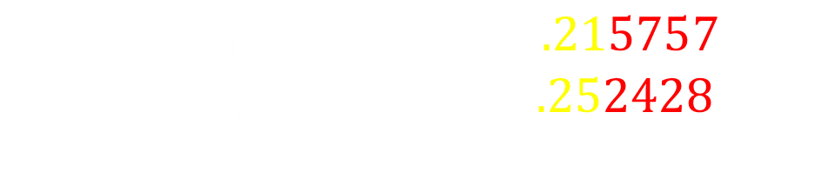
Important fact to consider:
$$\begin{matrix}x_{1} \\ y_{1} \end{matrix}\begin{matrix}= \\ =\end{matrix}\begin{matrix} .999 \\ −1.001\end{matrix}$$
$$\begin{matrix}x_{2} \\ y_{2} \end{matrix}\begin{matrix}= \\ =\end{matrix}\begin{matrix} .341 \\ −0.087\end{matrix}$$
Recall we are trying to solve:
$$\begin{matrix}.780 x+ .563 y= .217 \\ .913 x+ .659 y=.254\end{matrix}$$
For the first pair, we have:
$$\begin{matrix}.780 x1+ .563 y1= .215757 \\ .913 x1+ .659 y1=.252428\end{matrix}$$
For the second pair, we have:
$$\begin{matrix}.780 x2+ .563 y2= .216999 \\ .913 x2+ .659 y2=.254 \end{matrix}$$
Which pair of these two is better?

Slide 27
Important fact to consider:
$$\begin{matrix}x_{1} \\ y_{1} \end{matrix}\begin{matrix}= \\ =\end{matrix}\begin{matrix} .999 \\ −1.001\end{matrix}$$
$$\begin{matrix}x_{2} \\ y_{2} \end{matrix}\begin{matrix}= \\ =\end{matrix}\begin{matrix} .341 \\ −0.087\end{matrix}$$
Which pair of these two is better?

Slide 28

Student: “Is there something funny about that problem?”

Slide 29

Student: “Is there something funny about that problem?”
Professor: “You bet your life. It looks innocent but it is very strange. The problem is knowing when you have a strange case on your hands.”
CLINE

Slide 30
Professor: “Geometrically, solving equations is like finding the intersections of lines.”
CLINE

Slide 31
When lines have no thickness …
here’s the intersection?

Slide 32
… but when lines have thickness …
where’s the intersection?

Slide 33

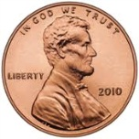
Galveston Island
25.96 miles

Slide 34
Galveston Island
25.96 miles
Where’s the intersection?

Slide 35
London Olympics Swimming
http://www.youtube.com/watch?v=fFiV4ymEDfY&feature=related
1:19

Slide 36
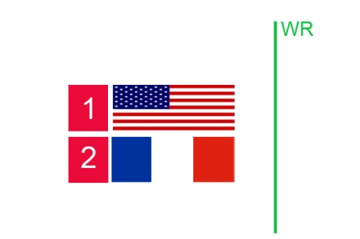
How do you transform this image …

Slide 37
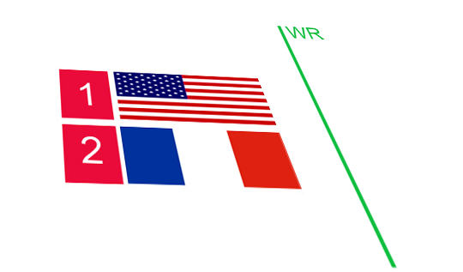
How do you transform this image …
into the coordinate system of another image?

Slide 38


and in greater generality, transform
3-dimensional objects

Slide 39
The $25 Billion Eigenvector
How does Google do Pagerank?

Slide 40
The $25 Billion Eigenvector
How did Google do Pagerank?

Slide 41
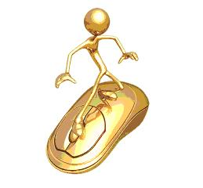
The Imaginary Web Surfer:
Starts at any page,
Randomly goes to a page linked from the current page,
Randomly goes to any web page from a dangling page,
… except sometimes (e.g. 15% of the time), goes to a purely random page.

Slide 42
A tiny web: who should get the highest rank?
J
A
B
I
C
H
D
G
F
E

Slide 43
The associated stochastic matrix:
0.0150 0.0150 0.0150 0.0150 0.0150 0.0150 0.4400 0.0150 0.0150 0.2983
0.4400 0.0150 0.0150 0.0150 0.0150 0.0150 0.0150 0.0150 0.0150 0.0150
0.0150 0.2983 0.0150 0.0150 0.0150 0.0150 0.0150 0.0150 0.0150 0.0150
0.0150 0.2983 0.8650 0.0150 0.0150 0.0150 0.0150 0.0150 0.0150 0.0150
0.4400 0.0150 0.0150 0.8650 0.0150 0.8650 0.0150 0.0150 0.0150 0.0150
0.0150 0.2983 0.0150 0.0150 0.8650 0.0150 0.0150 0.0150 0.0150 0.0150
0.0150 0.0150 0.0150 0.0150 0.0150 0.0150 0.0150 0.8650 0.0150 0.0150
0.0150 0.0150 0.0150 0.0150 0.0150 0.0150 0.0150 0.0150 0.8650 0.2983
0.0150 0.0150 0.0150 0.0150 0.0150 0.0150 0.0150 0.0150 0.0150 0.2983
0.0150 0.0150 0.0150 0.0150 0.0150 0.0150 0.4400 0.0150 0.0150 0.0150

Slide 44
We seek to find a vector x so that
A x = x
One way is to start with some initial x⁰,
and then:
for k = 1, 2, 3,…
x^{k} = A x^{k-1}
This converges to an x so that A x = x

Slide 45
Start with equal components

Slide 46
One iteration

Slide 47
Two iterations

Slide 48
Three iterations

Slide 49
Four iterations

Slide 50
Five iterations

Slide 51
Six iterations

Slide 52
Seven iterations

Slide 53
Eight iterations

Slide 54
Nine iterations

Slide 55
Ten iterations

Slide 56
The Eigenvector

Slide 57
[U,G] = surfer ('http://cns.utexas.edu/honors/honors-programs-center/deans-scholars', 100)

Slide 58
Pagerank Power Iteration the limit

Slide 59
And the winners are…
'http://www.utexas.edu'
'http://www.utexas.edu/maps'
'http://www'
'http://m.utexas.edu'
'http://www.utexas.edu/emergency'
'http://www.lib.utexas.edu' 'http://www.utexas.edu/parking/transportation/shuttle'
'http://healthyhorns.utexas.edu'
'http://www.utexas.edu/know/feed'
'http://www.utexas.edu/know'
'http://cns.utexas.edu'

Slide 60
How much storage to hold this array?
Current estimate of indexed WWW:
      4.7 · 10¹⁰ web pages
If placed into an array this would have
      2.21 · 10²¹ elements
If each element is stored in 4 bytes, this would be
    8.8 · 10²² bytes
Current estimate of world’s data storage capacity is 3.0 · 10¹⁸ bytes (.003% of necessary space)
http://www.smartplanet.com/blog/thinking-tech/what-is-the-worlds-data-storage-capacity/6256
Notes:
http://www.smartplanet.com/blog/thinking-tech/what-is-the-worlds-data-storage-capacity/6256

Slide 61
How much time to do one power step?
Current estimate of indexed WWW:
      4.7 · 10¹⁰ web pages
If placed into an array this would have
      2.21 · 10²¹ elements
Fastest current machine does 33.86 · 10¹⁵ operations per second
One step of y = Ay takes 3.68 days
Notes:
http://www.smartplanet.com/blog/thinking-tech/what-is-the-worlds-data-storage-capacity/6256

Slide 62
Go Home Now.
Notes:
http://www.smartplanet.com/blog/thinking-tech/what-is-the-worlds-data-storage-capacity/6256

