Slide 1

Milestones of The
Dean’s Scholars

Slide 2
The Beginning 1983-84

Slide 3
The Beginning 1983-84
Was there something earlier?

Slide 4
The Beginning 1983-84
Was there something earlier?
Program intended to admit about 25 per year – achieve a steady state of 100.

Slide 5
The Beginning 1983-84
Was there something earlier?
Program intended to admit about 25 per year – achieve a steady state of 100.
Jim Vick was Director.

Slide 6
The Beginning 1983-84
Was there something earlier?
Program intended to admit about 25 per year – achieve a steady state of 100.
Jim Vick was Director.
Mike Starbird taught the freshman seminar.

Slide 7
The Beginning 1983-84
Was there something earlier?
Program intended to admit about 25 per year – achieve a steady state of 100.
Jim Vick was Director.
Mike Starbird taught the freshman seminar.
January trip to Port Aransas

Slide 8
1985-86
Starbird goes on leave.
Cline replaces him in the freshman seminar.
(Zen and the Art of Motorcycle Maintenance.)

Slide 9
1986-87
Freshmen DS includes only 5 women.
First DS Musicale.
Sandman Song
First end of year dinner.
Snicker’s Cake

Slide 10
1987- 88
Student group (Rozendaal, Slagle, Wobus, Otillar, Fleckenstein) propose a more serious program.
Fall Picnic

Slide 11
1988-89
Vick becomes Student Affairs VP
Starbird becomes Associate Dean and DS Director.

Slide 12
1989-90:
Second student group recommends changes
Starbird says all DSers should complete deaprtmental honors degrees

Slide 13
1990-91:
Cline out of program

Slide 14
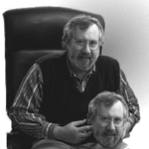
1991-92
Cline becomes DS Director
Tiny freshman class. (2 women).
Monthly activities started
Beitzel, Ramser, Murthy, Herrod, Huckaby
1994 – Computer Accounts for DS
Middle School Enrichment Program initiated (Murthy, Feldmeyer)

Slide 15
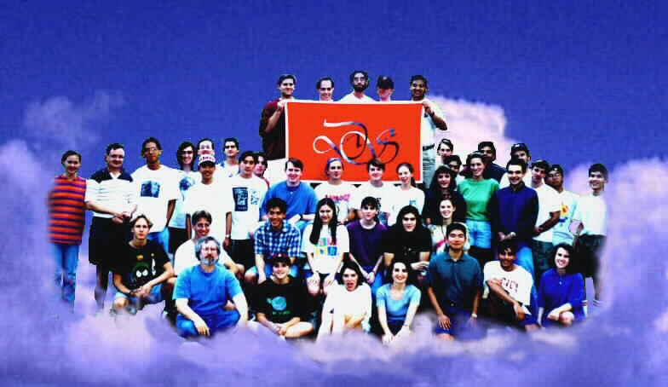
Picnic 1994

Slide 16
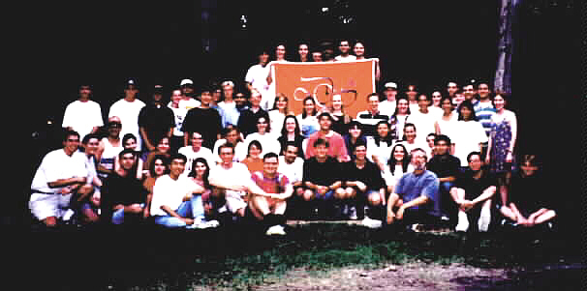
Picnic 1995

Slide 17
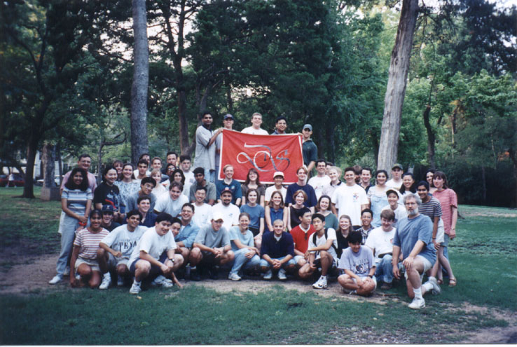
Picnic 1996

Slide 18
Picnic 1996

Slide 19
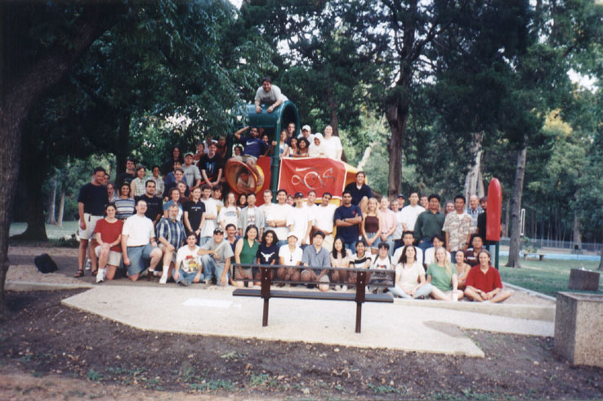
Picnic 1997

Slide 20
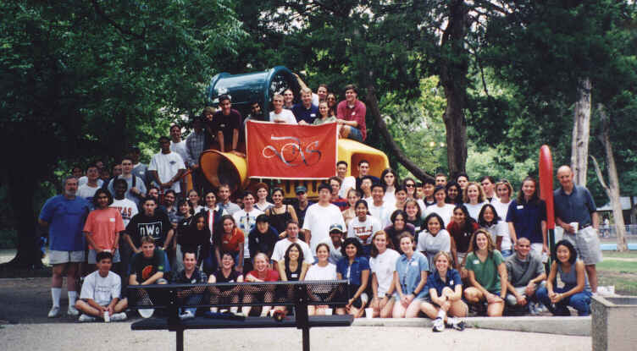
Picnic 1998

Slide 21
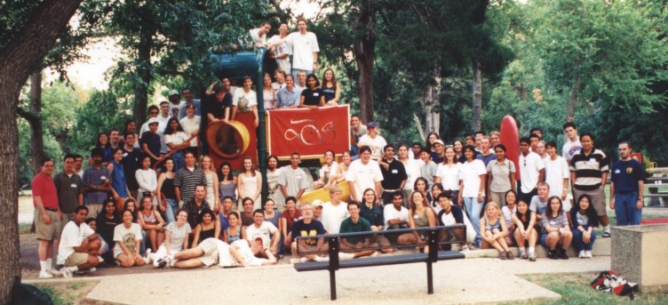
Picnic 1999

Slide 22
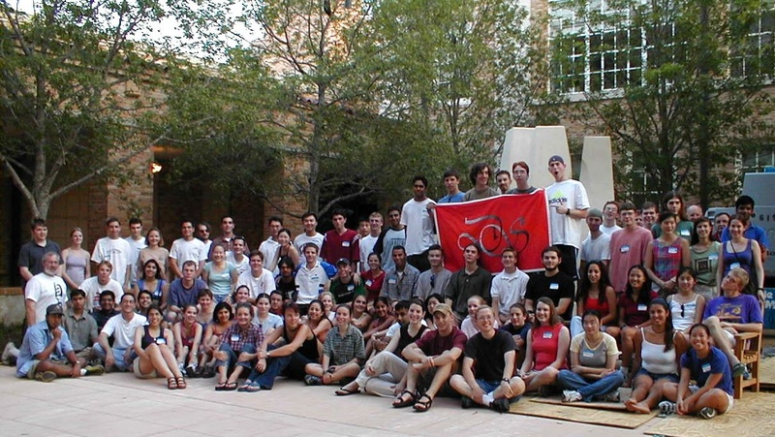
Picnic 2000

Slide 23
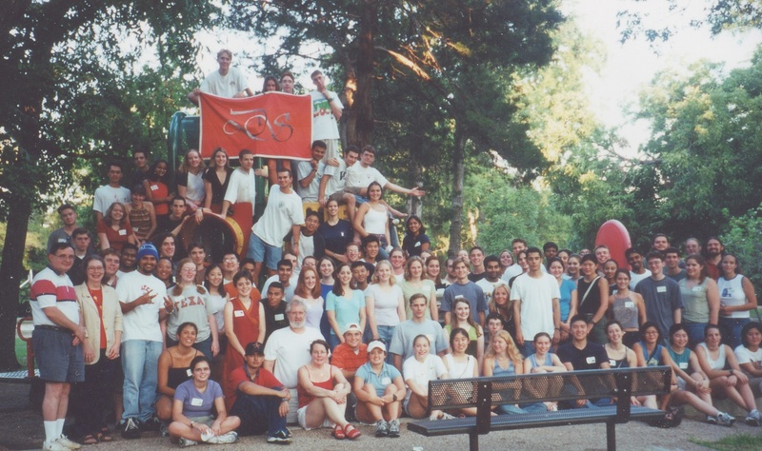
Picnic 2001

Slide 24
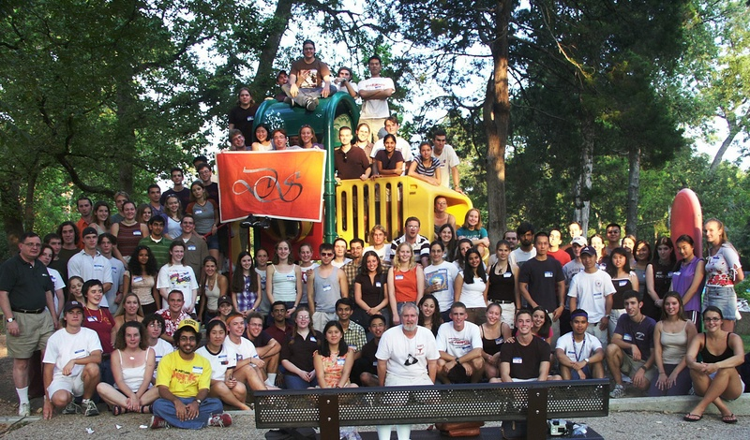
Picnic 2002

Slide 25
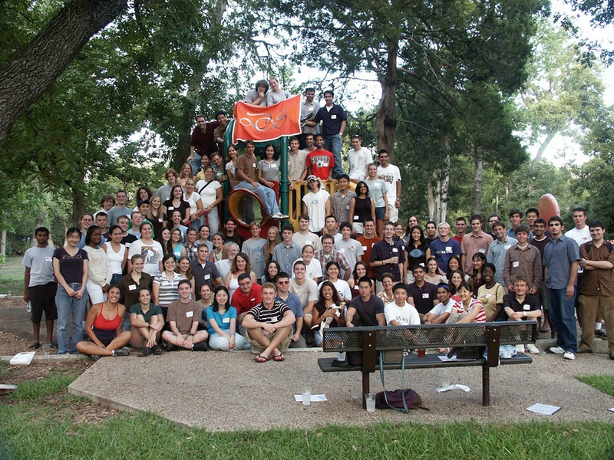
Picnic 2003

Slide 26
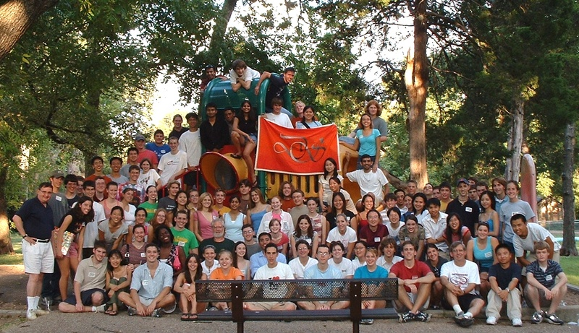
Picnic 2004

Slide 27
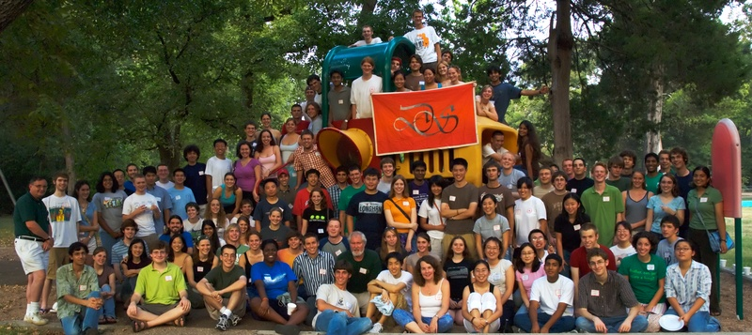
Picnic 2005

Slide 28
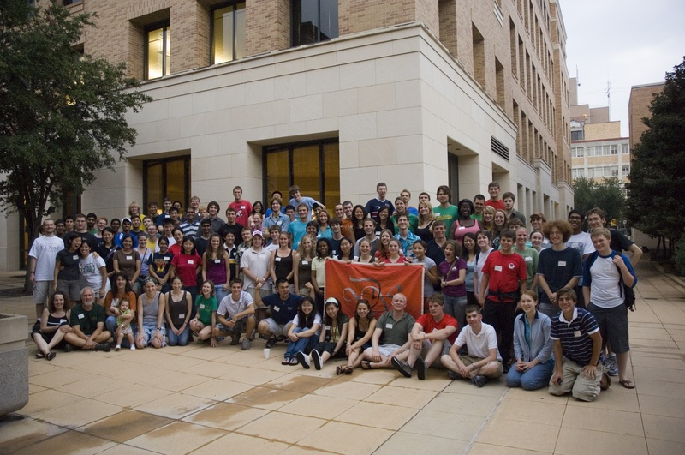
Picnic 2006

Slide 29
Picnic 2007
Where are you?

Slide 30
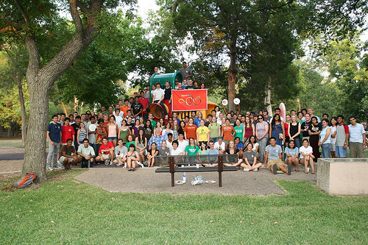
Picnic 2008

Slide 31
… and then
1994 - Present Berdahl speaks at lunch
1994 – Priority Registration for DS
1995 - MSEP brings students to UT (Bhogte)

Slide 32
The Charge
1996 – Program approaching 100 Dean’s Scholars
Dean Rankin asks for the program to be doubled

Slide 33
The DS Student Association
DS Student Association born in 1997
suggested by Brehm
First council chaired by Liao
Third Student Committee
Second year’s speaking seminars

Slide 34
…and more activities
1998 – Upper Division DS Speaker Series
2000 – Oliver Sacks, Jared Diamond, …
1998 – December dinner
1998 - DS given office space in ESB
“The Dungeon”
2000 - Organ Donor Drive (DeZern)

Slide 35
Where did we stand?
March, 2001
160 Dean’s Scholars
8-10 seminars
30 admitted from HS – 20 from current students
about half pre-med (several MD/PhD per year)

Slide 36
Looking Back from 2001
400 Alumni
Many scientists and physicians
4 UT Outstanding Students
3 Marshall Scholars plus many NSF and other leading fellowships
Three DS marriages

Slide 37
Where do we stand?
March, 2011
Currently 160 Dean’s Scholars
8-10 seminars
30 admitted from HS – 20 from current students
about half pre-med (several MD/PhD per year)
215
11
35
15
40%

Slide 38
And Now
1000
400 Alumni
Many scientists and physicians
4 UT Outstanding Students
3 Marshall Scholars plus many NSF and other leading fellowships
Three DS marriages
6
many

Slide 39
And Now
1000
400 Alumni
Many scientists and physicians
4 UT Outstanding Students
3 Marshall Scholars plus many NSF and other leading fellowships
Three DS marriages
One Gates Scholar
One Rhodes Scholar
6
Four

Slide 40
And Now
700
400 Alumni
Many scientists and physicians
4 UT Outstanding Students
3 Marshall Scholars plus many NSF and other leading fellowships
Three DS marriages
One Gates Scholar
One Rhoads Scholar
5
Four

Slide 41
New Activities
2003 Picasso at the Lapin Agile

Slide 42
New Activities
2003 Picasso at the Lapin Agile
2003 Arsenic and Old Lace … and more

Slide 43
New Activities
2003 Picasso at the Lapin Agile
2003 Arsenic and Old Lace … and more
Three Time Intramural Women’s Track Champions

Slide 44
New Activities
2003 Picasso at the Lapin Agile
2003 Arsenic and Old Lace … and more
Three Time Intramural Women’s Track Champions
One Time (B League) Coed Soccer Champions

Slide 45
New Activities
2003 Picasso at the Lapin Agile
2003 Arsenic and Old Lace … and more
Three Time Intramural Women’s Track Champions
One Time (B League) Coed Soccer Champions
Tutoring

Slide 46
New Activities
2003 Picasso at the Lapin Agile
2003 Arsenic and Old Lace … and more
Three Time Intramural Women’s Track Champions
One Time (B League) Coed Soccer Champions
Tutoring
Lunch (yes, but not like before)

Slide 47
New Activities
2003 Picasso at the Lapin Agile
2003 Arsenic and Old Lace … and more
Three Time Intramural Women’s Track Champions
One Time (B League) Coed Soccer Champions
Tutoring
Lunch (yes, but not like before)
DS Dance (on, off, on)

Slide 48
Administrative Assistance
1983-1992 – Dean’s Office

Slide 49
Administrative Assistance
1983-1992 – Dean’s Office
1992-2001 – Students (lots)

Slide 50
Administrative Assistance
1983-1992 – Dean’s Office
1992-2001 – Students (lots)
2001-2005 – Brett Westbrook-Program Coordinator

Slide 51
Administrative Assistance
1983-1992 – Dean’s Office
1992-2001 – Students (lots)
2001-2005 – Brett Westbrook-Program Coordinator
2005-2006 - Dean’s Office (again)

Slide 52
Administrative Assistance
1983-1992 – Dean’s Office
1992-2001 – Students (lots)
2001-2005 – Brett Westbrook-Program Coordinator
2005-2006 - Dean’s Office (again)
2006-2010 – Allisa Carter – Program Coordinator + academic advisors

Slide 53
Administrative Assistance
1983-1992 – Dean’s Office
1992-2001 – Students (lots)
2001-2005 – Brett Westbrook-Program Coordinator
2005-2006 - Dean’s Office (again)
2006-2010 – Allisa Carter – Program Coordinator + academic advisors
2010-present - Office for Honors, Research and International Study

Slide 54
The Faculty Review as of 2001
An expanded program ?
More students ?
Special Classes ?

Slide 55
Recommendations - 2002
Dean’s Scholars Honors Degrees to be administered by the college
Honors Courses – Biology, Mathematics, Computer Sciences, Physics, Chemistry

Slide 56
Approved - 2003
Dean’s Scholars Honors Degrees to be administered by the departments
Honors Courses – Biology, Mathematics, Computer Sciences, Physics, Chemistry

Slide 57
The Dean’s Scholars Degrees

Slide 58
The Dean’s Scholars Degrees
30 hours in major

Slide 59
The Dean’s Scholars Degrees
30 hours in major
30 hours DS requirements
  Honors courses in 4 or 5 areas
  Rhetoric
  Research and Honors Thesis

Slide 60
The Dean’s Scholars Degrees
30 hours in major
30 hours DS requirements
  Honors courses in 4 or 5 areas
  Rhetoric
  Research and Honors Thesis
30 hours UT requirements
  History, Government, Humanities, Fine Arts

Slide 61
The Dean’s Scholars Degrees
30 hours in major
30 hours DS requirements
  Honors courses in 4 or 5 areas
  Rhetoric
  Research and Honors Thesis
30 hours UT requirements
  History, Government, Humanities, Fine Arts
30 Hours Electives

Slide 62
The Dean’s Scholars Degrees
First Three Graduates 2006
First Four Year Graduates 2007

Slide 63
The Dean’s Scholars Degrees
First Three Graduates 2006
First Four Year Graduates 2007
Applications – 600 (2007)

Slide 64
The Dean’s Scholars Degrees
First Three Graduates 2006
First Four Year Graduates 2007
Applications – 600 (2007) …
and past 1000 still more (2008)

Slide 65
The Dean’s Scholars Degrees
First Three Graduates 2006
First Four Year Graduates 2007
Applications – 600 (2007) …
and past 1000 still more (2008)
Quality of applications – hard to believe

Slide 66
The Dean’s Scholars Degrees
First Three Graduates 2006
First Four Year Graduates 2007
Applications – 600 (2007) …
and past 1000 still more (2008)
Quality of applications – hard to believe
Quality of Graduates – even harder to believe

Slide 67

2008
First Rhodes Scholar:
Sarah Miller

Slide 68
2008
Why have I never seen
all these stars over RLM
before?
First Rhodes Scholar:
Sarah Miller

Slide 69
Award 2009
Dean’s Scholars Student Association wins
Swing Out Award as “Best New Organization”

Slide 70
Applications 2009-10
67

Slide 71
Applications 2009-10
67
For the 2010 class, there were 67 high school valedictorians who applied for the program … .

Slide 72
Applications 2009-10
67
For the 2010 class, there were 67 high school valedictorians who applied for the program and were rejected.

Slide 73
2010
New Program

Slide 74
2010
New Program
Health Science Honors Program

Slide 75
2010
DS in Space

Slide 76
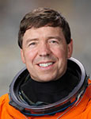
2010
DS in Space
Dean’s Scholar Joseph Barratt’s father Dr. Michael Barratt offers to carry memento of program aboard the final flight of space shuttle Discovery

Slide 77
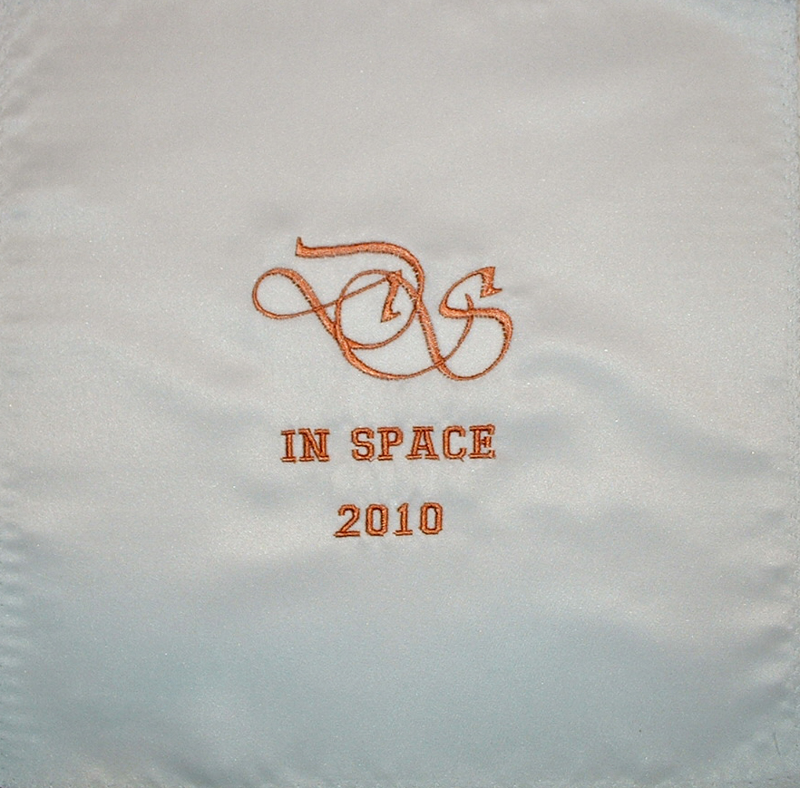

Slide 78
2010
DS in Space
Launched Thursday, February 24, 2011

Slide 79
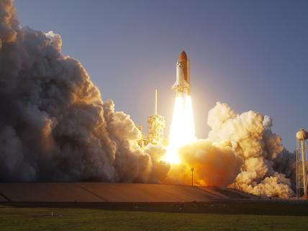

Slide 80
2010
Some Setbacks

Slide 81
2010
Some Setbacks
Lost our coordinator

Slide 82
2010
Some Setbacks
Lost our coordinator
Lost most scholarships

Slide 83
The Future

Slide 84
The Future
No growth

Slide 85
The Future
No growth
More early research experience

Slide 86
The Future
No growth
More early research experience
More switches of interest from medical school to graduate school

Slide 87
The Future
No growth
More early research experience
More switches of interest from medical school to graduate school
More MD/PhD candidates

Slide 88
The Future
No growth
More early research experience
More switches of interest from medical school to graduate school
More MD/PhD candidates
More and stronger applications

Slide 89
The Future – 2011

Slide 90
The Future – 2011
Cline steps down as director

Slide 91
The Future – 2011
Cline steps down as director
David Hillis to be fourth DS Director

