Slide 1
Milestones of The Dean’s Scholars

Slide 2
The Beginning 1983-84

Slide 3
The Beginning 1983-84
Was there something earlier?

Slide 4
The Beginning 1983-84
Was there something earlier?
Program intended to admit about 25 per year – achieve a steady state of 100.

Slide 5
The Beginning 1983-84
Was there something earlier?
Program intended to admit about 25 per year – achieve a steady state of 100.
Jim Vick was Director.

Slide 6
The Beginning 1983-84
Was there something earlier?
Program intended to admit about 25 per year – achieve a steady state of 100.
Jim Vick was Director.
Mike Starbird taught the freshman seminar.

Slide 7
The Beginning 1983-84
Was there something earlier?
Program intended to admit about 25 per year – achieve a steady state of 100.
Jim Vick was Director.
Mike Starbird taught the freshman seminar.
January trip to Port Aransas

Slide 8
1985-86
Starbird goes on leave.
Cline replaces him in the freshman seminar.

Slide 9
1986-87
Freshmen DS includes only 5 women.
First DS Musicale.
Sandman Song
First end of year dinner.
Snicker’s Cake

Slide 10
1987- 88
Student group (Rozendaal, Slagle, Wobus, Otillar, Fleckenstein) propose a more serious program.
Fall Picnic

Slide 11
1988-89
Vick becomes Student Affairs VP
Starbird becomes Associate Dean and DS Director.

Slide 12
1989-90:
Second student group recommends changes
Starbird says all DSers should complete departmental honors degrees

Slide 13
1990-91:
Cline out of program

Slide 14
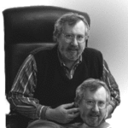
1991-92
Cline becomes DS Director
Tiny freshman class. (2 women).
Monthly activities started
Beitzel, Ramser, Murthy, Herrod, Huckaby
1994 – Computer Accounts for DS
Middle School Enrichment Program initiated (Murthy, Feldmeyer)

Slide 15
Picnic 1994

Slide 16
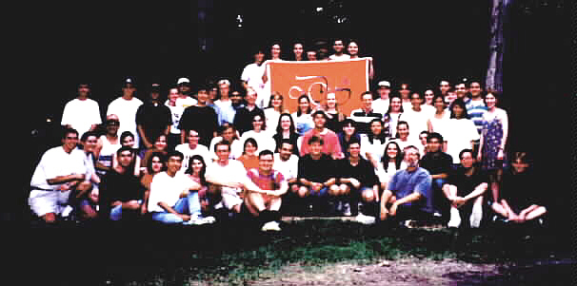
Picnic 1995

Slide 17
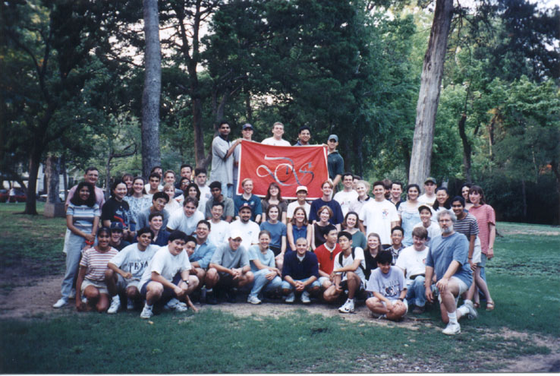
Picnic 1996

Slide 18
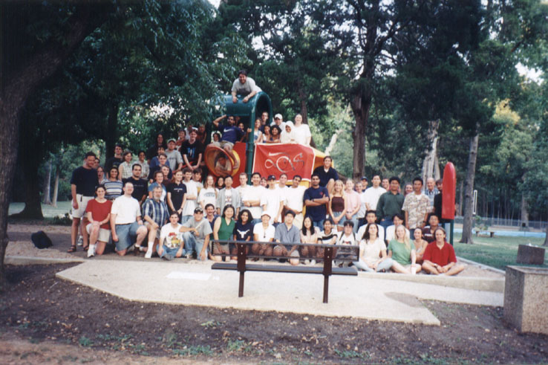
Picnic 1997

Slide 19
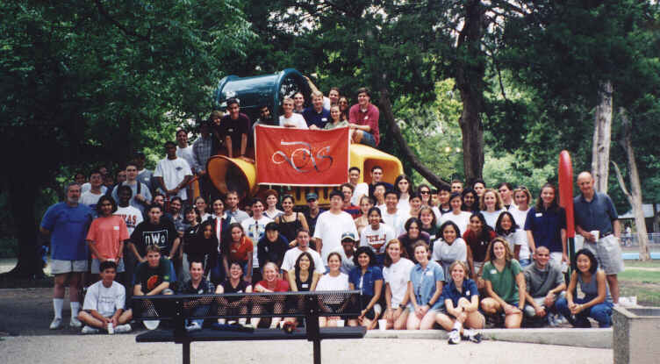
Picnic 1998

Slide 20
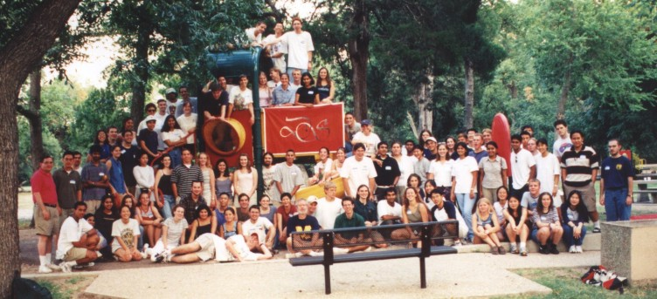
Picnic 1999

Slide 21
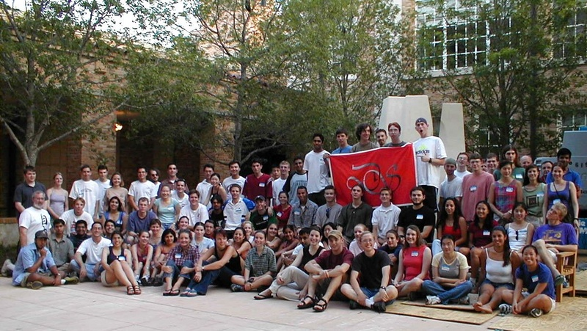
Picnic 2000

Slide 22
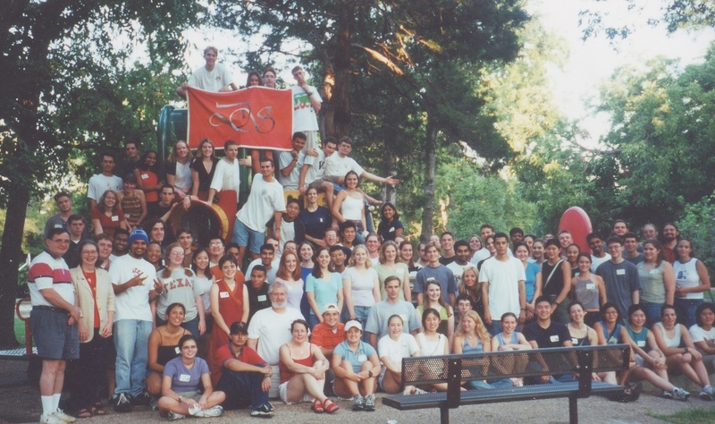
Picnic 2001

Slide 23
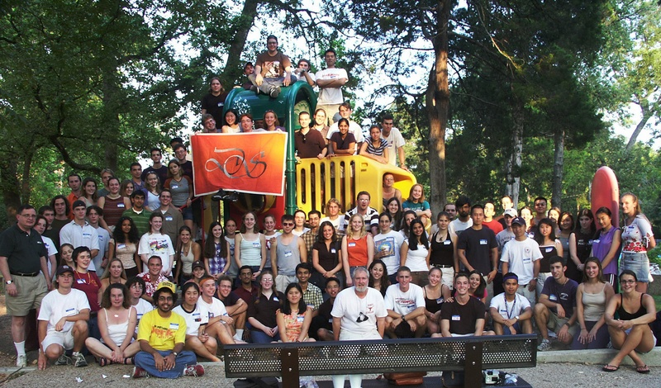
Picnic 2002

Slide 24
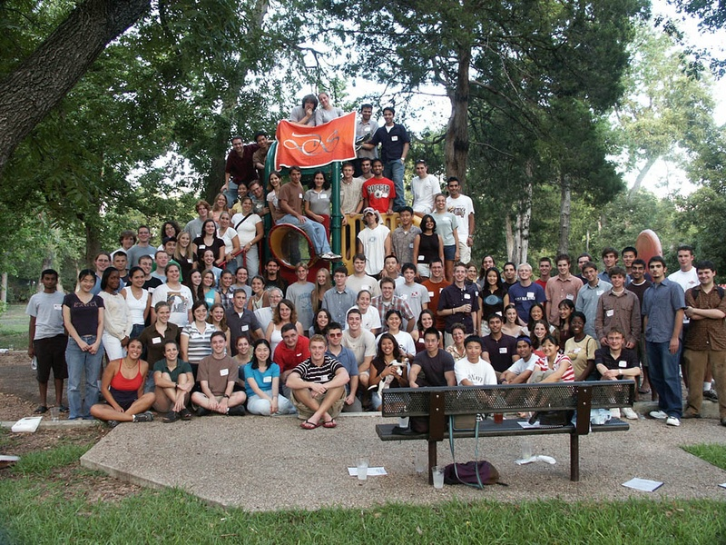
Picnic 2003

Slide 25
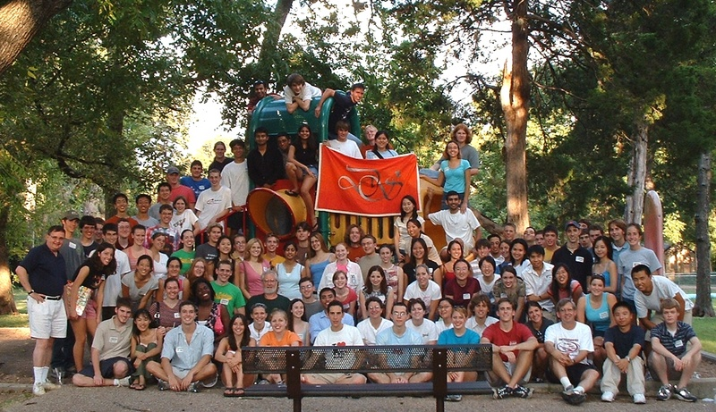
Picnic 2004

Slide 26
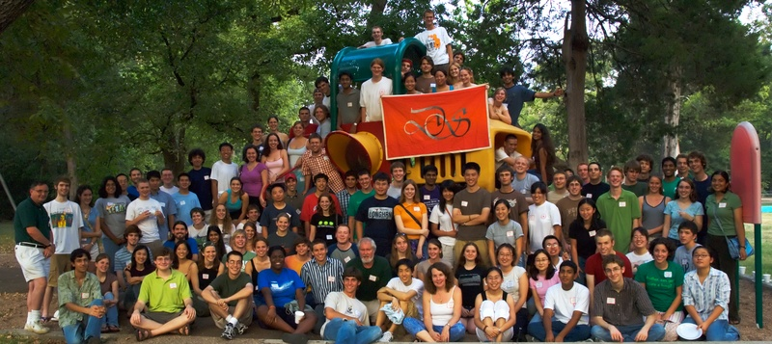
Picnic 2005

Slide 27
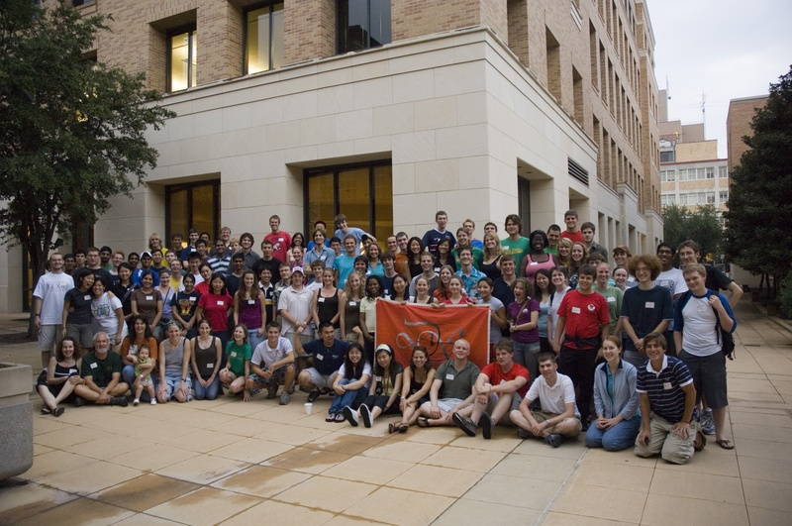
Picnic 2006

Slide 28
Picnic 2007
Where are you?

Slide 29
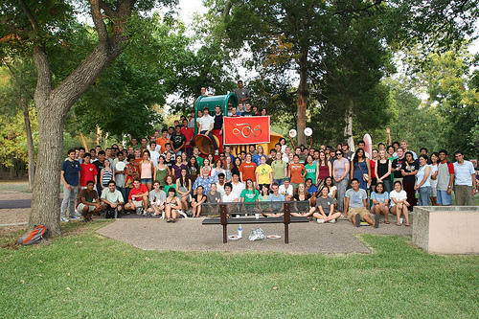
Picnic 2008

Slide 30
… and then
1994 - Present Berdahl speaks at lunch
1994 – Priority Registration for DS
1995 - MSEP brings students to UT (Bhogte)

Slide 31
The Charge
1996 – Program approaching 100 Dean’s Scholars
Dean Rankin asks for the program to be doubled

Slide 32
The DS Student Association
DS Student Association born in 1997
suggested by Brehm
First council chaired by Lily Liao
Third Student Committee
Second year’s speaking seminars

Slide 33
…and more activities
1998 – Upper Division DS Speaker Series
2000 – Oliver Sacks, Jared Diamond, …
1998 – December dinner
1998 - DS given office space in ESB
“The Dungeon”
2000 - Organ Donor Drive (DeZern)

Slide 34
Where did we stand? March, 2001
160 Dean’s Scholars
8-10 seminars
30 admitted from HS – 20 from current students
about half pre-med (several MD/PhD per year)

Slide 35
Looking Back from 2001
400 Alumni
Many scientists and physicians
4 UT Outstanding Students
3 Marshall Scholars plus many NSF and other leading fellowships
Three DS marriages

Slide 36
Where do we stand? March, 2011
Currently 160 Dean’s Scholars
8-10 seminars
30 admitted from HS – 20 from current students
about half pre-med (several MD/PhD per year)
215
11
35
15
40%

Slide 37
And Now
1000
400 Alumni
Many scientists and physicians
4 UT Outstanding Students
3 Marshall Scholars plus many NSF and other leading fellowships
Three DS marriages
6
many

Slide 38
And Now
1000
400 Alumni
Many scientists and physicians
4 UT Outstanding Students
3 Marshall Scholars plus many NSF and other leading fellowships
Three DS marriages
One Gates Scholar
One Rhodes Scholar
6
Many

Slide 39
New Activities
2003 Picasso at the Lapin Agile

Slide 40
New Activities
2003 Picasso at the Lapin Agile
2003 Arsenic and Old Lace … and more

Slide 41
New Activities
2003 Picasso at the Lapin Agile
2003 Arsenic and Old Lace … and more
Three Time Intramural Women’s Track Champions

Slide 42
New Activities
2003 Picasso at the Lapin Agile
2003 Arsenic and Old Lace … and more
Three Time Intramural Women’s Track Champions
One Time (B League) Coed Soccer Champions

Slide 43
New Activities
2003 Picasso at the Lapin Agile
2003 Arsenic and Old Lace … and more
Three Time Intramural Women’s Track Champions
One Time (B League) Coed Soccer Champions
Tutoring

Slide 44
New Activities
2003 Picasso at the Lapin Agile
2003 Arsenic and Old Lace … and more
Three Time Intramural Women’s Track Champions
One Time (B League) Coed Soccer Champions
Tutoring
Lunch (yes, but not like before)

Slide 45
New Activities
2003 Picasso at the Lapin Agile
2003 Arsenic and Old Lace … and more
Three Time Intramural Women’s Track Champions
One Time (B League) Coed Soccer Champions
Tutoring
Lunch (yes, but not like before)
DS Dance (on, off, on)

Slide 46
Administrative Assistance
1983-1992 – Dean’s Office

Slide 47
Administrative Assistance
1983-1992 – Dean’s Office
1992-2001 – Students (lots)

Slide 48
Administrative Assistance
1983-1992 – Dean’s Office
1992-2001 – Students (lots)
2001-2005 – Brett Westbrook-Program Coordinator

Slide 49
Administrative Assistance
1983-1992 – Dean’s Office
1992-2001 – Students (lots)
2001-2005 – Brett Westbrook-Program Coordinator
2005-2006 - Dean’s Office (again)

Slide 50
Administrative Assistance
1983-1992 – Dean’s Office
1992-2001 – Students (lots)
2001-2005 – Brett Westbrook-Program Coordinator
2005-2006 - Dean’s Office (again)
2006-2010 – Allisa Carter – Program Coordinator + academic advisors

Slide 51
Administrative Assistance
1983-1992 – Dean’s Office
1992-2001 – Students (lots)
2001-2005 – Brett Westbrook-Program Coordinator
2005-2006 - Dean’s Office (again)
2006-2010 – Allisa Carter – Program Coordinator + academic advisors
2010-present - Office for Honors, Research and International Study

Slide 52
The Faculty Review as of 2001
An expanded program ?
More students ?
Special Classes ?

Slide 53
Recommendations - 2002
Dean’s Scholars Honors Degrees to be administered by the college
Honors Courses – Biology, Mathematics, Computer Sciences, Physics, Chemistry

Slide 54
Approved - 2003
Dean’s Scholars Honors Degrees to be administered by the departments
Honors Courses – Biology, Mathematics, Computer Sciences, Physics, Chemistry

Slide 55
The Dean’s Scholars Degrees

Slide 56
The Dean’s Scholars Degrees
30 hours in major

Slide 57
The Dean’s Scholars Degrees
30 hours in major
30 hours DS requirements
Honors courses in 4 or 5 areas
Rhetoric
Research and Honors Thesis

Slide 58
The Dean’s Scholars Degrees
30 hours in major
30 hours DS requirements
Honors courses in 4 or 5 areas
Rhetoric
Research and Honors Thesis
30 hours UT requirements
History, Government, Humanities, Fine Arts

Slide 59
The Dean’s Scholars Degrees
30 hours in major
30 hours DS requirements
Honors courses in 4 or 5 areas
Rhetoric
Research and Honors Thesis
30 hours UT requirements
History, Government, Humanities, Fine Arts
30 Hours Electives

Slide 60
The Dean’s Scholars Degrees
First Three Graduates 2006
First Four Year Graduates 2007

Slide 61
The Dean’s Scholars Degrees
First Three Graduates 2006
First Four Year Graduates 2007
Applications – 600 (2007)

Slide 62
The Dean’s Scholars Degrees
First Three Graduates 2006
First Four Year Graduates 2007
Applications – 600 (2007) …
and past 1000 still more (2008)

Slide 63
The Dean’s Scholars Degrees
First Three Graduates 2006
First Four Year Graduates 2007
Applications – 600 (2007) …
and past 1000 still more (2008)
Quality of applications – hard to believe

Slide 64
The Dean’s Scholars Degrees
First Three Graduates 2006
First Four Year Graduates 2007
Applications – 600 (2007) …
and past 1000 still more (2008)
Quality of applications – hard to believe
Quality of Graduates – even harder to believe

Slide 65
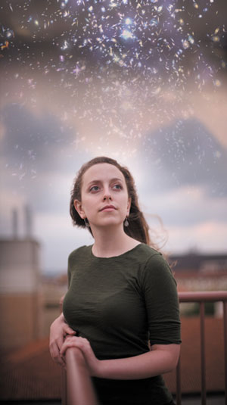
2008
First Rhodes Scholar:
Sarah Miller

Slide 66
2008
Why have I never seen
all these stars over RLM
before?
First Rhodes Scholar:
Sarah Miller

Slide 67
Award 2009
Dean’s Scholars Student Association wins
Swing Out Award as “Best New Organization”

Slide 68
Applications 2009-10
67

Slide 69
Applications 2009-10
67
For the 2010 class, there were 67 high school valedictorians who applied for the program … .

Slide 70
Applications 2009-10
67
For the 2010 class, there were 67 high school valedictorians who applied for the program and were rejected.

Slide 71
2010 New Program
Health Science Honors Program

Slide 72
2010 DS in Space

Slide 73
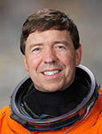
2010 DS in Space
Dean’s Scholar Joseph Barratt’s father Dr. Michael Barratt offers to carry memento of program aboard the final flight of space shuttle Discovery

Slide 74
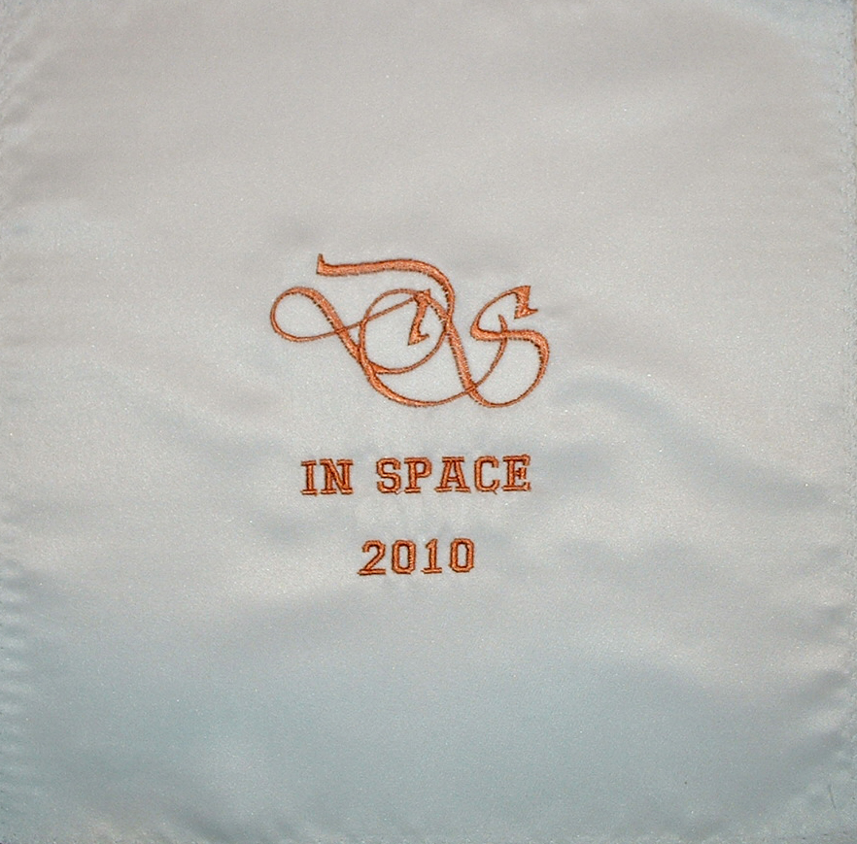

Slide 75
2010 DS in Space
Launched Thursday, February 24, 2011

Slide 76
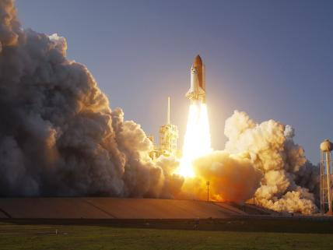

Slide 77
2010 Some Setbacks

Slide 78
2010 Some Setbacks
Lost our coordinator

Slide 79
2010 Some Setbacks
Lost our coordinator
Lost most scholarships

Slide 80
2011
Third DS Alumni Reunion

Slide 81
2011
Third DS Alumni Reunion
Cline steps down as director

Slide 82
2011
Third DS Alumni Reunion
Cline steps down as director

Slide 83
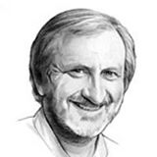
2011
David Hillis is fourth DS Director

Slide 84
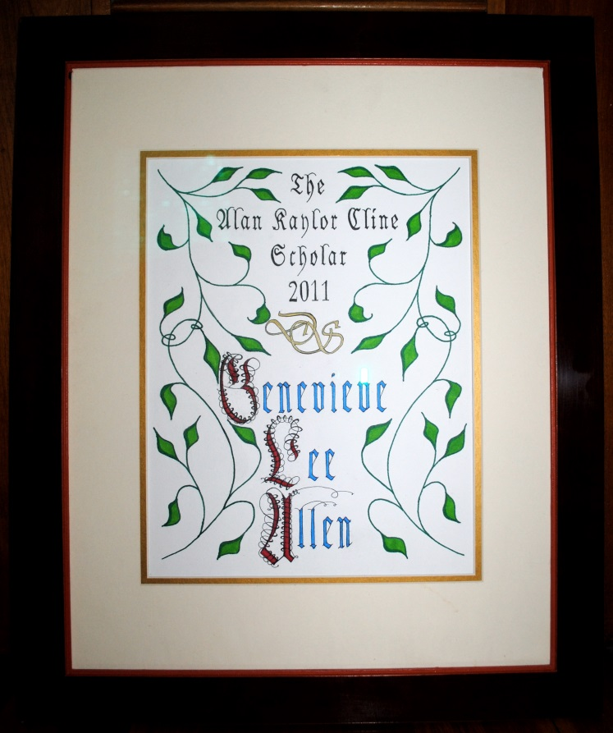
Dean’s Scholars Endowment Fund 2011

Slide 85
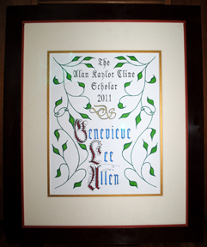
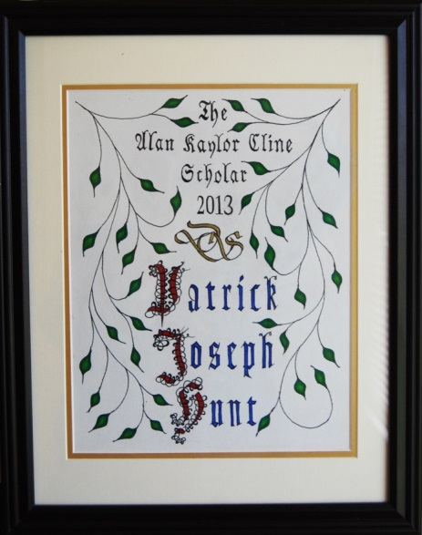
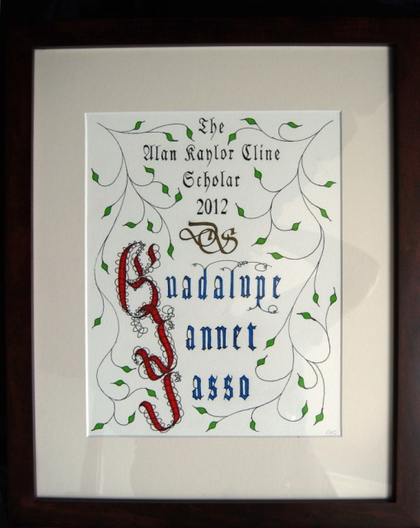
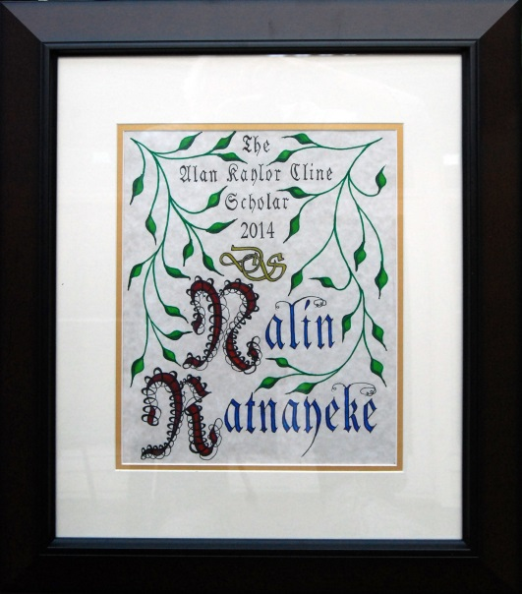
AKC Scholarship – 2011
2011
2013
2012
2014

Slide 86
What is DS?

Slide 87
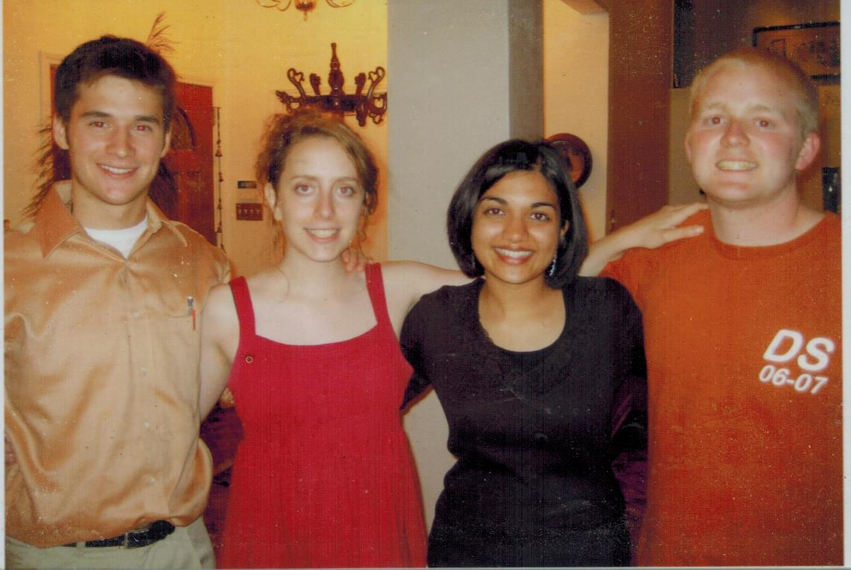
What is DS?

Slide 88
What is DS?
Pat Lawlor, in MD/PhD program at Northwestern

Slide 89
What is DS?
Pat Lawlor, in MD/PhD program at Northwestern
Rob Seilheimer, in MD/PhD program at Baylor College of Medicine

Slide 90
What is DS?
Pat Lawlor, in MD/PhD program at Northwestern
Rob Seilheimer, in MD/PhD program at Baylor College of Medicine
Richa Gupta, in MD/Masters of Public Health program at Johns Hopkins

Slide 91
What is DS?
Pat Lawlor, in MD/PhD program at Northwestern
Rob Seilheimer, in MD/PhD program at Baylor College of Medicine
Richa Gupta, in MD/Masters of Public Health program at Johns Hopkins
Sarah Miller, Rhodes Scholar, PhD Oxford

Slide 92
What is DS?
Pat Lawlor, in MD/PhD program at Northwestern
Rob Seilheimer, in MD/PhD program at Baylor College of Medicine
YOU
You, wonderful stuff
Richa Gupta, in MD/Masters of Public Health program at Johns Hopkins
Sarah Miller, Rhodes Scholar, PhD Oxford

