Slide 1
Alte Kameraden (Old Comrades) https://en.wikipedia.org/wiki/File:Anker-5387-10815.ogg

Slide 2
This book is to be neither an accusation nor a
confession, and least of all an adventure, for
death is not an adventure to those who stand
face to face with it. It will try simply to tell of
a generation of men who, even though they
may have escaped its shells, were destroyed by
the war.
Erich Maria Remarque, preface to
All Quiet on the Western Front
Is it an accusation or not?

Slide 3
Some Questions
1. Do you know that Paul will die?
2. The traditional social values that had led to the war—honor, duty, glory, and discipline—seemed hollow, and many survivors blamed the older generation for permitting the war’s ghastly and wasteful destruction.
3. What does the fraternization with the “enemy” represent in the book?
4. Why do people become war time soldiers?
5. What are Paul Bäumer’s ideas about his own generation and that of his elders.
6. Based on Paul’s description of the front, what part of the experience do you think would be
the hardest to bear? What could provide consolation?
7.How are Müller’s feelings about Kemmerich’s dying different from Paul’s feelings?
8. Why does Paul say of himself and his friends, “I believe we are lost”?
9. What questions does a soldier ask himself or herself during a war?

Slide 4
Dealing with Stress
When people are under severe stress or dealing with strong negative emotions, they often fall back on certain coping strategies. Also called defense mechanisms, these strategies may temporarily protect a person from painful situations or thoughts, but they usually do not work as long-term solutions. Common coping strategies include denial, or refusing to recognize an emotion or problem;
compensation, or making up for a weakness in one area by excelling in another;
daydreaming, or inventing situations to escape unpleasant facts;
displacement, or transferring emotions from the true source to some other thing or person;
rationalization, or making excuses for one’s actions or feelings; and
regression, or returning to immature behavior to express emotions.
Can you find examples of these strategies as used by Paul or other characters in
the novel?

Slide 5
For us lads of eighteen they ought to have been mediators and guides to the world of maturity . . . to the future . . . in our hearts we trusted them. The idea of authority, which they represented, was associated in our minds with a greater insight and a more humane wisdom. But the first death we saw shattered this belief. We had to recognize that our generation was more to be trusted than theirs. . . . The first bombardment showed us our mistake, and under it the world as they had taught it to us broke in pieces.
All Quiet on the Western Front

Slide 6
A Sampling of World War One Posters

Slide 7
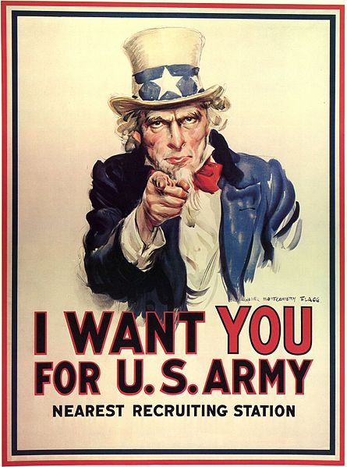
The Original Uncle Sam Image
James Montgomery Flag drew himself as Uncle Sam

Slide 8
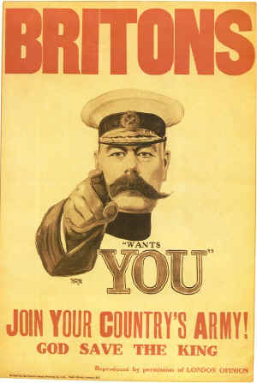
The inspiration for the original Uncle Sam poster
Field Martial Horatio Herbert Kitchener, British Secretary of State for War

Slide 9
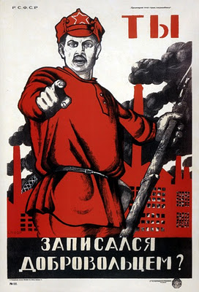
Russia

Slide 10
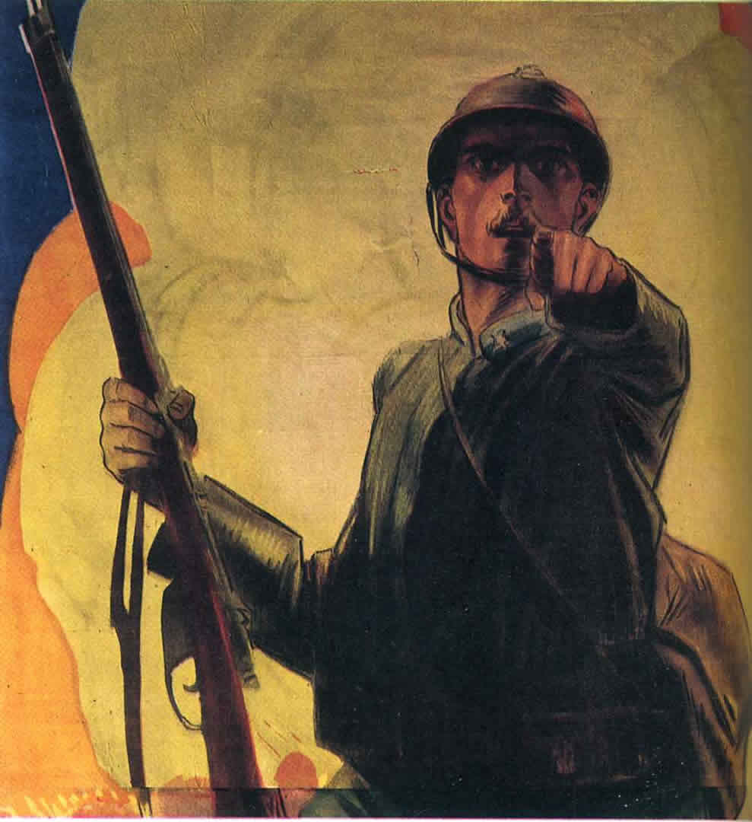
France

Slide 11

Jewish Legion - a unit in the British Army

Slide 12

… even Germany

Slide 13
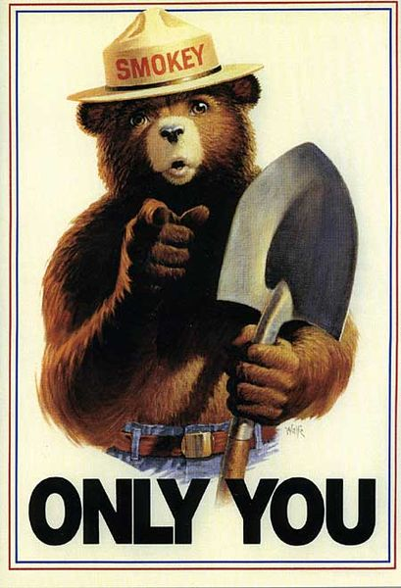
and the U. S. Forest Service

Slide 14
The Enemy is a Monster

Slide 15
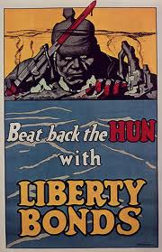
… not even called Germans, they are “the Hun”

Slide 16
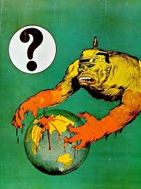

Slide 17
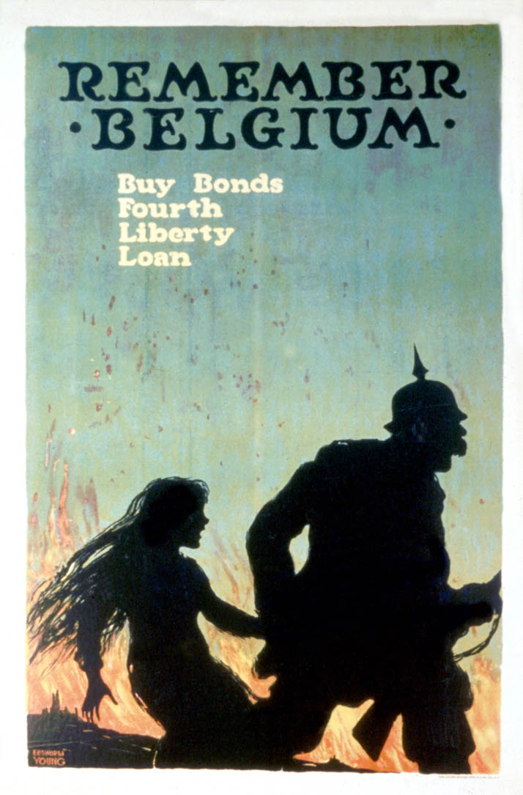
“Remember Belgium” is short for “Remember the Rape of Belgium”. This image makes it clear.

Slide 18
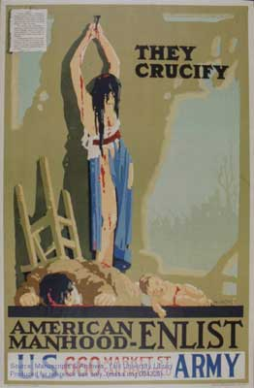
Another reference to Belgium.

Slide 19
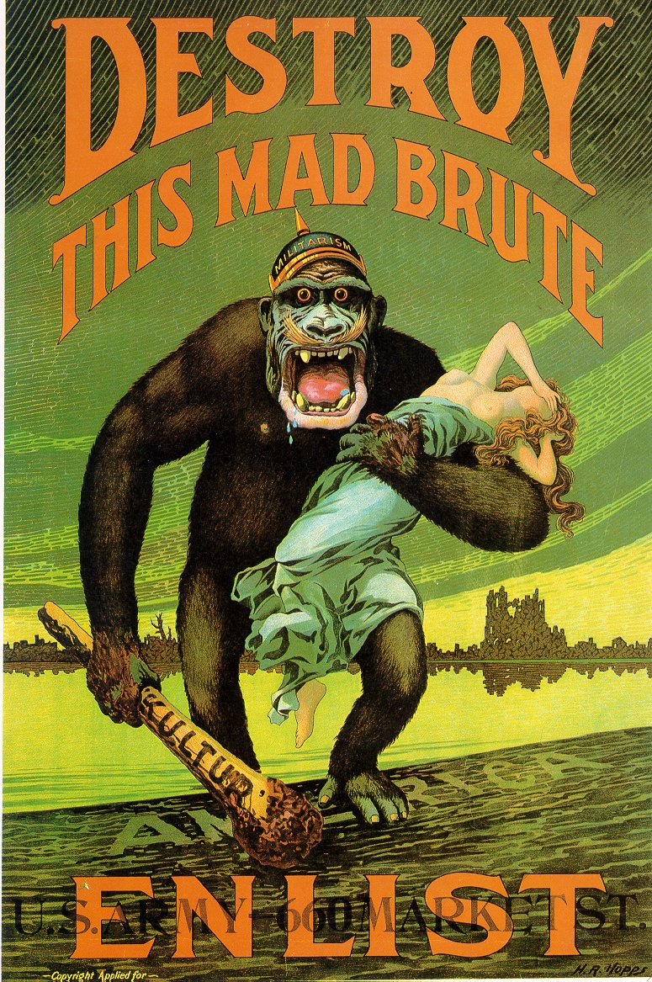
Sex always helps get attention. This image preceded the movie “King Kong” by 15 years.

Slide 20
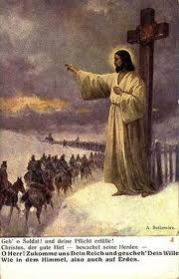
… and by the way, God is always on your side.

Slide 21
Pressure to Enlist

Slide 22
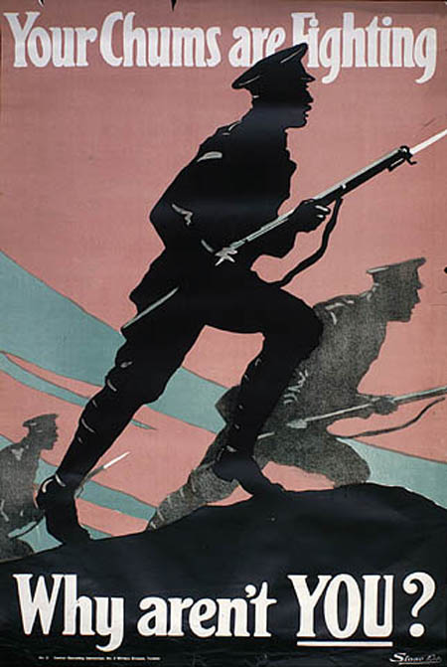
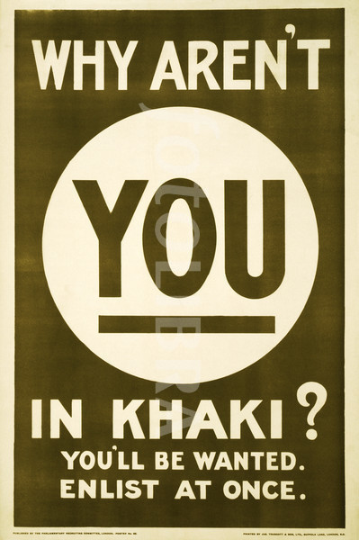

Slide 23
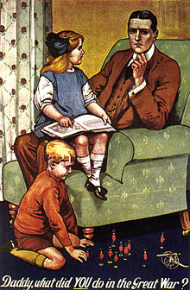
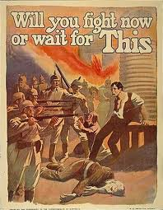

Slide 24
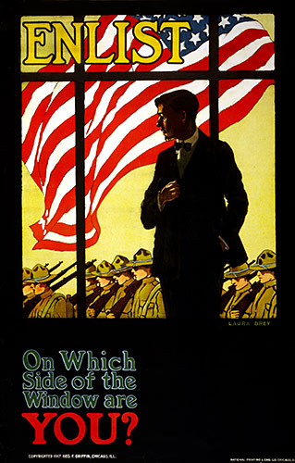
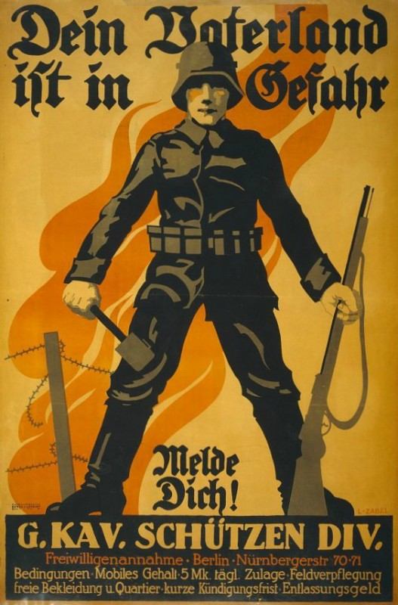

Slide 25
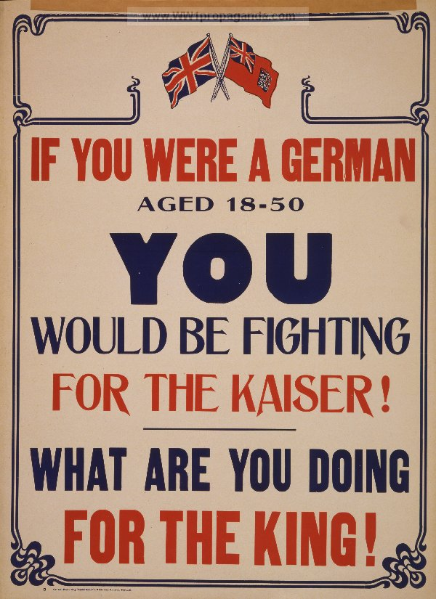
Is fighting for King or Kaiser or Emperor what this war was about?

Slide 26
Is fighting for King or Kaiser or Emperor what this war was about? Sadly, Yes.

Slide 27
The Movie Endings

Slide 28
1979

Slide 29
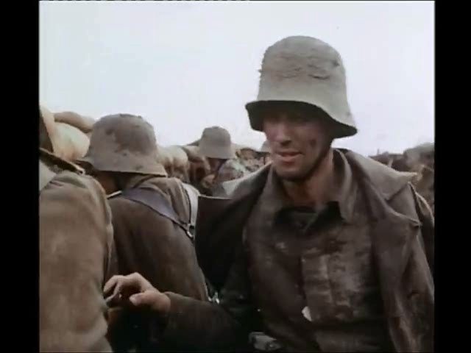

Slide 30
1930

Slide 31
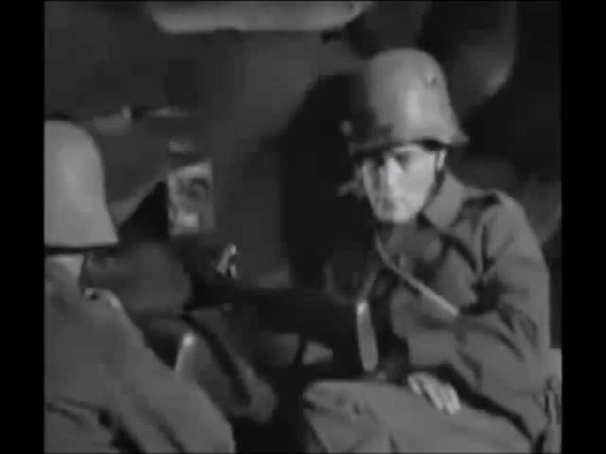

Slide 32
All quiet on the western front.

Slide 33
Im Westen nichts neues.

