Slide 1
Memories of
Inauguration Day
January 20, 1961
Alan Kaylor Cline

Slide 2
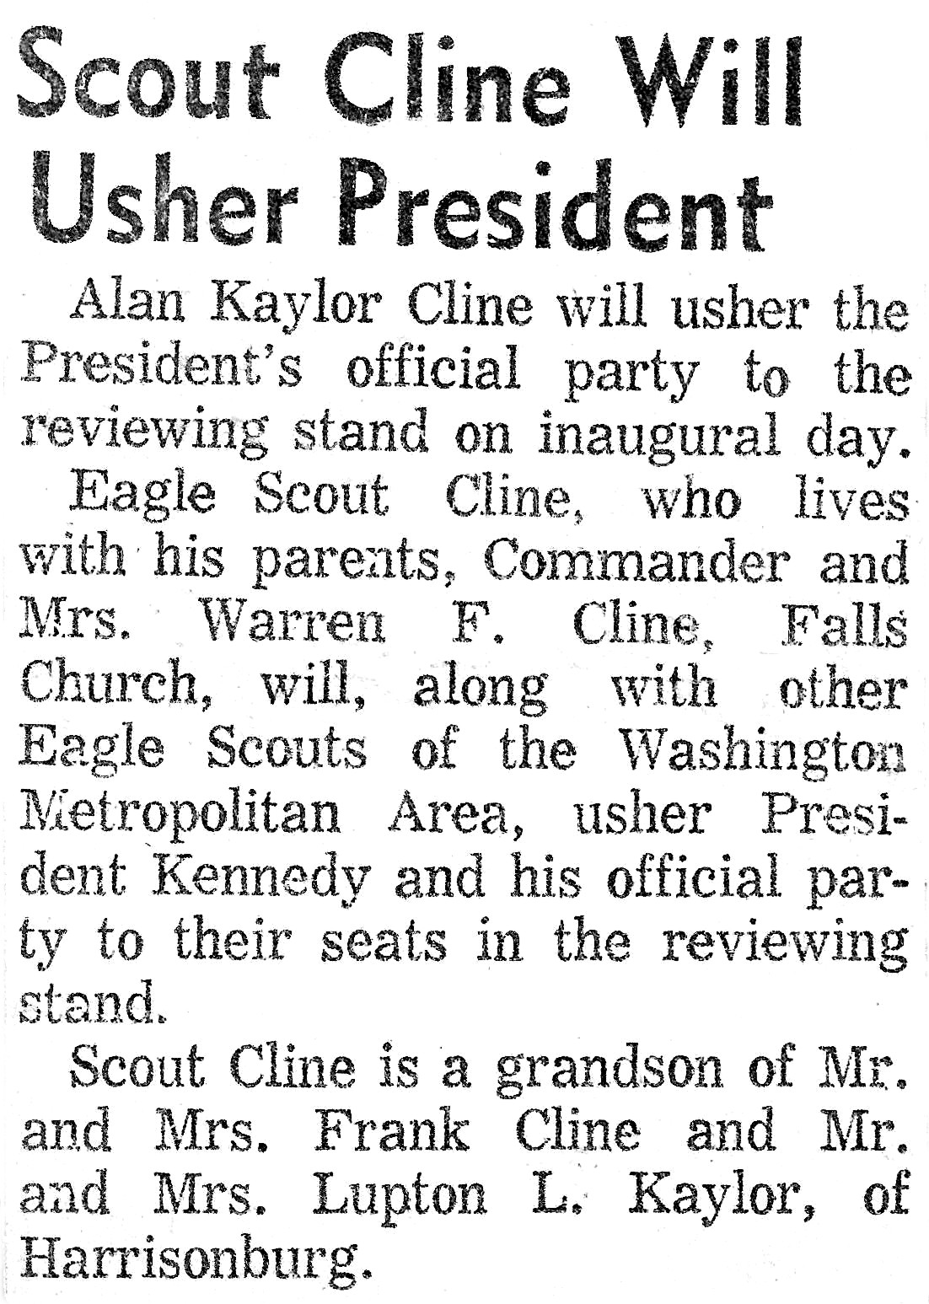
Don’t Believe All You Read
Story in the Daily News Record, Harrisonburg, Virginia. January, 1961
As far as I know, there were no scouts who ushered the president to the reviewing stand. I think the confusion came from the statement that I “would be an usher at the White House”, which was correct.

Slide 3
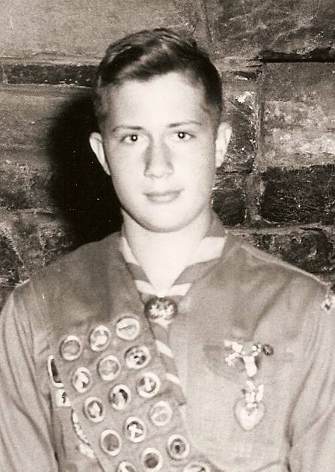
AKC at 13.
Eagle presentation, Septemebrer, 1960.
Photograph used by
The Washington Post,

Slide 4
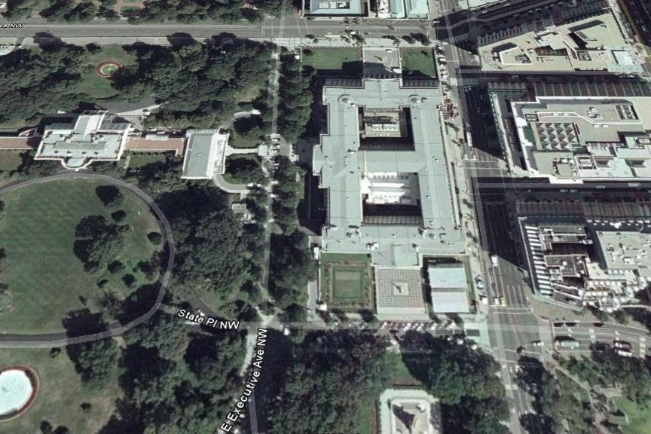
Pennsylvania Avenue
White House
Treasury Building
The turns in Pennsylvania Avenue to get around the Treasury Building

Slide 5
The final portion of the Inaugural Parade route

Slide 6
Presidential Reviewing Stand

Slide 7
My Stands
Presidential Reviewing Stand

Slide 8
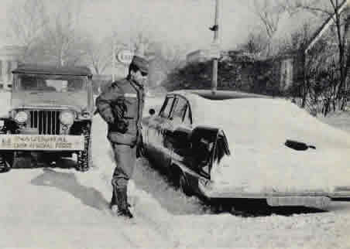
One of many abandoned cars
Six inches of snow in Washington the day before the inauguration

Slide 9
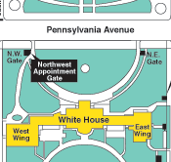
Car with President Eisenhower
and President-elect Kennedy
AKC
Ten Feet from Two Presidents
For breakfast, JFK met Eisenhower at the White House. Then, with their wives, took a single car to the Capitol. For several minutes the car parked just in front of me. The only thing preventing me from tapping on the window and saying “Hi” was my own reluctance.
*

Slide 10
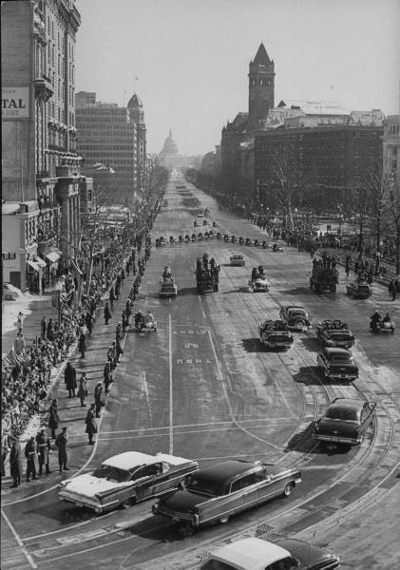
A few minutes later:
Kennedy and Eisenhower in route to the Capitol

Slide 11
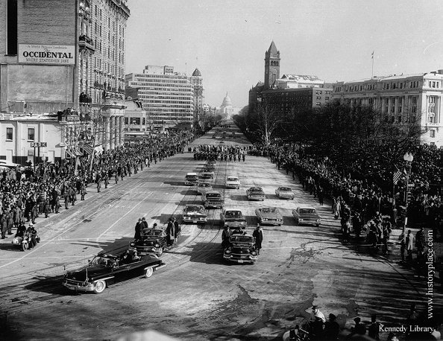
A few very cold hours later:
President and Mrs. Kennedy returning to The White House

Slide 12
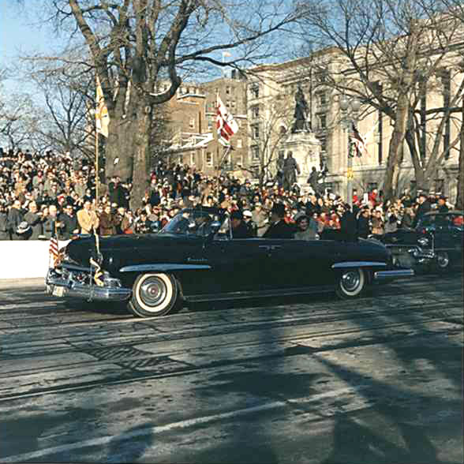
JFK and Jacqueline as
they drove by me

Slide 13
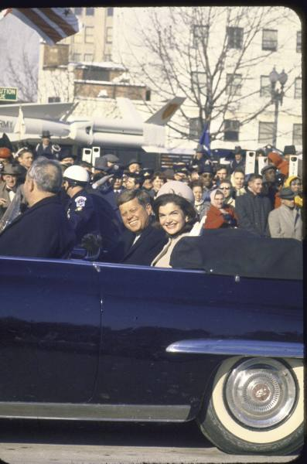

Slide 14
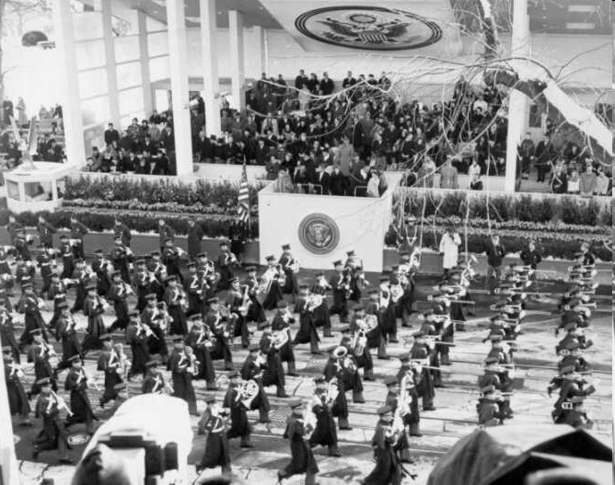
JFK
The Presidential Reviewing Stand as the Virginia Tech band passes.

Slide 15
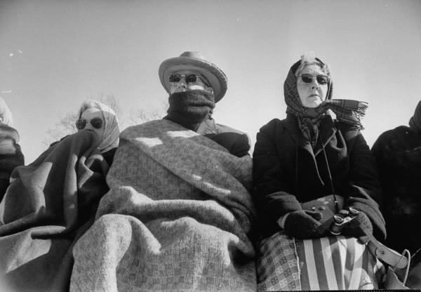
Bundling up against the weather

Slide 16
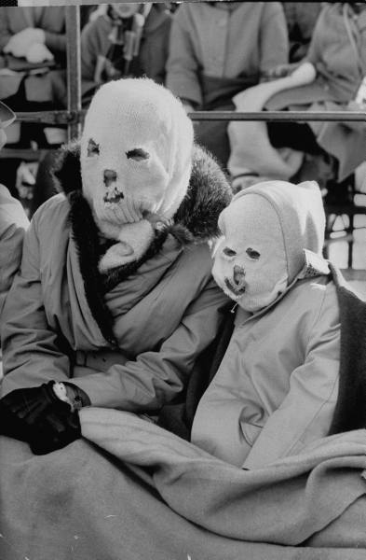

Slide 17
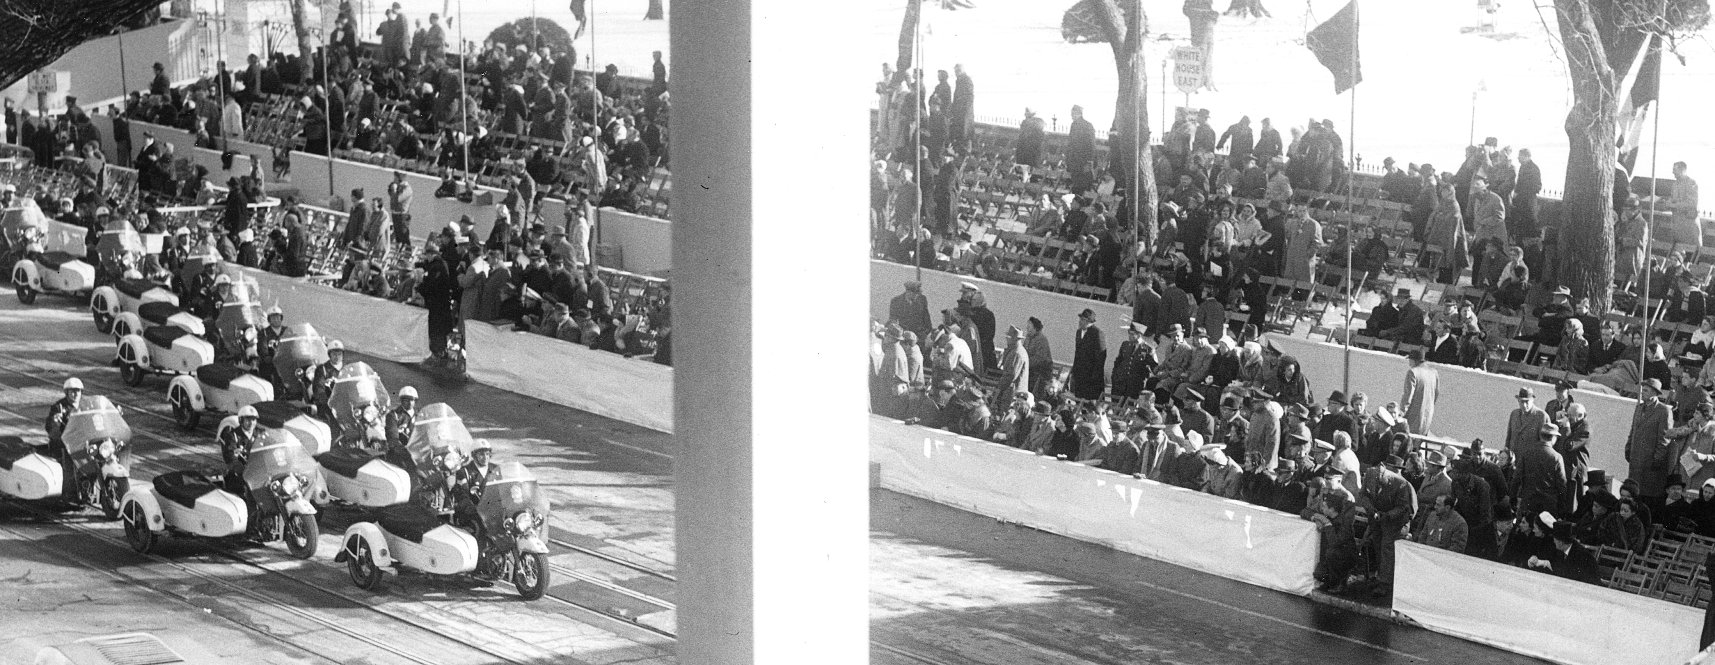
This was my area: seating for the members
of the Democratic National Committee.
Notice about 30% turnout thanks to the weather.

Slide 18
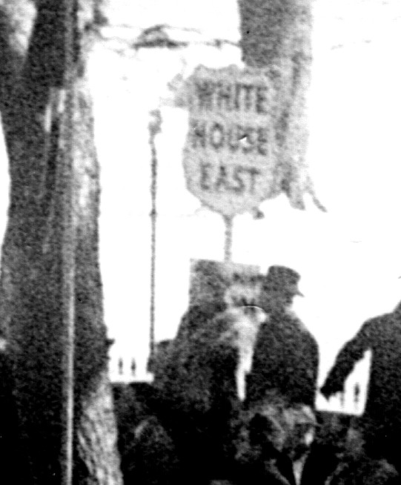
Enlargement of the previous image
Is this me?
Possible but I don’t think so.

Slide 19
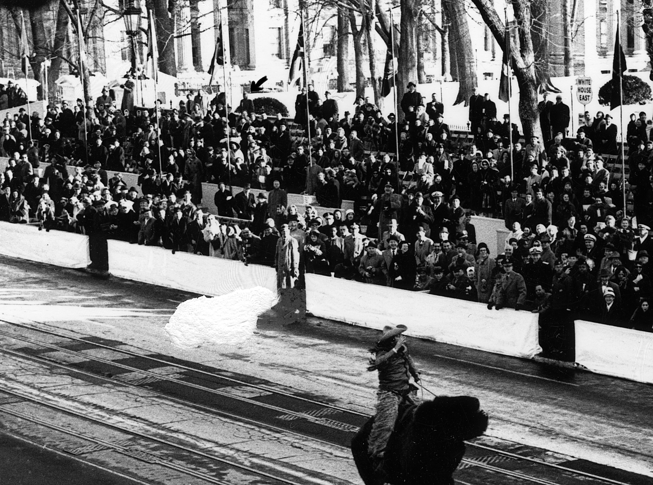
Another image. (Notice the fellow riding a buffalo.)

Slide 20
… also notice this fellow.

Slide 21
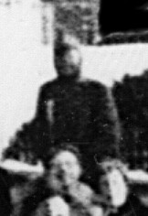
AKC at the White House: Inauguration Day, January 20, 1961

Slide 22
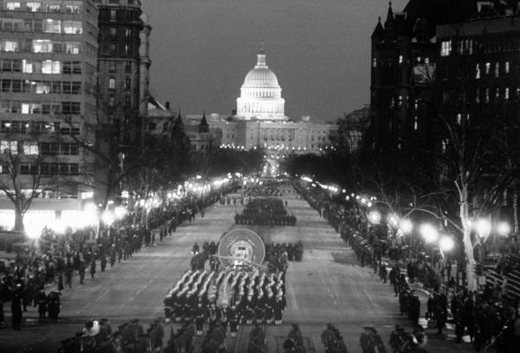
Addendum: The parade lasted long past dark. I was asked if I wanted to
usher at an Inaugural Ball but I was exhausted and caught the bus for home.

