Slide 1
Linear Algebra in a
Computational Setting
Alan Kaylor Cline
DS
September 24, 2014

Slide 2
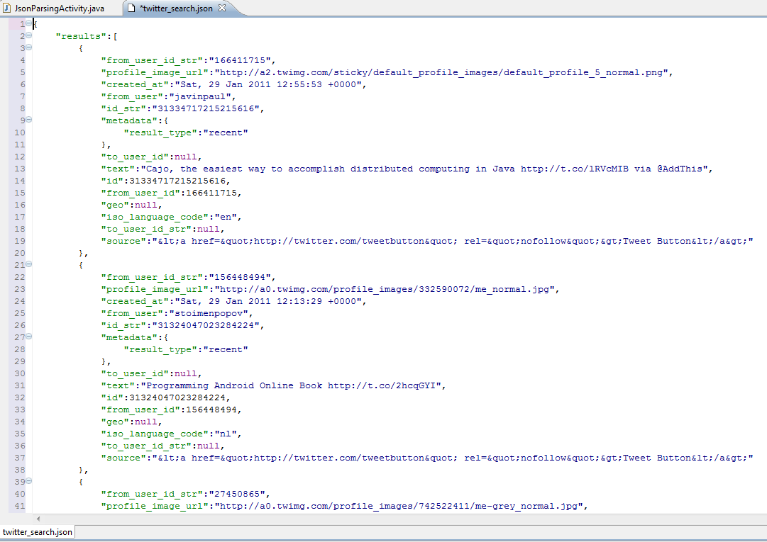
How long does it take for this code to run?

Slide 3
After examining the code you believe that the running time depends entirely upon some input parameter n and …
a good model for the running time is
Time(n) = a + b·log₂(n) + c·n + d·n·log₂(n)
where a, b, c, and d are constants
but currently unknown.

Slide 4
So you time the code for 4 values of n, namely n = 10, 100, 500, and 1000 and you get the times
Time(10) = 0.685 ms.
Time(100) = 7.247ms.
Time(500) = 38.511ms.
Time(1000) = 79.134 ms.
According to the model you then have
4 equations in the 4 unknowns a, b, c, and d:
a + b·log₂(10) + c·10 + d·10·log₂(10) = 0.685
a + b·log₂(100) + c·100 + d·100·log₂(100) = 7.247
a + b·log₂(500) + c·5000 + d·500·log₂(500) = 38.511
a + b·log₂(1000) + c·1000+ d·1000·log₂(1000) = 79.134

Slide 5
These equations are linear in the unknowns a, b, c, and d.
a + b·log₂(10) + c·10 + d·10·log₂(10) = 0.685
a + b·log₂(100) + c·100 + d·100·log₂(100) = 7.247
a + b·log₂(500) + c·5000 + d·500·log₂(500) = 38.511
a + b·log₂(1000) + c·1000+ d·1000·log₂(1000) = 79.134
We solve them and obtain:
a = 6.5
b = 10.3
c = 57.1
d = 2.2
So the final model for the running time is
Time(n) = 6.5 + 10.3·log₂(n) + 57.1·n + 2.2·n·log₂(n)

Slide 6
and now we may apply the model
Time(n) = 6.5 + 10.3·log₂(n) + 57.1·n + 2.2·n·log₂(n)
for a particular value of n (for example, n = 10,000)
to estimate a running time of
Time(10,000) = 6.5 + 10.3·log₂(10,000) +
57.1· 10,000 + 2.2· 10,000 ·log₂(10,000)
= 863.47 ms.

Slide 7
But have we ignored something?

Slide 8
So you time the code for 30 values of n, and you get these times {(n_{i},t_{i})}

Slide 9
If the model was perfect
and there were no errors in the timings
then for some values a, b, c, d, and e:
a + b·log₂(n_{i}) + c·n_{i} + d·n_{i}·log₂(n_{i}) +e·n_{i}² = t_{i}
for i =1,…,30

Slide 10
But the model was not perfect
and there were error in the timings
So we do not expect to get any values a, b, c, d, and e so that:
a + b·log₂(n_{i}) + c·n_{i} + d·n_{i}·log₂(n_{i}) +e·n_{i}² = t_{i}
for i =1,…,30
We will settle for values a, b, c, d, and e so that:
a + b·log₂(n_{i}) + c·n_{i} + d·n_{i}·log₂(n_{i}) +e·n_{i}² ≈ t_{i}
for i =1,…,30

Slide 11
Our sense of
a + b·log₂(n_{i}) + c·n_{i} + d·n_{i}·log₂(n_{i}) +e·n_{i}² ≈ t_{i}
for i =1,…,30
Will be to get a, b, c, d, and e so that sum of squares of all of the differences
∑ (a + b·log₂(n_{i}) + c·n_{i} + d·n_{i}·log₂(n_{i}) +e·n_{i}² - t_{i})²
is minimized over all possible choices of a, b, c, d, and e

Slide 12
After solving the least squares system to get the best values of a, b, c, d, and e, we plot a + b·log₂(n) + c·n + d·n·log₂(n) + e·n²

Slide 13
What’s a “good” solution when we don’t have the exact solution?

Slide 14
What’s a “good” solution when we don’t have the exact solution?
“Hey. That’s not a question that was
discussed in other math classes.”

Slide 15

What’s a “good” solution when we don’t have the exact solution?
Consider the two equations:
$$\begin{matrix}.780 x+ .563 y= .217 \\ .913 x+ .659 y=.254\end{matrix}$$

Slide 16


Consider two approximate solution pairs:
$$\begin{matrix}x_{1} \\ y_{1} \end{matrix}\begin{matrix}= \\ =\end{matrix}\begin{matrix} .999 \\ −1.001\end{matrix}$$
$$\begin{matrix}x_{2} \\ y_{2} \end{matrix}\begin{matrix}= \\ =\end{matrix}\begin{matrix} .341 \\ −0.087\end{matrix}$$
and these two equations:
$$\begin{matrix}.780 x+ .563 y= .217 \\ .913 x+ .659 y=.254\end{matrix}$$

Slide 17
Consider two approximate solution pairs:
$$\begin{matrix}x_{1} \\ y_{1} \end{matrix}\begin{matrix}= \\ =\end{matrix}\begin{matrix} .999 \\ −1.001\end{matrix}$$
$$\begin{matrix}x_{2} \\ y_{2} \end{matrix}\begin{matrix}= \\ =\end{matrix}\begin{matrix} .341 \\ −0.087\end{matrix}$$
and these two equations:
$$\begin{matrix}.780 x+ .563 y= .217 \\ .913 x+ .659 y=.254\end{matrix}$$
Which pair of these two is better?

Slide 18

Important fact to consider:
$$\begin{matrix}x_{1} \\ y_{1} \end{matrix}\begin{matrix}= \\ =\end{matrix}\begin{matrix} .999 \\ −1.001\end{matrix}$$
$$\begin{matrix}x_{2} \\ y_{2} \end{matrix}\begin{matrix}= \\ =\end{matrix}\begin{matrix} .341 \\ −0.087\end{matrix}$$
The exact solution is:
$$\begin{matrix}x=1 \\ y=−1\end{matrix}$$
Which pair of these two is better?

Slide 19
Consider two approximate solution pairs:
$$\begin{matrix}x_{1} \\ y_{1} \end{matrix}\begin{matrix}= \\ =\end{matrix}\begin{matrix} .999 \\ −1.001\end{matrix}$$
$$\begin{matrix}x_{2} \\ y_{2} \end{matrix}\begin{matrix}= \\ =\end{matrix}\begin{matrix} .341 \\ −0.087\end{matrix}$$
and these two equations:
$$\begin{matrix}.780 x+ .563 y= .217 \\ .913 x+ .659 y=.254\end{matrix}$$
Which pair of these two is better?

Slide 20
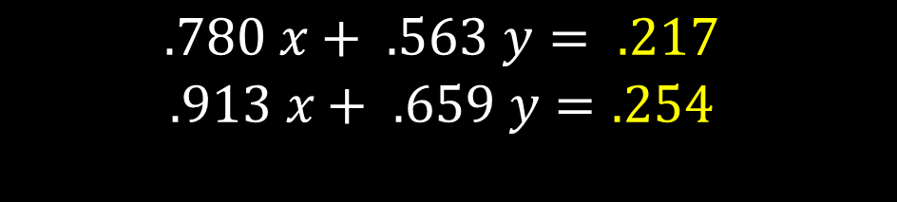
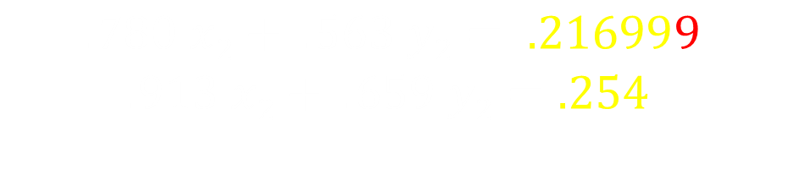
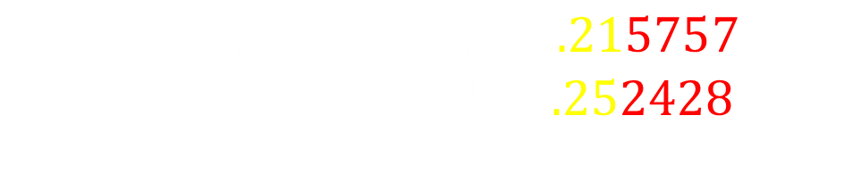
Important fact to consider:
$$\begin{matrix}x_{1} \\ y_{1} \end{matrix}\begin{matrix}= \\ =\end{matrix}\begin{matrix} .999 \\ −1.001\end{matrix}$$
$$\begin{matrix}x_{2} \\ y_{2} \end{matrix}\begin{matrix}= \\ =\end{matrix}\begin{matrix} .341 \\ −0.087\end{matrix}$$
Recall we are trying to solve:
$$\begin{matrix}.780 x+ .563 y= .217 \\ .913 x+ .659 y=.254\end{matrix}$$
For the first pair, we have:
$$\begin{matrix}.780 x1+ .563 y1= .215757 \\ .913 x1+ .659 y1=.252428\end{matrix}$$
For the second pair, we have:
$$\begin{matrix}.780 x2+ .563 y2= .216999 \\ .913 x2+ .659 y2=.254 \end{matrix}$$
Which pair of these two is better?

Slide 21
Important fact to consider:
$$\begin{matrix}x_{1} \\ y_{1} \end{matrix}\begin{matrix}= \\ =\end{matrix}\begin{matrix} .999 \\ −1.001\end{matrix}$$
$$\begin{matrix}x_{2} \\ y_{2} \end{matrix}\begin{matrix}= \\ =\end{matrix}\begin{matrix} .341 \\ −0.087\end{matrix}$$
Which pair of these two is better?

Slide 22

Student: “Is there something funny about that problem?”

Slide 23

Student: “Is there something funny about that problem?”
Professor: “You bet your life. It looks innocent but it is very strange. The problem is knowing when you have a strange case on your hands.”
CLINE

Slide 24
Professor: “Geometrically, solving equations is like finding the intersections of lines.”
CLINE

Slide 25
When lines have no thickness …
here’s the intersection?

Slide 26
… but when lines have thickness …
where’s the intersection?

Slide 27

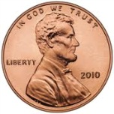
Galveston Island
25.96 miles

Slide 28
Galveston Island
25.96 miles
Where’s the intersection?

Slide 29
London Olympics Swimming
http://www.youtube.com/watch?v=fFiV4ymEDfY&feature=related
1:19

Slide 30
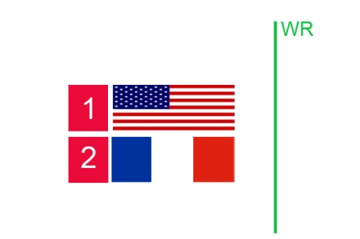
How do you transform this image …

Slide 31
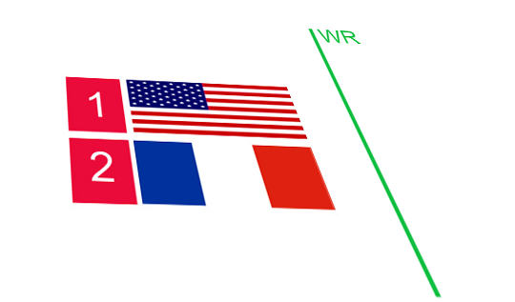
How do you transform this image …
into the coordinate system of another image?

Slide 32
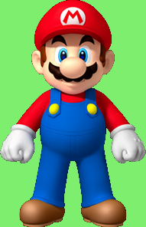
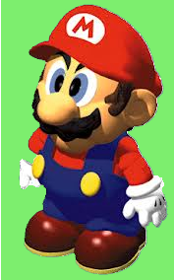
and in greater generality, transform
3-dimensional objects

Slide 33
The $25 Billion Eigenvector
How does Google do Pagerank?

Slide 34
The $25 Billion Eigenvector
How did Google do Pagerank?

Slide 35
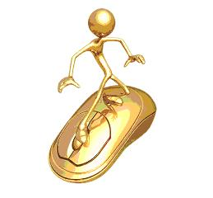
The Imaginary Web Surfer:
Starts at any page,
Randomly goes to a page linked from the current page,
Randomly goes to any web page from a dangling page,
… except sometimes (e.g. 15% of the time), goes to a purely random page.

Slide 36
A tiny web: who should get the highest rank?
J
A
B
I
C
H
D
G
F
E

Slide 37
The associated stochastic matrix:
0.0150 0.0150 0.0150 0.0150 0.0150 0.0150 0.4400 0.0150 0.0150 0.2983
0.4400 0.0150 0.0150 0.0150 0.0150 0.0150 0.0150 0.0150 0.0150 0.0150
0.0150 0.2983 0.0150 0.0150 0.0150 0.0150 0.0150 0.0150 0.0150 0.0150
0.0150 0.2983 0.8650 0.0150 0.0150 0.0150 0.0150 0.0150 0.0150 0.0150
0.4400 0.0150 0.0150 0.8650 0.0150 0.8650 0.0150 0.0150 0.0150 0.0150
0.0150 0.2983 0.0150 0.0150 0.8650 0.0150 0.0150 0.0150 0.0150 0.0150
0.0150 0.0150 0.0150 0.0150 0.0150 0.0150 0.0150 0.8650 0.0150 0.0150
0.0150 0.0150 0.0150 0.0150 0.0150 0.0150 0.0150 0.0150 0.8650 0.2983
0.0150 0.0150 0.0150 0.0150 0.0150 0.0150 0.0150 0.0150 0.0150 0.2983
0.0150 0.0150 0.0150 0.0150 0.0150 0.0150 0.4400 0.0150 0.0150 0.0150

Slide 38
We seek to find a vector x so that
A x = x
One way is to start with some initial x⁰,
and then:
for k = 1, 2, 3,…
x^{k} = A x^{k-1}
This converges to an x so that A x = x

Slide 39
Start with equal components

Slide 40
One iteration

Slide 41
Two iterations

Slide 42
Three iterations

Slide 43
Four iterations

Slide 44
Five iterations

Slide 45
Six iterations

Slide 46
Seven iterations

Slide 47
Eight iterations

Slide 48
Nine iterations

Slide 49
Ten iterations

Slide 50
The Eigenvector

Slide 51
[U,G] = surfer (‘http://google.com’, 100)

Slide 52
Pagerank Power Iteration 1 step

Slide 53
Pagerank Power Iteration 2 steps

Slide 54
Pagerank Power Iteration 3 steps

Slide 55
Pagerank Power Iteration 4 steps

Slide 56
Pagerank Power Iteration 5 steps

Slide 57
Pagerank Power Iteration the limit

Slide 58
And the winners are…
'http://www.loc.gov/standards/iso639-2'
'http://www.sil.org/iso639-3'
'http://www.loc.gov/standards/iso639-5'
'http://purl.org/dc/elements/1.1'
'http://purl.org/dc/terms'
'http://purl.org/dc'
'http://creativecommons.org/licenses/by/3.0'
'http://i.creativecommons.org/l/by/3.0/88x31.png'
'http://www.nlb.gov.sg'
'http://purl.org/dcpapers'
'http://www.nl.go.kr'
'http://purl.org/dcregistry'
'http://www.kc.tsukuba.ac.jp/index_en.html'

Slide 59
How much storage to hold this array?
Current estimate of indexed WWW:
      4.7 · 10¹⁰ web pages
If placed into an array this would have
      2.21 · 10²¹ elements
If each element is stored in 4 bytes, this would be
    8.8 · 10²² bytes
Current estimate of world’s data storage capacity is 3.0 · 10¹⁸ bytes (.003% of necessary space)
http://www.smartplanet.com/blog/thinking-tech/what-is-the-worlds-data-storage-capacity/6256
Notes:
http://www.smartplanet.com/blog/thinking-tech/what-is-the-worlds-data-storage-capacity/6256

