Slide 2
The First American Thanksgiving
Alan Kaylor Cline
November 19, 2010

Slide 4
Outline:
Meanings of Thanksgiving

Slide 5
Outline:
Meanings of Thanksgiving
The First Virginia Thanksgiving

Slide 6
Outline:
Meanings of Thanksgiving
The First Virginia Thanksgiving
The First Virginia Settlement

Slide 7
Outline:
Meanings of Thanksgiving
The First Virginia Thanksgiving
The First Virginia Settlement
The Native Population

Slide 8
Outline:
Meanings of Thanksgiving
The First Virginia Thanksgiving
The First Virginia Settlement
The Native Population
Pocahontas, John Smith, and John Rolfe

Slide 9
Outline:
Meanings of Thanksgiving
The First Virginia Thanksgiving
The First Virginia Settlement
The Native Population
Pocahontas, John Smith, and John Rolfe
The First Massachusetts Thanksgiving

Slide 10
Outline:
Meanings of Thanksgiving
The First Virginia Thanksgiving
The First Virginia Settlement
The Native Population
Pocahontas, John Smith, and John Rolfe
The First Massachusetts Thanksgiving
Early Texas, Florida, and Maine Thanksgivings

Slide 11
Outline:
Meanings of Thanksgiving
The First Virginia Thanksgiving
The First Virginia Settlement
The Native Population
Pocahontas, John Smith, and John Rolfe
The First Massachusetts Thanksgiving
Early Texas, Florida, and Maine Thanksgivings
If time: a heartwarming Thanksgiving Story:
“Lucy and the Duck”

Slide 12
Meanings of Thanksgiving

Slide 13
Meanings of Thanksgiving
Thanks Giving

Slide 14
Meanings of Thanksgiving
Thanks Giving (obviously)

Slide 15
The First Thanksgiving ?

Slide 16
The First Thanksgiving ?

Slide 17
Meanings of Thanksgiving
Thanks Giving (obviously)
Harvest Festival

Slide 18
Meanings of Thanksgiving
Thanks Giving (obviously)
Harvest Festival
Family Reunion

Slide 19
Meanings of Thanksgiving
Thanks Giving (obviously)
Harvest Festival
Family Reunion
Start of Holiday Season

Slide 20
Meanings of Thanksgiving
Thanks Giving (obviously)
Harvest Festival
Family Reunion
Start of Holiday Season
Football games
Ignore work
Start shopping

Slide 21
Virginia and the James River

Slide 23
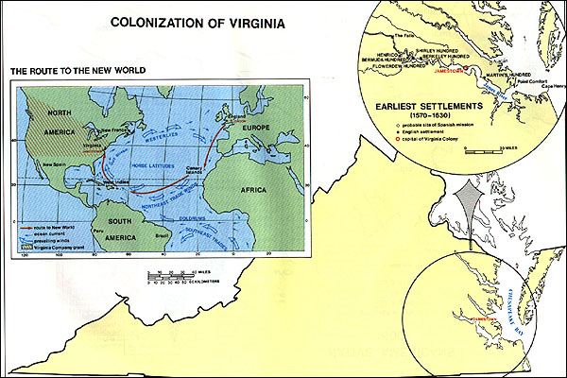
Colonization of Virginia
Notes:
1652 Map

Slide 24
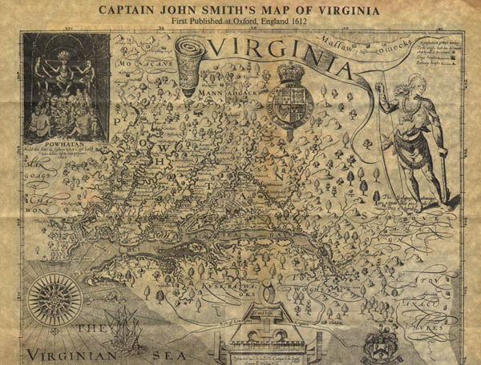
John Smith's A Map of Virginia: With a Description of the Countrey, the Commodities, People, Government and Religion (1612)
Notes:
1652 Map

Slide 25
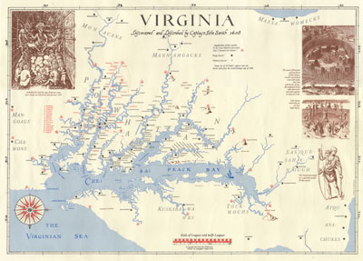
John Smith's A Map of Virginia: With a Description of the Countrey, the Commodities, People, Government and Religion (modified by Edward Wright Haile )
Notes:
1652 Map

Slide 26
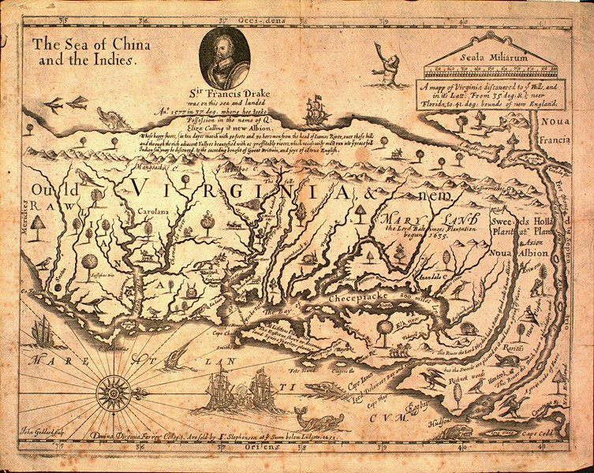
Virginia 1652
Notes:
1652 Map

Slide 30
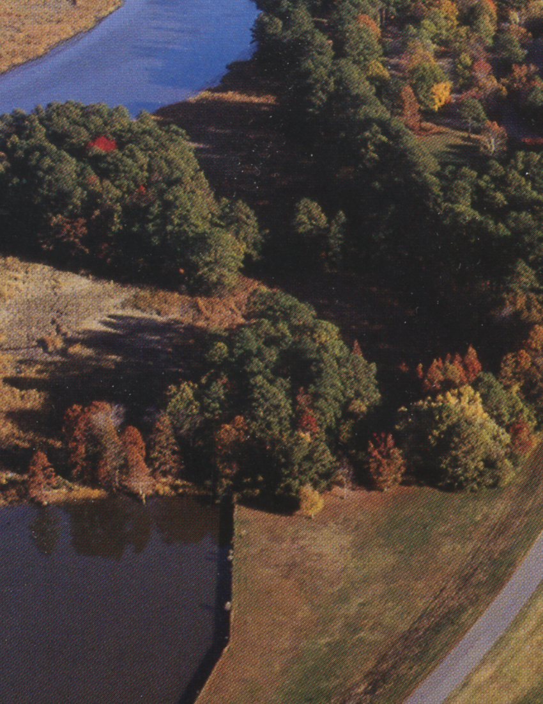
Jamestown Today
Notes:
Jamestown Now

Slide 31
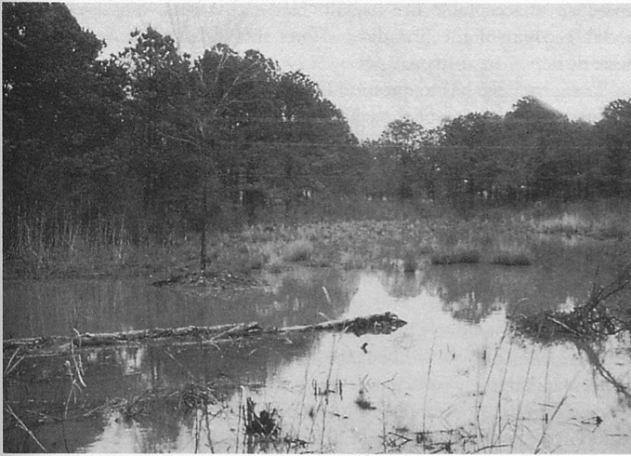
Notes:
Jamestown Swamp

Slide 32
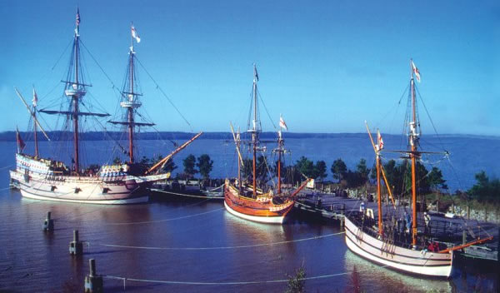
Discovery, Susan Constant, Godspeed

Slide 33
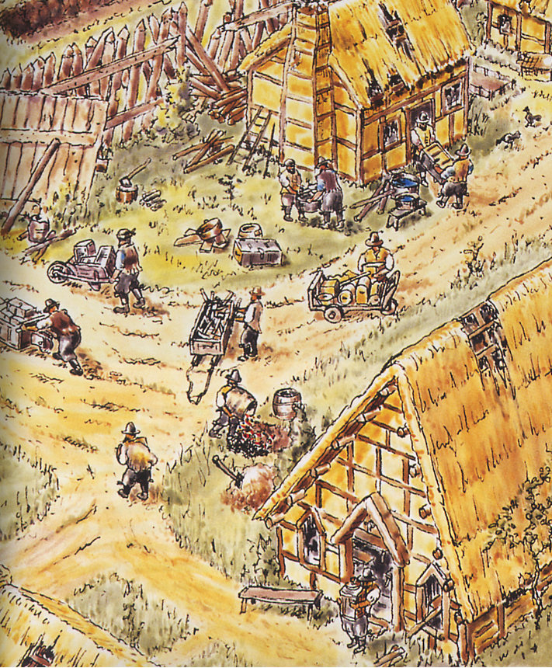
Activity inside Jamestown
~1608
Notes:
Jamestown 1608

Slide 34
A Jamestown Chronology
1585-90 The “Lost Colony”
1607 Landing of 105 men
1608 Fire and starvation –50 survivors
1609 Arrival of women population >200
1609-10 “Starving Time” 40 survivors
1610 Near abandonment

Slide 35
1619

Slide 36
1619
First Elected Legislature

Slide 37
1619
First Elected Legislature
First Slave Ship

Slide 38
1619
First Elected Legislature
First Slave Ship
First Thanksgiving

Slide 39
The Native Population

Slide 40
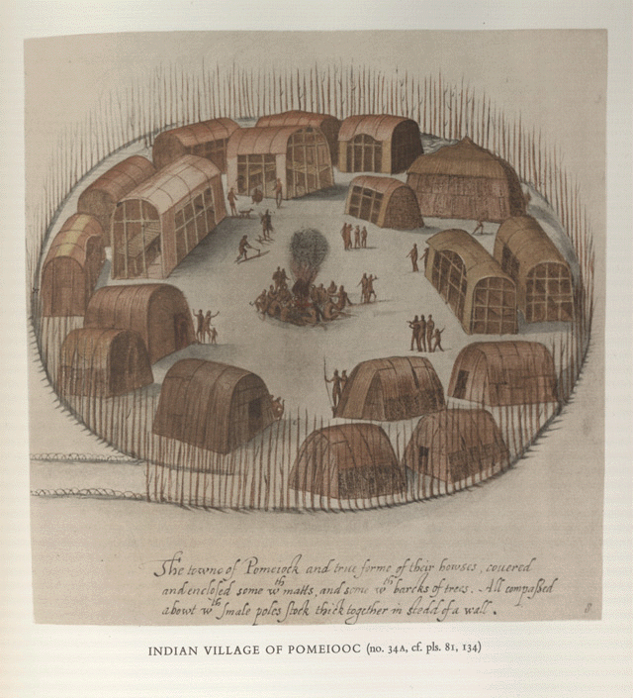
John White’s
Indian Village at
Pomeiooc
(1585-1586)

Slide 41
John White’s
Indians Dancing Around A Circle of Posts
and
Indian Village of Secoton
(1585-1586)

Slide 43
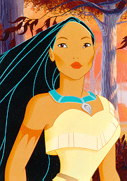

Slide 45
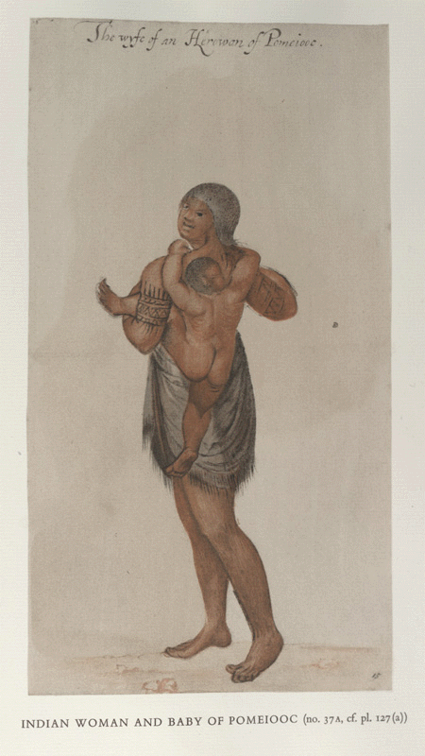
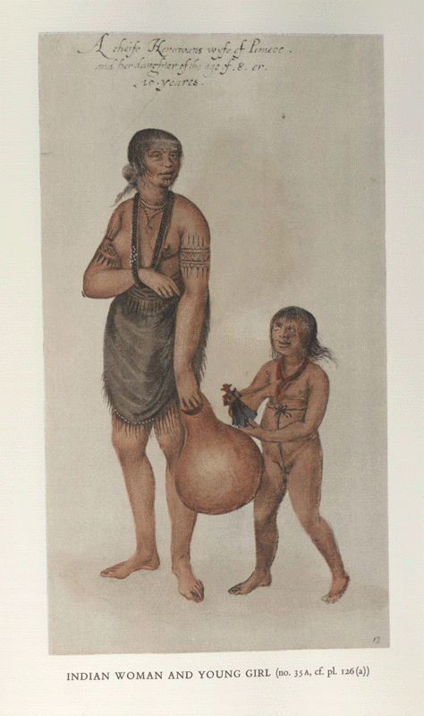
John White’s
Indian Woman and Baby of Pomieooc and
Indian Woman and Young Girl
(1585-1586)

Slide 46
John White’s
Indian Woman of Secoton
and
Indian Elder or Chief
(1585-1586)

Slide 48
The Historical Pocahontas

Slide 49
The Historical Pocahontas
~1595 born daughter of Powhatan

Slide 50
The Historical Pocahontas
~1595 born daughter of Powhatan
1607 the “rescue” of John Smith

Slide 51
The Historical Pocahontas
~1595 born daughter of Powhatan
1607 the “rescue” of John Smith
1607-9 assistance to Jamestown settlers

Slide 52
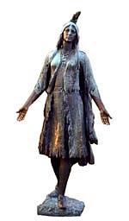

Slide 54
The Historical Pocahontas
~1595 born daughter of Powhatan
1607 the “rescue” of John Smith
1607-9 assistance to Jamestown settlers
1612 abduction as hostage

Slide 55
The Historical Pocahontas
~1595 born daughter of Powhatan
1607 the “rescue” of John Smith
1607-9 assistance to Jamestown settlers
1612 abduction as hostage
1613 baptism as Rebecca

Slide 56
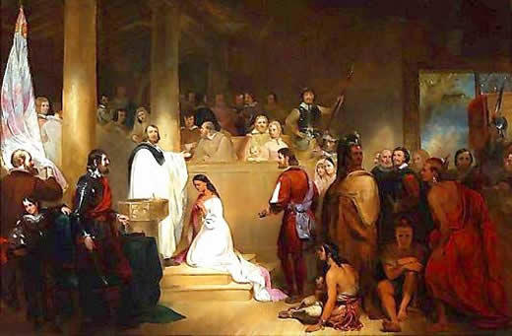
The Baptism of Pocahontas – John Gadsby Chapman 1840

Slide 57
The Historical Pocahontas
~1595 born daughter of Powhatan
1607 the “rescue” of John Smith
1607-9 assistance to Jamestown settlers
1612 abduction as hostage
1613 baptism as Rebecca
1614 marriage to John Rolfe

Slide 58
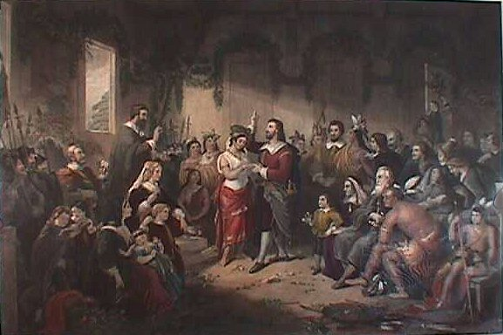

Slide 59
The Historical Pocahontas
~1595 born daughter of Powhatan
1607 the “rescue” of John Smith
1607-9 assistance to Jamestown settlers
1612 abduction as hostage
1613 baptism as Rebecca
1614 marriage to John Rolfe
1615 birth of Thomas Rolfe

Slide 60
The Historical Pocahontas
~1595 born daughter of Powhatan
1607 the “rescue” of John Smith
1607-9 assistance to Jamestown settlers
1612 abduction as hostage
1613 baptism as Rebecca
1614 marriage to John Rolfe
1615 birth of Thomas Rolfe
1616 trip to England

Slide 61
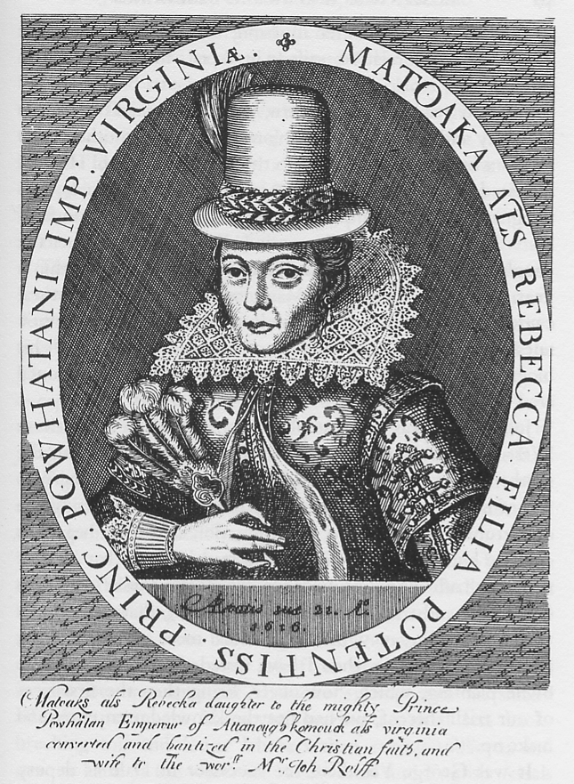

Slide 62
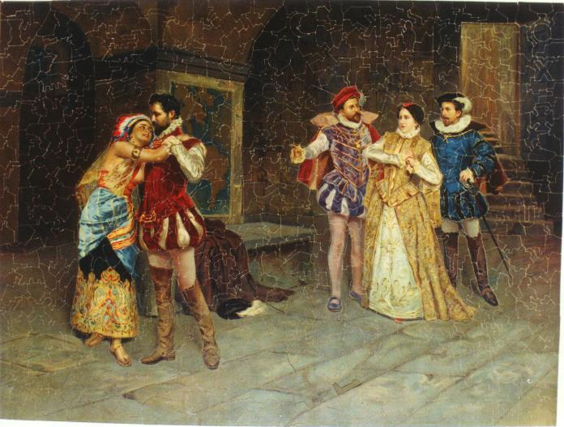

Slide 63
The Rescue
Execution
Ritual
Imaginary

Slide 64
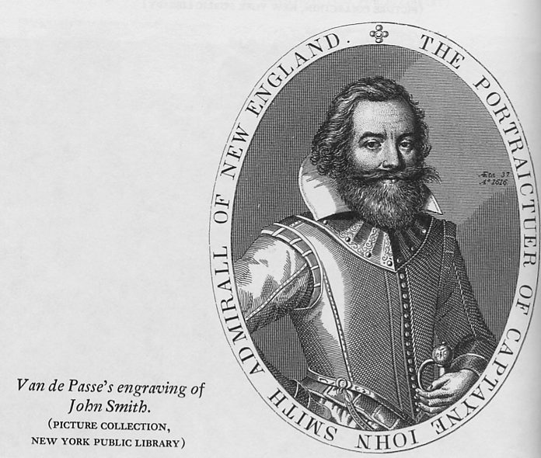

Slide 65
“After some six weeks fatting amongst those Salvage Courtiers,
at the minute of my execution, she hazarded the beating out of
her owne braines to save mine, and not only that, but so prevailed
with her father, that I was safely conducted to James towne,
where I found about eight and thirty miserable poore and sicke
creatures, to keepe possession of all those territories of Virginia
such was the weaknesse of this poore Common-wealth, as had
the Salvages not fed us, we directly have starved.”
John Smith Generall Historie 1624

Slide 67
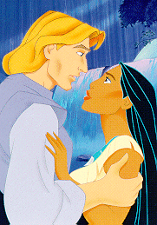

Slide 70
The Historical Pocahontas
~1595 born daughter of Powhatan
1607 the “rescue” of John Smith
1607-9 assistance to Jamestown settlers
1612 abduction as hostage
1613 baptism as Rebecca
1614 marriage to John Rolfe
1615 birth of Thomas Rolfe
1616 trip to England
1617 death in England

Slide 71
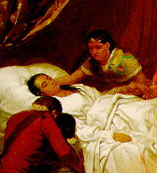

Slide 72
Berkeley Plantation

Slide 73
Berkeley Plantation
First settled in 1619 by thirty-eight men from Berkeley Parish in England.
They came on shore December 4, 1619 and obeyed their instructions:
"Wee ordaine that the day of our ships arrivall at the place assigned for plantacon in the land of Virginia shall be yearly and perpetually keept holy as a day of thanksgiving to Almighty God."

Slide 74
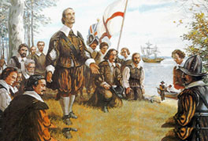
Landing at Berkeley

Slide 76
Berkeley Plantation with “Feast”

Slide 77
Berkeley House
Built in 1726, by Benjamin Harrison IV and Anne Harrison.
Benjamin Harrison V, was a signer of the Declaration of Independence and three-time Governor of Virginia.
William Henry Harrison, Benjamin's third son, born at Berkeley, became the ninth President of the United States, in 1841. (His grandson, Benjamin Harrison, was the 23rd President.)
First ten presidents stayed here.

Slide 78
W. H. Harrison’s Election Spin
Birthplace. Right.

Slide 79
Other Berkeley Interesting Stuff
First American bourbon whiskey distilled -- 1621, by George Thorpe, an Episcopal minister
First time Army bugle call "Taps“ was played -- July 1862, by bugler Oliver W. Norton; the melody was written at Berkeley then by General Daniel Butterfield.
Abraham Lincoln visited twice in the summer of 1862 during occupation by U. S. Army.

Slide 80
Even More Berkeley Interesting Stuff
Harrison family forced to leave – never to regain the house.
The house went into disrepair until purchased in 1907 by John Jamieson, a Scotsman who had served as a drummer boy in the U. S. Army during the Civil War.
Jamieson family still owns it.

Slide 81
Imaginary View of Plymouth Thanksgiving

Slide 82
Close-up Emphasizing Non-History

Slide 83
In 1638, the Puritans and their Indian allies signed the Treaty of Hartford, which declared the Pequot nation dissolved. The spirit behind this genocide is encapsulated in the victory sermon of Increase Mather, a leading Puritan minister, who asked his congregation to thank God 'that on this day we have sent six hundred heathen souls to hell'
Chalk, Frank and Kurt Jonassohn. (1990)
The History and Sociology of Genocide:
Analyses and Case Studies.

Slide 84
“The myth of the Pilgrims, with its three central themes, the Forefathers, the Rock and the Compact, became increasingly pervasive in the American collective consciousness during the nineteenth century. It would receive even greater attention, this time on an international scale, when in 1858, just one year before construction began on the Forefathers’ monument, Henry Wadsworth Longfellow wrote an epic poem, The Courtship of Myles Standish.”
James F. Deetz and Patricia Scott Deetz
The Plymouth Colony Archive Project Times of Their Lives in Plymouth Colony

Slide 85
How, then, the Founding Fathers of Massachusetts contrived to steal the thunder from the Founding Fathers of Virginia is not easy to make out. Much of the larceny dates back to the vicious sectionalism of the post-Civil War period, when the Boston Brahmins wrote American history without a South. The legend of the preeminence of the Massachusetts colony began, even earlier, with the early New England chroniclers and orators, who reflected pride in the fact that theirs alone, among all the planters, had been a distinct, a purely moral purpose, a wholly religious dedication: the Puritans of New England founded "a Citty uppon a Hill." They were conscious of a worldwide audience: "the eies of all people ... uppon us"; theirs was an Errand into the Wilderness. Nineteenth-century American literature (notably the versifying of Longfellow) enlarged on this theme, and America seized upon the identification with Puritans and Pilgrims as the most heroic of national origins.
Frances Mossiker: Pocahontas: The Life and the Legend

Slide 86
May 23rd, 1541
Palo Duro Canyon, Texas
During Coronado's expedition a Eucharistic thanksgiving, with the friendly Teya Indians present, occurred in Palo Duro Canyon in West Texas.

Slide 87
June 30th, 1564
Jacksonville, Florida
On that date French Huguenots who had come to the New World for religious freedom, took time to give thanks to God with a hymn of thanksgiving and prayer for the future after they had successfully begun their colony by constructing huts of logs and earth and digging a well. Unfortunately, the colony they established was a short lived one.

Slide 88
September 8th, 1565
St. Augustine, Florida
Don Pedro Menedez landed a Spanish expedition at what is now Mission Nombre de Dios and immediately held a Mass of Thanksgiving. Later, Menedez dined with the local Seloy Indians in a meal of cocido (a stew of salt pork, garbanzo beans and garlic), hard sea biscuits, and red wine.

Slide 89
April 30th, 1598
Near El Paso, Texas
After a nine day period of refreshment, hunting, and fishing, Don Juan de Onate decreed that the general assembly should celebrate a day of thanksgiving to God the following day, the 30th. It was a memorable occasion: each person dressed up in his/her best clothes; a High Mass was conducted and a sermon was given by the friars in a chapel built under some shady trees.

Slide 90
August 9, 1607
mouth of Kennebec River, Maine
A group of settlers, led by George Popham under a charter of the Plymouth Company, arrived at the mouth of Maine’s Kennebec River and held a thanksgiving service there in gratitude for a safe Atlantic voyage and landing. However, their attempt at colonization failed and they abandoned their site within a year of their landing, leaving no permanent tradition behind.

Slide 91
So what’s it mean to you?

Slide 92
Lucy and the Duck
A Heartwarming Story of Courage in the Midst of Horror
Setting: Pleasant Valley, Rockingham County, Virginia – October 6, 1864

Slide 93
Lucy and the Duck
A Heartwarming Story of Courage in the Midst of Horror
Setting: Pleasant Valley, Rockingham County, Virginia – October 6, 1864
Dramatis Personae:

Slide 94
Lucy and the Duck
A Heartwarming Story of Courage in the Midst of Horror
Setting: Pleasant Valley, Rockingham County, Virginia – October 6, 1864
Dramatis Personae:
Jacob and Margaret Byerly: 48 and 39 years old, respectively. They had four daughters and two sons living with them on a large and prosperous farm. They also owned a flour mill. (My great-great-grandparents).

Slide 95
Lucy and the Duck
A Heartwarming Story of Courage in the Midst of Horror
Setting: Pleasant Valley, Rockingham County, Virginia – October 6, 1864
Dramatis Personae:
Jacob and Margaret Byerly: 48 and 39 years old, respectively. They had four daughters and two sons living with them on a large and prosperous farm. They also owned a flour mill. (My great-great-grandparents).
Martha Jane Byerly: a nineteen year old daughter (our heroine).

Slide 96
Lucy and the Duck
A Heartwarming Story of Courage in the Midst of Horror
Setting: Pleasant Valley, Rockingham County, Virginia – October 6, 1864
Dramatis Personae:
Jacob and Margaret Byerly: 48 and 39 years old, respectively. They had four daughters and two sons living with them on a large and prosperous farm. They also owned a flour mill. (My great-great-grandparents).
Martha Jane Byerly: a nineteen year old daughter (our heroine).
Nanny: a middle-aged slave in the Byerly household.

Slide 97
Lucy and the Duck
A Heartwarming Story of Courage in the Midst of Horror
Setting: Pleasant Valley, Rockingham County, Virginia – October 6, 1864
Dramatis Personae:
Jacob and Margaret Byerly: 48 and 39 years old, respectively. They had four daughters and two sons living with them on a large and prosperous farm. They also owned a flour mill. (My great-great-grandparents).
Martha Jane Byerly: a nineteen year old daughter (our heroine).
Nanny: a middle-aged slave in the Byerly household.
Mary Frances (Fannie) Byerly: a seven year old daughter.

Slide 98
Lucy and the Duck
A Heartwarming Story of Courage in the Midst of Horror
Setting: Pleasant Valley, Rockingham County, Virginia – October 6, 1864
Dramatis Personae:
Jacob and Margaret Byerly: 48 and 39 years old, respectively. They had four daughters and two sons living with them on a large and prosperous farm. They also owned a flour mill. (My great-great-grandparents).
Martha Jane Byerly: a nineteen year old daughter (our heroine).
Nanny: a middle-aged slave in the Byerly household.
Mary Frances (Fannie) Byerly: a seven year old daughter.
Lucy Margaret Byerly: the youngest of the Byerly children – still a month shy of her fourth birthday. (My great-grandmother.)

Slide 99
Lucy and the Duck
A Heartwarming Story of Courage in the Midst of Horror
Setting: Pleasant Valley, Rockingham County, Virginia – October 6, 1864
Dramatis Personae:
Jacob and Margaret Byerly: 48 and 39 years old, respectively. They had four daughters and two sons living with them on a large and prosperous farm. They also owned a flour mill. (My great-great-grandparents).
Martha Jane Byerly: a nineteen year old daughter (our heroine).
Nanny: a middle-aged slave in the Byerly household.
Mary Frances (Fannie) Byerly: a seven year old daughter.
Lucy Margaret Byerly: the youngest of the Byerly children – still a month shy of her fourth birthday. (My great-grandmother.)
Soldiers of Col. Daniel Macauley’s Third Brigade, Second Division, XIX Corps, United States Army: infantrymen from New York and Massachusetts.

Slide 100
Lucy and the Duck
A Heartwarming Story of Courage in the Midst of Horror
Setting: Pleasant Valley, Rockingham County, Virginia – October 6, 1864
Dramatis Personae:
Jacob and Margaret Byerly: 48 and 39 years old, respectively. They had four daughters and two sons living with them on a large and prosperous farm. They also owned a flour mill. (My great-great-grandparents).
Martha Jane Byerly: a nineteen year old daughter (our heroine).
Nanny: a middle-aged slave in the Byerly household.
Mary Frances (Fannie) Byerly: a seven year old daughter.
Lucy Margaret Byerly: the youngest of the Byerly children – still a month shy of her fourth birthday. (My great-grandmother.)
Soldiers of Col. Daniel Macauley’s Third Brigade, Second Division, XIX Corps, United States Army: infantrymen from New York and Massachusetts.
A Duck: age and genealogy unknown.

Slide 102
Lucy at 22
Lucy at 28
Lucy at 35

Slide 103
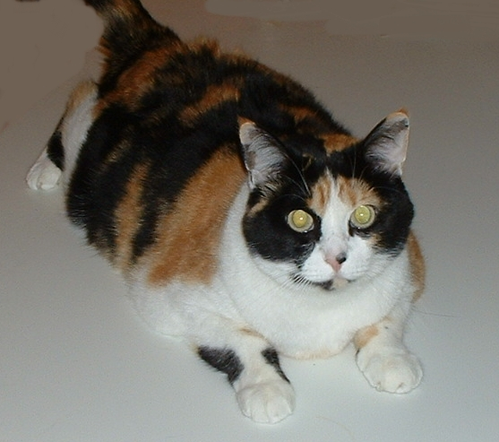
Lucy at 22
Lucy at 28
Lucy Margaret Byerly Kaylor KittyCat Cline
at 6
Lucy at 35

Slide 104
Pleasant Valley

Slide 105
Pleasant Valley
Province of Protohumans

Slide 106
What Shall we do with the Shenandoah Valley?
Gen. U. S. Grant:
“Such as cannot be consumed, destroy.”
“Eat out Virginia clean and clear...so that crows flying over it for the balance of the season will have to carry their own provinder.”

Slide 107
What Shall we do with the Shenandoah Valley?
Gen. Sheridan:
“The people must be left with nothing but their eyes to weep with over the war.”

Slide 108
What Shall we do with the Shenandoah Valley?
Gen. Sheridan:
“The people must be left with nothing but their eyes to weep with over the war.”
(later)
“The only good Indian is a dead Indian.”

