Slide 1

The First American Thanksgiving
Alan Kaylor Cline
November 21, 2014

Slide 2
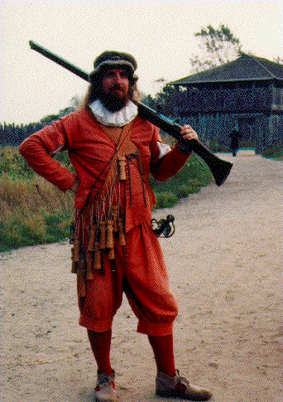

Slide 3
Outline:
  Meanings of Thanksgiving
  The First Virginia Thanksgiving
    The First Virginia Settlement
    The Native Population
    Pocahontas, John Smith, and John Rolfe
  The First Massachusetts Thanksgiving
  Early Texas, Florida, and Maine Thanksgivings
If time: a heartwarming Thanksgiving Story:
“Lucy and the Duck”

Slide 4
  Meanings of Thanksgiving

Slide 5
  Meanings of Thanksgiving
  Thanks Giving

Slide 6
  Meanings of Thanksgiving
  Thanks Giving (obviously)

Slide 7
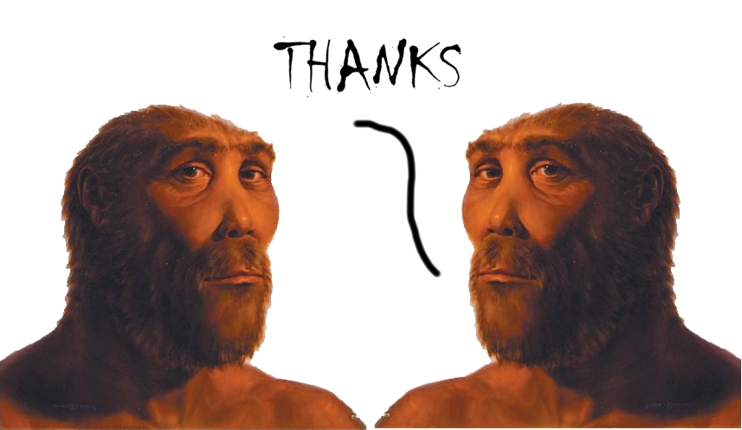
The First Thanksgiving ?

Slide 8
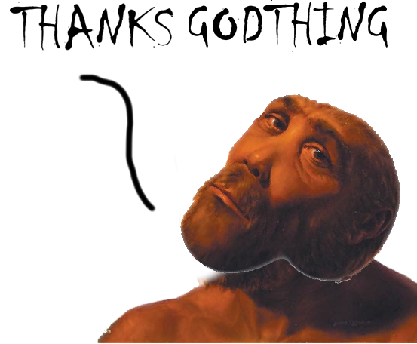
The First Thanksgiving ?

Slide 9
  Meanings of Thanksgiving
  Thanks Giving (obviously)
  Harvest Festival
  Family Reunion
  Start of Holiday Season
    Football games
    Ignore work
    Start shopping

Slide 10
Virginia and the James River

Slide 11
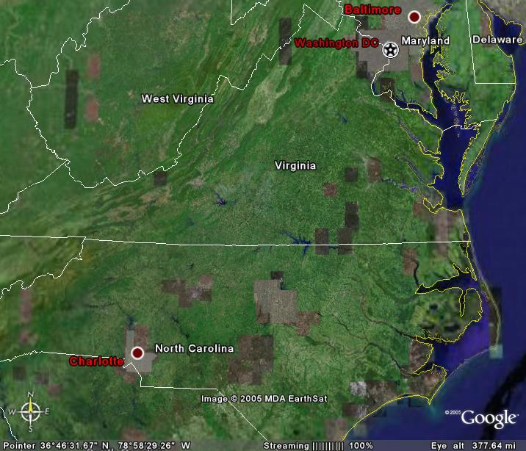

Slide 12
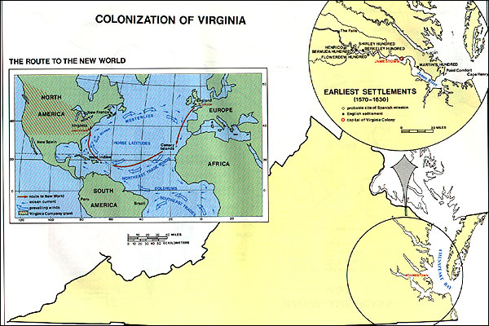
Colonization of Virginia
Notes:
1652 Map

Slide 13
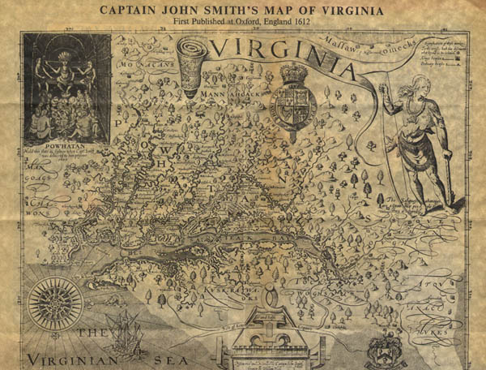
John Smith's A Map of Virginia: With a Description of the Countrey, the Commodities, People, Government and Religion (1612)
Notes:
1652 Map

Slide 14
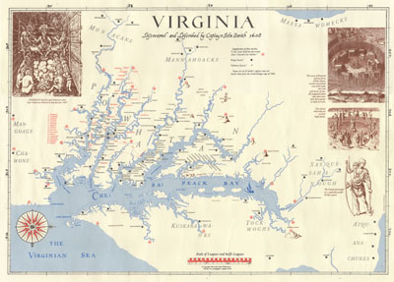
John Smith's A Map of Virginia: With a Description of the Countrey, the Commodities, People, Government and Religion (modified by Edward Wright Haile )
Notes:
1652 Map

Slide 15
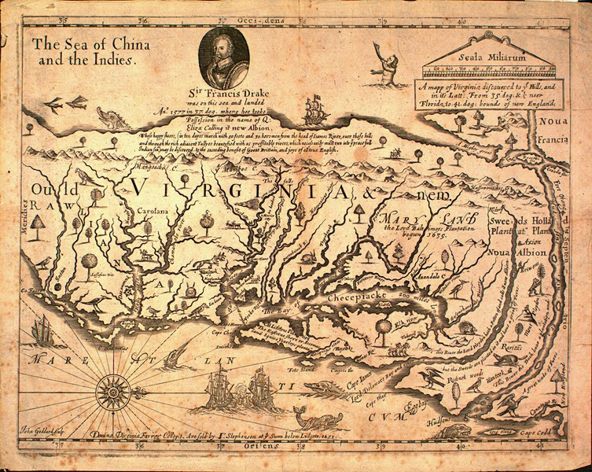
Virginia 1652
Notes:
1652 Map

Slide 16
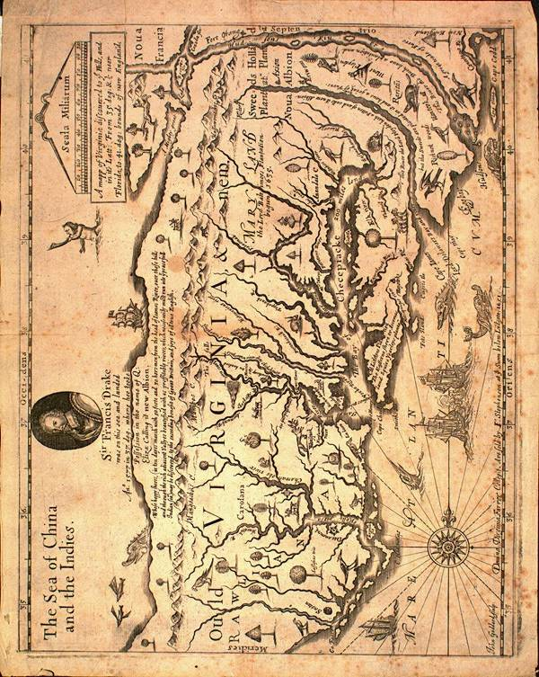

Slide 17
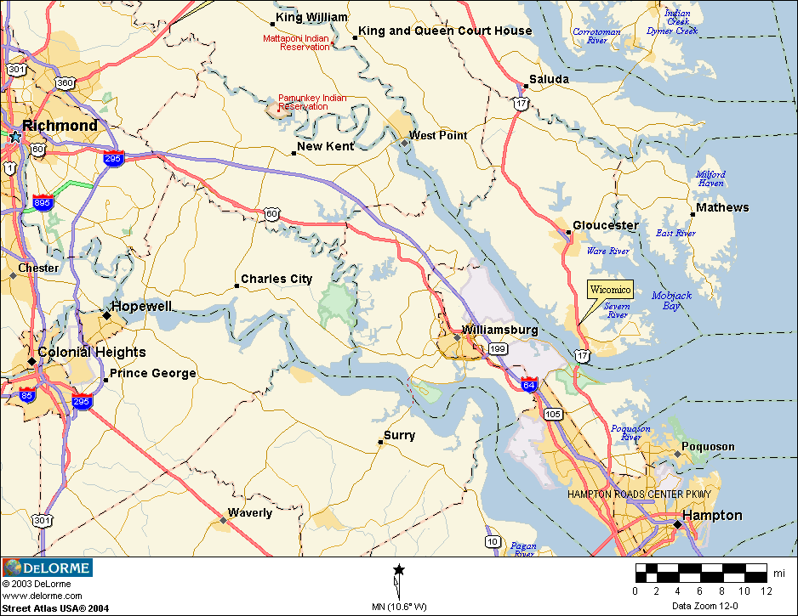

Slide 18
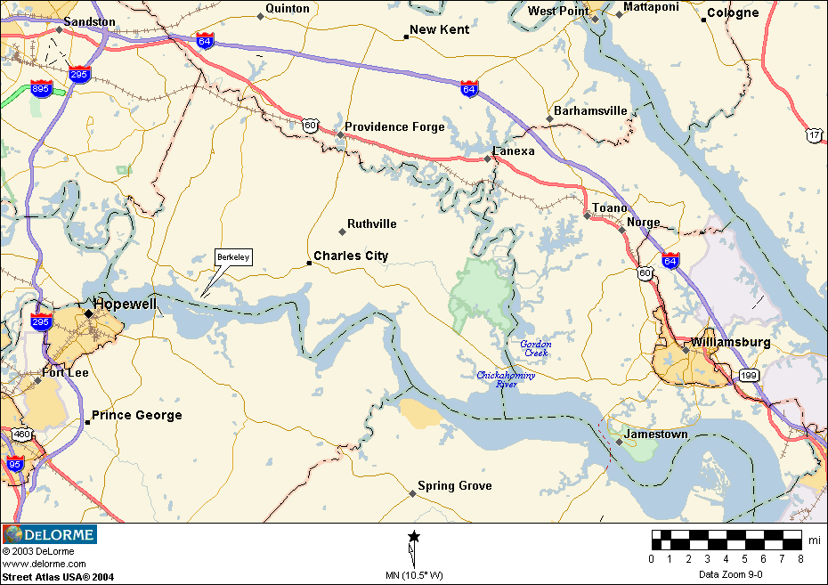

Slide 19
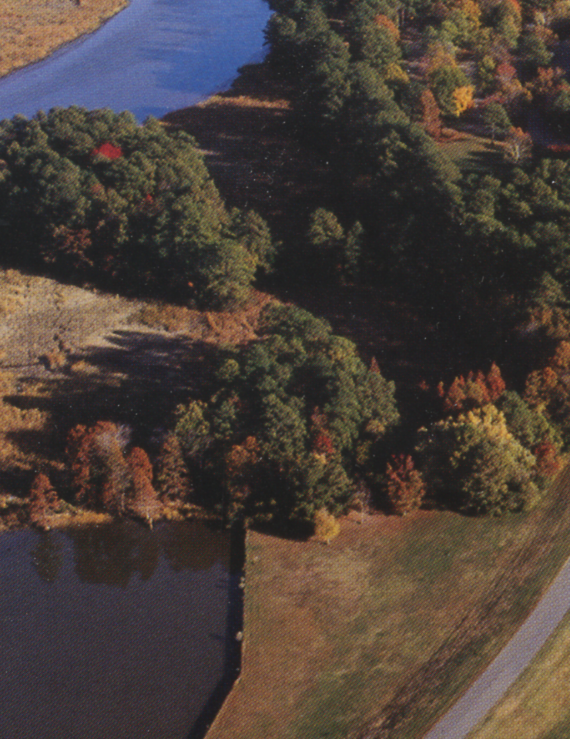
Jamestown Today
Notes:
Jamestown Now

Slide 20
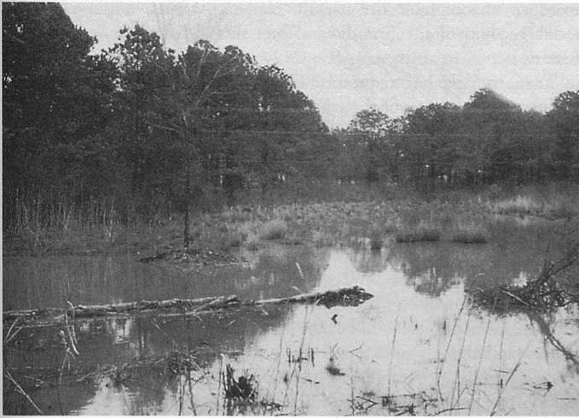
Notes:
Jamestown Swamp

Slide 21
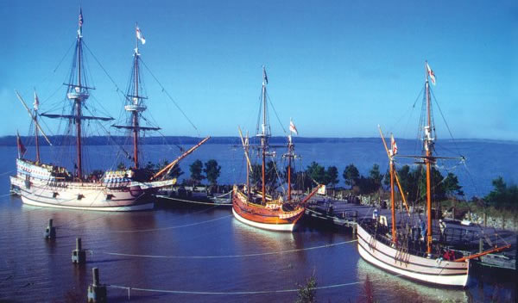
Discovery, Susan Constant, Godspeed

Slide 22
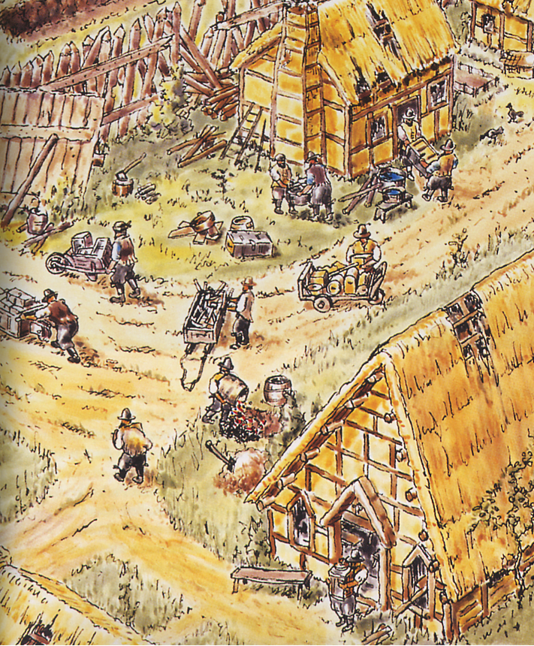
Activity inside Jamestown
~1608
Notes:
Jamestown 1608

Slide 23
A Jamestown Chronology
1585-90 The “Lost Colony”
1607 Landing of 105 men
1608 Fire and starvation - 50 survivors
1609 Arrival of women population >200
1609-10 “Starving Time” - 40 survivors
1610 Near abandonment

Slide 24
1619
First Elected Legislature
First Slave Ship
First Thanksgiving

Slide 25
The Native Population

Slide 26
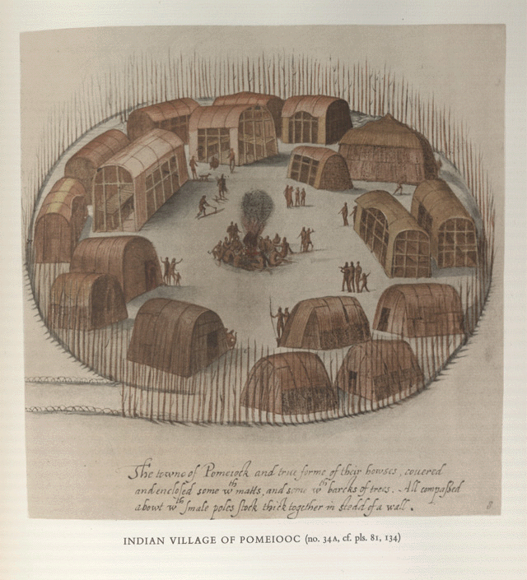
John White’s
Indian Village at
Pomeiooc
(1585-1586)

Slide 27
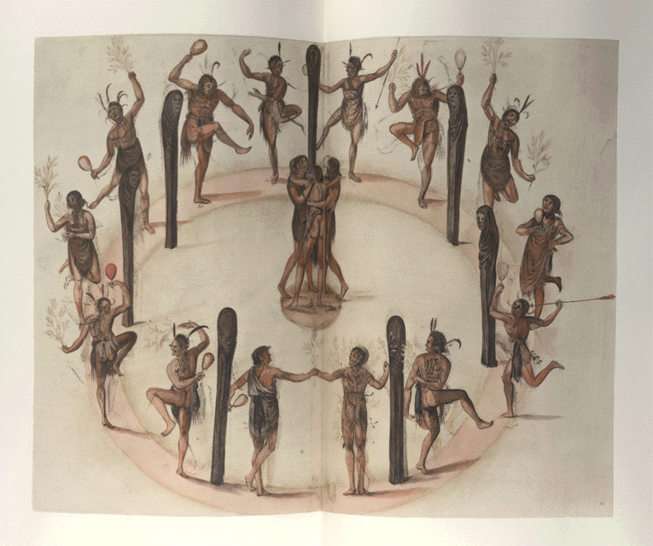
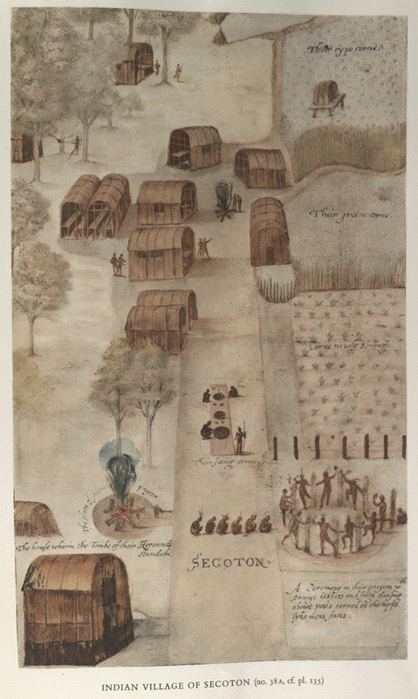
John White’s
Indians Dancing Around A Circle of Posts
and
Indian Village of Secoton
(1585-1586)

Slide 28
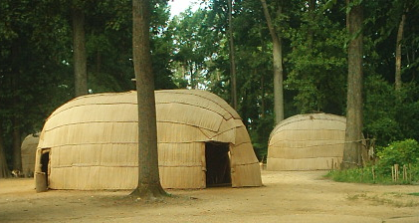

Slide 29
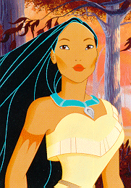

Slide 31
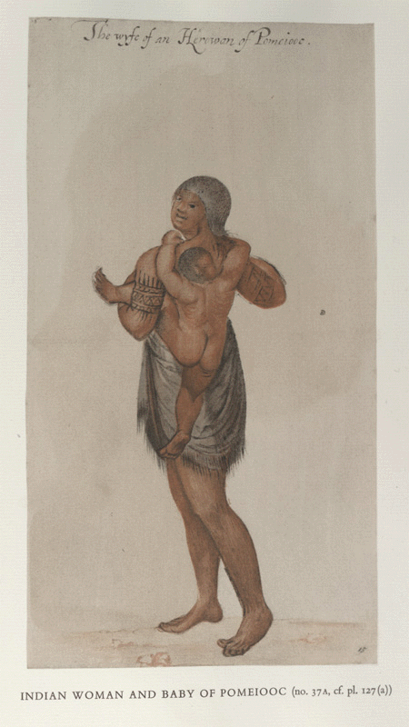
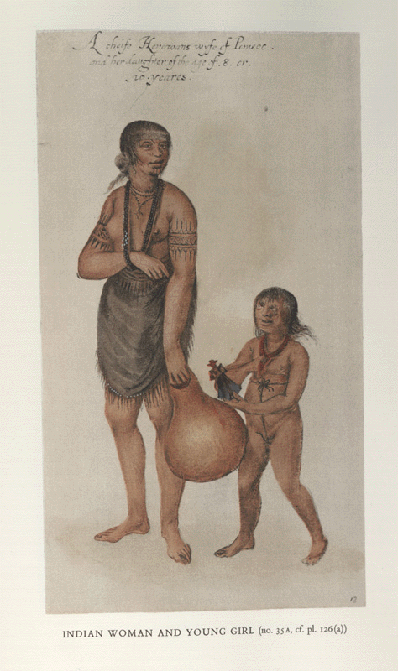
John White’s
Indian Woman and Baby of Pomieooc and
Indian Woman and Young Girl
(1585-1586)

Slide 32
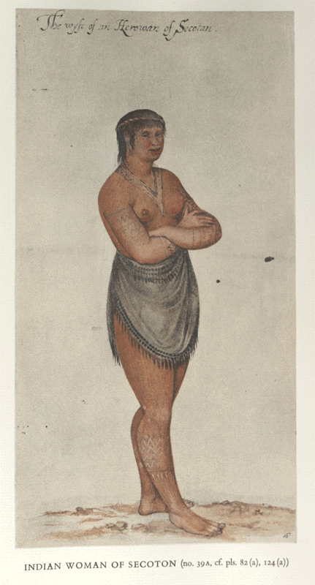
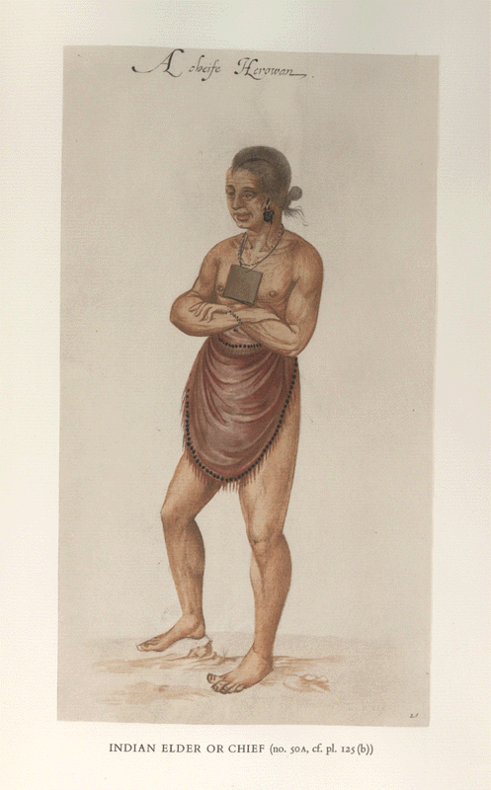
John White’s
Indian Woman of Secoton
and
Indian Elder or Chief
(1585-1586)

Slide 33
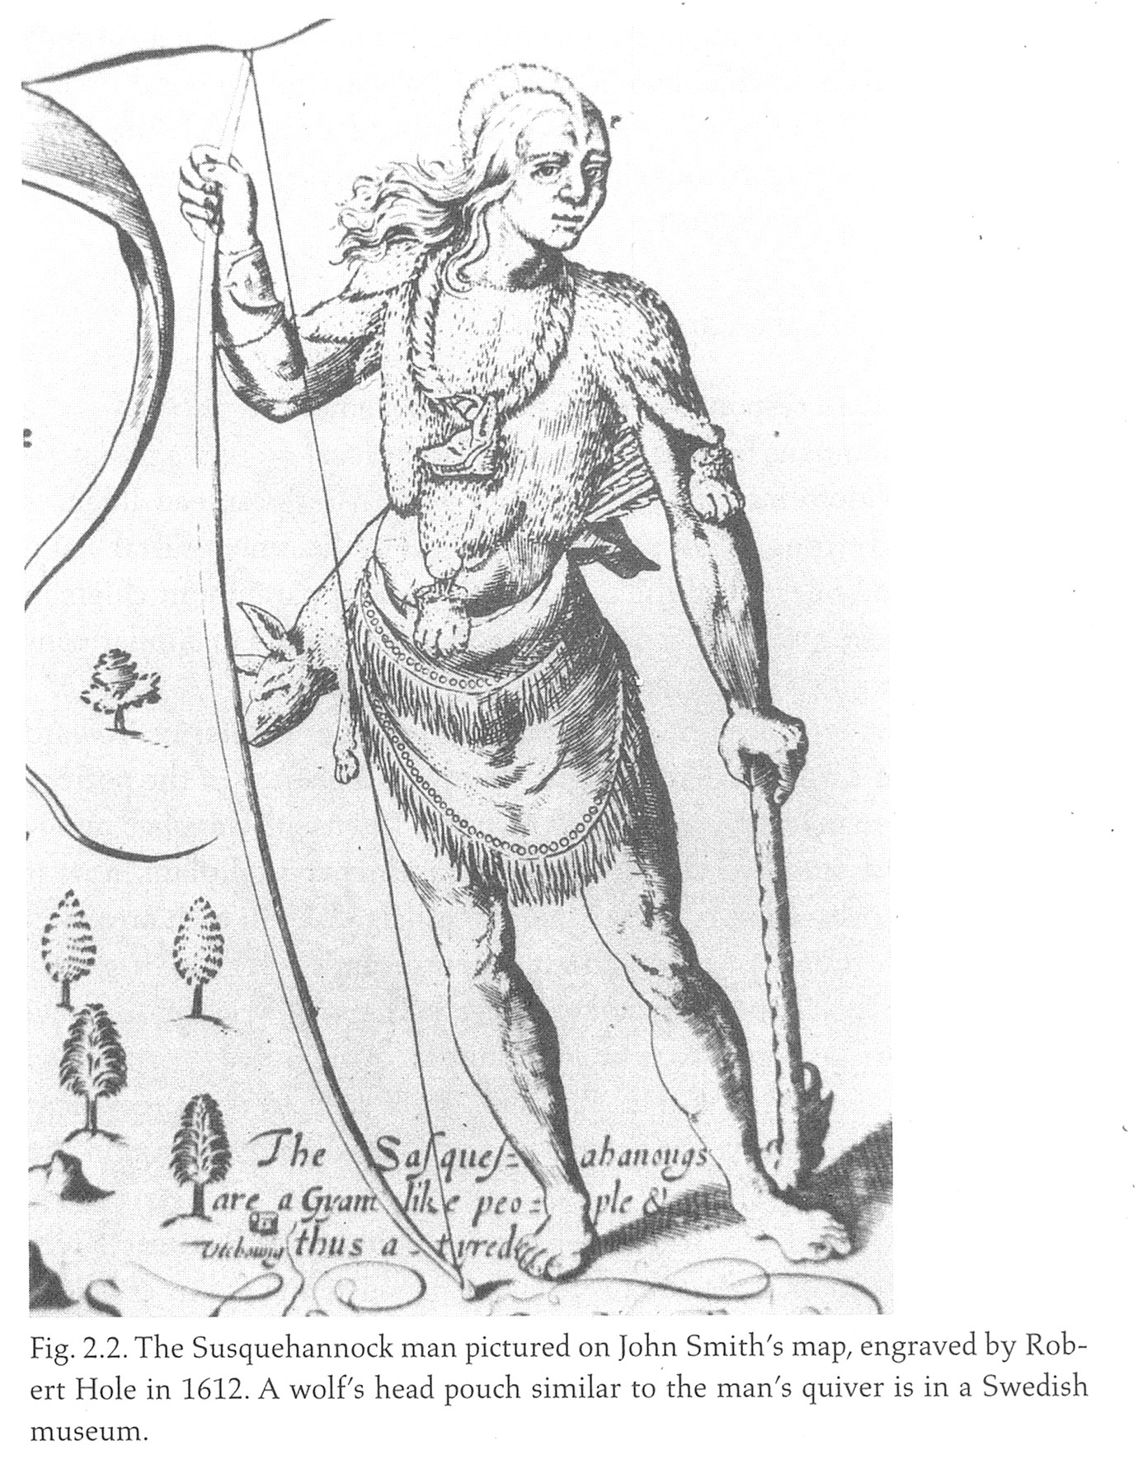

Slide 34
The Historical Pocahontas
~1595 born daughter of Powhatan
1607 the “rescue” of John Smith
1607-9 assistance to Jamestown settlers

Slide 35
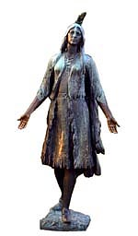

Slide 36
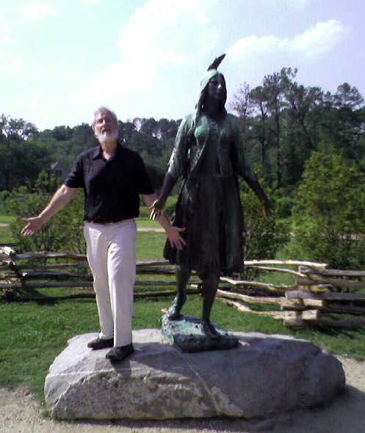

Slide 37
The Historical Pocahontas
~1595 born daughter of Powhatan
1607 the “rescue” of John Smith
1607-9 assistance to Jamestown settlers
1612 abduction as hostage
1613 baptism as Rebecca

Slide 38
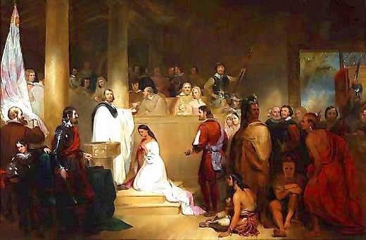
The Baptism of Pocahontas – John Gadsby Chapman 1840

Slide 39
The Historical Pocahontas
~1595 born daughter of Powhatan
1607 the “rescue” of John Smith
1607-9 assistance to Jamestown settlers
1612 abduction as hostage
1613 baptism as Rebecca
1614 marriage to John Rolfe

Slide 40
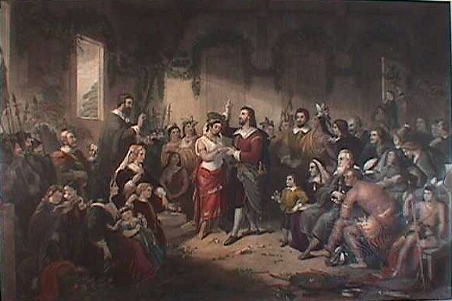

Slide 41
The Historical Pocahontas
~1595 born daughter of Powhatan
1607 the “rescue” of John Smith
1607-9 assistance to Jamestown settlers
1612 abduction as hostage
1613 baptism as Rebecca
1614 marriage to John Rolfe
1615 birth of Thomas Rolfe
1616 trip to England

Slide 42
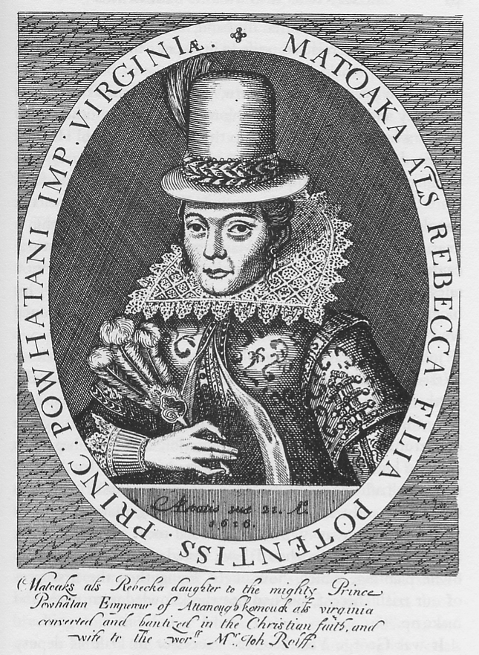

Slide 43
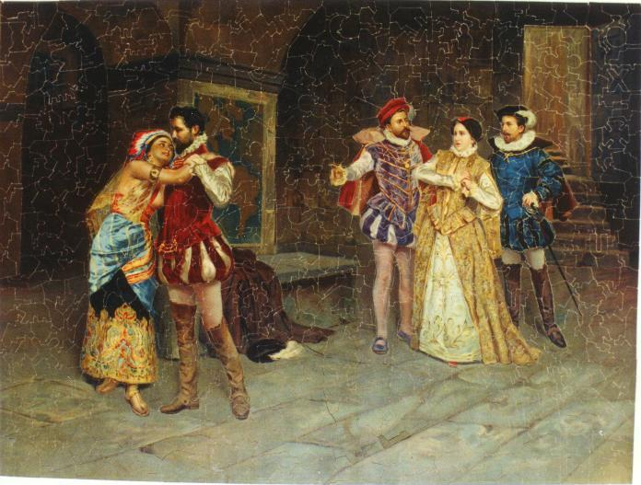

Slide 44
The Rescue
Execution
Ritual
Imaginary

Slide 45
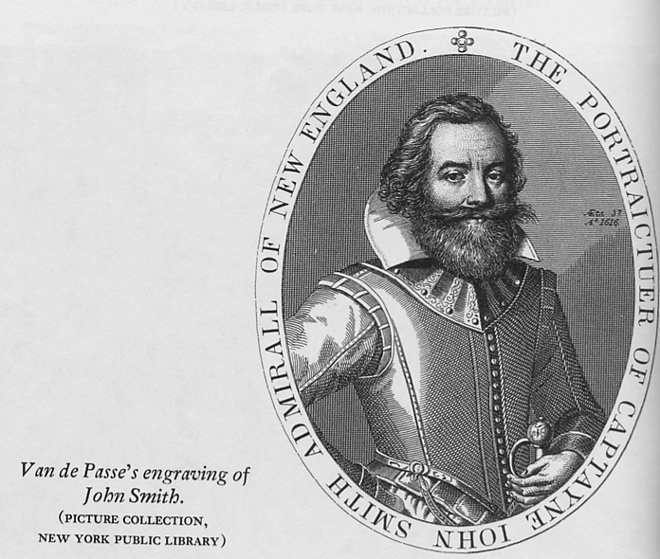

Slide 46
“After some six weeks fatting amongst those Salvage Courtiers,
at the minute of my execution, she hazarded the beating out of
her owne braines to save mine, and not only that, but so prevailed
with her father, that I was safely conducted to James towne,
where I found about eight and thirty miserable poore and sicke
creatures, to keepe possession of all those territories of Virginia
such was the weaknesse of this poore Common-wealth, as had
the Salvages not fed us, we directly have starved.”
John Smith Generall Historie 1624

Slide 47
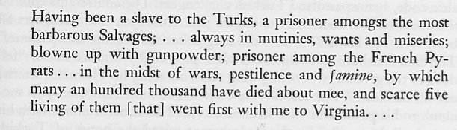

Slide 48
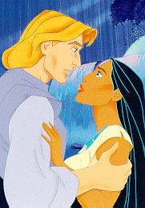

Slide 49
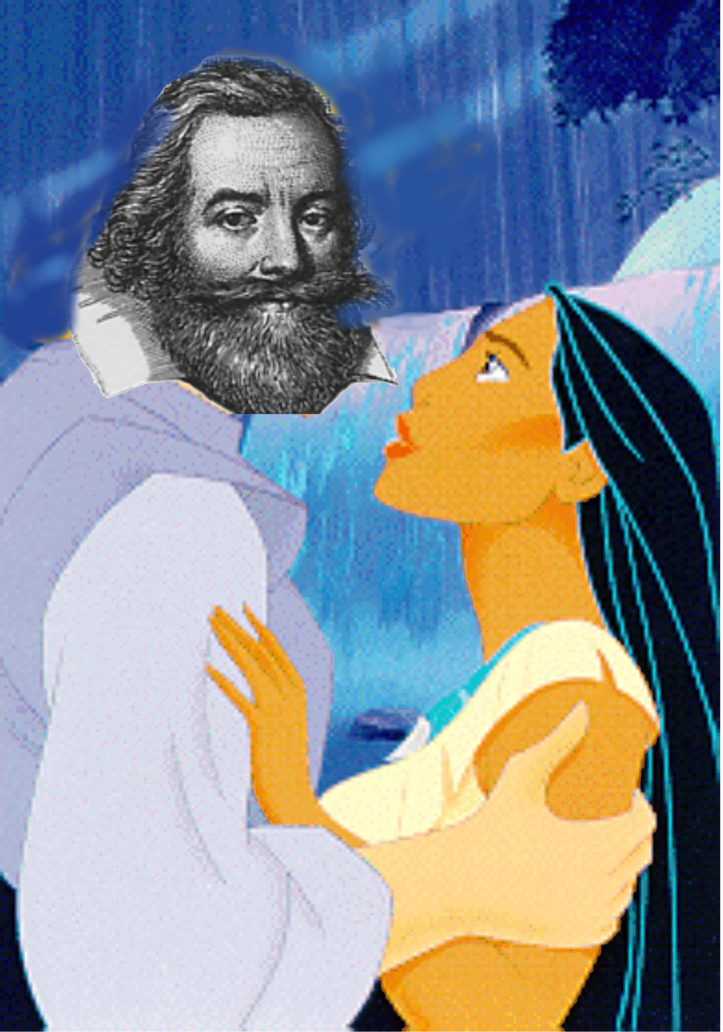

Slide 50
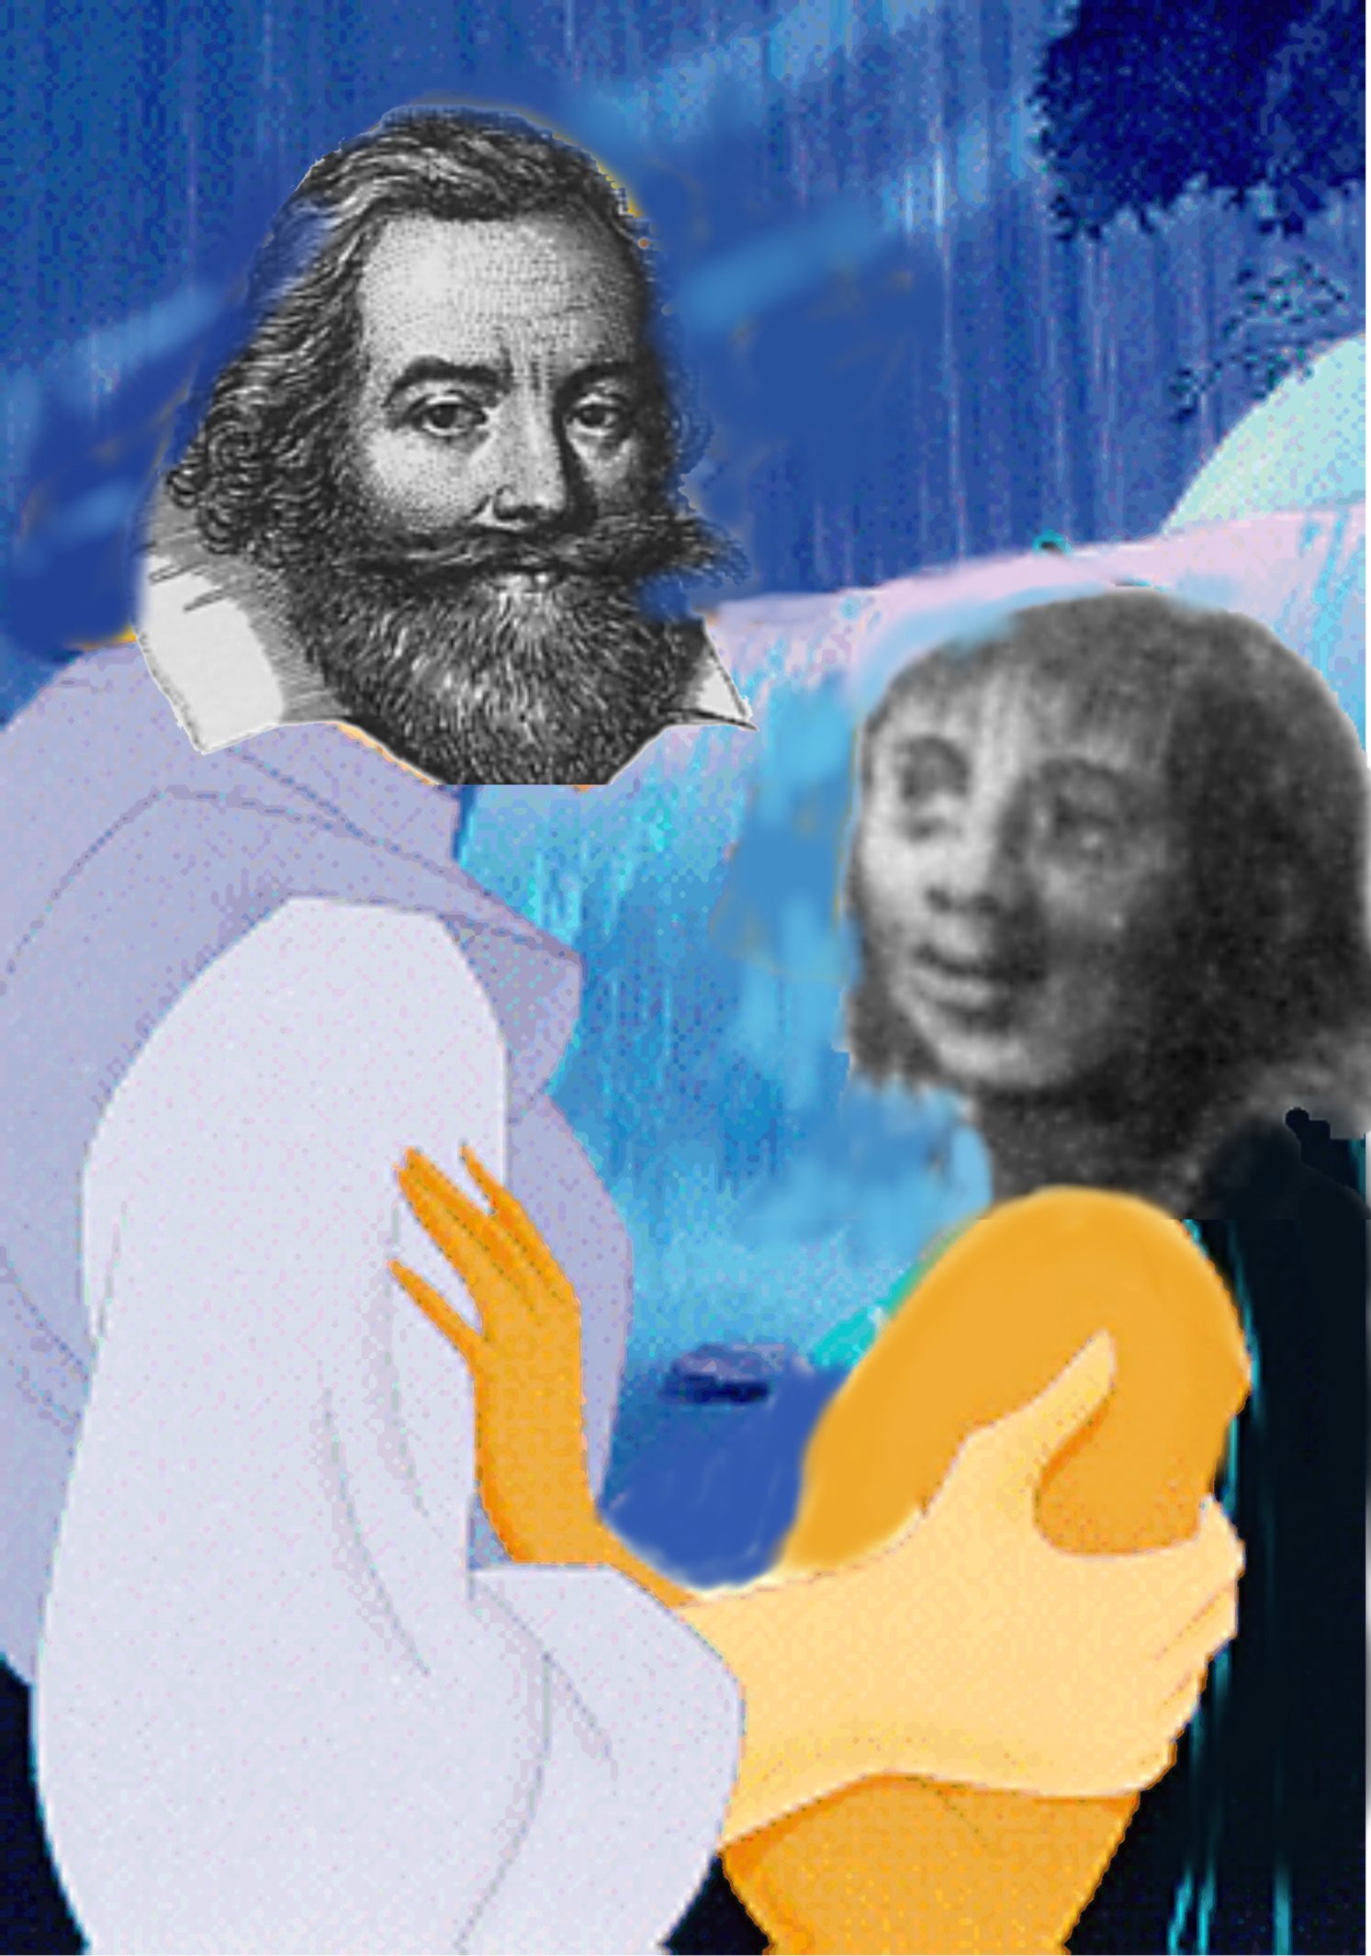

Slide 51
The Historical Pocahontas
~1595 born daughter of Powhatan
1607 the “rescue” of John Smith
1607-9 assistance to Jamestown settlers
1612 abduction as hostage
1613 baptism as Rebecca
1614 marriage to John Rolfe
1615 birth of Thomas Rolfe
1616 trip to England
1617 death in England

Slide 52
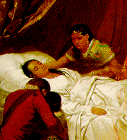

Slide 53
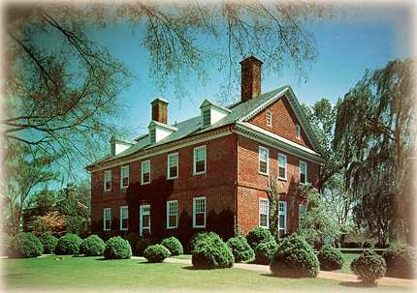
Berkeley Plantation

Slide 54
Berkeley Plantation
First settled in 1619 by thirty-eight men from Berkeley Parish in England.
They came on shore December 4, 1619 and obeyed their instructions:
"Wee ordaine that the day of our ships arrivall at the place assigned for plantacon in the land of Virginia shall be yearly and perpetually keept holy as a day of thanksgiving to Almighty God."

Slide 55
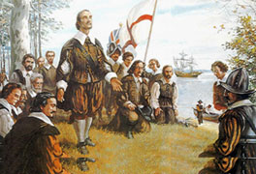
Landing at Berkeley

Slide 56
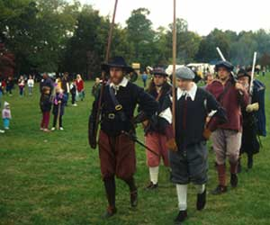

Slide 57
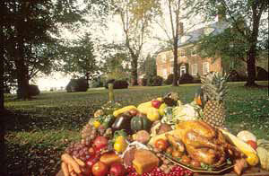
Berkeley Plantation with “Feast”

Slide 58
Berkeley House
Built in 1726, by Benjamin Harrison IV and Anne Harrison.
Benjamin Harrison V, was a signer of the Declaration of Independence and three-time Governor of Virginia.
William Henry Harrison, Benjamin's third son, born at Berkeley, became the ninth President of the United States, in 1841. (His grandson, Benjamin Harrison, was the 23rd President.)
First ten presidents stayed here.

Slide 59
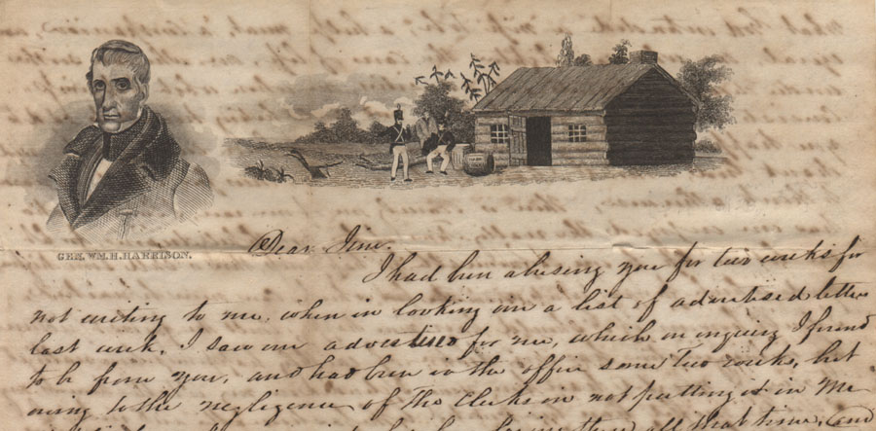
W. H. Harrison’s Election Spin
Birthplace. Right.

Slide 60
Other Berkeley Interesting Stuff
First American bourbon whiskey distilled -- 1621, by George Thorpe, an Episcopal minister
First time Army bugle call "Taps“ was played -- July 1862, by bugler Oliver W. Norton; the melody was written at Berkeley then by General Daniel Butterfield.
Abraham Lincoln visited twice in the summer of 1862 during occupation by U. S. Army.

Slide 61
Even More Berkeley Interesting Stuff
Harrison family forced to leave – never to regain the house.
The house went into disrepair until purchased in 1907 by John Jamieson, a Scotsman who had served as a drummer boy in the U. S. Army during the Civil War.
Jamieson family still owns it.

Slide 62
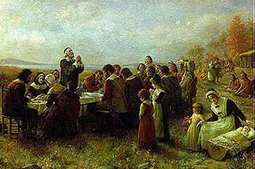
Imaginary View of Plymouth Thanksgiving

Slide 63
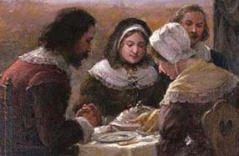
Close-up Emphasizing Non-History

Slide 64
In 1638, the Puritans and their Indian allies signed the Treaty of Hartford, which declared the Pequot nation dissolved. The spirit behind this genocide is encapsulated in the victory sermon of Increase Mather, a leading Puritan minister, who asked his congregation to thank God 'that on this day we have sent six hundred heathen souls to hell'
Chalk, Frank and Kurt Jonassohn. (1990)
The History and Sociology of Genocide:
Analyses and Case Studies.

Slide 65
“The myth of the Pilgrims, with its three central themes, the Forefathers, the Rock and the Compact, became increasingly pervasive in the American collective consciousness during the nineteenth century. It would receive even greater attention, this time on an international scale, when in 1858, just one year before construction began on the Forefathers’ monument, Henry Wadsworth Longfellow wrote an epic poem, The Courtship of Myles Standish.”
James F. Deetz and Patricia Scott Deetz
The Plymouth Colony Archive Project
Times of Their Lives in Plymouth Colony

Slide 66
How, then, the Founding Fathers of Massachusetts contrived to steal the thunder from the Founding Fathers of Virginia is not easy to make out. Much of the larceny dates back to the vicious sectionalism of the post-Civil War period, when the Boston Brahmins wrote American history without a South. The legend of the preeminence of the Massachusetts colony began, even earlier, with the early New England chroniclers and orators, who reflected pride in the fact that theirs alone, among all the planters, had been a distinct, a purely moral purpose, a wholly religious dedication: the Puritans of New England founded "a Citty uppon a Hill." They were conscious of a worldwide audience: "the eies of all people ... uppon us"; theirs was an Errand into the Wilderness. Nineteenth-century American literature (notably the versifying of Longfellow) enlarged on this theme, and America seized upon the identification with Puritans and Pilgrims as the most heroic of national origins.
Frances Mossiker: Pocahontas: The Life and the Legend

Slide 67
May 23rd, 1541
Palo Duro Canyon, Texas
During Coronado's expedition a Eucharistic thanksgiving, with the friendly Teya Indians present, occurred in Palo Duro Canyon in West Texas.

Slide 68
June 30th, 1564
Jacksonville, Florida
On that date French Huguenots who had come to the New World for religious freedom, took time to give thanks to God with a hymn of thanksgiving and prayer for the future after they had successfully begun their colony by constructing huts of logs and earth and digging a well. Unfortunately, the colony they established was a short lived one.

Slide 69
September 8th, 1565
St. Augustine, Florida
Don Pedro Menedez landed a Spanish expedition at what is now Mission Nombre de Dios and immediately held a Mass of Thanksgiving. Later, Menedez dined with the local Seloy Indians in a meal of cocido (a stew of salt pork, garbanzo beans and garlic), hard sea biscuits, and red wine.

Slide 70
April 30th, 1598
Near El Paso, Texas
After a nine day period of refreshment, hunting, and fishing, Don Juan de Onate decreed that the general assembly should celebrate a day of thanksgiving to God the following day, the 30th. It was a memorable occasion: each person dressed up in his/her best clothes; a High Mass was conducted and a sermon was given by the friars in a chapel built under some shady trees.

Slide 71
August 9, 1607
mouth of Kennebec River, Maine
A group of settlers, led by George Popham under a charter of the Plymouth Company, arrived at the mouth of Maine’s Kennebec River and held a thanksgiving service there in gratitude for a safe Atlantic voyage and landing. However, their attempt at colonization failed and they abandoned their site within a year of their landing, leaving no permanent tradition behind.

Slide 72
So what’s it mean to you?

Slide 73
Lucy and the Duck
A Heartwarming Story of Courage in the Midst of Horror
Setting: Pleasant Valley, Rockingham County, Virginia – October 6, 1864
Dramatis Personae:
Jacob and Margaret Byerly: 48 and 39 years old, respectively. They had four daughters and two sons living with them on a large and prosperous farm. They also owned a flour mill. (My great-great-grandparents).
Martha Jane Byerly: a nineteen year old daughter (our heroine).
Nanny: a middle-aged slave in the Byerly household.
Mary Frances (Fannie) Byerly: a seven year old daughter.
Lucy Margaret Byerly: the youngest of the Byerly children – still a month shy of her fourth birthday. (My great-grandmother.)
Soldiers of Col. Daniel Macauley’s Third Brigade, Second Division, XIX Corps, United States Army: infantrymen from New York and Massachusetts.
A Duck: age and genealogy unknown.

Slide 74
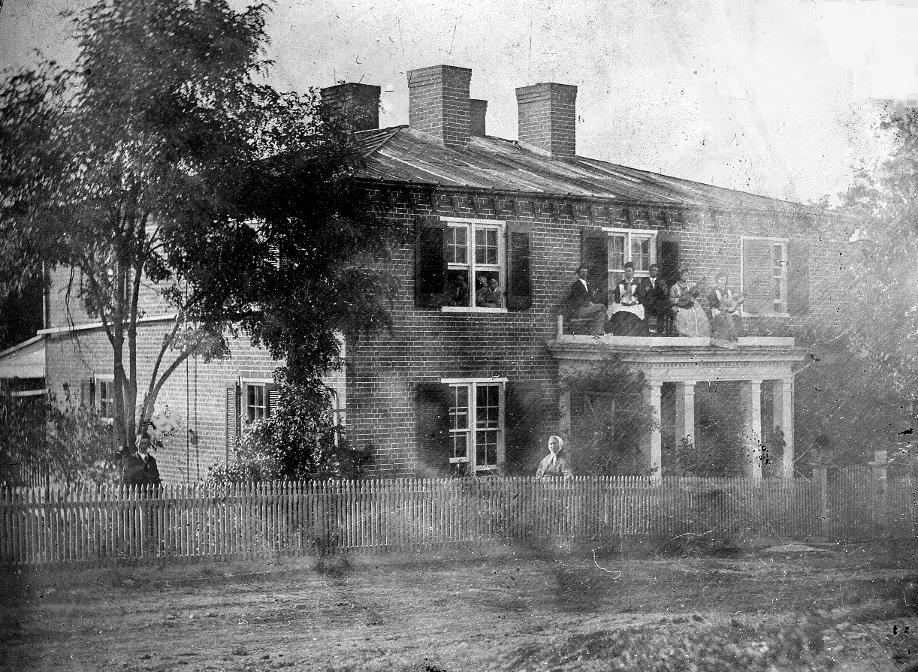

Slide 75
Pleasant Valley

Slide 76
Pleasant Valley
Province of Protohumans

Slide 77
What Shall we do with the Shenandoah Valley?
Gen. U. S. Grant:
“Such as cannot be consumed, destroy.”
“Eat out Virginia clean and clear...so that crows flying over it for the balance of the season will have to carry their own provinder.”

Slide 78
What Shall we do with the Shenandoah Valley?
Gen. Sheridan:
“The people must be left with nothing but their eyes to weep with over the war.”
(later)
“The only good Indian is a dead Indian.”

Slide 79
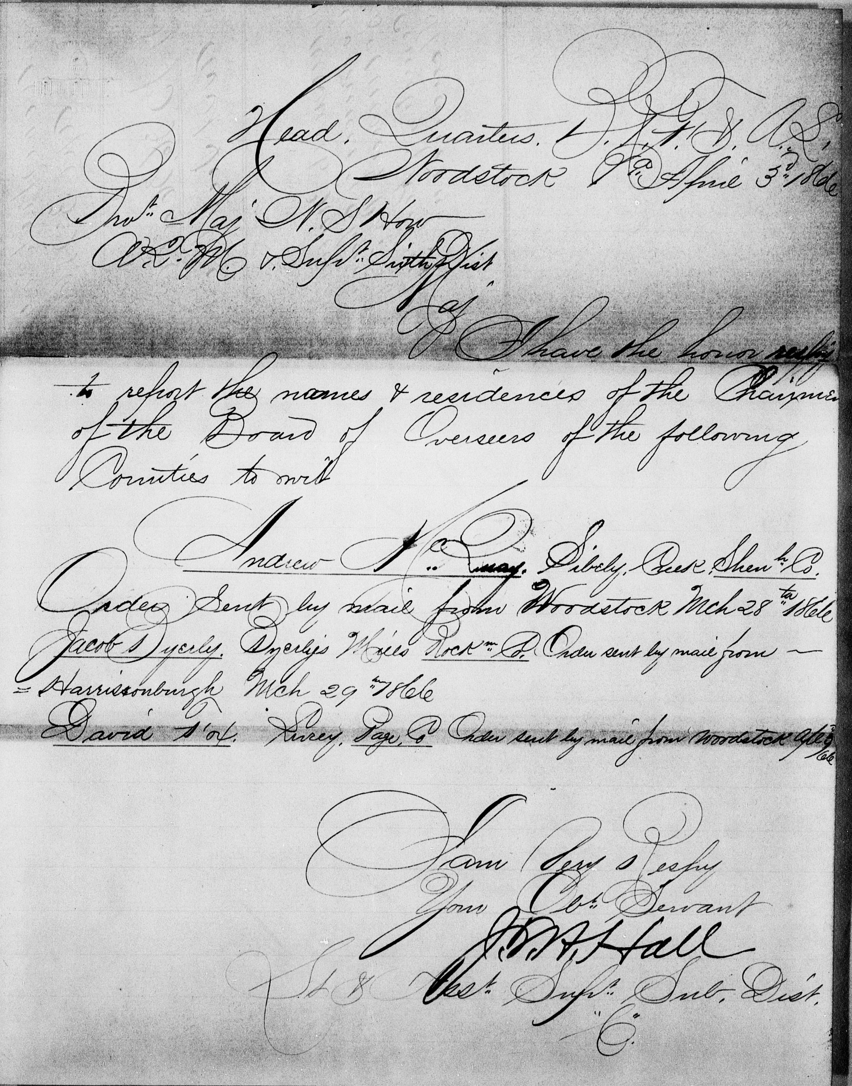
Order reflecting Jacob Byerly’s appointment as Chairman of the Board of Supervisors of the Freedmen’s Bureau in Rockingham County. April 3, 1866

Slide 80
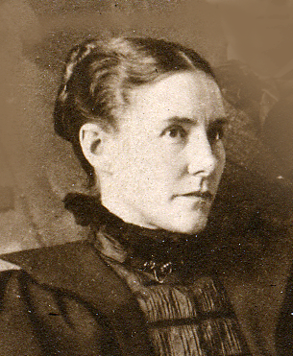
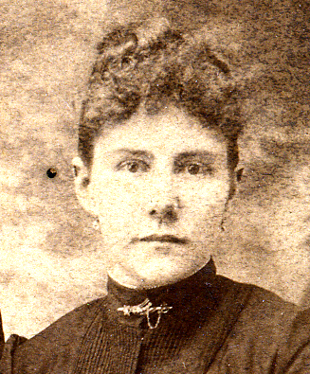
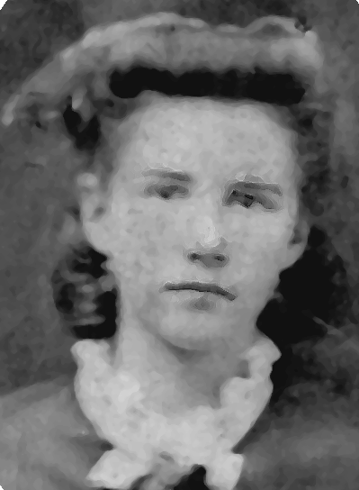
Lucy at 22
Lucy at 28
Lucy at 35

Slide 81
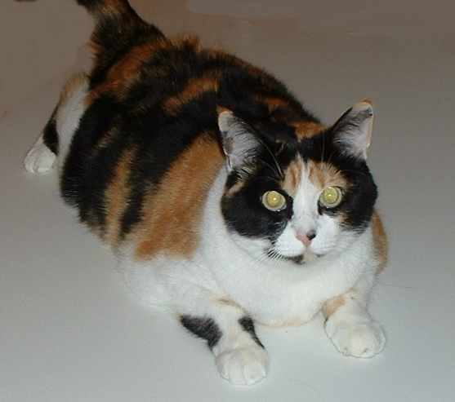
Lucy at 22
Lucy at 28
Lucy Margaret Byerly Kaylor KittyCat Cline
at 6
Lucy at 35

