Slide 1
6.440 Essential Coding Theory
Dana Moshkovitz

Slide 2

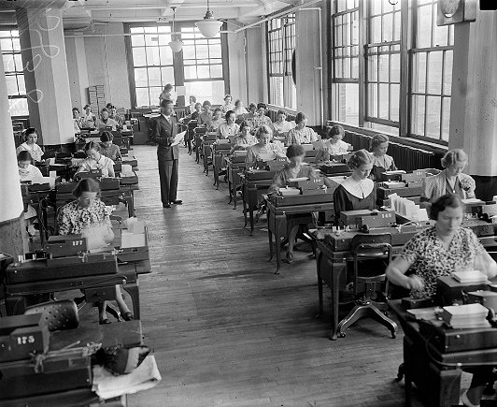
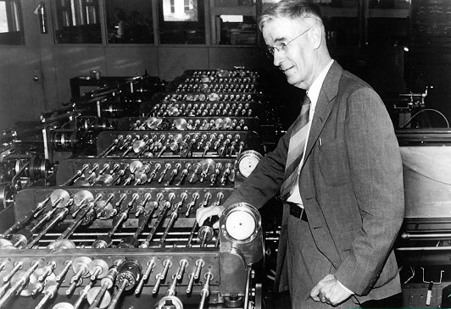
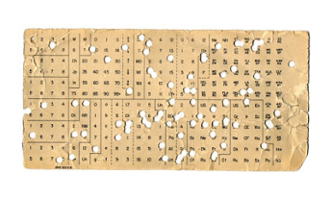
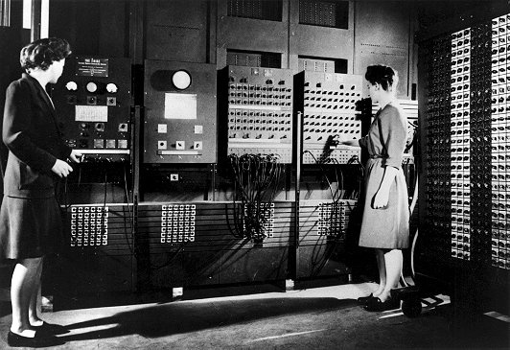
Computing in the 20’s-40’s
Punch cards – 30’s
Analog computers – 20-30’s Vannevar Bush @ MIT
First electronic computer, ENIAC - 1945

Slide 3
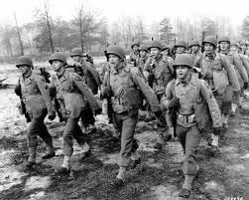
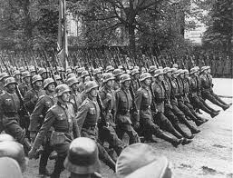
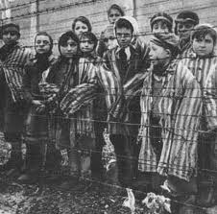
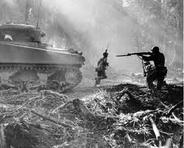
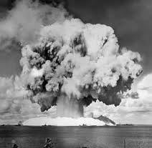
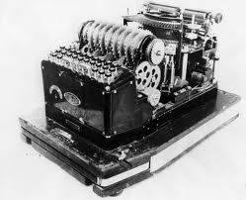
World War II
The Manhattan Project
Breaking the Enigma

Slide 4
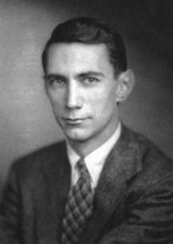
Claude Shannon (1916-2001)
1937: MIT Master’s thesis: compute any function using switches.
1940: Completes his MIT PhD under Vannevar Bush, and goes to the Institute for Advanced Study.
WWII: Crypto at Bell Labs, talks to Turing.
1948: Paper that starts information theory.
1956: Professor at MIT.

Slide 5
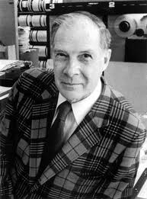
Richard Hamming (1915-1998)
WWII: Programs one of the earliest computers for the Manhattan Project.
1946: At Bell, together with Shannon.
1950: Paper that starts error correcting codes.
What are the most important problems in your field?
Are you working on one of them?

