Slide 1

Academic Job Search
Dana Moshkovitz
EECS, MIT

Slide 2

Fall: Apply or Not Apply?
This is the Question
What to apply to?
  Post-docs: with/without teaching, program/with professor.
  Research positions (no teaching)
  Tenure track positions
  Scholarships to fund post-doc
Where to apply?
  Universities
  Research labs/institutes
  Individual professors
Advice: Ask around! Tell people you’re applying.
Notes:
Talk to your advisor,
Talk to colleagues,
Tell people at other universities that you’re applying
Many possibilities, but no central website lists all

Slide 3


Post-Doc – Little Commitment
Between studentship and professorship, time to prove yourself as an independent researcher.
Different environment (people, expertise, resources, etc).
Typically: little commitment, unstructured, 1-3 years, no money of your own, many times a single host.
Notes:
Get more people to know you – more rec letters
Get more experience (lecturing, teaching, working with students)

Slide 4

Tenure Track – Big Commitment
Teaching takes a lot of time! But also good for your research.
Advising– big responsibility, good for research.
Applying for grants – can usually wait until after first year, but then takes time.
Academic system is supportive of assistant professors.
Notes:
Through teaching: deepen your understanding, explore new areas, get to know students and colleagues and get them to know you, improve your presentation skills, get inspired, some comfort when research doesn’t work
Start-up money usually enough for first year+, but need to apply to grants (e.g., NSF CAREER Award).

Slide 5
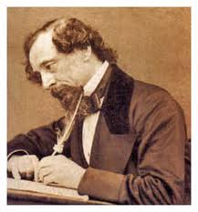
Fall-Winter: The Application
Prepare table: places, contacts, deadlines.
Research Statement: Your work & future directions; Clear for non-experts who scan it.
Teaching Statement: Goals in teaching, what would you improve or develop? & Teaching experience.
Recommendation Letters:
  3-4: from advisor(s) + ≥1 outside home institute.
  Best letters: by known people who know you and your work well and appreciate it.
  Send writers contacts + deadlines.
Advice: Figure your story; take time for it to simmer.
Notes:
- Good for you to distill your story/achievements/goal – you’ll later have to present them repeatedly

Slide 6

Late Fall-Winter: Prepare The Job Talk
Most of it: the research you did.
Then: the research you plan to do.
Focus on a theme, tell a story.
Make it enjoyable and memorable: plan jokes, use props,…
Polish through interaction.
Advice: Can have a slide at the end mentioning all the work you didn’t talk about.

Slide 7
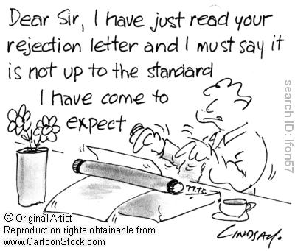
Winter-Early Spring: Hear Back
Post-doc: Usually no interviews except for research labs.
Tenure-track: invitation to interview ⇔ you’re one of their top candidates.
Plan schedule! Group geographically close interviews; have breaks; get to favorite places experienced but not tired.
Notes:
- If you can, it’s good to visit a place that offered you a post-doc before coming there.
Number of interviewed people depends on size of department and number of slots they have.
Experienced: it should probably not be the first place you interview at; Not tired: don’t have it at the end of a long, intensive tour.

Slide 8

Winter-Early Spring: Interviews
1-2 days of half hour meetings with faculty & department head.
Job talk in the afternoon of first day.
Dinner before last day.
Unique opportunity to meet many people.
Get a feel for the place.
Have ready answers : What research did you do? What do you plan to do? What teaching?
Dress code: suit.
Nice meeting you!
Advice: It takes time to get used to it
Notes:
Exhausting…
Dress code: typically a suit (including a buttoned shirt, nice pants, nice shoes) for men; women can also wear a dress/skirt.
You don’t have to wear a suit/tie if you’re uncomfortable with it:
A buttoned shirt and nice pants and shoes are enough.
Important: look clean, tidy, serious.

Slide 9

Spring: Offers
Salary & Start-up package (student funding, summer salary, travel, discretionary money,…)
Let other places know.
Second visit: check housing, living conditions,...
Negotiate:
  Defer offer for post-doc
  Teaching first semester?
  Less-restricted/more start-up funds.
  Special cases: shorter tenure-track, more money, chair, joint appointment, etc.
Advice: What’s important to YOU?
Notes:
You negotiate with department head; department head negotiates with the university.
You need to make a good case for what you ask for.

Slide 10

It’s Not You, It’s Them
Advice: Hiring committees generally do a good job, but always reject some excellent people.
How many slots available?
How are the other candidates and their letters?
Expert(s) making the case for you?
  In which area target hire?
  In which area hired recently?
  Diversity issues.
  Extra funds/slots available from different sources?
Different opinions on what to look for: Did something big? Single-authored? Many citations? Collaborative?
Notes:
Committees try to do a good work, but many times people get reject in a pretty arbitrary way

Slide 11
Emotional Issues
Self-worth: “Am I good enough?”, “What do people think about me?”
Ego: “Only first tier for me!”
Preparedness: “Am I ready??”
Two-body problem: “Give up on opportunities??”
Advice: Acknowledge that these are part of the process. Maintain a professional attitude.
Notes:
Good to focus on the (many) things you have to do; don’t tire yourself with thoughts about “what if?” – just wait for answers and then consider your alternatives.

