Slide 1
Possibilities and Limitations in Computation
Dana Moshkovitz
Notes:
I need jokes…

Slide 2
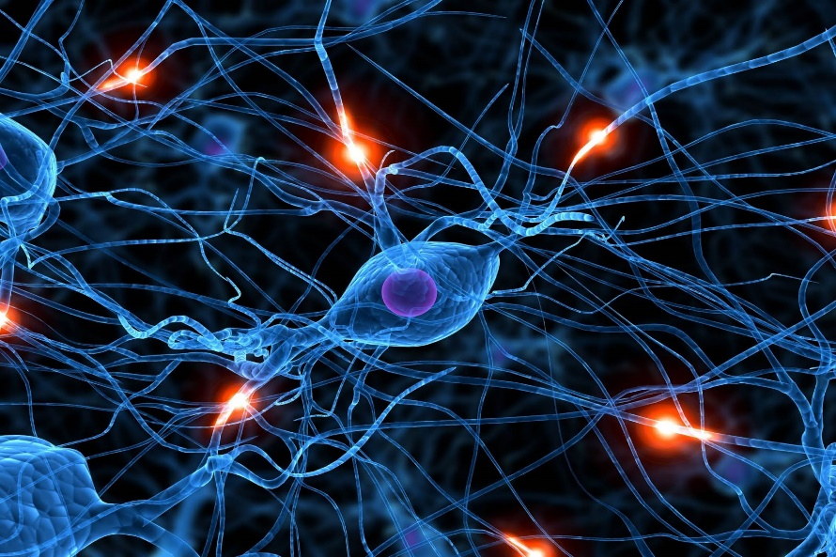
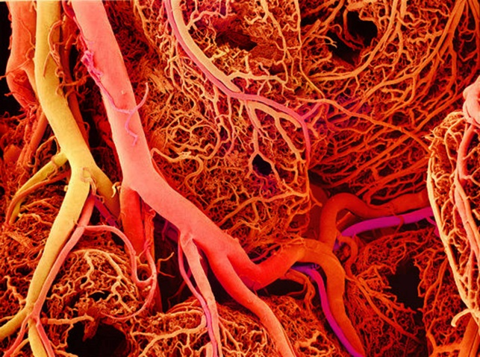
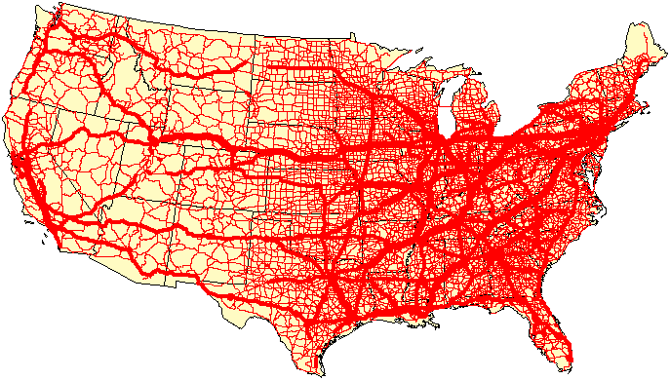
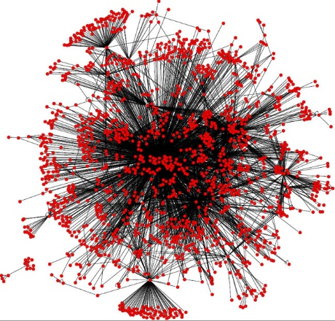
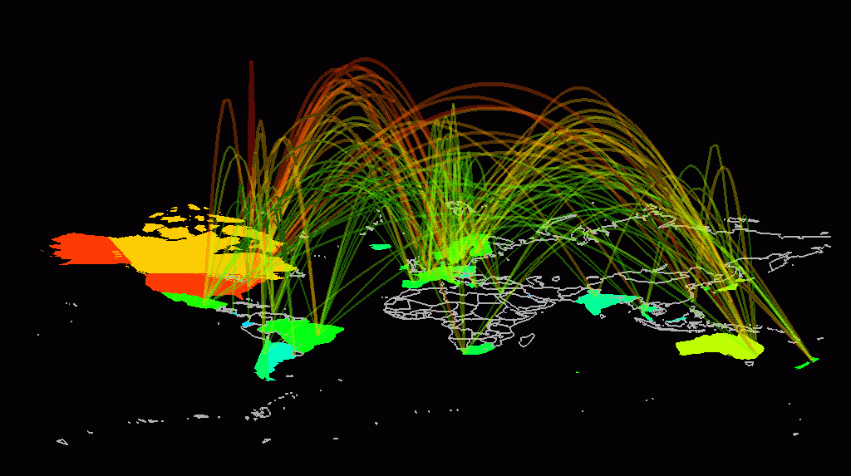
Computation is Everywhere There’s Data and Something We Want to Figure Out.
Sometimes figuring out is done by hand.
Computation enters when we ask how it scales.
Notes:
Data = input
What we want to figure out = output

Slide 3
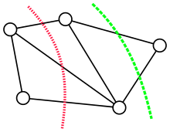
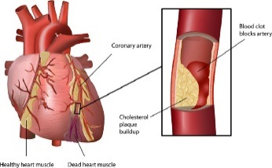
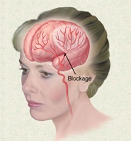
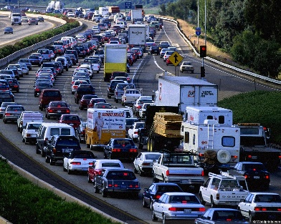
Theoretical computer science considers the most basic, universal, computational problems.
For instance, Min-Cut: given a graph, how to partition the vertices to two sets so the number of edges between parts is minimized.
Notes:
If you figure out an efficient way to do something, you can use it everywhere.
If you realize something is hard, it tells you more complicated problems are only harder.

Slide 4
The Jargon
Computation is done by an algorithm that gets an input and gives an output.
The input size is often denoted by n.
The run-time of the algorithm is the worst-case number of steps it performs as a function of the input size.
We typically only consider “order of magnitude”, not exact numbers. E.g., Min-Cut has a linear time algorithm.

Slide 5
We call an algorithm efficient if, given input of size n, its run-time is at most n^{c} for some constant c (“polynomial-time”).
We call a problem easy if it has an efficient algorithm.
Notes:
For many problems we don’t have a linear time algorithm, but we have quadratic time algorithm or cubic time algorithm.
We define “reasonable” time as “polynomial time”. Polynomials compose.
Most algorithms we have run in time <= n^3. Even when an algo with time n^10 is devised, it’s usually improved to run in faster tim

Slide 6
The greatest discovery: Many basic, universal, problems are likely hard.
Min-Cut is easy, but Sparsest-Cut and Max-Cut are “NP-hard”.
Notes:
(minimize #edges-crossed/#vertices-on-small side)

Slide 7
Given a partition of the vertices, it is easy to compute the number of edges between parts.
This is an example of a natural requirement from a search problem: you should be able to evaluate a proposed solution efficiently.

Slide 8
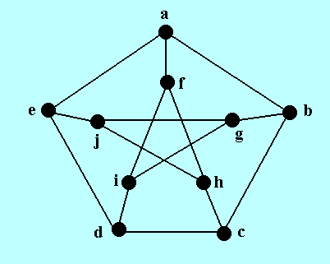
Solving Efficiently vs. Evaluating a Solution Efficiently
The input is a graph of size n.
Does it have a triangle (=clique of size 3)?
Does it have a clique of size √n?

Slide 9
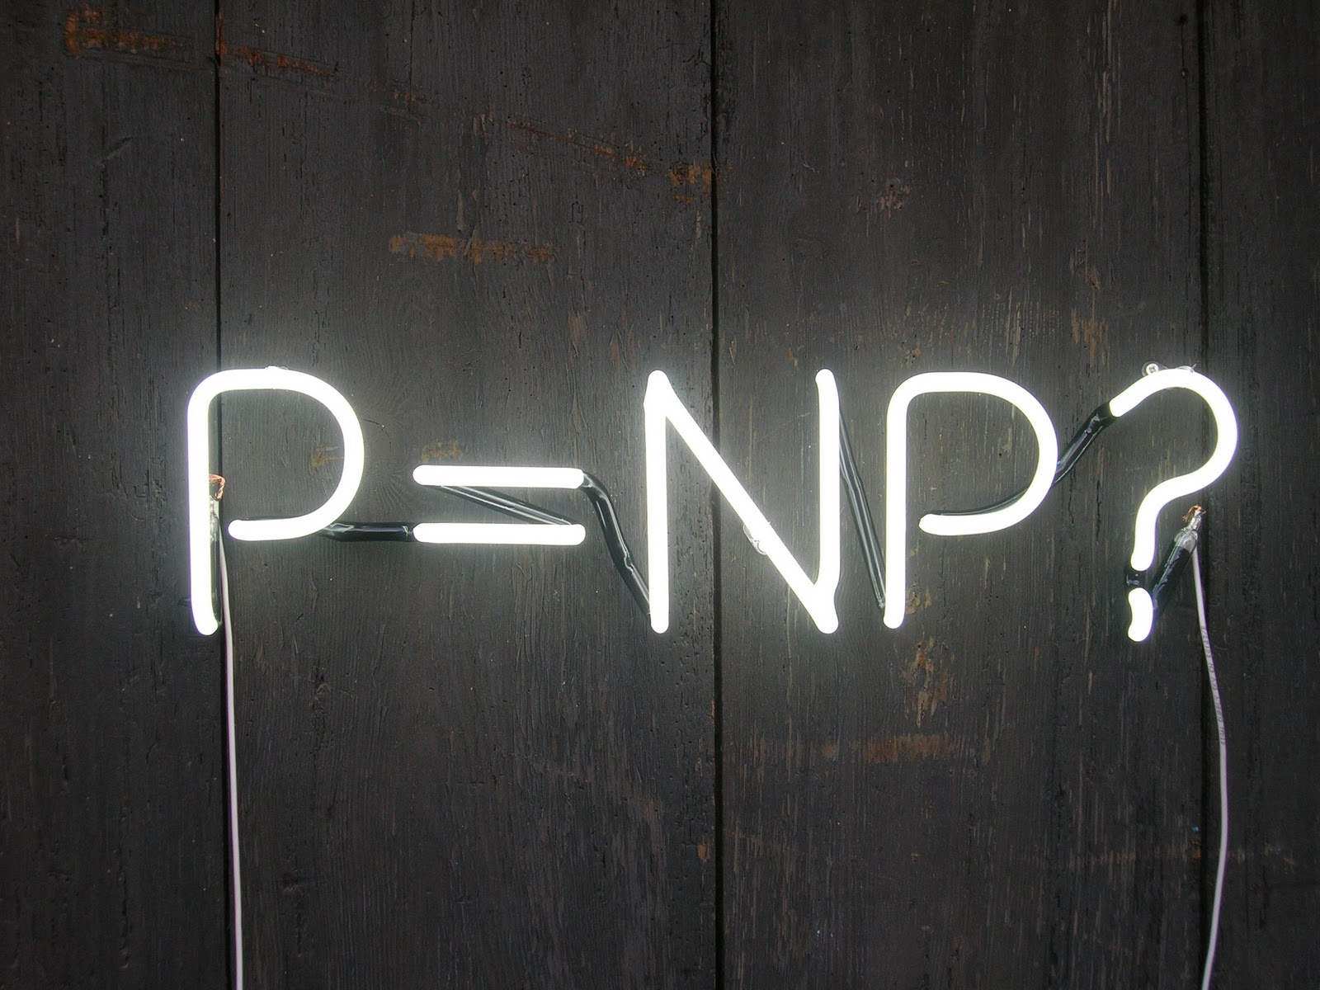
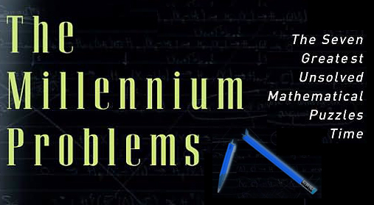
Can evaluate a solution efficiently
Can be solved efficiently

Slide 10
Thm: If Max-Cut can be solved efficiently, then P=NP.
This is what it means for a problem to be “NP-hard”.
Many other problems are NP-hard, e.g., clique.
The other direction is also true: Max-cut can be solved efficiently if and only if P=NP.
Max-Cut
NP

Slide 11
NP-Hardness: The Aftermath
Special cases: Structure in the data can make a hard problem easy.
Super-polynomial time: Maybe it’s possible to find a 1.01^{n} time algorithm?
Approximation: Maybe there’s a more efficient algorithm for finding a sub-optimal solution?

Slide 12
Max-Cut Approximation Algorithm
For every edge, the probability it crosses parts is 1/2.

Slide 13
What’s the best approximation ratio for Max-Cut?
R^{n}
Goemans-Williamson algorithm gives ~0.878 approximation by embedding the graph in R^{n}.
If the “Unique Games Conjecture” is true, doing better is NP-hard!
2LIN(p): Given a system of equations, each of the form x_{i}-x_{j}=c_{ij} (mod p), find the solution that satisfies the largest number of equations.
Unique Games Conjecture: For sufficiently large p, it’s NP-hard, given 2LIN(p) input, where 99% of the equations can be satisfied, to satisfy even 1% of the equations.
If the conjecture is true, then it implies optimality of geometric algorithms for a wide family of problems.

Slide 14
Many Thresholds Already Proven
3LIN(p): Given a system of equations, each of the form x_{i}+x_{j}+x_{k}=c_{ijk} (mod p) find the solution that satisfies the largest number of equations.
One can get 1/p approximation by picking the assignments to the variables at random.
Doing better is NP-hard!
Similar threshold behavior for Set Cover, Clique, kCSP(Σ), etc etc.

Slide 15
3LIN(p) Approximation (Under “Exponential Time Hypothesis”)
running-time
2^{Ω(n)}
exponential
Exponential hardness
Sharp threshold
n^{O(1)}
fraction of equations satisfied
polynomial
1/p
1
Notes:
It took 11 more years before, in a joint work with Ran Raz, we could prove that it takes exponential time to approximate Max-3-SAT,
And the running-time goes down to polynomial only in a window of o(1) at 7/8.

