Slide 1
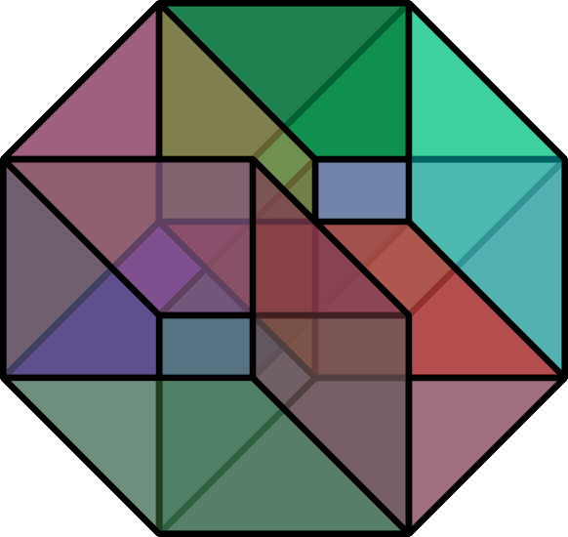
Small Set Expansion in The Johnson Graph
Subhash Khot (NYU),
Dor Minzer (TAU),
Dana Moshkovitz (UT Austin),
Muli Safra (TAU)

Slide 2


The Unique Games Conjecture (2002)
Candidate Hard Unique Game [Khot-M]
x_{i} – x_{k} = b_{ik} (mod p)
For sufficiently large p it is NP-hard: given such a system of equations where 1-δ of the equations hold, to find a solution that satisfies ε fraction of the equations.
For a large family of problems (including Max-2-SAT, Max-Cut, Vertex-Cover, etc etc), geometric algorithm (semidefinite programming) is best. […,Khot-Kindler-Mossel-O’Donnell,…,Raghavendra,…]

Slide 3







2-2 Games Theorem (2018)
x_{i} ± x_{k} = b_{ik} (mod p)
For appropriate p it is NP-hard: given such a system of equations where 1-δ of the equations hold, to find a solution that satisfies ε fraction of the equations.
Improved inapproximability results for Vertex-Cover, Independent Set,…

Slide 4
Small Set Expansion in The Grassmann Graph
The last piece in the proof of the 2-2 Games Theorem was to analyze the small non-expanding sets of the Grassmann graph.
Definition (Grassmann graph): The nodes are linear subspaces of dimension K in a space of dimension N (typically, K<<N). Two subspaces are connected if they intersect in a K-1 dimensional subspace.
This talk is about analyzing the small non-expanding sets of the closely-related Johnson graph. This: (i) was a crucial step towards the Grassmann analysis; (ii) is of independent interest, and (iii) is simpler to describe.

Slide 5
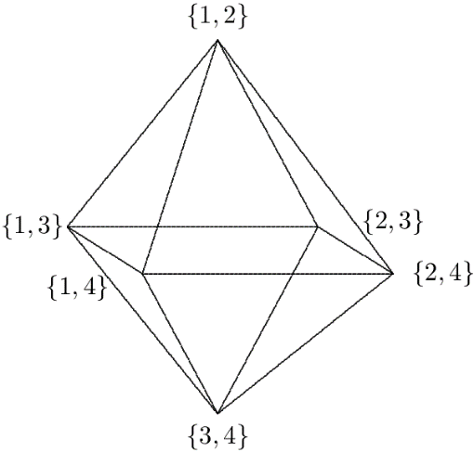

The Johnson Graph
Definition (Johnson graph): The nodes are sets of size K in a universe of size N (typically, K<<N). Two sets are connected if they intersect in L elements (typically, L=Θ(K)).
Hard to Approximate Input

Slide 6
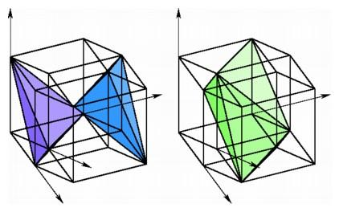
The Johnson Graph As Slice of Noisy Hypercube
Noisy hypercube graph (variant): the vertices are strings in {0,1}^{N}. There is an edge between x and y if they differ on εN coordinates.
Johnson graphs are “slices” of noisy hypercube: restrict to strings with K ones. Edges correspond to intersection of size L=(1-ε)K.
N
1 | 0 | 0 | 1 | 0 | 0 | 0 | 1 | 0 | 0
Prove a “Fourier analytic” result for slices analogous to a fundamental result for hypercube

Slide 7


Johnson Graph Underlies Direct Product Tests
We obtain an optimal direct product testing theorem (if the verifier accepts with non-negligible probability, players must agree on N bits)
Direct Product Test:
Two players supposedly agree on N bits.
A verifier picks at random two sets S,T⊆[N], |S|=|T|=k, |S∩T|=L.
The verifier sends S to one player, T to the other player.
Each player is supposed to send the K bits indicated by their set.
The verifier checks that the answers on L common bits are the same.
S
S
T
T

Slide 8
Expansion
Let G=(V,E) be a d-regular graph. The expansion of S⊆V is
Φ(S) = |E(S,V-S)| / (d|S|).
Small Set Expander: Φ(S) ≥ 1-ε for all S of size < δ|V|.
Examples:
The noisy hypercube is a small set expander by hypercontractivity.
The Johnson graph is not a small set expander (K<<N, L/K large).
S

Slide 9

Johnson Graph - Not Small Set Expander
Dictator
The Zoom-in family:
Pick an element x and consider the family S of all sets that contain x.
|S|/|(^{N}_{k})| ≈ (K/N) [small for K<<N]
Φ(S) ≈ 1 – (L/K) [much smaller than 1 for constant L/K].
Rough Statement of Main Theorem: Except for “dictator like families”, all small families S in the Johnson graph have Φ(S)≈1-o(1).

Slide 10
Unlike Dictator
Dfn: A family S of sets is (r,ε)-pseudorandom if for all R⊆[N], |R|≤r,
|P_{A⊇R}(A∈S) - P_{A}(A∈S) | ≤ ε
Examples:
Dictator is not pseudorandom: for S = {A that contains x} take R={x}, so P_{A⊇R}(A∈S)=1, while P_{A}(A∈S)≈K/N.
A sufficiently large random family S is pseudorandom with high probability.
Main Theorem: Let S be of fraction at most δ≤ε and (r,ε)-pseudorandom. For sufficiently large N (as a function of K and 1/δ),
Φ(S)>1 – (L/K)^{r} – 2^{O(r)}poly(ε) – o(1).
Notes:
Φ(S)>1 – (L/K)^{r} – r^{O(r)}poly(1/ε) – poly(2^{K3},1/δ)/N^{1/16}

Slide 11


Approach
The proof is via spectral analysis.
Let J be the transition matrix of the Johnson graph.
Let F be the indicator of a small pseudorandom family.
Want to show <F,JF> is small.
$$\left({N \atop K}\right)$$
$$\left({N \atop K}\right)$$
J
F

Slide 12
Level Picture
The Johnson transition matrix J
has K+1 eigenspaces; the i’th has eigenvalue roughly (L/K)^{i}.
Main Lemma: Small pseudorandom families F= ∑_{i} F_{i} concentrated on upper levels, i.e., ∑_{i≤r}|F_{i}|₂²<0.01|F|₂².
K
K-1
…
r
r-1
…
0
From Main Lem To Main Thm:
Let F be small pseudorandom. Write F=∑_{i} F_{i} with F_{i} in i‘th space.
<F,JF> = ∑_{i} <F_{i},JF_{i}>
≈ ∑_{i>r} (L/K)^{i}|F_{i}|₂²
≤ (L/K)^{r}|F|₂².

Slide 13
The Eigenspaces
A
We say that a function F from sets of size K to the reals is of degree i if there exists f from sets of size i to the reals such that:
F(A) = ∑_{I⊆A,|I|=i} f(I).
For example: F(A) = “does A contain x?” is of degree 1: take f({y})=“does y=x?”.
Lemma: Let S_{i} be the space of functions of degree i that are orthogonal to the functions of degree i-1. Then S_{i} is an eigenspace of J with eigenvalue ≈ (L/K)^{i}.

Slide 14
Level Picture
The Johnson transition matrix J has K+1 eigenspaces; the i’th corresponds to degree i; has eigenvalue roughly (L/K)^{i}.
Main Lemma: Small pseudorandom families F= ∑_{i} F_{i} concentrated on upper levels, i.e., ∑_{i≤r}|F_{i}|₂²<0.01|F|₂².
K
K-1
…
r
...
1
0
For simplicity, we’ll prove that F is not almost entirely in one level i, i.e., |F_{i}|₂²<0.99|F|₂²
Zoom-in/Dictators

Slide 15
Fourth Moment Lemma: Let N be sufficiently large. Let F be of fraction δ≤ε and (r,ε)-pseudorandom with F=F₀+…+F_{K} where F_{i} is in the i‘th eigenspace. Then for i=0,…,r, we have E_{A}[F_{i}(A)⁴] ≤ 2^{O(i)} ε E_{A}[F_{i}(A)²] + o(1).
F not almost entirely on one level 0≤i≤r: Assume on way of contradiction that |F_{i}|₂²≥ 0.99|F|₂²=0.99δ. Then F(A)≈F_{i}(A) for all but at most 0.01δ fraction of A, and since F is a set of fraction δ we have E_{A}[F_{i}(A)⁴]≈ E_{A}[F(A)⁴]=E_{A}[F(A)²]≈ E_{A}[F_{i}(A)²] , which contradicts the Fourth Moment Lemma.
(More generally, Fourth Moment Lemma implies E_{A}[F_{i}(A)²] ≤ 2^{O(i)} δε^{1/4} + o(1) for i=0,…,r, which implies the main lemma)
Notes:
Fourth Moment Lemma: Let N be sufficiently large. Let F be (r,ε)-pseudorandom with F=F₀+…+F_{K} where F_{i} is in the i‘th eigenspace. Then for i=0,…,r, we have E_{A}[F_{i}(A)⁴] ≤ i^{O(i)} ε E_{A}[F_{i}(A)²] + o(1).
Claim: Let δ=E_{A}[F(A)] and δ_{i}=E_{A}[F_{i}(A)²]. Then P_{A}( F_{i}(A) ≥ δ_{i}/(4δ) ) ≥ δ_{i}/2.
Claim ⇒ E_{A}[F_{i}(A)⁴] ≥ δ_{i}⁵/(2⁹δ⁴) ⇒ By 4th Moment Lem, E_{A}[F_{i}(A)²] ≤ i^{O(i)} δε^{1/4} + o(1), which implies main lemma.
Proof of Claim:
E_{A}[F(A)²]=δ ⇒ By orthogonality, E_{A}[(F(A)-F_{i}(A))²]=δ-δ_{i}.
By Markov, P_{A}( (F(A)-F_{i}(A))² ≥ 1-δ_{i}/(2δ) ) ≤ (δ-δ_{i})/(1-δ_{i}/(2δ)) ≤ δ-δ_{i}/2.

Slide 16
The Main Technical Difficulty
Fourth Moment Lemma: Let N be sufficiently large. Let F be of fraction δ≤ε and (r,ε)-pseudorandom with F=F₀+…+F_{K} where F_{i} is in the i‘th eigenspace. Then for i=0,…,r, we have E_{A}[F_{i}(A)⁴] ≤ 2^{O(i)} ε E_{A}[F_{i}(A)²] + o(1).
Write F_{i}(A)=∑_{I⊆A,|I|=i} f(I).
E_{A}[F_{i}(A)⁴]=E_{A}[∑_{I1,I2,I3,I4⊆A,|Ij|=i} f(I₁)f(I₂)f(I₃)f(I₄)].
I₂
How to bound correlations??
I₁
I₄
I₃

Slide 17
For simplicity, assume i=3 and consider third moments.
Fix the “intersection pattern” (How many elements in I₁∩I₂∩I₃? How many in I₁^{c}∩I₂∩I₃? …). For simplicity, focus on the pattern below.
Cauchy-Schwarz & Restrict technique:
Can be shown to be proportional to:
(max_{x2}E_{x3,x1}[f({x₁,x₂,x₃})²]E_{x2,x4,x3}[f({x₂,x₃,x₄})²]E_{x2,x4,x1}[f({x₁,x₂,x₄})²])^{1/2}
E_{x2}[E_{x3,x1}[f({x₁,x₂,x₃})²]E_{x4,x3}[f({x₂,x₃,x₄})²]]^{1/2}E_{x2,x4,x1}[f({x₁,x₂,x₄})²]^{1/2}
(max_{x2}E_{x3,x1}[f({x₁,x₂,x₃})²])^{1/2} E_{x1,x2,x3}[f({x₁,x₂,x₃})²]
E_{x2}[E_{x3,x1}[f({x₁,x₂,x₃})²]^{1/2}E_{x4,x3}[f({x₂,x₃,x₄})²]^{1/2}E_{x4,x1}[f({x₁,x₂,x₄})²]^{1/2}]
E_{x2}[E_{x3,x1}[f({x₁,x₂,x₃})²]^{1/2}E_{x4}[E_{x3}[f({x₂,x₃,x₄})²]^{1/2}E_{x1}[f({x₁,x₂,x₄})²]^{1/2}]]
E_{x2,x4}[E_{x3}[E_{x1}[f({x₁,x₂,x₃})²]^{1/2} f({x₂,x₃,x₄})]E_{x1}[f({x₁,x₂,x₄})²]^{1/2}]
E_{x2,x3,x4}[E_{x1}[f({x₁,x₂,x₃})²]^{1/2} E_{x1}[f({x₁,x₂,x₄})²]^{1/2}f({x₂,x₃,x₄})]
E_{x2,x3,x4}[E_{x1}[f({x₁,x₂,x₃})f({x₁,x₂,x₄})]f({x₂,x₃,x₄})]
E_{x2,x4}[E_{x3,x1}[f({x₁,x₂,x₃})²]^{1/2}E_{x3}[f({x₂,x₃,x₄})²]^{1/2}E_{x1}[f({x₁,x₂,x₄})²]^{1/2}]
E_{x1,x2,x3,x4}[f({x₁,x₂,x₃})f({x₁,x₂,x₄})f({x₂,x₃,x₄})]
I₂
(max_{x}E_{B}[F_{i}(B∪{x})²])^{1/2} E_{A}[F_{i}(A)²]
Upper bounded by O(ε) from pseudorandomness
I₁
I₃

