Slide 1
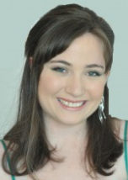
What Cannot Be Learned With Bounded Memory
Dana Moshkovitz
UT Austin
With Michal Moshkovitz, UC San Diego

Slide 2
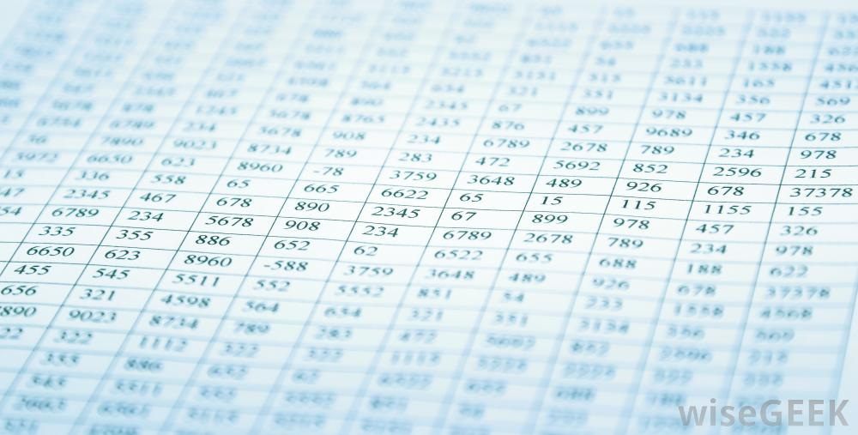
Limitations
?
?
Learning Algorithm
?
Data
Space Bounded

Slide 3
We say that an algorithm learns an hypothesis class H={h:X→{0,1}} if:
For any h∈H,
For any distribution D over X,
Learning Algorithm
(x,h(x))
for x∼D
(x,h(x))
for x∼D
(x,h(x))
for x∼D
h'
P_{x∼D}(h’(x)=h(x))≈1 with high probability.

Slide 4
Unbounded Learner
hypotheses
Initially, all h in H are possible.
Repeat: Given example (x,b), rule out h’ where h’(x)≠b.
Claim: With high probability, after seeing O(log|H|) random examples any h’ not ruled out satisfies P_{z}(h’(z)=h(z))>0.99.
hypotheses
consistent with example
But this requires a lot of memory! min{Θ(log|H|log|X|),|H|} memory bits.
Notes:
- PAC learning: can always learn after seeing O(log|H|) examples if you can save all the labeled examples you get in memory.
Saving k examples in memory requires klog|X| bits of memory.
E.g., H = parities, log|H|=n. log|X|=n. Need O(n^2) bits of memory.
* Focus on hypotheses classes where different hypotheses differ on a constant fraction of the labeled examples.

Slide 5
Bounded Learner
Initially, h’ is the first function in H.
Repeat: Given example (x,b), if h’(x)≠b, then let h’ be the next function in H.
Claim: With high probability, after seeing O(|H|log|H|) random examples, h’ satisfies P_{z}(h’(z)=h(z))>0.99.
This requires only a minimal number of log|H| memory bits.

Slide 6
Time-Space Tradeoffs
examples
|H|lg|H|
Shamir’14, Steinhardt-Valiant-Wager’16: What are the limits of space-bounded learning?
??
log|H|
memory bits
log|H|
min{ log|H|log|X|,|H|}

Slide 7
Time-Space Tradeoffs
examples
|H|lg|H|
Raz, FOCS’16 co-best paper:
For parities, every learner must have either Ω(log|H|log|X|) memory bits or |H|^{Ω(1)} examples.
log|H|
memory bits
log|H|
min{ log|H|log|X|,|H|}

Slide 8
Time-Space Tradeoffs
examples
|H|lg|H|
Moshkovitz-Moshkovitz’17a+b; Raz’17:
For most classes H, every learner must have either Ω(log²|H|) memory bits or |H|^{Ω(1)} examples.
log|H|
memory bits
log|H|
min{ log|H|log|X|,|H|}

Slide 9
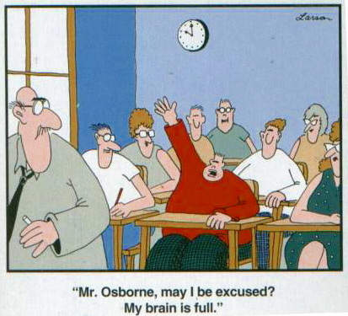
The Intuition (The proof is about 50 pages)
Given an example there are two things you can do:
Don’t remember the example in full detail. For a typical H, gain almost no information about h.
Remember the example in detail, but then have to erase previous memories.

Slide 10
Mixing Hypotheses Graph
Note: For mixing hypotheses classes H, most hypotheses are far apart, so approximating h by h’∈H requires finding h exactly.
average degree d
D-Mixing: For every set S of hypotheses, every set T of labeled examples,
HYPOTHESES
LABELED EXAMPLES
.
.
.
.
.
.
consistent
Almost all H’s (including parities) are O(√|X|)-mixing
Main Theorem (“Mixing Implies Lower Bounds”): Let m:=|H||X|/D². Either Ω(log²m) memory bits or m^{Ω(1)} examples are needed to learn H with probability at least 1/m^{Θ(1)}.

Slide 11
Learning With Bounded Memory
time
h₁
h₂
h₃
.
.
.
h_{s-1}
h_{s}
Labeled example
memory states
. . .
output hypothesis
.
.
.
.
.
.
.
.
.
.
.
.
Notes:
next we'll outline the proof. The outline will contain the main parts, main ideas, main notions, but will refrain from getting into difficult proofs.
learners as branching programs
Examples are random, labeled according to an underlying hypothesis.

Slide 12
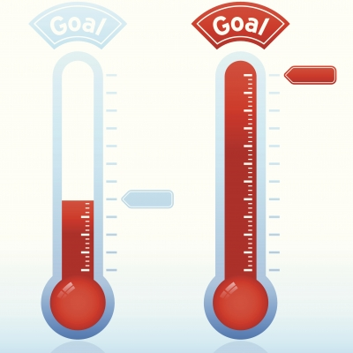
Certainty at time t: A progress measure for the learning algorithm E_{state}P(h|state)². Initially small. After learning must be large. We bound the increase at each time step.

Slide 13
Decomposition Lemma
Heavy step:
Mixing ⇒ No big certainty increase here
Only retain a sketch of the example
Large set of labeled examples
m^{t+1}
m^{t}
Many step:
m^{t}₁
Erase memory to store example
No big certainty increase too, but harder to analyze
Large probability memories
m^{t}₂
Single example, unpredictable label
m^{t+1}
…
m^{t}_{k}

Slide 14
Knowledge Graph
Pseudorandomness: We show that the knowledge graph must be “pseudorandom” at all time steps. Allows us to bound certainty increase for “many” steps.
.
.
.
HYPOTHESES
TIME-T MEMORY STATES
computation path
.
.
.

Slide 15
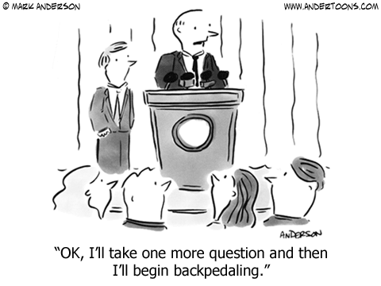
“In conclusion: you can confuse anyone who can‘t remember everything and doesn’t have endless time.”

