Slide 1
Find!
Fill out letters on the right, to satisfy as much of the constraints on the left.
animal
verb
transportation
food
furniture
verb

Slide 2
Find!
When the letters form a word in a category, get 1 point per letter.
b
a
t
b | a | t
animal
verb
transportation
food
furniture
verb
Score: 3

Slide 3
Find!
When the letters form a word in a category, get 1 point per letter.
b
c
a
b
t
b | a | t
animal
verb
c | a | b
transportation
food
furniture
verb
Score: 6

Slide 4
Find!
When the letters form a word in a category, get 1 point per letter.
b
c
a
b
t
b | a | t
animal
verb
c | a | b
transportation
food
furniture
verb
Score: 6

Slide 5
Find!
When the letters partially match a word in a category, get 1 point per match.
b
c
a
b
e
t
b | a | t
animal
verb
c | a | b
transportation
food
b | e | d
furniture
verb
Score: 8

Slide 6
Find!
When the letters partially match a word in a category, get 1 point per match.
b
c
a
b
e
t
y
b | a | t
animal
verb
c | a | b
transportation
food
b | e | d
furniture
c | r | y
verb
Score: 10

Slide 7
Find!
When the letters partially match a word in a category, get 1 point per match.
b
c
a
b
e
t
y
b | a | t
animal
? | a | y
verb
c | a | b
transportation
food
b | e | d
furniture
c | r | y
verb
Score: 10

Slide 8
Find!
When the letters partially match a word in a category, get 1 point per match.
b
c
a
b
e
t
y
b | a | t
animal
? | a | y
verb
c | a | b
transportation
? | e | y
food
b | e | d
furniture
c | r | y
verb
Score: 10

Slide 9
Find!
When the letters partially match a word in a category, get 1 point per match.
b
p
c
a
b
e
t
y
b | a | t
animal
p | a | y
verb
c | a | b
transportation
p | e | a
food
b | e | d
furniture
c | r | y
verb
Score: 15

Slide 10
Find!
Your turn: How much can you score?
animal
verb
transportation
food
furniture
verb
Score:

Slide 11
Find!
To get the total score, sum up the points from all the categories.
b
p
c
a
b
e
t
y
b | a | t
animal
p | a | y
verb
c | a | b
transportation
p | e | a
food
b | e | d
furniture
c | r | y
verb
Score: 15

Slide 12
Find!
Perfect score!
c
s
c
a
r
o
t
y
c | a | t
animal
s | a | y
verb
c | a | r
transportation
s | o | y
food
c | o | t
furniture
c | r | y
verb
Score: 18

Slide 13
Given a projection game so that perfect score is achievable,
can you score 1% ?
Projection games
Notes:
Consider the algorithmic problem associated with the game: the graph, the alphabet and the constraints are the input. This problem is known “projection game” or “label cover”

Slide 14
Given a projection game so that perfect score is achievable.
Can you get a perfect score ?
Notes:
Consider the algorithmic problem associated with the game: the graph, the alphabet and the constraints are the input. This problem is known “projection game” or “label cover”

Slide 15
Given a projection game so that perfect score is achievable.
Can you score 99% ?
Notes:
Reaching perfect score is NP-hard, what about approximating?

Slide 16
Given a projection game so that perfect score is achievable.
Can you score 75% ?

Slide 17
Given a projection game so that perfect score is achievable.
Can you score 50% ?

Slide 18
Observations:
If there are X edges, can always score 1/X.

Slide 19
Observations:
If there are X edges, can always score 1/X.
If each constraint is on X locations, can score 1/X.

Slide 20
Observations:
If there are X edges, can always score 1/X.
If each constraint is on X locations, can score 1/X.
If each location is in X constraints, can score 1/X.

Slide 21
Observations:
If there are X edges, can always score 1/X.
If each constraint is on X locations, can score 1/X.
If each location is in X constraints, can score 1/X.
If all categories are of size X, can score 1/X.
All 3 letter words under “food”
Notes:
Category size

Slide 22
Observations:
If there are X edges, can always score 1/X.
If each constraint is on X locations, can score 1/X.
If each location is in X constraints, can score 1/X.
If all categories are of size X, can score 1/X.
If the alphabet is of size X, can score 1/X.
Notes:
alphabet

Slide 23
Given a projection game with large categories, alphabet and degrees,
so perfect score is achievable.
Can you score 1% ?
Notes:
The approx problem we think about

Slide 24
Projection Games Theorem (M-Raz 08):
There exists α>0 such that for all ε=ε(n)≥1/n^{α}, there exist k=poly(1/ε), D=poly(1/ε), so given a projection game of size n, alphabet size ≥ k and degrees ≥D, where perfect score is achievable, NP-hard to score even ε percent.
More than that –
Almost as hard as exact 3SAT.
Notes:
Next: three reasons why this theorem should blow your mind!

Slide 25
From Trivial To Super-Hard In A Flash! [Håstad 97, M-Raz 08]
Assuming that exact SAT takes exponential time
time
2^{Ω(n)}
exponential
Exponential hardness
Sharp threshold
n^{O(1)}
polynomial
approx
t
1

Slide 26
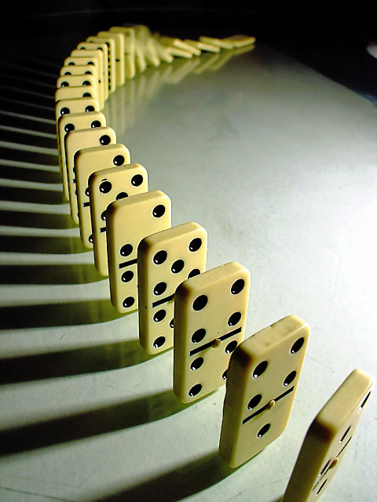
Max-3SAT
Max-3LIN
Clique
Closest Vector Problem
Set-Cover
Independent Set
Densest Subgraph
Max-CSP
Directed Sparsest Cut
Directed Multi-cut
K-Spanner
…..
The best hardness of approximation results we know are based on projection games
Notes:
HUGE project in approximation community, tens (hundreds?) of people involved

Slide 27
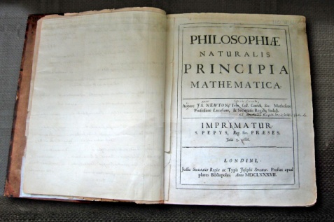
Probabilistic Checking of Proofs (PCP) [FGLSS 91]
Conjecture: 1 + 1 = 2
Proof: 1. ∀x;x=y⇒(x=z⇒y=z)
2. ∀x;x=y⇒(x=z⇒y=z)⇒x+0=y⇒(x+0=z⇒y=z)
3. x+0=y⇒(x+0=z⇒y=z) …

Slide 28
Probabilistic Checking of Proofs (PCP) [FGLSS 91]
Conjecture: A + B = C
w | i | t
w
p
s
i
i
t
n
p | i
w | i | n
Proof: 1. ∀x;x=y⇒(x=z⇒y=z)
2. ∀x;x=y⇒(x=z⇒y=z)⇒x+0=y⇒(x+0=z⇒y=z)
3. x+0=y⇒(x+0=z⇒y=z) …
i | t
i | n

Slide 29
Probabilistic Checking of Proofs (PCP) [FGLSS 91]
Conjecture: A + B = C
Proof: 1. ∀x;x=y⇒(x=z⇒y=z)
2. ∀x;x=y⇒(x=z⇒y=z)⇒x+0=y⇒(x+0=z⇒y=z)
3. x+0=y⇒(x+0=z⇒y=z) …
False!
Score ≤ ε

Slide 30
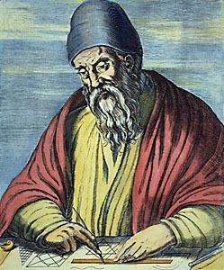
Probabilistic Checking of Proofs (PCP) [FGLSS 91]
Conjecture: A + B = C
w | i | t
w
p
s
i
i
t
n
p | i
w | i | n
Proof: 1. ∀x;x=y⇒(x=z⇒y=z)
2. ∀x;x=y⇒(x=z⇒y=z)⇒x+0=y⇒(x+0=z⇒y=z)
3. x+0=y⇒(x+0=z⇒y=z) …
i | t
i | n
Observe: The PCP Thm induces a new format for proofs; can be tested by checking one implication!

Slide 31
What Goes Into PCPs?
Algebra
polynomials over finite fields..
Analysis
Fourier, isoperimetry..
Combinatorics expanders,..
Notes:
Also: math applications: low degree testing, tiling, invariance principle, etc etc.

Slide 32
Favorite Open Problems
Projection Games Conjecture: Projection games NP-hard even when all categories are of size poly(1/ε).
Unique Games Conjecture: Projection games NP-hard even when in each category all possible words differ in all their letters;
best score is (1-δ) fraction of maximum.
Notes:
My favorite big open problems in the area

