Slide 1
The Power of Randomness in Computation
David Zuckerman
University of Texas at Austin

Slide 2
Random Sampling: Flipping a Coin
Flip a fair coin 1000 times.
# heads is 500 ± 35, with 95% certainty.
n coins gives n/2 ± √n.
Converges to fraction 1/2 quickly.

Slide 3
Cooking
Sautéing onion:
Expect half time on each side.
Random sautéing works well.

Slide 4
Polling
Do you favor legalizing gay marriage?
Gallup Poll, May 5-8
Margin of error = 4%
95% confidence
Sample size = 1,018
Huge population
Sample size independent of population

Slide 5
Investing
Assume stock prices follow “random walk.”
Best to diversify: own many stocks.
Achieve same average return while reducing risk.

Slide 6
Random Sampling in CS
Area of region
Pick many random points in square.
Compute fraction r that lie in region.
Area estimate = r . Area(square).

Slide 7
Outline
Power of randomness:
Randomized algorithms
Monte Carlo simulations
Cryptography (secure computation)
Is randomness necessary?
Pseudorandom generators
Randomness extractors
Conclusions/coding theory/miscellaneous

Slide 8
Basic Definitions
Random bit X: Pr[X=0] = Pr[X = 1] = ½.
Random integer Y in {1,2,…,100}.
For all i, Pr[Y=i] = 1/100.
Independent random bits X₁X₂…X₁₀₀:
For any i, conditioned on all X_{j} except X_{i}, still X_{i} is a random bit.
Equivalently, Pr[X₁…X₁₀₀ = b₁…b₁₀₀] = 2⁻¹⁰⁰.

Slide 9
Random Sampling in Computer Science
Sophisticated random sampling used to approximate various quantities.
Volume of a region
Integral
# solutions to an equation
Load balancing

Slide 10
Another Use of Randomness: Equality Testing
Does 12^{2,000,001}+7⁴⁴²=143^{1,000,001}+197?
Natural algorithm: multiply it out and add.
Inefficient: need to store 2,000,000 digit numbers.
Better way?

Slide 11
Another Use of Randomness: Equality Testing
Does 12^{2,000,001}+7⁴⁴²=143^{1,000,001}+197?
No: even+odd≠odd+odd.
What if both sides even (or both sides odd)?
Odd/even: remainder mod 2.

Slide 12
Randomized Equality Testing
Pick random number r of appropriate size (in example, < 100,000,000).
Compute remainder mod r.
Can do efficiently: only keep track of remainder mod r.
Example: 7³ mod 47:
7³=7^{2 .}7=49.7=2.7=14 mod 47.

Slide 13
Randomized Equality Testing
If =, then remainder mod r is =.
If ≠, then remainder mod r is ≠, with probability > .9.
Can improve error probability by repeating:
For example, start with error .1.
Repeat 10 times.
Error becomes 10⁻¹⁰=.0000000001.

Slide 14
Randomized Algorithms
Examples:
Randomized equality testing
Primality testing
Approximation algorithms
Optimization algorithms
Many more
Often much faster and/or simpler than known deterministic counterparts.

Slide 15
Monte Carlo Simulations
Many simulations done on computer:
Economy
Weather
Molecular interactions
Often have random components
Can model actual randomness or complex phenomena.

Slide 16
Cryptography
laptop user
Amazon.com
Alice and Bob have no shared secret key.
Eavesdropper can hear (see) everything communicated.
Is private communication possible?
Proofs essential.

Slide 17
Security impossible (false proof)
Eavesdropper has same information about Alice’s messages as Bob.
Whatever Bob can compute from Alice’s messages, so can Eavesdropper.

Slide 18
Security possible!
Flaw in proof: although Eavesdropper has same information, computation will take too long.
Bob can compute decryption much faster.
How can task be easier for Bob?

Slide 19
Key tool: 1-way function
• Easy to compute, hard to invert.
Toy example: assume no computers, but large phone book.
f(page #)=1st phone number on page.
Given page #, easy to find 1st phone number.
Given 1st phone number, hard to find page #.

Slide 20
Key tool: 1-way function
• Easy to compute, hard to invert.
Example: multiplication of 2 primes easy.
e.g. 97.127=12,319
• Factoring much harder: e.g. given 12,319, find its factors.
• f(p,q) = p.q is a 1-way function.

Slide 21
Public Key Cryptography
Bob chooses 2 large primes p,q randomly.
Sets N=p.q.
p,q secret
N
Enc(N,message)
Fast decryption requires knowing p and q.
Notes:
Due to Diffie-Hellman, Rivest-Shamir-Adleman. N=public key, p,q private key. Alice can encrypt knowing only N.

Slide 22
More Cryptography
Authentication.
Millionaire’s problem:
Who’s richer?
No other information revealed.
Zero Knowledge:
Alice to convince Bob she knows password.
Without revealing password.
Bob can catch Alice if she lies.

Slide 23
Power of Randomness
Randomized algorithms
Random sampling and approximation algorithms
Randomized equality testing, primality testing
Many others
Monte Carlo simulations
Cryptography

Slide 24
Randomness wonderful, but …
Computers typically don’t have access to truly random numbers.
Example: exact time of clock
2:54.9417 gives random number 417.
But program may check clock in regular pattern.
What to do?

Slide 25
Is Randomness Necessary?
Essential for cryptography: if secret key not random, Eavesdropper could learn it.
Unclear for algorithms.
Example: perhaps a clever deterministic algorithm for equality testing.
Major open question in field: does every efficient randomized algorithm have an efficient deterministic counterpart?

Slide 26
What is minimal randomness requirement?
Can we eliminate randomness completely?
If not:
Can we minimize quantity of randomness?
Can we minimize quality of randomness?
What does this mean?

Slide 27
What is minimal randomness requirement?
Can we eliminate randomness completely?
If not:
Can we minimize quantity of randomness?
Pseudorandom generator
Can we minimize quality of randomness?
Randomness extractor

Slide 28
Pseudorandom Numbers
Computers rely on pseudorandom generators:
PRG
71294
141592653589793238
short random
string
long “random-enough”
string
What does “random enough” mean?

Slide 29
Classical Approach to PRGs
PRG good if passes certain ad hoc tests.
Example: frequency of each digit ≈ 1/10.
But: 012345678901234567890123456789
Failures of PRGs reported:
95% confidence intervals
( ) ( ) ( )
PRG1 PRG2 PRG3

Slide 30
Pairwise Independence
Every pair of random variables independent.

Slide 31
Pairwise Independence
PRG maps k bits to 2^{k} – 1 bits.
Very useful tool.
But: fails in many situations
E.g., Parity.

Slide 32
Modern Approach to PRGs [Blum-Micali, Yao]
Require PRG to “fool” all efficient algorithms.
Alg
random
≈ same
behavior
Alg
pseudorandom

Slide 33
Modern Approach to PRGs
Hard functions give PRGs [Nisan-Wigderson]
What if no assumption?
Unsolved and very difficult: related to $1,000,000 “NP = P?” question.
Can construct PRGs which fool restricted classes of algorithms, without assumptions.

Slide 34
Quality: Weakly Random Sources
What if only source of randomness is defective?
Weakly random number between 1 and 1000: each has probability ≤ 1/100.
Can’t use weakly random sources directly.

Slide 35
Goal
very long
Ext
long
weakly random
almost random
Problem: impossible.

Slide 36
Solution: Extractor [Nisan-Zuckerman]
short
truly random
very long
Ext
long
weakly random
almost random

Slide 37
Power of Extractors
Sometimes can eliminate true randomness by cycling over all possibilities.
Many unexpected applications to variety of areas.
Useful even when no weakly random source apparently present.
Caveat: strong in theory but practical variants weaker.

Slide 38
Extractors in Cryptography
Alice and Bob know N = secret 100 digit #
Eavesdropper knows 40 digits of N.
Alice and Bob don’t know which 40 digits.
Can they obtain a shorter secret unknown to Eve?

Slide 39
Extractors in Cryptography [Bennett-Brassard-Roberts, Lu, Vadhan]
Eve knows 40 digits of N = 100 digits.
To Eve, N is weakly random:
Each number has probability ≤ 10⁻⁶⁰.
Alice and Bob can use extractors to obtain a 50 digit secret number, which appears almost random to Eve.

Slide 40
Extractor-Based PRGs for Random Sampling [Zuckerman]
n digits
per sample
1.01n digits
PRG
Nearly optimal number of random bits.
Downside: need more samples for same error.

Slide 41
Other Applications of Extractors
PRGs for Space-Bounded Computation [Nisan-Z]
Highly-connected networks [Wigderson-Z]
Coding theory [Ta-Shma-Z]
Hardness of approximation [Z, Mossel-Umans]
Efficient deterministic sorting [Pippenger]
Time-storage tradeoffs [Sipser]
Implicit data structures [Fiat-Naor, Z]

Slide 42
Conclusions
Randomness extremely useful in CS:
Algorithms
Monte Carlo simulations
Cryptography.
Don’t need a lot of true randomness:
Short truly random string: PRG.
Long weakly random string: extractor.

Slide 43
Theoretical Computer Science
Mathematical aspects of CS.
Algorithms and complexity.
Complexity includes study of and nontrivial connections among:
Intractibility
Pseudorandomness
Cryptography
Coding Theory

Slide 44



Error Correcting Codes
Communication over a Noisy Channel:
Adversary corrupts 10% of the bits.
Problem: Recover the (entire) message.
Solution: Introduce redundancy.

Slide 45
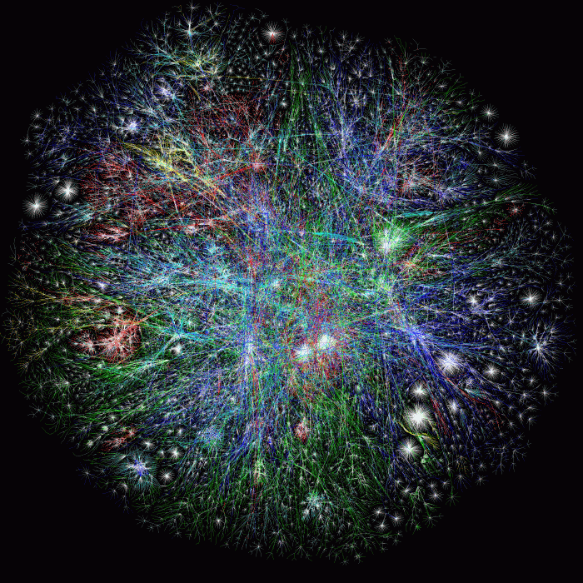
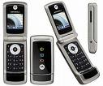
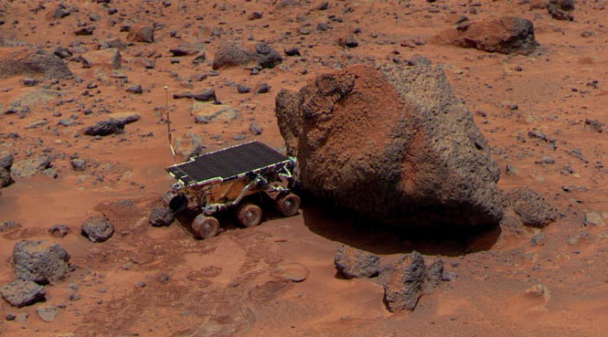
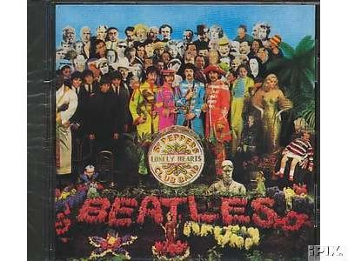

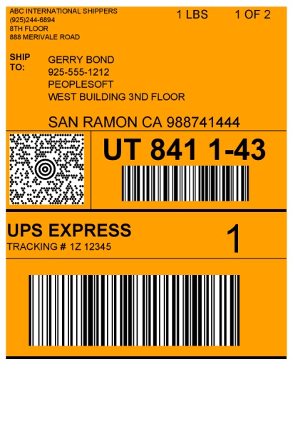
Error-Correcting Codes
Deep-space
communication
Internet
Cellphones
Audio CDs
Satellite Broadcast
Bar-codes

Slide 46
Codes from Polynomials
Encoding: Alice wants to send (a,b).
Let L(x) = ax +b.
Send L(1), L(2), …, L(7).

Slide 47
Codes from Polynomials
Adversary: Corrupts two values.
Decoding: Find the (unique) line that passes through 5 points.

Slide 48
Math in Computer Science
Probability
Discrete mathematics
Graph theory, combinatorics, logic
Linear algebra
Number theory
Particularly for cryptography
G.H. Hardy statement

Slide 49
A Professor’s Duties at a Research University
Research
Also, funding
Teaching
Organized classes
Individualized instruction
Service
External: program committees, editorial boards
Internal: various committees

