Slide 1
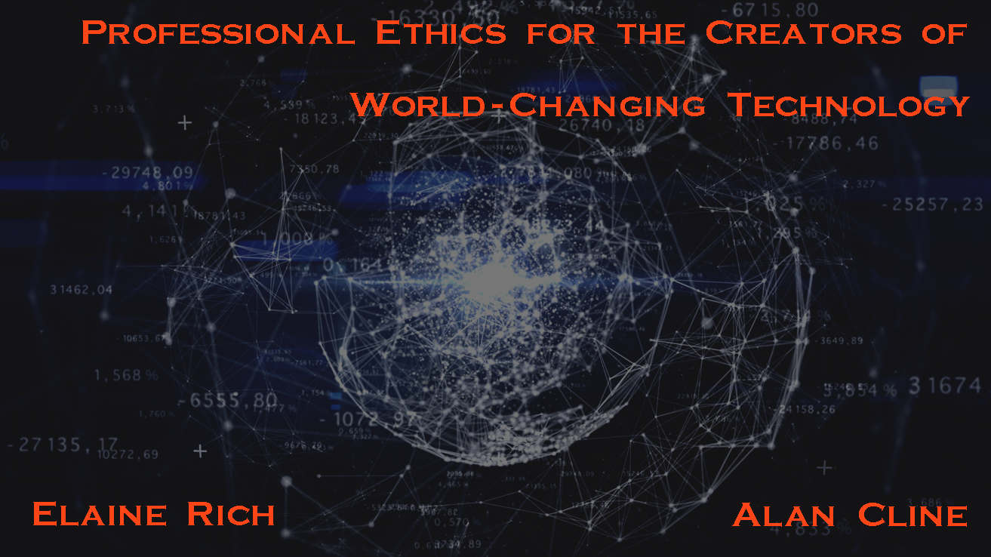

Slide 2
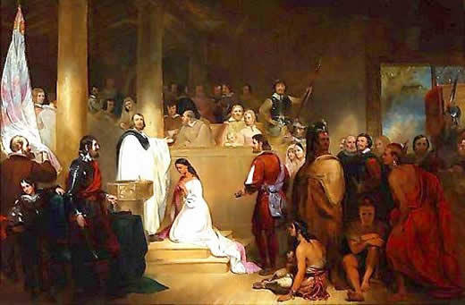
Who is this Person and Why Do We Care?
Notes:
John Rolfe (c. 1585 – 1622)

Slide 3
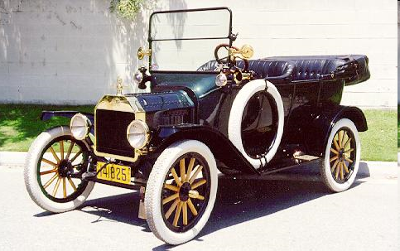
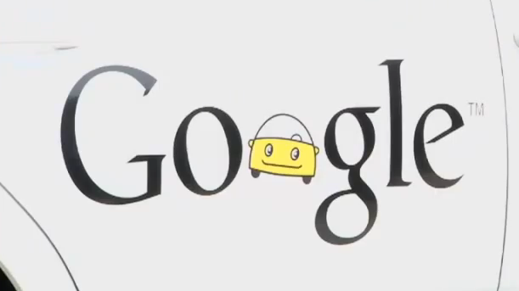
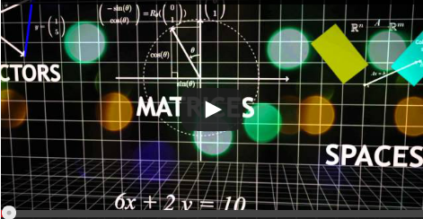
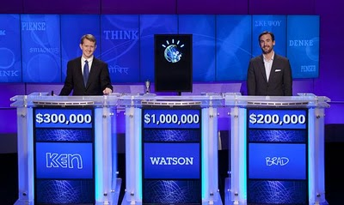
More Unintended Consequences
Notes:
Image from: http://www.musclecarclub.com/other-cars/classic/ford-model-t/ford-model-t.shtml EAR
Video for google car: http://www.youtube.com/watch?v=EAHdX2I4fuE
Van de Geijn and Myers Linear Algebra MOOC
http://blog.storyful.com/2016/04/12/five-tips-for-improving-facebook-discovery/#.V3asWbgrI2w

Slide 4
Notes:
Here’s you. But you wear two hats.
https://1.bp.blogspot.com/-URrPdLOu3uo/VQai_6Lkl7I/AAAAAAAAAY8/_XQjHG0pGe4/w800-h800/typing-computer-icon.png

Slide 5
Notes:
There’s you, the professional, doing your job. Then there’s you, the informed citizen scientist in our complex world.
Job: https://pixabay.com/p-1257204/?no_redirect
Blue person: http://www.clker.com/cliparts/Q/z/8/1/1/Q/walking-cartoon-man-md.png
Earth: http://www.psychsearch.net/wp-content/uploads/Earth-Psychitrists-psychs-psychiatry-psychiatric-psychiatrists-psychiatrist-psychsearch.net-psych.jpg

Slide 6
Professional Ethics
Your first job after graduation is system administrator for a 200 person
privately held manufacturing company.
The president/owner sends this message to the employees:
“I want to encourage each of you to make comments to me about any facet of our operation you care to. Your response should be made through our anonymizer program so that your identity will not be disclosed”
Notes:
https://blogs.gonzaga.edu/guswtech/the-suggestion-box/ AKC

Slide 7
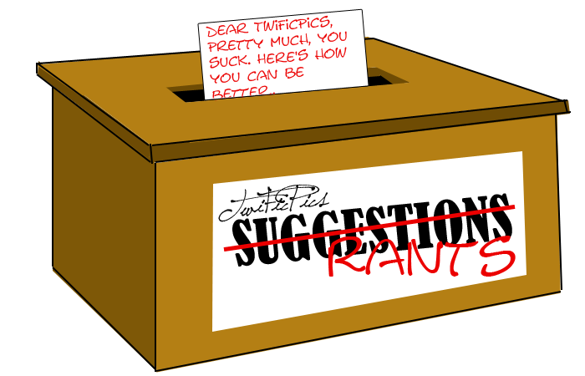
Professional Ethics
Your first job after graduation is system administrator for a 200 person
privately held manufacturing company.
The president/owner sends this message to the employees:
“I want to encourage each of you to make comments to me about any facet of our operation you care to. Your response should be made through our anonymizer program so that your identity will not be disclosed”
The president/owner finds one response saying:
“This company sucks. The only way I find to retaliate for the way I have been treated is sabotage. Every tenth part I turn out is defective.”
The president/owner insists that you examine the computer usage records to determine the identity of the alleged saboteur.
What should you do?
Notes:
http://yourforum.gr/InvisionBoard/index.php?showtopic=392745 AKC

Slide 8
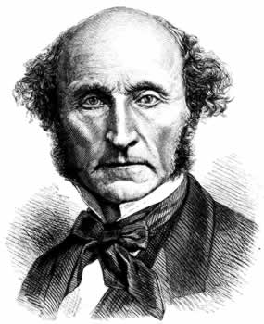
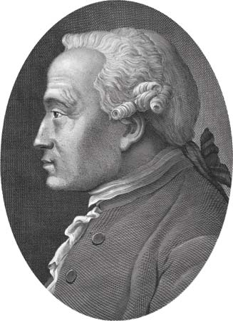
How can we can behave ethically?
Utilitarianism
Kant and Deontology
Notes:
Mill (hair sticking out): http://www.utilitarian.net/jsmill/ EAR
Kant: http://media-2.web.britannica.com/eb-media/69/99069-004-1D777F95.jpg

Slide 9
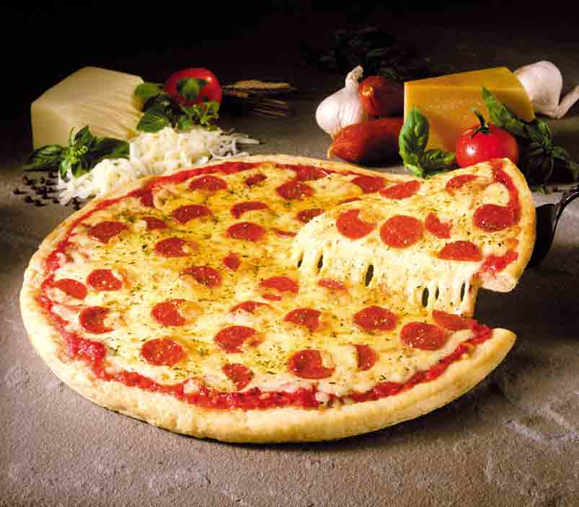
Privacy
http://www.aclu.org/pizza/
Notes:
We go through several important topics and look at them from the point of view of what is right. The first big one we discuss is privacy, despite the fact that most students recognize that they haven’t got any and they seem okay with that. First, talk about what is happening with privacy. EAR

Slide 10
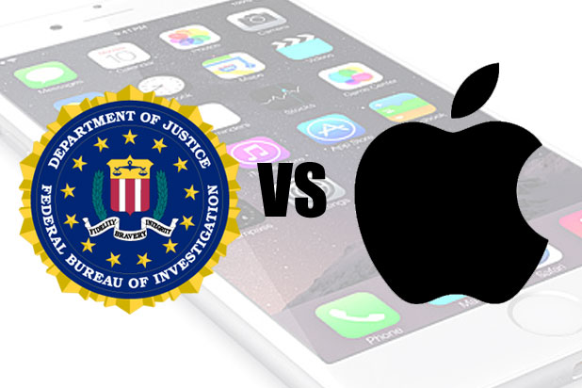
Technology and Rights Tradeoffs Security vs Privacy
Notes:
But often the issue is trading off rights in new ways. It’s not just what happens to one person or decisions that one person can make. Good example of where we need expertise. What might happen if we allow backdoors?
http://www.thewrap.com/fbi-admits-it-reset-san-bernardino-shooters-iphone-password/ EAR

Slide 11
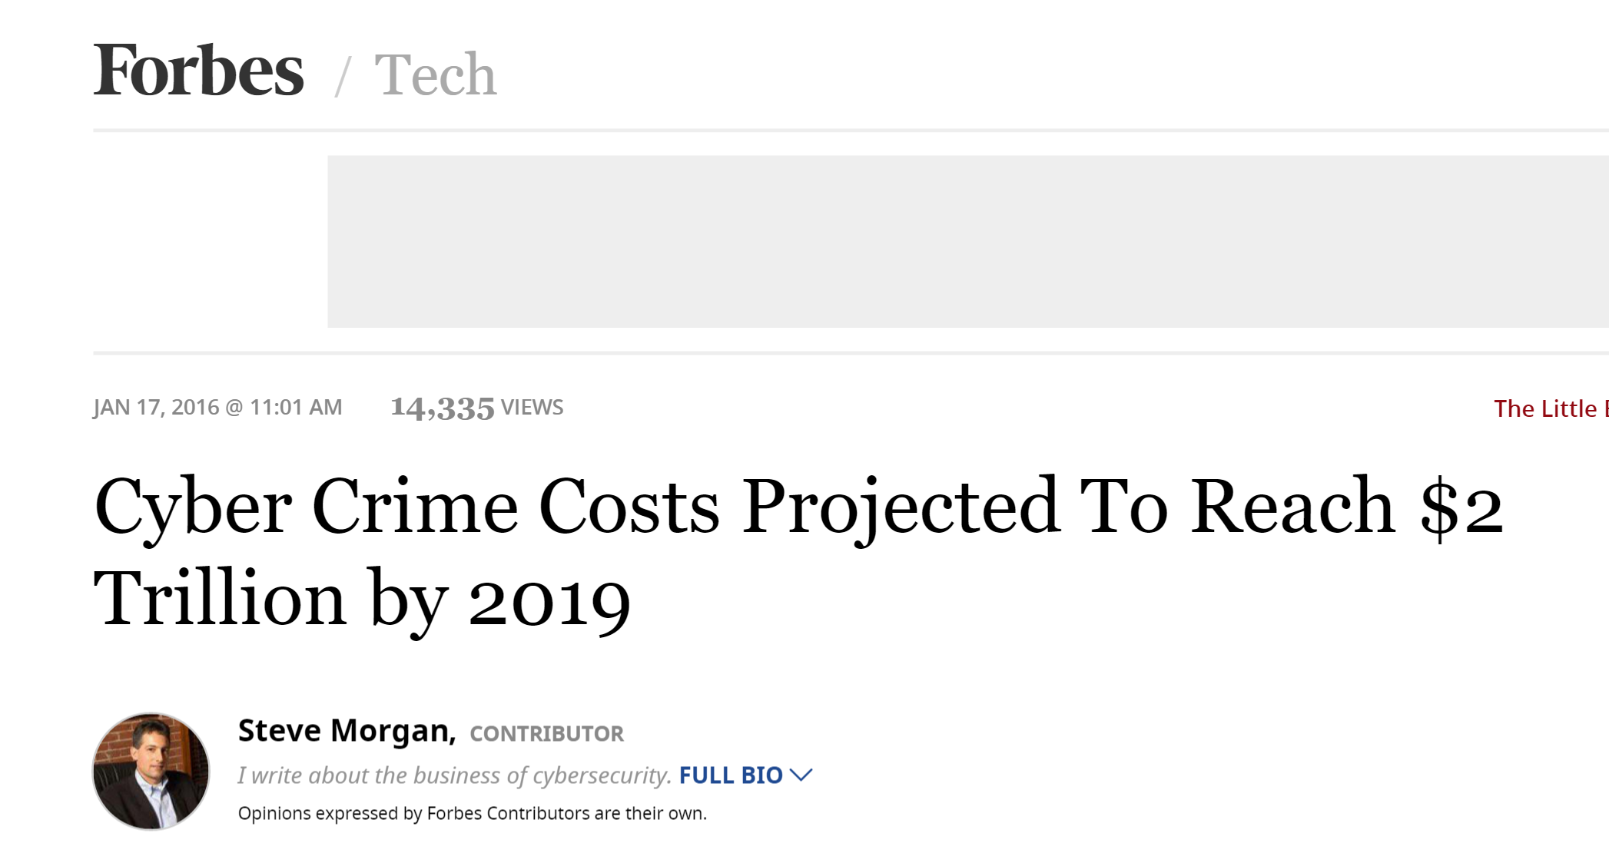
Cybercrime
Notes:
But we can’t ignore security of all sorts. AKC
http://www.forbes.com/sites/stevemorgan/2016/01/17/cyber-crime-costs-projected-to-reach-2-trillion-by-2019/#6d58302e3bb0

Slide 12
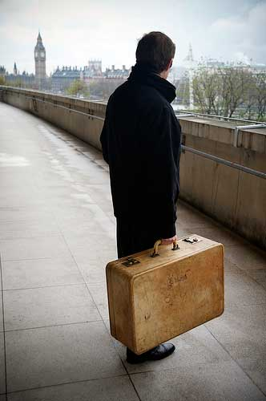
Vacuums and Muddles
No
Yes
Then
Now
Notes:
Or exactly what is some new thing. EAR
Article about US government using border entry as excuse to grab electronics and go through them:
http://www.nytimes.com/2013/09/10/business/the-border-is-a-back-door-for-us-device-searches.html?_r=0
Muddle: is the contents of your laptop like the stuff in your suitcase or the stuff in your head?
Old picture: http://www.hektoeninternational.org/Intercepted-letters.html
Laptop picture: http://www.freedigitalphotos.net/images/search.php?search=laptop

Slide 13
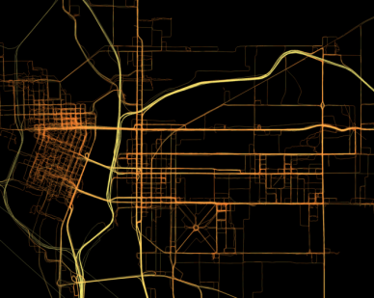
Vaccuums and Muddles
Warrant-less demands for cell location data:
Is raw location data protected by your right to privacy in the same way that the content of what you say on your phone is?
Conceptual muddle: what is cell location?
Policy vacuum: Can the police get it without a warrant?
Notes:
Note: conceptual muddle: what is cell location data (is it the same as cell call content data)?
Policy vaccuum: Can the police get it without a warrant? EAR

Slide 14
Protecting Sources
Policy vacuum: Must a blogger reveal sources? Is a blogger protected by shield laws?
Conceptual muddle:
http://www.wired.com/threatlevel/2010/04/too-much-media/
http://newjerseylawreview.blogspot.com/2011/06/blogger-must-reveal-sources-says-nj.html
Obsidian v Cox: https://en.wikipedia.org/wiki/Obsidian_Finance_Group,_LLC_v._Cox
Notes:
Muddle: Is every blogger a journalist? NJ Supreme Court says not journalist. Blogger must reveal sources. EAR
But the 9th Circuit, in reviewing Obsidian v Cox, said that first amendment defamation rules apply equally to the institutional press and individual speakers (2014).

Slide 15
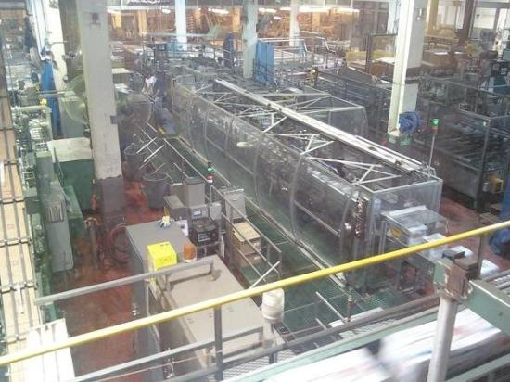
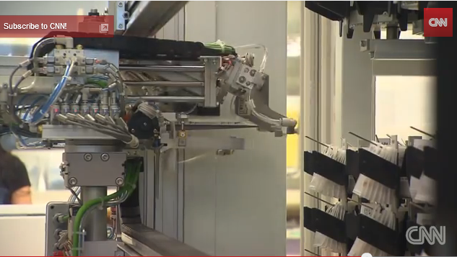
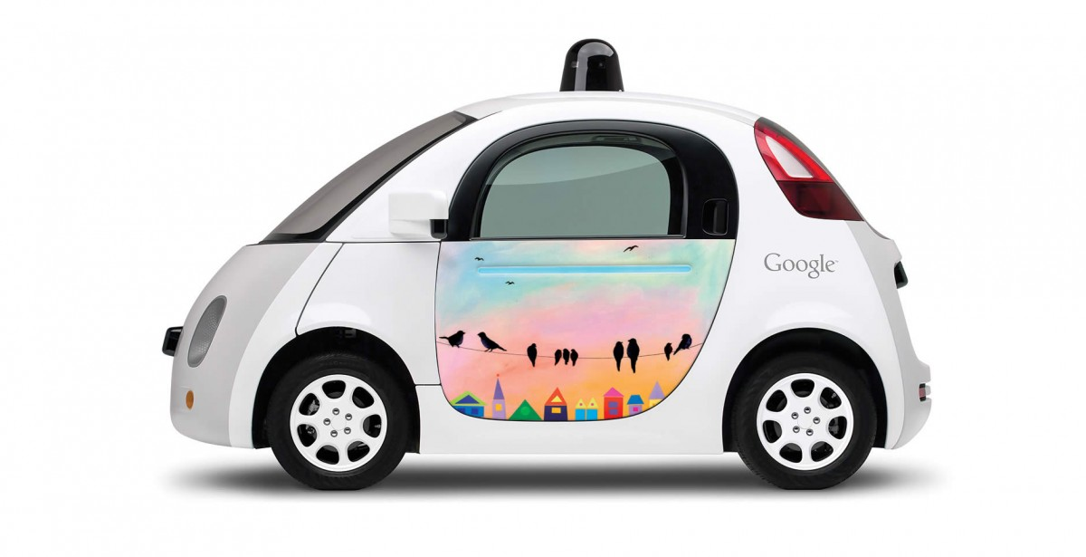
Coping with Change
Notes:
Fast change affects many aspects of society. Let’s look at one: jobs. EAR
Watson
Robotic pharmacist: https://www.youtube.com/watch?v=EQGSk3Lt9X0
Coors factory: Note no people. https://www.tripadvisor.com/LocationPhotoDirectLink-g33388-i23828601-Denver_Colorado.html
Google car: https://youtu.be/nBkQQ6czRJI

Slide 16
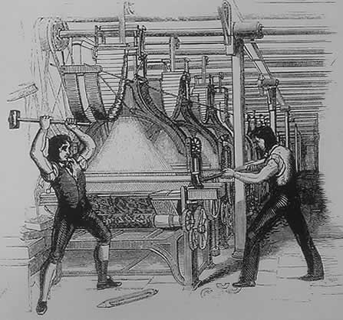
The Luddites
The Luddites, 1812
Notes:
Of course, technology has been replacing jobs for a long time. AKC

Slide 17
The Luddites
The Trumpites, 2016
Notes:
Of course, technology has been replacing jobs for a long time. AKC

Slide 18
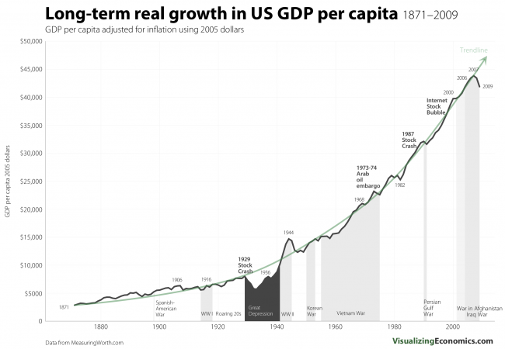
GDP Growth
Notes:
Our standard of living keeps going up because of technology.
http://visualizingeconomics.com/2011/03/08/long-term-real-growth-in-us-gdp-per-capita-1871-2009/

Slide 19
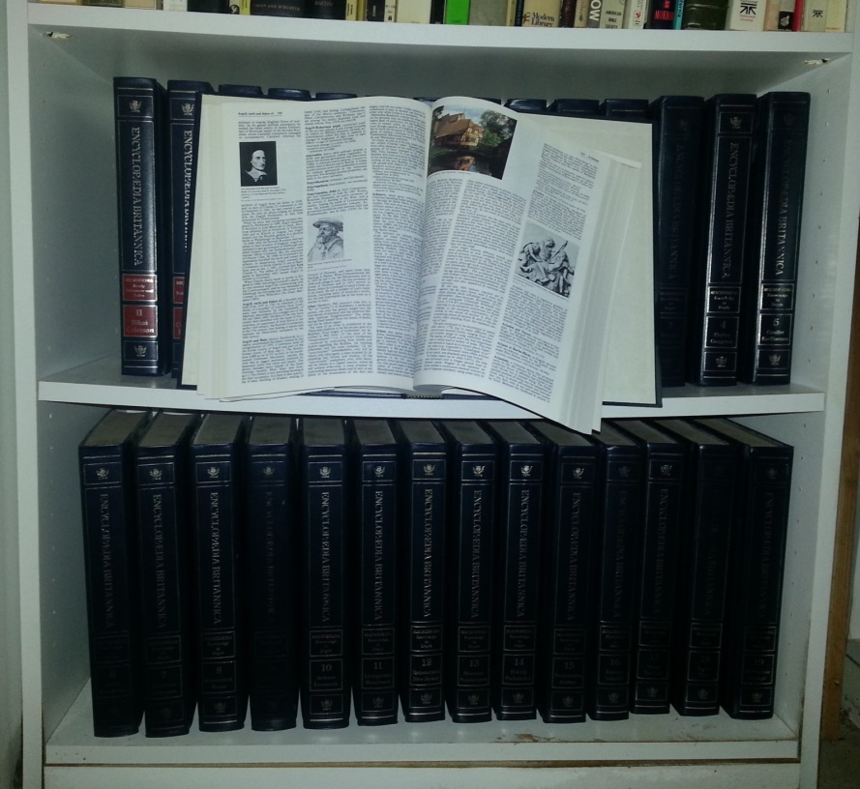
And GDP Isn’t the Whole Story
GDP doesn’t measure free or almost free.
$1,395.00
Notes:
We have a lot more “product” but how can we measure it? In fact, if Encyclopedia Britannica isn’t selling these sets anymore, it looks like there’s less product. March, 2012 – Encyclopedia Britannica announced the end of the print edition after 244 years.

Slide 20
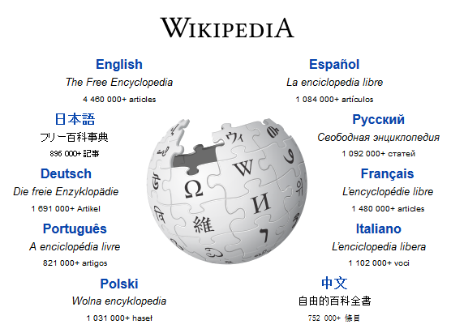
And GDP Isn’t the Whole Story
GDP doesn’t measure free or almost free.
$1,395.00
Notes:
We have a lot more “product” but how can we measure it? In fact, if Encyclopedia Britannica isn’t selling these sets anymore, it looks like there’s less product. March, 2012 – Encyclopedia Britannica announced the end of the print edition after 244 years.

Slide 21
And GDP Isn’t the Whole Story
GDP doesn’t measure free or almost free.
$1,395.00
GDP Growth ≠ Economic Growth
Notes:
We have a lot more “product” but how can we measure it? In fact, if Encyclopedia Britannica isn’t selling these sets anymore, it looks like there’s less product. March, 2012 – Encyclopedia Britannica announced the end of the print edition after 244 years.

Slide 22
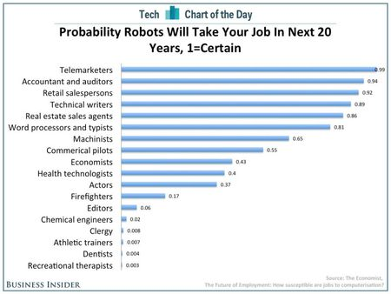
But What Is the Cost?
Notes:
http://www.hrcapitalist.com/2014/01/probability-hr-jobs-will-be-lost-to-robots-in-the-next-20-years.html Jan, 2014.
There are lots of other projections like this. Differ in details. AKC

Slide 23
How Does Technology Destroy Jobs?
Technology replaces human labor.

Slide 24
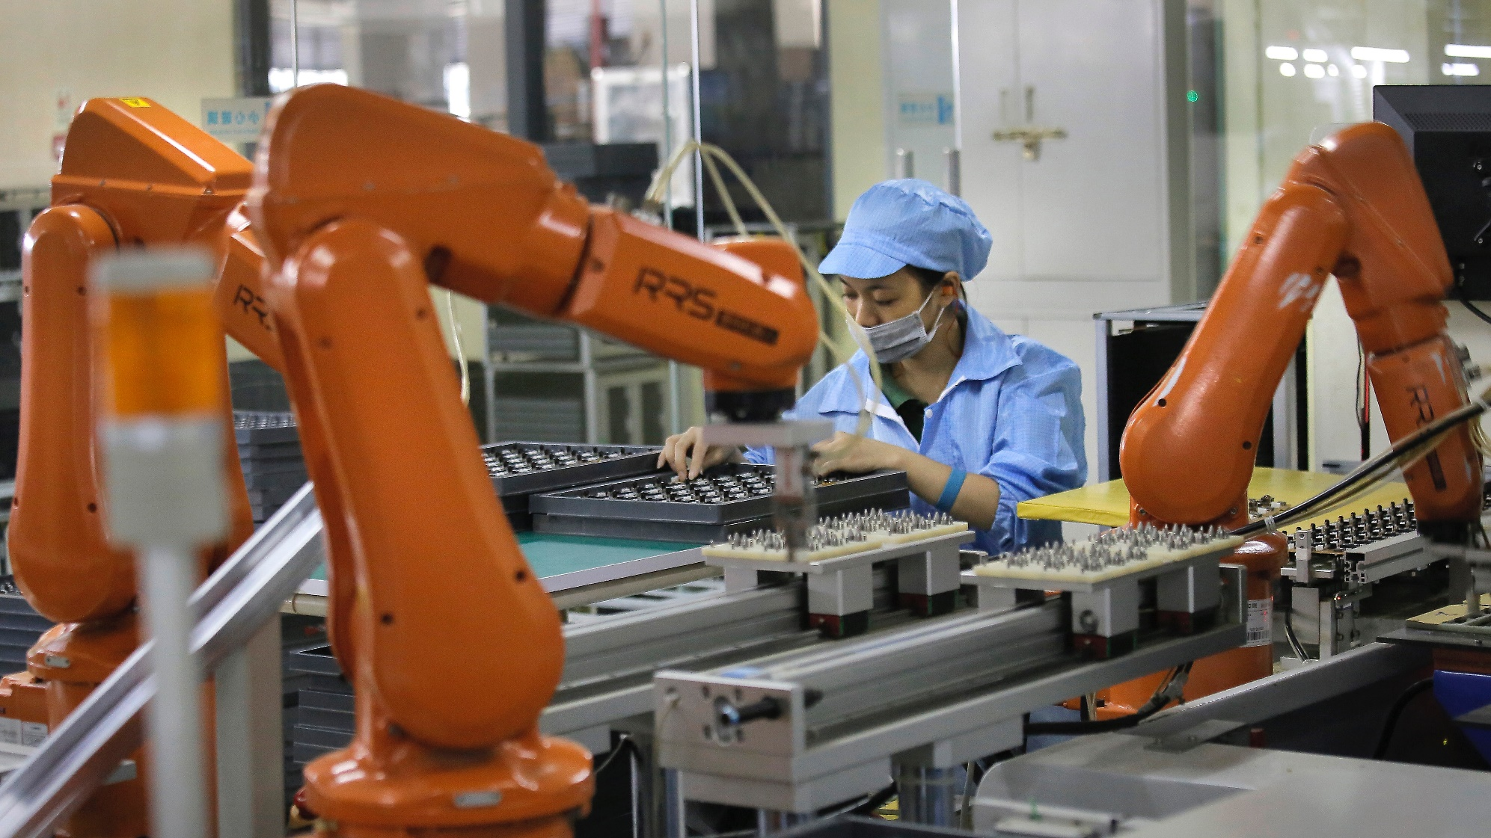
From Cheap Labor to Robotic Labor
May, 2016: iPhone manufacturer Foxconn is replacing 60,000 workers with robots
Notes:
http://qz.com/692389/iphone-manufacturer-foxconn-is-replacing-60000-workers-with-robots/ May 25, 2016

Slide 25
Maddie’s Job
Common practice:
Invest in a machine if you can earn back its cost in 2 years.
In the past decade, the flow of goods emerging from U.S. factories has risen by about a third.
Factory employment has fallen by roughly the same fraction.
Notes:
http://www.theatlantic.com/magazine/archive/2012/01/making-it-in-america/8844/ Standard is name of factory. AKC
Maddie is cheaper than a machine. It would be easy to buy a robotic arm that could take injector bodies and caps from a tray and place them precisely in a laser welder. Yet Standard would have to invest about $100,000 on the arm and a conveyance machine to bring parts to the welder and send them on to the next station. As is common in factories, Standard invests only in machinery that will earn back its cost within two years.
Interesting thing: If demand for product goes up and the factory can run more shifts, then, in fact, jobs for humans will disappear.

Slide 26
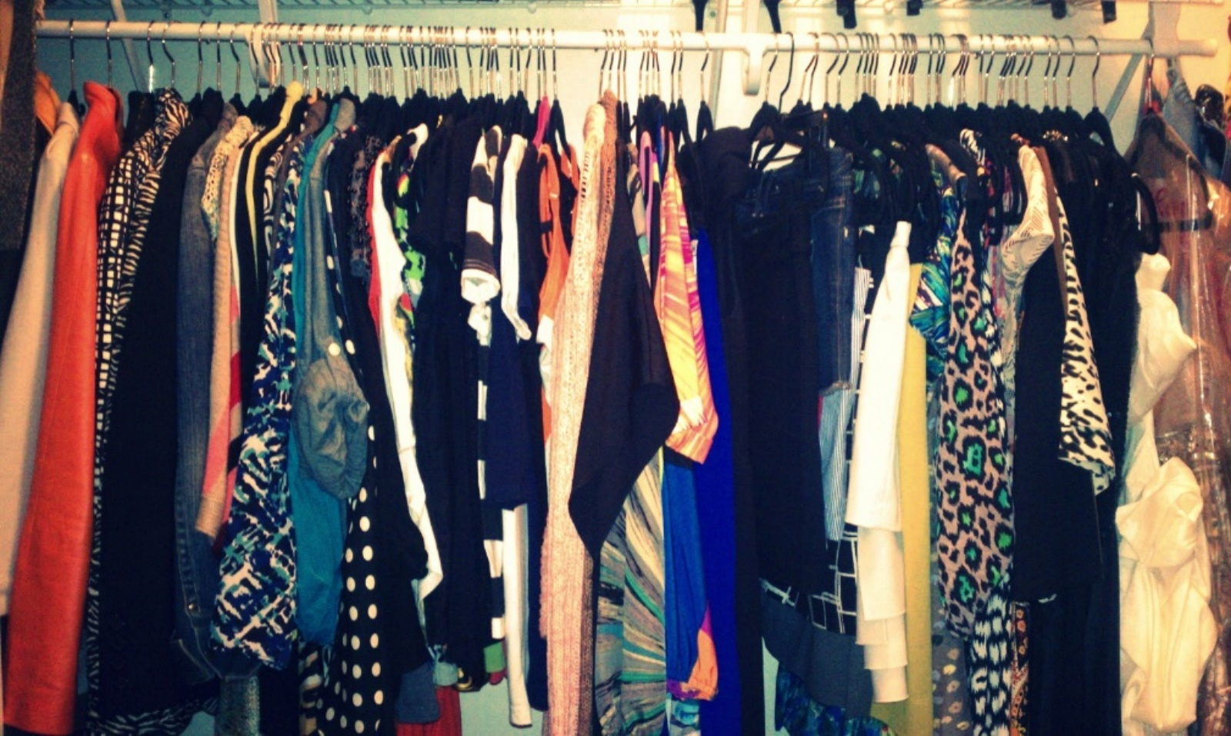
The Luddite Fallacy
The Luddite view:
Automation will eliminate the need for human labor.
Is a fallacy because:
Automation reduced cost and this increased demand. We all just have more stuff.
Notes:
http://az616578.vo.msecnd.net/files/2016/08/05/636059598405059380-634356351_clothes_13.jpg

Slide 27
The Luddite Fallacy
The Luddite view:
Automation will eliminate the need for human labor.
Is a fallacy because:
Workers were not up against any hard productivity limit. Most workers have been smart enough to become more productive with the new technology.
Notes:
http://blog.xyleme.com/sites/default/files/blog2/posts/xyleme-knowledge-workers.png

Slide 28
The Luddite Fallacy
Fallacy
The Luddite view:
Automation will eliminate the need for human labor.
May not be a fallacy because:
Too much stuff already.
Can’t get any smarter.
Notes:
http://az616578.vo.msecnd.net/files/2016/08/05/636059598405059380-634356351_clothes_13.jpg

Slide 29
How Does Technology Destroy Jobs?
Technology replaces human labor.
Winner takes all.

Slide 30
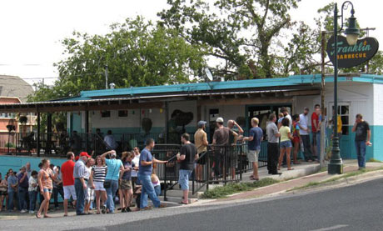
Winner Doesn’t Take All
Notes:
Do this one first because it’s shorter. Franklin’s bbq. People in line. If line gets too long, people will go to second best bbq.
http://www.theguardian.com/travel/2012/oct/17/10-best-local-food-diners-austin

Slide 31
Winner Takes All
When it’s digital, no one needs second best:
No lines.
No geography issues.
Notes:
http://us.battle.net/forums/static/images/game-logos/game-logo-wow.png
Van de Geijn and Myers Linear Algebra MOOC
http://blog.storyful.com/2016/04/12/five-tips-for-improving-facebook-discovery/#.V3asWbgrI2w

Slide 32
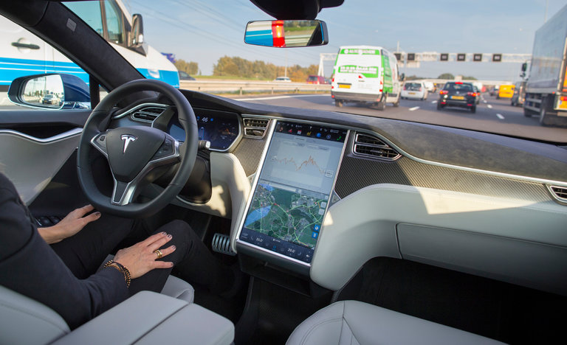
The Risk of Doing Nothing
Semi-automatic Tesla in accident: 1 person killed
Notes:
Speaking of one very disruptive technology: EAR
Back to how we should make decisions:
http://www.nytimes.com/2016/07/01/business/self-driving-tesla-fatal-crash-investigation.html?_r=0
We show people how to do expected value computations.

Slide 33
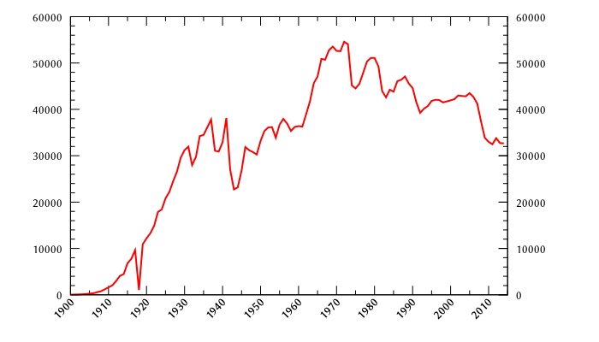
The Risk of Doing Nothing
Human driven cars: people killed per year
Notes:
https://en.wikipedia.org/wiki/List_of_motor_vehicle_deaths_in_U.S._by_year EAR
Why the decline even as passenger miles have increased? http://www.cnn.com/2011/US/04/01/traffic.fatalities/
Experts attribute the change to a variety of reasons, including changes to cars -- such as vehicle rollover protection -- and programs to change driver behavior -- such as campaigns addressing drunk driving, distracted driving and seat belt use. Laws aimed at young people also likely have had an impact, notably older minimum drinking ages and graduated drivers' licenses.

Slide 34
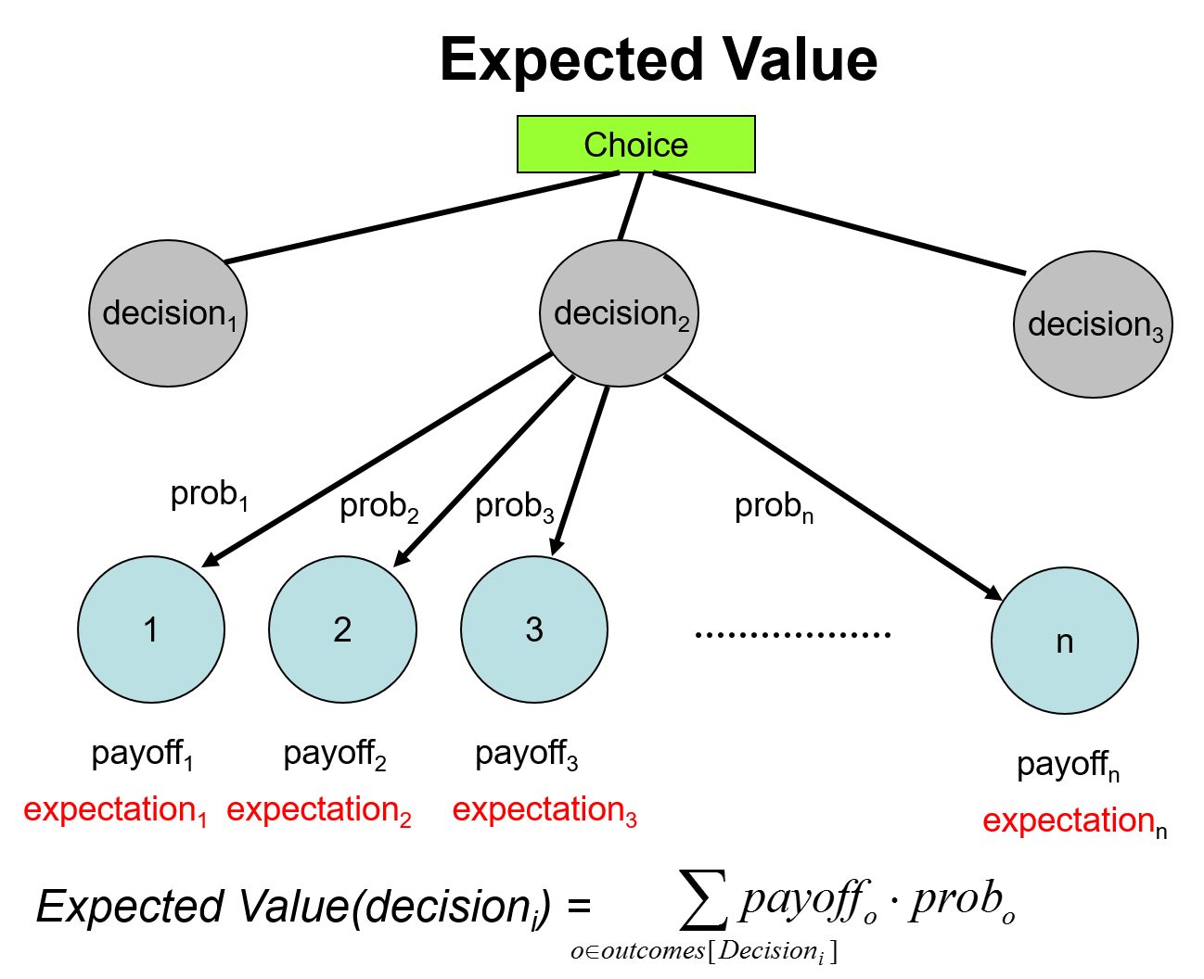
The Risk of Doing Nothing - How to Compare?
Notes:
Balance risks. AKC
In 2014, for car with drivers, 1.08 fatalities per 100M vehicle miles traveled.
As of March 2016, Google had test driven their fleet of vehicles, in autonomous mode, a total of 1,498,214 mi (Wikipedia) with no fatalities. Tesla said this was the first known death in over 130 million miles of Autopilot operation. Citation: http://www.pbs.org/newshour/rundown/driver-killed-in-self-driving-car-accident-for-first-time/

Slide 35
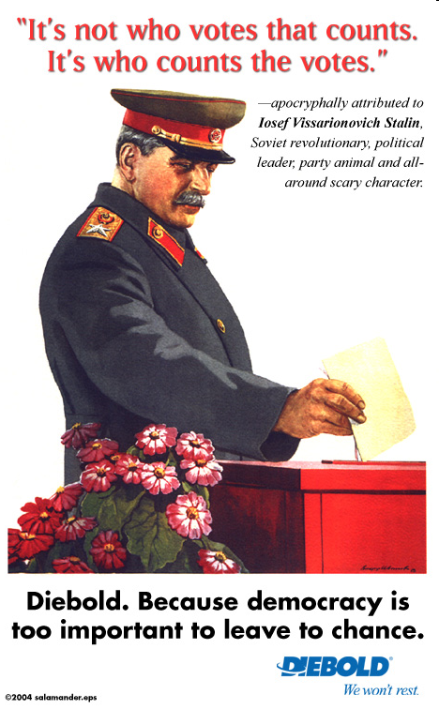
Why Is This Important and What Should You Do about It?
Notes:
AKC

Slide 36
Why Is This Important and What Should You Do about It?
Notes:
http://gizmodo.com/why-californias-new-web-wide-delete-button-for-teens-w-1377730365 AKC
Why California’s new wide-wide delete button for teens won’t work.
Now all this sounds nice in theory, but more than anything, this law
is a testament to the fact that lawmakers (at least in California)
have no real idea how the internet actually works.

Slide 37
So much for how we should act ….
How should we program machines to act ….
Machine Ethics
Notes:
EAR

Slide 38
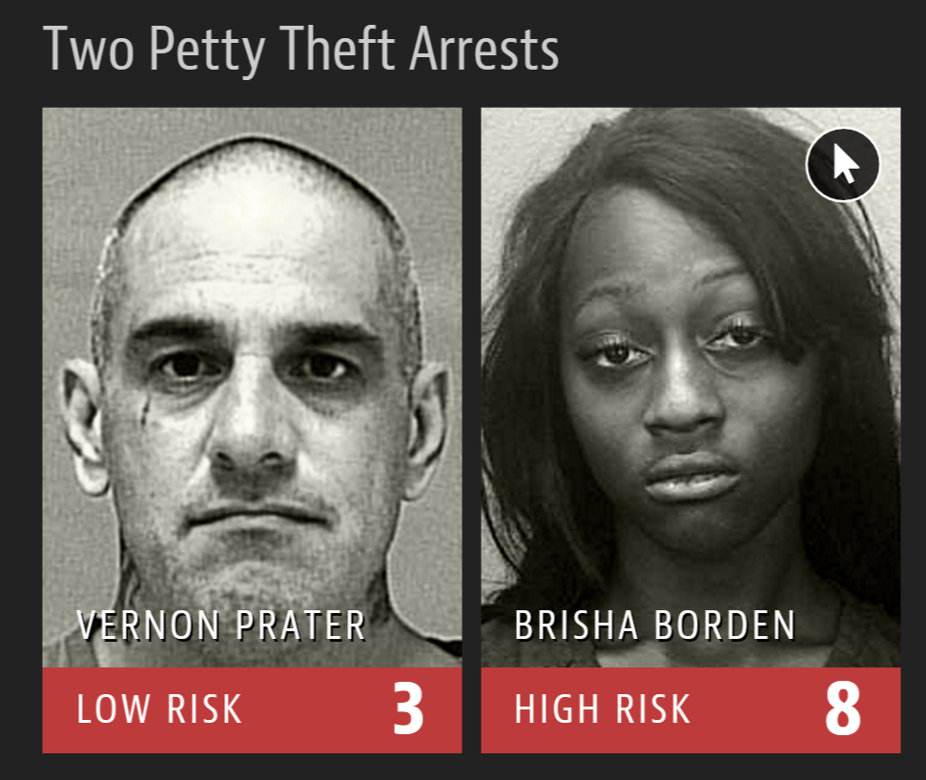
Algorithmic Bias
Notes:
http://www.nytimes.com/2016/06/26/opinion/sunday/artificial-intelligences-white-guy-problem.html?_r=0
https://www.propublica.org/article/machine-bias-risk-assessments-in-criminal-sentencing Yet Prater was the more seasoned criminal. And Borden did not reoffend. Prater did. EAR

Slide 39
Machine Ethics
https://youtu.be/nBkQQ6czRJI
Notes:
http://www.huffingtonpost.com/entry/driverless-cars-moral-dilemma_us_576c1bd0e4b0aa4dc3d4b557
EAR

Slide 40
Professional Ethics
ACM Code of Ethics and Professional Conduct

