Slide 1
Easy, Hard, and Impossible
Elaine Rich

Slide 2
Easy

Slide 3
Tic Tac Toe
Notes:
Let the kids play a game or two.
At first, it appears we need to search to find a winning strategy. But quickly we realize that there’s exactly one optimal move. This game is trivial.

Slide 4
Hard

Slide 5
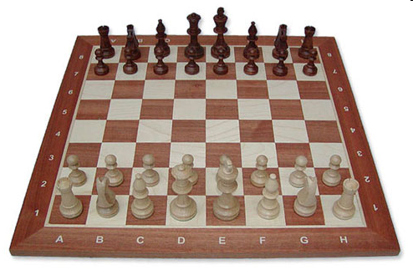
Chess
Notes:
Image from: http://www.polandchess.com/chess_sets_galleries/Staunton5_wb_chess_set/Staunton5_wb_chess_set.htm

Slide 6
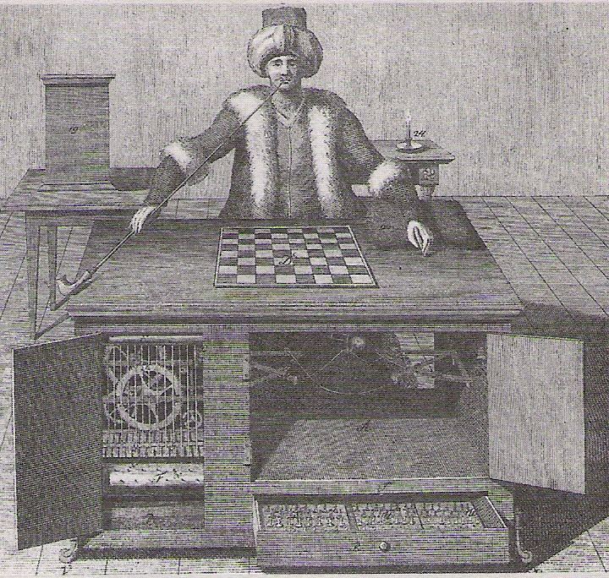
The Turk
Unveiled in 1770.
Notes:
Built in 1770.

Slide 7
Searching for the Best Move
A
B C D
E F G H I J K L M
(8) (-6) (0) (0) (2) (5) (-4) (10) (5)
Notes:
Point out that we don’t just want to pick D so that we can go to L because we don’t get to pick the move from D.
Note that the number of leaf nodes is 3 * 3. Ask how many there would be at the next level.

Slide 8
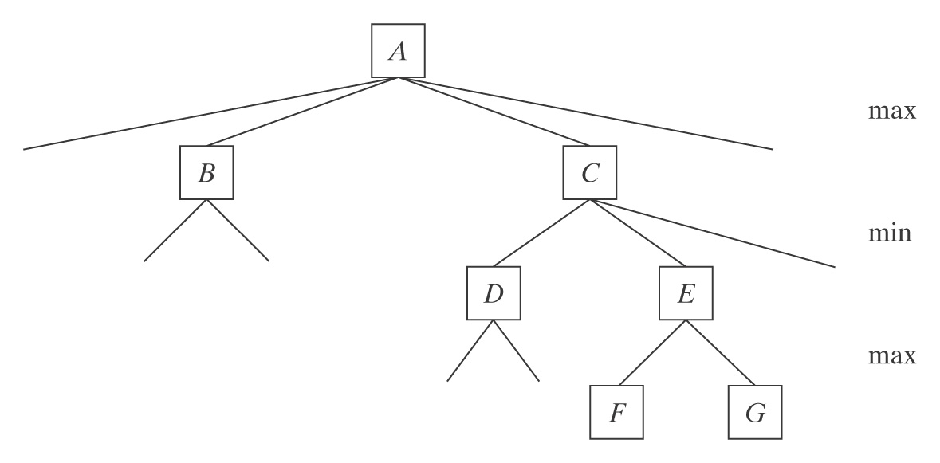
How Much Computation Does it Take?
Middle game branching factor ≈ 35
Lookahead required to play master level chess ≈ 8
35⁸ ≈

Slide 9
How Much Computation Does it Take?
Middle game branching factor ≈ 35
Lookahead required to play master level chess ≈ 8
35⁸ ≈ 2,000,000,000,000
Seconds in a year ≈

Slide 10
How Much Computation Does it Take?
Middle game branching factor ≈ 35
Lookahead required to play master level chess ≈ 8
35⁸ ≈ 2,000,000,000,000
Seconds in a year ≈ 31,536,000
Seconds since Big Bang ≈ 300,000,000,000,000,000

Slide 11
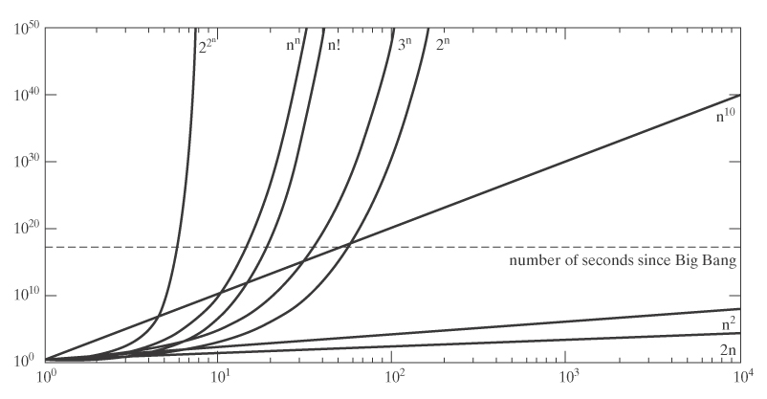
Growth Rates of Functions

Slide 12
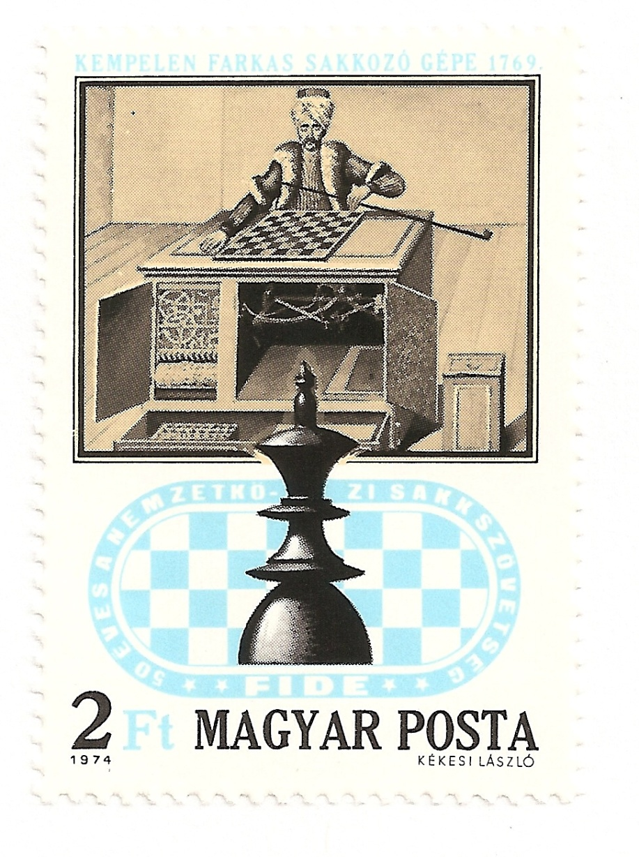
The Turk
Still fascinates people.

Slide 13
How Did It Work?
Notes:
From: Automata, The Golden Age , Christian Bailly

Slide 14
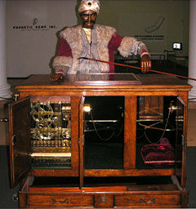
A Modern Reconstruction
Built by John Gaughan. First displayed in 1989. Controlled by a computer. Uses the Turk’s original chess board.

Slide 15
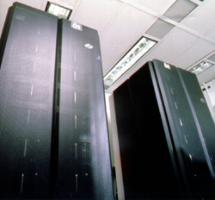
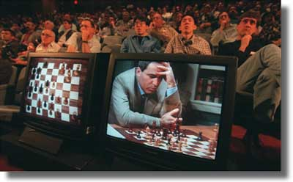
Chess Today
In 1997, Deep Blue beat Garry Kasparov.
Notes:
What about role playing games? Need a lot more knowledge.

Slide 16
Seems Hard But Really Easy

Slide 17
Nim
At your turn, you must choose a pile, then remove as many sticks from the pile as you like.
The player who takes the last stick(s) wins.
Notes:
Let the kids play. It works to hand out a stack of toothpicks to each pair of students.
First player should remove one stick from either pile 1 or pile 2 or remove all sticks from pile 3. Then there is no guaranteed winning move for the other player.

Slide 18
Nim
Now let’s try:

Slide 19
Nim
Now let’s try:
Oops, now there are a lot of possibilities to try.

Slide 20
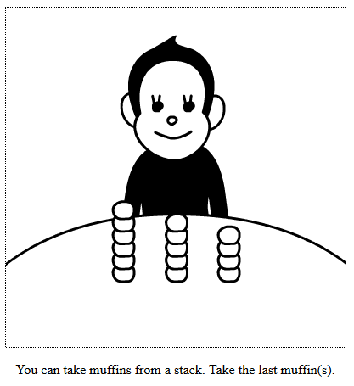
Nim
http://www.gamedesign.jp/flash/nim/nim.html

Slide 21
Decimal Numbers
 | 10000 | 1000 | 100 | 10 | 1
89 |  |  |  | 8 | 9
Notes:
Need to introduce this in order to be able to explain the “trick” for Nim. There’s a separate .doc file that contains a table of binary numbers. You might want to copy it and hand it out.

Slide 22
Decimal Numbers
 | 10000 | 1000 | 100 | 10 | 1
89 |  |  |  | 8 | 9
587
Notes:
Need to introduce this in order to be able to explain the “trick” for Nim.

Slide 23
Decimal Numbers
 | 10000 | 1000 | 100 | 10 | 1
89 |  |  |  | 8 | 9
567 |  |  | 5 | 6 | 7
34765
Notes:
Need to introduce this in order to be able to explain the “trick” for Nim.

Slide 24
Decimal Numbers
 | 10000 | 1000 | 100 | 10 | 1
89 |  |  |  | 8 | 9
567 |  |  | 5 | 6 | 7
34765 | 3 | 4 | 7 | 8 | 5
Notes:
Need to introduce this in order to be able to explain the “trick” for Nim.

Slide 25
Binary Numbers
 | 16 | 8 | 4 | 2 | 1
5
Notes:
Need to introduce this in order to be able to explain the “trick” for Nim.

Slide 26
Binary Numbers
 | 16 | 8 | 4 | 2 | 1
5 |  |  | 1 | 0 | 1
9

Slide 27
Binary Numbers
 | 16 | 8 | 4 | 2 | 1
5 |  |  | 1 | 0 | 1
9 |  | 1 | 0 | 0 | 1
21

Slide 28
Binary Numbers
 | 16 | 8 | 4 | 2 | 1
5 |  |  | 1 | 0 | 1
9 |  | 1 | 0 | 0 | 1
21 | 1 | 0 | 1 | 0 | 1
3

Slide 29
Binary Numbers
 | 16 | 8 | 4 | 2 | 1
5 |  |  | 1 | 0 | 1
9 |  | 1 | 0 | 0 | 1
21 | 1 | 0 | 1 | 0 | 1
3 |  |  |  | 1 | 1
16

Slide 30
Binary Numbers
 | 16 | 8 | 4 | 2 | 1
5 |  |  | 1 | 0 | 1
9 |  | 1 | 0 | 0 | 1
21 | 1 | 0 | 1 | 0 | 1
3 |  |  |  | 1 | 1
16 | 1 | 0 | 0 | 0 | 0

Slide 31
Nim
My turn:
10 (2)
10 (2)
11 (3)
11
For the current player:
Guaranteed loss if last row is all 0’s.
Guaranteed win otherwise.
Notes:
To form last row, XOR each column.
I should remove one stick from either pile one or pile two. Or all from pile three.

Slide 32
Nim
My turn:
100 (4)
010 (2)
101 (5)
011
For the current player:
Guaranteed loss if last row is all 0’s.
Guaranteed win otherwise.

Slide 33
Nim
Your turn:
100 (4)
001 (1)
101 (5)
000
For the current player:
Guaranteed loss if last row is all 0’s.
Guaranteed win otherwise.

Slide 34
Or You Could Use Your Toothpicks for …

Slide 35
Or You Could Use Your Toothpicks for …

Slide 36
Or You Could Use Your Toothpicks for …

Slide 37
Following Paths
Notes:
You can print this page and copy it and hand it out for the students to try.

Slide 38
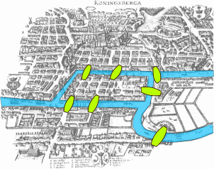
Seven Bridges of Königsberg
Notes:
Königsberg was the capital of eastern Prussia from the Late Middle Ages until 1945. Now in Russia, called Kaliningrad.

Slide 39
Seven Bridges of Königsberg
Seven Bridges of Königsberg:
1
3
4
2

Slide 40
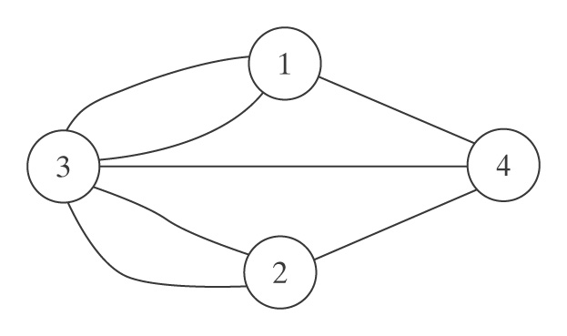
Seven Bridges of Königsberg
Seven Bridges of Königsberg:
1
3
4
2
As a graph:

Slide 41
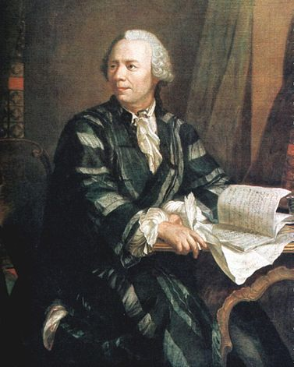
Eulerian Paths and Circuits
Cross every edge exactly once.
All these people care:
• Bridge inspectors
• Road cleaners
• Network analysts
Leonhard Euler
1707 - 1783

Slide 42
Eulerian Paths and Circuits
Cross every edge exactly once.
Leonhard Euler
1707 - 1783

Slide 43
Eulerian Paths and Circuits
Cross every edge exactly once.
Leonhard Euler
1707 - 1783
There is a circuit if every node touches an even number of edges.

Slide 44
So, Can We Do It?
1
3
4
2
As a graph:

Slide 45
The Good King and the Evil King
The good king wants to build exactly one new bridge so that:
There’s an Eulerian path from the pub to his castle.
But there isn’t one from the pub to the castle of his evil brother on the other bank of the river.

Slide 46
Here’s What He Starts With
1
3
4
2
As a graph:
Notes:
Print this and hand it out. Let the students try it.

Slide 47
Here’s What He Ends Up With
1
3
4
2
As a graph:
Notes:
Let the kids try this.

Slide 48
Unfortuntately, There Isn’t Always a Trick
Suppose we need to visit every vertex exactly once.

Slide 49
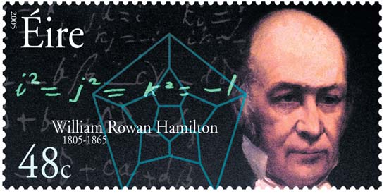
Visting Nodes Rather Than Edges
● A Hamiltonian path: visit every node exactly once.
● A Hamiltonian circuit: visit every node exactly once and end up where you started.
All these people care:
Salesmen,
Farm inspectors,
Network analysts

Slide 50
The Traveling Salesman Problem
15
25
10
28
20
4
40
8
9
7
3
23
Given n cities:
Choose a first city n
Choose a second n-1
Choose a third n-2
… n!

Slide 51
The Traveling Salesman Problem
Can we do better than n!
● First city doesn’t matter.
● Order doesn’t matter.
So we get (n-1!)/2.

Slide 52
The Growth Rate of n!
2 | 2 | 11 | 479001600
3 | 6 | 12 | 6227020800
4 | 24 | 13 | 87178291200
5 | 120 | 14 | 1307674368000
6 | 720 | 15 | 20922789888000
7 | 5040 | 16 | 355687428096000
8 | 40320 | 17 | 6402373705728000
9 | 362880 | 18 | 121645100408832000
10 | 3628800 | 19 | 2432902008176640000
11 | 39916800 | 36 | 3.6⋅10⁴¹

Slide 53
Putting it into Perspective
Speed of light | 3⋅10⁸ m/sec
Width of a proton | 10⁻¹⁵ m
At one operation in the time it takes light to cross a proton | 3⋅10²³ ops/sec
Since Big Bang | 3⋅10¹⁷ sec
Ops since Big Bang | 9⋅10⁴⁰ ops | 36! = 3.6⋅10⁴¹
Neurons in brain | 10¹¹
Parallel ops since Big Bang | 9⋅10⁵¹ | 43! = 6⋅10⁵²

Slide 54
Growth Rates of Functions

Slide 55
Getting Close Enough
Use a technique that is guaranteed to find an optimal solution and likely to do so quickly.
Use a technique that is guaranteed to run quickly and find a “good” solution.
The Concorde TSP Solver found an optimal route that visits 24,978 cities in Sweden.
The World Tour Problem

Slide 56
Is This The Best We Can Do?
It is generally believed that there’s no efficient algorithm that finds an exact solution to:
The Travelling Salesman problem
The question of whether or not a Hamiltonian circuit exists.
Would you like to win $1M?
The Millenium Prize

Slide 57
Impossible

Slide 58
An Interesting Puzzle
 | List 1 | List 2
1 | b | bbb
2 | babbb | ba
3 | ba | a
4 | bbbaa | babbb
2
List 1 b a b b b
List 2 b a

Slide 59
An Interesting Puzzle
 | List 1 | List 2
1 | b | bbb
2 | babbb | ba
3 | ba | a
4 | bbbaa | babbb
2 1
List 1 b a b b b b
List 2 b a b b b

Slide 60
An Interesting Puzzle
 | List 1 | List 2
1 | b | bbb
2 | babbb | ba
3 | ba | a
4 | bbbaa | babbb
2 1 1
List 1 b a b b b b b
List 2 b a b b b b b b

Slide 61
An Interesting Puzzle
 | List 1 | List 2
1 | b | bbb
2 | babbb | ba
3 | ba | a
4 | bbbaa | babbb
2 1 1 3
List 1 b a b b b b b b a
List 2 b a b b b b b b a

Slide 62
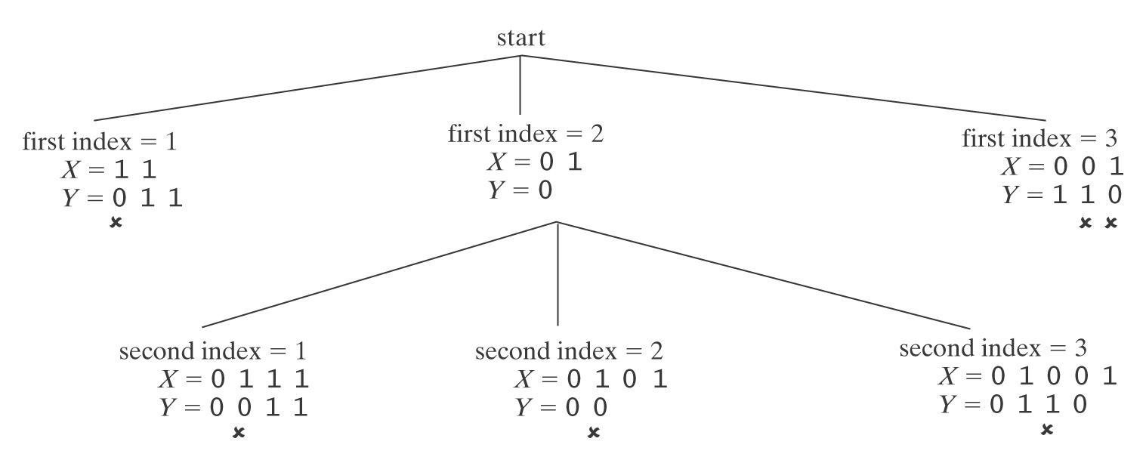
The Post Correspondence Problem
 | List 1 | List 2
1 | 11 | 011
2 | 01 | 0
3 | 001 | 110
Notes:
Easy to see that this one is impossible. We rule out all possibilities.

Slide 63
The Post Correspondence Problem
 | List 1 | List 2
1 | ab | a
2 | ab | ba
3 | aa | baa
Notes:
Let students try this one. 1,3 and 1,2,3 are solutions.

Slide 64
The Post Correspondence Problem
 | List 1 | List 2
1 | ba | bab
2 | abb | bb
3 | bab | abb
Notes:
Let the students try this one. No solution exists.

Slide 65
The Post Correspondence Problem
 | List 1 | List 2
1 | 1101 | 1
2 | 0110 | 11
3 | 1 | 110
Notes:
Tell them about this one. Its shortest solution has length 252

Slide 66
Can A Program Do This?
Can we write a program to answer the following question:
Given a PCP instance P, decide whether or not P has a solution. Return:
True if it does.
False if it does not.

Slide 67
What is a Program?

Slide 68
What is a Program?
A procedure that can be performed by a computer.

Slide 69
The Post Correspondence Problem
A program to solve this problem:
Until a solution or a dead end is found do:
If dead end, halt and report no.
Generate the next candidate solution.
Test it. If it is a solution, halt and report yes.
So, if there are say 4 rows in the table, we’ll try:
1 2 3 4
1,1 1,2 1,3 1,4 1,5
2,1 ……
1,1,1 ….

Slide 70
Will This Work?
If there is a solution:
If there is no solution:

Slide 71
A Tiling Problem
Notes:
Explain the rules.

Slide 72
A Tiling Problem

Slide 73
A Tiling Problem

Slide 74
A Tiling Problem

Slide 75
A Tiling Problem

Slide 76
A Tiling Problem

Slide 77
A Tiling Problem

Slide 78
A Tiling Problem

Slide 79
A Tiling Problem

Slide 80
A Tiling Problem
Notes:
Now notice that we can tile forever because this 3 x 3 is the same top and bottom and right and left.

Slide 81
Another Tiling Problem
Notes:
This one can easily be shown not to work.

Slide 82
Another Tiling Problem
Notes:
Hand out cut out tiles and let the students try this one. There’s a 2 x 3 that is symmetric.

Slide 83
Another Tiling Problem

Slide 84
Can A Program Do This?
Can we write a program to answer the following question:
Given a tiling problem T, decide whether or not T can tile a plane. Return:
True if it can.
False if it can not.

Slide 85
Deciding a Tiling Problem
A program to solve this problem:
Until the answer is clearly yes or a dead end is found do:
If dead end, halt and report no.
Generate the next candidate solution.
Test it. If it is a solution, halt and report yes.

Slide 86
Will This Work?
If T can tile a plane:
If T can not tile a plane:

Slide 87
Programs Debug Programs
Given an arbitrary program, can it be guaranteed to halt?
read name
if name = “Elaine”
then print “You win!!”
else print “You lose ☹”
Notes:
Obviously halts. No loops.

Slide 88
Programs Debug Programs
Given an arbitrary program, can it be guaranteed to halt?
read number
set result to 1
set counter to 2
until counter > number do
set result to result * counter
add 1 to counter
print result
Notes:
Easy to show this one halts because counter gets one step closer to number each time. Simulation on next slide.

Slide 89
Programs Debug Programs
Given an arbitrary program, can it be guaranteed to halt?
read number
set result to 1
set counter to 2
until counter > number do
set result to result * counter
add 1 to counter
print result
Suppose number = 5:
result number counter
1 5 2
2 5 3
6 5 4
24 5 5
120 5 6
Notes:
Easy to show this one halts because counter gets one step closer to number each time.

Slide 90
Programs Debug Programs
Given an arbitrary program, can it be guaranteed to halt?
read number
set result to 1
set counter to 2
until counter > number do
set number to number * counter
add 1 to counter
print result
Suppose number = 5:
result number counter
1 5 2
1 10 3
1 30 4
1 120 5
1 600 6
Notes:
Easy to show this one never halts.

Slide 91
Programs Debug Programs
Given an arbitrary program, can it be guaranteed to halt?
The 3x + 1 Problem
read number
until number = 1 do
if number is even then set number to number/2
if number is odd then set number to 3∗number + 1
Suppose number is 7:

Slide 92
Programs Debug Programs
Given an arbitrary program, can it be guaranteed to halt?
read number
until number = 1 do
if number is even then set number to number/2
if number is odd then set number to 3∗number + 1
Collatz Conjecture: This program always halts.
We can try it on big numbers:
http://math.carleton.ca/%7Eamingare/mathzone/3n+1.html

Slide 93
The Impossible
The halting problem cannot be solved.
We can prove that no program can ever be written that can look at arbitrary other programs and decide whether or not they always halt.

Slide 94
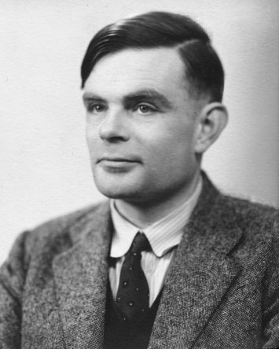
What is a Program?
A Python program
But before Python, before computers even, a simple mathematical model:
The Turing Machine
Alan Turing 1912- 1954
Notes:
Recall that we’ve already mentioned Turing. We said that he proved that there’s no algorithm to decide whether a formula of quantified logic is valid.

Slide 95
Turing Machines

Slide 96
Turing Machines
But we can prove that anything that any standard computer can do can also be done on a Turing machine.

Slide 97
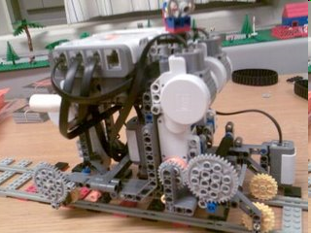
Watch One in Action
http://www.youtube.com/watch?v=cYw2ewoO6c4&eurl=http://www.google.com/ig?hl=en
Notes:
Picture from: http://legoofdoom.blogspot.com/

Slide 98
The Halting Problem is Not Solvable
Suppose, for the sake of argument, that the following program did exist:
def halts(string1,string2):
if string₁ would halt if run on string₂:
return(True)
else:
return(False)
Notes:
Key – we’ve said nothing about how halts would work. Only that it can do the job.

Slide 99
The Halting Problem is Not Solvable
Consider the following program:
def trouble(string):
if halts(string, string):
while 1 == 1:
pass # loop forever
else:
return
Now we invoke trouble(<trouble>)
What should halts(<trouble>,<trouble>) say? If it:
Returns True (trouble will halt): trouble
Returns False (trouble will not halt): trouble

Slide 100
The Halting Problem is Not Solvable
Consider the following program:
def trouble(string):
if halts(string, string):
while 1 == 1:
pass # loop forever
else:
return
Now we invoke trouble(<trouble>)
What should halts(<trouble>,<trouble>) say? If it:
Returns True (trouble will halt): trouble loops
Returns False (trouble will not halt): trouble

Slide 101
The Halting Problem is Not Solvable
Consider the following program:
def trouble(string):
if halts(string, string):
while 1 == 1:
pass # loop forever
else:
return
Now we invoke trouble(<trouble>)
What should halts(<trouble>,<trouble>) say? If it:
Returns True (trouble will halt): trouble loops
Returns False (trouble will not halt): trouble halts
So both answers lead to contradictions.

Slide 102
Recall the Tiling Problem

Slide 103
Other Unsolvable Problems
Tiling:
We can encode a <program>,<input> pair as an instance of a tiling problem so that there is an infinite tiling iff <program> halts on <input>.
00010000111000000111110000000000000 00010000111010000111110000000000000
00010000111011000111110000000000000
…
So if the tiling problem were solvable then Halting would be.
But Halting isn’t. So neither is the tiling problem.

Slide 104
Recall the Post Correspondence Problem
 | List 1 | List 2
1 | ab | a
2 | ab | ba
3 | aa | baa
Notes:
Let students try this one. 1,3 and 1,2,3 are solutions.

Slide 105
Other Unsolvable Problems
PCP:
We can encode a <program>,<input> pair as an instance of PCP so that the PCP problem has a solution iff <program> halts on <input>.
2 1 1
List 1 b a b b b b b
List 2 b a b b b b b b
So if PCP were solvable then Halting would be.
But Halting isn’t. So neither is PCP.

Slide 106
Which is Amazing
Given the things programs can do.

Slide 107
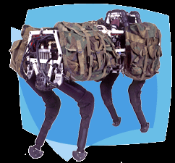
Which is Amazing
Given the things programs can do.
http://www.youtube.com/watch?v=cNZPRsrwumQ
Notes:
Watch the video.

Slide 108
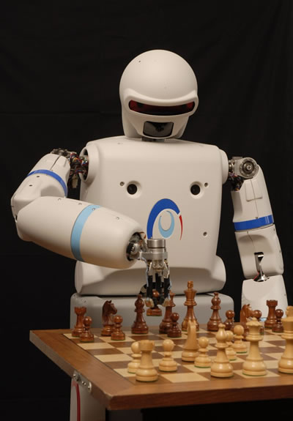
Which is Amazing
Given the things programs can do.
REEM-A
http://www.youtube.com/watch_popup?v=2wzT4vafXOA&vq=medium
Notes:
Watch the video.

Slide 109
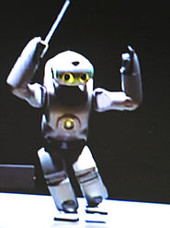
Which is Amazing
Given the things programs can do.
http://pc.watch.impress.co.jp/docs/2003/1218/sony_06.wmv
Notes:
Watch the video.

Slide 110
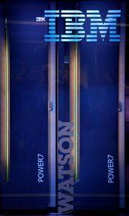
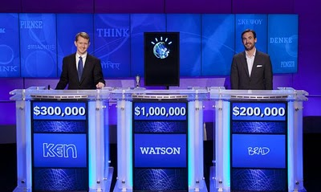
Which is Amazing
Given the things programs can do.
IBM’s site: http://www-03.ibm.com/innovation/us/watson/what-is-watson/index.html
Introduction: http://www.youtube.com/watch?v=FC3IryWr4c8
Watch a sample round: http://www.youtube.com/watch?v=WFR3lOm_xhE
From Day 1 of the real match: http://www.youtube.com/watch?v=seNkjYyG3gI
Bad Final Jeopardy: http://www.youtube.com/watch?v=mwkoabTl3vM&feature=relmfu
How does Watson win? http://www.youtube.com/watch?v=d_yXV22O6n4

