Slide 1

The Challenger Disaster

Slide 2
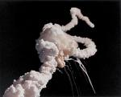
January 28, 1986

Slide 3
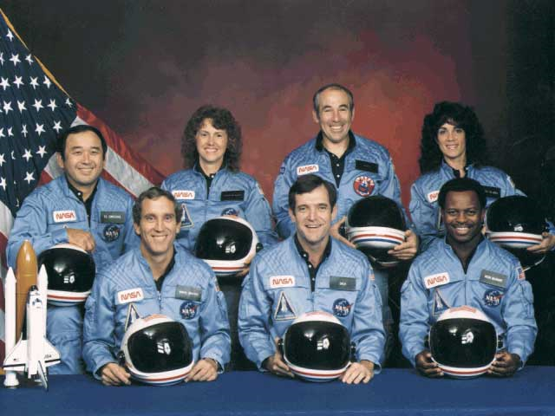
The Challenger Crew

Slide 4
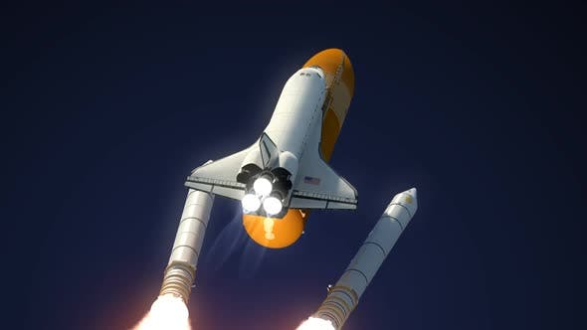
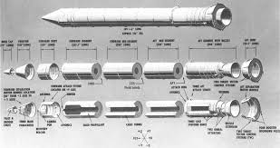
Locations of the O Rings
The Solid Rocket Boosters

Slide 5
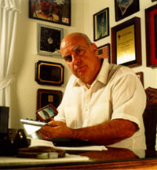
Roger Boisjoly
Notes:
Do we decide by listening to the boss?
http://www.aerospaceguide.net/spaceshuttle/challenger_disaster.html

