Slide 1
Encoding Things for Computers
Section 17.1
Chapter 3

Slide 2
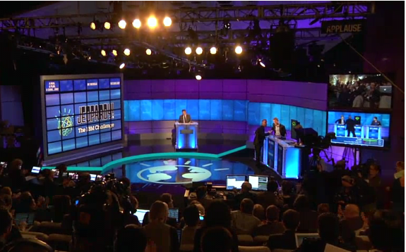
Watson
http://www.youtube.com/watch?v=WFR3lOm_xhE

Slide 3
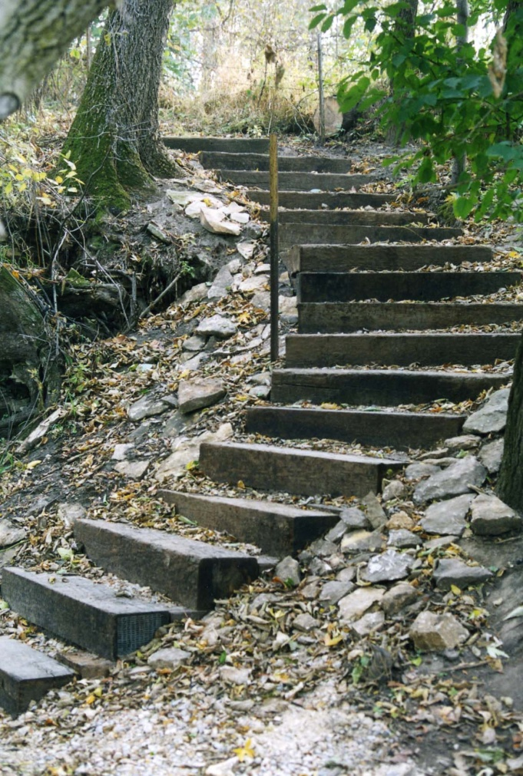
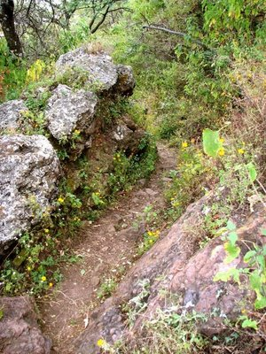
Digital vs Analog
Digital is to analog as steps are to ramps.
Notes:
Quote taken from David Reed, “A Balanced Introduction to Computer Science”, 3rd Edition, page216.
Steps: http://www.co.marshall.ia.us/zenphoto/conservation/TB+4+-+Trail+Steps.jpg.php
Trail: http://cookjmex.blogspot.com/2009_04_01_archive.html

Slide 4
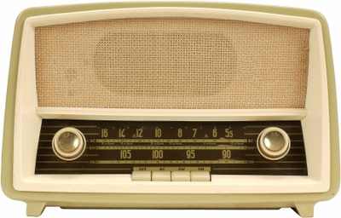
Digital vs Analog
.
Notes:
Analog: hard to get right, jiggle, can’t store.
Old radio: http://sellingtobigcompanies.blogs.com/selling/podcasts/
Sony: http://www.dlp108.com/theater-systems/sony-xdrf1hd-high-fidelity-amfm-hd-radio-tuner.html

Slide 5
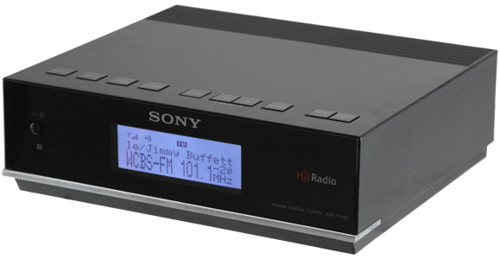
Digital vs Analog
.
Notes:
Analog: hard to get right, jiggle, can’t store.
Old radio: http://sellingtobigcompanies.blogs.com/selling/podcasts/
Sony: http://www.dlp108.com/theater-systems/sony-xdrf1hd-high-fidelity-amfm-hd-radio-tuner.html

Slide 6
Standards
A very old idea.
Sometimes there aren’t any.
But they’re very common.
And there’s a general trend in the direction of standards.

Slide 7
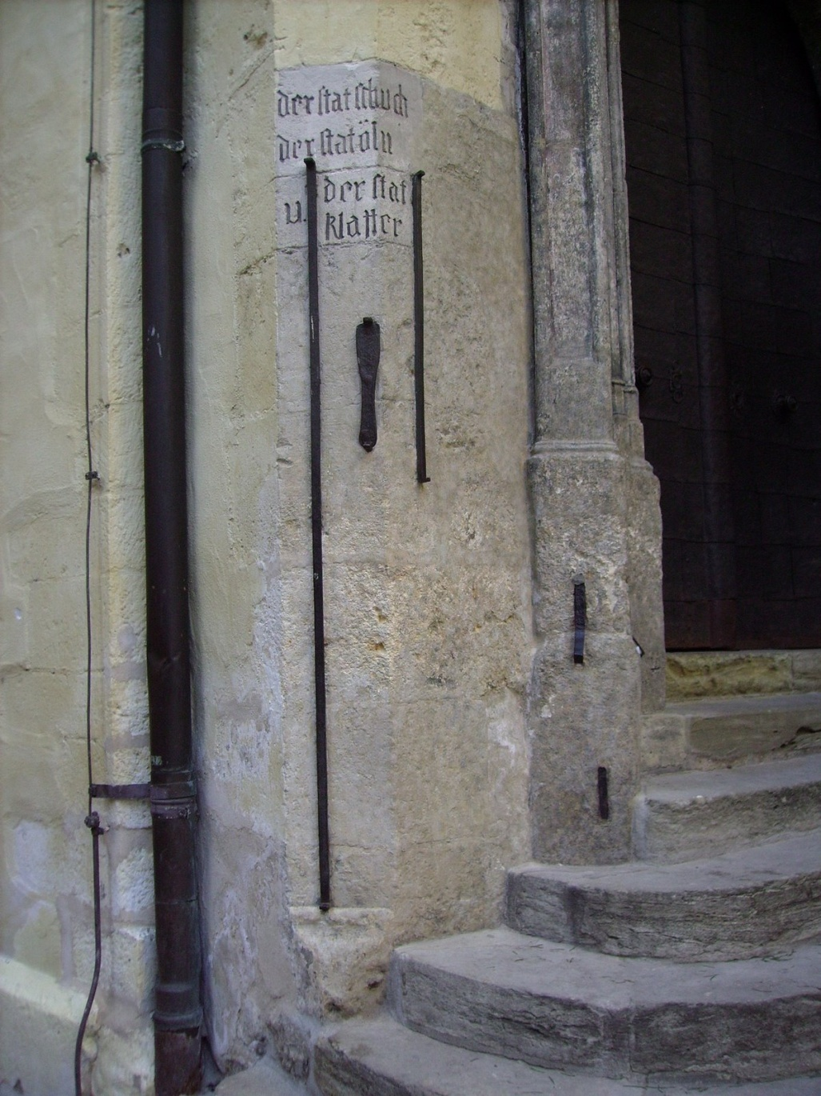
A Very Old Idea
Along the Danube River
Notes:
http://picasaweb.google.com/lh/photo/wumuAyQZash7tIq_upEDQA

Slide 8
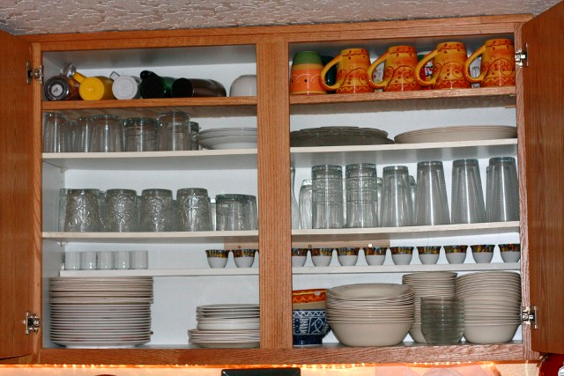
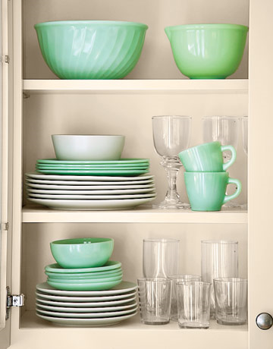
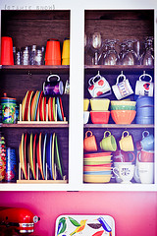
No Standards
Notes:
http://www.owlhaven.net/2010/01/05/kitchen-storage-making-the-most-of-space/
http://www.countryliving.com/homes/makeovers/country-kitchen-makeover-0306
http://fiveprime.org/hivemind/Tags/fiestaware

Slide 9
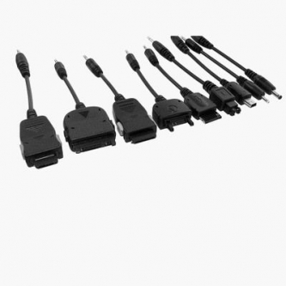
Not Much of a Standard
Notes:
But getting better
http://www.puremobile.ca/insiderblog/tag/chargers

Slide 10
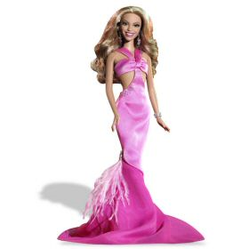
Some Common Standards
Notes:
The standard 11.5” doll. Why? For competition.
http://www.product-reviews.net/2007/08/22/toy-maker-mattel-suing-china-barbie-over-adult-site-abusing-the-name/

Slide 11
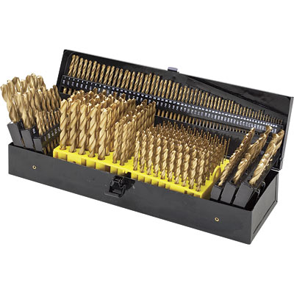
A Small Number of Standards
Notes:
Imperial vs. metric
http://www.drumsanders.net/drillbitsset-c-8_15_16.html

Slide 12
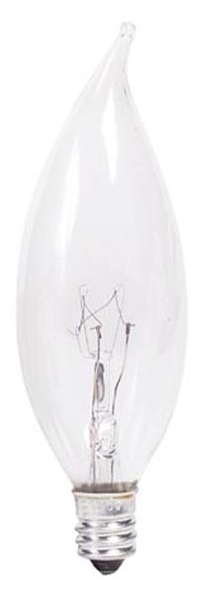
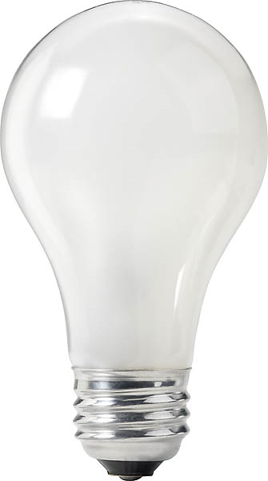
A Small Number of Standards
Notes:
Candelabra vs Edisonhttp://www.lightbulbmarket.com/product/048702_40-Watt-BA9-Philips-DuraMax-Clear-Long-Life-Bent-Tip-Candelabra-Bulb
http://stuartmillerdesign.co.uk/Other%20Services/otherservices.htm

Slide 13
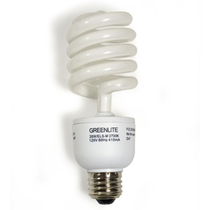
A Small Number of Standards
Notes:
Candelabra vs Edison, , even when new things are introduced, they must conform.
http://www.lightbulbmarket.com/product/048702_40-Watt-BA9-Philips-DuraMax-Clear-Long-Life-Bent-Tip-Candelabra-Bulb
http://stuartmillerdesign.co.uk/Other%20Services/otherservices.htm
http://www.seanpaune.com/2007/06/17/compact-fluorescent-light-bulb/

Slide 14
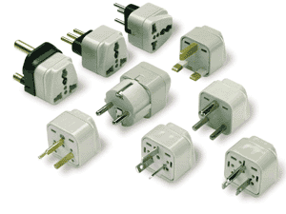
Bitten by Lack of a Single Standard
Notes:
http://www.iecee.org/whatsnew/archives/whatsnew_2004.html

Slide 15
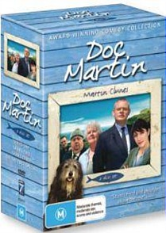
Bitten by Lack of a Single Standard
Notes:
http://www.jbhifionline.com.au/dvd/dvd-genres/tv/doc-martin-collection-7-dvd-set/373019

Slide 16
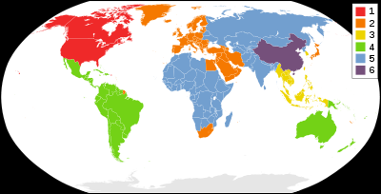
Bitten by Lack of a Single Standard
Notes:
Region codes intended to make it hard for things to be universal
http://en.wikipedia.org/wiki/DVD_region_code

Slide 17
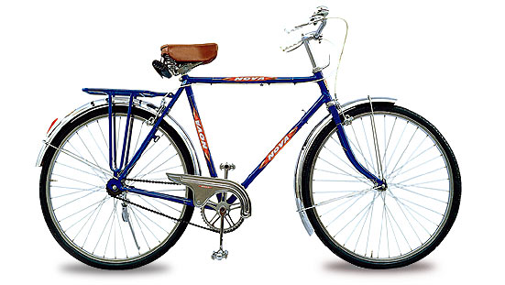
Wishing for Standards
http://www.sheldonbrown.com/tire-sizing.html
Notes:
Go to this article to see how complicated the tire size situation is.
Image: http://blogs.villagevoice.com/dailymusto/2010/11/my_rules_for_bi.php

Slide 18
A General Trend Toward Standards
Word Sizes of Early Computers
EDVAC | 44 bits | 1947
MARK 1 | 40 bits | 1948
EDSAC | 17 bits | 1949
CSIRAC | 20 bits | 1949
UNIVAC I | 12 digits | 1951
IBM 701 | 36 bits | 1952
CDC 1604 | 48 bits | 1959
CDC 6600 | 60 bits | 1964
IBM 360 | 32 bits | 1965
x-86 | 16 bits | 1978
x-32 | 32 bits | 1986
x-64 | 64 bits | 2004
Notes:
EDSAC had 18 bits but the first one wasn’t usable
CSIRAC - Australian

Slide 19
Integers
The first step is obvious:
104 0 1 1 0 1 0 0 0

Slide 20
What About Long Integers?
n! : if n = 1 then 1
else n * (n-1)!
def factorial(n):
result = 1
for j in range(1,n+1):
result = result * j
return (result)
Notes:
Remind about the range issue. Then run it. It works at least up to 10000.

Slide 21
Integers
The first step was obvious:
104 0 1 1 0 1 0 0 0
But what about this:
-104 1 1 1 0 1 0 0 0
sign bit

Slide 22
Two Problems
-104 1 1 1 0 1 0 0 0
sign bit
Two representations of 0:
Adder and subtractor have to check sign bit and branch accordingly.
The best representation:
Should make things easy for the computer.
Since people don’t matter: we’ll never see it.

Slide 23
Two’s Complement
104 0 1 1 0 1 0 0 0
-104:
1 0 0 1 0 1 1 1
Flip the bits:
Add 1:
1 0 0 1 1 0 0 0
A good explanation of why it works:
http://www.cs.cornell.edu/~tomf/notes/cps104/twoscomp.html
Notes:
Note that you have to tell me how many bits. Then use leading 0’s as necessary.
Point out that now addition and subtraction just work.

Slide 24
But What Happens Now?
11011001
+ 11100101

Slide 25
But What Happens Now?
11011001
+ 11100101
Overflow, if we stick with a fixed-length word (which Python doesn’t do)
Notes:
Python implements long integers.

Slide 26
Another Problem
What should we do about:
104.23
Notes:
Sort of like counting cents instead of dollars. But we want a more general solution.

Slide 27
Another Problem
What should we do about:
104.23
If we always want two places after . : Then we could write:
10423
And then always treat it as though the decimal point were there.
Notes:
Sort of like counting cents instead of dollars. But we want a more general solution.

Slide 28
Floating Point
We’ll do it in decimal:
Number | Floating Point
4.32 | 4.32e0
Notes:
We can solve both the fractions and the very large numbers problem in the same way.
Go to IDLE and play. You won’t get floats until you divide.
Tell them that binary works the same way.
In IDLE, import math. Then do sqrt(10). Multiply by 100000000. Then again.

Slide 29
Floating Point
We’ll do it in decimal:
Number | Floating Point
4.32 | 4.32e0
456.2 | 4.56e+2
Multiply by 10²
Notes:
We can solve both the fractions and the very large numbers problem in the same way.
Go to IDLE and play. You won’t get floats until you divide.
Tell them that binary works the same way.
In IDLE, import math. Then do sqrt(10). Multiply by 100000000. Then again.

Slide 30
Floating Point
We’ll do it in decimal:
Number | Floating Point
4.32 | 4.32e0
456.2 | 4.56e+2
.0004 | 4.0e-4
Multiply by 10⁻⁴
Notes:
We can solve both the fractions and the very large numbers problem in the same way.
Go to IDLE and play. You won’t get floats until you divide.
Tell them that binary works the same way.
In IDLE, import math. Then do sqrt(10). Multiply by 100000000. Then again.

Slide 31
Floating Point
We’ll do it in decimal:
Number | Floating Point
4.32 | 4.32e0
456.2 | 4.56e+2
.0004 | 4.0e-4
56784657846352*34526251 | 1960561349752268586352
Note: Python will create very large integers.
Notes:
We can solve both the fractions and the very large numbers problem in the same way.
Go to IDLE and play. You won’t get floats until you divide.
Tell them that binary works the same way.
In IDLE, import math. Then do sqrt(10). Multiply by 100000000. Then again.

Slide 32
Floating Point
We’ll do it in decimal:
Number | Floating Point
4.32 | 4.32e0
456.2 | 4.56e+2
.0004 | 4.0e-4
56784657846352*34526251 | 1960561349752268586352
1960561349752268586352/2 | 9.802806748761343e+20
Notes:
We can solve both the fractions and the very large numbers problem in the same way.
Go to IDLE and play. You won’t get floats until you divide.
Tell them that binary works the same way.
In IDLE, import math. Then do sqrt(10). Multiply by 100000000. Then again.

Slide 33
Rounding Error
Our balance is $1,567.38 and the interest rate is 2.8%:
>>> 156738*.028
4388.664
>>> int(_)
4388
>>>
Where did the .664 cents go?
We can force Python to round instead of truncate.

Slide 34
Rounding Error
Our balance is $1,567.38 and the interest rate is 2.8%:
>>> 156738*.028
4388.664
>>> int(_ + .5)
4389
>>>
But what about this:
>>> 166730*.05
8336.5
>>>
Notes:
If we round up all the time, we lose. If we round down all the time, the customer loses.

Slide 35
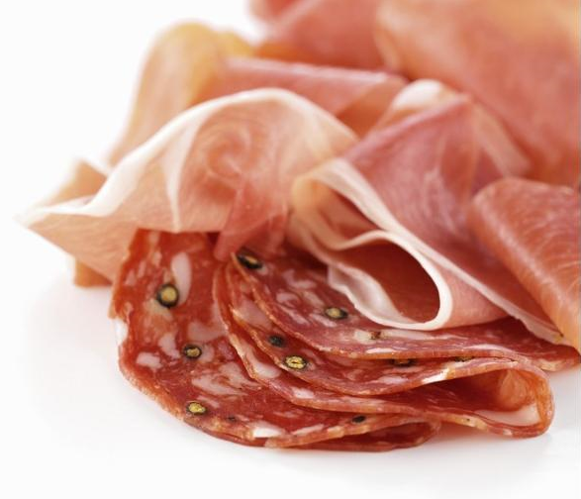
Salami Slicing
Notes:
The idea is that a lot of very thin slices add up to real money.

Slide 36
Text
Computers have revolutionized our world. They have changed the course of our daily lives, the way we do science, the way we entertain ourselves, the way that business is conducted, and the way we protect our security.

Slide 37
Text
Computers have revolutionized our world. They have changed the course of our daily lives, the way we do science, the way we entertain ourselves, the way that business is conducted, and the way we protect our security.
Les ordinateurs ont révolutionné notre monde. Ils ont changé le cours de notre vie quotidienne, notre façon de faire la science, la façon dont nous nous divertissons, la façon dont les affaires sont menées, et la façon dont nous protégeons notre sécurité.

Slide 38
Text
Computers have revolutionized our world. They have changed the course of our daily lives, the way we do science, the way we entertain ourselves, the way that business is conducted, and the way we protect our security.
Les ordinateurs ont révolutionné notre monde. Ils ont changé le cours de notre vie quotidienne, notre façon de faire la science, la façon dont nous nous divertissons, la façon dont les affaires sont menées, et la façon dont nous protégeons notre sécurité.
計算機已經徹底改變我們的世界。當然，他們已經改變了我們的日常生活中，我們這樣做科研，我們自娛自樂的方式，經營的方式進行的方式，以及我們保護我們的安全。

Slide 39
Representing Text
Decide how many characters we need to represent.
Determine the required number of bits.
ASCII: 7 bits. Can encode 2⁷ = 128 different symbols.
  At the time (1963), it was felt that this was enough.
  Much concern about data transmission speed.
  The 8th bit, if available, could be used for a parity bit.

Slide 40
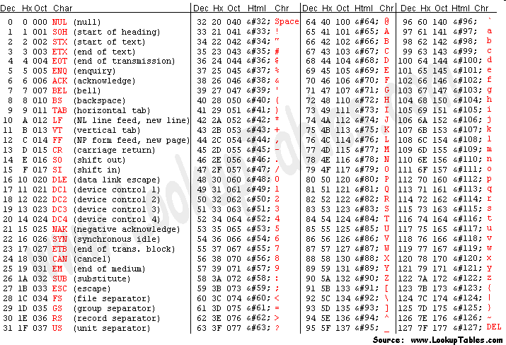
ASCII
http://www.krisl.net/cgi-bin/ascbin.pl
Notes:
http://www.asciitable.com/ Note that most of the control codes are obsolete now.

Slide 41
Representing Text
Fourscore and seven …
F o u r
01000110 01101111 01110101 01110010

Slide 42
Representing Text
T h e n u m b e r i s 1 7 .
54 68 65 20 6E 75 6D 62 65 72 20 69 73 20 31 37 2E

Slide 43
Computing with Text
Suppose we want to capitalize this entire paragraph:
Computers have revolutionized our world. They have changed the course of our daily lives, the way we do science, the way we entertain ourselves, the way that business is conducted, and the way we protect our security.
Let’s go back and look at the ASCII table to see how to do that.
Notes:
Add Octal 40 to all the letters (but not the punctuation). Show how to do it in Python. If st has a string, then use st.upper().

Slide 44
Computing with Text in Python
chr(65)
ord('A')
ord('A') + 32
st = chr(_)
mystuff = 'Now is the time ')
mystuff.upper()

Slide 45
When We Need More Characters
What about things like:
简体字
Notes:
Chinese string means “simple writing”

Slide 46
When We Need More Characters
What about things like:
简体字
Answer: Unicode
A conversion applet:
http://www.pinyin.info/tools/converter/chars2uninumbers.html
Notes:
Chinese string means “simple writing”

Slide 47
Unicode
Unicode lists 1,114,112 code points in the range:
0₁₆ to 10FFFF₁₆
divided into seventeen planes:
the basic multilingual plane, and
16 supplementary planes),
each with 65,536 (= 2¹⁶) code points.
http://www.unicode.org/charts/

Slide 48
Unicode
There exist different ways of mapping those 1,114,112 code points to specific byte patterns.
In December, 2007 UTF-8 surpassed Ascii on the Web.
Watch them stream by:
http://www.babelstone.co.uk/Unicode/unicode.html
Notes:
Good summary of history of character encodings: http://coding.smashingmagazine.com/2012/06/06/all-about-unicode-utf8-character-sets/
Why not just do them in order using 4 bytes each? Because then standard Roman alphabet takes 4 times the space it takes in ASCII.

Slide 49
Saving Space
Key idea: Common things should be short.
Natural languages evolve to do this.
Examples:
http://www.paulnoll.com/Books/Clear-English/English-3000-common-words.html
Notes:
Look at list of 500 most common words in English

Slide 50
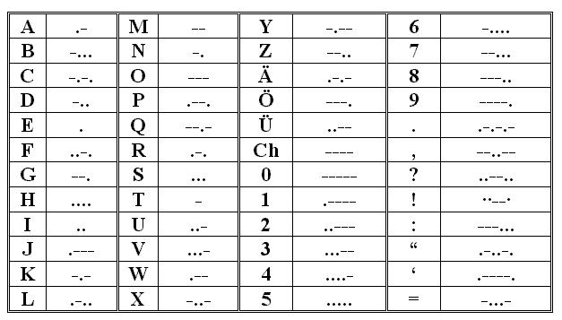
Saving Space
Key idea: Common things should be short.
Samuel Morse:
Notes:
http://homepage.ntlworld.com/dmitrismirnov/MorseMusic.html

Slide 51
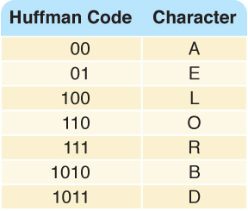
Saving Space
Key idea: Common things should be short.
Huffman coding:
Notes:
Tradeoff: how much space do we save vs time to decode? Also, is error checking harder?

Slide 52
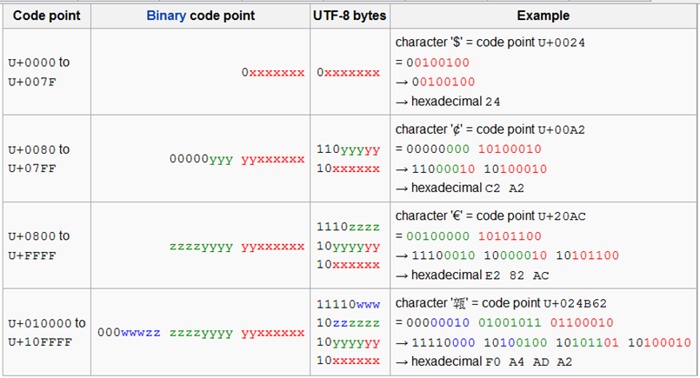
Saving Space
Key idea: Common things should be short.
UTF-8 encoding of Unicode
http://en.wikipedia.org/wiki/UTF-8
Notes:
So the first 128 characters (US-ASCII) need one byte. The next 1,920 characters need two bytes to encode. This includes Latin letters with diacritics and characters from the Greek, Cyrillic, Coptic, Armenian, Hebrew, Arabic, Syriac and Tāna alphabets. Three bytes are needed for the rest of the Basic Multilingual Plane (which contains virtually all characters in common use). Four bytes are needed for characters in the other planes of Unicode, which include less common CJK characters and various historic scripts.

Slide 53
But What Do Symbols Look Like?
Computers have revolutionized our world.
Computers have revolutionized our world.
Computers have revolutionized our world.
Computers have revolutionized our world.
Computers have revolutionized our world.

Slide 54
The Basic Idea
results = google(text, query)
Notes:
So we keep the text in a form that is suitable for all these operations.
But what does a font look like?

Slide 55
The Basic Idea
results = google(text, query)
if word_count(text) > 5000:
return(“Done!!”)
else:
return(“No sleep yet.”)
Notes:
So we keep the text in a form that is suitable for all these operations.
But what does a font look like?

Slide 56
The Basic Idea
results = google(text, query)
if word_count(text) > 5000:
return(“Done!!”)
else:
return(“No sleep yet.”
display = render(text, font)
Notes:
So we keep the text in a form that is suitable for all these operations.
But what does a font look like?

Slide 57
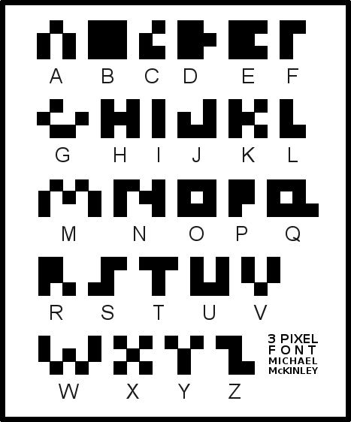
Pixel Based Fonts
Notes:
http://mckgyver.pbworks.com/w/page/20654171/Sharkskin_Plastic_Extruder

Slide 58
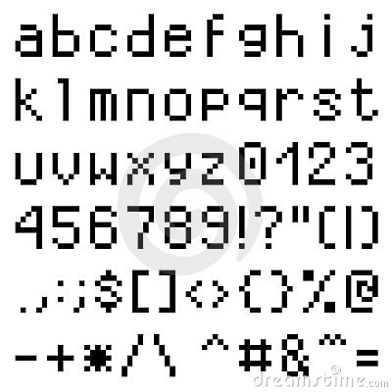
Pixel Based Fonts
Notes:
This is much better. But there are still issues of scalability.
http://www.dreamstime.com/royalty-free-stock-photo-lower-case-pixel-font-image6323035

Slide 59
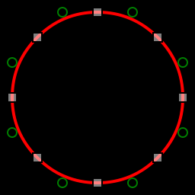
TrueType Fonts
Each symbol is represented as a set of lines and Bézier curves:
Then code associated with each display device turns the description into pixels or rasters as necessary.
So a font is just another file of bits.
Notes:
http://en.wikipedia.org/wiki/File:Circle_and_quadratic_bezier.svg Go to Control Panel and look at them.

Slide 60
The First Part of the Arial TrueType Font File
???????pDSIG$=ùç?Œ??|GDEF^#]r?u???¦GSUBÕðÝÌ?uÀ?? ªJSTFm*i?l???LTSH€eú<??x??ŽOS/2ß2k??ø???VPCLTý{>C?tà???6VDMXP’jõ??#??”cmapç@j:??ÑÄ??jcvt –*Òv??ú ??0fpgmÌyYš??é0??ngasp?? ?tÐ???glyf÷ì?ü?çbhdmx¾»Ã—??4œ??(headÎ˜&’??|???6hhea3ÿ??´???$hmtx4X@??P??(kern7a96?`??`locaai2??Ð??,maxp
G¨??Ø??? nameÀòe;?À??
posté×~?2Ð??AÿprepRþÄé??ï ??
ÿ??????æèºê_<õ?????¢ã'*????¹Õ´öú¯ýg???? ????????? >þN?C?ú¯þ&????????????????Š???Š????v? ???/?V??
ÿ???ˆ???š3??š3??Ñ?f
??z‡€??????????Mono?@? ÿüÓþQ3 >²@?ÿÿÿ??????????9??9??9?°×?^s?s?I ?wV?X‡?Zª?|ª?|?@¬?r9?ªª?A9?º9??s?Us?ßs?<s?Vs?s?Us?Ms?as?Ss?U9?¹9?ª¬?p¬?r¬?ps?Z?oVÿýV?–Ç?fÇ?žV?¢ã?¨9?mÇ?¤9?¿??7V?–s?–ª?˜Ç?œ9?cV?ž9?XÇ?¡V?\ã?0Ç?¡V? ?V? V?ã?)9?‹9??9?'Á?6sÿáª?Ys?Js?†??Ps?Fs?K9?s?Bs?‡Ç?ˆÇÿ¢??ˆÇ?ƒª?‡s?‡s?Ds?‡s?Hª?…???9?$s?ƒ??Ç?????!??(¬?9?¼¬?/¬?WVÿýVÿýÇ?hV?¢Ç?œ9?cÇ?¡s?Js?Js?Js?Js?Js?J??Ps?Ks?Ks?Ks?K9?½9?#9ÿå9? s?‡s?Ds?Ds?Ds?Ds?Ds?ƒs?ƒs?ƒs?ƒs?I3?€s?ks?s?QÍ?mL?ã?™å?å???áª?Þª?=d?N??9?S´?šd?Nd?Md?Msÿýœ? ô?8´?z–?¡d??1??ö?/ì?-%? ?Dã?ã?žª?è¬?rd?Ts?.d?3å?s?†s?Œ??ïVÿýVÿý9?c?? ?Rsÿü

Slide 61
It’s Just About Using the Bits
What is this?
http://www.cs.utexas.edu/~ear/cs302/Encoding.doc
Notes:
There are just lots of bits until there’s a pdf viewer that knows what to do with them.

Slide 62
It’s Just About Using the Bits
What is this?
http://www.cs.utexas.edu/~ear/cs302/Encoding.doc
Answer:
http://www.cs.cmu.edu/afs/cs/usr/wing/www/publications/Wing06.pdf
Notes:
There are just lots of bits until there’s a pdf viewer that knows what to do with them.

Slide 63
It’s Just About Using the Bits
What is this?
http://www.cs.utexas.edu/~ear/cs302/Encoding.doc
Answer:
http://www.cs.cmu.edu/afs/cs/usr/wing/www/publications/Wing06.pdf
Because:
PDF is a standard.
Notes:
There are just lots of bits until there’s a pdf viewer that knows what to do with them.

Slide 64
Images
Vector graphics
      http://www.vecteezy.com/
Raster (bit mapped) graphics
Notes:
Vector works well when the image can be described as a composite of lines and other basic shapes. Easy to render in different colors. Easy to scale. But, to display on a bit mapped screen, must be converted to bitmap. Doesn’t work well for photos, which don’t tend to have regular regions. Click link to see examples of good vector graphics.

Slide 65
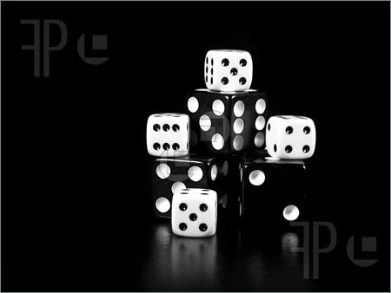
Images
Notes:
http://www.featurepics.com/online/Black-White-Dice-Stacked-Picture398297.aspx

Slide 66
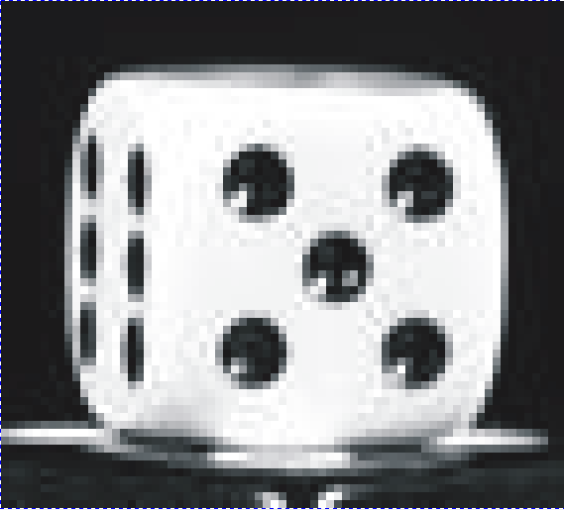
Pixels

Slide 67
Pixels
Now we must turn this 2-dimensional bit matrix into a string of bits.

Slide 68
Pixels
0000110000 0001111000 0011111100
0111111110 0111111110 0111111110
0111001110 0111001110 0111001110 0111001110

Slide 69
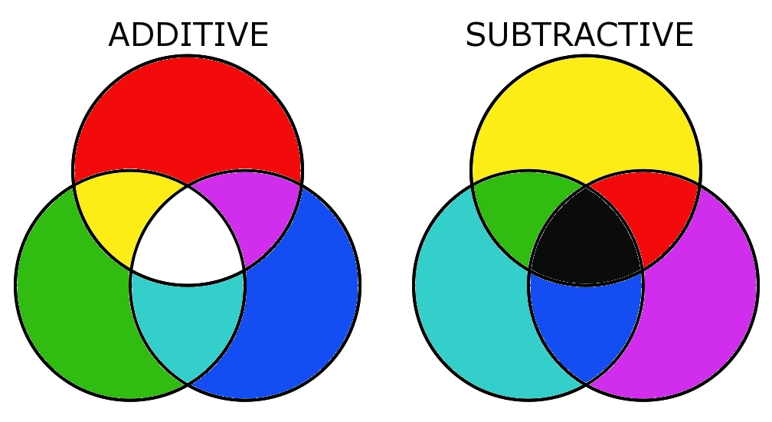
Two Color Models
Notes:
http://lucaskrech.com/blog/index.php/2010/01/22/color-theory-basics-additive-and-subtractive-color-mixing/

Slide 70
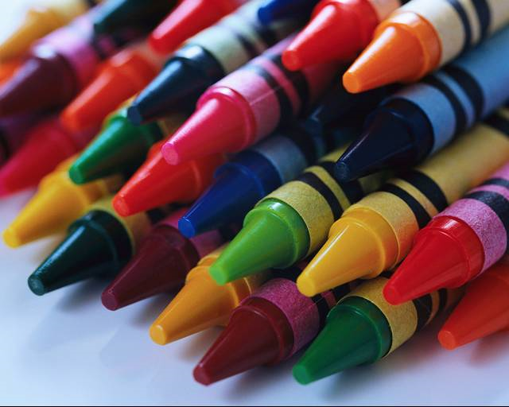
Subtractive Color
More generally: Pigments
Let’s try it: http://www.jgiesen.de/ColorTheory/CMYColorApplet/cmycolorapplet.html
Notes:
http://jennifergeldard.wordpress.com/2009/05/20/crayons/

Slide 71
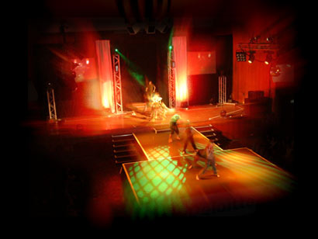
Additive Color
More generally: Any light, including computer screens and tvs
Notes:
http://www.theatre-lighting-hire.co.uk/stage_lighting/stage_lighting.php

Slide 72
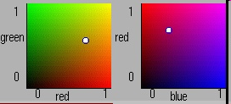
Experimenting with RGB
http://www.jgiesen.de/ColorTheory/RGBColorApplet/rgbcolorapplet.html
http://easycalculation.com/color-coder.php
Notes:
First app is java. First control holds blue at 0. Second one hold green at 0. From: http://hydra.nac.uci.edu/~wiedeman/cspace/me/inforgb.html
Second app isn’t.

Slide 73

Burnt Orange
CC5500
http://www.jgiesen.de/ColorTheory/RGBColorApplet/rgbcolorapplet.html
http://easycalculation.com/color-coder.php

Slide 74
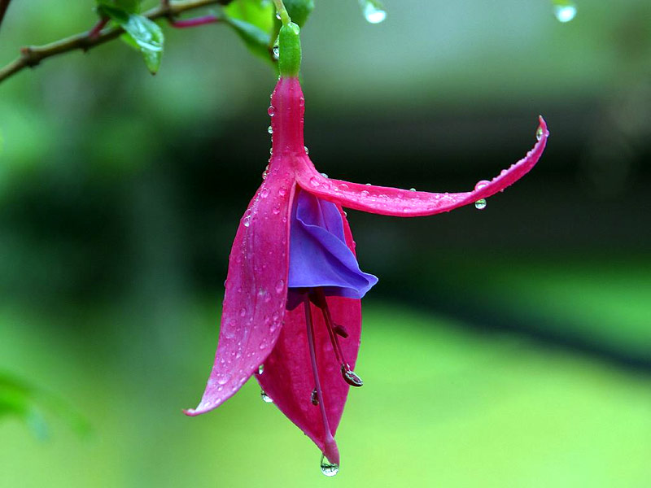
Representing Images

Slide 75
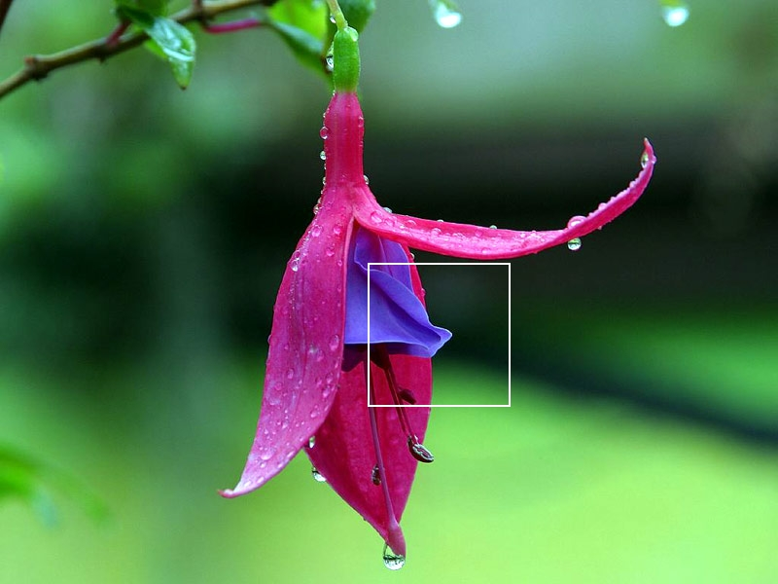
Representing Images

Slide 76
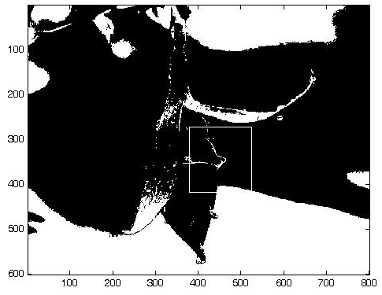
Black and White

Slide 77
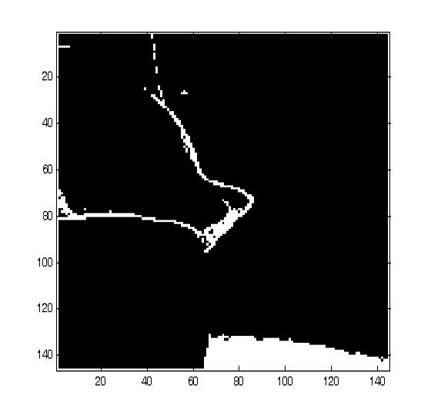
Black and White
How many bits per pixel?
Notes:
2

Slide 78
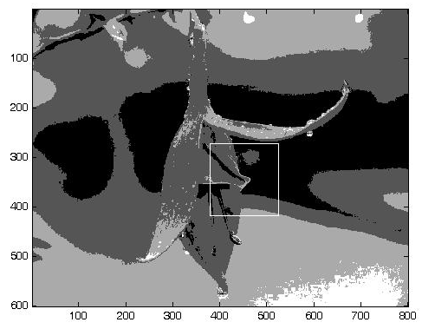
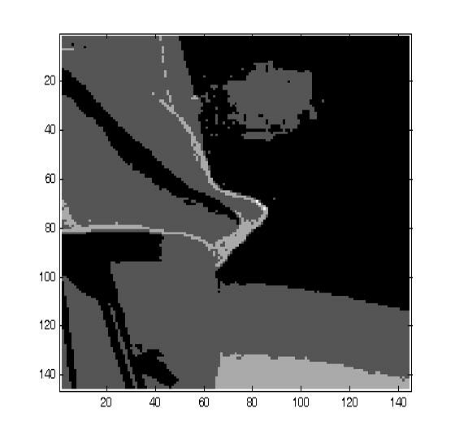
Black and White
How many bits per pixel?

Slide 79
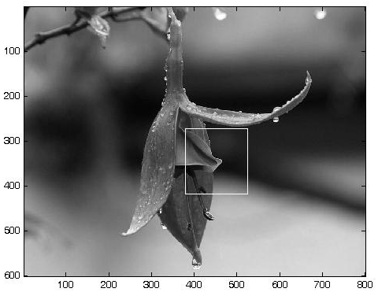
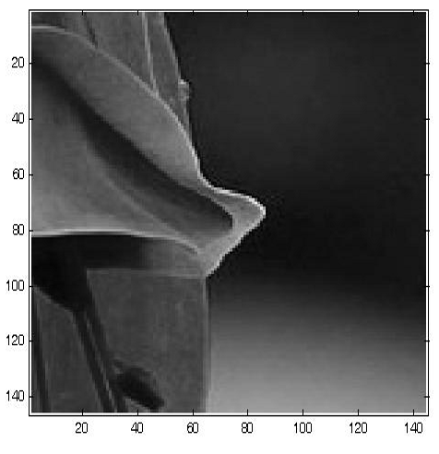
Black and White
How many bits per pixel?
Notes:
8 bit gray scale.

Slide 80
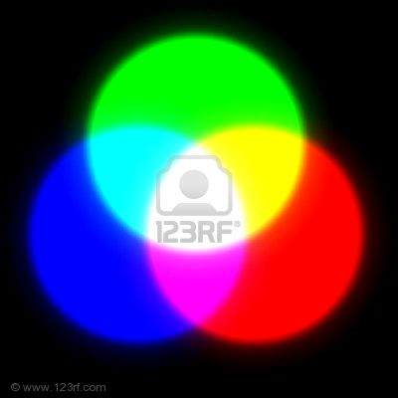
Color
Think of three lights:
  Red
  Blue
  Green
For each pixel, we will specify how much of each.
The more bits for each such number, the more colors we can get.
24 bits is standard, so 8 bits per channel.
Notes:
Remind: White means all of everything. Black means no light.

Slide 81
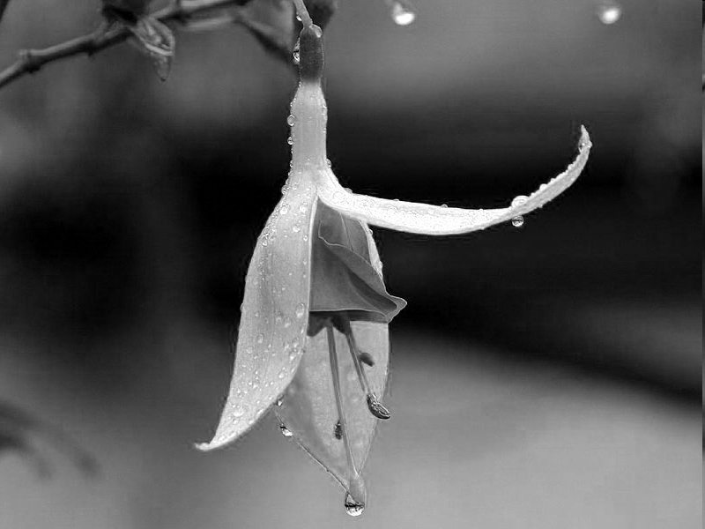

The Red Channel
Each pixel has a value in the range 00 to FF.

Slide 82
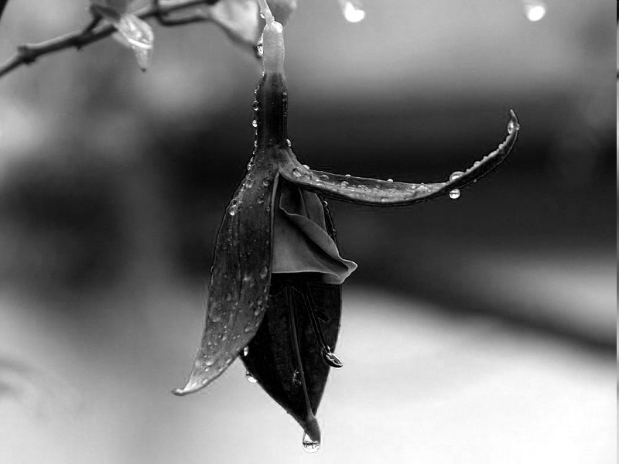

The Green Channel
Each pixel has a value in the range 00 to FF.

Slide 83
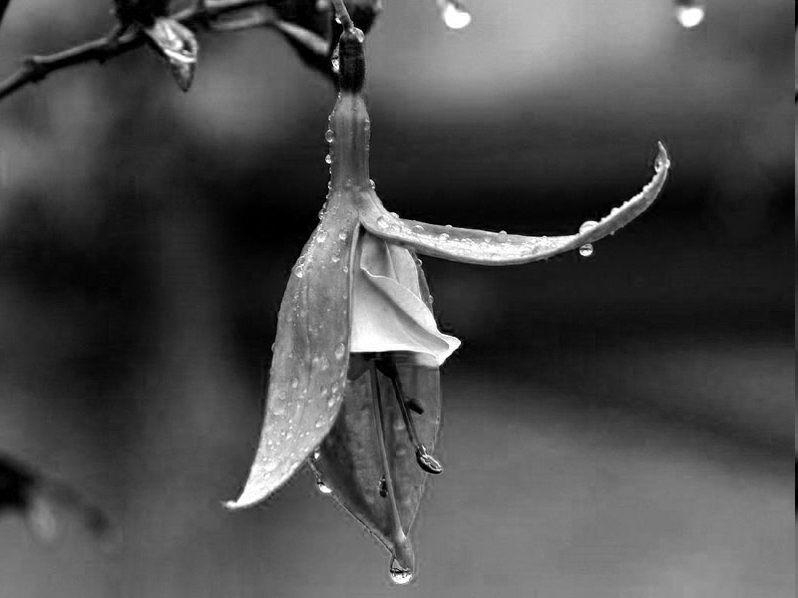
The Blue Channel
Each pixel has a value in the range 00 to FF.

Slide 84
Putting the Three Channels Together
000000
Each pixel has a value in the range 00 to FF.
Notes:
Why no FFFFFF? Because no white in picture

Slide 85
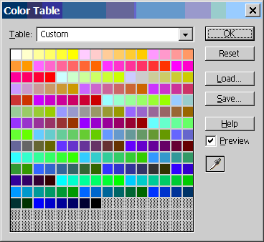
What if We Don’t Want to Spend 24 Bits/Pixel?
The gif file format uses 8 bits.
Those bits index into a palette:
Notes:
Pretty much obsolete now that everyone has 24 bit video cards. But an interesting example of compromises that get made at particular technology points. Note that there aren’t enough blues to make the gradual bar across the top. This was a standard “web safe” palette used back in the day.
http://www.scantips.com/palettes.html

Slide 86
The Original Again
Notes:
Here’s the original.

Slide 87
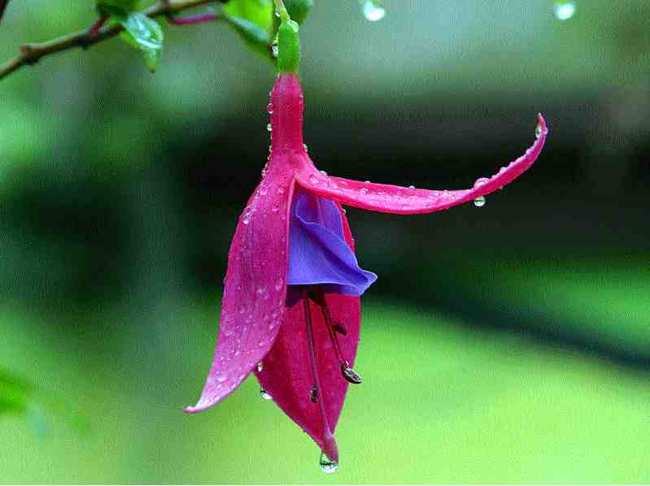
8 Bit Color with a Palette (gif)
Notes:
See what we lose with only 8 bits.

Slide 88
Compression
Lossless
Lossy

Slide 89
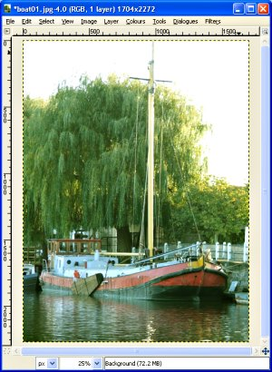
Compression
Lossless
FFFFFF FFFFFF FFFFFF FFFFFF FFFFFF FFFFFF FFFFFF FFFFFF FFFFFF FFFFFF FFFFFF
Notes:
Boat picture: http://www.gregtutor.plus.com/digphoto/levels.html
No need to replicate all those identical pixels. Just indicate how many there are.

Slide 90
Compression
Lossless
Lossy
  Example: jpeg

Slide 91
JPEG
628 KB

Slide 92
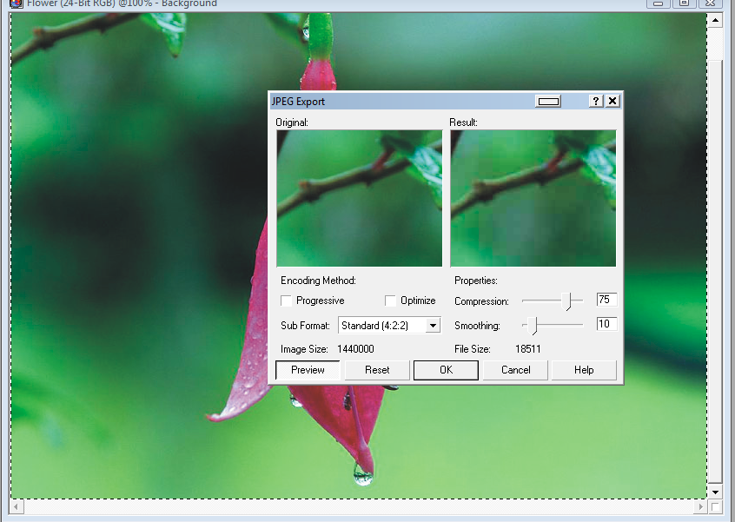
JPEG

Slide 93

JPEG
19KB

Slide 94
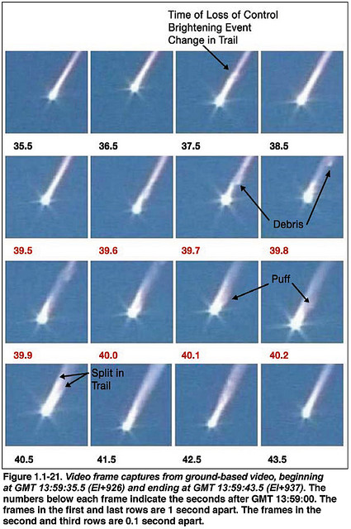
Video
Notes:
Note how similar one frame is to the next. Now compression is critical.
http://www.flickr.com/photos/badastronomy/3150922619/

Slide 95
Video - Why Compression is Key
Assume a 640 x 480 pixel screen. = 307,200 pixels
      (I’m currently using 1280 x 800.)
Assume 24 bit color. = 921,600 bytes/frame
Assume 30 frames/second. = 27,648,000 bytes/sec
= 1,658,889,000 bytes/min
= 100 GB/hour (without sound)
Yet the 16GB iPod Touch holds 20 hours of video.
Notes:
The numbers argument comes from Charles Petzold, Code p. 379
iPod number: http://wiki.answers.com/Q/How_many_songs_and_movies_could_you_fit_on_a_16GB_ipod_touch_or_a_32GB_ipod_touch

Slide 96

MPEG
Key idea: Store only the changes from one frame to the next.
Notes:
MPEG – Moving Pictures Expert Group
http://www.roughlydrafted.com/RD/RDM.Tech.Q1.07/6FFE4614-E1AB-45C7-8611-19D06ECCAD9F.html

Slide 97

MPEG
Key idea: Store only the changes from one frame to the next.
Notes:
More compact, but way less redundancy.
Example of what happens if the reference frame packet is lost.
http://www.tmworld.com/article/325225-IPTV_Video_s_latest_test_frontier.php

Slide 98

Sound
A good introduction to sound waves:
http://www.school-for-champions.com/science/sound.htm
Notes:
A vibrating object produces waves of vibrating air. The ear picks up the vibrations.
http://www.privateline.com/TelephoneHistory/speech.jpg

Slide 99


The Simplest Sound
A sine wave:
Notes:
See the relationship between what the air is doing and the wave that we draw.
http://library.thinkquest.org/06aug/02101/physics_soundwaves.htm

Slide 100

More Interesting Sounds
The amplitude is how much the material is compressed (loudness).
The wavelength is the time between maximal compressions (pitch, usually measured as frequency, the inverse of wavelength).
Notes:
http://library.thinkquest.org/06aug/02101/images/Sine2xWave.jpg

Slide 101

Analog Representation of Sound
How does it work:
http://www.youtube.com/watch?v=6Td03cIpAF8
Notes:
http://www.thundersquee.com/wp-content/uploads/2009/09/old_rocker_dude_vinyl_record_ornament_photosculpture-p1535574711764372443s98_400.jpg

Slide 102


Analog/Digital Representation of Sound
How does a CD work:
http://www.youtube.com/watch?v=5YLqwTqpDhA
Notes:
http://www.thundersquee.com/wp-content/uploads/2009/09/old_rocker_dude_vinyl_record_ornament_photosculpture-p1535574711764372443s98_400.jpg
CD: https://www.google.com/search?hl=en&site=imghp&tbm=isch&source=hp&biw=1280&bih=654&q=compact+disc&oq=compact+disc&gs_l=img.12...0.0.1.14801.0.0.0.0.0.0.0.0..0.0.ernk_timediscountb..0.0...1..2.img.SOXGBoyFJpY#imgrc=E_zJRMO_pFC8VM%3A%3BElQ8xiW0LCgmDM%3Bhttp%253A%252F%252Fwww.freefoto.com%252Fimages%252F11%252F12%252F11_12_9---Compact-Disc_web.jpg%3Bhttp%253A%252F%252Fwww.freefoto.com%252Fpreview%252F11-12-9%252FCompact-Disc%3B600%3B400

Slide 103

Sound
Digitizing sound
Notes:
http://volga.eng.yale.edu/uploads/Main/soundwave.png

Slide 104

Sound
What happens if we don’t sample frequently enough?
Notes:
http://help.adobe.com/en_US/Soundbooth/2.0/images/da06.png

Slide 105
Sound
What happens if we don’t sample frequently enough?
We can hear up to about 22,000 cycles per second (22kHz).
So we need to sample at about 44 kHz (the Nyquist rate).
http://www.youtube.com/watch?v=4zpmjhue_bs
Notes:
Nyquist frequency is half the sampling rate – point where the sound appears to fold – this youtube is a cool demonstration. Keep sampling rate fixed. Go through sine wave with increasing frequency (starting well below half of sampling rate). The pitch appears to go up until it hits half the sampling rate. Then it appears to go down.
http://help.adobe.com/en_US/Soundbooth/2.0/images/da06.png

Slide 106
Sound
So we need to sample at about 44 kHz.
How many bits do we need per sample?
96 decibels is about the range between:
“can barely hear” and “physical pain”.
How loud is 1 db?
http://www.animations.physics.unsw.edu.au/jw/dB.htm
But db is a logarithmic scale. So high values correspond to VERY high amplitudes.
Notes:
The number 96 and the numbers on the following slides come from Charles Petzold, Code, p. 377ff

Slide 107

Sound
So we need to sample at about 44 kHz.
How many bits do we need per sample?
Bit depth | Quality level | Amplitude values | Dynamic range
8‑bit | Telephony | 256 | 48 dB
16‑bit | CD | 65,536 | 96 dB
24‑bit | DVD | 16,777,216 | 144 dB
32‑bit | Best | 4,294,967,296 | 192 dB
Notes:
http://help.adobe.com/en_US/Soundbooth/2.0/WS41FBD92E-39EA-4eda-B490-EDE8EA1175C8a.html

Slide 108

Sound
So we need to sample at about 44 kHz.
We need 2 bytes/sample for CD quality.
So:
Mono | 44,100 * 2 | 88,100 bytes/sec
Stereo | 44,100* 2 * 2 | 176,400 bytes/sec
 |  | 10,584,000 bytes/min
 |  | 783,216,000 bytes/74 min
 |  | 783 MB/74 min
Recall:
IBM 360/67, in 1970:
2 MB.
Notes:
These numbers come from Charles Petzold, Code, p. 377ff

Slide 109


Storing Sound
=
Notes:
How high is the stack that corresponds to an iPod?
Records: http://www.istockphoto.com/file_thumbview_approve/4301538/2/istockphoto_4301538-stack-of-old-scratched-45rpm-records.jpg

Slide 110


Storing Sound
=
16 GB ≈ 4,000 songs
2,000 records
Notes:
Assume each record is 1/16” thick, 125” = about 10’ = about one story.
Records: http://www.istockphoto.com/file_thumbview_approve/4301538/2/istockphoto_4301538-stack-of-old-scratched-45rpm-records.jpg
Triceratops: http://i6.photobucket.com/albums/y231/eternalrecluse/rttriceratops.jpg

Slide 111
Once Sampled, It’s All Bits
So, we can:
Store
Replay
Transmit
Speed it up
Make it sound like a different instrument
Analyze it to understand speech

Slide 112
The Special Case of Music
Representing the score (DARMS)
Representing the notes, the voices, the amplitude, etc. (MIDI)
Recording the actual sound (MP3)
Notes:
If we want to compose it, play it, etc. we want a more abstract model than exact physical sounds. Also note that the more abstract, the smaller the files.

Slide 113

DARMS Representation of Musical Score
Bartok, String Quartet No. 4, measures 1 – 6.
Notes:
This notation supports printing the score.
http://books.google.com/books?id=81_KSO-VWTQC&pg=PA752&lpg=PA752&dq=DARMS+music+example&source=bl&ots=GA299ksg8i&sig=epBk01j7_TkTxM9o2EA3_D8RChY&hl=en&ei=r3NQTZaeEobEgQeAodEY&sa=X&oi=book_result&ct=result&resnum=1&ved=0CBYQ6AEwAA#v=onepage&q=DARMS%20music%20example&f=false

Slide 114

DARMS Representation of Musical Score
Notes:
http://books.google.com/books?id=81_KSO-VWTQC&pg=PA752&lpg=PA752&dq=DARMS+music+example&source=bl&ots=GA299ksg8i&sig=epBk01j7_TkTxM9o2EA3_D8RChY&hl=en&ei=r3NQTZaeEobEgQeAodEY&sa=X&oi=book_result&ct=result&resnum=1&ved=0CBYQ6AEwAA#v=onepage&q&f=false

Slide 115
MIDI
Tell a synthesizer what notes to play when.
Separately tell it what instruments to play on.
Play a MIDI file on different instruments:
http://sunsite.univie.ac.at/Mozart/dice/midiedit.cgi
See what a MIDI file contains: http://www.sonicspot.com/guide/midifiles.html
Notes:
Scroll down til you can enter the numbers for the instruments.

Slide 116

Web Pages
Notes:
Show a page, then the html. The point is that there are conventions and progams that agree to use them.

Slide 117
The HTML
<!DOCTYPE html PUBLIC "-//W3C//DTD XHTML 1.0 Transitional//EN" "http://www.w3.org/TR/xhtml1/DTD/xhtml1-transitional.dtd">
<html xmlns="http://www.w3.org/1999/xhtml">
<head>
<meta http-equiv="Content-Type" content="text/html; charset=iso-8859-1" />
<meta name="verify-v1" content="ItY/sHkwIRAAb87RkiU3Px7sSC9ZKfDw0+Qesj0p1FI=" />
<title>Automata, Computability and Complexity: Theory &amp; Applications</title>
<link href="style/style.css" type="text/css" media="all" rel="stylesheet" />
</head>
<body>
<div id="envelope">
<div id="container">
<div id="titleblock"><a href="index.html"><img src="images/title.gif" alt="Automata, Computability, and Complexity: Theory and Applications by Elaine Rich" /></a></div>
<div id="menublock"><img src="images/menu/section.png" alt="Section" style="width: 137px; height: 39px;" /><img src="images/menu/chapter.png" alt="Chapter" style="width: 138px; height: 39px;" /><img src="images/menu/link.png" alt="Link" style="width: 137px; height: 39px;" /><a href="students.html"><img src="images/menu/students.png" alt="Information for students" style="width: 129px; height: 39px;" class="domroll images/menu/students_r.png" /></a><a href="instructors.html"><img src="images/menu/instructors.png" alt="Information for instructors" style="width: 129px; height: 39px;" class="domroll images/menu/instructors_r.png" /></a><a href="errata.html"><img src="images/menu/errata.png" alt="Errata" style="width: 129px; height: 39px;" class="domroll images/menu/errata_r.png" /></a></div>
<div id="contentblock">

Slide 118
Markup Languages More Generally
Notes:
From Snyder, Chapter 8, p. 238

Slide 119

Graphic User Interfaces (GUIs)
How does something like this work?
http://www.easternaviationfuels.com/rep_map.php
Notes:
The map is pixels. The mouse controlled picks up the x,y coordinates of wherever you click. Thus it knows where on the map.

Slide 120

Chess Boards
Forsythe-Edwards Notation
rnbqkbnr/pppppppp/8/8/8/8/PPPPPPPP/RNBQKBNR w KQkq - 0 1
http://en.wikipedia.org/wiki/Forsyth-Edwards_Notation

Slide 121


Molecules
Notes:
http://en.wikipedia.org/wiki/MDL_Molfile
http://www.physics.sfsu.edu/~mugawa/molecule.html

Slide 122


Proteins
Notes:
In nature with amino acids. For computers, they’re just character strings.
Protein in color: http://www.mpsciences.com/index-2.html
Strand: http://www.ispub.com/journal/the_internet_journal_of_endocrinology/volume_4_number_1_16/article_printable/insulin_detemir_and_its_unique_mechanism_of_action.html

Slide 123

How Does Nature Do It?
A gene (a fragment of DNA) is composed of a sequence of nucleotides.
There are four nucleotides. So we’re using base 4 (but instead of 0, 1, 2, 3, we use T, A, G, C).
There are 20 standard amino acids.
So how many “digits” do we need to specify one?
Notes:
2 digits gives us just 16 values. So we need 3.
http://dna.microbiologyguide.com/516-components-of-dna-chemical-macromolecules-nucleotides/

Slide 124

How Does Nature Do It?
So there’s redundancy.
http://en.wikipedia.org/wiki/Genetic_code
Notes:
http://en.wikipedia.org/wiki/Genetic_code
Scroll down to the see the table of encodings. See why many mutations have no effect.

Slide 125
How Programs Do It?
It’s just a string:
AUGACGGAGCUUCGGAGCUAG
Notes:
Do we even need a whole byte for each symbol?
http://en.wikipedia.org/wiki/Genetic_code

Slide 126

The Human Genome Project
3.3 billion base-pairs
2 bits/pair
825 MB
Notes:
Chromosomes: http://rameshgar.blogspot.com/
Numbers: http://en.wikipedia.org/wiki/Human_Genome_Project
CD : http://the-human-genome-project.blogspot.com/2009/06/human-genome-project-cd-rom-multimedia.html

Slide 127

The Human Genome Project
3.3 billion base-pairs
2 bits/pair
825 MB
Notes:
Chromosomes: http://rameshgar.blogspot.com/
Numbers: http://en.wikipedia.org/wiki/Human_Genome_Project
CD : http://the-human-genome-project.blogspot.com/2009/06/human-genome-project-cd-rom-multimedia.html

Slide 128

What Happens When You Double Click?

Slide 129

A .ppt Saved as a .txt File

Slide 130

Saved as a .ppt File

Slide 131

UPCs
Digit | L Pattern | R Pattern
0 | 0001101 | 1110010
1 | 0011001 | 1100110
2 | 0010011 | 1101100
3 | 0111101 | 1000010
4 | 0100011 | 1011100
5 | 0110001 | 1001110
6 | 0101111 | 1010000
7 | 0111011 | 1000100
8 | 0110111 | 1001000
9 | 0001011 | 1110100
The UPC encodes 12 decimal digits as SLLLLLLMRRRRRRE, where S (start) and E (end) are the bit pattern 101, M (middle) is the bit pattern 01010 (called guard bars), and each L (left) and R (right) are digits, each one represented by a seven-bit code. This is a total of 95 bits. The bit pattern for each numeral is designed to be as little like the others as possible, and to have no more than four consecutive 1s or 0s in order. Both are for reliability in scanning.
Notes:
http://en.wikipedia.org/wiki/Universal_Product_Code

Slide 132

UPCs
Campbell’s Chicken Noodle Soup
Notes:
Charles Petzold, The Hidden Langauge of Computer Hardware and Software, p. 79-80

Slide 133

QR Codes
Let’s generate one: http://qrcode.kaywa.com/
Notes:
http://en.wikipedia.org/wiki/File:QR_Code_Structure_Example_2.svg
Developed at Toyota, so in native mode supports numeric, alphanumeric, binary and Kanji.

Slide 134

Visualizing Data
http://www.stanford.edu/group/spatialhistory/cgi-bin/site/viz.php?id=265
Notes:
Since it’s all bits, we can massage the data and then figure out how to display them.

