Slide 1
Imitation Learning from Video by Leveraging Proprioception
Faraz Torabi*, Garrett Warnell^, Peter Stone*
*University of Texas at Austin,
^Army Research Laboratory

Slide 2
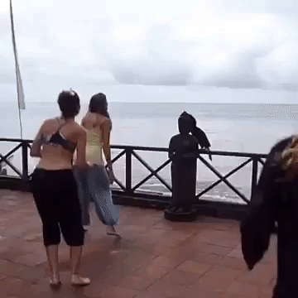
What is Imitation from Observation?

Slide 3
Related Work
Time Contrastive Networks [Sermanet et al. 2017]
Behavioral Cloning from Observation [Torabi et al. 2018]
Generative Adversarial Imitation from Observation [Torabi et al. 2018)]

Slide 4
Problem
In IfO problems, how to improve
performance
and, sample efficiency?

Slide 5
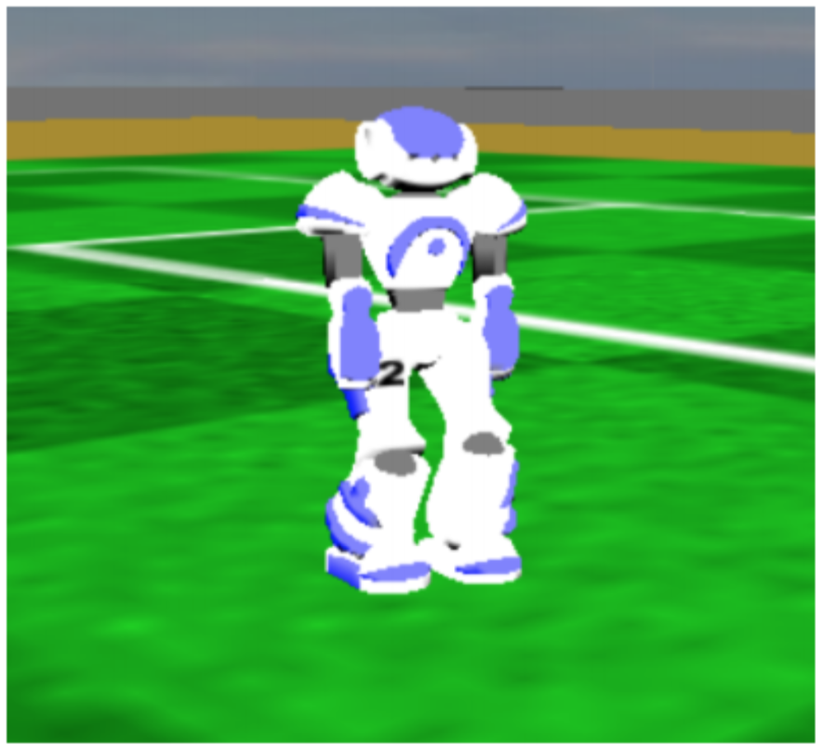
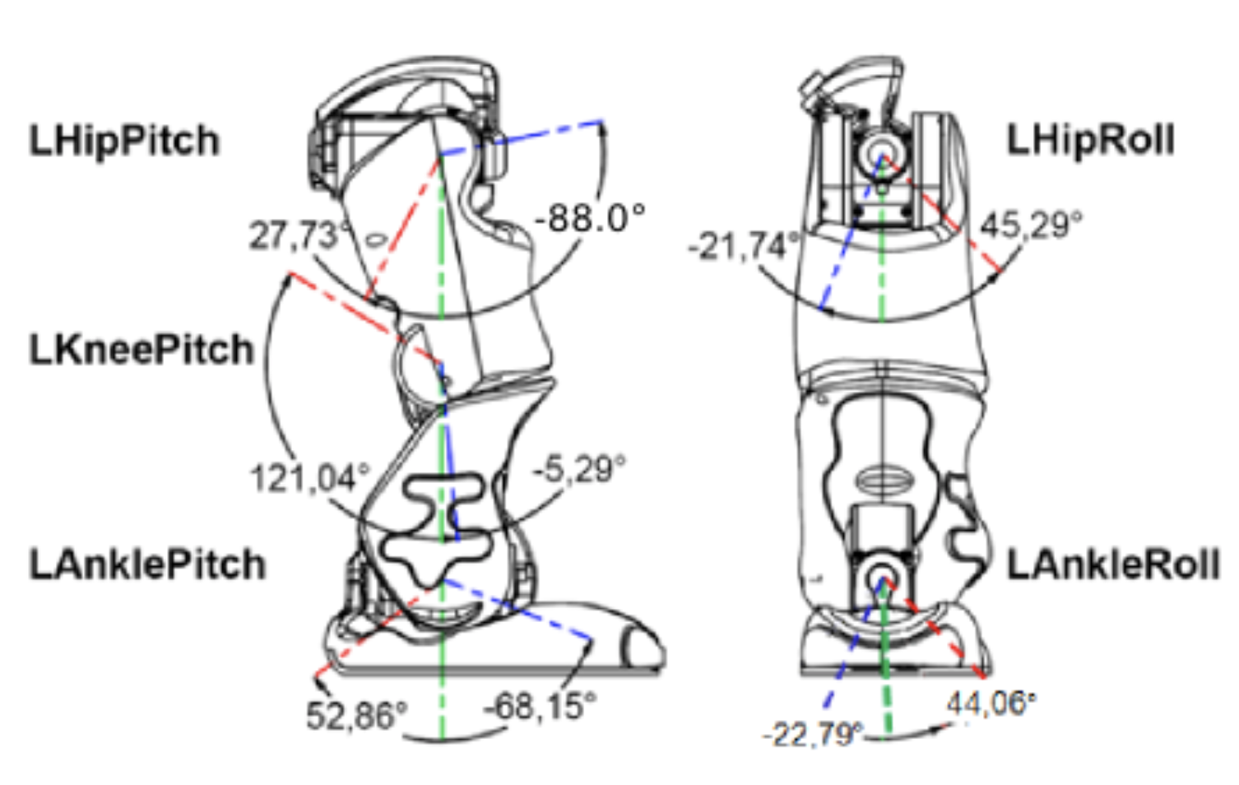
Visual Information
Proprioceptive Information
RGB, Grayscale, etc.
Low-level features such as Joint angles
http://doc.aldebaran.com/2-1/family/robots/joints_robot.html

Slide 6
Problem
In IfO problems, how to improve
performance
and, sample efficiency?
Hypothesis:
Leveraging proprioceptive information will help with both issues

Slide 7
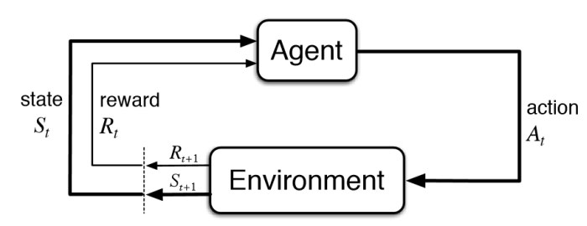
Reinforcement Learning (RL)

Slide 8
Markov Decision Process (MDP)
Formally, we model agent interaction as an MDP i.e.
Where,
S is the state space of the agent
A is the action space of the agent
T is transition probabilities i.e.
R is the scalar reward i.e.
is the discount factor
Goal:
where we want to find policy,
Drawback:
Requires extensive explorations
Designing reward functions are requires domain knowledge
$$M=<S,A,T,R,γ>$$
$$T:S×A×S→[0,1]$$
$$R:S×A×S→ℝ$$
$$\max_{π:S→A}\overset{∞}{\underset{i=0}{∑}}γ^{t}R_{t}$$

Slide 9
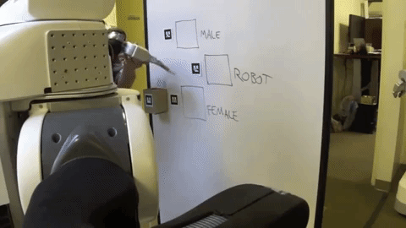
Imitation Learning
Goal:
Learn how to make decisions by trying to imitate another agent.
Observations of other agent (demonstrations) consist of state-action pairs.
Limitation:
Precludes using a large amount of demonstration data where action sequences are not given (e.g. YouTube videos).

Slide 10
Imitation from Observation
Goal:
Learn how to perform a task given state-only demonstrations.
Formulation:
Given:
Learn:
$$τ_{e}=\{o_{t}\}$$
$$π:s_{t}→a_{t}$$

Slide 11
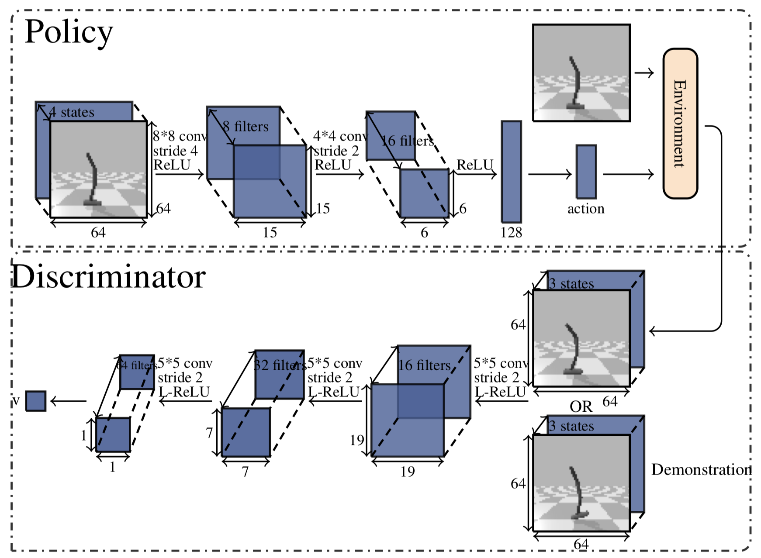
Generative Adversarial Imitation from Observation

Slide 12
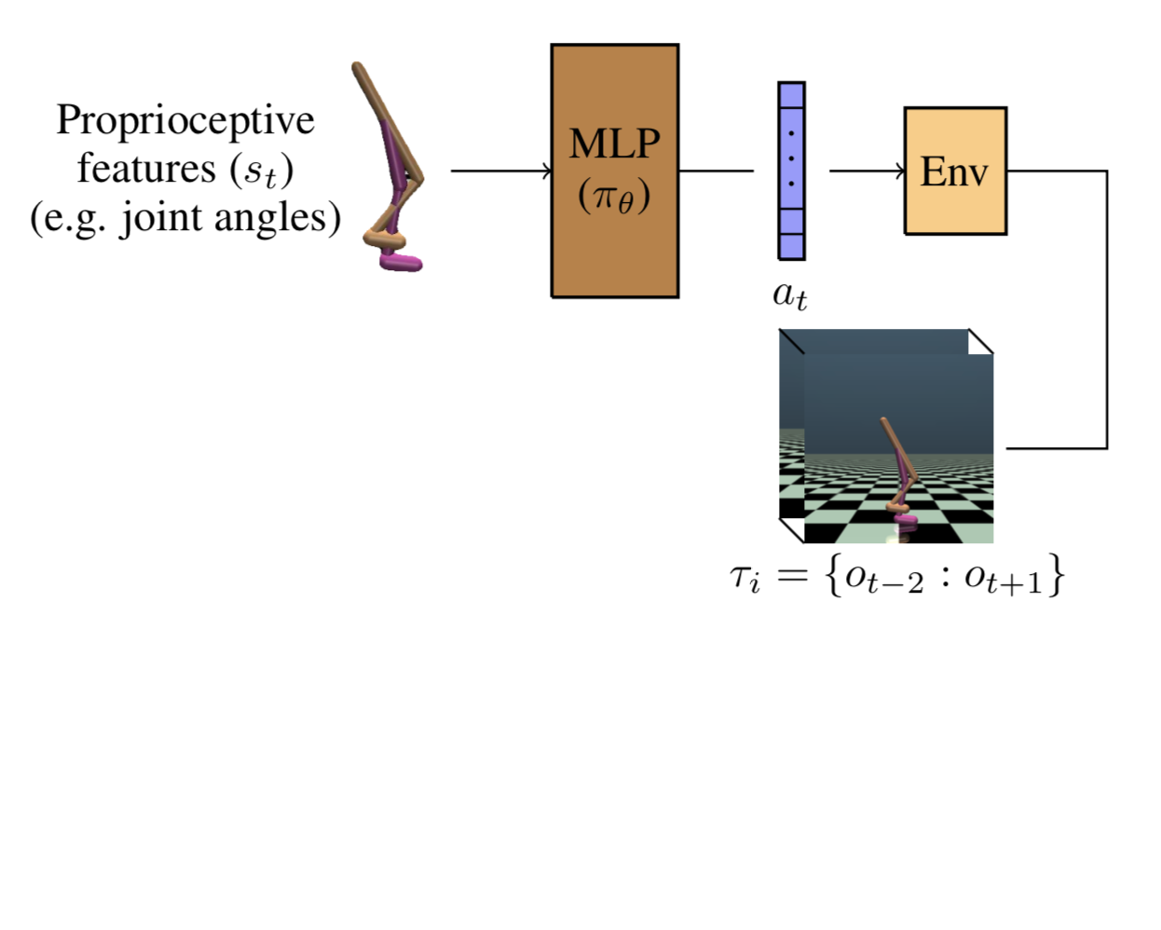
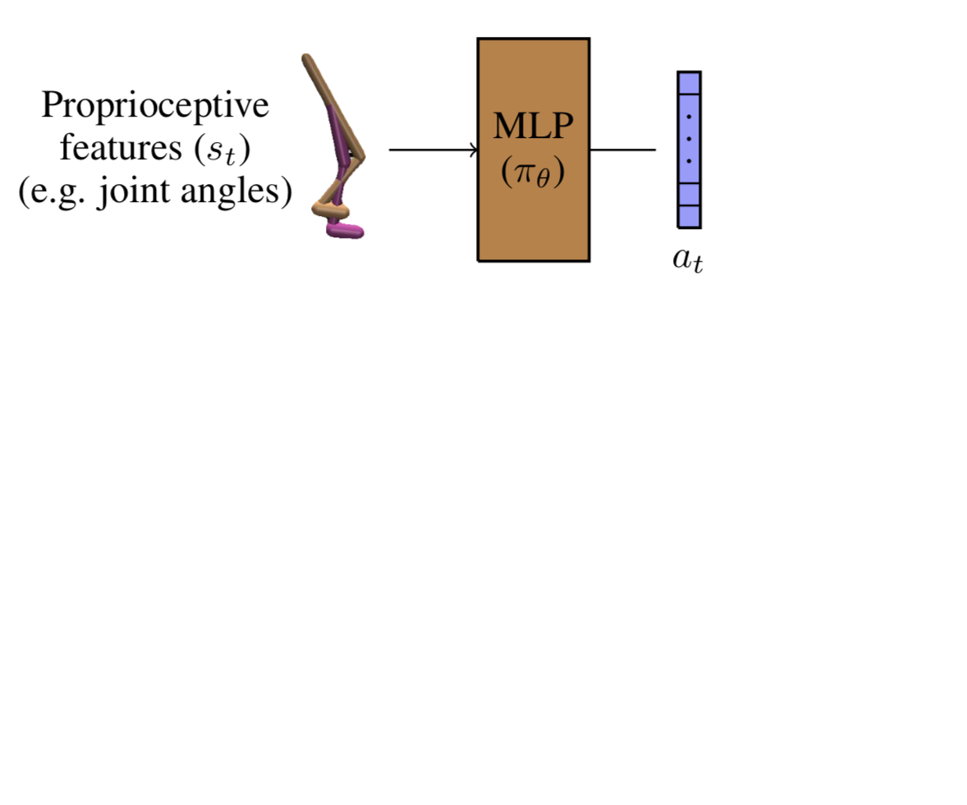
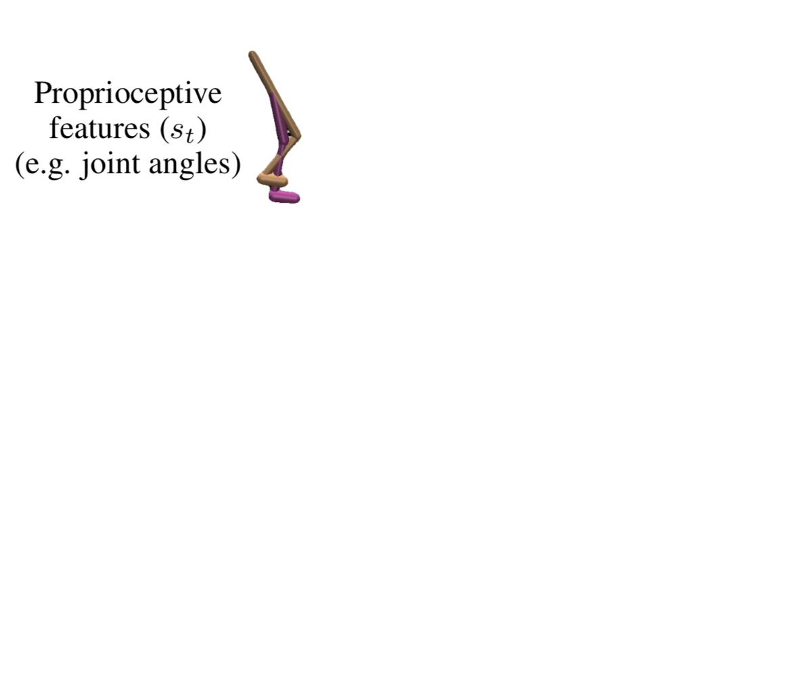
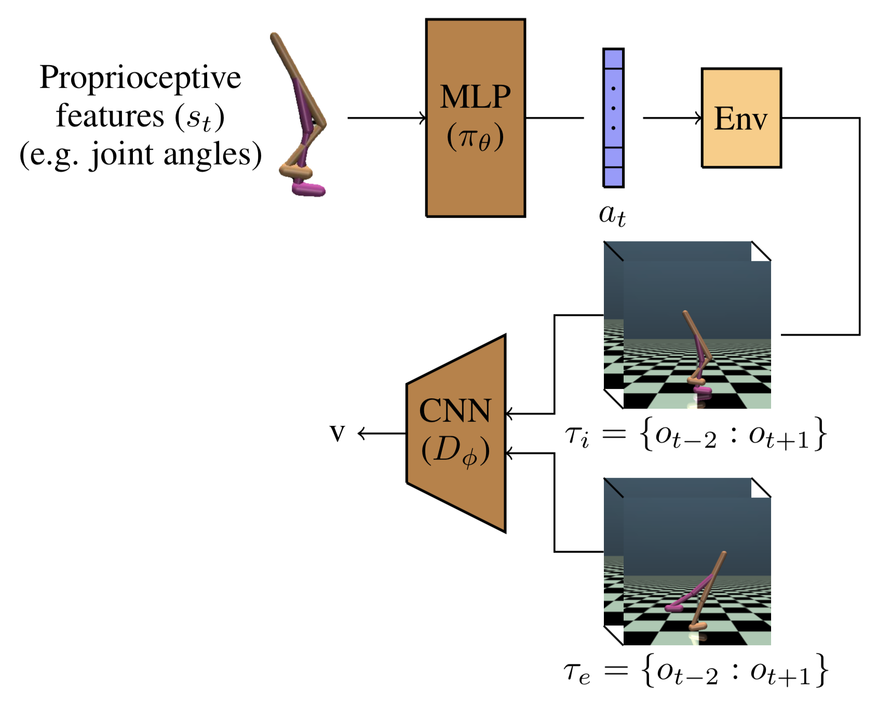
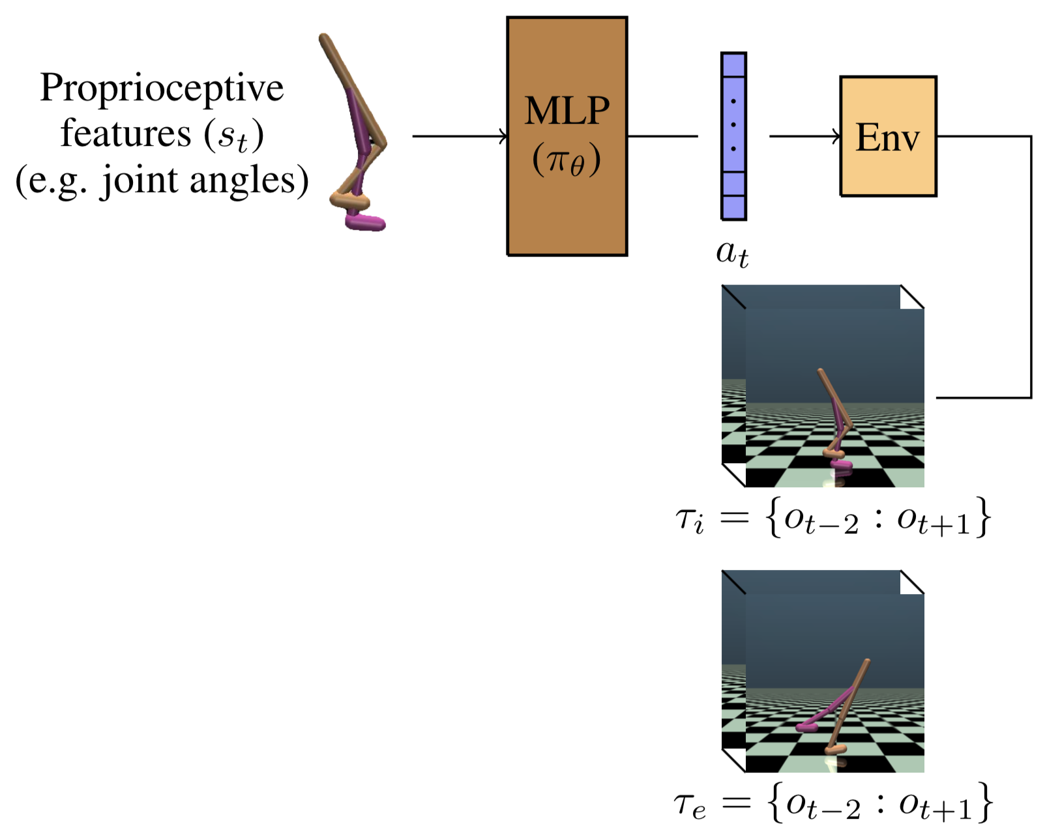
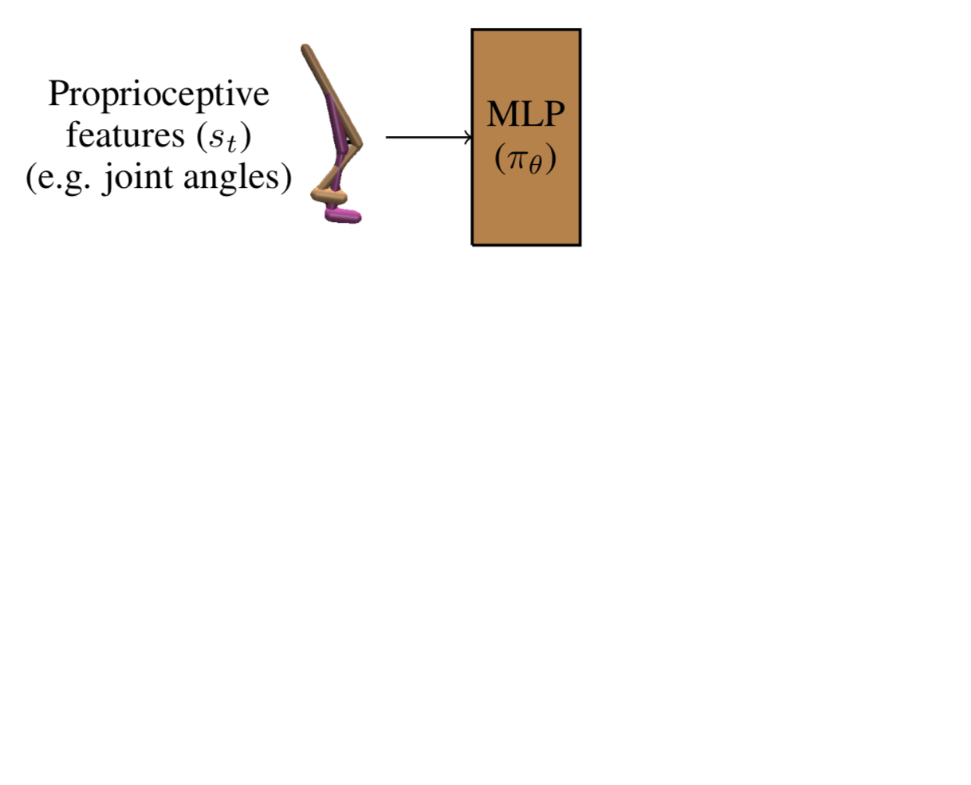
Proposed method
Propose an algorithm that uses both proprioceptive and visual information in order to:
Improver performance
Improve sample complexity

Slide 13
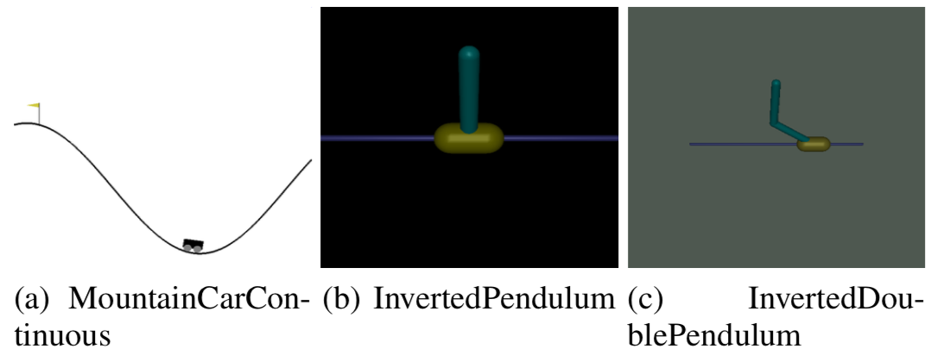
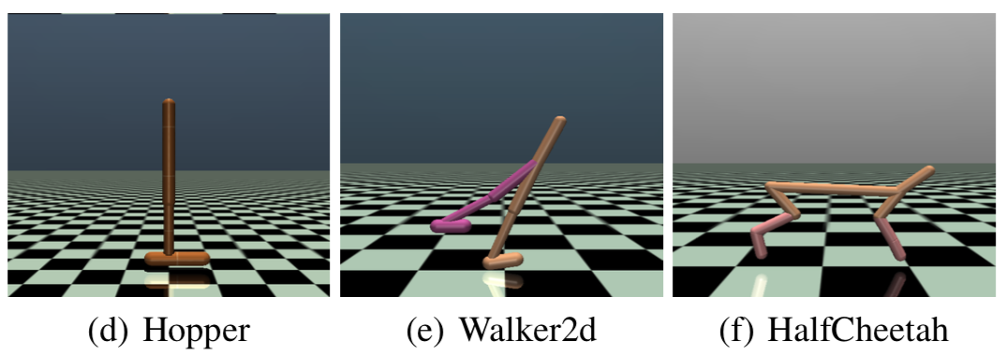
Experiments
Tasks:
OpenAI Gym Environments
Expert policies:
Learned by PPO
Visual demonstrations:
64*64 grayscale frames

Slide 14
Experiments
Baselines:
Generative Adversarial Imitation from Observation (GAIfO)¹
Behavioral Cloning from Observation (BCO)²
Time Contrastive Networks (TCN)³
1Torabi, Faraz, Garrett Warnell, and Peter Stone. "Generative adversarial imitation from observation." arXiv preprint arXiv:1807.06158 (2018).64*64 grayscale frames
2Torabi, Faraz, Garrett Warnell, and Peter Stone. "Behavioral cloning from observation." Proceedings of the 27th International Joint Conference on Artificial Intelligence. AAAI Press, 2018.
3Sermanet, Pierre, et al. "Time-contrastive networks: Self-supervised learning from video." 2018 IEEE International Conference on Robotics and Automation (ICRA). IEEE, 2018.

Slide 15
Experiments
Demonstration:
Notes:
The agent focuses on optimizing for performance while using the expert’s state-transitions as a template for optimal behavior

Slide 16
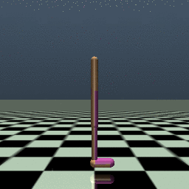
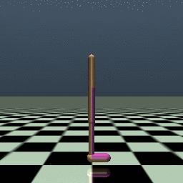
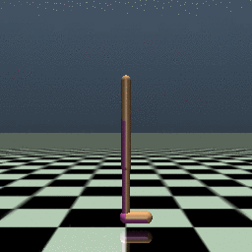
Experiments
Iteration 0:
Iteration 100:
Iteration 1942:

Slide 17
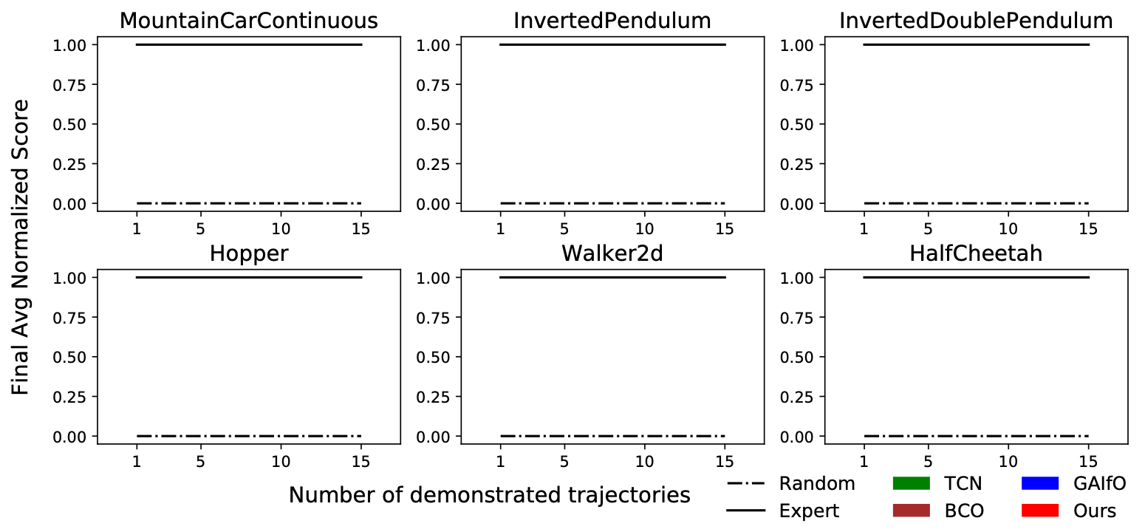
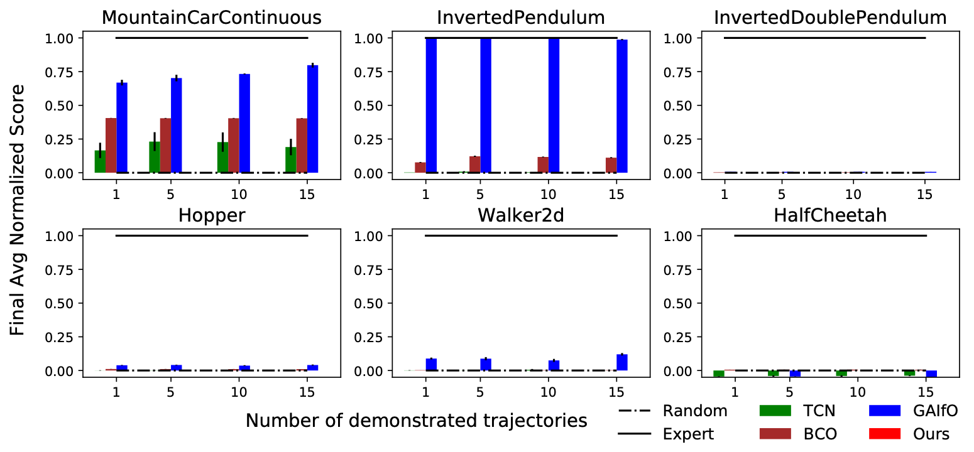
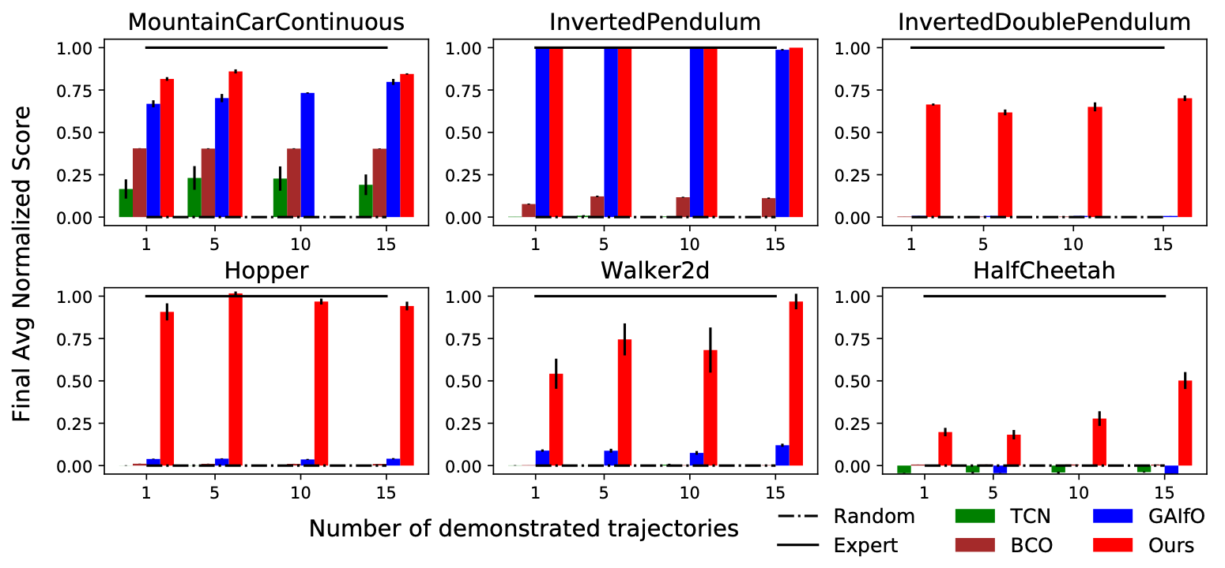
Experiments
Final Performance

Slide 18
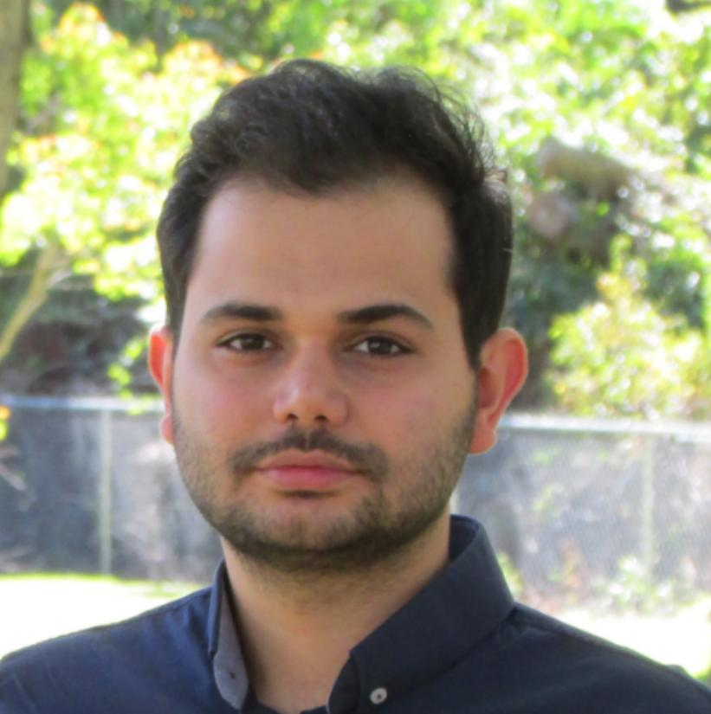
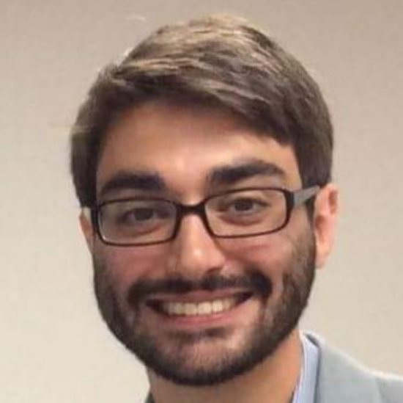
Summary
Hypothesis:
Leveraging proprioceptive information helps with learning speed and performance in IfO problems
Proposed an adversarial imitation learning from observation algorithm that:
Results in better final performance
Improves sample efficiency
Collaborators
Garrett Warnell
Faraz Torabi

