Slide 1

RIDM: Reinforced Inverse Dynamics Modeling for Learning from a Single Observed Demonstration
Brahma Pavse¹, Faraz Torabi¹, Josiah Hanna², Garrett Warnell³, Peter Stone^{1,4}
¹University of Texas at Austin, ²University of Wisconsin-Madison, ³Army Research Laboratory, ⁴Sony AI

Slide 2
Motivation
Allow an artificial intelligent agent to learn tasks when:
  A demonstration is available
  A reward function is available
  The demonstrator is sub-optimal
  Demonstrator actions are not available
  Not many demonstration trajectories are available
  Only raw state information is available

Slide 3
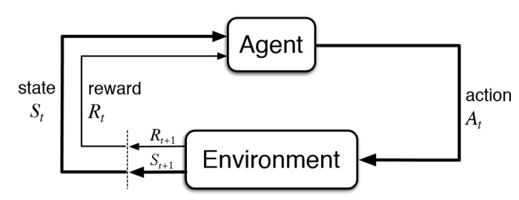
Reinforcement Learning
Goal:
  Learn how to make decisions by maximizing the cumulative reward feedback.

Slide 4
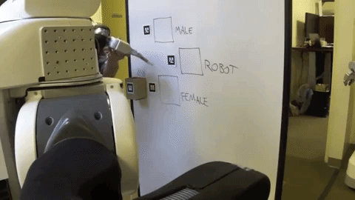
Imitation Learning
Goal:
  Learn how to make decisions by trying to imitate another agent.
Observations of other agent (demonstrations) consist of state-action pairs.
Limitation:
  Precludes using a large amount of demonstration data where action sequences are not given.

Slide 5
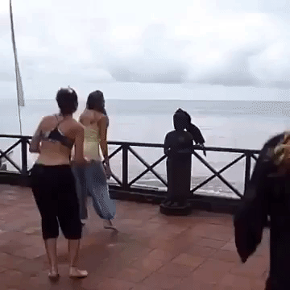

Imitation Learning from Observation
Goal:
  Learn how to perform a task given state-only demonstrations.
Formulation:
  Given: $D^{e}=\left\{s_{t}^{e}\right\}$
  Learn: $π:s_{t}→a_{t}$

Slide 6
Related Work
Reinforcement Learning:
  Playing Atari with Deep Reinforcement Learning [Mnih et al. 2013]
  End-to-End Training of Deep Visuomotor Policies [Levine et al. 2015]
  Trust Region Policy Optimization [Schulman et al. 2015]
  Mastering the game of Go without human knowledge [Silver et al. 2017]
Imitation Learning and Reinforcement Learning:
  Integrating reinforcement learning with human demonstrations of varying ability [Taylor et al. 2011]
  Exploration from demonstration for interactive reinforcement learning [Subramanian et al. 2016]
  Overcoming exploration in reinforcement learning with demonstration [Nair et al. 2017]
  Reinforcement and imitation learning for diverse visuomotor skills [Zhu et al. 2018]
Imitation Learning from Observation:
  Time Contrastive Networks [Sermanet et al. 2017]
  Behavioral Cloning from Observation [Torabi et al. 2018]
  Generative Adversarial Imitation from Observation [Torabi et al. 2018]
  Provably Efficient Imitation Learning from Observation Alone [Sun et al. 2019]
  Imitation learning from video by leveraging proprioception [Torabi et al. 2019]
Imitation Learning:
  Apprenticeship learning via inverse reinforcement learning [Ng et al. 2004]
  Maximum Entropy Inverse Reinforcement Learning [Ziebart et al. 2008]
  Guided Cost Learning [Finn et al. 2016]
  Generative Adversarial Imitation Learning [Ho et al. 2016]
IL
RL
IfO

Slide 7

Our Goal
Augmenting “imitation from observation” and “reinforcement learning” to learn tasks when:
  The demonstrator is sub-optimal
  Demonstrator actions are not available
  Not many demonstration trajectories are available
  Only raw state information is available
Given:
  A single state-only (sub-optimal) demonstration: $D^{e}=\left\{s_{t}^{e}\right\}$
  A reward function: $R_{env}$
Learn:
  A policy to perform the task
IL
RL
IfO

Slide 8
RIDM: Reinforced Inverse Dynamics Modeling
Expert Trajectory
Expert Trajectory
RIDM represents a new paradigm for combining IL and RL in that the agent's behavior is driven directly by the fixed demonstration trajectory coupled with a parameterized inverse dynamics model.
In RIDM, demonstration is treated as fixed and the RL is to select the IDM that causes *attempting* to follow the demonstration to lead to the highest environmental reward
Steps:
  Initialize an inverse dynamics model (IDM)
  Pre-train the IDM by collecting data using an exploration policy
  Use IDM on the current state of the agent and next state of the expert to calculate the next action
  Execute the action and collect the reward
  Train the IDM to maximizing the reward and go back to step 3
Learner Actual Trajectory
Learner Actual Trajectory
Model Trajectory Correction
Model Trajectory Correction

Slide 9
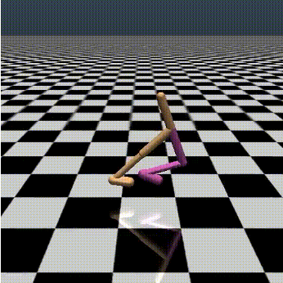
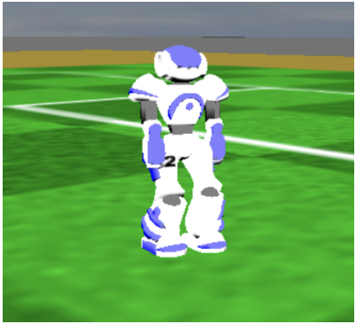
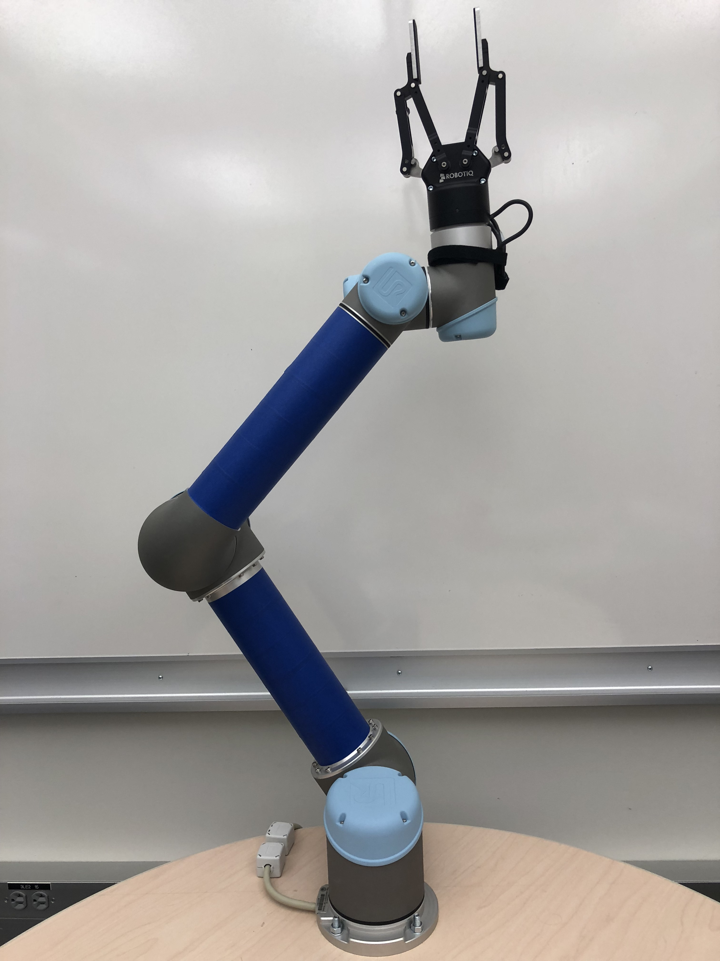
Experiments
Robot control domains:
  MuJoCo Simulator
  SimSpark Simulator
  UR5 Arm Robot
Hypothesis:
  RIDM is able to learn tasks efficiently with comparable performance compared to the demonstrator
  If the demonstrator is sub-optimal, RIDM is potentially able to outperform the demonstrator

Slide 10
Experiments: SimSpark Robot Soccer
Used in 3D Simulation RoboCup
Developing skills such as walk and kick is challenging
Tasks:
  Fast Walk
  Long Kick
Demonstrators:
  FUT-K
  FC Portugal
Demonstrators are sub-optimal with respect to the designed reward
Notes:
The first set of experiments that I’m gonna talk about is in SimSpark simulator. This simulator is used in 3D simulation robocup which is a competition that is held every year. There are many teams participating each year. Each team has 11 players like a regular soccer game. Each of the players is a simulated Nao as it is shown in this picture. All of the skills such as walking and kicking of the players should be developed by the teams. Developing these skills is challenging and if a team has a better walk or kick they would have advantage over other teams. At the end of the competition, all of the teams should release a binary of their team which could be used to play against them. The only information that could be accessed through that binary is the joint angles of the agents, in other words their states. So the hypothesis that we want to test here is that whether we can learn other teams skills and potentially outperform them using these binaries.

Slide 11
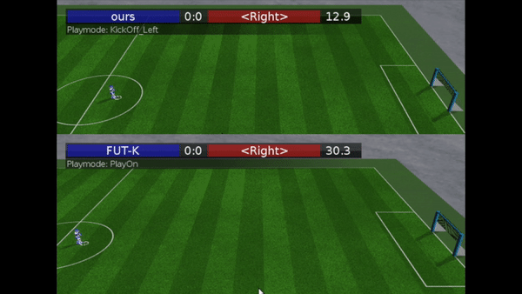
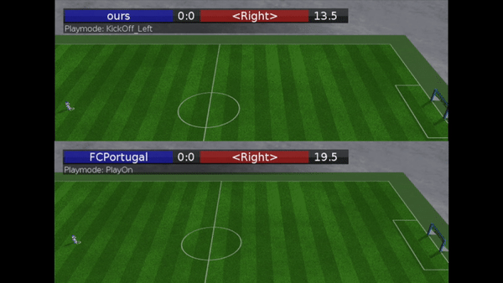
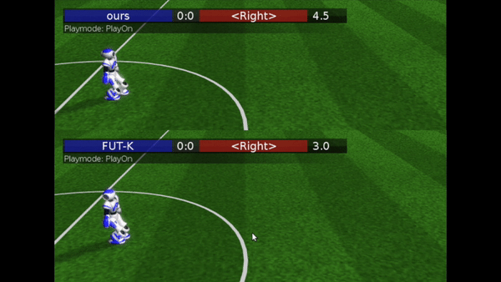
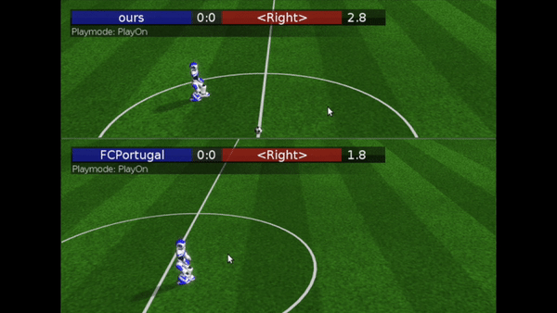
Experiments: SimSpark Robot Soccer
Our experiments on SimSpark 3D simulator show learned behavior outperforms the suboptimal experts.
Long Kick (FUT-K):
Fast Walk (FUT-K):
Fast Walk (FC Portugal):
Long Kick (FC Portugal):
Learned
Behavior:
Learned
Behavior:
Learned
Behavior:
Learned
Behavior:
Demo:
Demo:
Demo:
Demo:

Slide 12
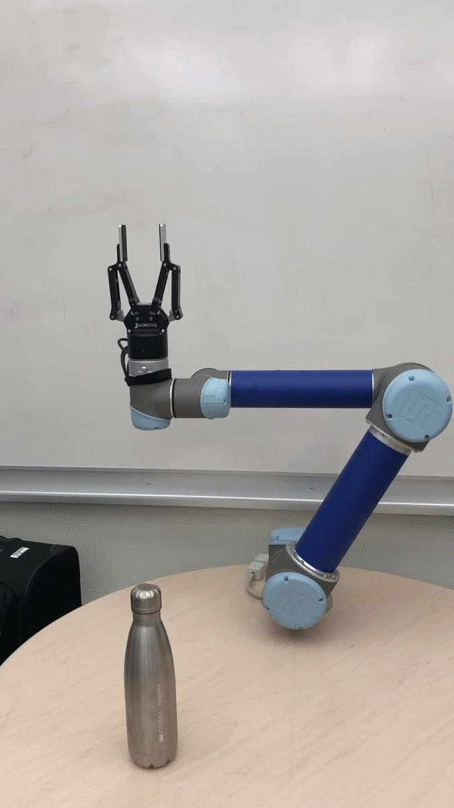
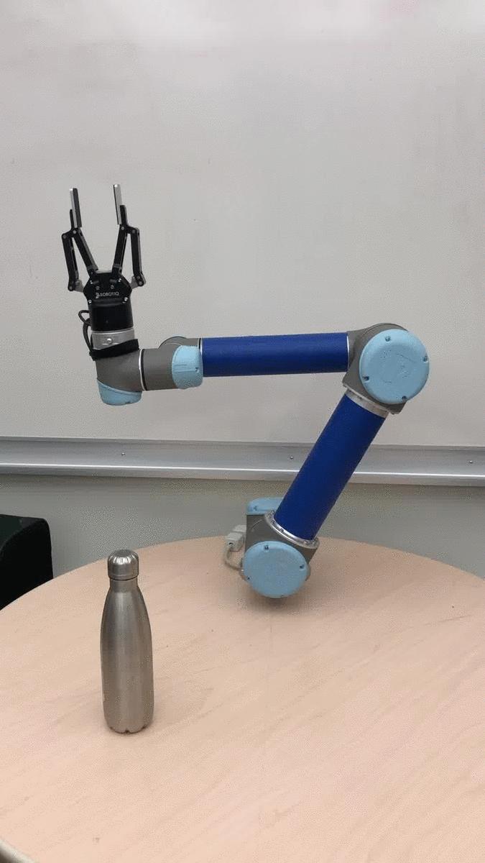
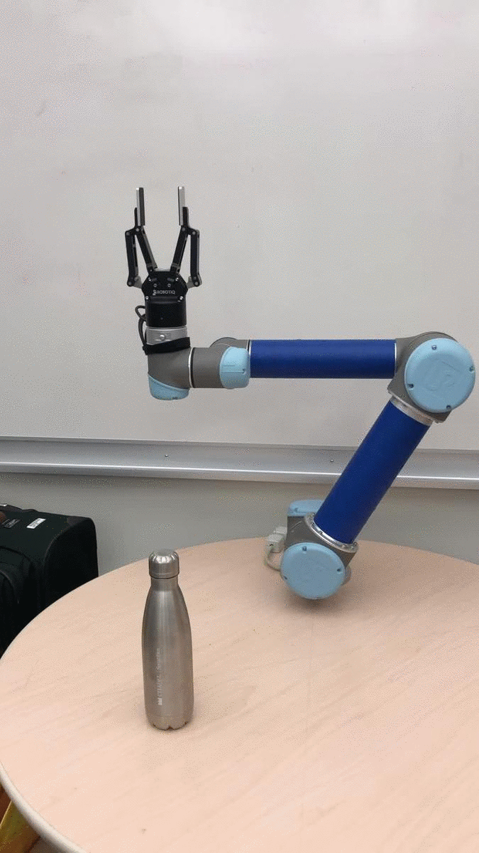
Experiments: UR5 Arm Robot
Our experiments on UR5 robots show learned behavior outperforms robot’s default PID performance.
Pushing Task (10x):
Demonstration
Default UR5 PID
Learned Behavior

Slide 13
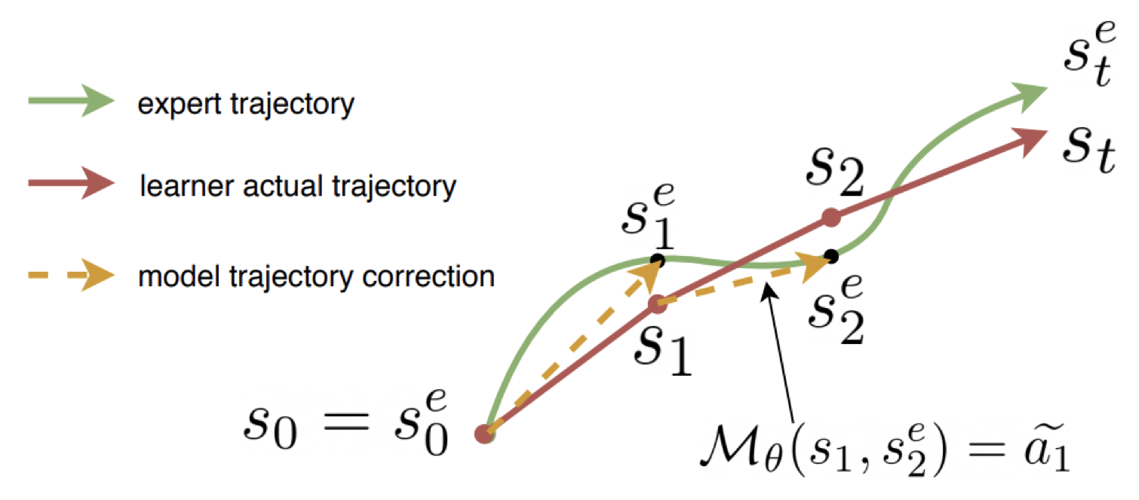
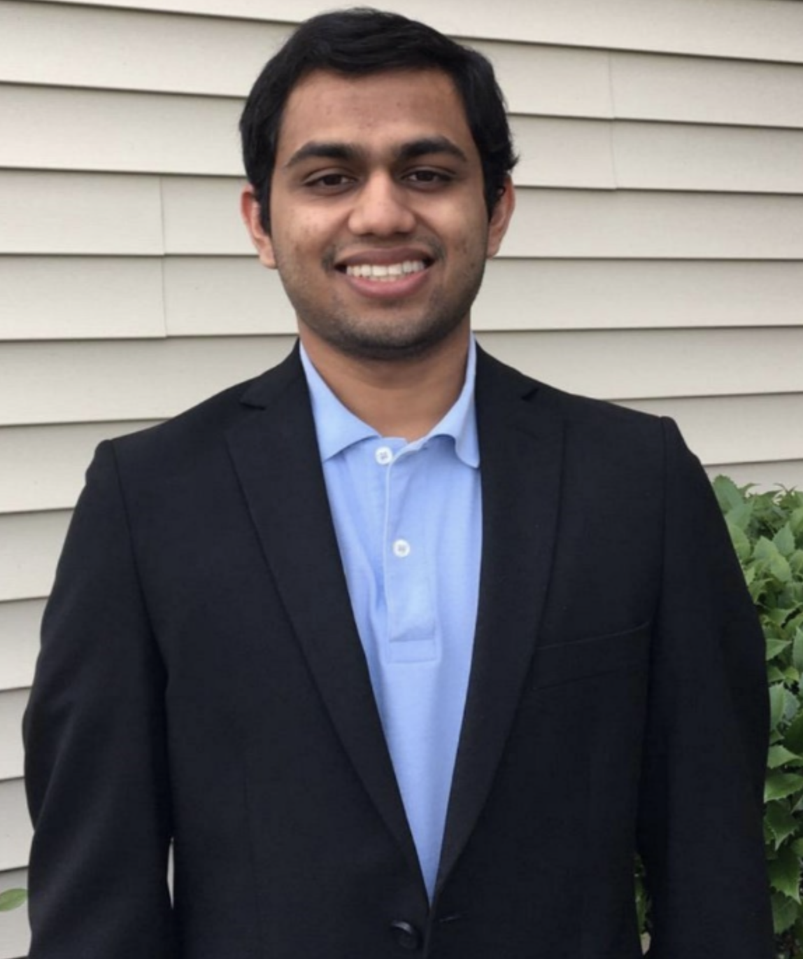
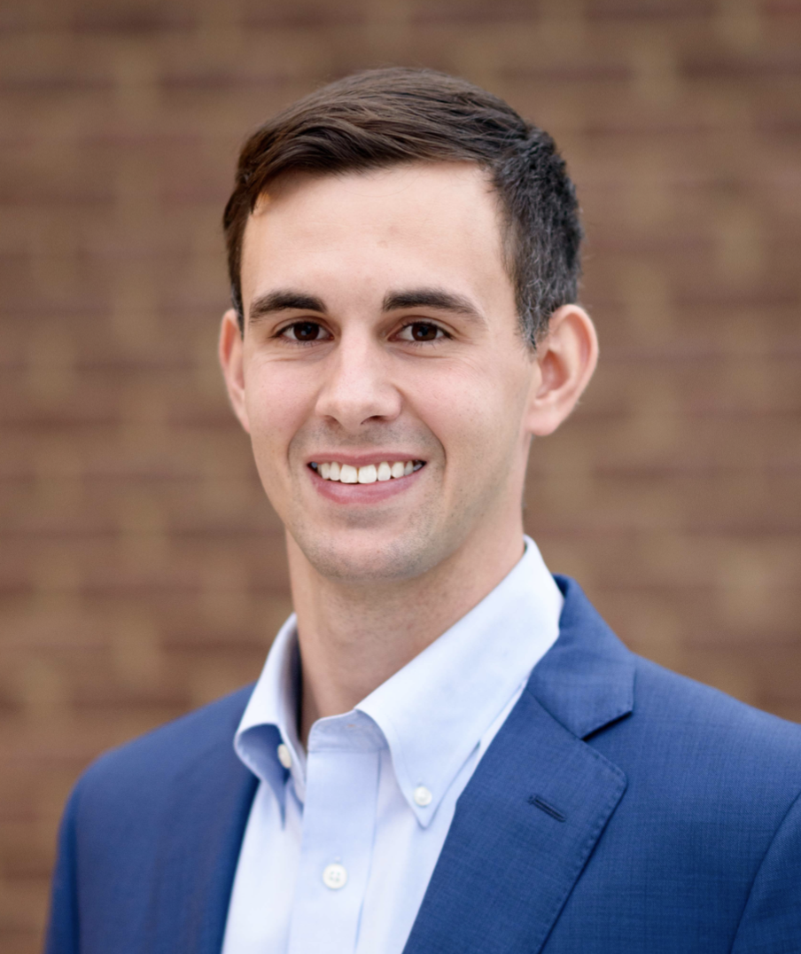
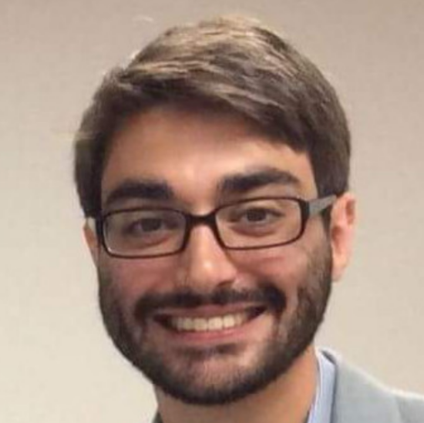
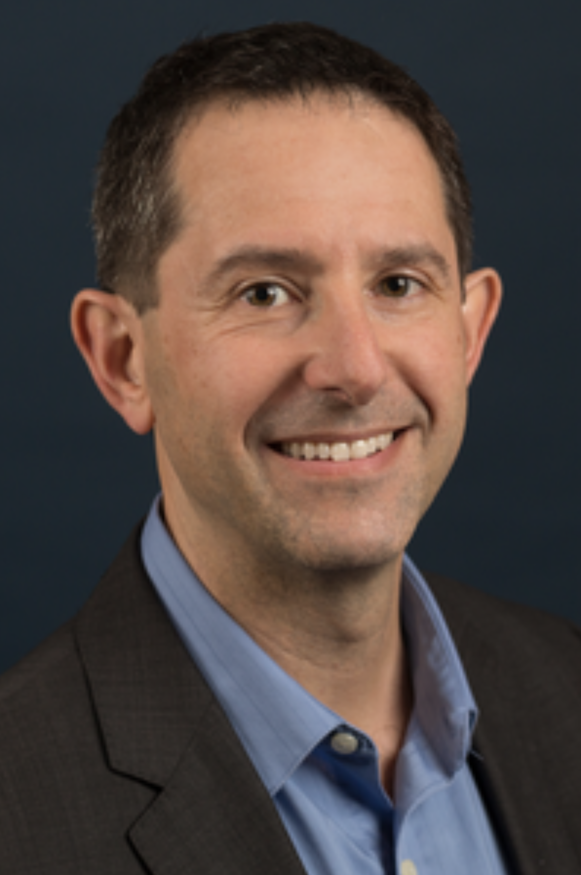
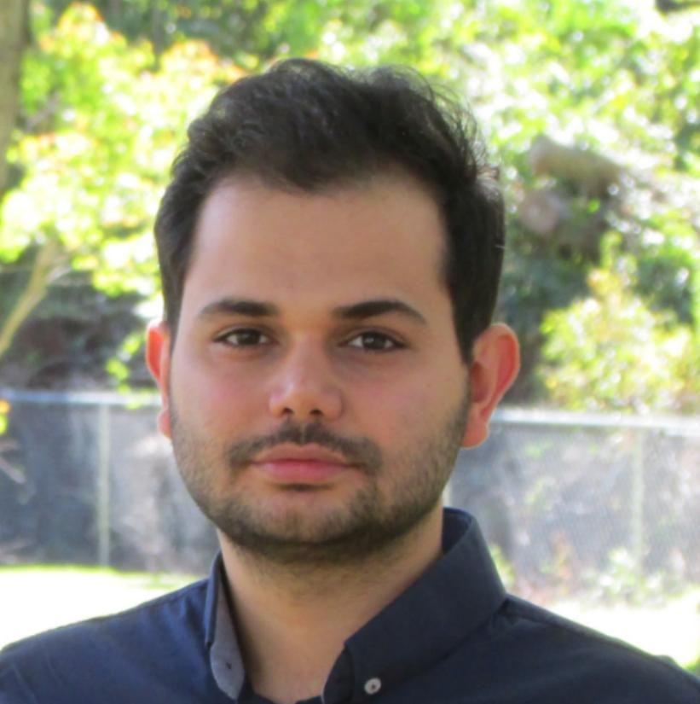
Summary
Proposed an algorithm:
  Augmenting IfO and RL
  Requires only one state-only demonstration
  Can potentially outperform sub-optimal demonstrator
Authors:
  Brahma Pavse Josiah Hanna Garrett Warnell Peter Stone Faraz Torabi (faraztrb@cs.utexas.edu)

