Slide 1
Application Programming Interface
CS330 – Elements of Software Engineering I

Slide 2
Outline
What is an API?
Scrape an API

Slide 3
What is an API?
An Application Programming Interface (API) is a messenger between two pieces of software.
  One side provides functionality and provides an interface to access that functionality.
  The other side will use such functionality through the interface.
    Takes a request from one piece of software
    Tells the other piece of software what is needed
    Returns the response back to the requesting software

Slide 4
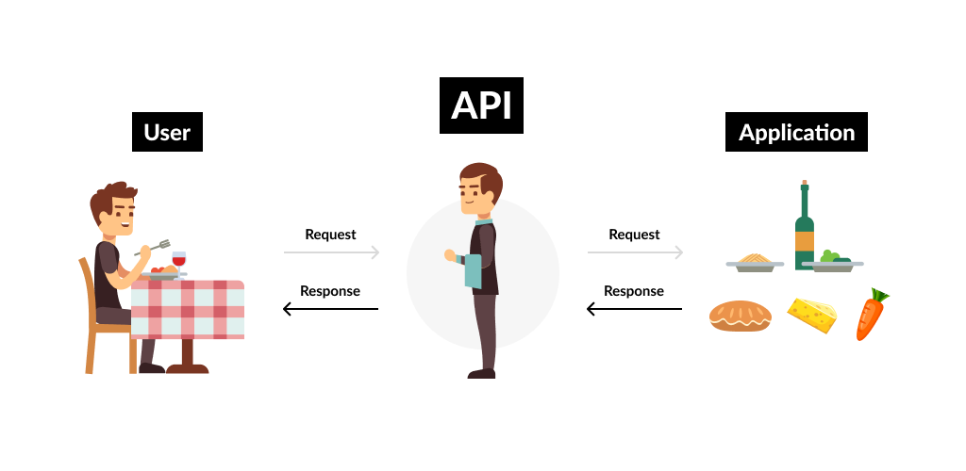
What is an API?
An API is a messenger between two pieces of software
Notes:
An API is like a waiter in a restaurant.
A customer is setting on a table with a menu of choices to order from.
The kitchen is the part of the system that will prepare your order.
What’s missing is the critical link to communicate your order to the kitchen and deliver your food back to the table (that’s were the waiter or API comes in).
The waiter is the messenger that takes your request or order and tells the system (in this case the kitchen) what to do and then delivers the response back to the customer (or you), in this case food..

Slide 5
No one Universal Type of API’s
Different types of APIs
Library, PL-specific or OS-level API (example Reach, Flask)
If you have React installed, you can invoke its interface via “import React from ‘react’”. This would allow you to invoke its JavaScript libraries to make beautiful websites.
But we’re interested in Web API’s
Notes:
First type of API is kind of more local kind of APIs, a library API. So, if you install Python libraries, they will have an API that is Programing Language specific.
Alternatively, if you’re an OS developer or if you develop low level applications, you need access to an OS-level API. You will have an API that allows user applications to request system resources.
Another example is React API.

Slide 6
Web API’s - RESTful API
REST Representational State Transfer
Someone has data and wants to present it in a controlled manner
They would construct REST API endpoints to present the information. Each endpoint is like an item on the restaurant menu, and it is also a point of contact with other systems.
API requests usually return in JSON format, with key:value pairs
Architectural style for designing network applications
Notes:
Problems with websites: lots of aesthetic, different kind of formatting in tables or cards. So, if you’re a client or another software developer that is interested in the data, you don’t need all that formatting and aesthetic, you only need the data.

Slide 7
JSON
JSON is a standard data interchange format
Consists of attribute value pairs
You can nest values into a tree format of any depth, but typically this depth is shallow
JSON visualization: http://jsonviewer.stack.hu/

Slide 8
Anatomy of a Request
Endpoint: https://api.twitter.com/path/path
Method: GET POST DELETE PUT/PATCH
Headers: curl -H "Content-Type: application/json" https://api.github.com
Typically pass auth info or request metadata
Body: not included in GET requests
Notes:
Endpoint: where do you want to get your data from? Presented in url format with carious routes toward the end.
Method:
Headers: contain meta data. For example, the following header “Content-Type: application/json” indicates that you want your data back in json format. You can also pass other things like authentication info and other request metadata.
“-H” is used to add a header.
Body: for all types of requests except GET, you have a body. This is an optional parameter used to pass information directly related to your app.

Slide 9
First API Call Using curl
Open Git-Bash
Type in the following command:
$ curl -H "Content-Type: application/json" https://api.github.com
Alternatively, you can make the same request directly through a web browser.
Type in the following url in your web browser.
https://api.github.com/
Notes:
Curl is a UNIX command which can send GET, POST, PUT and DELETE request to a URL.
To pretty print:
curl -H "Content-Type: application/json" https://api.github.com | python -m json.tool
In the above command, we hit the base at github api endpoint. We receive a json response with attribute value pairs and all these values are urls to other API endpoints. You can view this as a table of contents of some sort.
From this table of contents, you can try out any end point, for example, https://api.github.com/events
You can also try to load this endpoint to http://jsonviewer.stack.hu/
Go to the url, choose “load JSON data” and specify the url “http” not “https”.
You can also click “Viewer” to see a visualization of the JSON.

Slide 10
Different Methods of API Requests
GET: typically used for reading data, request parameters are presented in the URL.
POST: typically used for creating or modifying data, request parameters are NOT presented in the URL and data can be exchanged via the request body.
There is also PUT, PATCH and DELETE. These are like POST but are more specific to modifying data.
Notes:
GET: typically used for scrapping data from a third-party APIs.
POST: most suitable for creating or modifying data and data can be exchanged more securely via the request body.
PUT and PATCH are for modifying data and DELETE for removing.
PUT is typically used for update.
CRUD VS method of request
Create – POST, Read – GET, Update – PUT, Delete: DELETE
PATCH: Submits a partial modification to a resource. If you only need to update one field for the resource, you may want to use the PATCH method.

Slide 11
More about APIs
API’s can be tested using a web browser, curl command and with third-party applications like Postman, and of course, with your own app.
Testing or generating documentation for API’s can be achieved using Postman – will be covered later.
Now, let’s work with some examples.
Notes:
If you want to provide information about what data you have to other software developer, it’s a good idea to generate documentation for your API.

Slide 12
API Scraping Examples
Consider the file “api.py”
The requests module allows you to send HTTP requests using Python. The HTTP request returns a Response Object with all the response data (content, encoding, status, etc)
  Note: “requests” is different from “request”
  Request.form[‘name’] is used to reference the html form received.
  the json module provides an API like convert in-memory Python objects to a serialized representation known as JavaScript Object Notation (JSON) and vice-a-versa.

Slide 13
API Scraping Examples
Api1.
Shows astronauts currently in space.
Prints the status code and the data.
Status code 200 which means successful request
Status code 400-500 means an error
Api2.
Shows times when ISS passes over specific location.
We add a parameters field

Slide 14
API Scraping Examples
Api3.
Shows the public projects that I have on my GitLab account.
Api4.
Returns an authentication error since the token is expired.
Api5.
Shows how can you scrape an API running on localhost.

Slide 15
API Scraping Examples
Api6.
Is an example of a POST request.
Notes:
How to make a request with data and a header. The dictionary has to be converted to JSON first.
url in this example is just a place holder.

