Slide 1
Client, Server and Protocols
CS330e-Elements of Software Engineering I

Slide 2
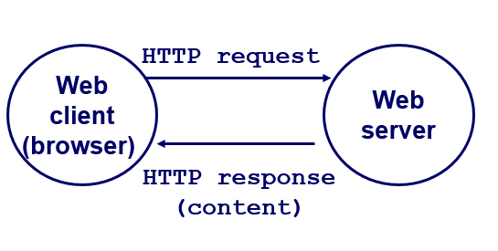
Client, Server and Protocols
You can think of the client as a computer that requests information, and the server as the computer that provides the information.
The client sends a request for information.
The server listens for incoming requests from clients.
For a client and a server to communicate, they must use the same protocol (language).
Network protocols define the rules that ensure all machines on the internet communicate in a consistent way.

Slide 3
Client, Server and Protocols
Common Internet protocols are
Transmission Control Protocol (TCP) and User Datagram Protocol (UDP)
Internet Protocol (IP)
Hypertext Transfer Protocol (HTTP)

Slide 4
TCP / UDP - Clients and Servers communicate
The two basic ways that clients and servers communicate
Connections (TCP):
  reliable two-way byte-stream.
  looks like a file.
  akin to placing a phone call.
  slower but more robust.
Datagrams (UDP):
  data transferred in unreliable chunks.
  can be lost or arrive out of order.
  akin to using surface mail.
  faster but less robust.

Slide 5
IP- Clients and Servers communicate
IP addresses are similar to postal addresses.
They enable routing messages to all destinations on the internet.
Every device connected to the internet has a unique IP address.
When you type www.mywebpage.com into your browser, your machine first looks up the IP address of the website using a DNS (Domain Name System).
DNS acts like a lookup table that maps domain names to their corresponding IP addresses.
Once your machine obtains the IP address, it uses it to initiate communication with the website.
Multiple internet-connected applications can run on the same machine.
Operating systems use ports to manage communication channels on the same IP address.
Example: 123.32.43.1:8080
This means communication is taking place on port 8080 of the machine with IP address 123.32.43.1.

Slide 6
IP- Clients and Servers communicate
Ports typically range from 0 to 65,535.
Ports 0 to 10,000 are generally reserved by the operating system for specific uses.
Port 80 is the most common for web servers. Most websites we use daily communicate through port 80.
Port 8080 is also commonly used for web communications, especially in development or testing environments.
When client and server applications run on the same machine, we refer to this setup using the term localhost.
Localhost has a special IP address: 127.0.0.1.
When you type 127.0.0.1 (or localhost) into your browser, the operating system looks for a web server running on your own machine instead of accessing the internet.

Slide 7
HTTP - Client, Server and Protocols
HTTP stands for HyperText Transfer Protocol.
The World Wide Web (WWW) is based on communication between web clients and servers.
Clients tell servers what they want by using an HTTP verb (also known as an HTTP method).
Communication between client computers and web servers occurs through HTTP requests and HTTP responses.

Slide 8
HTTP Request / Response
Communication between clients and servers occurs through requests and responses:
A client (such as a web browser) sends an HTTP request to the web.
A web server receives the request.
The server runs an application to process the request.
The server sends back an HTTP response (the output) to the browser.
The client (the browser) receives the response.

Slide 9
HTTP Methods
The list of HTTP methods is shown below. These method names are case-sensitive and must be written in uppercase.
GET
Retrieves information from the server using a specific URI.
Requests using GET should only fetch data and must not modify it.
(Example: A client requests data from the server.)
POST
Sends data to the server, such as form inputs, file uploads, or customer information.
Commonly used with HTML forms.
(Example: A client sends data to create or update a resource on the server.)
Other HTTP methods include:
PUT, HEAD, DELETE, PATCH, and OPTIONS.
The server responds with a status code (e.g., 200 OK) and the requested resource (such as an HTML file).

Slide 10
References:
W3Schools – What is HTTP?
Carnegie Mellon University Lecture – Computer Systems: Lecture 27 (Fall 2002)

