Slide 1
Propagating the Time Dependent
Schroedinger Equation
B. I. Schneider
Division of Advanced Cyberinfrastructure
National Science Foundation
  National Science Foundation
  September 6, 2013

Slide 2

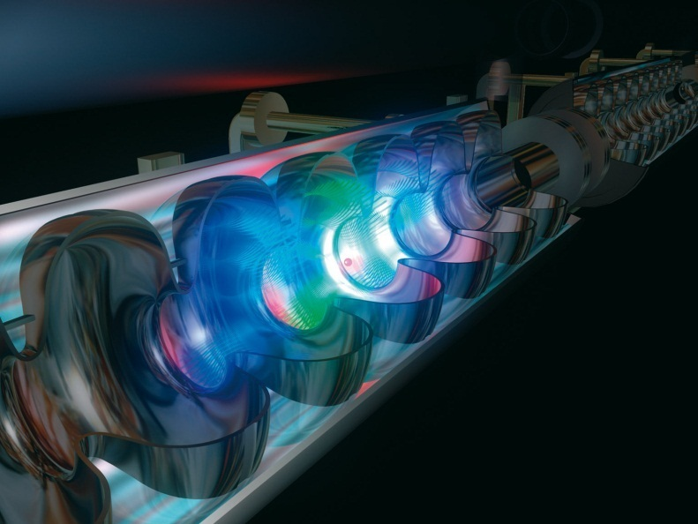
What Motivates Our Interest
Novel light sources: ultrashort, intense pulses
◻ Nonlinear (multiphoton) laser-matter interaction
Attosecond pulses
probe and control electron dynamics
XUV + IR pump-probe
Free electron lasers (FELs)
Extreme intensities
◻ Multiple XUV photons

Slide 3
Basic Equation
Possibly
Non-Local
or
Non-Linear
Where

Slide 4
Properties of Classical Orthogonal Functions

Slide 5
More Properties

Slide 6
Matrix Elements

Slide 7
Properties of Discrete Variable Representation

Slide 8
Its Actually Trivial

Slide 9
Multidimensional Problems
Tensor Product Basis
  Consequences

Slide 10
Multidimensional Problems
Two Electron matrix elements also ‘diagonal” using Poisson equation

Slide 11
Finite Element Discrete Variable
Representation
Properties
  Space Divided into Elements – Arbitrary size
  “Low-Order” Lobatto DVR used in each element: first and last DVR point shared
  by adjoining elements
  Elements joined at boundary – Functions continuous but not derivatives
  Matrix elements requires NO Quadrature – Constructed from renormalized, single element, matrix elements
  Sparse Representations – N Scaling
  Close to Spectral Accuracy

Slide 12
Finite Element Discrete Variable
Representation
Structure of Matrix

Slide 13
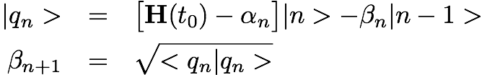
Time Propagation Method
Diagonalize Hamiltonian in Krylov basis
Few recursions needed for short time- Typically 10 to 20 via adaptive time stepping
Unconditionally stable
Major step - matrix vector multiply, a few scalar products and diagonalization of tri-diagonal matrix

Slide 14
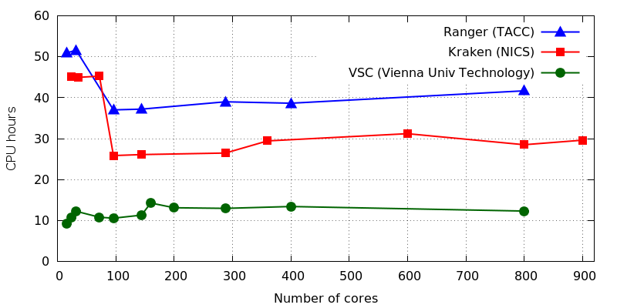
Putting it together for the He Code
NR₁ NR₂ Angular
Linear scaling with number of CPUs
Limiting factor: Memory bandwidth
XSEDE Lonestar and VSC Cluster have identical Westmere processors

Slide 15
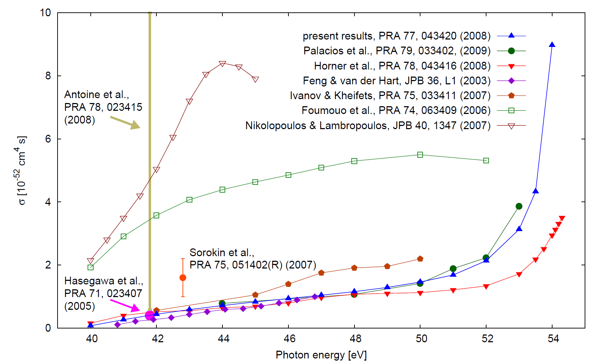
Comparison of He Theoretical and Available Experimental Results NSDI -Total X-Sect
Considerable discrepancies!
Rise at sequential threshold
Extensive convergence tests:
angular momenta, radial grid, pulse duration (up to 20 fs),
time after pulse (propagate electrons to asymptotic region)
➔ error below 1%

Slide 16
Two-Photon Double Ionization in
The spectral Characteristics of the Pulse can be Critical

Slide 17
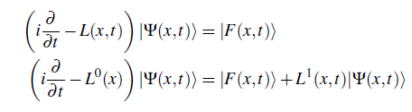
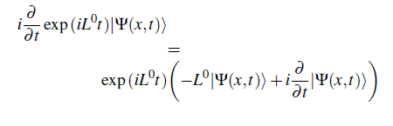

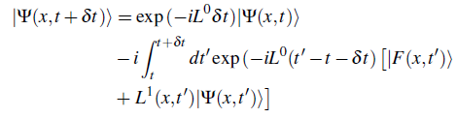
Can We Do Better ?
How to efficiently approximate the integral is the key issue

