Slide 1

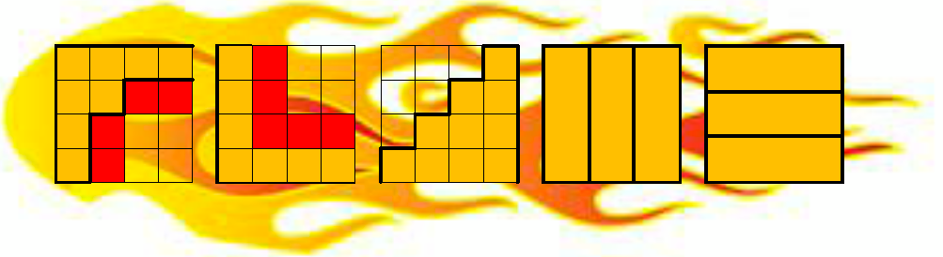
Beyond GEMM: How Can We Make Quantum Chemistry Fast?
or: Why Computer Scientists Don’t Like Chemists
Devin Matthews

Slide 2
A Motivating Example
S₁
Equation-of-Motion Coupled Cluster Theory: what is the difference in energy between the ground and excited states of some molecule?
?
E
S₀
“matrix”:
Describes the interactions in the system. The bar means it is “dressed” (i.e. tuned to a specific ground state).
“vector”:
Describes the excited state. Should be an eigenvector of H.
scalar:
The energy difference.

Slide 3
This is Linear Algebra, But…
R₁
R₂
R₃
R₄
Tensors!

Slide 4
This is Linear Algebra, But…
(+ all permutations!)

Slide 5
…It’s Really Multi-(non)-linear Algebra
Hundreds of tensor contractions in a single “matrix-vector multiply”…

Slide 6
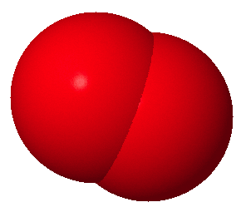
Oh Yeah, It’s Sparse Too…
O₂
~0.002% non-zero…
~0.39% non-zero…

Slide 7
Oh Yeah, It’s Sparse Too…
100.0%
Spin-orbital
0.174%
+Symmetry
,
,…
0.047%
+Spin-integration
+Non-orthogonal spin-adaptation
0.016%
+More symmetry

Slide 8
Oh Yeah, It’s Sparse Too…
ijkl=
0000
A B E F
0001
A B E F
Blocks may be distributed to disk or other processors.
No symmetry makes using GEMM easier.
This symmetry is very unwieldy to use and maintain when using GEMM.
This tensor may be very large and need to be split amongst several processors or be cached to disk.
0002
A B E F
0010
A B E F
0011
A B E F
0012
A B E F
…

Slide 9
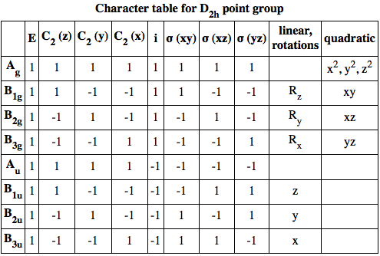
Oh Yeah, It’s Sparse Too…
The final reduction from 0.016% to ~0.002% in the previous example is due to point group symmetry:

Slide 10
Oh Yeah, It’s Sparse Too…
The final reduction from 0.016% to ~0.002% in the previous example is due to point group symmetry:
ab
a
ij
b

Slide 11
Adding It All Up
X
X
X
X
1 matrix-vector multiply
1 complicated tensor
Point group symmetry
Column symmetry
Solution of eigenproblem
100s-1000s of tensor contractions
100s-1000s of simpler tensors
Multiple GEMMs per contraction
10s of permutations
10s of iterations
Potentially billions (!!) of calls to GEMM

Slide 12
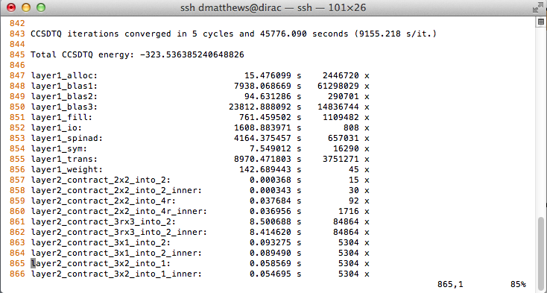
Adding It All Up

Slide 13
The Big Picture
“Simple” eigenproblem…
,
In terms of tensors…
Chemistry
In terms of other tensors…
With structured sparsity…
With symmetry…
Linear Algebra
With slicing (or blocking etc.)…
With more sparsity…
In terms of matrices.

Slide 14
Status Quo (CFOUR)
“Simple” eigenproblem…
Layer 4
,
In terms of tensors…
In terms of other tensors…
Layer 3
Me
With structured sparsity…
With symmetry…
With slicing (or blocking etc.)…
Layer 2
MPI
+
With more sparsity…
OMP
Someone
Else
Layer 1
In terms of matrices.
OMP

Slide 15
Dealing With Chemistry: Large Scale
Node 1
Node 2
Node 3
Node 4
Node 5
Node 6
Node 7
Node 8
Node 9
Pros:
Each block has little to no symmetry/sparsity.
Blocks can be distributed in many ways.
Load balancing can be static or dynamic.
Cons:
Blocks require padding for edge case. Padding can be excessive for many dimensions or short edge lengths.
To avoid padding, some blocks must keep complex structure.

Slide 16
Dealing With Chemistry: Large Scale
Node 1
Node 2
Node 3
Node 4
Node 5
Node 6
Node 7
Node 8
Node 9
Pros:
Load balancing is automatic.
Communication is regular.
Little to no padding needed.
Can be composed with blocking.
Cons:
Complex structure is retained at all levels.
Communication and local computation needs to take this structure into account.

Slide 17
Dealing With Chemistry: Small Scale
The Old Way
The New Way?
=
Memory movement
ck
ai
BLIS:
BLAS:
em
ck
ai
em

Slide 18
Dealing With Chemistry: Small Scale
kl
abcd
Z
BLIS:
AXPY!
mn
kl
R
W
abcd
mn

Slide 19

Flexibility Through Interfaces
Capabilities:
Tensor<…>
,
Basic Operator
Commutator expansion
Similarity-transform operator
Factorization, operator resolution
Spin-orbital operator
Tensor<DIST|IPS|SO|PGS>
Index permutation symmetry
Spin-integration or spin-adaptation
Blocking/packing
Distributed
Tensor<DIST|IPS>
Point group symmetry
CTF
(Basic tensor functionality)

Slide 20
Summary
Chemistry is hard.
A fast GEMM implementation is nice, but doesn’t go far enough.
Complex structure can be dealt with
  By breaking the problem into simple blocks,
  By incorporating the structure into communication and computation,
  By relating a complex object to a simpler one (a matrix) bit by bit.
Layered and composable interfaces are important.
  Implementations written at a “high level” can use “low level” interfaces through intermediate ones.
  Adapters can go from one well-defined interface to another.

Slide 21

Thanks!
BLIS:
Field van Zee
Tyler Smith
Many others…
CTF/AQ:
Edgar Solomonik
Jeff Hammond
Tensormental:
Martin Schatz
Bryan Marker
Tensor packing:
Woody Austin
Martin Schatz
Robert van de Geijn
John Stanton
The CFOUR developers

