Slide 1
Convolutional Neural Networks for Architectures with Hierarchical Memories
Ardavan Pedram
VLSI Research Group
Stanford University

Slide 2
Scientific Computing Applications
Parallelism & locality
Algorithm complexity vs. Memory behavior
FLOP/Memory
Algorithm changes memory behavior
Nominal Complexity or the big O

Slide 3
Convolutional Neural Networks

Slide 4
Neural Nets vs. CNNs
Source: [Fei-Fei Li & Andrej Karpathy]

Slide 5
3D Data
Source: [Fei-Fei Li & Andrej Karpathy]

Slide 6
Local Neighborhoods
Source: [Fei-Fei Li & Andrej Karpathy]

Slide 7
Local Neighborhoods
Source: [Fei-Fei Li & Andrej Karpathy]

Slide 8
Kernels (Filters) Create Depth
Source: [Fei-Fei Li & Andrej Karpathy]

Slide 9
Kernels (Filters) Create Depth
Source: [Fei-Fei Li & Andrej Karpathy]

Slide 10
Convolutional Layers
Source: [Fei-Fei Li & Andrej Karpathy]

Slide 11
Filters, Convolutions, Depth
Source: [Fei-Fei Li & Andrej Karpathy]

Slide 12
Multiple Convolutional Layers

Slide 13
Outline
Proposed Blocking
  Revisit Blocking in GEMM
  Different Perspective
CNNs
  Blocking
  Parallelism for CNNs
No Experimental Results

Slide 14
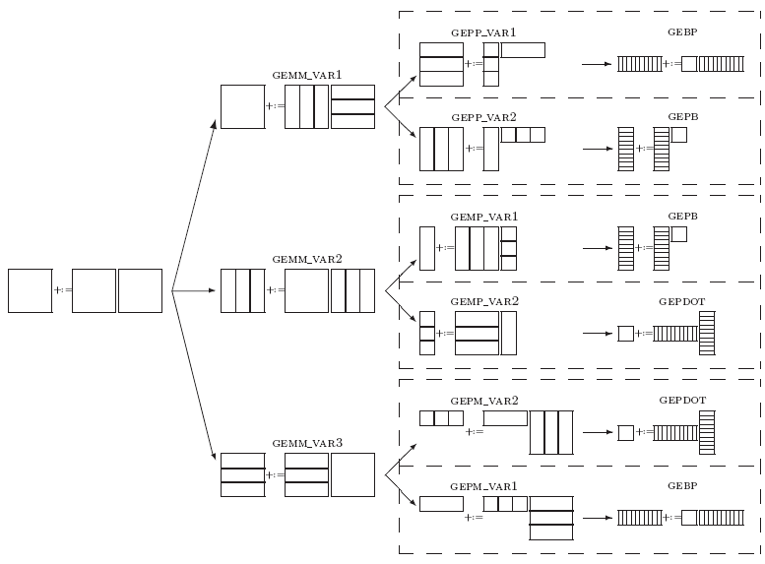
General Matrix-Matrix Multiplication (GEMM)
Blocked algorithm variants
  Fastest general-purpose
  implementation [GotoBLAS]
C
+:=
A
×
B
C
Notes:
Don’t describe the detail
Message: GEMM requires blocking that can be done in various ways
The best is the top branch
The choice is the same as what I independently arrived at.

Slide 15


Slide 16
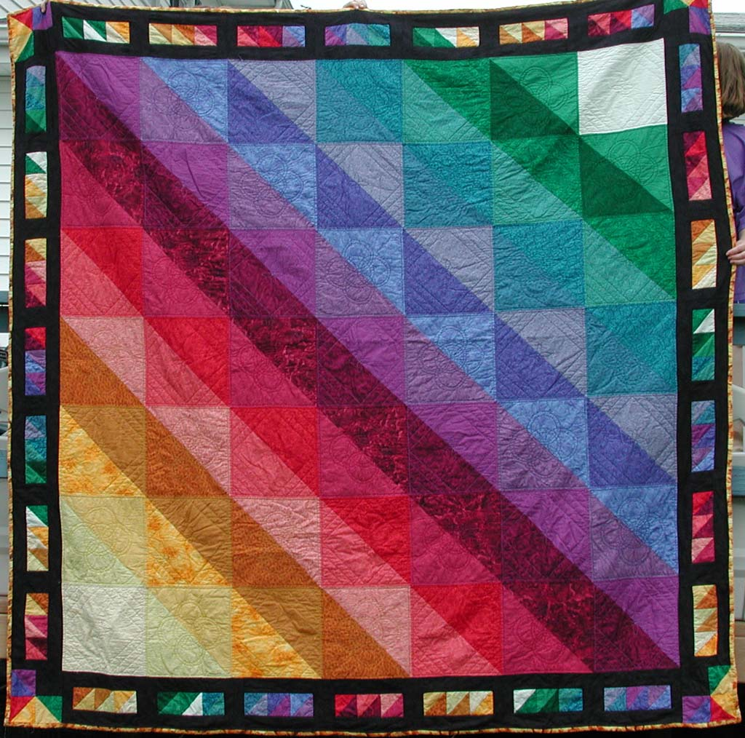
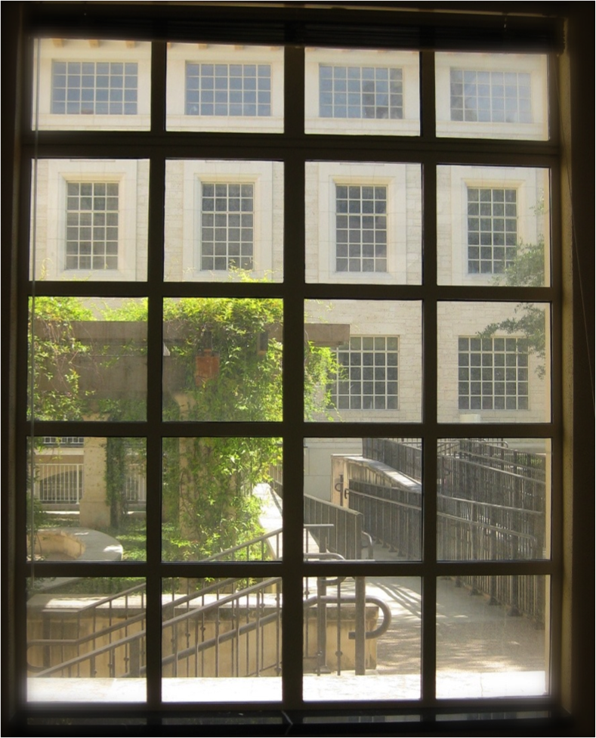
Blocking Tradition

Slide 17
Loop Representation String
n_{C}
n_{C}
Rules for each new character
  Buffers
  Re-fetch rate
m_{r} n_{r} k_{c}
m₀ n₀ k₀
C_{j}
+=
A
B_{j}
k_{C}
B_{p}
C_{j}
+=
A_{p}
k_{C}
C_{i}
m_{C}
m_{C}
A_{i}
~
B_{p}
+=
n_{R}
~
n_{R}
~
C_{i}
A_{i}
B_{p}
m_{R}
+=
k_{C}
n_{R}
m_{R}
+=
k_{C}
micro-kernel [registers] K_{c}
C
1
+=
1

Slide 18
Loop Representation String
n_{C}
n_{C}
Rules for each new character
  Buffers
  Re-fetch rate
m_{r} n_{r} k_{c} m_{c}
m₀ n₀ k₀ m₁
C_{j}
+=
A
B_{j}
k_{C}
B_{p}
C_{j}
+=
A_{p}
k_{C}
C_{i}
m_{C}
m_{C}
A_{i}
~
B_{p}
+=
n_{R}
~
n_{R}
~
C_{i}
A_{i}
B_{p}
m_{R}
+=
k_{C}
n_{R}
1st loop around micro-kernel [L1 cache] m_{c}
m_{R}
+=
B
k_{C}
micro-kernel [registers] K_{c}
C
1
+=
1

Slide 19
Loop Representation String
n_{C}
n_{C}
Rules for each new character
  Buffers
  Re-fetch rate
m_{r} n_{r} k_{c} m_{c} n_{c}
m₀ n₀ k₀ m₁ n₁
C_{j}
+=
A
B_{j}
k_{C}
B_{p}
C_{j}
+=
A_{p}
k_{C}
C_{i}
m_{C}
m_{C}
A_{i}
~
B_{p}
+=
2nd loop around micro-kernel [L2 cache] n_{c}
~
n_{R}
~
n_{R}
B_{p}
C_{i}
A_{i}
m_{R}
+=
A
k_{C}
n_{R}
1st loop around micro-kernel [L1 cache] m_{c}
m_{R}
+=
B
k_{C}
micro-kernel [registers] K_{c}
C
1
+=
1

Slide 20
Loop Representation String
n_{C}
n_{C}
Rules for each new character
  Buffers
  Re-fetch rate
m_{r} n_{r} k_{c} m_{c} n_{c} m
m₀ n₀ k₀ m₁ n₁ m₂
C_{j}
+=
A
B_{j}
k_{C}
B_{p}
C_{j}
+=
A_{p}
k_{C}
3rd loop around micro-kernel [L3 cache] m
C_{i}
m_{C}
m_{C}
A_{i}
~
B_{p}
+=
B
2nd loop around micro-kernel [L2 cache] n_{c}
~
n_{R}
~
n_{R}
B_{p}
C_{i}
A_{i}
m_{R}
+=
A
k_{C}
n_{R}
1st loop around micro-kernel [L1 cache] m_{c}
m_{R}
+=
B
k_{C}
micro-kernel [registers] K_{c}
C
1
+=
1

Slide 21
Loop Representation String
n_{C}
n_{C}
Rules for each new character
  Buffers
  Re-fetch rate
m_{r} n_{r} k_{c} m_{c} n_{c} m k
m₀ n₀ k₀ m₁ n₁ m₂ k₁
C_{j}
+=
A
B_{j}
4th loop around micro-kernel k
k_{C}
B_{p}
C_{j}
+=
A_{p}
C
k_{C}
3rd loop around micro-kernel [L3 cache] m
C_{i}
m_{C}
m_{C}
A_{i}
~
B_{p}
+=
B
2nd loop around micro-kernel [L2 cache] n_{c}
~
n_{R}
~
n_{R}
B_{p}
C_{i}
A_{i}
m_{R}
+=
A
k_{C}
n_{R}
1st loop around micro-kernel [L1 cache] m_{c}
m_{R}
+=
B
k_{C}
micro-kernel [registers] K_{c}
C
1
+=
1

Slide 22
Loop Representation String
n_{C}
n_{C}
Rules for each new character
  Buffers
  Re-fetch rate
m_{r} n_{r} k_{c} m_{c} n_{c} m k n
m₀ n₀ k₀ m₁ n₁ m₂ k₁ n₂
C_{j}
+=
A
B_{j}
4th loop around micro-kernel k
k_{C}
B_{p}
C_{j}
+=
A_{p}
C
k_{C}
3rd loop around micro-kernel [L3 cache] m
C_{i}
m_{C}
m_{C}
A_{i}
~
B_{p}
+=
B
2nd loop around micro-kernel [L2 cache] n_{c}
~
n_{R}
~
n_{R}
B_{p}
C_{i}
A_{i}
m_{R}
+=
A
k_{C}
n_{R}
1st loop around micro-kernel [L1 cache] m_{c}
m_{R}
+=
B
k_{C}
micro-kernel [registers] K_{c}
C
1
+=
1

Slide 23
GEMM Blocking
Loop representation string
Rules for each new character
  Buffers
  Re-fetch rate
m_{r} n_{r} k_{c} m_{c} n_{c} m k n:
m₀ n₀ k₀ m₁ n₁ m₂ k₁ n_{2:}

Slide 24
Recursive Formulation
Fixed order as follows:
N_{i-1}M_{i-1}K_{i-1}
From left to right observing
Higher Level (Lower in the Picture)
[Black Box]

Slide 25
Recursive Formulation
Fixed order as follows:
N_{i-1}M_{i-1}K_{i-1}N_{i}
From left to right observing
  N: New A
Higher Level (Lower in the Picture)
[Black Box]
Re-fetch
Rate
A Buffer

Slide 26
Recursive Formulation
Fixed order as follows:
N_{i-1}M_{i-1}K_{i-1}N_{i}M_{i}
From left to right observing
  N: New A
  M: New B
Higher Level (Lower in the Picture)
[Black Box]
Re-fetch
Rate
A Buffer
B Buffer

Slide 27
Recursive Formulation
Fixed order as follows:
N_{i-1}M_{i-1}K_{i-1}N_{i}M_{i}K_{i}…...
From left to right observing
  N: New A
  M: New B
  K: New C
Higher Level (Lower in the Picture)
[Black Box]
Re-fetch
Rate
C Buffer
A Buffer
B Buffer

Slide 28
GEMM Exploration
Goto Solution
  CPUs (BLIS)
  LAP (is it optimal?)

Slide 29

Giant Needs A Break
Auto-tuning?
Design space is huge?
What is the optimal blocking?
What is the optimal HW?
O for Optimization

Slide 30
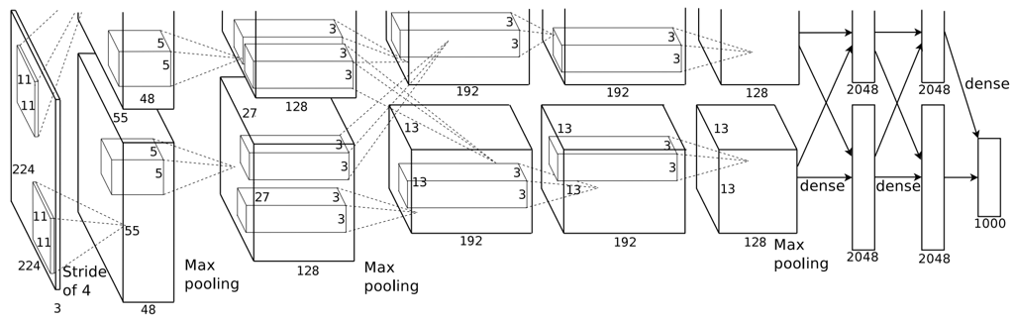
Deep Convolutional Network
Four dimensions in each layer
  Image Dimensions (X,Y)
  # Channels (C)
  # Kernels (K)
  Filter dimensions (F_{h}, F_{w})
Last layer is fully connected (GEMM)
Alex Krizhevsky, Ilya Sutskever, Geoffrey E. Hinton, ImageNet Classification with Deep Convolutional Neural Networks
Alex Krizhevsky, Ilya Sutskever, Geoffrey E. Hinton, ImageNet Classification with Deep Convolutional Neural Networks
Notes:
Single Convolution Layer
4 Dimensions (X,Y,C,K)
Next Convolution Layer
3 Extra dimensions

Slide 31
Convolution Layer

Slide 32
Multilevel Blocking of Convolutional Layer
Input Image Dimensions:
  Image Dimensions (X,Y)
  # Channels (C)
  # Kernels (K)
  Filter dimensions (F_{h}, F_{w})
Nested blocking

Slide 33
Multilevel Blocking of Convolutional Layer
Kernel Dimensions:
  Image Dimensions (X,Y)
  # Channels (C)
  # Kernels (K)
  Filter dimensions (Fh, Fw)
Nested blocking

Slide 34
Multilevel Blocking of Convolutional Layer
Output Dimensions:
  Image Dimensions (X,Y)
  # Channels (C)
  # Kernels (K)
Nested blocking

Slide 35
Multilevel Blocking of Convolutional Layer
Reduction

Slide 36
Convolution Operation
In
Out
×
coefficients

Slide 37
Convolution Operation
×
coefficients

Slide 38
Convolution Operation
×
coefficients

Slide 39
Formal Derivation
Loop representation string
Rules for each new character
  Buffers
  Re-fetch rate
Y₀K₀C₀X₀K₁C₁Y₁X₁:

Slide 40
Recursive Formulation
Fixed order as follows:
Y_{i-1}X_{i-1}C_{i-1}K_{i-1}
From left to right observing
Higher Level
[Black Box]

Slide 41
Recursive Formulation
Fixed order as follows:
Y_{i-1}X_{i-1}C_{i-1}K_{i-1}Y_{i}X_{i}
From left to right observing
  X or Y: New KB
Higher Level
[Black Box]
Re-fetch
Rate
Kernel Buffer

Slide 42
Recursive Formulation
Fixed order as follows:
Y_{i-1}X_{i-1}C_{i-1}K_{i-1}Y_{i}X_{i}C_{i}
From left to right observing
  X or Y: New KB
  C: New OB
Higher Level
[Black Box]
Re-fetch
Rate
Kernel Buffer
Output Buffer

Slide 43
Recursive Formulation
Fixed order as follows:
Y_{i-1}X_{i-1}C_{i-1}K_{i-1}Y_{i}X_{i}C_{i}K_{i}…...
From left to right observing
  X or Y: New KB
  C: New OB
  K: New IB
Higher Level
[Black Box]
Re-fetch
Rate
Image Buffer
Kernel Buffer
Output Buffer

Slide 44
Low Level Kernel Loop and Blocking
F_{h} and F_{w}
Comparable Size
Many relations
F_{h} and F_{w} act similar to both K and C
K: F_{h} and F_{w} are another dimension of coefficients
C: Reduction across F_{h} F_{w} dimensions is performed

Slide 45
Multi-Core Parallelism and Partitioning
Across channels (C)
  Reduction
  Synchronization
Across kernels (K)
  Synchronization
Across image (X or Y)
  Independent
Broadcast operation
Partitioned memory
Nested parallelism

Slide 46
The Framework
Design Constraints:
Performance
Energy
Area
Team
  Xuan Yang
  Jing Pu
Explore tradeoffs
  Buffer size
  Energy/ access
  # of Accesses
  Parallelism
Cost Model
Energy, Area
Optimizer
Loop Scheduling
Block sizes
Parallelism
Design Metrics
Core Design
Memory Hierarchy
/ Interconnect

Slide 47
Questions?

