Slide 1
Implementation of Linear Algebra Libraries for Embedded Architectures Using BLIS
September 28, 2015
Devangi Parikh
Francisco Igual Peña
Murtaza Ali

Slide 2
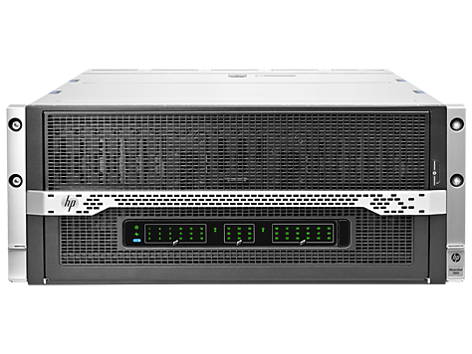
Outline
TI Embedded Processors
Library Development Strategy
TI LINALG library
BLIS on C66x
Testing
Performance
http://processors.wiki.ti.com/index.php/MCSDK_HPC_3.x_Linear_Algebra_Library
Picture Credit: HP

Slide 3
TI Embedded Processors

Slide 4
5 Generations of TI Multicore Processors
Keystone architecture
  Lowers development effort
  Speeds time to market
  Leverages TI’s investment
  Optimal software reuse

Slide 5
TI 66AK2H12 SoC
Keystone II architecture
Cores
  4 ARM A15s at 1.0 GHz
    4 MB shared L2 cache
    32 Gflops single precision
    8 Gflops double precision
  8 C66x DSPs at 1.0 GHz
    32 kB L1 scratch / cache each
    1 MB L2 scratch / cache each
    128 Gflops single precision
    32 Gflops double precision
Memory
  8 GB DDR3 DRAM (external)
  6 MB shared SRAM/L3
Interfaces
  2x Gigabit Ethernet ~ 100 MB/s
  4x SRIO ~ 400 MB/s
  2x Hyperlink ~ 1 GB/s

Slide 6
Library Development Strategy

Slide 7
Development Philosophy
User view
  Embedded Linux running on the ARM
  Standard GCC tool chain
  Simply link to a TI provided library with an ARM callable API to accelerate applications using multiple ARM cores, DSP cores and processors as appropriate
  Use TI provided tools and examples to write new applications and libraries which use multiple ARM cores, DSP cores and processors to accelerate performance
Using multiple cores on a single processor
  OpenMP for shared memory parallelization across ARM cores
  OpenCL or OpenMP Accelerator for heterogeneous acceleration with multiple DSP cores
Using multiple processors
  Open MPI over Ethernet, SRIO or Hyperlink

Slide 8
ARM + OpenCL DSP Acceleration

Slide 9
TI LINALG library

Slide 10
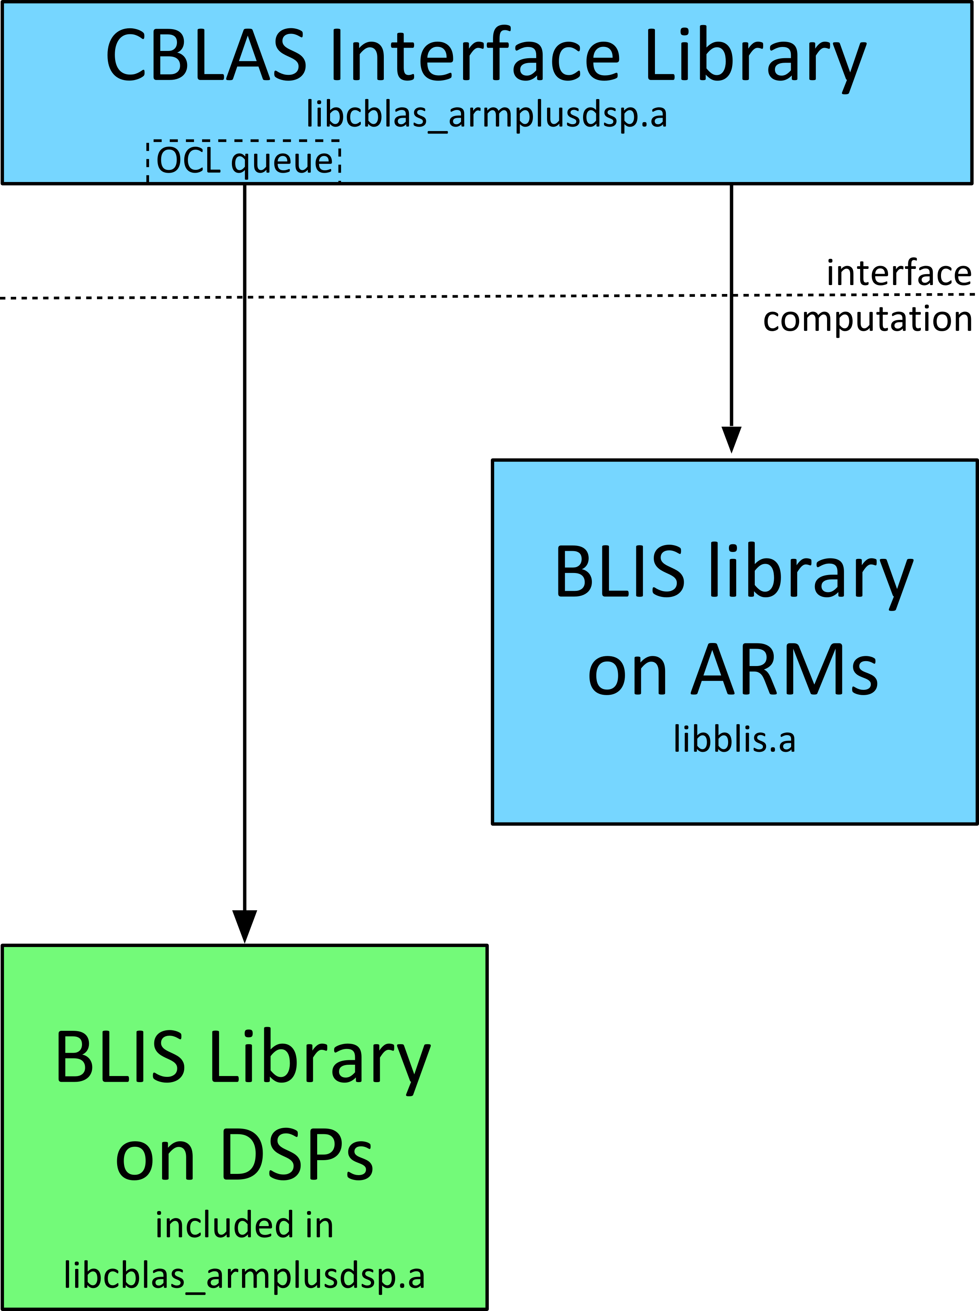
CBLAS
Use BLIS (BLAS-like Library Instantiation Software) for underlying BLAS computations
Advantages of using BLIS over traditional BLAS libraries
  Portable across architectures
  Generalized Matrix Storage
  Ease to use (BLAS and CBLAS compatibility layers)
  Code Reuse
Allows us to bring BLIS into embedded processing markets

Slide 11
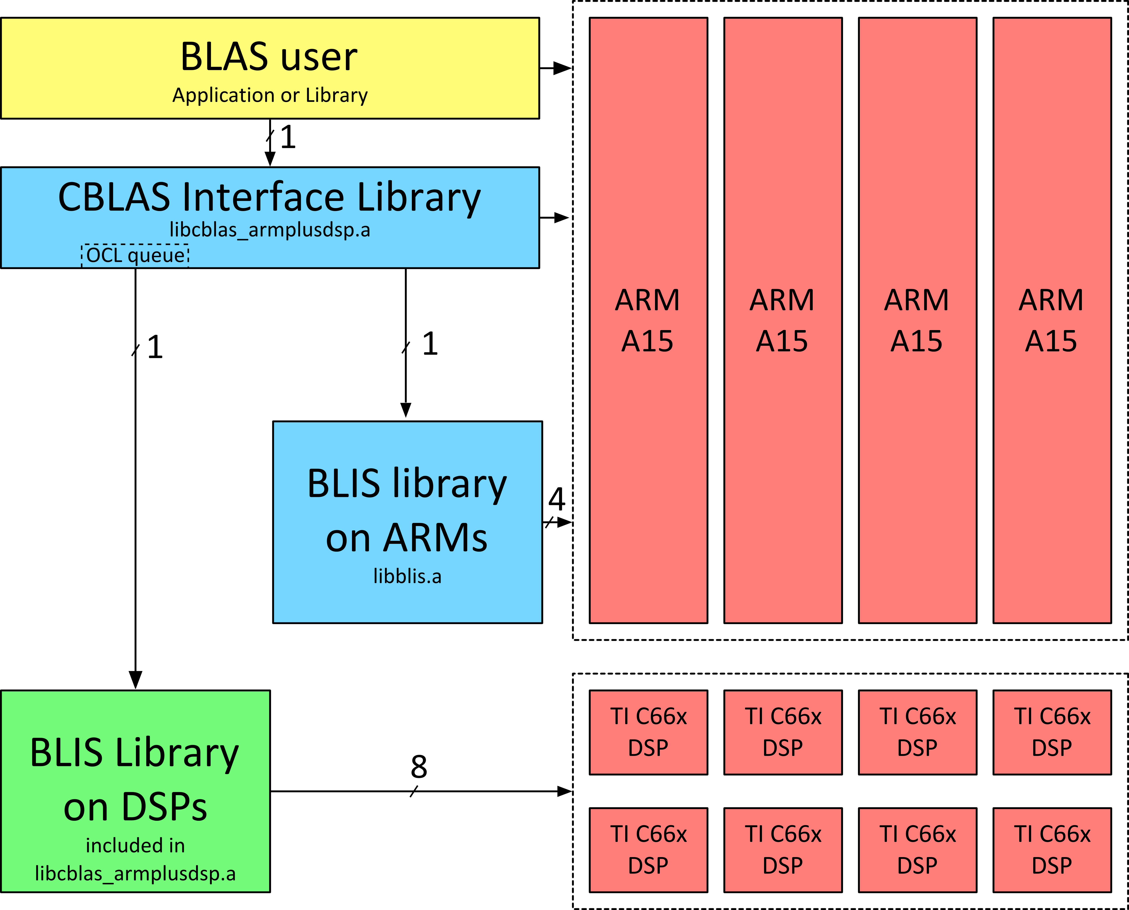
Single Threaded Applications
Support for the standard CBLAS and CLAPACK APIs
CBLAS runs on either the available ARM or DSP cores
Support for single core and multi core CBLAS computation
Automatically chooses between ARM and DSP cores for compute based on problem size
  User can override through environment variables
CBLAS calls to DSP are blocking

Slide 12
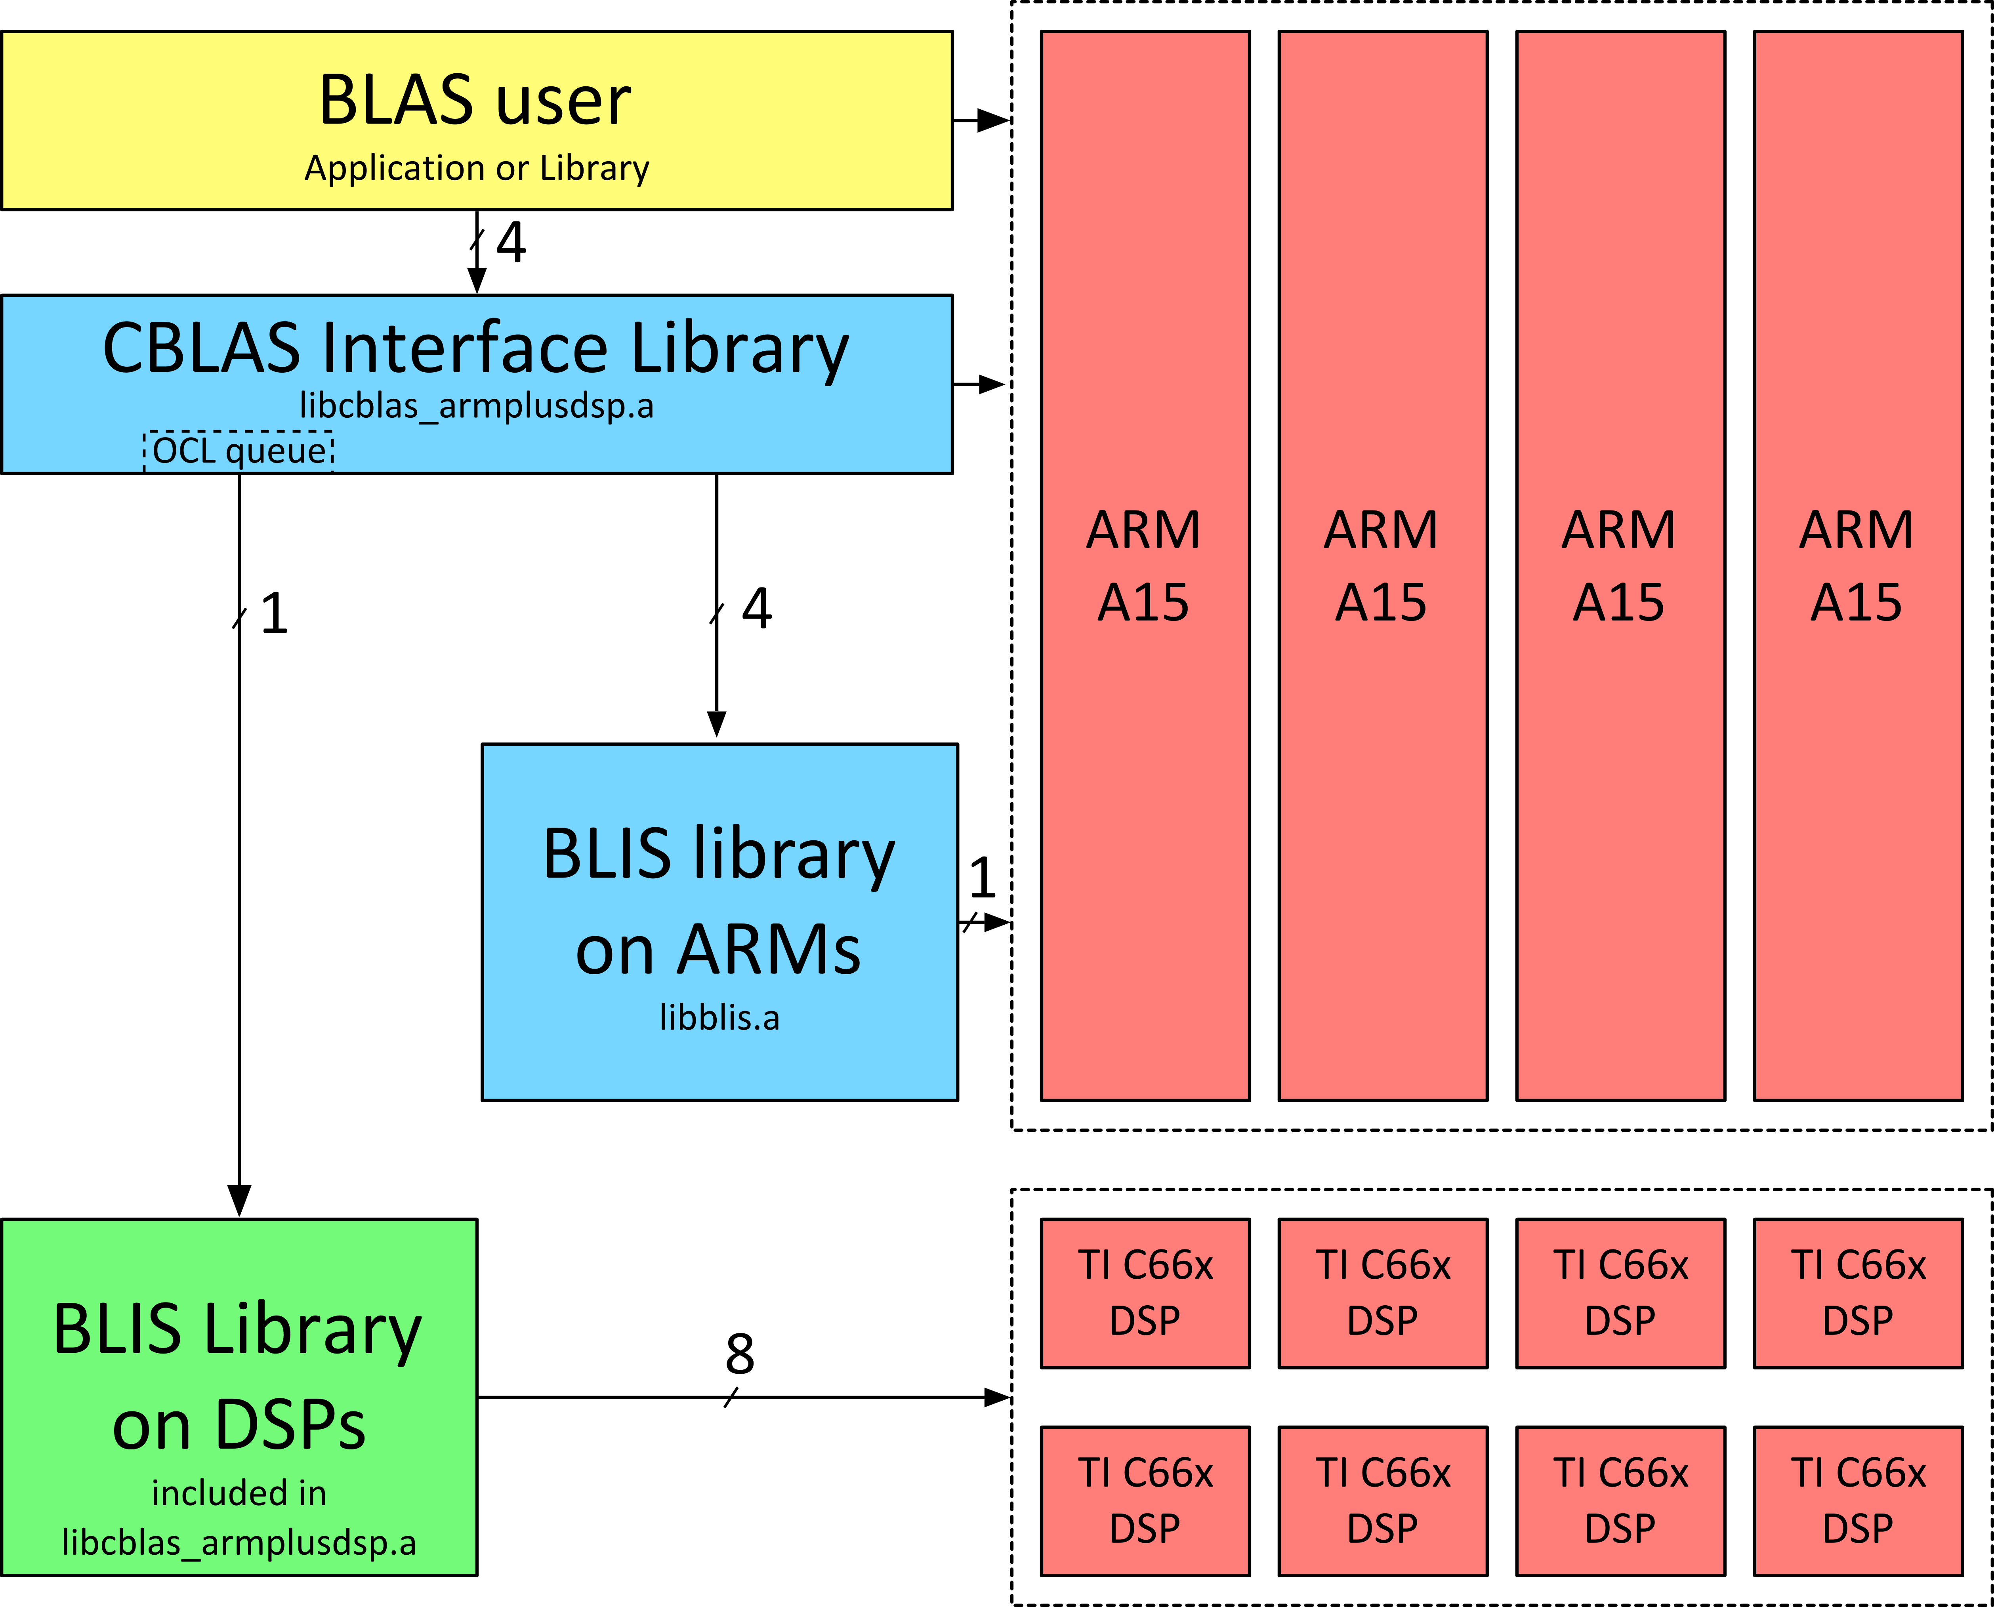
Multi Threaded Applications
Application can make BLAS calls from multiple threads
ARM compute supports up to four threads (# of Application threads) x (# of CBLAS ARM compute threads) = 4
DSP compute calls are enquequed in the OpenCL command queue

Slide 13
Compute to Data Movement Ratio
For vector length = N, and matrix size = NxN
 | Theoretical Data Movement (D) | Compute (C) | C/D
Level 1 | 3N | N | 1/3
Level 2 | N^2+3N | 2(N^2)+N | 2N+1 / (3N+1)
Level 3 | 4(N^2) | 2(N^3) | N/2
Level 3 BLAS operations are compute bound (C/D > 1)
  Automatic offloading decision available only for Level 3 BLAS operations

Slide 14
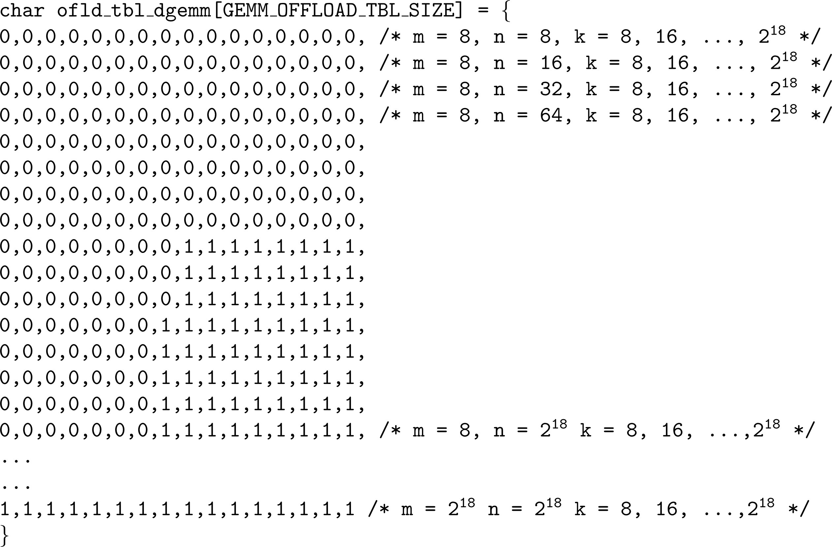
Offload Strategy
  Automatic offloading decision available only for Level 3 BLAS operations
  Tuning : For each level 3 operation, find the matrix sizes for which the execution on DSP is faster
  Performed offline
  Sweep matrix sizes, e.g. (m,k,n) for xGEMM
  For each combination of (m,k,n), benchmark DSP execution and ARM execution
  Generate offload lookup table based on benchmarking results
Making offloading decision for each level 3 function
  Configuration through environment variable
  Offload lookup table obtained through tuning

Slide 15
BLIS on C66x

Slide 16
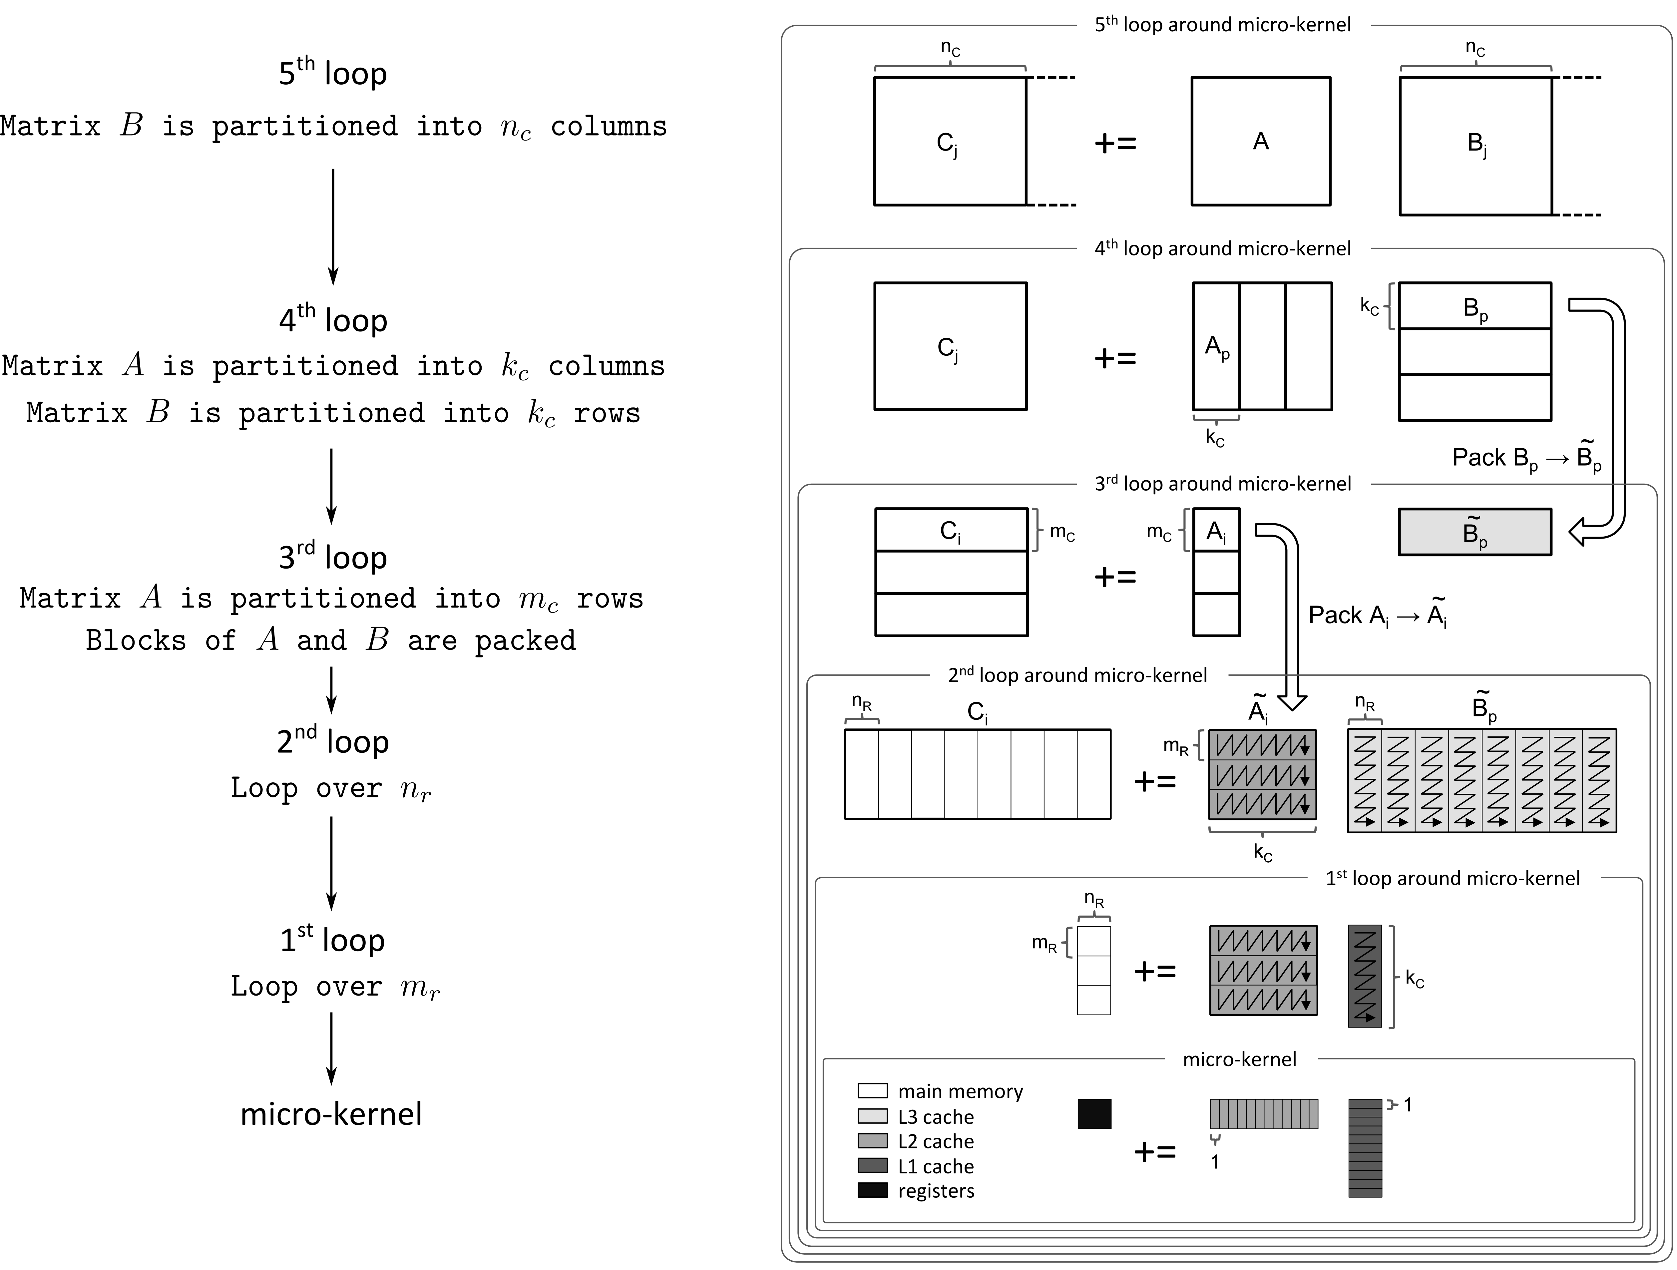
BLIS High-Performance GEMM

Slide 17
C66x High-Performance GEMM
BLIS is designed for cache based architectures
C66x is a DMA based architecture
  Integrate DMA capabilities into BLIS to obtain high-performance on C66x
  Parallelize data movement through various levels of memory with the computation by using the DMA
Parameters are selected such that ping-pong buffers fill up the SRAM memory available
Parameter values for C66x
 | MC | KC | NC | MR | NR
S (single) | 144 | 428 | 944 | 4 | 8
D (double) | 132 | 220 | 864 | 4 | 4
C (single complex) | 124 | 260 | 824 | 2 | 4
Z (double complex) | 90 | 178 | 588 | 8 | 4

Slide 18
DMA Integration Goals
Flexible
  User or library developer must be able to select when and where to transfer data for an operation
Transparent
  User must not be aware of the usage of the DMA, but if desired can manage the DMA
Integrated into the control tree mechanism

Slide 19
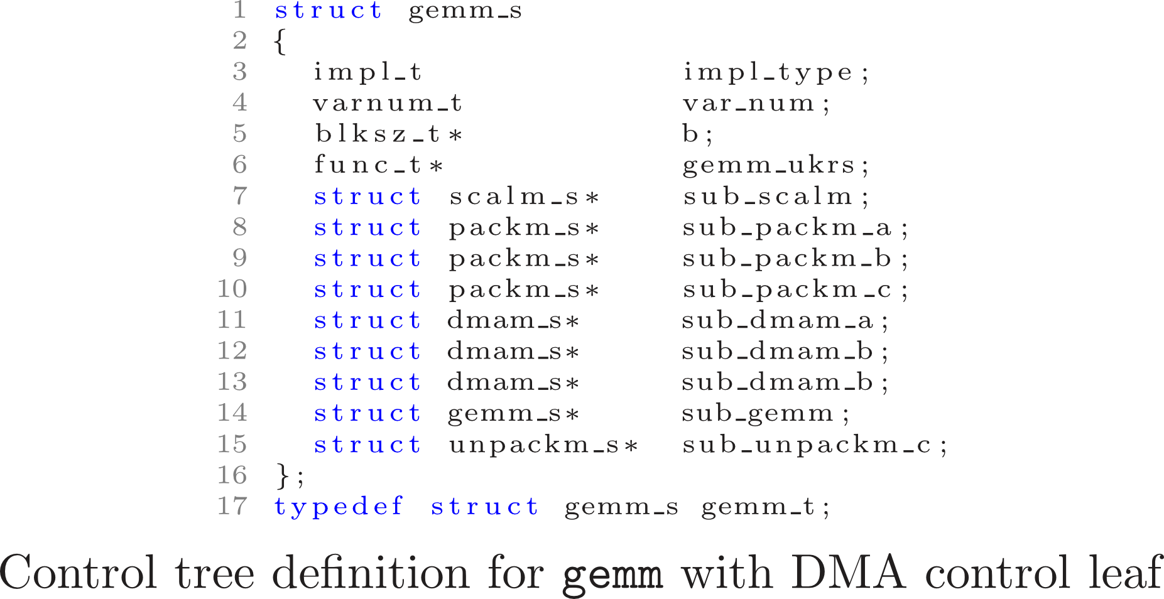
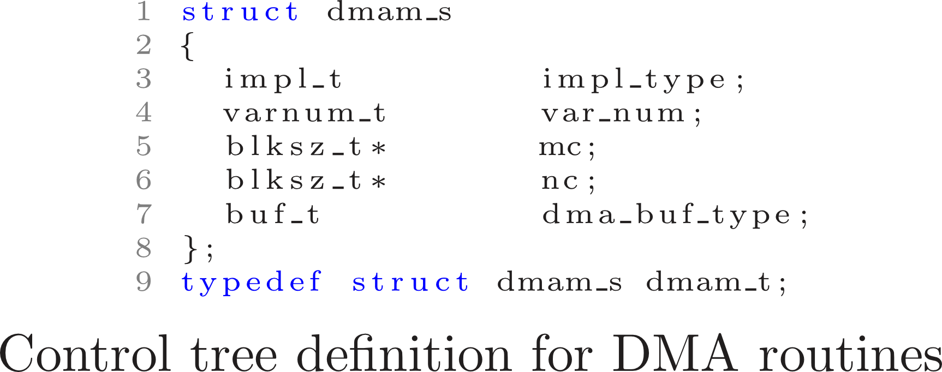
GEMM Control Tree Definitions

Slide 20
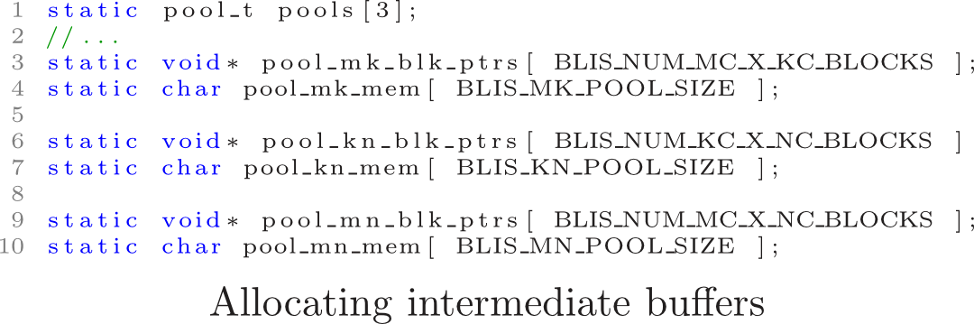
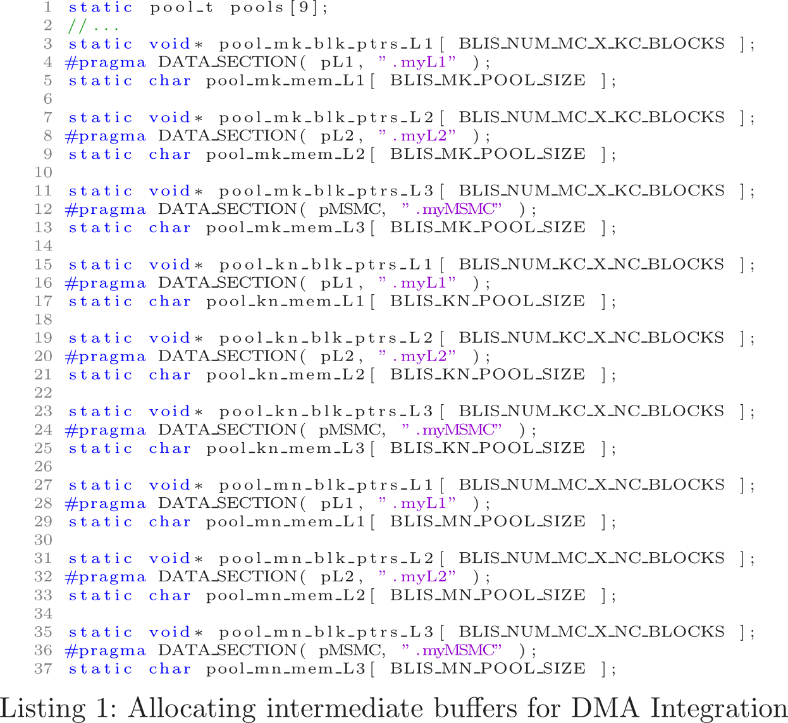
Memory Buffers

Slide 21
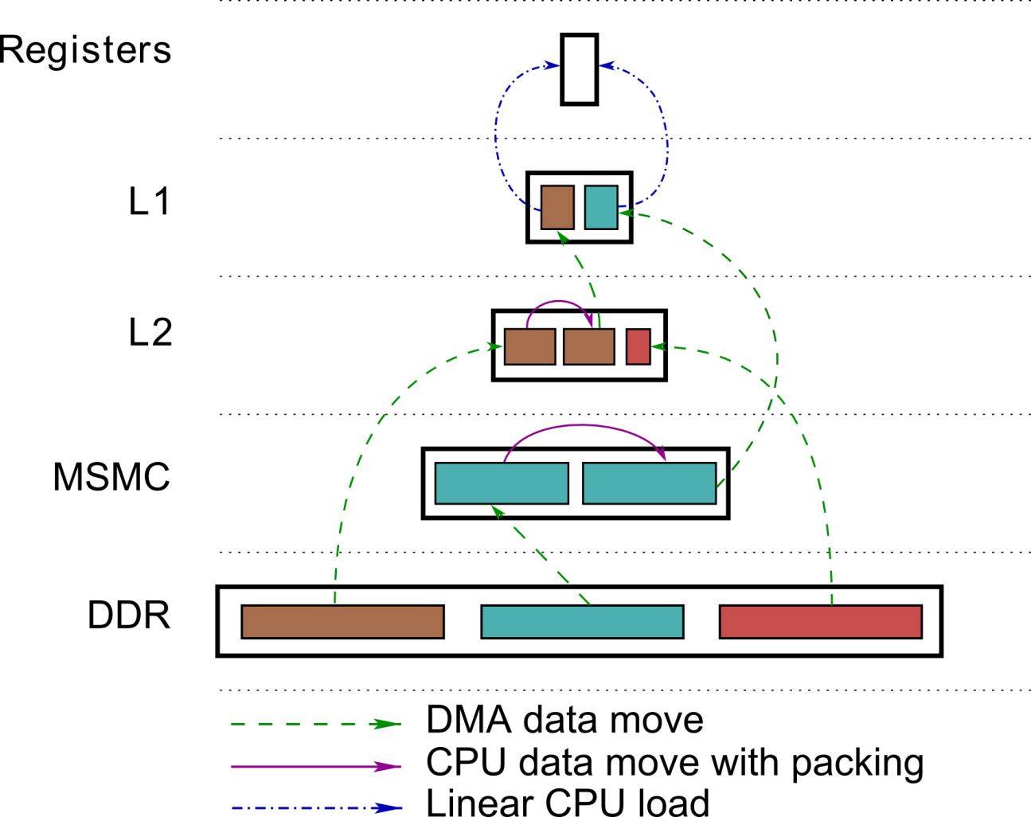
C66x Data Movement for Level 3 BLIS
A
B
C

Slide 22
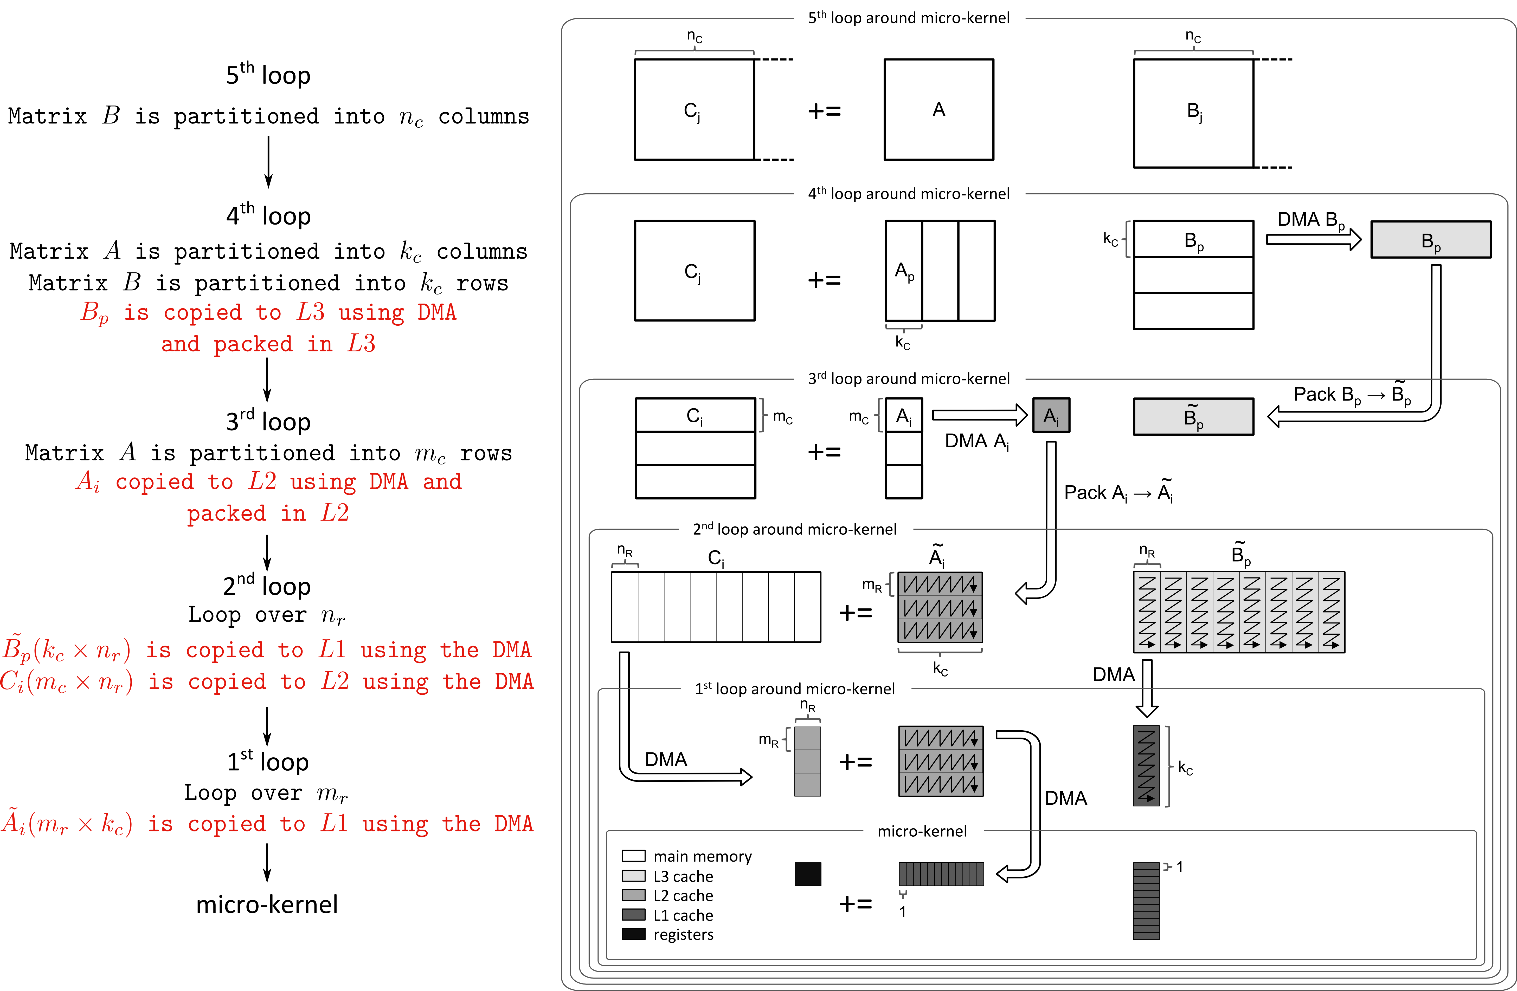
C66x High-Performance GEMM

Slide 23
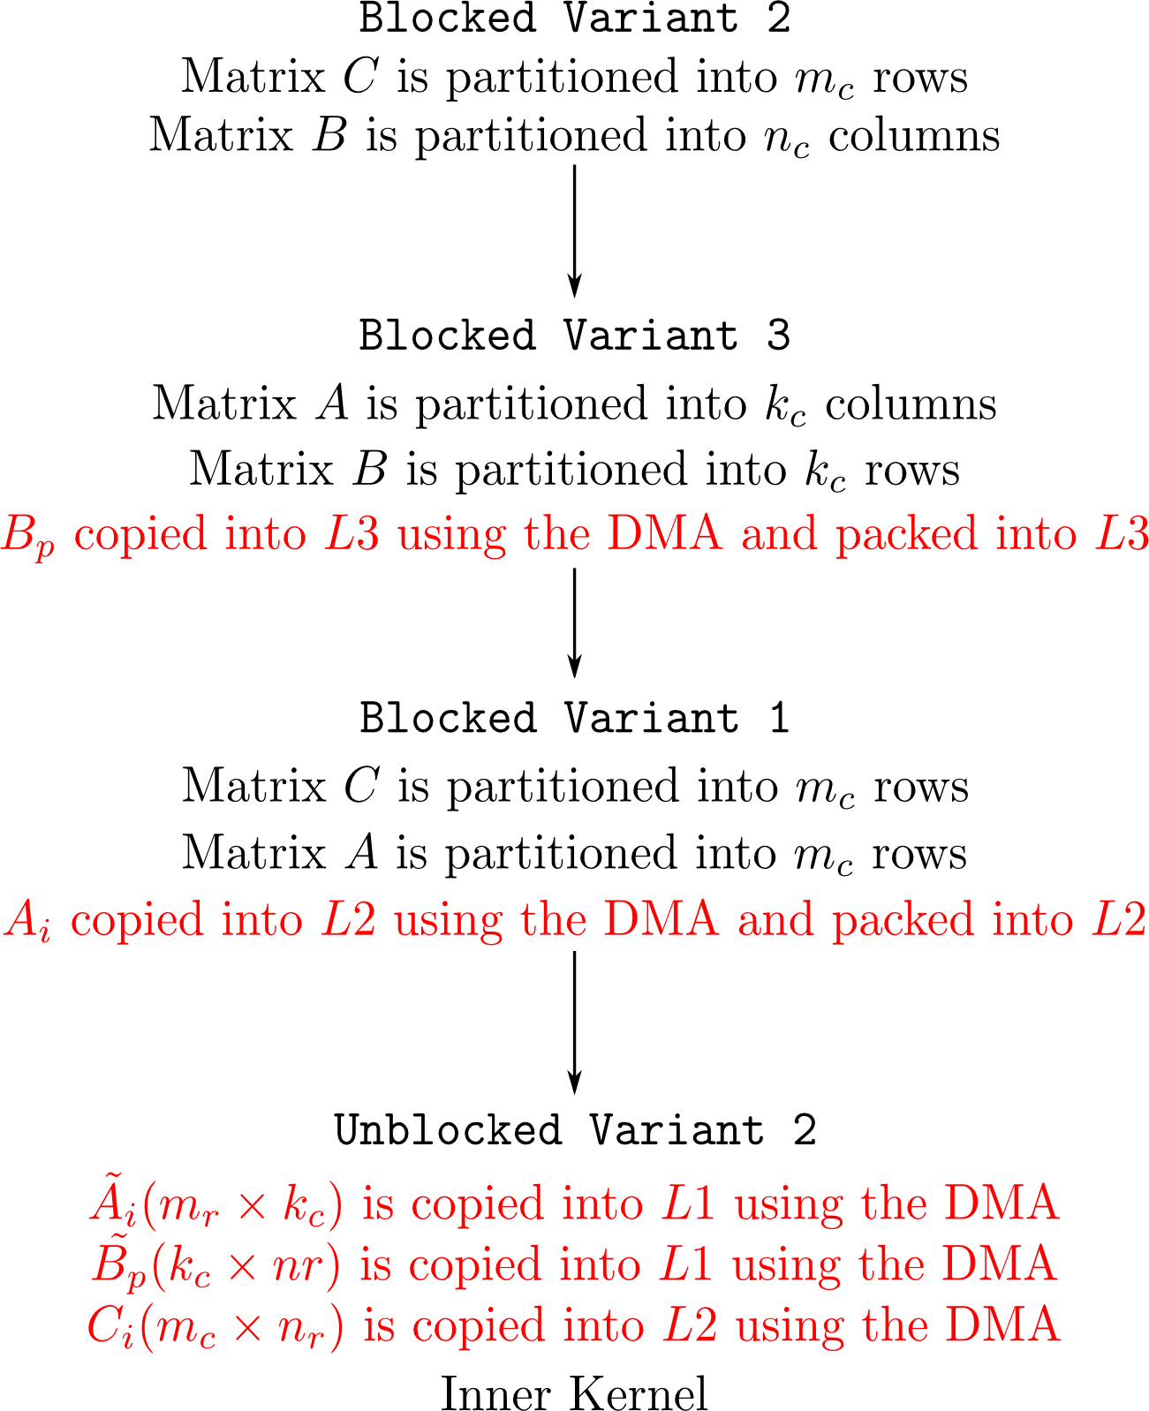
Algorithmic Variants for GEMM

Slide 24
Testing

Slide 25
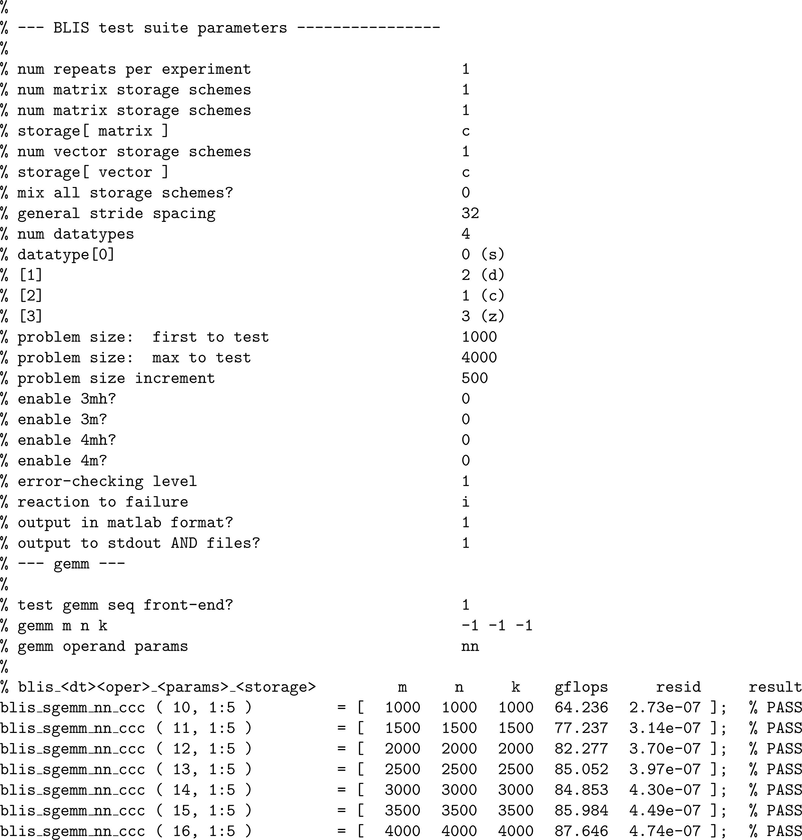
BLIS Test Suite
Suitable for
  Larger matrix sizes
  Performance benchmarks
  Selective functionality tests
Customizable
  Can sweep over BLAS routines with all possible permutations of the available options

Slide 26
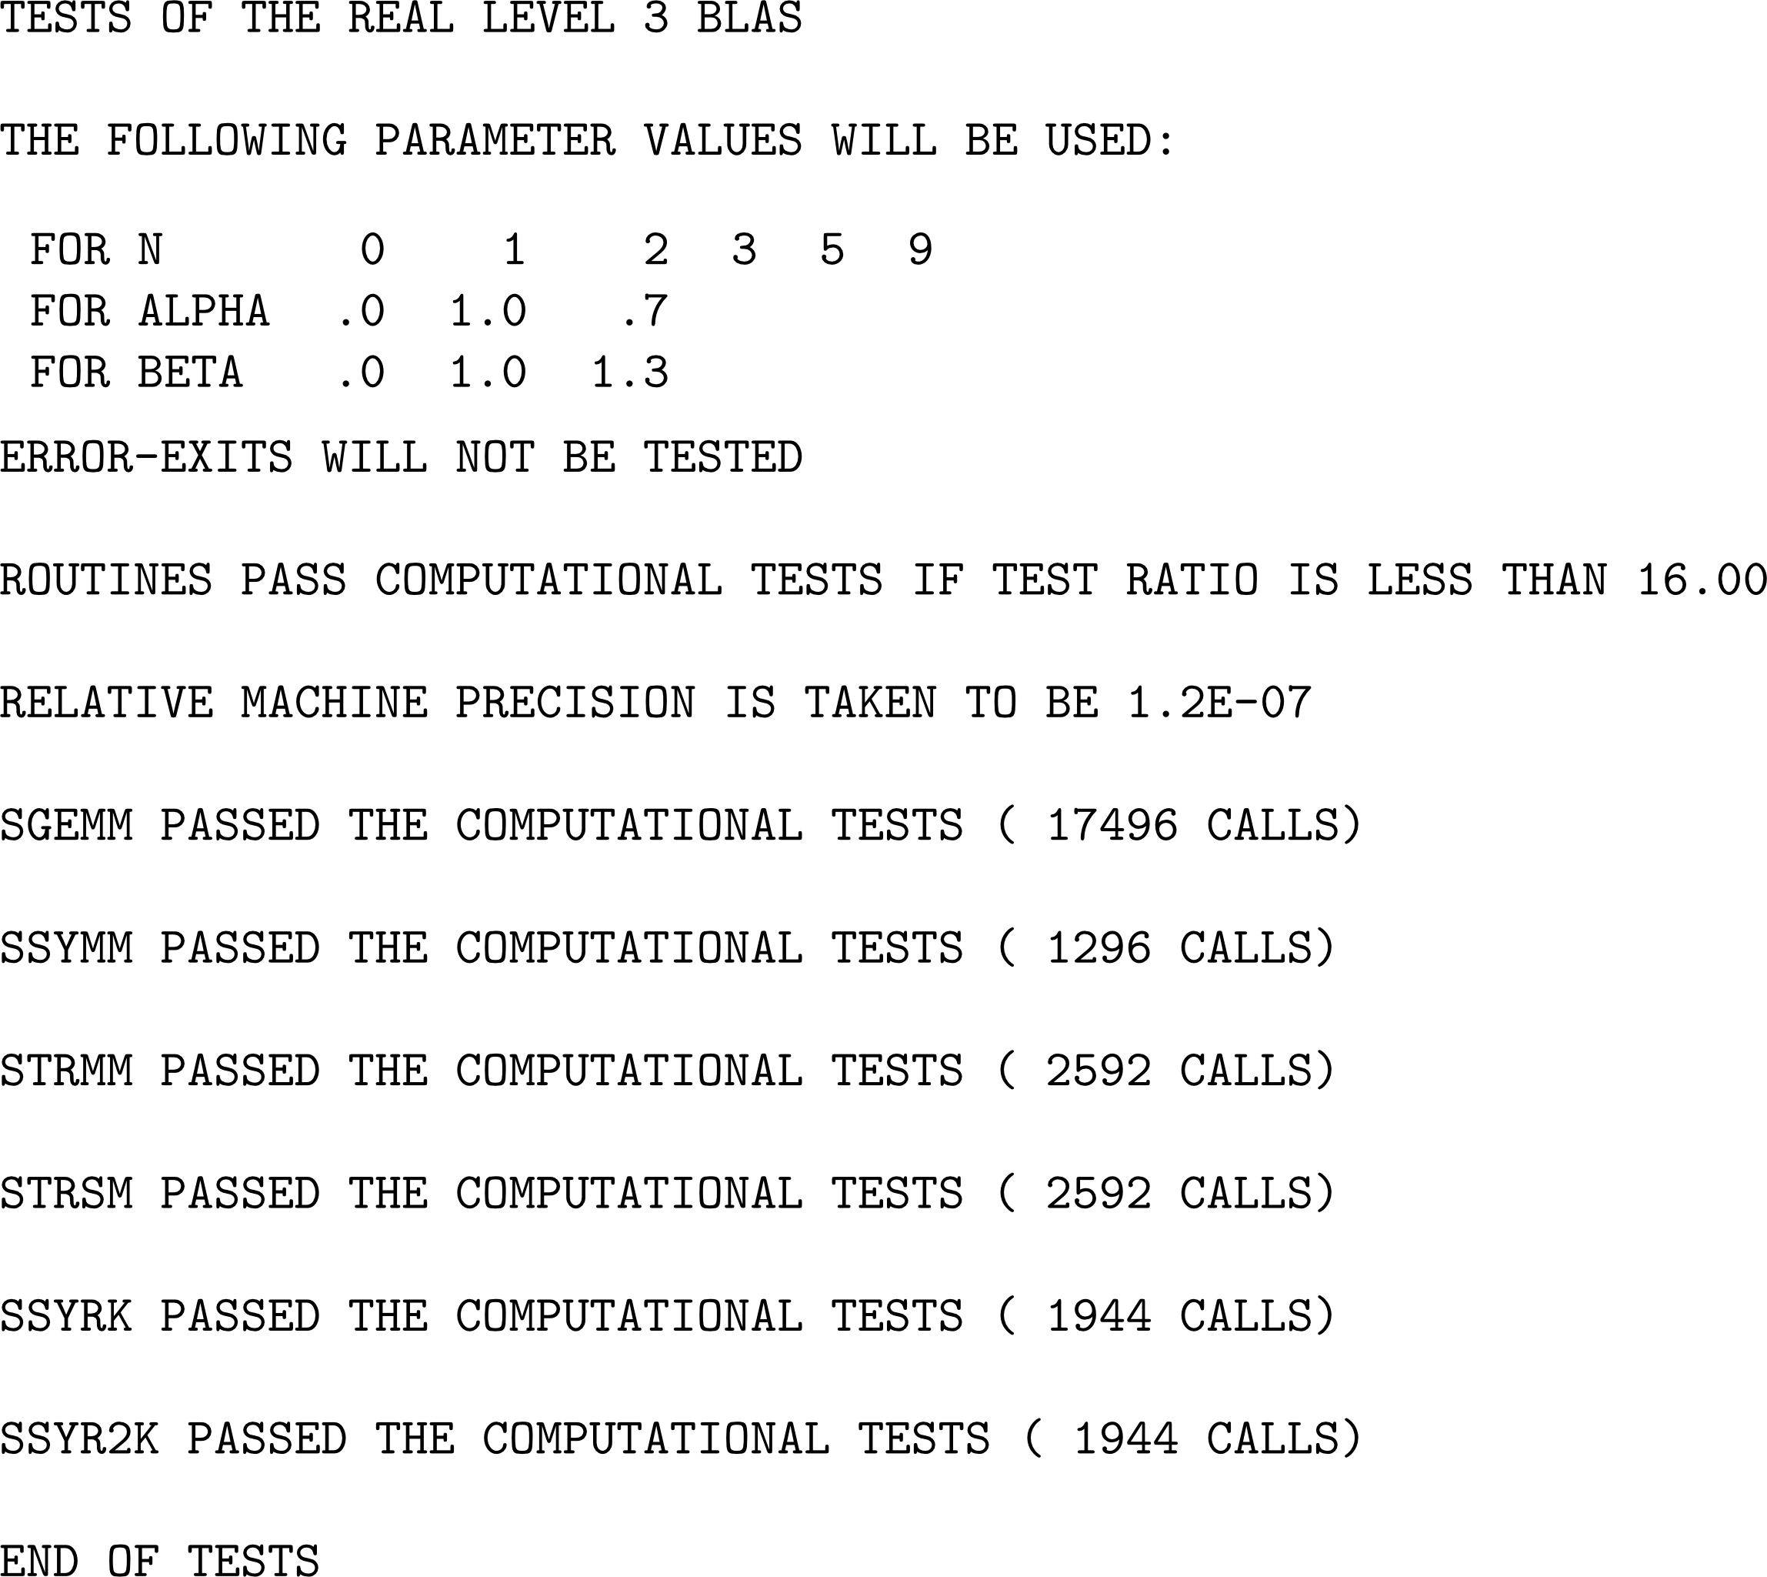
BLAS Test Suite
Suitable for
  Corner cases (zero matrix dimension, near-underflow and near-overflow valued matrices)
  Smaller matrix sizes
Not customizable
Total tests = 239,052

Slide 27
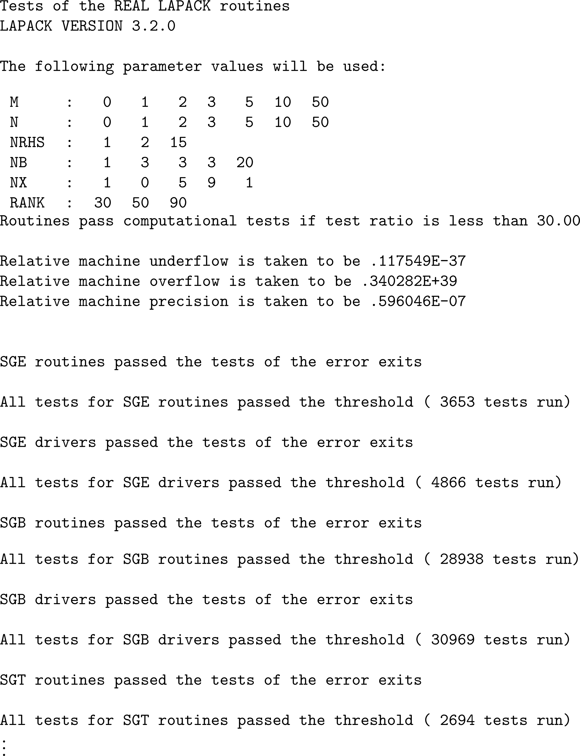
CLAPACK Test Suite
Suitable for
  Corner cases (zero matrix dimension, near-underflow and near-overflow valued matrices)
  Smaller matrix sizes
Not customizable
Types of tests = 83
Total tests = 3,073,466

Slide 28
Performance

Slide 29
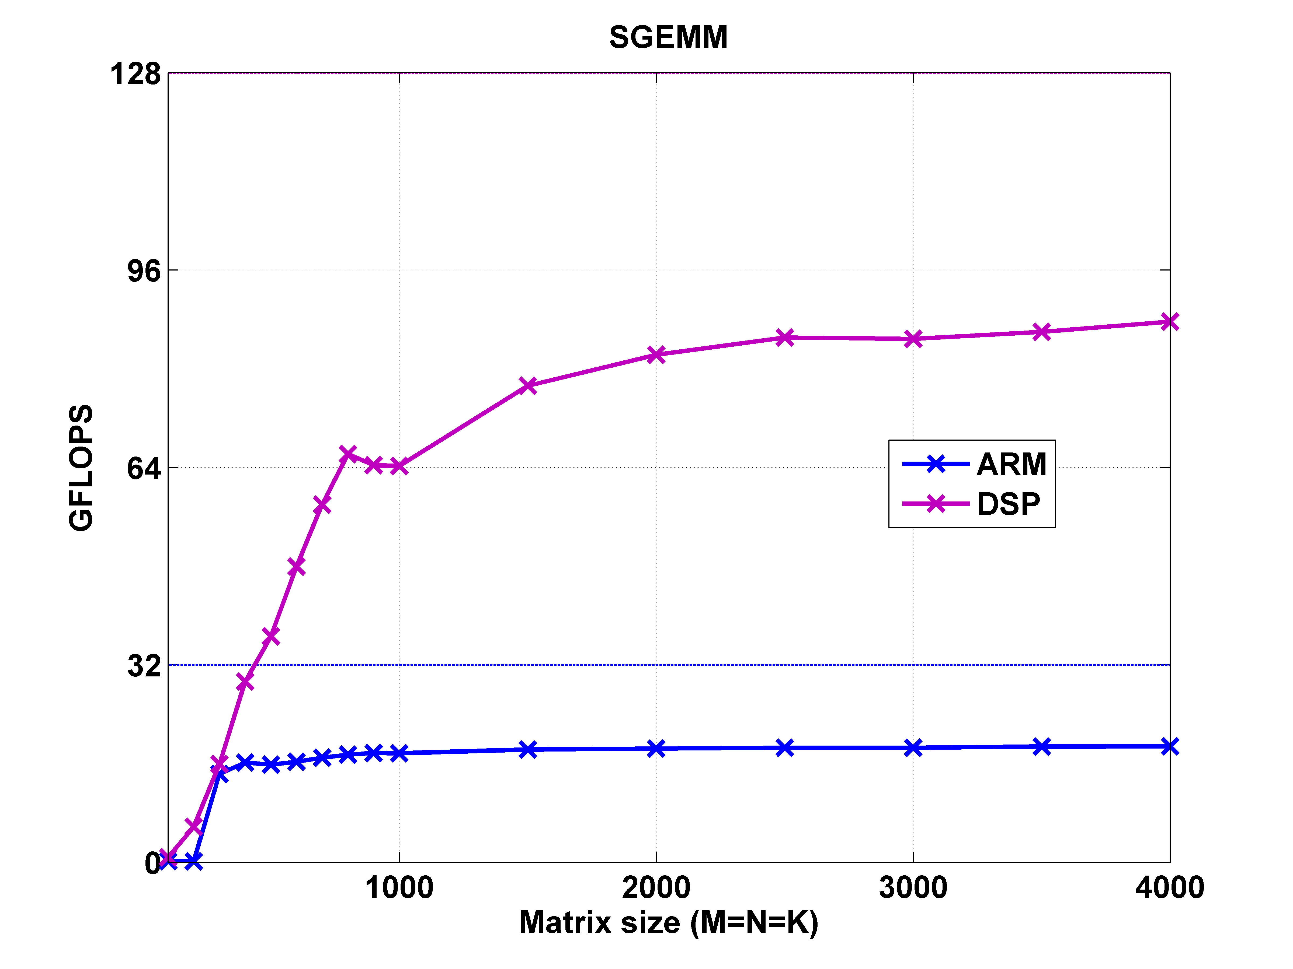
SGEMM
Single precision general matrix-matrix multiplication
Obtained using a TI 66AK2H12 SoC at a 1 GHz clock
Theoretical peak DSP performance = 128 GFLOPS
Theoretical peak ARM performance = 32 GFLOPS

Slide 30
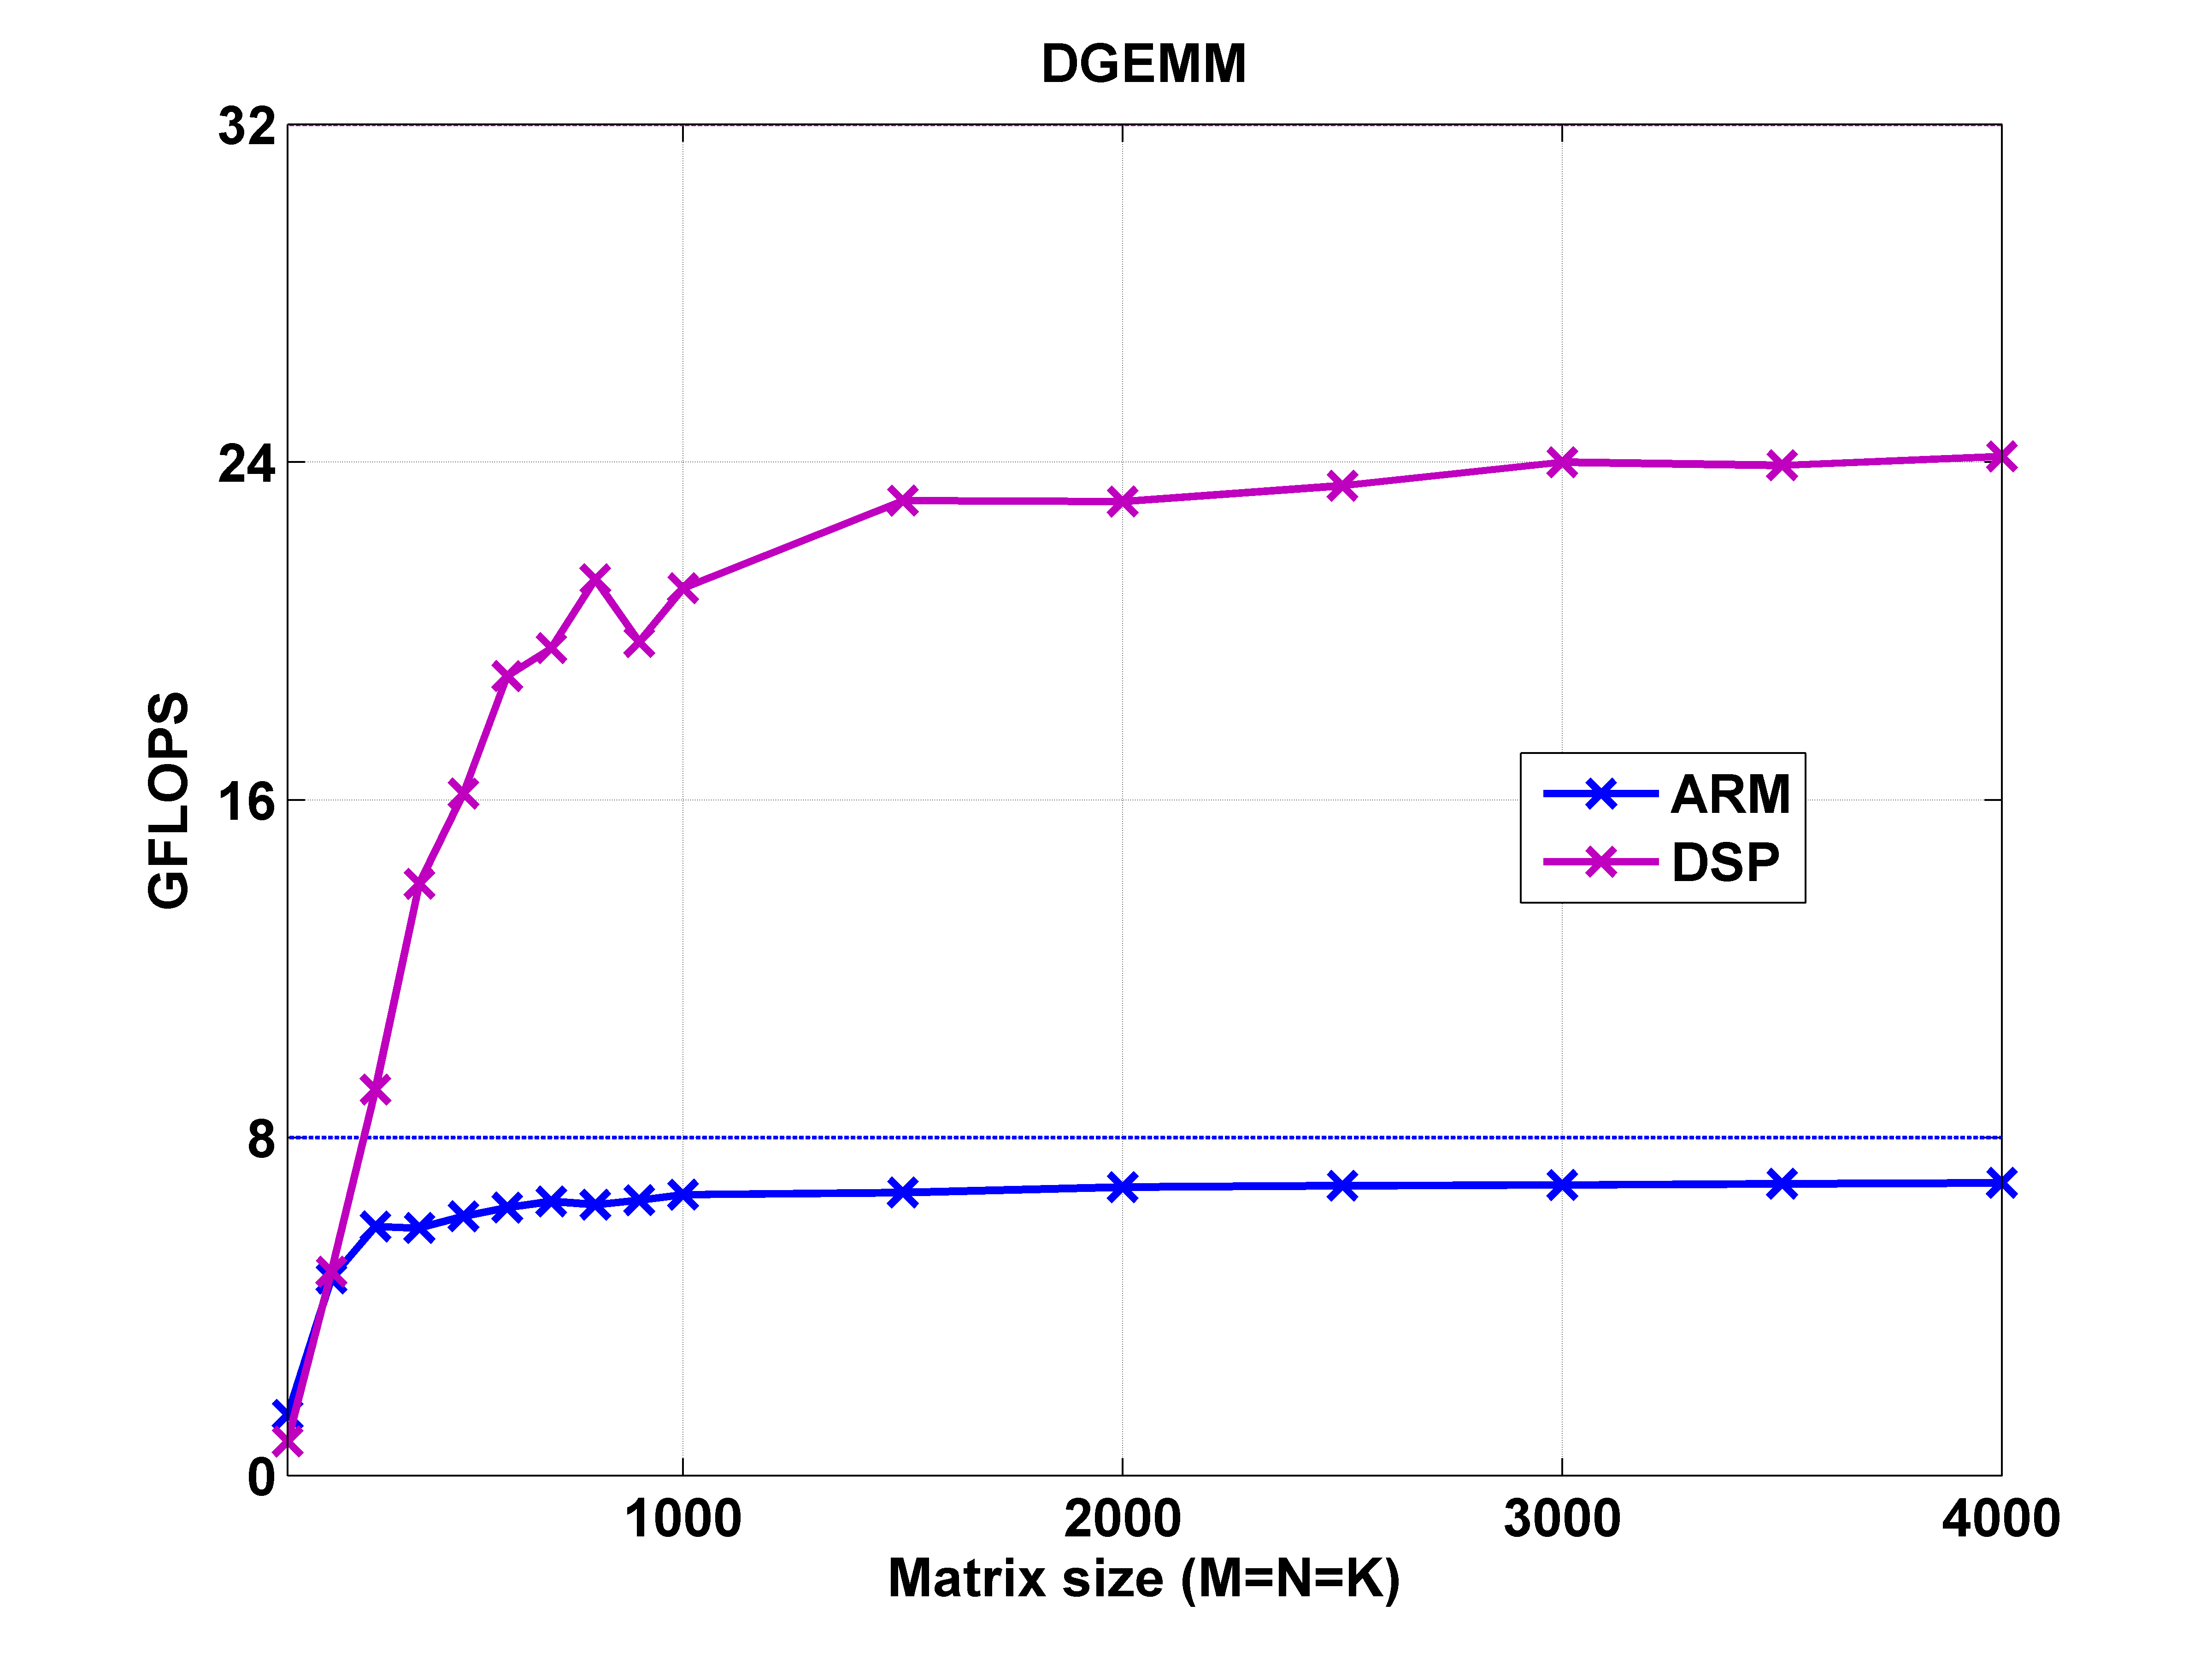
DGEMM
Double precision general matrix-matrix multiplication
Obtained using a TI 66AK2H12 SoC at a 1 GHz clock
Theoretical peak DSP performance = 32 GFLOPS
Theoretical peak ARM performance = 8 GFLOPS

Slide 31
Thanks!

